Slide 1
WORK & SIMPLE MACHINES
Simple machines DON’T change the amount of WORK done!
(They change the size, distance or direction of your FORCE!)
WORK IN = WORK OUT*
(*usually machines lose a bit of work due to FRICTION…)

Slide 2
INCLINED PLANE
An inclined plane is a flat, sloped surface. It connects a lower level to a higher level.
You use less force over a longer distance to raise a load to a higher level.
Input Force
Output Force

Slide 3
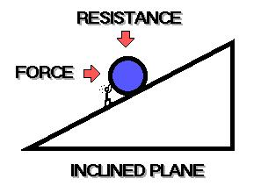
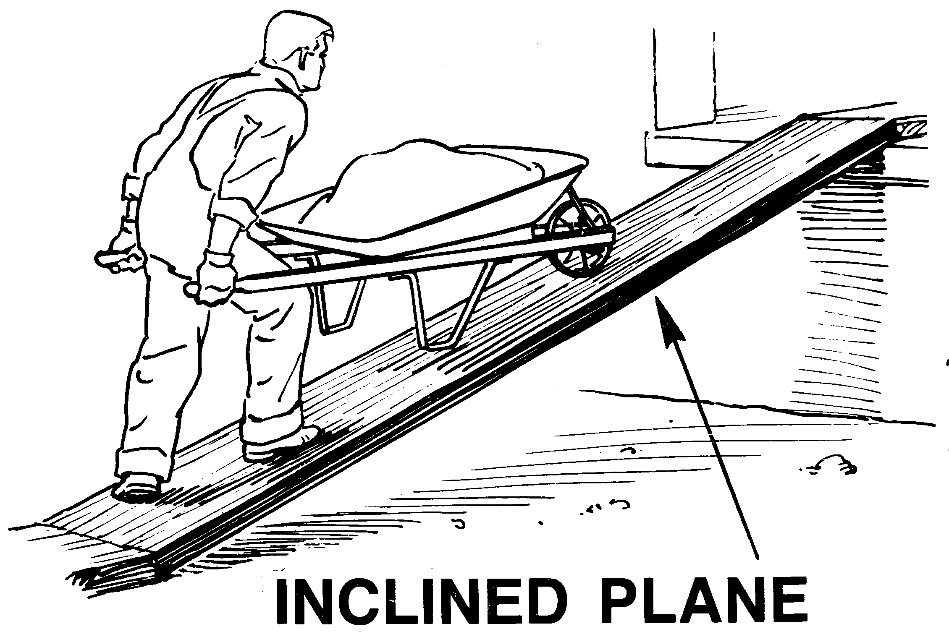
INCLINED PLANE:
Examples
Ramps (Boat ramps, wheelchair ramps)
Ladders/Stairs

Slide 4

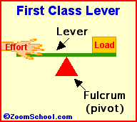
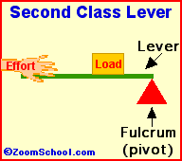
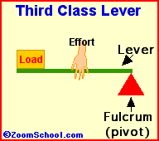
LEVER
A lever is a bar that pivots or rotates on a point (called a fulcrum).
Levers may change the size, distance or direction of the force.

Slide 5
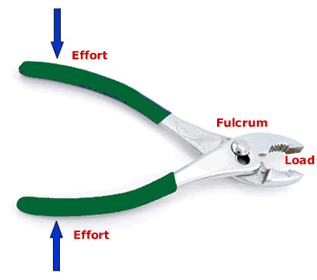
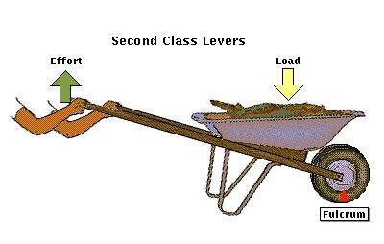

LEVERS:
Examples & Uses
First Class Levers:
  Scissors, See-saws, Pliers
Second Class Levers:
  Staplers, Nutcrackers,
  Wheelbarrows
Third Class Levers
  Shovels, baseball bats, tweezers

Slide 6
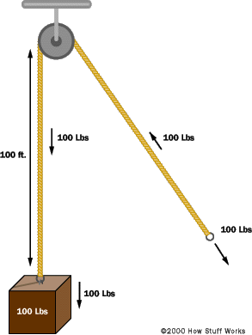
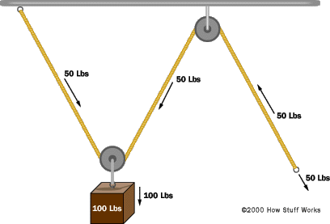
PULLEY
A pulley is a grooved wheel with a rope, used to raise/lower/move a load.
Pulley systems change the direction and/or decrease the input force so you can move heavier loads.
Output Force
Input Force
Output
Force
Input Force

Slide 7
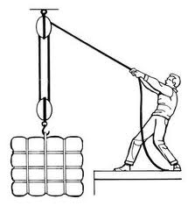
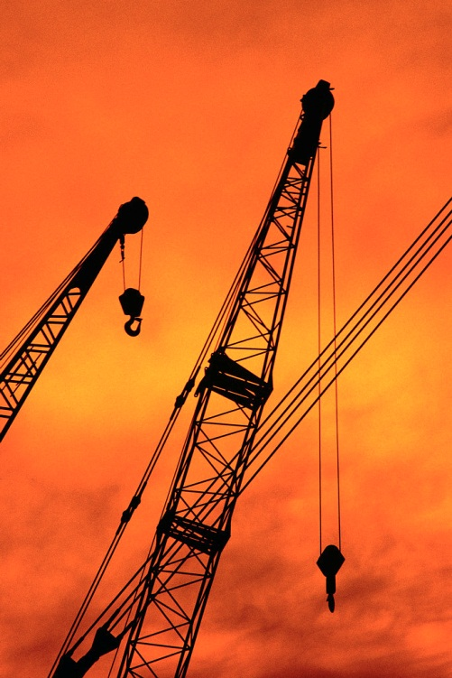
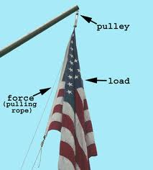
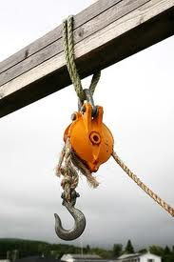

PULLEY:
Examples & Uses
Cranes
Raising a flag on a pole
Window Blinds
Raising a sail on a boat
Clothesline

Slide 8
WEDGE
A wedge has slanting slides that meet at an edge – it splits material apart.
It changes force in one direction into a splitting force that acts at right angles to the blade.
Input Force
Output Force
Output Force

Slide 9
WEDGE:
Examples & Uses
Ax, Knife, etc.
Zippers
Used in all cutting machines (to split materials apart)

Slide 10
WHEEL & AXLE
The wheel is locked to the central axle – when one turns, so does the other one.
A short powerful force at the axle, will move the wheel’s edge a long distance.
A long motion at edge of wheel, moves the axle with great force.
Input Force
Output Force
Output Force
Input Force

Slide 11

WHEEL & AXLE:
Examples & Uses
Screwdriver
Windmill
Cars/Bicycles
Rolling Pin
Door Knob
Fan

Slide 12
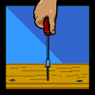
SCREW
A screw has a “thread” or “groove” wrapped around a central cylinder.
While turning, it converts a twisting force into a forward or backward force.
Output Force
Input Force

Slide 13
SCREW:
Examples & Uses
Screws can holds things together or lift materials.
Screws
Screw top lids for jars/bottles
Light bulb
Swivel stools/chairs

Slide 14
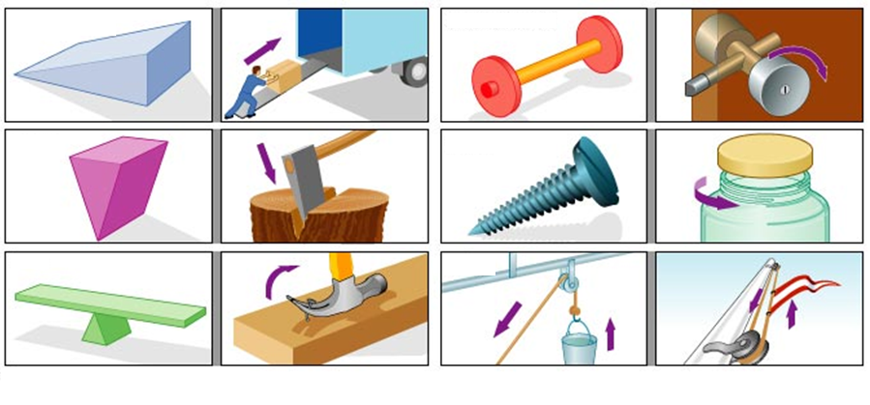
Simple Machine Review!
Write the name of the type of simple machine next to the picture.

