Slide 1
TREATMENT OF PSYCHOLOGICAL DISORDERS

Slide 2
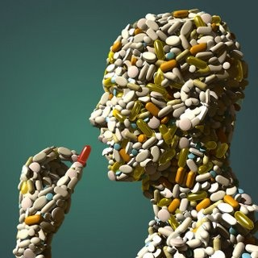

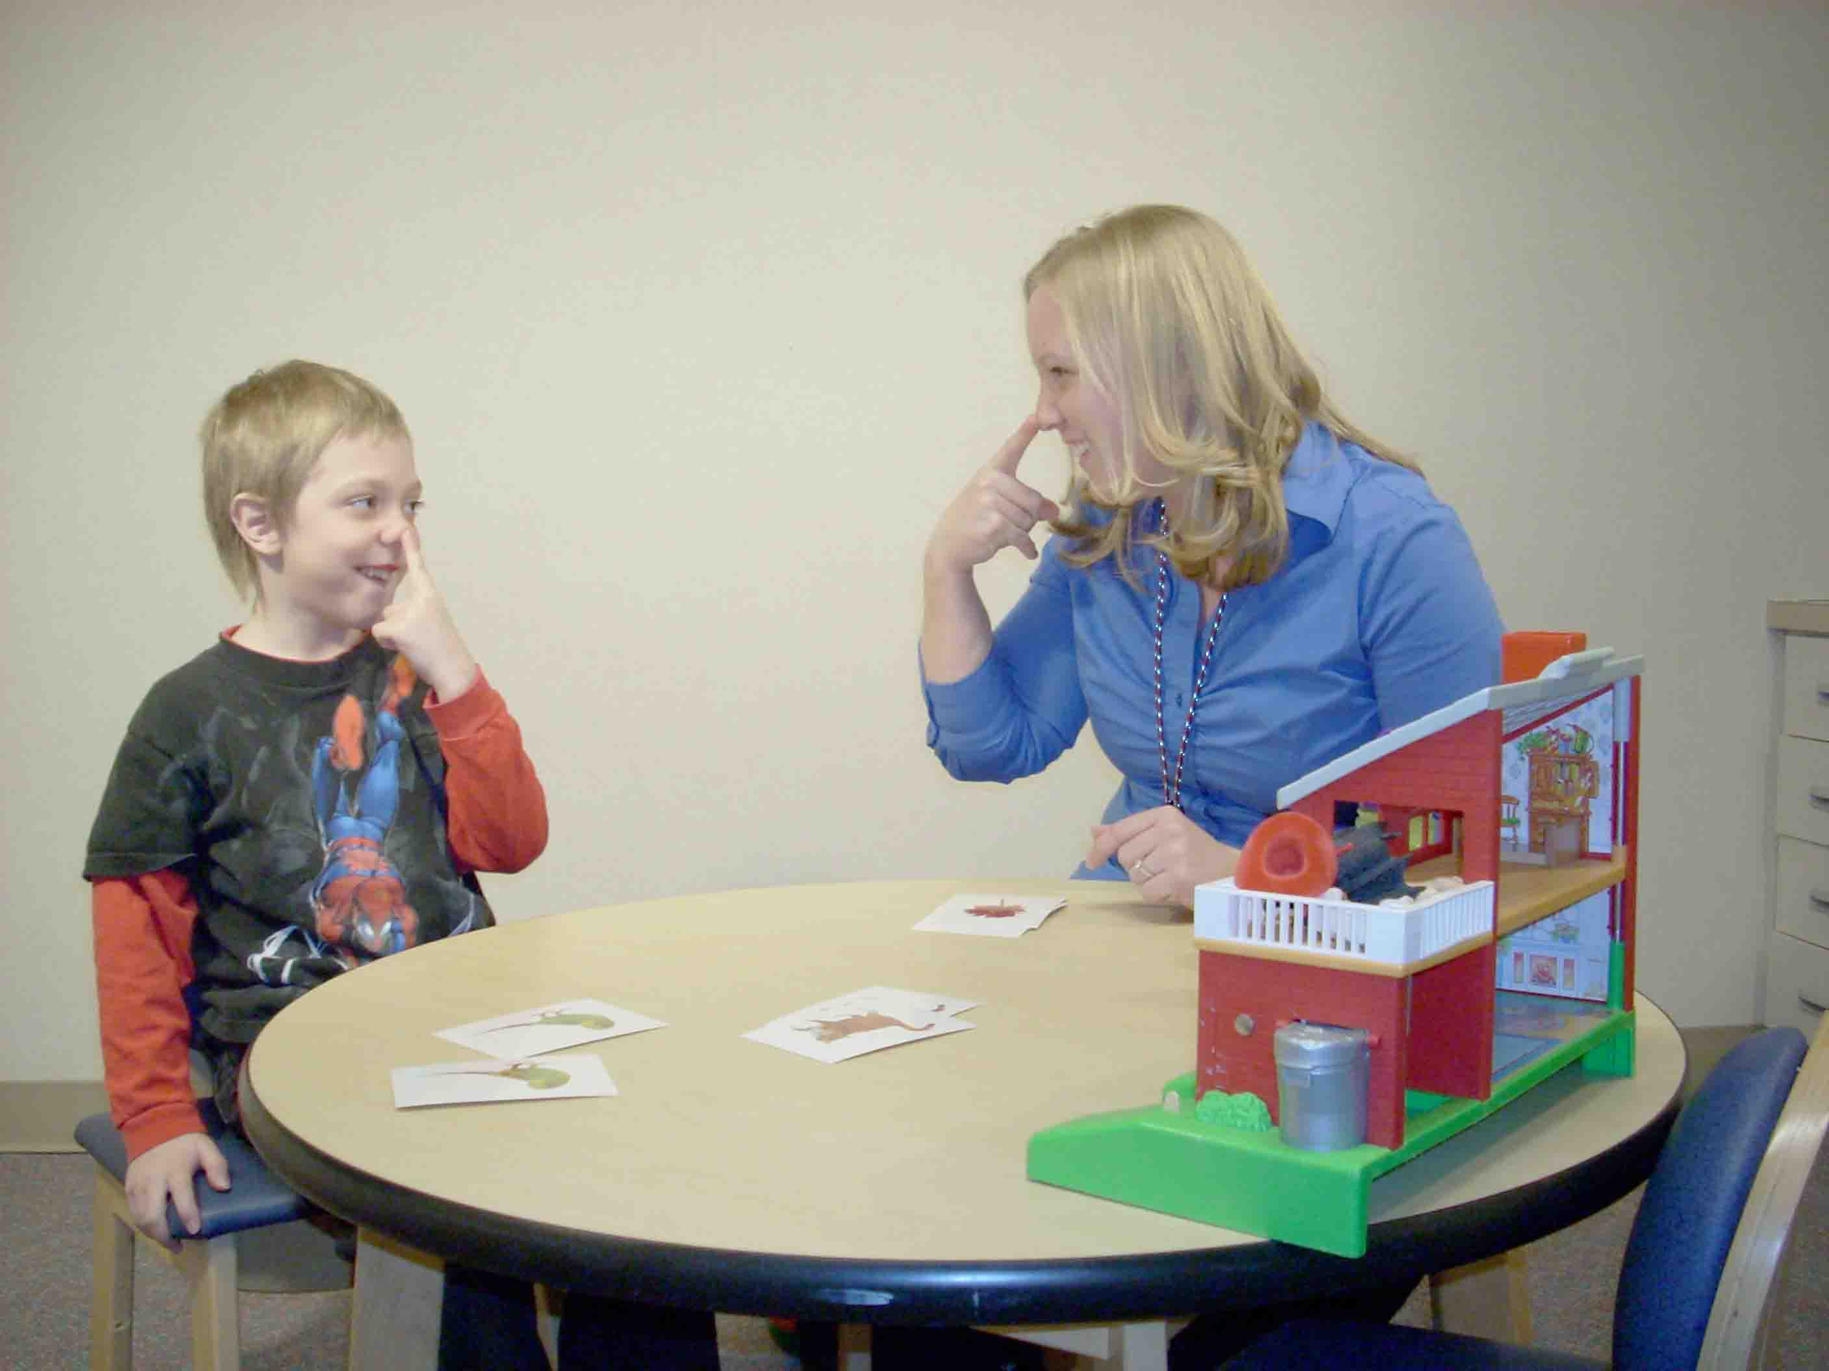
HOW MANY TYPES OF TREATMENTS?
3 major categories:
1) Insight therapies: “talk therapy”
2) Behavior therapies: based on principle of learning; procedures involve classical/operant conditioning, and observational learning
3) Biomedical therapies: drug therapy, shock therapy

Slide 3
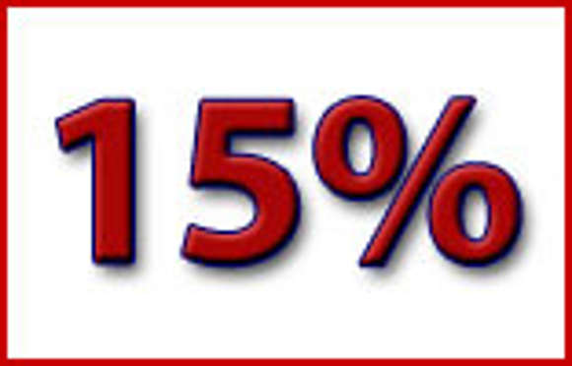
WHO SEEKS THERAPY?
C. 15% of U.S. pop. use mental health services in a given year
Most common issues: excessive anxiety and depression
Over half of clients do not have a specific disorder

Slide 4

WHO SEEKS THERAPY?
Women more likely than men to receive therapy
Lack of health insurance coverage is main reason for people not seeking treatment

Slide 5

WHO PROVIDES PROFESSIONAL TREATMENT?
Clinical and counseling psychologists: specialize in the diagnosis and treatment of psych disorders and everyday behavioral problems
Clinical treat full disorders; counseling treat more everyday issues

Slide 6

WHO PROVIDES PROFESSIONAL TREATMENT?
Psychiatrists are physicians who specialize in the diagnosis and treatment of psychological disorders
Mostly deal with severe disorders
Have an M.D.
Usually emphasize drug therapy

Slide 7

OTHER MENTAL HEALTH PROFESSIONALS
Clinical social workers and psychiatric nurses aid psychs and psychiatrists
Nurses help in inpatient treatment
Social workers help patients integrate back into the community
School counselors

Slide 8
INSIGHT THERAPIES
Involve verbal interactions intended to enhance clients’ self-knowledge and thus promote healthful changes in personality and behavior

Slide 9
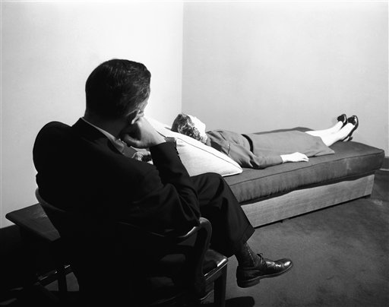
PSYCHOANALYSIS
DEF: emphasizes the recovery of unconscious conflicts, motives, and defenses through techniques such as free association and transference

Slide 10
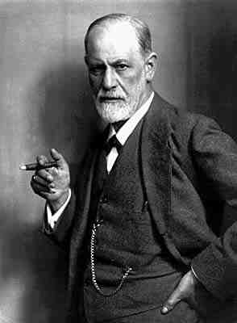
PSYCHOANALYSIS
Freud treated mostly disorders called neuroses
Believed problems are caused by unconscious conflicts
Id, Ego, Superego fight over sexual and aggressive tendencies
Help to create defense mechanisms

Slide 11

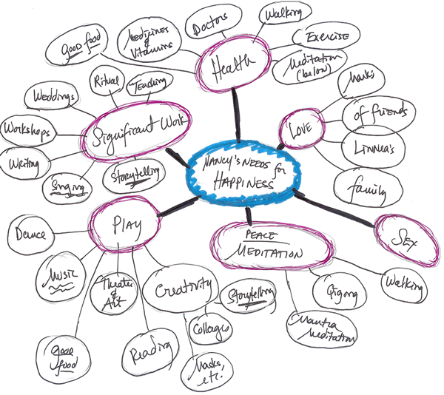

PROBING THE UNCONSCIOUS
Free association: clients spontaneously express their thoughts and feelings exactly as they occur, w/little censorship
Dream analysis: therapist interprets symbolic meaning of client’s dreams

Slide 12

INTERPRETATION
DEF: the therapists attempts to explain the inner significance of the client’s thoughts, feelings, memories, and behaviors
Gradual process

Slide 13
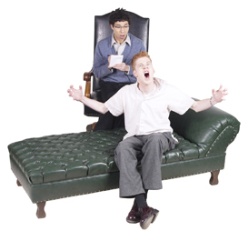
RESISTANCE
DEF: largely unconscious defensive maneuvers intended to hinder the progress of therapy
Show up late for sessions, pretend, hostile toward therapist

Slide 14
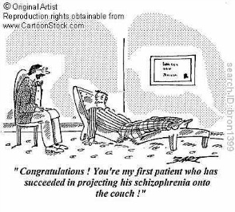
TRANSFERENCE
DEF: when clients unconsciously start relating to their therapist in ways that mimic critical relationships in their lives
They transfer their issue onto the therapist
Encouraged in psychoanalysis

Slide 15
CLIENT-CENTERED THERAPY
DEF: insight therapy that emphasizes providing a supportive emotional climate for clients, who play a major role in determining the pace and direction of their therapy
Foster self-acceptance and personal growth

Slide 16

THERAPEUTIC CLIMATE
How to create a supportive environment:
1) Genuineness: don’t be phony
2) Unconditional positive regard: provide warmth and caring
3) Empathy: understanding

Slide 17
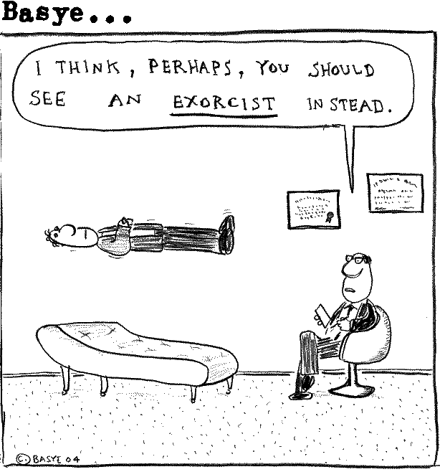
THERAPEUTIC PROCESS
Therapist key task is providing clarification
Therapists mirror client statements with enhanced clarity

Slide 18
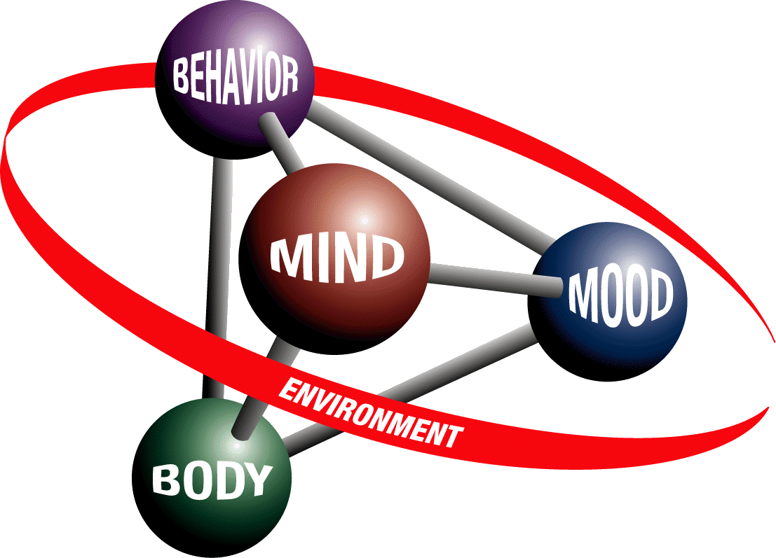
COGNITIVE THERAPY
DEF: insight therapy that emphasizes recognizing and changing negative thoughts and maladaptive beliefs
Originally devised for depression

Slide 19
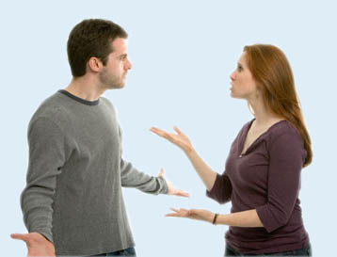
GOALS AND TECHNIQUES
Goal: change the way a client thinks
Help client use more reasonable evaluation process
4-20 sessions
May argue with client to persuade

Slide 20
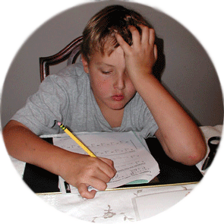
KINSHIP WITH BEHAVIOR THERAPY
Clients given “homework” assignments
Cognitive therapy has been adapted for group therapy

Slide 21
GROUP THERAPY
DEF: the simultaneous treatment of several clients
Usually 4-15 people
8 is ideal
Members act as therapists for one another
Provide support for one another
Therapist role: selecting clients, setting goals, initiating and maintaining process, protecting clients from harm
Advantages: save time and money, shows participants that their issue is not unique, provides opportunity to develop social skills

Slide 22
EVALUATING INSIGHT THERAPIES
1952: Hans Eysenck reports there is no evidence that insight therapy works
Said untreated neurotics get better
Spontaneous remission: a recovery from a disorder that occurs w/o formal treatment
SR rate for neurotics is today said to be 30-40%
Recent studies show that insight therapy is very beneficial to patients

