Slide 1
BEHAVIOR THERAPIES
The application of learning principles to direct efforts to change clients’ maladaptive behaviors

Slide 2
ASSUMPTIONS
1) Behavior is a product of learning
2) What has been learned can be unlearned

Slide 3
SYSTEMATIC DESENSITIZATION
DEF: a behavior therapy used to reduce phobic clients’ anxiety responses through counterconditioning
Counterconditioning: an attempt to reverse the process of classical conditioning by associating the crucial stimulus with a new conditioned response
Procedure: build an anxiety hierarchy; train client in deep muscle relaxation; client works through hierarchy, learning to remain relaxed while imagining each stimulus

Slide 4
AVERSION THERAPY
DEF: behavior therapy in which an averse stimulus is paired with a stimulus that elicits an undesirable response
Antabuse
Not a widely used technique
Successful with alcoholism, gambling, stuttering, smoking, and overeating

Slide 5
SOCIAL SKILLS TRAINING
Def: behavior therapy designed to improve interpersonal skills that emphasizes modeling, behavioral rehearsal, and shaping

Slide 6
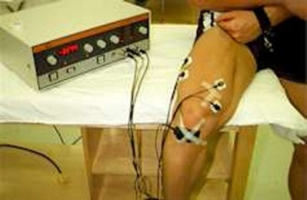
BIOFEEDBACK
DEF: a bodily function is monitored, and info about the function is fed back to the person to facilitate improved control of the physiological process
EEG, EMG, etc…

Slide 7
EVALUATING BEHAVIOR THERAPIES
Measuring therapeutic outcomes is important
Good for phobias, OCD, sexual dysfunction, schizophrenia, drug problems, eating disorders, psychosomatic disorders, hyperactivity, autism, and mental retardation

Slide 8
BIOMEDICAL THERAPIES
Physiological interventions intended to reduce symptoms associated with psychological disorders

Slide 9
TREATMENT WITH DRUGS
Psychopharmacotherapy: the treatment of mental disorders with medication
3 major groups:
1) antianxiety drugs
2) antipsychotic drugs
3) antidepressant drugs

Slide 10
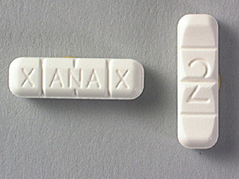
ANTIANXIETY DRUGS
Relieve tension, apprehension, and nervousness
Valium, Xanax---benzodiazepine family; tranquilizers
Side effects: drowsiness, nausea, confusion, depression
Potential for addiction and overdose

Slide 11
ANTIPSYCHOTIC DRUGS
DEF: used to gradually reduce psychotic symptoms, including hyperactivity, mental confusion, hallucinations, and delusions
Decrease activity in dopamine synapses
Used for schizophrenia
Side effects: drowsiness, constipation, cotton mouth, muscle tremors, muscular rigidity, impaired motor coordination
Could cause tardive dyskinesia: neurological disorder marked by involuntary writhing and tic-like movements of the mouth, tongue, face, hands, or feet
New group of antipsychotics are called atypical antipsychotic drugs

Slide 12
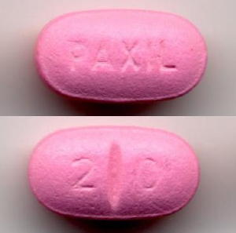
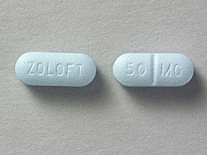
ANTIDEPRESSANT DRUGS
Gradually elevate mood and help bring people out of a depression
2 classes: tricyclics and MAO inhibitors
New class: selective serotonin reuptake inhibitors (SSRIs)---Prozac, Paxil, and Zoloft---also helpful w/OCD and panic disorders
Side effects: negative effect on sexual functioning, withdrawal

Slide 13
LITHIUM
DEF: chemical used to control mood swings in patients w/bipolar mood disorders
Can be used to prevent swings or get out of an episode
Kidney and thyroid gland complications are the major concern w/its use

Slide 14
EVALUATING DRUG THERAPIES
Critics: drugs only offer superficial relief; many drugs are overprescribed; side effects are worse that disorder they are meant to cure
Still controversial

Slide 15
ELECTROCONVULSIVE THERAPY (ECT)
DEF: a biomedical treatment in which electric shock is used to produce a cortical seizure accompanied by convulsions
Risks: memory loss, impaired attention, other cognitive deficits

Slide 16
CURRENT TRENDS AND ISSUES IN TREATMENT

Slide 17
CONSTRAINTS OF MANAGED CARE
Free-for-service: hospitals, physicians, psychs, and other providers charge fees for whatever health care services were needed and most fees were reimbursed by private insurance or government
Managed care systems: people enroll in prepaid plans w/small copayments for services, typically run by health maintenance organizations (HMOs), which agree to provide ongoing health care for a specific sum of money
You pay lower prices, but give up the freedom to choose the medical professional

Slide 18
IDENTIFYING EMPIRICALLY VALIDATED TREATMENTS
The managed care system has made it necessary for clinicians to demonstrate the efficacy of their treatments
Must be superior to placebo or no treatment

Slide 19
BLENDING APPROACHES TO TREATMENT
Multiple approaches are valuable
Eclecticism: drawing ideas from 2 or more systems of therapy instead of committing to just one system
Theoretical integration: 2 or more systems of therapy are combined or blended to take advantage of the strengths of each
Technical eclecticism: borrowing ideas, insights, and techniques from a variety of sources while tailoring one’s intervention strategy to the unique needs of each client

Slide 20
INCREASING MULTICULTURAL SENSITIVITY IN TREATMENT
Many minority groups underuse therapeutic services
1) Cultural barriers—many turn to informal therapies
2) Language barriers
3) Access barriers—lack of health insurance in many minority groups
4) Institutional barriers—many therapists are unfamiliar with other cultural backgrounds

Slide 21
INSTITUTIONAL TREATMENT IN TRANSITION

Slide 22
MENTAL HOSPITAL
DEF: a medical institution specializing in providing inpatient care for psychological disorders
Mentally ill used to be housed in jails
Dorothea Dix helped reform that

Slide 23
DISENCHANTMENT WITH MENTAL HOSPITALS
1950s: realization that hospital conditions could actually contribute to development of pathology
Facilities were understaffed and overcrowded

Slide 24
DISENCHANTMENT CON’T
1960s: Community mental health movement
Emphasized: 1) local, community-based care, 2) reduced dependence on hospitalization, and 3) prevention of psychological disorders

Slide 25
DEINSTITUTIONALIZATION
DEF: transferring the treatment of mental illness from inpatient institutions to community-based facilities that emphasize outpatient care
Made possible by: 1) emergence of effective drug therapies for severe disorders and 2) the deployment of community mental health centers to coordinate local care

Slide 26
MENTAL ILLNESS, THE REVOLVING DOOR, HOMELESS
Many suffer from chronic disorders
They respond well to medicine and are released, only to relapse
Deinstitutionalization has been blamed for growth of homeless pop.
1/3 of homeless suffer from a mental illness

