Slide 1
MEDITATION
Spiritual or simply a relaxation technique?

Slide 2
MEDITATION
Def: a family of practices that train attention to heighten awareness and bring mental processes under greater voluntary control

Slide 3
MEDITATION
Many types
Yoga, Zen, and Transcendental Meditation (TM) are popular in the U.S.
Rooted in eastern religions
Deliberate effort to alter consciousness

Slide 4
CLAIMS FOR MEDITATION
Enhances learning, creativity, cognitive development, energy level, work productivity, physical health, mental health, and happiness
Reduces stress

Slide 5
SHORT TERM EFFECTS
When in meditative state:
Alpha and theta waves become prominent in EEG
Heart rate, respiration, oxygen consumption, and CO2 elimination decrease
Bodily arousal is suppressed

Slide 6
LONG TERM EFFECTS
Could improve mood, lessen fatigue, and reduce anxiety and drug use
Could improve physical and mental health
Increased longevity
Critics: simply relaxation techniques

Slide 7
ALTERING CONSCIOUSNESS WITH DRUGS
Recreational drug use is a social problem in the U.S.. Unfortunately, scare tactics have been used and they have backfired. A proper education in drugs and their effects are what we need…

Slide 8
PRINCIPAL ABUSED DRUGS AND THEIR EFFECTS
Psychoactive drugs: chemical substances that modify mental, emotional, or behavioral functioning
6 categories of psychoactive drugs…

Slide 9
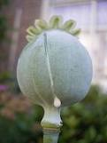
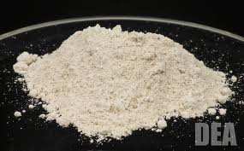
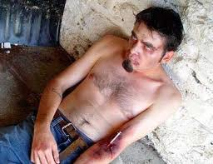
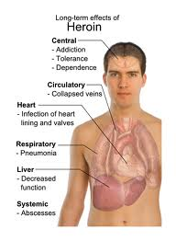
NARCOTICS (OPIATES)
Def: drugs derived from opium that are capable of relieving pain
Heroin, morphine, Demerol, methadone
Produce a sense of euphoria
Side effects: lethargy, nausea, impaired mental and motor functioning

Slide 10
SEDATIVES
Def: sleep-inducing drugs that tend to decrease central nervous system activation and behavioral activity
Creates sense of intoxication
Side effects: drowsiness, mood swings, severe motor and mental impairment

Slide 11
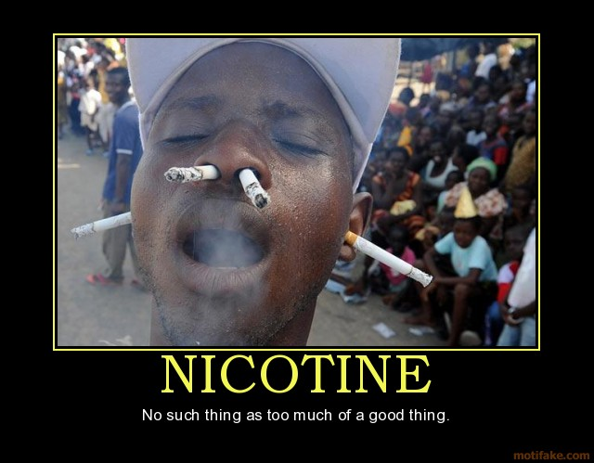
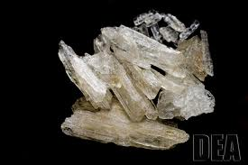
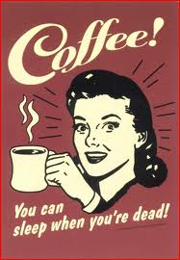
STIMULANTS
Def: drugs that tend to increase central nervous system activation and behavioral activity
Caffeine, nicotine, cocaine, amphetamines
Side effects: restlessness, anxiety, paranoia, and insomnia

Slide 12
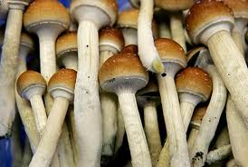
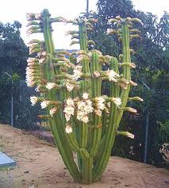
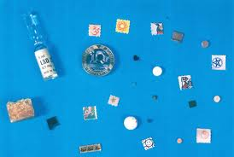
HALLUCINOGENS
Def: group of drugs that have powerful effects on mental and emotional functioning, marked most prominently by distortions in sensory and perceptual experience
LSD, mescaline, psilocybin
Side effects: hallucinations, impaired judgment, and impaired thought processes

Slide 13
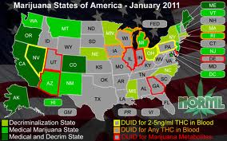
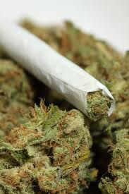
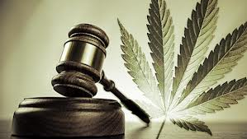
CANNABIS
Def: the hemp plant from which marijuana, hashish, and THC are derived
Mild, relaxed euphoria, enhanced sensory awareness
Side effects: anxiety, slow mental functioning, impaired memory, and the munchies

Slide 14
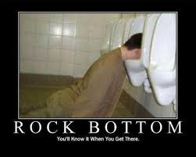
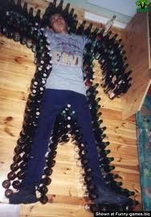
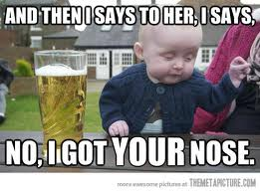
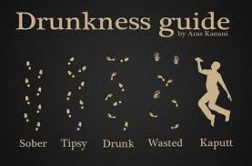
ALCOHOL
Def: beverages containing ethyl alcohol
Creates relaxed euphoria, increased self-esteem, diminished inhibitions
Side effects: impaired mental and motor functioning, mood swings
Most commonly used drug

Slide 15
FACTORS INFLUENCING DRUG EFFECTS
Effects are subjective
Expectations heavily influence effect
Tolerance: a progressive decrease in a person’s responsiveness to a drug

Slide 16
MECHANISMS OF DRUG ACTION
PA drugs alter neurotransmitter activity in the brain
Amphetamines increase release of dopamine and norepinephrine
Sedatives increase activity in the GABA system
Alcohol: complex effects on dopamine, serotonin, and others
Opiates: elevate dopamine activity
All drugs: increase activity in the mesolimbic dopamine pathway

Slide 17
DRUG DEPENDENCE
Physical dependence: must take the drug to avoid withdrawal illness
Psychological dependence: must take a drug to satisfy intense mental and emotional craving for the drug

Slide 18
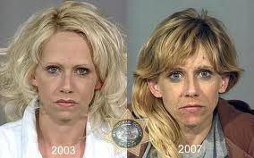
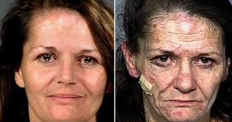
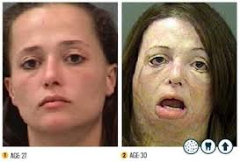
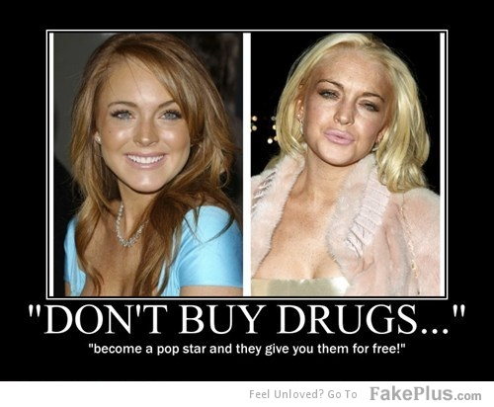
DRUGS AND PHYSICAL HEALTH
Overdose: any drug can kill if too much is taken
Direct effects: tissue damage, altered cardiovascular, liver damage, etc..
Indirect effects: behavior, sleep, eating, injury, disease

