Slide 1
CHAPTER 7: ALTERED STATES OF CONSCIOUSNESS
Sleeping, dreaming, hypnotizing, meditating, and…drugging?

Slide 2
SECTION 1: SLEEP AND DREAMS
Sleep is an essential state of consciousness. It involves stages and periods of dreaming

Slide 3
CONSCIOUSNESS
Def: a state of awareness, including a person’s feelings, sensations, ideas, and perceptions
Many different levels

Slide 4
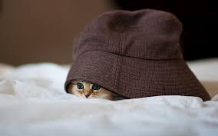
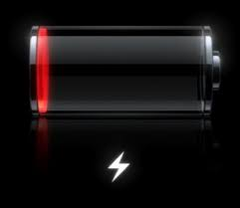
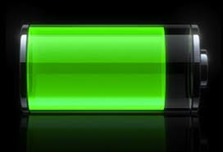
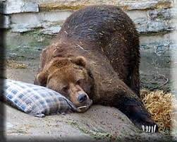
WHY DO WE SLEEP?
Theories:
1) Restorative: recharge the batteries
2) Hibernation: to conserve energy
3) Adaptation: helped early man hide from predators
4) Information dump: useless info/data is tossed out

Slide 5
STAGES OF SLEEP

Slide 6
BRAIN WAVES
Gamma: formation of ideas, language, memory, learning
Beta: awake
Alpha: awake but relaxed; no concentration
Theta: light sleep or extreme relaxation
Delta: deep, dreamless sleep

Slide 7
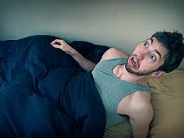
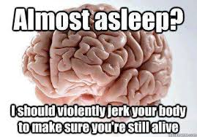
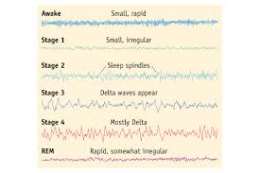
EARLY STAGES
Stage 1: drifting; pulse slows, muscles relax, lasts around 10 minutes; theta waves
Stage 2: hypnic jerks; eyes move slowly; lasts 30 minutes
Stage 3: sweeping delta waves; passing into deep sleep

Slide 8
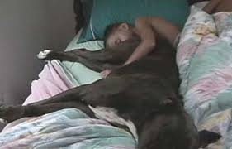
LATER STAGES
We spend 75% of sleep in stages 1-3 (called nREM or non-REM)
Then we enter REM…

Slide 9
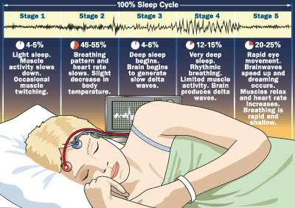
R.E.M. SLEEP
Rapid Eye Movement
High level of brain activity
Brain waves of an awake person
Deep relaxation of muscles (comatose)
Most dreaming occurs in this stage
Lasts 15-45 minutes
Cycling through all the stages takes c. 90 minutes, then repeats
We have about 4-5 sleep cycles in one night

Slide 10
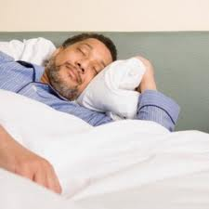
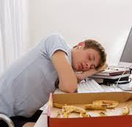
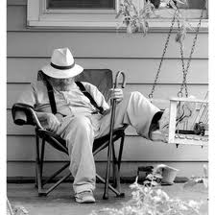
HOW MUCH SLEEP?
Newborns: 16 hours a day
Teens: 10-11 hours
Middle age people: 6-7 hrs
70+: 5 hours
As you get older, the length of time spent in REM lessens

Slide 11
CIRCADIAN RHYTHM
Def: the rhythm of activity and inactivity lasting approximately one day
Related to biological clocks
Does not control sleep

Slide 12
SLEEP DISORDERS

Slide 13
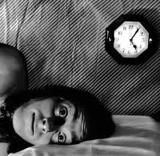
INSOMNIA
Def: the failure to get enough sleep at night in order to feel rested the next day
Causes: stress, anxiety, drug abuse

Slide 14
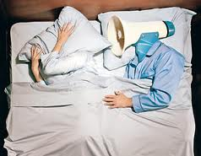
SLEEP APNEA
Def: trouble breathing while asleep
Marked by short snoring episodes
Cause: blockage of the airway
Effects 1 in 100 in U.S.

Slide 15
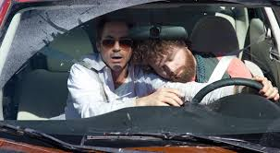
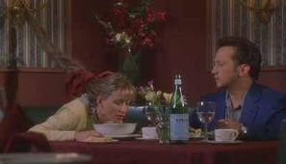
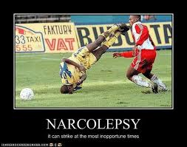
NARCOLEPSY
Def: condition characterized by suddenly falling asleep or feeling very sleepy during the day
Can also include unusual sleep and dream patterns

Slide 16
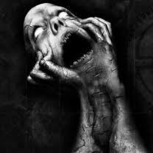
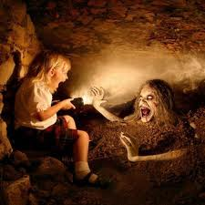
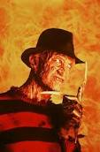
NIGHTMARES AND NIGHT TERRORS
Nightmare: unpleasant dream
Night terrors: sleep disruptions that occur during Stage IV of sleep, involving screaming, panic, or confusion; usually no memory of event

Slide 17
DREAMS
What are they? Do they serve a purpose?

Slide 18
WHAT ARE THEY?
Mental activity while you sleep
Usually 4-5 a night
First ones are vague thoughts left over from the day
Become longer and more vivid as night progresses
Appear to be necessary

Slide 19
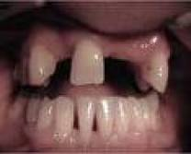
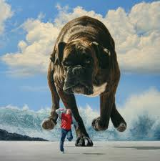
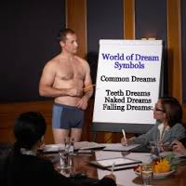
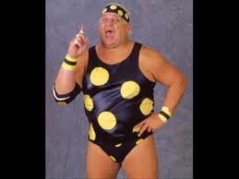
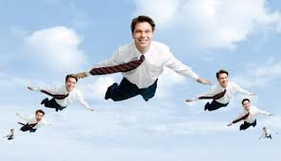
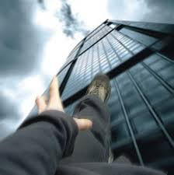
CONTENT OF DREAMS
Usually about everyday activities
Occur in common settings
Emotions experienced in dreams are usually negative
Dreams occur in real time
Sweet Dreams!

Slide 20
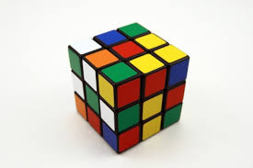
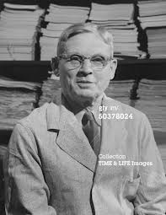
DREAM INTERPRETATION
I’m boring.I
Freud: dreams are thoughts you are afraid to acknowledge when awake
Tribal: entering the spirit world; predictive ability
Nathaniel Kleitman: no function; byproduct of brain cell activity
Problem-solving theory: resolve issues faced in the day
Francis Crick: mental housecleaning

Slide 21
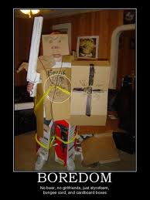
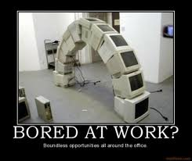
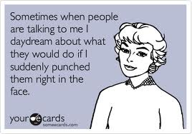
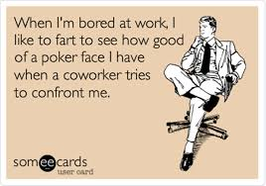
DAYDREAMS
Low level of awareness
Idle thinking
Usually when bored
Helps to remind of things or to prepare for future events
Improves creativity
May help or control emotions

Slide 22
SECTION 2: HYPNOSIS, BIOFEEDBACK, AND MEDITATION

Slide 23
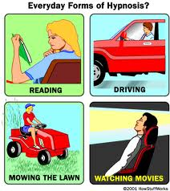
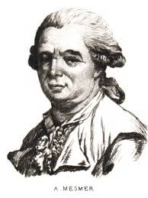
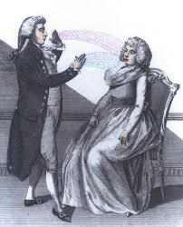
WHAT IS HYPNOSIS?
Def: the state of consciousness resulting from a narrowed focus of attention and characterized by heightened suggestibility
Persuading to relax and lose interest in external distractions
It is cooperation, NOT domination

Slide 24
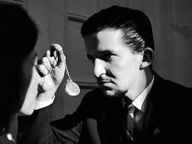
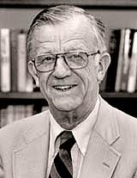
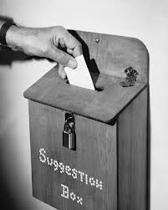
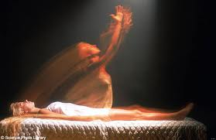
THEORIES ON HYPNOSIS
Theodore Barber: simple suggestibility
Ernest Hilgard: Neodissociation—conscious mind dissociates during hypnosis; you become a hidden observer
Other: the hypnotized has an expectation of what a hypnotized person is supposed to do

Slide 25
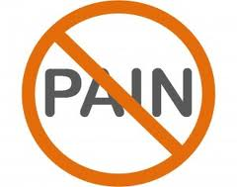
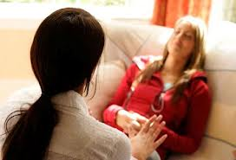
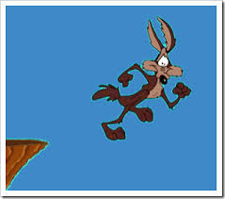
USES OF HYPNOSIS
Posthypnotic suggestion: a suggestion made during hypnosis that influences the participant’s behavior afterward
Hypnotic analgesia: reducing pain with hypnosis
Hypnotherapy: helps people to view something from another perspective

Slide 26
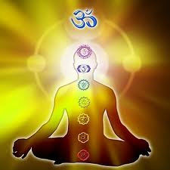
MEDITATION
Def: the focusing of attention to clear one’s mind and produce relaxation
3 approaches:
1) Transcendental: mental repetition of a mantra
2) Mindfulness: focus on the present (Buddhist)
3) Breath: concentrate on breathing
All lower blood pressure, heart rate, and respiration

Slide 27
SECTION 3: DRUGS! AND CONSCIOUSNESS

Slide 28
PSYCHOACTIVE DRUGS
Def: chemicals that affect the nervous system and result in altered consciousness
Alcohol, LSD, Opiates, Pot, Caffeine

Slide 29
HOW DRUGS WORK
Absorbed in the blood
Act as neurotransmitters
Attach to nerve endings and send signals to excite or inhibit neurons

Slide 30
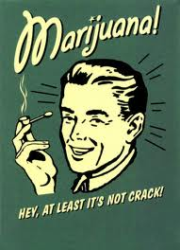
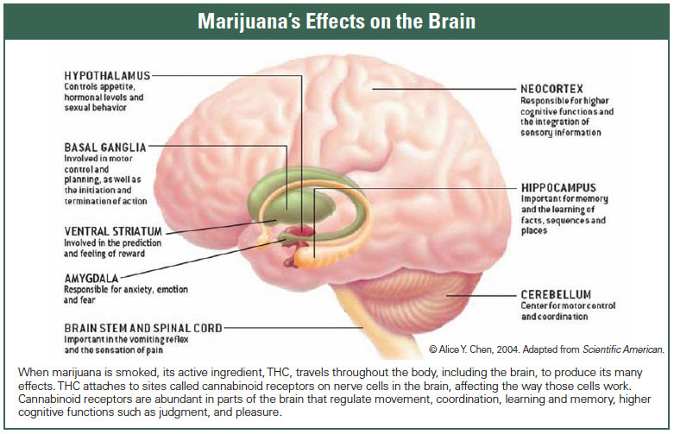
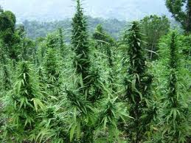
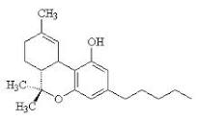
MARIJUANA
Def: the dried leaves and flowers of Indian hemp (Cannabis sativa) that produce an altered state of consciousness
Active ingredient: tetrahydrocannabinol (THC)
Effects: augmented senses, elation, disrupted memory formation
NOT physically addictive, but can be psychologically addictive

Slide 31
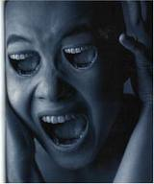
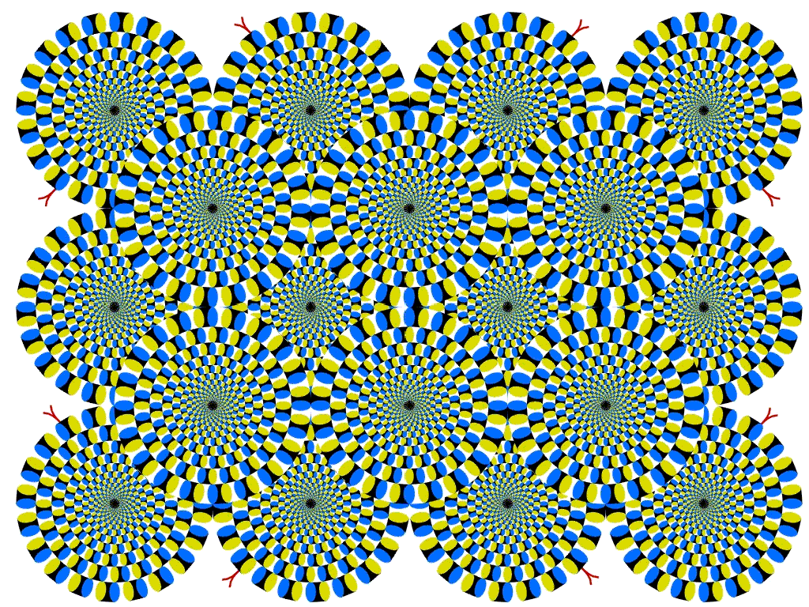
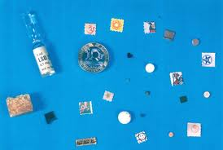
HALLUCINOGENS
Def: drugs that produce hallucinations
Called psychedelics
Best known: Lysergic Acid Diethylamide (LSD)
Effects: distortions of thought and perception; hallucinations, time distortion, panic attacks
Avg dose: 100-300 micrograms
Emotional state affects drug experience

Slide 32
OPIATES
Opium, morphine, heroin
Called narcotics
Made from the poppy flower
Effects: analgesia, euphoria, constipation
Very physically addictive

Slide 33
CENTRAL NERVOUS SYSTEM INHIBITOR
Cocaine
Effects: dopamine and serotonin inhibitor; alertness, increases heart rate
Causes a build up of dopamine in synapses

Slide 34
ALCOHOL
Most widely used and abused substance in the U.S.
Effects: loss of inhibition, depressant, decreased functioning
Effects depend on frequency of use and body weight (tolerance)
Overuse can result in permanent liver and brain damage

Slide 35
DRUG ABUSE AND TREATMENT
Abuser: one who regularly or excessively uses illegal drugs
Treatment steps:
1) Admit there is a problem
2) Enter a treatment program of therapy
3) remain drug free

