Slide 1
PHYSICAL GEOGRAPHY OF LATIN AMERICA

Slide 2
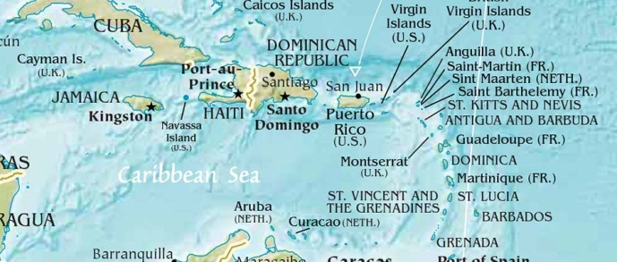
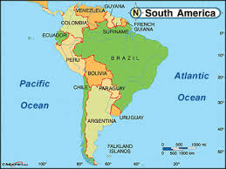
WHAT IS LATIN AMERICA?
Divided into 3 parts:
1) Middle America: Mexico and Central America
2) Caribbean Islands (aka: West Indies)
3) South America

Slide 3
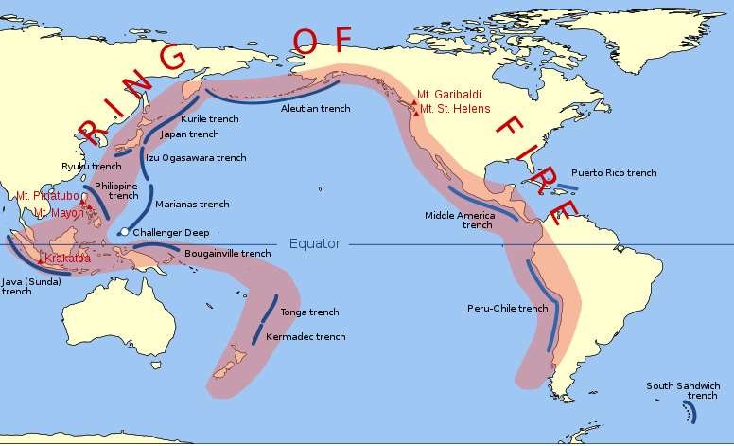
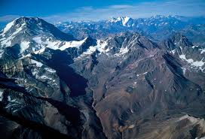
MOUNTAINS
Rocky mts of N. America extend to the southern tip of S. America
Mts. created by tectonic plate movement---much of the region lies on the Pacific Ring of Fire
Terrain used to block movement and trade; isolated regions and peoples

Slide 4
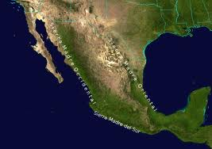
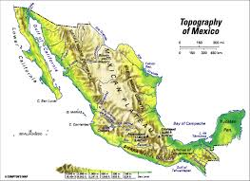
MOUNTAINS OF MEXICO
Called the Sierra Madre
2 ranges:
1) Sierra Madre Oriental (“eastern”)
2) Sierra Madre Occidental (“western”)
Meet near Mexico City to form the Sierra Madre del Sur
Ranges surround the Mexican Plateau

Slide 5
MOUNTAINS OF CENTRAL AMERICA AND CARIBBEAN
Called the Central Highlands
Volcanic mountains
Many Caribbean islands are actually mountain peaks

Slide 6
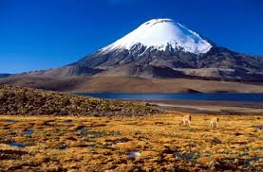
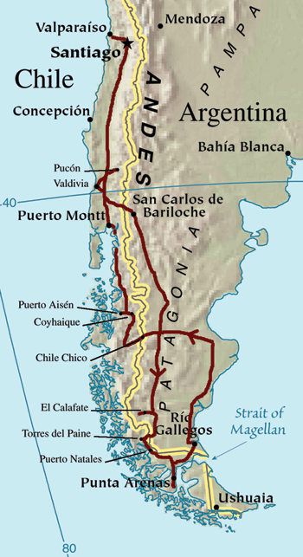
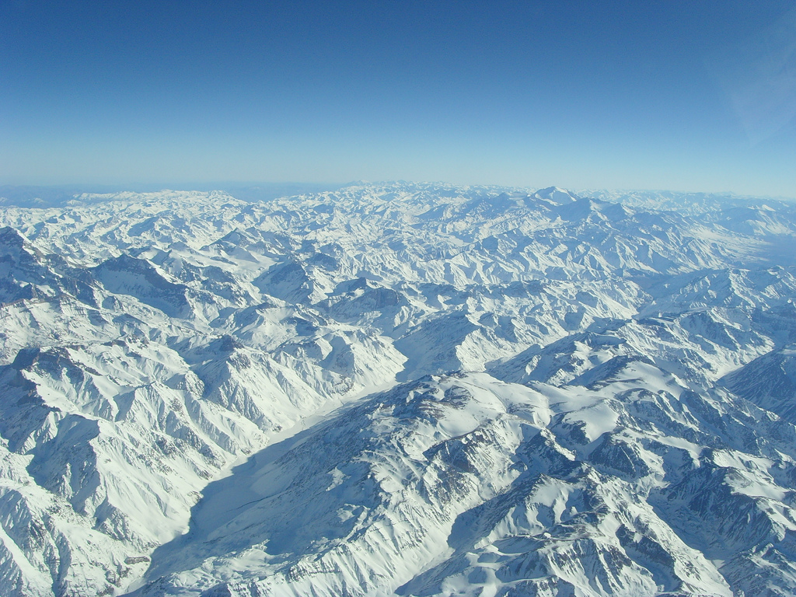
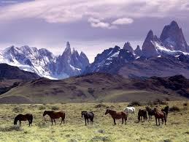
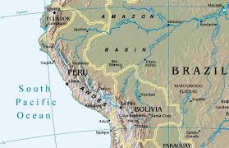
THE ANDES OF SOUTH AMERICA
4500 miles long (world’s longest)
Consist of several CORDILLERAS: ranges that run parallel to each other
Altiplano: area of Peru and Bolivia encircled by the Andes
Patagonia: flatlands and hills that form a plateau in Argentina

Slide 7
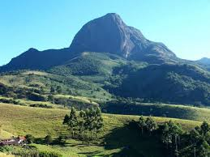
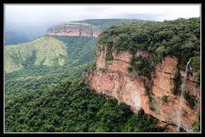
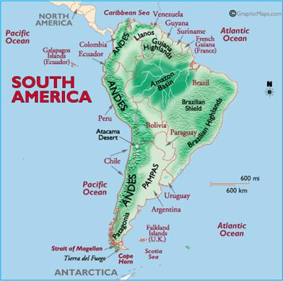
HIGHLANDS OF BRAZIL
Mato Grosso Plateau: begins in western Brazil, continues into Bolivia
Brazilian Highlands: east of Mato Grosso; vast plateau

Slide 8
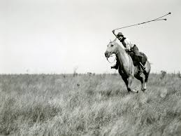
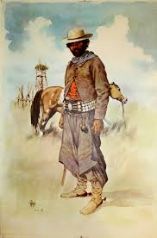
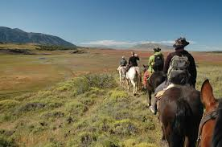
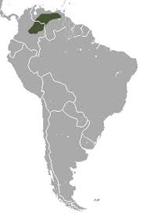
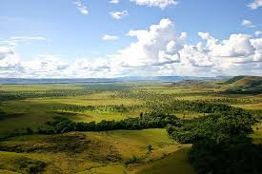
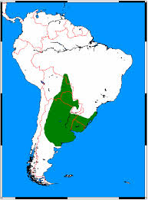
LOWLANDS AND PLAINS
Coastal lowlands run along both Atlantic and Pacific coasts of Central and South America
South America has vast grasslands
Llanos: Colombia and Venezuela
Pampas: Argentina and Uruguay
Good for ranching
Gauchos

Slide 9
WATERWAYS

Slide 10
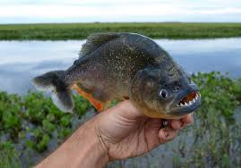
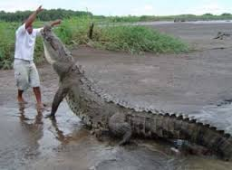
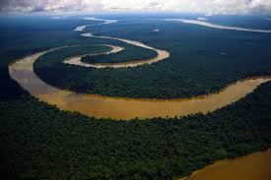
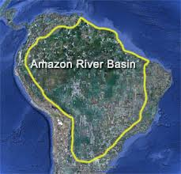
THE AMAZON RIVER
Longest river in the western hemisphere (4000 miles)
---10x the water volume of the Mississippi River
Amazon basin drains parts of Bolivia, Peru, Ecuador, Colombia, Venezuela, and Brazil

Slide 11
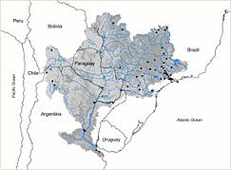
PARANA RIVER AND RIO DE LA PLATA
Parana River: 2nd largest basin in S. Am
Rio de la Plata: estuary between Argentina and Uruguay

Slide 12
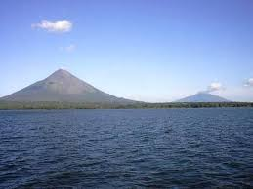
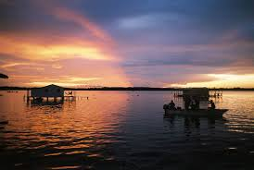
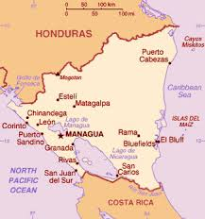
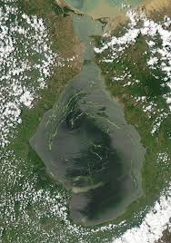
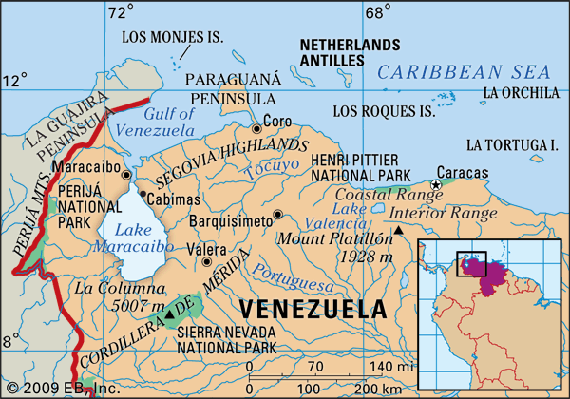
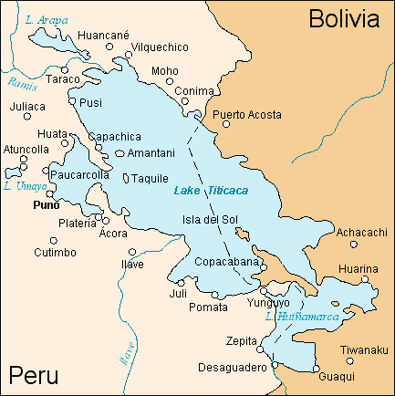
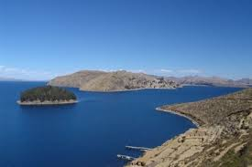
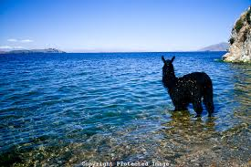
LAKES
Lake Titicaca: world’s highest navigable lake; 12,500 ft. above sea level
Lake Maracaibo: regarded as S. Am.’s largest lake
Lake Nicaragua: largest lake in Central Am.

Slide 13
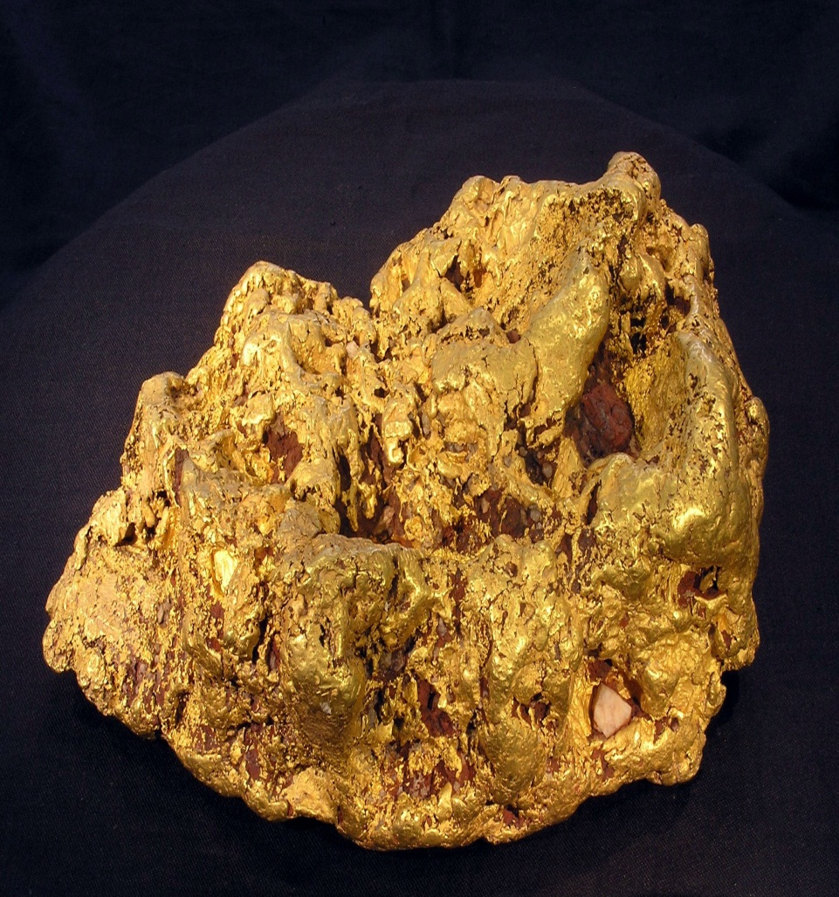
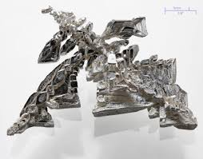
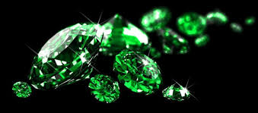
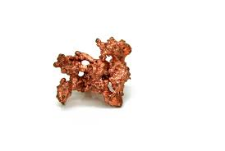
NATURAL RESERVES
Mexico and Venezuela: oil
Venezuela and Brazil: gold
Peru and Mexico: silver
Colombia: emeralds
Chile: world’s largest exporter of copper

Slide 14
SECTION 2: CLIMATE AND VEGETATION REGIONS
Much of Latin America lies between the Tropic of Cancer and the Tropic of Capricorn…

Slide 15
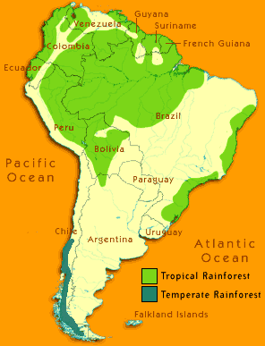
TROPICAL REGIONS
Tropical rainforest dominates much of the region
Amazon Basin: hot temperatures and lots of rain (approx. 7.5 feet annually)
Amazon Basin covers roughly 1/3 of S. America

Slide 16
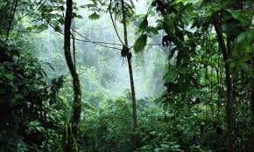
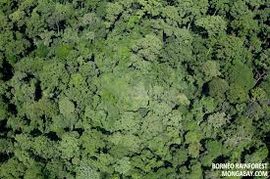
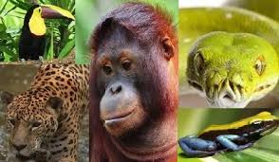
THE RAINFOREST
So many trees, so closely packed
Tops of trees create a canopy: continuous layer of leaves
So thick that sunlight might not reach the ground
Numerous species of animal

Slide 17
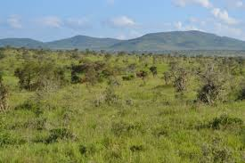
TROPICAL SAVANNA
Hot temps., lots of rain, with an extended dry period
SW Mexico, most Caribbean islands, and north-central S. America
Vast grasslands
Considered transition zones between forests and grasslands

Slide 18
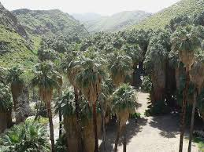
HUMID SUBTROPICS
Short, mild winters
Long, hot, humid summers
Covers much of southeastern South America (Argentina and Uruguay)

Slide 19
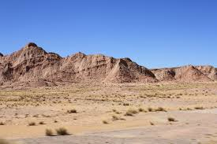
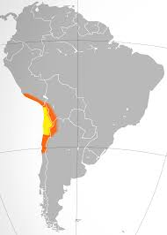
DESERTS
Very arid
Sparse vegetation
Parts of northern Mexico, coastal Peru and Chile, and coast of Argentina
Atacama Desert

Slide 20
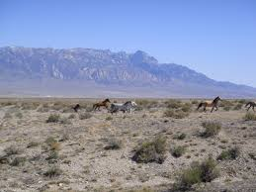
STEPPES
Close to desert climate
Hot summers, cool winters, little rainfall
Parts of northern Mexico, northern Brazil, and south central S. America

