Slide 1
CHAPTER 3: CLIMATE AND VEGETATION

Slide 2
SECTION 1: SEASONS AND WEATHER

Slide 3
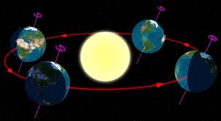
EARTH’S TILT
23.5 degrees in relation to sun
Revolution and tilt of Earth causes changes in seasons

Slide 4
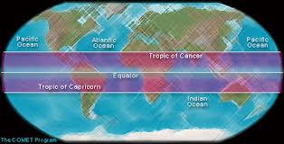
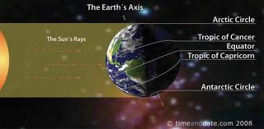
SOLSTICE
Tropic of Cancer and Tropic of Capricorn mark the farthest points north and south that the sun’s rays shine directly overhead at noon
Those days are called solstices
Summer solstice is longest day
Winter is the shortest

Slide 5
EQUINOX
When the day and night are equal in length
Twice a year
Mark the beginning of spring (vernal) and autumn

Slide 6
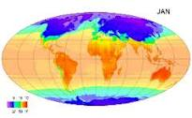
WEATHER
Def: the condition of the atmosphere at a particular location and time
CLIMATE: weather conditions at a particular location over a long period of time

Slide 7
WHAT CAUSES WEATHER?
Water vapor: determines amount and form of precipitation
Cloud cover: holds water vapor
Landforms and bodies of water
Elevation
Air movement

Slide 8
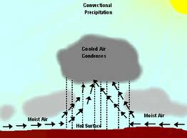
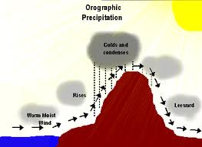
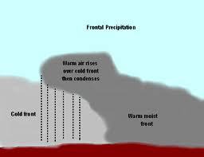
PRECIPITATION
Warm air rises, cools, air loses ability to hold moisture
Water vapor condenses and droplets form in clouds
3 types of precipitation:
1) Convectional: in hot, moist climates
2) Orographic: falls on windward side of mountain or hill
3) Frontal: in middle latitudes

Slide 9
WEATHER EXTREMES
Air masses clash as they are warming and cooling

Slide 10
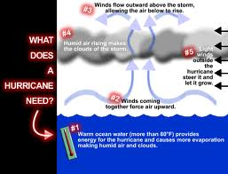
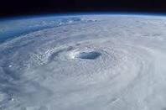
HURRICANES
Def: storms that form over warm, tropical ocean waters (aka typhoons)
When water is 80 degrees or higher huge amounts of heat and energy are collected
An “eye” will form
Surrounding winds can reach 200 mph

Slide 11
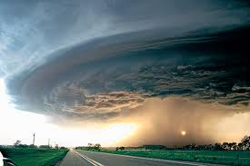
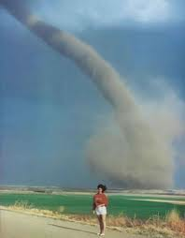
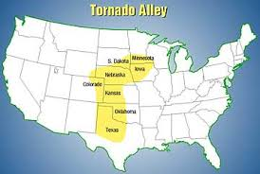
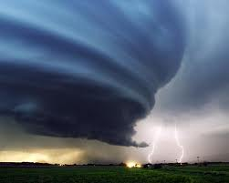
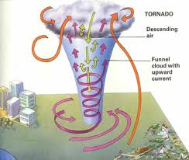
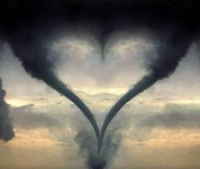
TORNADOES
Def: powerful funnel-shaped column of spiraling air
Winds swirl in counterclockwise motion around a low pressure center
U.S. averages 700 tornadoes a year

Slide 12
Don’t live here!

Slide 13
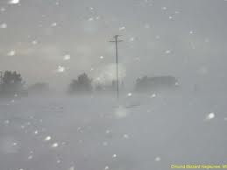
BLIZZARD
Def: heavy snowstorm with winds of more than 35 mph and reduced visibility

Slide 14
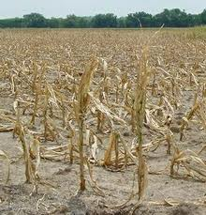
DROUGHT
Def: a long period of time without rain or with minimal rain

Slide 15
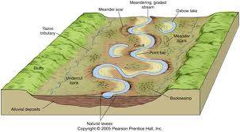
FLOODS
When water spreads over an area not usually covered with water
Area flooded is called a floodplain

Slide 16
SECTION 2: CLIMATE

Slide 17
FACTORS AFFECTING CLIMATE
Wind and ocean currents, latitude, elevation, and topography

Slide 18
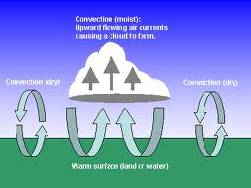
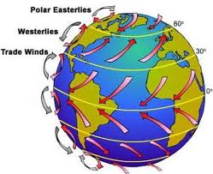
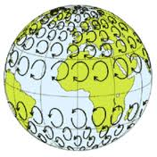
WIND CURRENTS
Help distribute heat
Convection: transfer of heat in the atmosphere by upward motion of air
Globally: hot air flows toward poles; cool air flows toward equator
Coriolis effect: bending of wind due to rotation of the earth

Slide 19
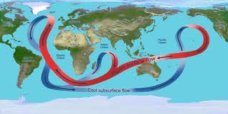
OCEAN CURRENTS
Underwater rivers
Warm water flows toward poles; cooler water toward equator
Affects the climate of the area

Slide 20
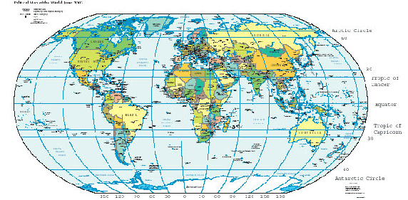
ZONES OF LATITUDE
3 general zones:
1) Low or Tropical: either side of equator; hot
2) Middle or Temperate: between tropics and poles; weather varies greatly
3) High or Polar: North and South Pole; cold all the time

Slide 21
ELEVATION
Distance above sea level
Air temp drops 3.5 degrees Fahrenheit for every 1000 ft above sea level

Slide 22
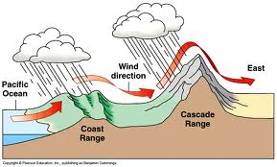
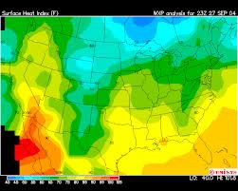
TOPOGRAPHY
Mountains have greatest effect on climate
Moist winds cool as they move up; heat up as they move down

Slide 23
CHANGES IN CLIMATE
Climates change over time. Some changes are natural, some are man-made

Slide 24
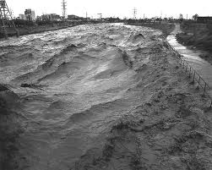
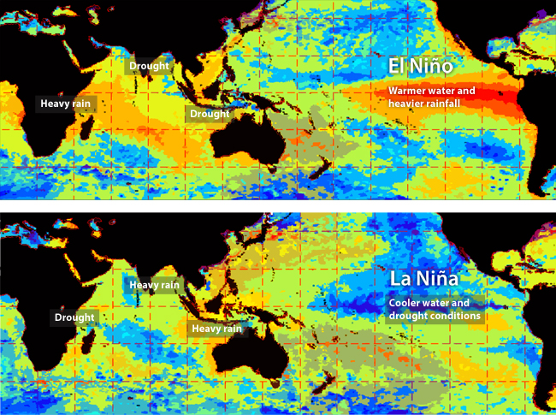
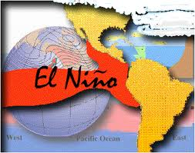
EL NIÑO
The warming of the waters off the west coast of S. America
C. every 2-7 years
Happens when easterly winds change direction or slow
Causes floods, mudslides
When it blows west, it is called La Niña

Slide 25
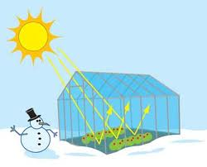
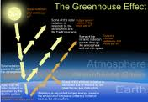
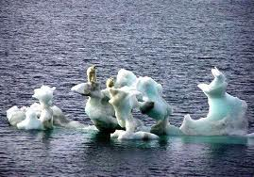
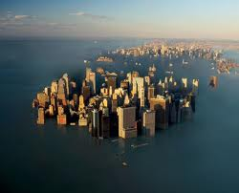
GLOBAL WARMING
Since late 1800s, Earth’s temp has increased by 1 degree
Some argue it’s natural
Others argue it’s due to the GREENHOUSE EFFECT: layer of gases released from burning coal and petroleum traps solar energy, thus increasing the planet’s temp.

Slide 26
SECTION 3: WORLD CLIMATE REGIONS

Slide 27
CLIMATE REGION
Temperature and precipitation are most significant factors
5 general climate regions:
1) Tropical (low latitude)
2) dry
3) mid-latitude
4) high latitude
5) highland

Slide 28
TYPES OF CLIMATES
The 5 major climate regions are divided into smaller subregions…

Slide 29
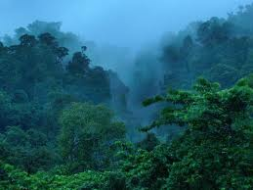
TROPICAL WET
Little variation in temp
Avg temp of 80 degrees
Avg annual rainfall: 80 inches
Found in Central and S. America, Africa, and Southwest Asia

Slide 30
TROPICAL WET AND DRY
Rainy in summer, dry in winter
Temps cooler in dry season, warmer in wet season
Found around tropical wet regions

Slide 31
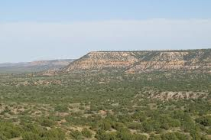
SEMIARID
Avg 16 inches of rain annually
Hot summers, mild to cold winters
Found in interior of continents and around deserts

Slide 32
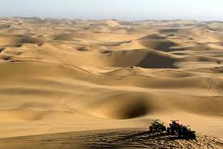
DESERT
Can be hot or cool/cold
< 10 inches of rain annually
Hot during the day, cold at night

Slide 33
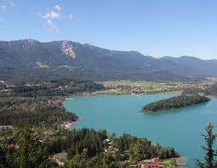
MEDITERRANEAN
Land around the Mediterranean Sea
Dry, hot summers
Cool, rainy winters
Rich agriculture

Slide 34
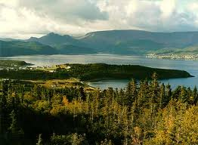
MARINE WEST COAST
Close to the ocean
Cloudy, foggy, damp
Precipitation is even annually
Western U.S./Canada and West coast of Europe

Slide 35
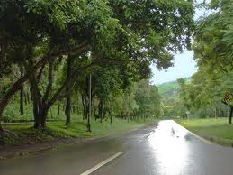
HUMID SUBTROPICAL
Long periods of summer heat and humidity
Found on east coasts of continents
Hurricanes
Winters are mild to cool

Slide 36
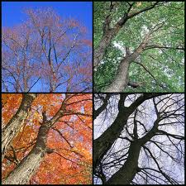
HUMID CONTINENTAL
Great variety in temp and precipitation
Found in mid-latitude interiors of Northern Hemisphere continents
Cold northern air collides with tropical air masses, causing severe changes in climate

Slide 37
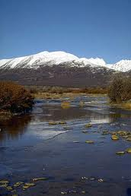
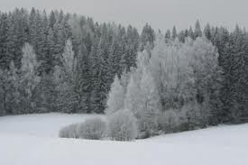
SUBARCTIC
Short, cool summers
Very cold winters; below zero 5-8 months out of the year
Known for evergreen forests

Slide 38
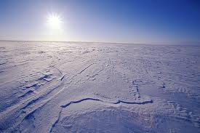
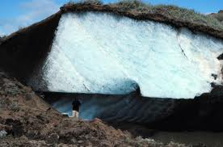
TUNDRA
Flat, treeless lands forming a ring around the Arctic Ocean
Located in Northern Hemisphere
PERMAFROST: constantly frozen subsoil

Slide 39
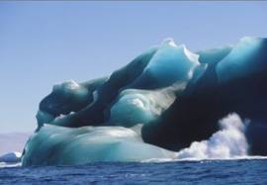
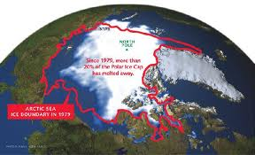
ICE CAP
Snow, ice, permanently freezing temps
So cold, it rarely snows
Called polar deserts

Slide 40
HIGHLANDS
Climates vary due to latitude, elevation, topography, and continental location
Ex: Andes Mountains

Slide 41
SECTION 4: VEGETATION

Slide 42
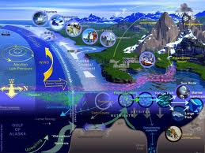
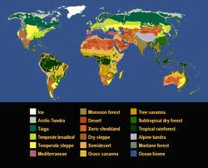
VEGETATION REGIONS
Regions that provide for human activities
ECOSYSTEM: interdependent community of plants and animals
BIOME: regional ecosystem

Slide 43
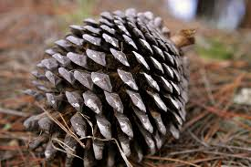
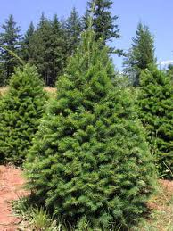
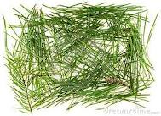
FORESTLANDS
DECIDUOUS TREES: broadleaf trees (maple, oak, birch)
RAINFOREST: tropical concentration of deciduous trees
CONIFEROUS TREES: needleleaf trees; cone-bearing

Slide 44
GRASSLANDS
Mostly flat regions with a few trees
SAVANNA: tropical grasslands; flat, grassy, mostly treeless
STEPPE: prairie; N. hemisphere temperate grassland

