Slide 1
Background to English Colonization 1492-1607 “Colliding Worlds” See textbook Ch. 1-3

Slide 2
CAUSES →
EFFECTS

Slide 3
The Crusades
Efforts for Middle East business and trade routes
Monopoly by Italian merchants
Spanish and Portuguese ambitions
Christopher Columbus

Slide 4
Exploration to…
Africa
Trade
Development of new ideas of slavery and trade
America
Trade
Development of new ideas of slavery and trade

Slide 6
Native American cultural attributes
Land
Religion
Economies based on geography and climate
Relationship with other tribes (trade and conflicts)
Relationship with Europeans (trade, conflict, subjugation, disease)

Slide 7
West Africa
Relationship with Portugal
Relationship with the Caribbean
Relationship with Central and South America
Relationship with North America
Indentured servitude vs. subjugation
Cultural attributes

Slide 8
European Religion—Catholicism and then…
Protestant Reformation
Catholic Counter-Reformation
Germany—Martin Luther
John Calvin
Henry VIII of England
Dutch Reform
French Huguenots (later)
Italy
Spain
France (usually)

Slide 9
Exploration
Spain and Portugal
France and Netherlands (Later)
Columbus to Hispaniola
Amerigo Vespucci—maps
Cortes, Pizarro, Ponce de Leon
Mexico, Peru
Africa
Treaty of Tordesillas
Cabral and Brazil
New France
Quebec
New Netherlands
Patroon system

Slide 10
Treaty of Tordesillas

Slide 11
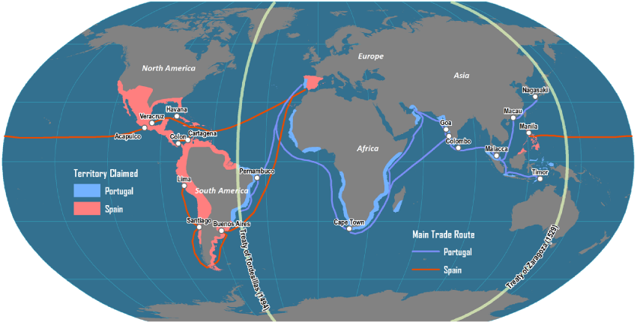

Slide 13
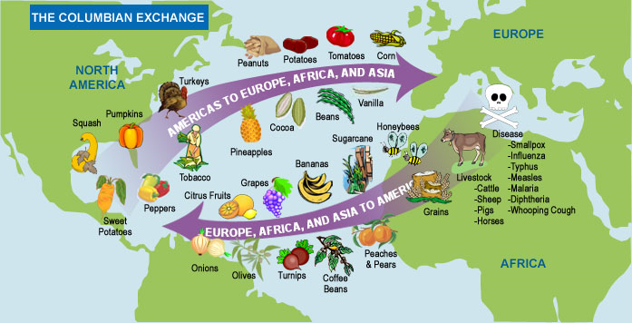

Slide 14
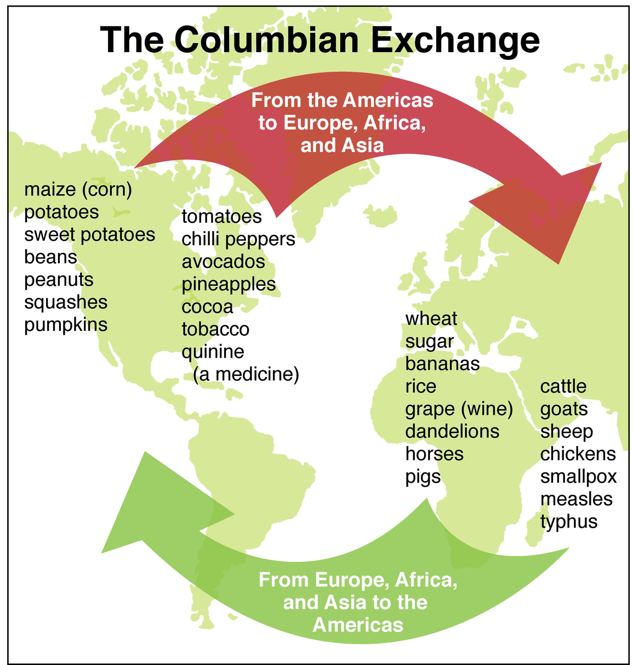

Slide 16
England’s history
Henry VIII: Tudor dynasty, Reformation, Church of England, Ireland
Elizabeth I: Sir Walter Raleigh and Roanoke
James I: Jamestown, 1607
English Civil War: Cavaliers/Royalists vs. Puritans/Parliamentarians
Oliver Cromwell and Interregnum

Slide 17
Puritans and Pilgrims: What’s the difference?
PURITANS
PILGRIMS
Members of the Church of England (Anglican)
They want to “purify” the religious practices of the Church of England without breaking away
Lived by a strict moral code (known for intolerance)
Founders of Boston and Salem
Led by John Winthrop in 1630
Attended Congregational churches
Believed in predestination
Former Puritans who left England for Netherlands and embraced Calvinism
“Separatists”—split apart from the Anglican Church and went to America aboard the Mayflower in 1620
Settled in Plymouth and celebrated first Thanksgiving
Known for religious toleration and eventually made conscience a basis for religious doctrine
Led by William Bradford in 1620

Slide 18
Both Pilgrims and Puritans…
Settled in Massachusetts
Came as families which multiplied and populated New England
Suffered hardships during first years in America
Lived under a strict moral code
Valued education, hard work, thrift, self-discipline
Used churches for self-governing political stability
Known for Protestant Work Ethic
Worshiped in “congregational” churches (not hierarchal or “popish”)

Slide 19
So who else came to America?
Dutch:
Places:
Influences:
Swedes:
See handout: British Empire in North America

Slide 20
Review:
How did the Crusades lead to Columbus sailing to Hispaniola in 1492?
What was the long term effect of the Treaty of Tordesillas and its Line of Demarcation of 1494?
Describe the institution of slavery before the Age of Exploration and exploitation of American and African natives.
4. List several common qualities of Native American peoples.
5. What motivated the Spanish to come to America?
6. How did slavery develop in the Americas? What role did Bartolome De Las Casas play?
7. Describe the Columbian Exchange.

Slide 21
8. What was the effect of the Reformation in England on American colonization?
9. What was the effect of the Counter-Reformation in Spain on American colonization?
What was the effect of the British Civil War on American colonization?
Describe the differences between French, Spanish, and English colonization regarding places, economies and cultural influences.
(see chart)
12. What long-term effects did the Puritans and Separatists have on America?

Slide 22
13. Describe the differences between French, Spanish, and English colonization regarding places, economies, and cultural influences.

