Slide 1
Welcome to United States History Class
What makes the U.S. a unique nation?
Quotables…
How do we learn about history?
APUSH Exam and Homework

Slide 2
We are a Unique Nation
Work Cited
Ellis, Joseph J., Founding Brothers,
New York: Vintage Books, 2000.

Slide 3
The U.S is the “oldest enduring republic in the world” (5)
We are still living the legacy of the Founding Fathers (12).
John Adams stated that all progress in the world happened in a westward movement (3).

Slide 4
While republican governments are the norm in the 20th century, no republican government prior to the American Revolution had ever survived for long over a landmass the size of our thirteen colonies.

Slide 5
The constitutional government was an illegal creation under American traditions after the revolution (8-9).
The terms, American and democrat began as epithets or insults used by the British (10).

Slide 6
“The Civil War…was a direct consequence of the decision to evade and delay the slavery question during the most vulnerable years of the republic” (12).
No other country ever attempted to have different races live together as equals before the U.S. (99).

Slide 7
History…
You may quote these people…
(35 examples)

Slide 8
Writing Activity: Pick two Quotes
Quote 1
Quote 2

Slide 9
“There is no such thing as an uninteresting life.”
Mark Twain

Slide 10
“There is no history—only biography.”
Ralph Waldo Emerson

Slide 11
“Great minds discuss ideas. Average minds discuss events. Small minds discuss people.”
Eleanor Roosevelt

Slide 12
“It is well that war is so terrible or else we should grow too fond of it.”
George Washington

Slide 13
“Journalism is the first rough draft of history…”
Philip Graham

Slide 14
From John Ford’s Western Film, The Man Who Shot Liberty Valance
“Education is the basis of law and order.”
“This is the West, sir. When the legend becomes fact, print the legend.”

Slide 15
“There is a relation between the hours of our life and the centuries of time.”
Ralph Waldo Emerson

Slide 16
“It is the duty of good education to arrive at wisdom by means of a definite order.”
St. Augustine, c. 400 AD

Slide 17
“Those who would sacrifice liberty for security deserve neither.”
Benjamin Franklin

Slide 18
“People are more impressed by the power of our example than the example of our power.”
President Bill Clinton
Democratic Convention, 2008

Slide 19
“We can disagree without being disagreeable.”
President Barack Obama

Slide 20
“The past is never dead. It’s not even past.”
William Faulkner

Slide 21
“If this nation is to be wise as well as strong, if we are to achieve our destiny, then we need more new ideas for more wise men reading more good books in more public libraries.”
JFK, 1960

Slide 22
“The first important step in anyone’s education is to know your own people.”
Chaim Potok, The Chosen (224)

Slide 23
“Ye were not formed to be like brutes but to pursue knowledge and virtue high.”
Dante’s Inferno XXIII

Slide 24
“The great gift I received from God is when He created my desire for freedom.”
Dante

Slide 25
“Those who stand for nothing will fall for anything.”
Alexander Hamilton

Slide 26
“Towers fell and a nation rose.”
President George W. Bush, 2001

Slide 27
“For we must consider that we shall be as a city upon a hill. The eyes of all people are upon us.”
John Winthrop
(quoted by Presidents Ronald Reagan and Barack Obama)

Slide 28
“I may not agree with what you say, but I will defend to the death your right to say it.”
Patrick Henry

Slide 29
“The goal of education is the advancement of knowledge and the dissemination of the truth.”
JFK

Slide 30
“All history is gossip.”
JFK

Slide 31
“Those who can’t remember the past are condemned to repeat it.”
George Santayana

Slide 32
“Any fool can make history, but it takes a genius to write it.”
Oscar Wilde

Slide 33
“Every year, with each new writer, opinion as to what constitutes the welfare of humanity changes; so that what once seemed good, ten years later seems bad, and vie versa…We even find in history, at one and the same time, quite contradictory views as to what was good and what was bad.”
Leo Tolstoy in War and Peace

Slide 34
“…the art of a nation is not only the measure of its prosperity, but also of its intelligence.”
Otto Wagner (Austrian architect and urban planner)

Slide 35
“A collective historical consciousness, therefore, may be as much a prerequisite for a healthy well-rounded society as is the proper ecological balance for a healthy forest and a healthy planet.”
John Lewis Gaddis in The Landscape of History

Slide 36
“The past becomes a place of refuge.”
Paraphrased from National Gallery in Berlin, Germany

Slide 37
“Right is right even if everyone is against it, and wrong is wrong, even if everyone is for it.”
William Penn

Slide 38
“It is history that teaches us to hope.”
General Robert E. Lee

Slide 39
“The reward for a thing well done is to have done it.”
Ralph Waldo Emerson

Slide 40
“… the American people are the greatest people in the world. What makes America the greatest nation in the world is the heart of the American people: hardworking, innovative, risk-taking, God- loving, family-oriented American people. “
Governor Mitt Romney

Slide 41
“News is the oxygen of democracy.”
Center for News Literacy

Slide 42
Writing Activity—Pick Two Quotes
“Quote”
“Quote”
Comment or explain this quote using an informal style and voice.
Comment or explain this quote using a formal style and voice.

Slide 43
History: What is it?
Why do we need to study it?
How do we learn about it?

Slide 44
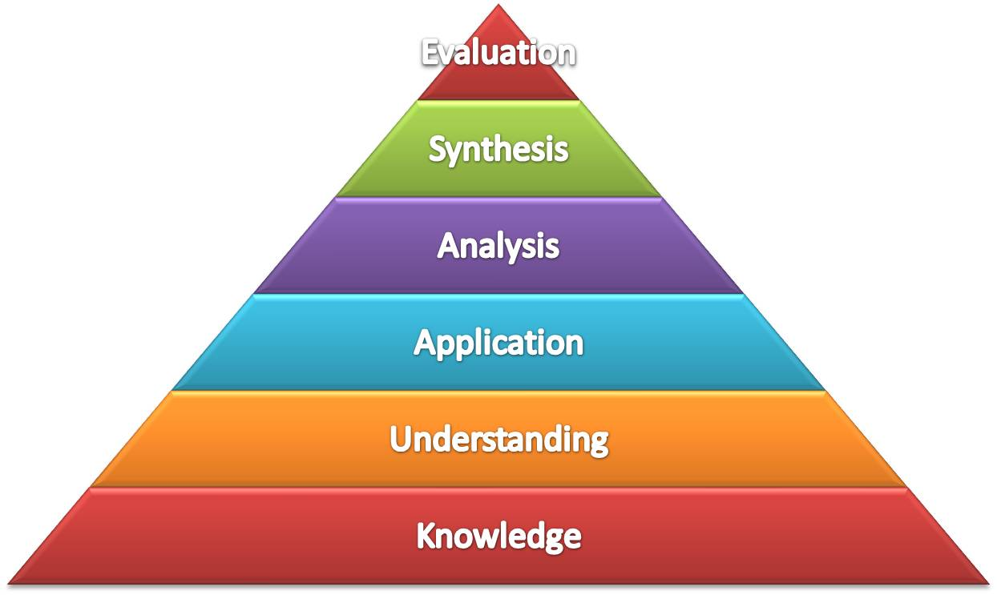
Bloom’s Taxonomy

Slide 45
U.S. History
History is the study of the past to help understand the present and prepare for the future
The U.S. is a unique “experiment” in a democratic republic
Our “founding fathers” were influenced by ideas of the Enlightenment

Slide 46
Alexis de Tocqueville
French historian who visited the U.S. in the 1830s
In Democracy in America, he wrote about American “exceptionalism” notably:
freedom of the press
mix of religions
movement within social classes

Slide 47
Alexis De Tocqueville identified five values leading to America’s success as a constitutional republic
Liberty
Egalitarianism (equality)
Individualism
Populism
Laissez-faire (leave things alone!)

Slide 48
So does history ever change?
Yes—interpretations of past events can change
The events considered important or unimportant often reflect cultural bias
Historiography is the study of how history is learned
Emphasis can be placed on different ideas and events reflected in current events when viewing past events

Slide 49
Historical Sources
Primary Sources—eyewitnesses
Secondary Sources—2nd hand information

Slide 50
Is the source reliable?
Who is behind the source?
Is there a bias? Can you still use it?

Slide 51
Who takes care of our sources?
Librarians
Archivists
Scholars
Historians
Curators
Collectors
Re-enactors

Slide 52
Are these primary or secondary sources?
Political cartoon
News article
Textbook
Diary
Your teacher
Photograph
Your parent
Picture album
Map

Slide 53
More sources
TV show
Documentary
You-Tube
Website
Furniture
Bullet
Rock
Painting
Portrait
Shopping catalog

Slide 54
Comic book
Magazine
Toy
Movie poster
War recruitment poster
Movie
Clothing
Weapon
Campaign button

Slide 56
“Brushes with History”
Personal connections or memories
Classes at school
Personal experiences
Family stories
People (six degrees of separation?)

Slide 57
You are a part of history—consider your personal timeline
1995—born
1996—
1997—impeachment of Clinton
1998—
1999—started preschool
2000—closest presidential election in history
2001—saw 9-11 events on TV
2002—
2003—invasion of Iraq
2004—
2005—Hurricane Katrina
2006—
2007—
2008—world-wide financial crisis, election of Obama
2009—
2010—Osama Bin Laden killed by U.S. Seals
2011---
2012—started studying history with Ms. Calabrese

Slide 58
Six Degrees of Separation
President Obama
Governor Romney
Congressman Ryan
Other politicians
JFK
Elvis
Marilyn Monroe
Princess Diana
Frank Sinatra
9-11 Victim
General Patton
Former President G. W. Bush

Slide 60
AP Test--Format
Multiple Choice—80 questions—50%
(MC questions are random—no chronological order)
Essays—1 DBQ and 2 free response –50%
(Essays must be written with a scholarly and detached voice)

Slide 61
AP Test--Eras
1492-1789—17%
1790-1914—50%
1915-present—33%

Slide 62
AP Test—Topics
Political institutions and behavior and public policy—35 %
Social Change—35%
Diplomacy and International Relations—15%
Cultural and Intellectual Developments—5 %
Economic Change—10%

Slide 63
APUSH Homework
Get Syllabus signed
List territories in North America before the Revolution for:
Spanish—
French—
Dutch--

