Slide 1
The Gilded Age Review
Circa 1870-1900
Industrialization, Monopolization, Immigration, Urbanization,
Unionization
(and Political Corruption!)

Slide 2
The Gilded Age Vocabulary
Capitalism
Socialism
Communism
Industrial Revolution
Gilded Age
Monopoly
Merge
Stocks
Captains of Industry
Robber barons
Laissez-faire
Urbanization
Social Darwinism
Gospel of Wealth
Immigration
Trust
Philanthropist
Bonus1: Labor Union
Bonus 2: Entrepreneurship

Slide 3
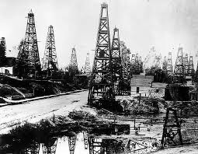
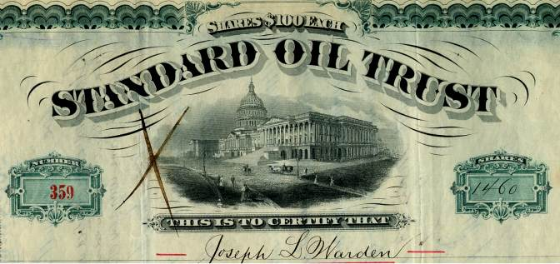
View Film Segment on Rockefeller
List 5 words from your vocabulary list or Gilded Age Notes sheet that is shown or illustrated by the film.
Film: 19th Century Turning Points
“Rockefeller Incorporates Standard Oil”

Slide 4
Gilded Age Password
Sit in pairs—one person will face the screen and the other will have his/her back to the screen.
The person facing the screen will give clues until the second person says the word. Then do the next one until you are done.

Slide 5
Capitalism
Melting pot
Statue of Liberty
Assembly line

Slide 6
Socialism
Trust
Monopoly
Gospel of Wealth

Slide 7
Communism
Stocks
Merge
trust

Slide 8
Captains of industry
Robber barons
Philanthropists
urbanization

Slide 9
Political machine
Social Darwinism
Chinese immigrants
Gilded Age

Slide 10
Monopoly
Laissez-faire
Industrial Revolution
Irish and Germans

Slide 11
Ellis Island
Italians and Russians
Assimilation
naturalization

Slide 12
Urbanization
Labor unions
Strikes
Laissez-faire

Slide 13
Democrats
Republicans
New York City
Push factors

Slide 14
Pull factors
Factories
Assembly lines
Rockefeller

Slide 15
Carnegie
Naturalization
President Garfield
monopoly

Slide 16
Multiple Choice Practice

Slide 17
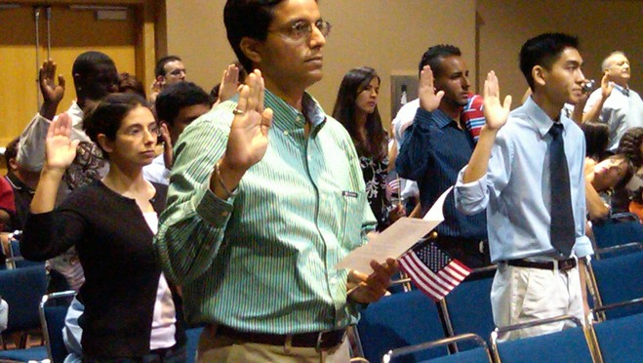
What is illustrated here?
a)Urbanization
b)Naturalization
c)Political machine
d)Taylor Scientific management

Slide 18
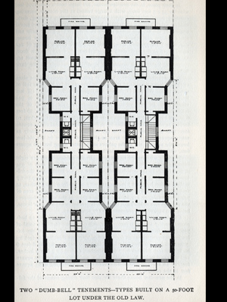
What is illustrated here?
Tenement
Monopoly
Ellis Island
Assembly line

Slide 19
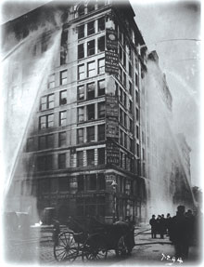
What is illustrated here?
a)Homestead Strike
b)Haymarket Strike
c)Pullman Strike
d)Triangle Shirtwaist Factory Fire
Result of this event led to:
a)Safer conditions
b)fire escapes and fire doors
c)Strong union
d)All of these

Slide 20
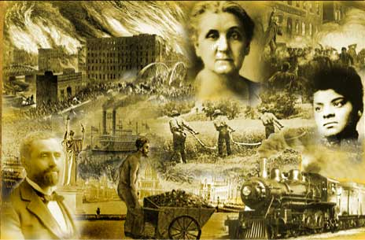
What is illustrated here?
a)Gilded Age c)Monopolies
b)Immigration d)Westward Expansion

Slide 21
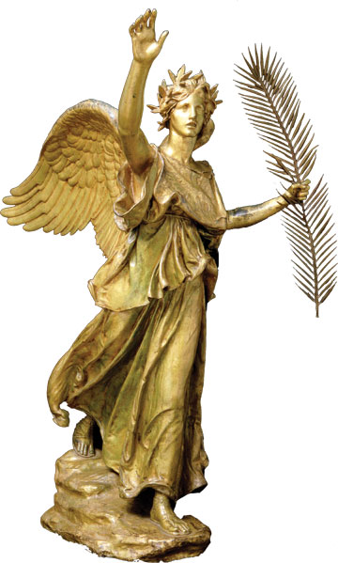
What is illustrated here?
a)Capitalism
b)Socialism
c)Gilded Age
d)Assembly Line

Slide 22
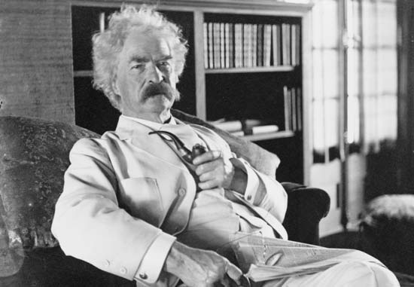
He named the period “The Gilded Age”
a)Rockefeller
b)Carnegie
c)Mark Twain
d)Horatio Alger

Slide 23
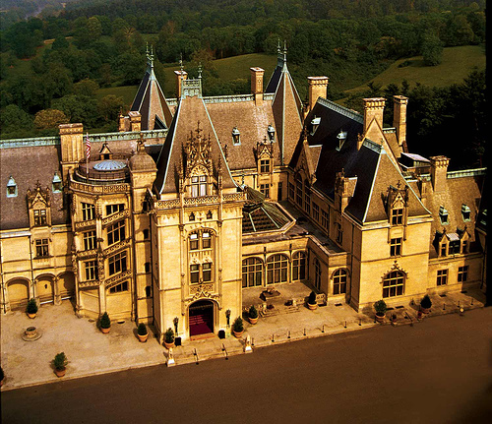
This illustrates all
of the following
except:
a)Social Darwinism
b)Capitalism
c)Captains of
Industry
d)Gospel of Wealth

Slide 24
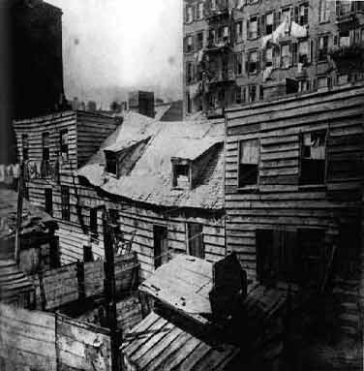
This illustrates all of the
following except:
a)Urbanization
b)Immigration
c)Tenements
d)Social Darwinism
e)philanthropy

Slide 25
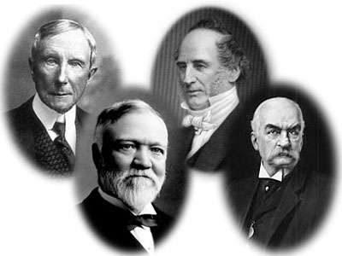
These men are:
a)Captains of
Industry
b)Capitalists
c)Robber Barons
d)Social Darwinists
e)philanthropists
f)All of these

Slide 26
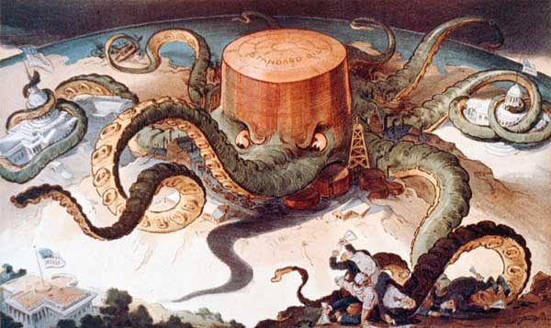
This cartoon illustrates
a)Carnegie’s Steel Trust
b)Rockefeller Oil Trust
c)Vanderbilt Shipping
Trust
d)J.P. Morgan Banks
Also:
a)Monopolies
b)Communism
c)Philanthropy
d)Railroads

Slide 27
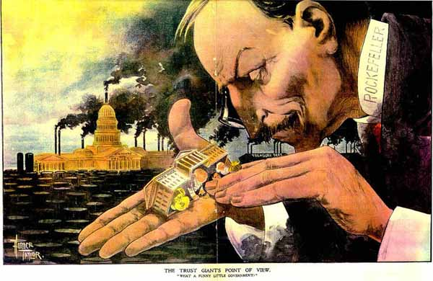
Who is this?
a)Carnegie b)Rockefeller c)Vanderbilt d)President Garfield
How do you
Know?

Slide 28
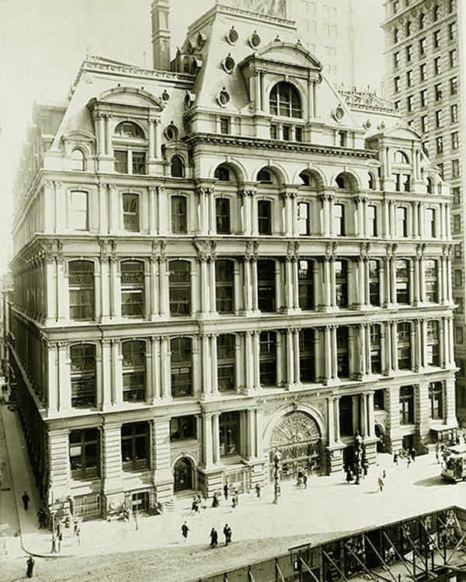
Where is this?
a)Rural Iowa
b)California lumber town
c)New York City
d)China
How do you know?

Slide 29
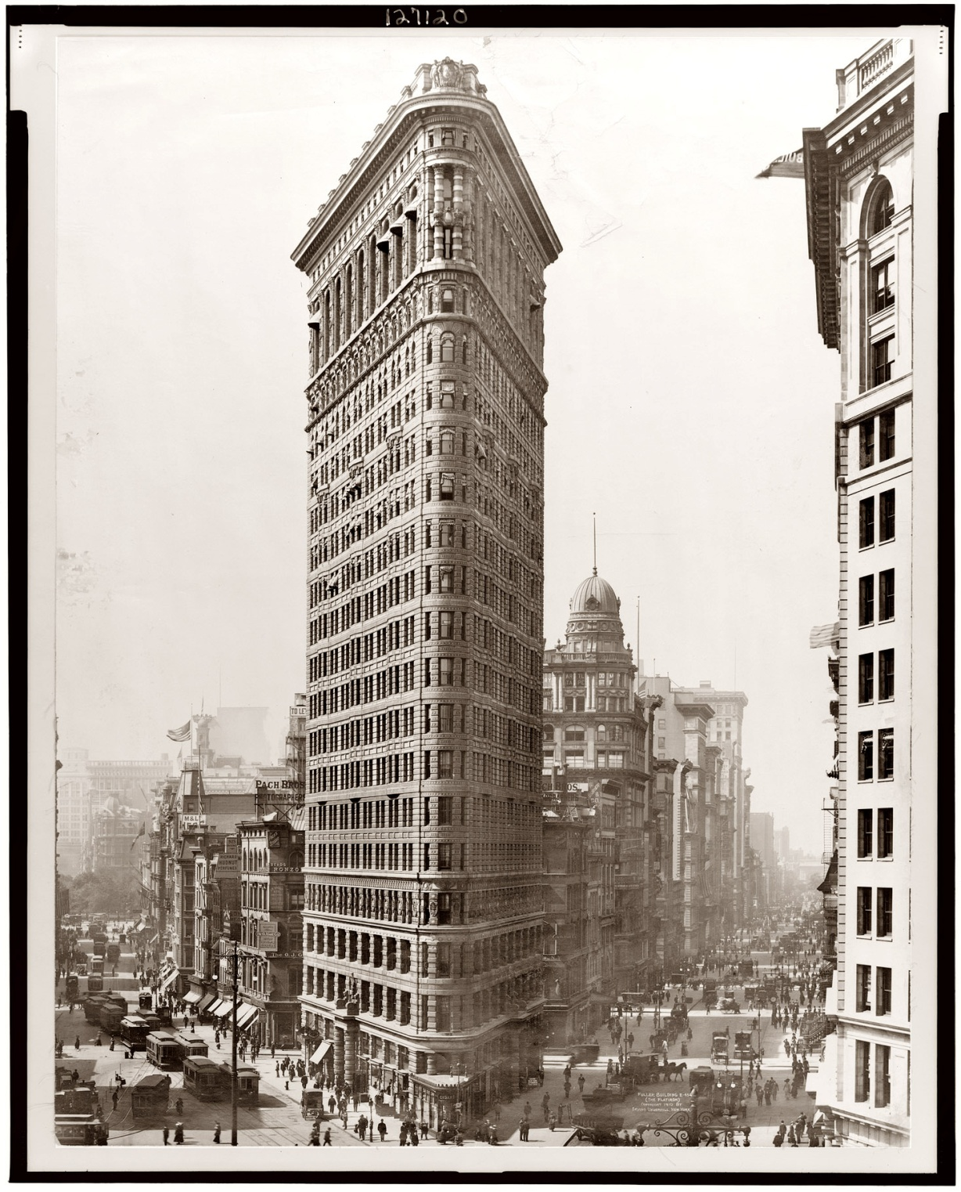
What does not belong?
a)New York City
b)Skyscraper
c)Tenement
d)Elevator
e)Urbanization

Slide 30
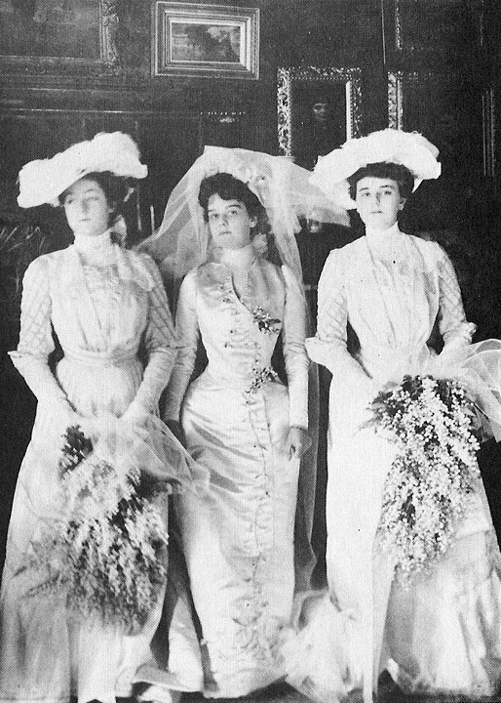
These women are associated with
a)Immigrant labor
b)Child labor
c)Captains of Industry
d)Middle class
How do you know?

Slide 31
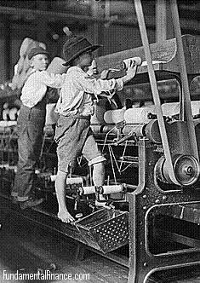
What does not belong?
a)Child labor
b)Immigrant labor
c)Industrialization
d)Socialism
e)Unions

Slide 32
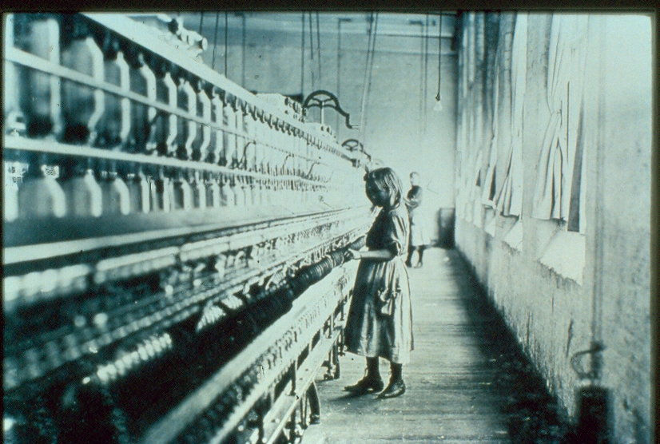
This illustrates:
a)Monopolies
b)Trusts
c)Industry
d)Unions
e)philanthropy

Slide 33
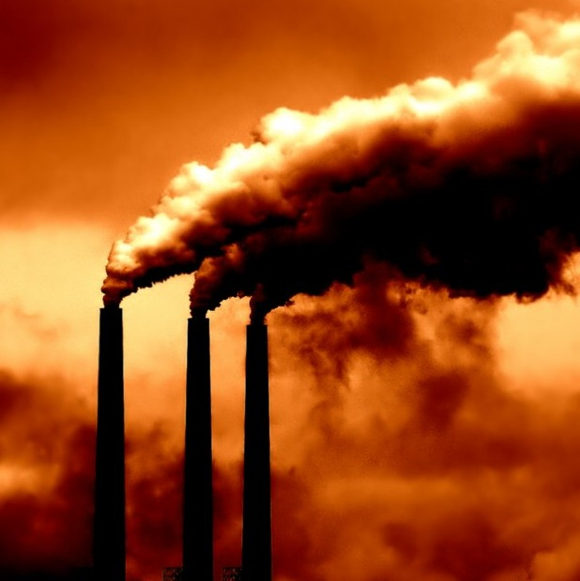
The Bessemer
Process led to:
a)Making steel
b)Textile mills
c)Banking trusts
d)Pullman Railroads
The photo shows:
a)Bell Telephone
b)Edison Lightbulb
d)Smokestacks
e)Captains of Industry

Slide 34
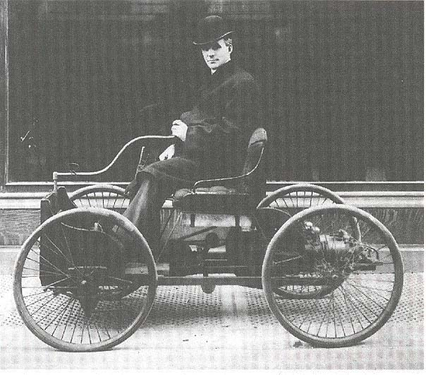
This photo shows:
a)Henry Ford’s earliest
automobile
b)Elisha Otis’ elevator
c)Alexander Bell’s
first telephone
d)The Thomas Edison
movie camera
Ford’s automobile factory
first used:
a)Moving assembly line
b)Smokestacks
c)Unions
d)Child labor

Slide 35
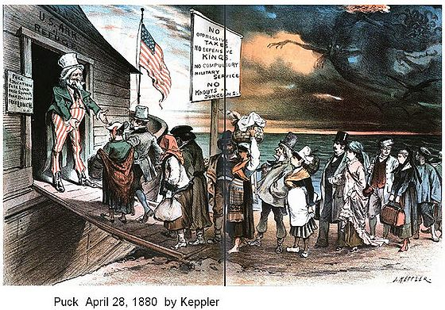
Why did immigrants come to the
U.S.?
a)Jobs in factories
b)So they could be
captains of industry
c)To become naturalized
citizens
d)To live in crowded
tenements
e)To experience a political
machine

Slide 36
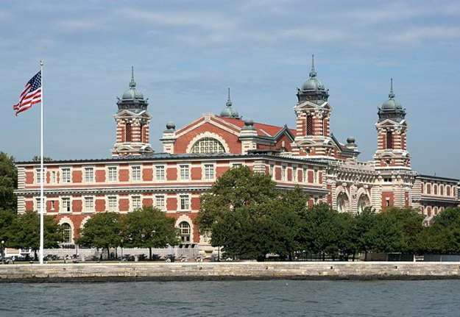
Which does not belong?
a)Ellis Island
b)New York Harbor
c)Chinese and Japanese immigrants
d)Southern and Eastern European immigrants
e) “Welcome Center”
f)Quarantines used

Slide 37
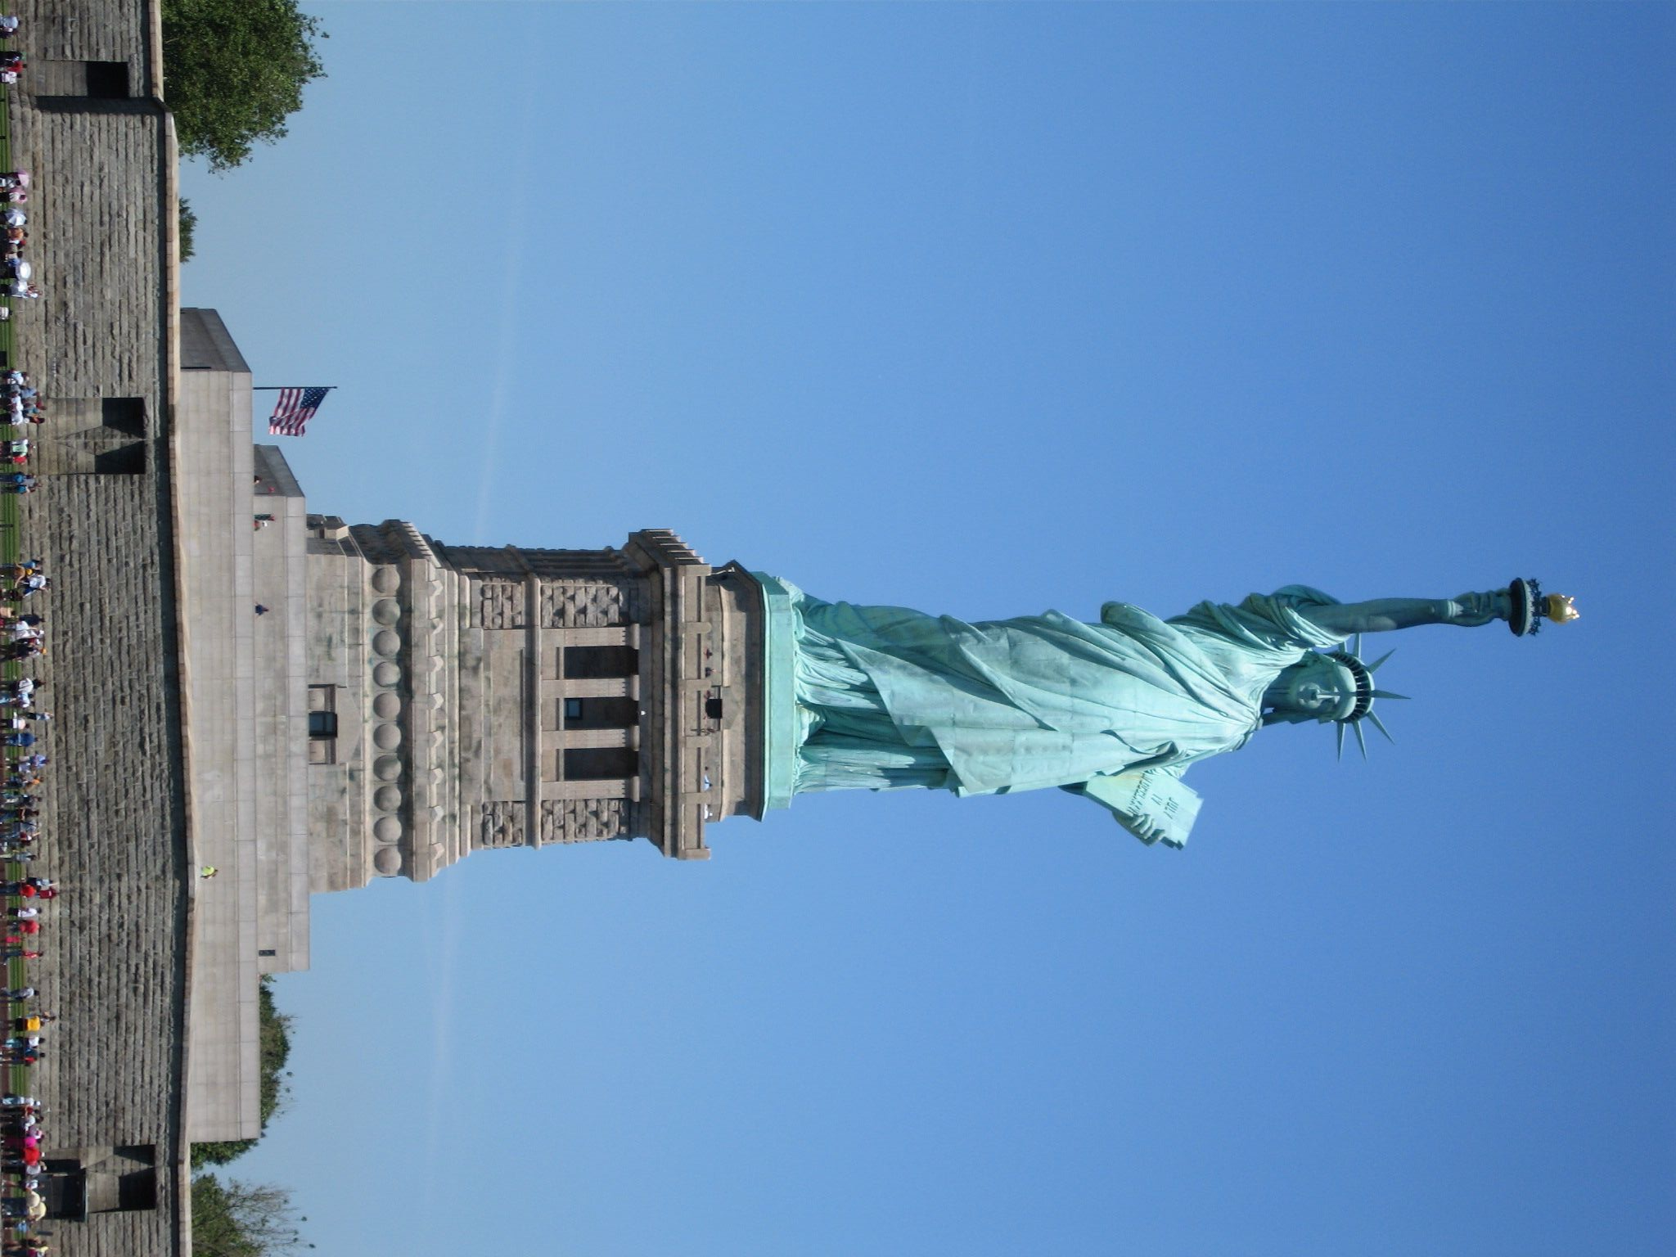
Symbol of…
a)Freedom
b)Welcome
c)Immigration
d)Knowledge
e)All of these

Slide 38
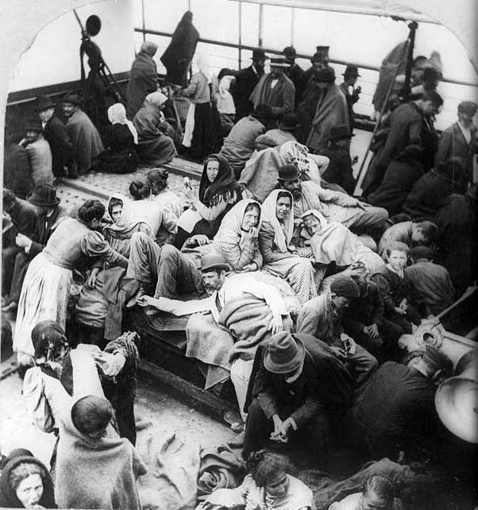
a)Southern European
immigrants
b)Steerage passengers
c)Future American
citizens
d)Future factory
workers
e)Future tenement
dwellers
f)All of these

Slide 39
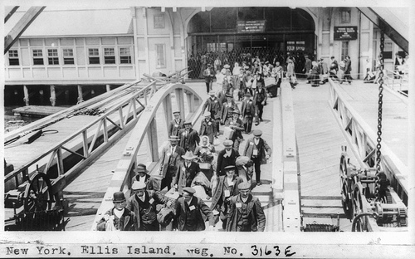
This shows:
a)Ellis Island
b)Statue of Liberty
c)Homestead Strike
d)Farmers on the Great
Plains

Slide 40
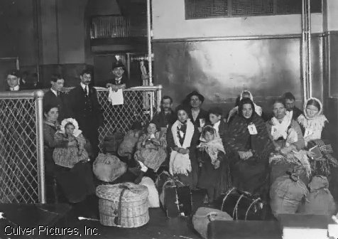
Which is probably
True?
a)Immigrants
b)Catholics or Jews
c)Low income
d)Urban dwellers
e)Industrial labor
f)All of these

Slide 41
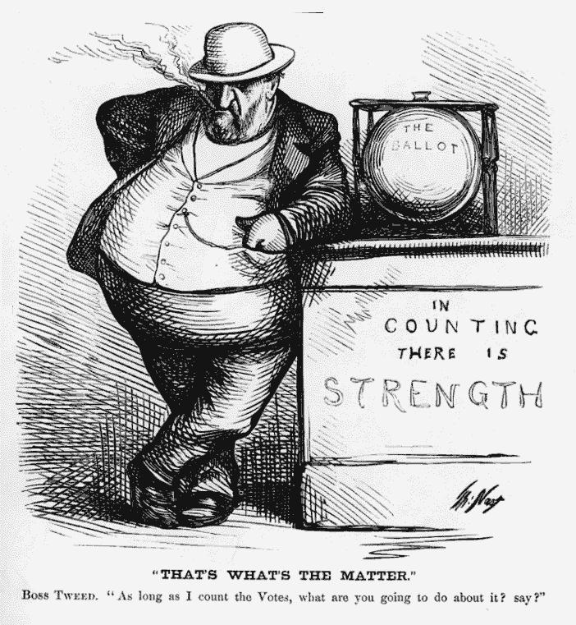
This illustrates:
a)Urbanization
b)Tweed’s political machine
c)Political corruption
d)Tammany Hall
e)All of these

Slide 42
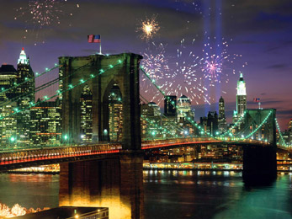
This is:
a)Statue of Liberty
b)Brooklyn Bridge
c)St. Patrick’s Cathedral
d)Ellis Island
e)Vanderbilt Mansion

Slide 43
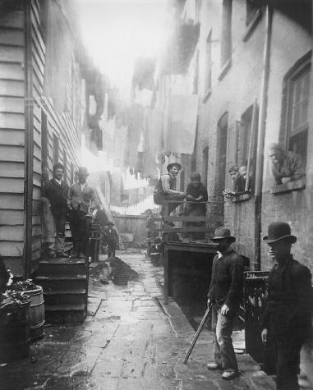
What does not belong?
a)Tenement
b)Urbanization
c)Immigrants
d)Gospel of Wealth
e)Political machine

Slide 44
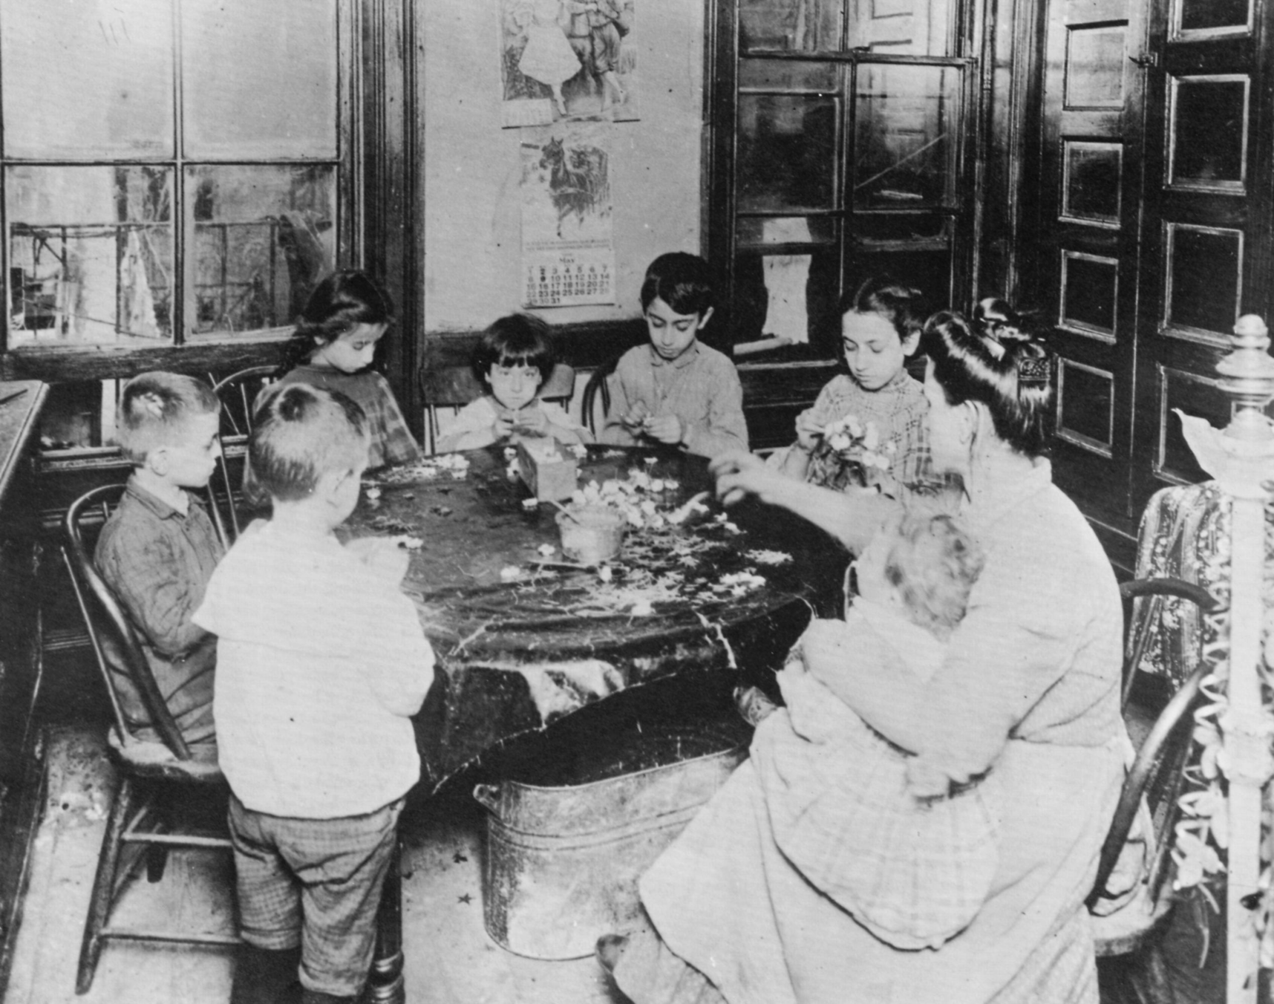
This shows:
a)Piecework
b)Assembly line
c)Unions
d)A strike
e)Gilded Age wealth

Slide 45
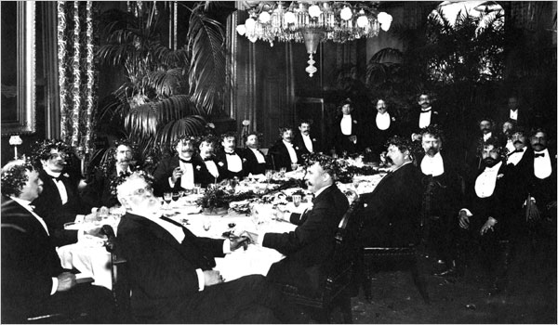
This shows:
a)Captains of industry
b)Robber barons
c)Philanthropists
d)Social Darwinists
e)All of these

Slide 46
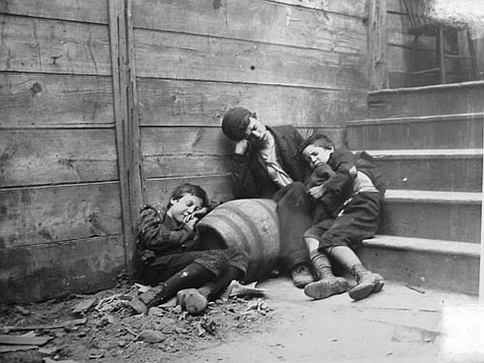
This photo by Jacob Riis
Illustrates:
a)Urban poverty
b)Child labor
c)Tenement life
d)Gilded Age class
differences
e)All of these

Slide 47
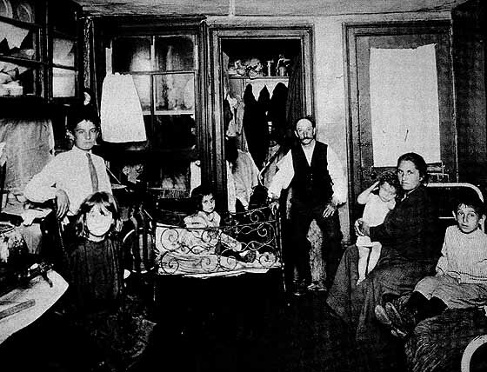
This shows:
a)Tenement life
b)Piecework
c)Political machine
d)Ellis Island

Slide 48
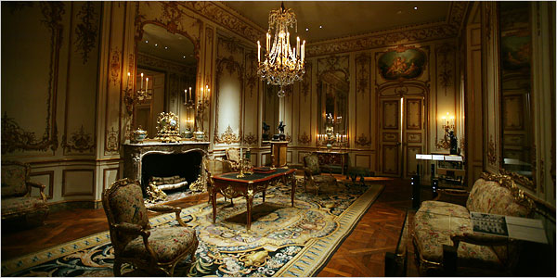
Who lives here? a)Horatio Alger b)Vanderbilt c)Union leader, Eugene Debs d)Socialists

Slide 49
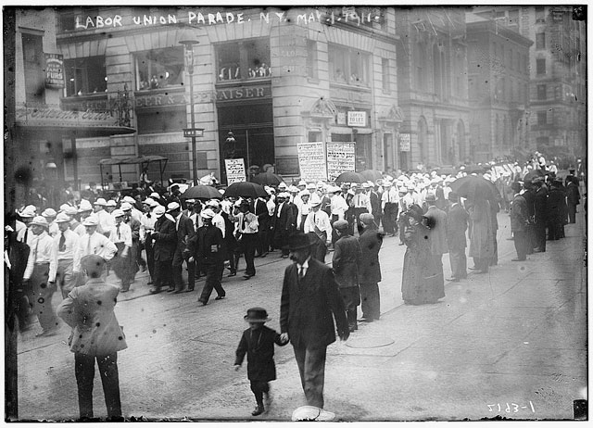
This Labor Day
Parade shows
Support for:
a)Child labor
b)Unions
c)Trusts
d)Monopolies
e)Social Darwinists

Slide 50
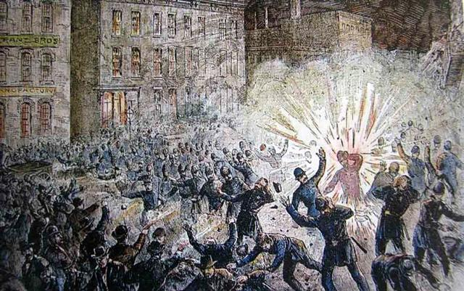
This event in
Chicago was the
Result of a:
a)Vaudeville show
b)Labor Strike
c)Ellis Island
quarantine
d)Populist farmers
rally

Slide 51
Cartoon 37
Explain how hyperbole is used.
Explain how satire is used.
Explain the symbol on the left.
Explain the symbol on the right.
What does the table represent?
Why is the figure on the left blind to the figure on the right?
Why does the giant have all of the food?
Explain the overall message of the cartoon.

Slide 52
View Political Cartoons of the
Gilded Age

