Slide 1
The 1920’s
A Republican Decade
Back to Isolationism

Slide 2
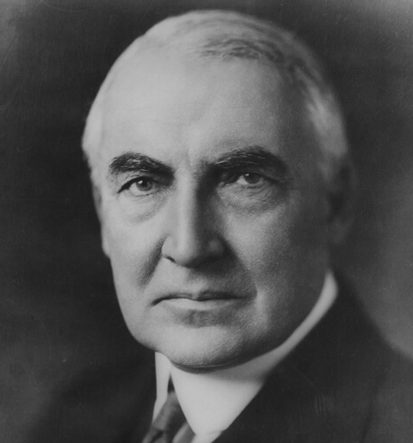
I. Warren G. Harding—1921-1923
In 1920: 18th amendment (prohibition)
19th amendment (women’s suffrage)
Election of Harding
“a return to normalcy”
“The Ohio Gang”
Teapot Dome Scandal
Died in office

Slide 3
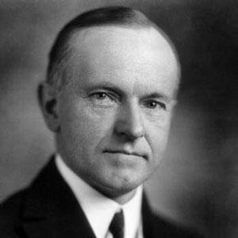
II. Calvin Coolidge—1923-1929
“Keep cool with Coolidge”
“The business of
America
is business.”
“Silent Cal”

Slide 4
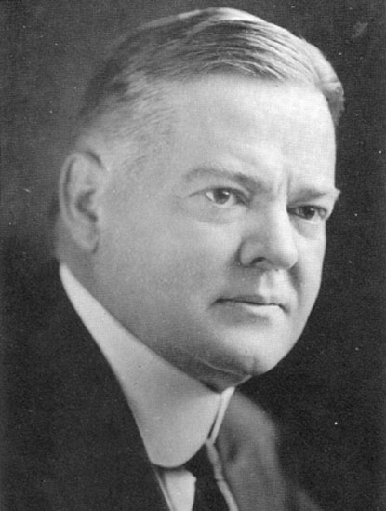
III. Herbert Hoover—1929-1933
“The engineer”
“Hooverizing”
“A chicken in every
pot!”

Slide 5
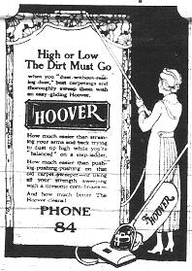
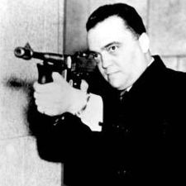
“ Three Hoovers”
J. Edgar Hoover—F.B.I.
The Vacuum Cleaner

Slide 6
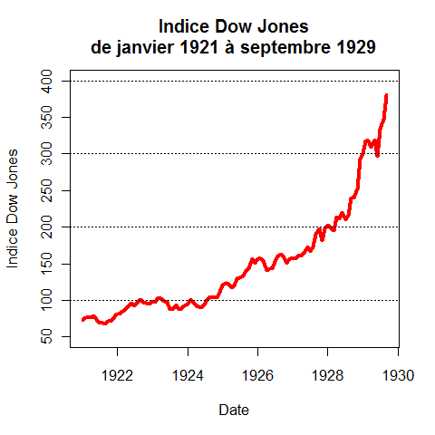
IV. The Economy
Prosperity
Big Business
Consumerism
Laissez-faire in
economics
Laissez-faire in
social issues

Slide 7
Prosperity…
Automobile industry
Household appliances
Clothing and gadgets
Madison Avenue advertising
Women in the workplace
NOT for farmers!

Slide 8
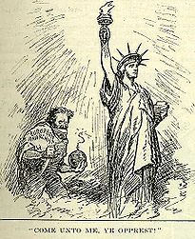
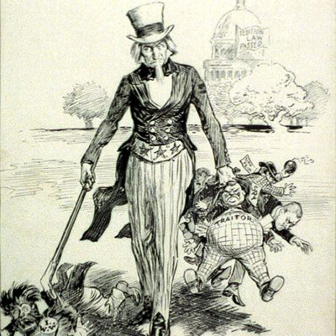
V. Red Scare
Fear of Communists
Fear of Russians
Fear of immigrants
Fear of socialists
Fear of anarchists
Fear of unions
Fear of foreigners

Slide 9
Immigration Closed!

Slide 10
AP: National Origins Act of 1924
Quotas on European Immigrants led to decrease
Mexican and Puerto Rican immigration increased

Slide 11
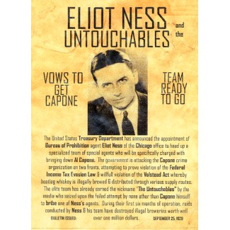
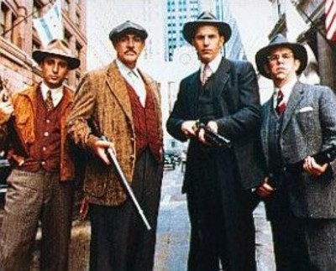
VI. Government Enforcement
Palmer Raids (enforcement
of Espionage Act)
The Volstead Act
(enforcement of 18th Am)
“The Untouchables”
Court cases…

Slide 12
“The income tax law is a lot of bunk. The government can’t collect legal taxes from illegal money.” Al Capone

Slide 13
AP: Court Cases
Gitlow v. New York—all of first amendment applies to all states—protects freedom of press and speech—addresses 14th amendment’s rights of citizenship
Schenk v. U.S.—does not protect freedom of speech and press during war—upheld Espionage Act (result of Socialist anti-war pamphlets distributed to draftees)— “clear and present danger”
(Others: Sacco and Vanzetti, Leopold and Loeb, Scopes, the biology teacher)

Slide 14
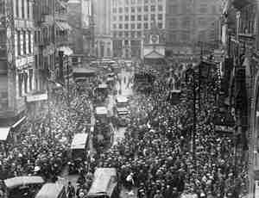
VII. Labor Unrest
Strikes and riots—Note: Union membership decreased
during
1920s

Slide 15
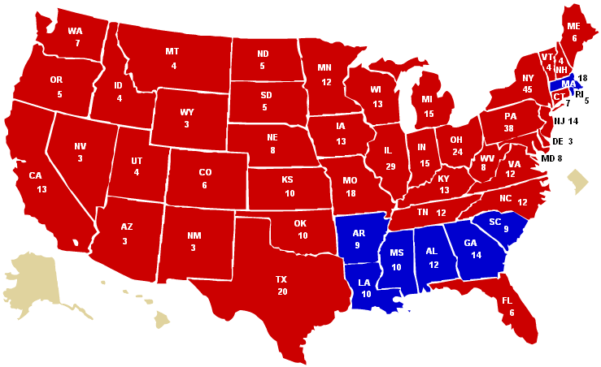
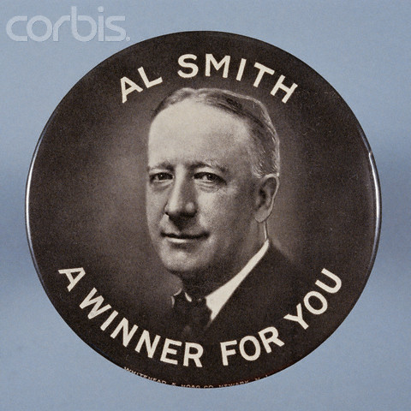
VII. Election of 1928
Al Smith ran for president in 1928 against HH as a Democrat against prohibition
He was the first Catholic candidate
for President
Soundly defeated

Slide 16
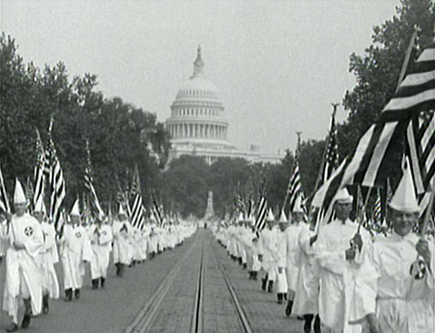
VIII. Rise of Intolerance
Growth of KKK nationwide targeted people who were not White Anglo-Saxon and Protestant.

Slide 17
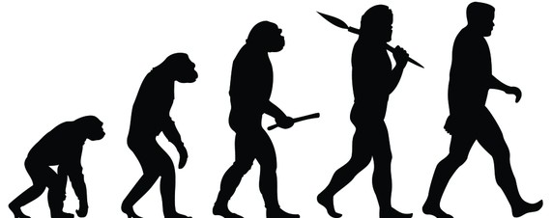
Conservative Ideas in Schools
It was illegal to teach evolution in most states
Law was challenged by a biology teacher in Tennessee
The Scopes Trial was a “media circus”

Slide 18
End of Progressive Ideas
Intolerance about race
Women divided about goals of feminism
Distractions of mass media—entertainment became a priority
“Me” Decade
Farmers still suffering and not part of prosperity

Slide 19
APUSH Open Ended Essay Prompt
To what degree did the Roaring Twenties represent both extreme conservative ideas and extreme liberal ideas?

Slide 20
The Twenties Dichotomy (Juxtaposition)
Conservative Politics
Staying out of international affairs
Big business
Wall Street tycoons
Isolationism
Limiting Immigration
Laissez-faire
Prohibition
KKK
Religious Fundamentalism and Scopes trial
Liberal attitudes toward women’s rights
Fashion
Speakeasies and drinking parties
Dating and youth
Consumerism and paying on time
Playing the stock market
Church attendance down
Freud
Movie stars
“Lost Generation”
Evolution and Scopes trial
CONSERVATIVE TRENDS
LIBERAL TRENDS

