Slide 1
U.S. Maps—see atlas
Physical Map
Political Map
Label Denton, Texas
Label Mountains
Label Plains
Label Rivers
Label Lakes
Label Oceans, Gulf, and major bays
Label significant features
Label Denton, Texas
Label all states
Label neighboring countries
Label capital cities
Label at least 10 major cities
Draw and label time zone divisions

Slide 2
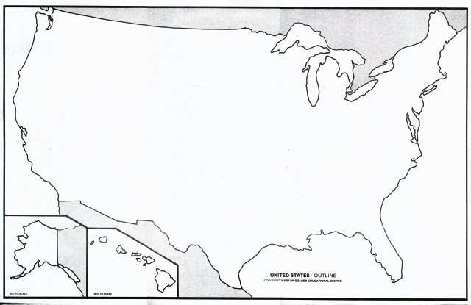

Slide 3
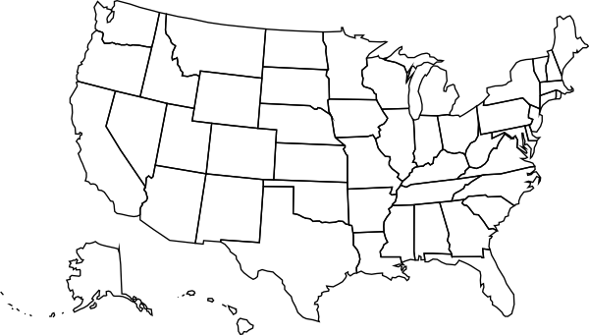

Slide 4
U.S. History Second Semester Exam Review
U.S.—start with slide #29

Slide 5
Before the Exam
We studied the Presidents covering 1865 to 2015.
1. Name the President that interested you the least.
2. Name the President that interested you the most.
3. Name three events or qualities associated with your favorite President.

Slide 6
20s
The 18th Amendment:
a)Prohibition of alcohol
b)women’s suffrage
c)Repeal of Prohibition
d)Direct election of Senators

Slide 7
20s
Which does not describe the new woman of the 20s?
a)Short skirts
b)Flapper
c)Rosie the Riveter
d)Bobbed hair

Slide 8
20s
Which is not correctly matched?
a)Harding-Teapot Dome
b)Calvin Coolidge—laissez-faire
c)Hoover-prosperity

Slide 9
20s
The passage of Prohibition led to:
a)Speakeasies
b)Bootlegging
c)Organized crime
d)All of these

Slide 10
20s
Which headline would not be seen during the 20s?
“St. Valentine’s Day Massacre Investigated by the FBI”
“First Television Station is KDKA”
“The Jazz Age Begins in Harlem”
“Flappers Make Talkies”

Slide 11
20s
The 20s are known for all except:
a)women’s rights
b)Household appliances
c)Communication with phones, radio and movies
d)Freedom from racial discrimination

Slide 12
20s
Which is not a 20s fad?
a)Charleston dance
b)Crossword puzzles
c)Counterculture
d)Dance marathons

Slide 13
20s
Hero in Aviation:
a)Al Capone
b)Charles Lindbergh
c)Babe Ruth
d)Rudolph Valentino

Slide 14
20s
Which trial was about evolution vs. fundamentalism?
a)Scopes Trial
b)Sacco and Vanzetti Trial
c)Brown v. Board of Education
d)Korematsu v. U.S.

Slide 15
20s
Which term is associated with stocks?
a)Assembly line
b)Tabloid
c)Bull market
d)Installment plan

Slide 16
30s
This assured people they would have some retirement money:
a)Social Security
b)Fair Labor Standards Act
c)Good Neighbor Policy

Slide 17
30s
Which is not a cause of the Great Depression?
a)Over production
b)Under consumption
c)Hoover’s policies
d)Buying stocks on the margin

Slide 18
30s
New Deal goals:
a)relief, recovery, and reform
b)remorse, resolve, renewal
c)cash, jobs, public works
d)Square Deal, New Deal, Fair Deal

Slide 19
30s
Collection of shanties:
a)Hoover blankets
b)Hoover flags
c)Hoover vacuum cleaners
d)Hoovervilles

Slide 20
30s
The New Deal promoted rugged individualism:
a)True
b)False

Slide 21
30s
Which is not part of FDR’s First Hundred Days?
a)Bank holiday
b)Fireside chats
c)Court packing
d)New Deal

Slide 22
30s
What led to the rise of homeless migrant Okies?
a)Dust Bowl
b)Foreclosures
c)Great Depression
d)All of these

Slide 23
30s
The 20th Amendment moved inauguration from March to January and was called:
a)Prohibition
b)Lame Duck Amendment
c)Women’s suffrage
d)Repeal of prohibition

Slide 24
30s
Criticism of the New Deal:
a)Jobs
b)Deficit
c)Rugged individualism
d)laissez-faire

Slide 25
30s
Which New Deal program protected bank deposits?
a)Fireside chats
b)Bank holiday
c)FDIC
d)Brain trust

Slide 26
30s
Criticism of FDR included:
a)Too much power of federal government
b)Court packing scheme was illegal
c)Violated two-term limit
d)All of these

Slide 27
30s
Which party dominated the 30s?
a)Republican
b)Democratic
c)Communist

Slide 28
30s
FDR’s greatest personal challenge:
a)his religion
b)polio
c)dyslexia
d)poverty
e)all of these

Slide 29
30s
Stock Market Crash:
a)Black Monday
b)October 29, 1932
c)December 7, 1941
d)November 22, 1963

Slide 30
30s
Famous Photographer of the Depression
a)Frances Perkins
b)Dorothea Lange
c)Huey Long
d)Marian Anderson

Slide 31
WWII
Fascism a)Hitler and Germany
Nazism b)Stalin and USSR
Communism c)FDR and U.S.A.
Capitalism d)Mussolini and Italy

Slide 32
WWII
MacArthur a)leader of European military alliance
Eisenhower b)leader of Pacific military alliance
Patton c)American general in North Africa, Italy, and Germany

Slide 33
WWII
Pearl Harbor a)Dec. 7, 1941
D Day b)June 6, 1944
VE Day c)May 8, 1945
Munich a)New Big Three, bomb, U.N.
Yalta b)Big Three and postwar Europe
Potsdam c)appeasement

Slide 34
WWII
Which came first?
a)Normandy
b)Hiroshima
c)Battle of the Bulge
d)Nagasaki

Slide 35
WWII
Pacific turning point:
a)Iwo Jima
b)Normandy
c)Midway
d)Okinawa

Slide 36
WWII
This allied nation liberated concentration camps and invaded Berlin from the East:
a)France
b)USSR
c)Great Britain
d)China

Slide 37
WWII
World War II resulted in 50 million dead; 25 million were civilians. What does this tell you about WWII?
a)it was a total war
b)it was the most violent war in history
c)the rules of warfare changed
d)all of these

Slide 38
WWII
Which is not associated with the United Nations alliance of 26 countries?
a)included China
b)also called Axis nations
c)formed a peace-keeping organization after the war
d)occupied defeated nations

Slide 39
WWII
Which is not associated with the American home front?
a)Manhattan Project
b)Rosie the Riveter
c)Japanese Internment
d)Office of War Information
e)Holocaust

Slide 40
Cold War
Containment a)aid and food to W. Europe
Marshall Plan b)alliance to protect W. Eur.
NATO c)keep communism from spreading
Truman Doctrine d)provide military aid to fight communism

Slide 41
Cold War
Warsaw Pact a)fear of communists in U.S.
Iron curtain b)dividing line in Europe
Red Scare c)power struggle between USSR and U.S.
Cold War d)communist alliance in E. Europe
Satellites e)Eastern communist countries

Slide 42
Cold War
Domino theory a)Truman rescued W. Berlin
Berlin Airlift b)one country after another will fall
Cuban Missile Crisis c)built by Soviets to keep communists in
Berlin Wall d)stand-off over missiles too close to home

Slide 43
Cold War
McCarthy a)wanted to invade China
MacArthur b)looked for communists in U.S.
Rosenbergs c)executed for treason

Slide 44
Cold War
Which is not associated with the United Nations?
a)Security Council
b)New York City
c)formed by Wilson after WWI
d)Police action in Korea

Slide 45
Cold War
Which is not true of Berlin?
a)divided into sectors after WWII
b)dominated by capitalism in East Berlin
c)divided by wall built in 1960s
d)re-united in 1989

Slide 46
50s
Capital of South Korea:
a)Pyongyang
b)Seoul
c)Saigon
d)Sputnik

Slide 47
50s
Division of North and South Korea:
a)38th Parallel
b)17th Parallel
c)iron curtain
d)none of these

Slide 48
50s
What is not associated with the 50s?
a)suburbs
b)rock and roll
c)feminism
d)television
e)baby boom

Slide 49
50s
Overall theme of fifties society:
a)counterculture
b)Civil Rights activism
c)conformity
d)women’s rights movement

Slide 50
Civil Rights
Supreme Court called for de-segregation of public schools:
a)Plessy v. Ferguson
b)Brown v. Board of Education
c)Marbury v. Madison
d)all of these

Slide 51
Civil Rights
First African American on the Supreme Court:
a)Shirley Chisholm
b)Thurgood Marshall
c)Clarence Thomas
d)Rosa Parks

Slide 52
Civil Rights
Ended Jim Crow in Southern States:
a)Busing
b)affirmative action
c)Civil Rights Act of 1964
d)Voting Rights Act of 1965

Slide 53
Civil Rights
Segregationists wanted:
a)states rights
b)Black Power
c)integrated public schools
d)all of these

Slide 54
Civil Rights
Rosa Parks is associated with:
a)Little Rock Nine
b)Emmit Till case
c)Montgomery bus boycott
d)sit-ins

Slide 55
Civil Rights
“I have a dream” was a speech here:
a)Birmingham Letter
b)March on Washington
c)Montgomery boycott
d)Nashville sit-in

Slide 56
Civil Rights
SCLC a)lunch counter sit-ins
SNCC b)bus boycott
NAACP c)litigation
CORE d)freedom rides

Slide 57
60s
Kent State a)riots at Dem. convention
Moon Landing b)Apollo 11
Chicago c)generation born 1946-64
Baby Boomers d)wrote Feminine Mystique
Betty Friedan e)shooting on campus

Slide 58
60s
LBJ’s War on Poverty included:
a)welfare
b)Head Start
c)Medicare
d)all of these

Slide 59
60s
Purpose of Vietnam War:
a)Containment of communism
b)Revenge against China
c)Response to direct attack on U.S. territory

Slide 60
60s
Gave LBJ full authority to fight in Vietnam:
a)Tet Offensive
b)Gulf of Tonkin Resolution
c)NASA
d)NATO

Slide 61
60s
JFK, MLK,RFK:
a)all Civil Rights leaders
b)all assassinated
c)all ran for President

Slide 62
70s-2000s
Controversy leading to the resignation of President Nixon:
a)Roe V. Wade
b)Pentagon Papers
c)Watergate

Slide 63
70s-2000s
What is not associated with President Nixon?
a)détente
B)Vietnamization
C)opening of Red China
D)Iran-Hostage Crisis

Slide 64
70s-2000s
The Equal Rights Amendment did not pass.
a)true b)false
During whose inauguration were the Iran hostages returned after over one year in captivity?
a)Carter b)Reagan c)GHW Bush

Slide 65
70s-2000s
The end of the Cold War and the Persian Gulf War was during the Presidency of:
a)Reagan b)GHW Bush c)Clinton
Nixon, Reagan, Bush, Bush: a)Democrats b)Republicans

Slide 66
70s-2000s
“It’s the economy, stupid!” a)Bush Sr. b)Clinton c)Bush Jr.
Reagan increased the role of the federal government: a)true b)false
Geraldine Ferraro and Sarah Palin were: a)members of the Senate b)governors of northern states c)vice-presidential candidates d)all of these

Slide 67
September 11, 2001 led to : a)invasion of Afghanistan b)election of GW Bush c)formation of NATO d)invasion of Iraq
Response to the 9-11 attack included: a) Patriot Act b)Homeland Security
c)a and b

Slide 68
70s-2000s
Sandra Day O’Connor, Ruth Bader Ginsberg, Elena Kagan, Sonia Sotomayor:
a)All women’s rights activists
b)All Supreme Court justices
c)All Presidential Candidates
d)All female scientists

Slide 69
70s-2000s
Osama Bin Laden of Al Qaida was killed during the Presidency of:
a)Clinton b)GW Bush c)Obama d)Reagan

Slide 70
70s-2000s
In 2003, the U.S. invaded this country to stop weapons of mass destruction: a)Afghanistan b)Iraq c)Saudi Arabia d)Iran
Greatest ally of U.S. in Middle East: a)Lebanon b)Israel c)Kuwait
The crisis of 2008: a)Great Recession b)9-11 c)Tea Party d)Ebola

Slide 71
70s—2000s
Camp David Accords and Nobel Prize: a)Ford b)Carter c)Reagan d)Bush Sr
Impeached: a)Bush Sr b)Clinton c)Bush Jr d)Obama
Republican candidates in 2008, 2012: a)Bush and Kerry b)McCain and Romney c)Goldwater and Nixon

Slide 72
70s-2000s
Which is not true of the Obama Administration?
a)First African American President
b)Budget Surplus
c)Affordable Care Act
d)Nobel Peace Prize

