Slide 1
CHAPTER 2: EARLY RIVER VALLEY CIVILIZATIONS
By 2000 B.C., 4 important civilizations were flourishing in major river valleys

Slide 2
FERTILE CRESCENT
DEF: An arc of rich farmland in Southwest Asia, between the Persian Gulf and the Mediterranean Sea
Tigris and Euphrates Rivers would flood Mesopotamia, leaving a thick bed of mud called SILT

Slide 3
DISADVANTAGES OF LIVING IN THE FERTILE CRESCENT (SUMER)
1) Flooding was unpredictable: could come as early as April or as late as June. Dry summer months, almost desert-like
2)Villages had no natural barriers and were defenseless to flood waters
3) Natural resources (stone, wood, and metal) were limited

Slide 4
SOLUTIONS TO SUMER’S PROBLEMS
1) Sumerians dug IRRIGATION ditches to carry water and create food surpluses
2) They built city walls with mud bricks to protect against floods
3) Sumerians traded with other people to get the materials they needed

Slide 5
THE CITY-STATE EMERGES IN SUMER
Sumerians are one of the first groups to form a civilization (remember the 5 characteristics)
By 3000 B.C. numerous cities with surrounding crop fields were built, sharing the same culture but each with their own government
CITY-STATE: A city and its surrounding lands functioning as an independent political unit

Slide 6
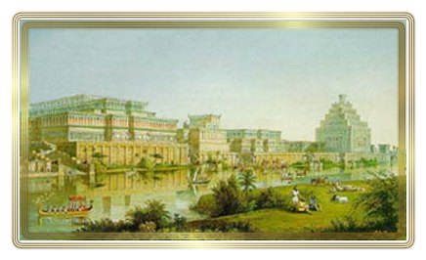
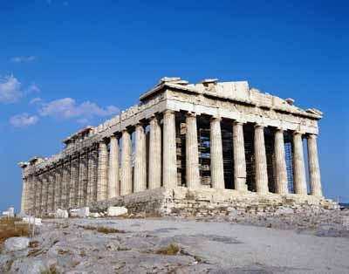
FAMOUS CITY-STATES IN HISTORY

Slide 7
PRIESTS AT THE TOP
Sumerian gov’t controlled by priests
Ziggurat was place of worship and city hall
Priests managed the irrigation systems
Demanded a portion of a farmer’s crops as a tax

Slide 8
MONARCHS TAKE OVER
During war a tough fighter was selected to lead the army
After 3000 B.C. war was more frequent and leaders were given permanent commands
DYNASTY: a series of rulers from a single family

Slide 9
CULTURAL DIFFUSION
DEF: the process of a new idea or product spreading from one culture to another
Population and trade were expanding as city-states grew prosperous from food surpluses

Slide 10
POLYTHEISM
Sumerians believed many gods controlled the forces in nature
Many of the Sumerians beliefs can be found in the long poem called the Epic of Gilgamesh

Slide 11
SUMERIAN SOCIAL CLASSES
Priests and Kings at the top
Wealthy merchants next
Everyday Sumerians
Slaves
Sumerian women could pursue any job, except for scribe or scholar

Slide 12
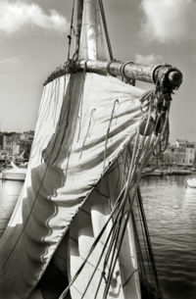
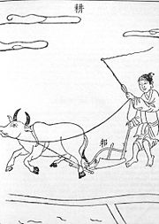
SUMERIAN INVENTIONS
The wheel, sail, and the plow
First to use bronze and writing
Also created a number system with a base of 60 (60 seconds= 1 minute, 360 degrees in a circle)

Slide 13
1ST EMPIRE BUILDERS
From 3000 to 2000 B.C. the city-states of Sumer were constantly at war

Slide 14
SARGON OF AKKAD
From Akkad---city-state north of Sumer
His people were SEMITIC: spoke a language related to Arabic and Hebrew
By conquering Sumer, Sargon created the first EMPIRE: several people, nations under the control of one ruler

Slide 15
BABYLONIAN EMPIRE
2000 B.C.: the Amorites invade Mesopotamia and establish their capital at Babylon
The Babylonian Empire reached its peak under Hammurabi (1792 B.C. – 1750 B.C.)

Slide 16
HAMMURABI
His most enduring legacy was his code of laws (CODE OF HAMMURABI)
This was a collection of existing rules, judgments, and laws
282 specific laws
Punishments were different for the rich and the poor
This code reinforced the principle that gov’t had a responsibility for what occurred in society

Slide 17
HAMMURABI AND HIS CODE

Slide 18
PYRAMIDS ON THE NILE
The Nile River flows northward for 4100 miles, making it the longest river in the world. Egypt’s settlements grew up along the Nile on a narrow strip of fertile land

Slide 19
UPPER AND LOWER EGYPT
Upper Egypt was in the south
Lower Egypt in the north---consists of the Nile Delta
DELTA: a broad, marshy, triangular area of land formed by deposits of silt at the mouth of the river

Slide 20
environment
Deserts on both sides of the Nile kept Egyptians close to the river and also kept invaders out
This reduced the interaction with other cultures but spared Egypt from constant warfare like in Mesopotamia

Slide 21
EGYPT UNITES INTO A KINGDOM
Initially there were two kingdoms of Egypt: Upper Egypt and Lower Egypt. Legend tells of one man uniting the land

Slide 22
MENES
3100 B.C.: Menes is the king of Upper Egypt
He unites the two kingdoms and begins the 1st Egyptian dynasty

Slide 23
Pharaohs rule as gods
Egyptian kings were considered gods
They were called PHARAOHS
THEOCRACY: gov’t where the ruler is a divine figure

Slide 24
BUILDING PYRAMIDS
Egyptians believed the king ruled even after death
They had elaborate tombs built that we know as PYRAMIDS

Slide 25
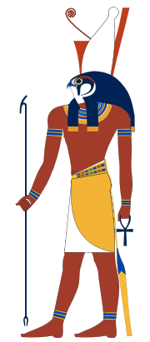
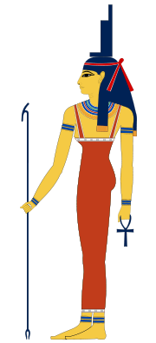
EGYPTIAN culture
Polytheistic---more than 2000 gods and goddesses
Ra, god of the sun
Horus, god of light
Isis, mother and wife

Slide 26
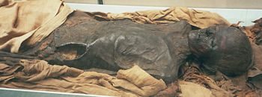
Death and afterlife
MUMMIFICATION: the embalming and drying of a corpse to prevent decay
The tomb was filled with clothing, food, jewelry for the afterlife

Slide 27
society
King and royal family at the top
Land owners, gov’t officials, priests, army commanders
Middle class---merchants and artisans
Peasant farmers and unskilled workers

Slide 28
writing
HIEROGLYPHICS: pictures used to represent ideas or sounds
PAPYRUS: a reed that grows in the Nile delta; used to make a paperlike material for writing

Slide 29
PLANNED CITIES ON THE INDUS
Around 2500 B.C. a civilization arose in India. Although we know little about its beginnings, many characteristics of modern Indian culture can be traced to this culture.

Slide 30
GEOGRAPHY
Mountains guard the fertile plains created by the Indus and Ganges Rivers
Seasonal winds called MONSOONS (winds that shift direction at certain times of the year) dominate the climate

Slide 31
CIVILIZATION ON THE INDUS
No one knows how people came to the Indus Valley
We do know that by about 3200 B.C. people were farming in villages along the Indus

Slide 32
CITIES
City planning was sophisticated---precise grid system with a citadel
Plumbing and sewage systems
Major cities: Kalibangan, Mohenjo-Daro, and Harappa

Slide 33
CULTURE AND TRADE
A prosperous society
Warfare was limited
Religious artifacts reveal links to modern Hindu culture
Long distance trade

Slide 34
A MYSTERIOUS END
Some believe a great natural disaster wiped out the civilization
Some believe a group known as the Aryans caused their collapse

Slide 35
RIVER DYNASTIES IN CHINA
China’s geography has allowed a civilization that started 3500 years ago to continue to thrive today

Slide 36
GEOGRAPHY
To the east is the Pacific Ocean
To the west is the Taklimakan desert and the 14,000 ft. Plateau of Tibet
To the southwest are the Himalayan Mountains
To the north are the Gobi Desert and the Mongolian Plateau

