Slide 1
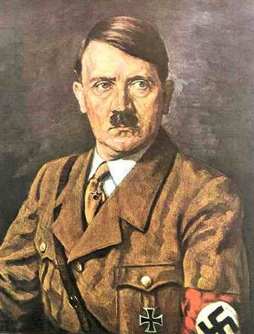
Germany’s takeover
1933
January 30: Appointment of Adolf Hitler as Reich Chancellor (Prime Minister)
February 28: German government takes away freedom of speech, assembly, press, and freedom from invasion of privacy (mail, telephone, telegraph) and from house search without warrant
March 4: Franklin D. Roosevelt is inaugurated President of the United States

Slide 2
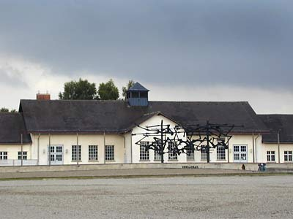
1933
March 9: Outbreak of rioting against German Jews by members of the S.A. (private security guards) and Stahlhelm
March 20: First concentration camp opens at Dachau, Germany, for political opponents of the regime
April 1: Nationwide boycott of Jewish-owned businesses in Germany is carried out under Nazi leadership.

Slide 3
1933
April 7: Law excludes “non-Aryans” from government employment; Jewish civil servants, including university professors and schoolteachers, are fired in Germany
May 10: Books written by Jews, political opponents of Nazis, and many others are burned during huge public rallies across Germany
July 14: Law passed in Germany permitting the forced sterilization of Gypsies, the mentally and physically disabled, African-Germans, and others considered “inferior”

Slide 4
1933
July 14: The Nazi Party proclaimed by law the one and only legal political party in Germany
August 20: Boycott of Nazi Germany declared by American Jewish Congress
October 19: Withdrawal of Germany from the League of Nations

Slide 5
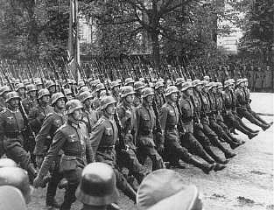
1934
June 30
The “Night of the Long Knives,” the murderous purge of the S.A.
August 3
Hitler declares himself president and chancellor of the Third Reich after the death of Paul Von Hindenburg
October
First major wave of arrests of homosexuals occurs throughout Germany, continuing into November

Slide 6
1935
March 16: Hitler violates Versailles Treaty by renewing compulsory military draft in Germany
March 17: The German Army invades the Rhineland
April: Jehovah’s Witnesses are banned from all civil service jobs and are arrested througout germany
June 30: General strike of Polish Jews in protest against anti-Semitism
September 15: Basic anti-Jewish racist legislation passed at Nuremberg

Slide 7
1936
January: 78,000 Jews left Germany since 1933
March 3: Jewish doctors no longer permitted to practice in government institutions in Germany
March 7: Jews no longer have the right to participate in German elections
August 1: Olympic Games open in Berlin, Germany. Anti-Jewish signs are removed until the games are over. Jews are not allowed to participate

Slide 8
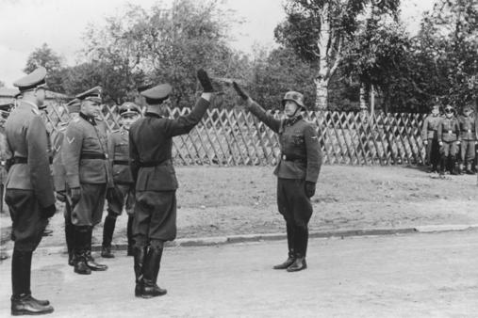
1937
July 16: Buchenwald concentration camp opened
November 16: Passports for Jews are limited
November 25: Germany and Japan sign a political and military treaty

Slide 9
1938
March 13: Annexation of Austria
July 6-15: Representatives from thirty-two countries meet at Evian, France to discuss refugee policies. Most of the countries refuse to let in more Jewish refugees.
October: Confiscation of property of German Jews begins
October 28: Over 17,000 Jews of Polish citizenship expelled from Germany to Zbaszyn on Polish border.

Slide 10
1938
November 9-10: “Kristallnacht” Anti-Jewish riots in Germany and Austria. Some 300,000 Jews arrested, 191 synagogues destroyed, 7,500 shops looted
November 12: German Jews forced to pay 1 billion Reichsmarks for damages of Kristallnacht.
November 15: All Jewish children are expelled from public schools.

Slide 11
1939
March 15
German occupation of Czechoslovakia
June
Cuba and the United States refuse to accept Jewish refugees aboard the ship S.S. St. Louis, which is forced to return to Europe
April 18
Anti-Jewish racist laws passed in Slovakia

Slide 12
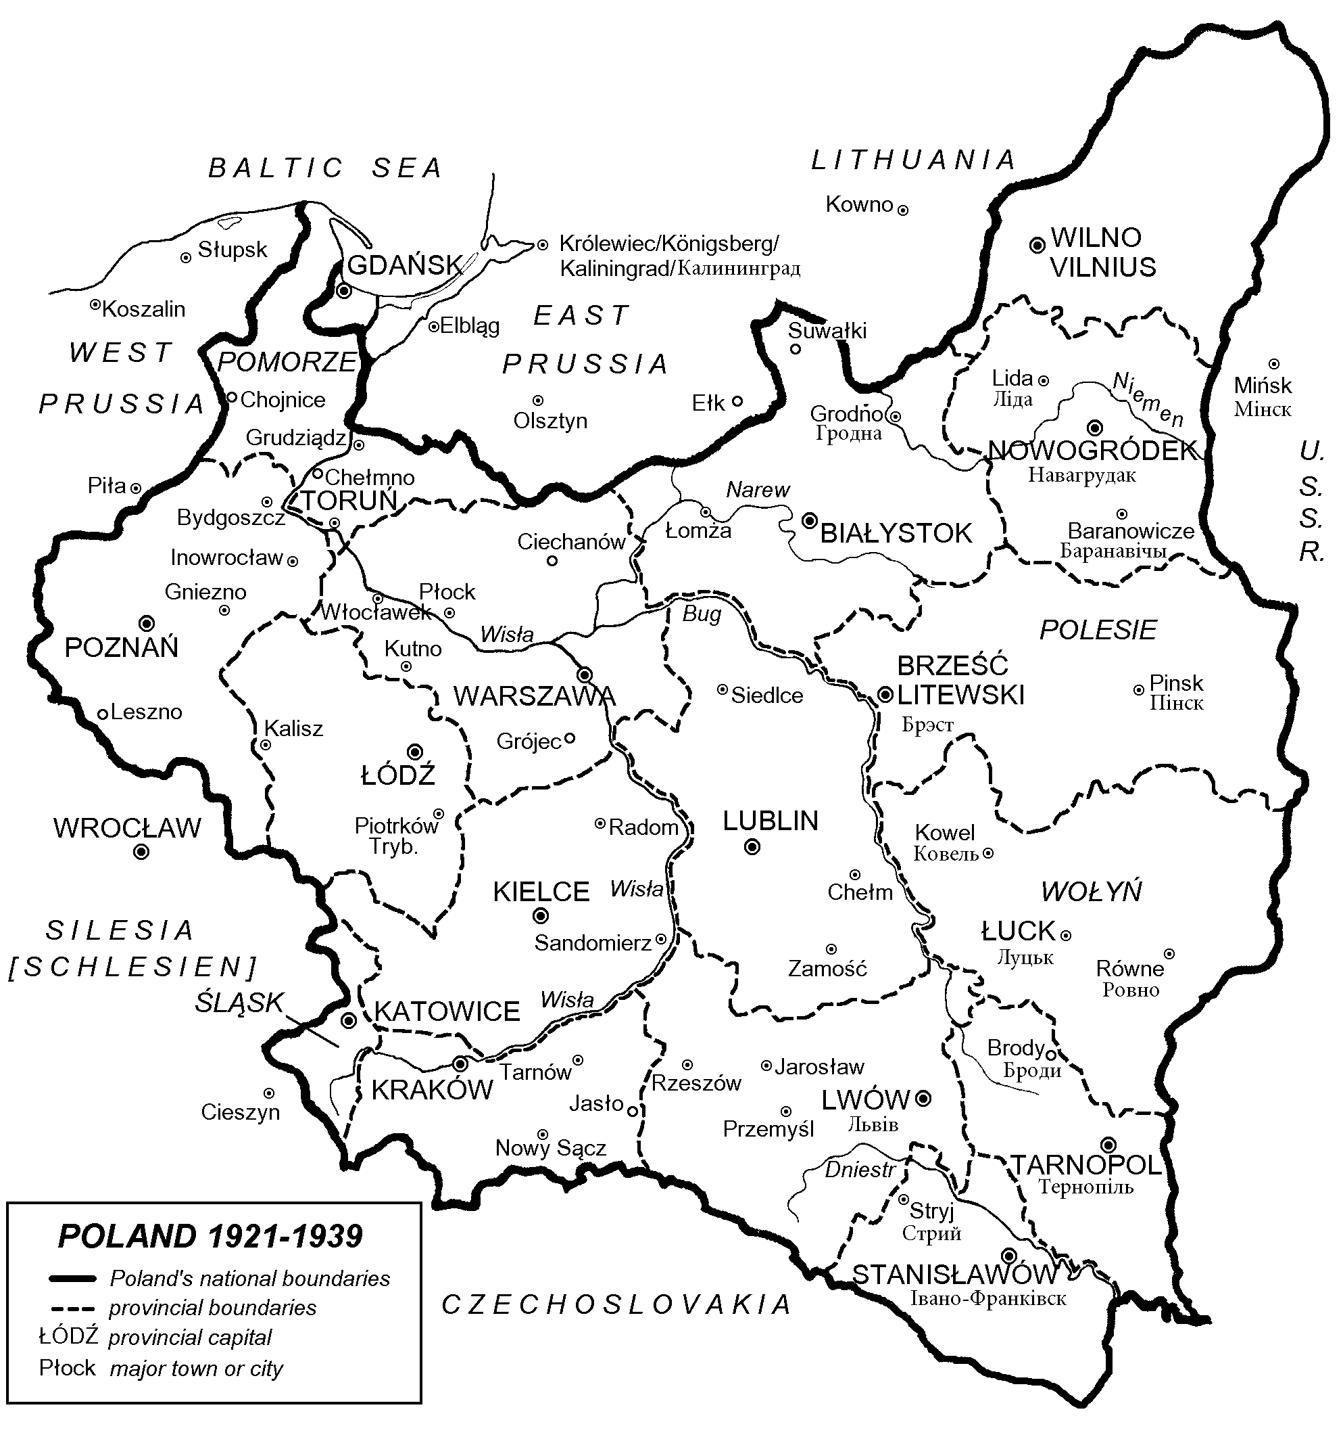
September 1, 1939: German army invades poland beginning of World War II

Slide 13
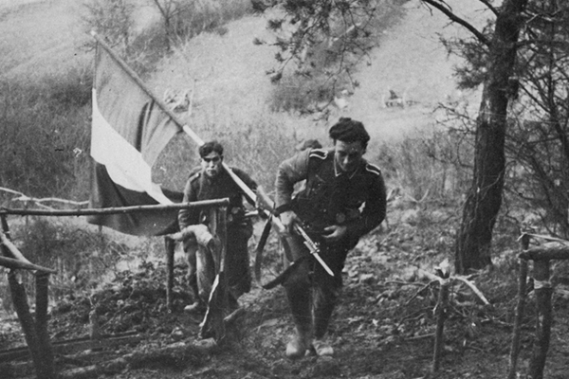
1939
September 3: Britain and France declare war on Germany
September 17: Invasion of Eastern Poland by the Soviet Army

Slide 14
1939
October: Hitler extends power of doctors to kill institutionalized mentally and physically disabled persons in the “euthanasia” program
September 21: Ghettos to be established in occupied Poland each under a “Judenrat” or Jewish Council, by order of Heydrich
November 1939: Dr. Emanuel Ringelblum convenes a conference in Warsaw with representative of underground parties in order to discuss provision of aid to Polish Jews
October: The Jewish Community of Palestine demands participation in the war against Nazism: 26,000 join the British Army
November 23: Distinctive identifying armband made obligatory for all Jews in Central Poland.

Slide 15
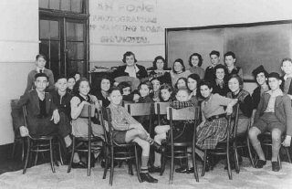
1940
January-February: First underground activities by Jewish youth movements in Poland
April 9: German Army occupies Denmark and Southern Norway, Copenhagen, and Oslo taken
April 27: Himmler directive to establish a concentration camp at Auschwitz
May 10: Massive German invasion of Holland, Belgium and France begins
June 4: Evacuation of British army from Dunkirk is completed

Slide 16
1940
June 22: French army surrenders. Marshall Petain signs armistice (truce) with Germany
September 27: Establishment of Berlin-Rome-Tokyo Axis
November 20-24: Hungary, Rumania, and Slovakia join the Axis
August 10: Anti-Jewish laws passed in Rumania

Slide 17
1940
October 3
Anti-Jewish passed by Vichy (France) Government
November 15
Warsaw Ghetto sealed off
December
Dr. Emanuel Ringelblum founds “Oneg Shabbat” secret archives in the Warsaw Ghetto

Slide 18
1941
April 6
Germany invades Yugoslavia and Greece
May 15
Rumania passes law condemning adult Jews to forced labor
June 7-8
Paimach units from Palestine take part in Allied invasion in Syria
June 22
Germany attacks U.S.S.R
July 2
Anti-racist riots in Lwow in which Ukrainian nationalist take part

Slide 19
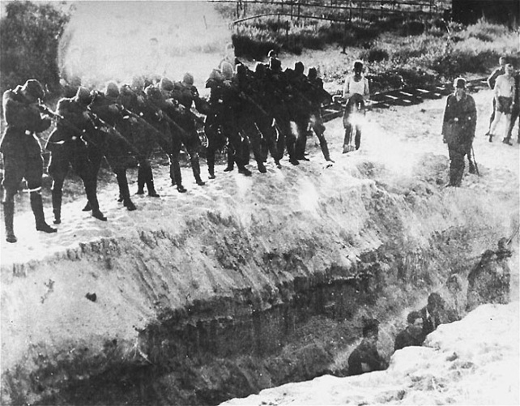
1941
July 12: Military treaty signed between U.S.S.R and Britain
July 31: Heydrich appointed by Goering to carry out the Final Solution
September 28-29: Nearly 34,000 Jews are murdered by “Einsatzgruppen”, mobile killing squads, at Babi Yar near Kiev (Ukraine)

Slide 20
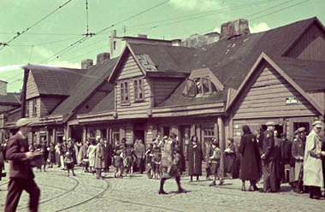
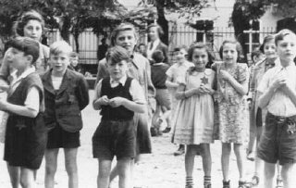
1941
October-November: First group of German and Austrian Jews are deported to ghettos in eastern Europe
October 10: Establishment of Theresienstadt Ghetto in Czechoslovakia
October 23: Massacre of 19,000 Odessa Jews

Slide 21
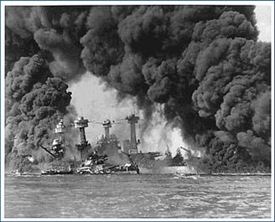
1941
December: Formation of an
underground Zionist Youth
Movement in France. Armed
underground organization established
in the Minsk Ghetto: the first Jewish
partisan group operates in the area
December 7: Japanese attack on Pearl Harbor
December 8: Chelmno extermination camp opened near Lodz; by April 1943, 360,000 Jews had been murdered there

Slide 22
December 11, 1941
Germany and Italy declare war on the United States

Slide 23
1 9 4 2
January: Resistance Organizations set up in the Kovno Ghetto
January 20: Wannsee Conference-here the details of the plan for the final solution to exterminate 11 million European Jews, were drafted
March: Belgian Jews established a mutual aid organization
March 1: Extermination begins at Sobibor; by the end of October 1943, 250,000 Jews had been murdered there

Slide 24
1 9 4 2
March 17
Extermination begins at Bezec; by the end of 1942, 600,000 Jews had been murdered there
March 26
Deportation of 60,000 Slovakian Jews, come to Auschwitz, others to Majdanek
April
Anti-Fascist bloc established in the Warsaw Ghetto

Slide 25
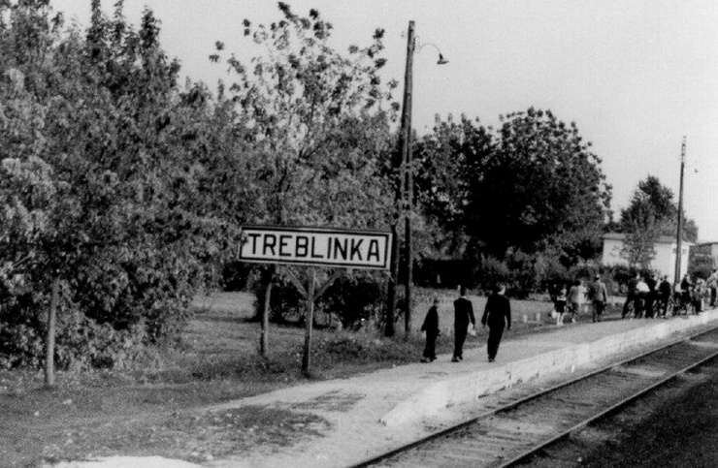
1942
June 1: Jews in France and
Holland required to wear identifying stars
June 1: Treblinka extermination camp opened; 700,000 Jews murdered there by August 1943
June 28: German and Italian armies reach El Alamein: danger of attack in Suez area
July 22: Beginning of the large-scale “Aktion” in the Warsaw Ghetto; by September 13, 300,000 Jews had been deported to Treblinka

Slide 26
1942
July 22: Armed resistance, during liquidation of the Nieswiez Ghetto, Western Byelorussia
July 28: “Jewish Fighting Organization” (Z.O.B.) set up in the Warsaw Ghetto
August 9: Armed resistance during the liquidation of the Mir Ghetto, Western Byelorussia
August 10-29: “Aktion” in Lwow Ghetto; 40,000 Jews deported to extermination camps
August 12: Consultations between Churchill and Stalin in Moscow

Slide 27
1942
September 23
Armed resistance during the liquidation of the Tutzin Ghetto, western Ukraine, -an armed group organized and led by Moshe Geldenman escape from the Kurtz Ghetto, Western Ukraine, to engage in partisan operations in the area
October 4
All Jews still in concentration camps in Germany are sent to death camp at Auschwitz
November 19
Major counter-attack by the Soviet army in the Stalingrad region
December 17
The allies resolve to inflict punishment on the exterminators of the Jewish people
November 2
British victorious over the Germans and Italians in the battle for El Alamein
December 22
Jewish Combat Organization set up in Cracow; attacks on German soldiers

Slide 28
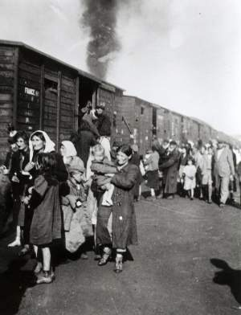
1943
January 18-21
First armed resistance in Warsaw Ghetto; street fighting under command of Mordechai Anielewics
February 5-12
“Aktion” in Bialystok Ghetto; 1,000Jews killed on the spot; 10,000 deported to Treblinka
April 19
Warsaw Ghetto revolt

Slide 29
1943
June Armed resistance by Jewish Combat Organization in Czestochova Ghetto
June-September: Hundrens of underground fighters leave the Vilna Ghetto for the forests
July 24: Revolt in Italy; Mussolini deposed by Badoglio
August 2: revolt in Treblinka
August 16: Bialystok Ghetto revolt breaks out; revolt at Krikove Tabour Camp, Lublin district

Slide 30
1943
September 20: Rome occupied by Germans. German army in command of most of the territory of Italy
October 2: Order for the expulsion of Danish Jews: thanks to the rescue operations by the Danish underground some 7,000 Jews were evacuated to Sweden: only 475 were captured by the Germans
November 28: Teheran Conference-meeting with Roosevelt, Stalin and Churchill

Slide 31
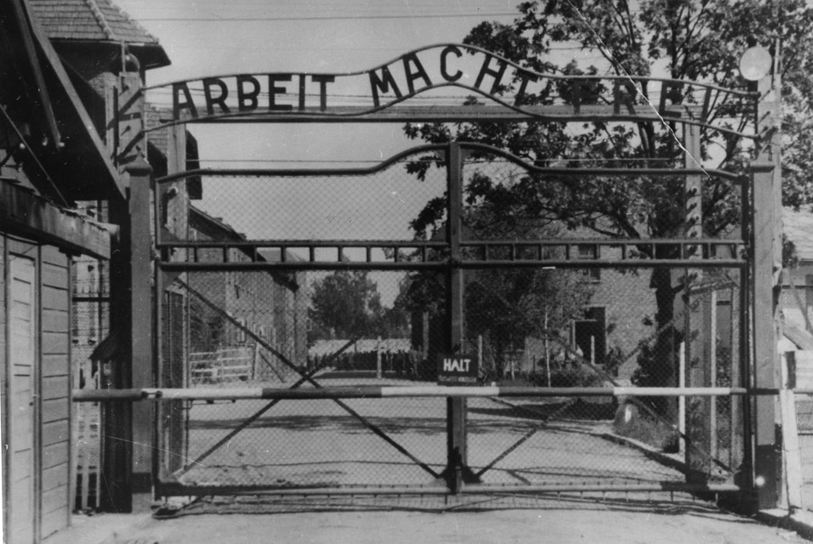
1944
January: The Jewish underground in Budapest set up a workshop for forging documents for rescue purposes; by the end of 1944, over 10,000 people had been supplied with such documents
March 19: German army invades Hungary
May 15: Deportation of 430,000 Hungarian Jews to Auschwitz begins

Slide 32
1944
June 6
July 20
July 24
Allied invasion of Normandy, D-Day
Abortive attempt on Hitler’s life by group of Nazi officers
Russians liberate Maidanek death camp

Slide 33
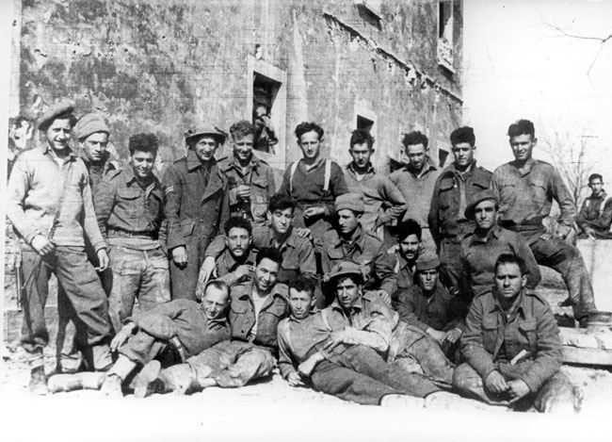
1944
October 7: Sonderkommando uprising at Auschwitz
October 31: 14,000 Jews transported from Slovakia to Auschwitz
November 1: Jewish
Brigade leaves for Italian
front

Slide 34
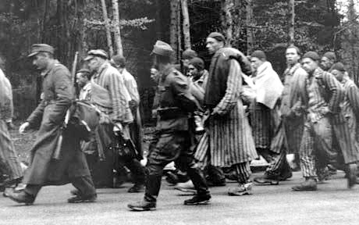
1 9 4 5
January 17
Evacuation of Auschwitz; the prisoners’ Death March” begins
January 27
Soviet troops enter Auschwitz
April
Russian Army enters Germany from the east; allied army enters from the west

Slide 35
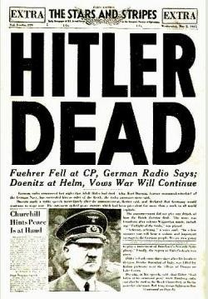
1945
April 30: Hitler commits suicide
May 8: Germany surrenders-the end of the Third Reich

Slide 36
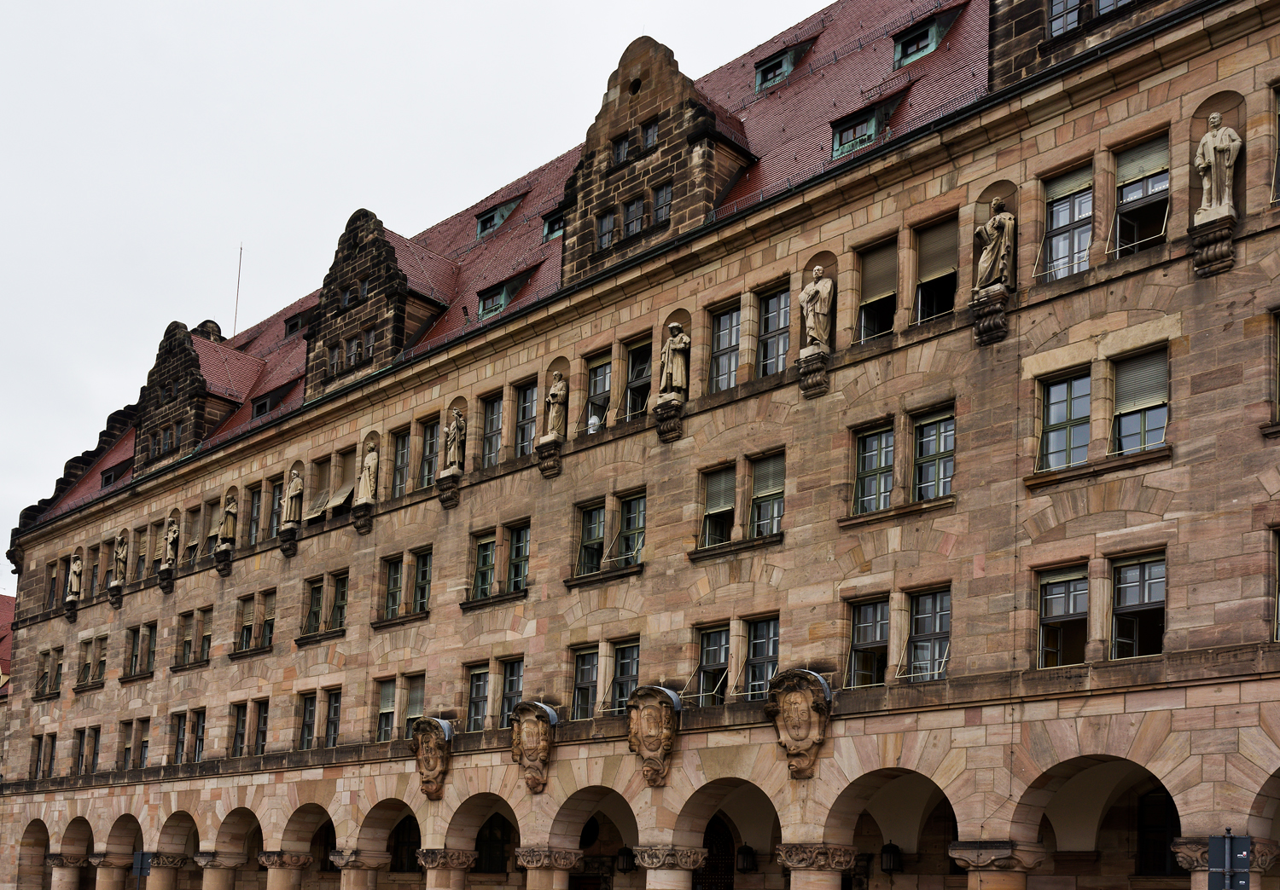
November 1945-October 1946
War crime trials held at Nuremberg, Germany

