Slide 1
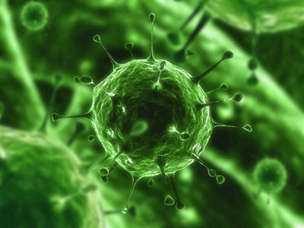
DISEASES

Slide 2
What Is a Disease?
An abnormal condition of a body part, organ, or system resulting from various causes, such as infection, genetic defect, or environmental stress, and characterized by an identifiable group of signs and symptoms.
(The American Heritage® Dictionary of the English Language, Fourth Edition
Copyright © 2009 by Houghton Mifflin Company.)

Slide 3
TYPES OF DISEASES
COMMUNICABLE
NONCOMMUNICABLE

Slide 4
COMMUNICABLE DISEASES
VIRUS
BACTERIA
PROTOZOA
FUNGUS

Slide 5
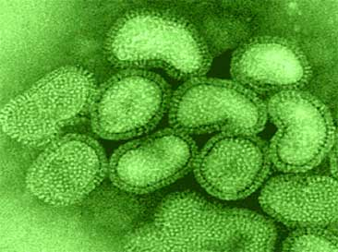
Flu
Common Cold
Human Immunodeficiency Virus
Pneumonia
Hepatitis A,B,C
Chicken Pox
VIRUSES

Slide 6
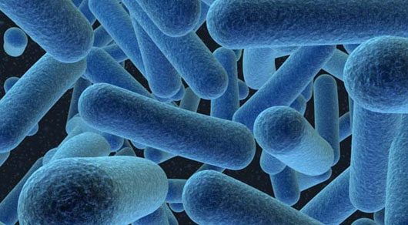
STREP THROAT
TIBERCULOSIS
DIPTHERIA
E COLI
SALMONELLA
BACTERIA

Slide 7
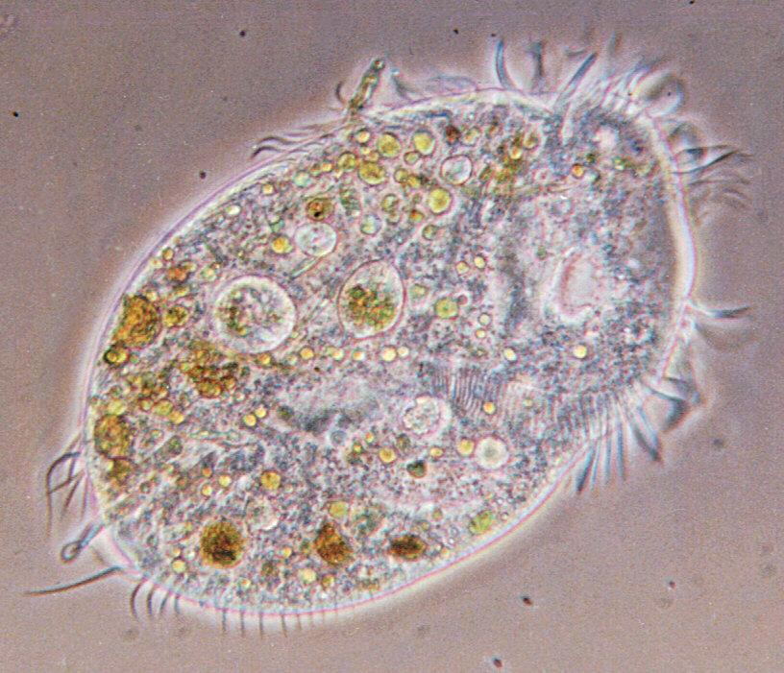
PROTOZOA
Malaria
Dysentery
Giardiasis
Toxoplasmosis

Slide 8
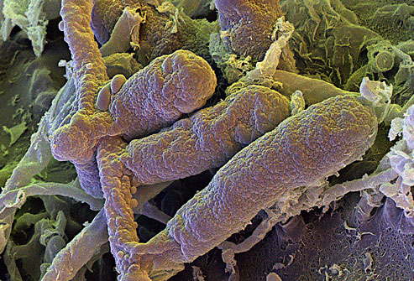
FUNGUS
ATHLETES FOOT
JOCK ITCH
VAGINAL YEAST INFECTION
RINGWORM

Slide 9
TRANSMISSION

Slide 10

DIRECT CONTACT

Slide 11

INDIRECT CONTACT

Slide 12

FOOD & DRINK

Slide 13
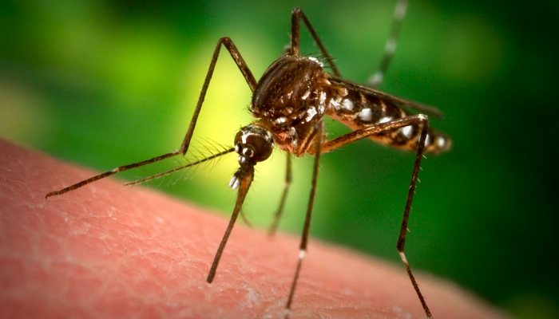
INSECTS & ANIMALS

Slide 14
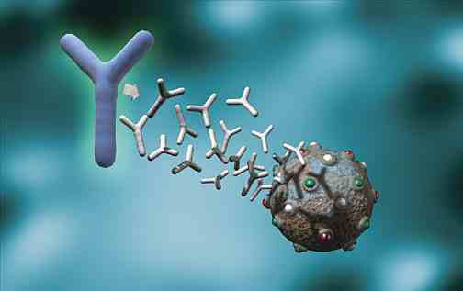
IMMUNE SYSTEM

Slide 15
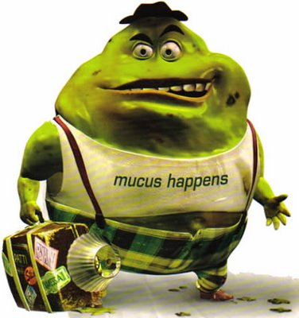
GENERAL DEFENSES
SKIN
MUCUS
SALIVA

Slide 16
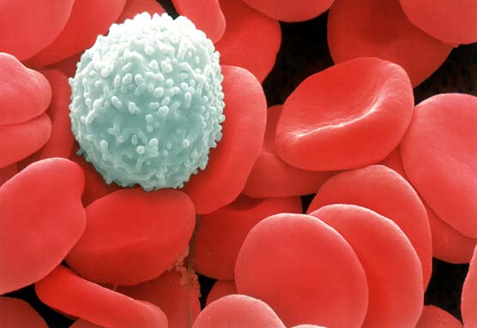
WHITE BLOOD CELLS
LYMPHOCITES
LEUKOCITES

Slide 17
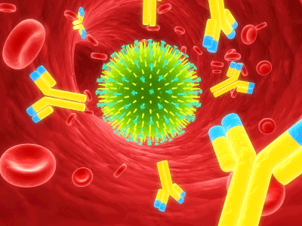
ANTIBODIES

Slide 18
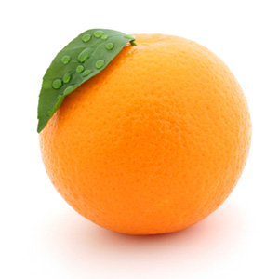
HOW TO MAKE
YOUR IMMUNE SYSTEM
STRONGER
VITAMIN C
SLEEP/REST
EAT HEALTHY
NO DRUGS

