Slide 1
Diseases
Health Unit Five

Slide 2
What Is a Disease?
An abnormal condition of a body part, organ, or system resulting from various causes, such as infection, genetic defect, or environmental stress, and characterized by an identifiable group of signs and symptoms
(The American Heritage® Dictionary of the English Language, Fourth Edition Copyright © 2009 by Houghton Mifflin Company.)

Slide 3
Types of Disease
Communicable
Noncommunicable

Slide 4
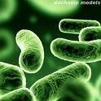
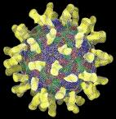
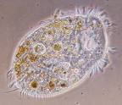
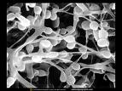
Types of Communicable Diseases
Bacteria
Virus
Protozoa
Fungus

Slide 5
Bacteria
Tuberculosis
Typhoid Fever
Diphtheria
Syphilis
E Coli
Strep Throat

Slide 6
Virus
Influenza (Flu)
Common Cold
Human Immunodeficiency Virus
Pnemonia
No Cures

Slide 7
Protozoa
One-celled organisms
Malaria

Slide 8
Fungus
Athlete’s Foot
Jock Itch
Vaginal Yeast Infection
Ringworm

Slide 9
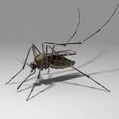
Transmission
Direct Contact
Indirect Contact
Food and Drink
Animals and Insects

Slide 10
Types of Noncommunicable Diseases
Hereditary
Environmental
Lifestyle

Slide 11
Different NC Diseases
Diabetes
Heart Disease
Cancer
Sickle Cell Anemia
Asthma
Allergies

Slide 12
Immune System

Slide 13
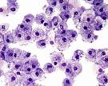
What is the Immune System?
A system of biological structures and processes within an organism that protects against disease by identifying and killing pathogens and tumor cells
2009 Wikipedia.com http://en.wikipedia.org/wiki/Immune_system

Slide 14
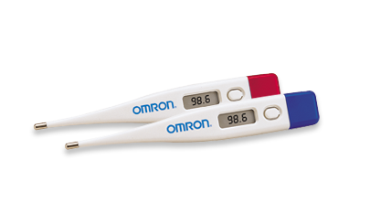
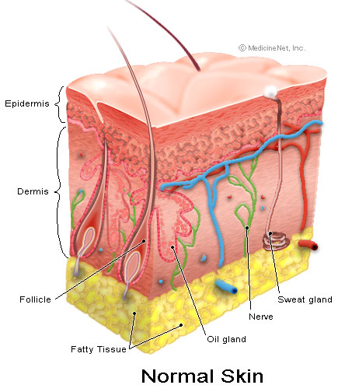
General Defenses against Disease
Skin
Saliva and Mucus
Fever

Slide 15
Disease Specific Defenses
Lymphocytes and White Blood Cells
Antibodies
http://www.brainpop.com/

Slide 16
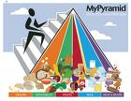
Ways to Strengthen Your Immune System
Get 8 hours of sleep
Eat Healthy
Get a lot of Vitamin C
Don’t Do Drugs

Slide 17
STDs

Slide 18
Sexually Transmitted Diseases
Communicable Diseases that are transmitted through sexual contact
Can also be transmitted by sharing “dirty” needles in drug use
Until 1985, STDs could be transmitted through blood transfusions

Slide 19
HIV/AIDS
Human Immunodeficiency Virus
Aquired Immunodeficiency Syndrome
HIV is the virus that leads to AIDS
Attacks the immune system
Can be managed with medications
Eventually the immune system will succumb to the disease

Slide 20
HIV/AIDS
People usually do not die from AIDS, but from other diseases that a healthy immune system can easily fight off (like pnemonia)
Babies can be born with HIV if their mother has the infection

Slide 21
Ways You Can NOT Get HIV/AIDS
Holding hands
Kissing
Sweating
Eating/Drinking
Sitting next to someone with the disease

Slide 22
Other STDs
Gonorrhea
Chlamydia
Syphilis
Herpes Simplex Virus
Human Papillomavirus
Genital Warts

