Slide 1
You Can’t Have One Without the Other
Body Systems

Slide 2

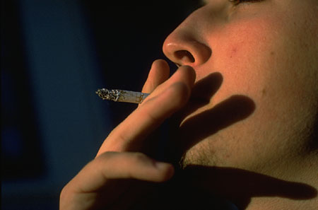
Body Systems work together
If you damage one system, you may damage several like smoking which irritates the lungs and also destroys the macrophages of the immune system and brain cells!

Slide 3

Body Systems work together
If you get excited, the nervous system increases the heart rate

Slide 4
Human Body Team
All the systems play a part. How do they interact?
Which one is the most important?
Notes:
As the you use the slides, discuss the system functions.

Slide 5
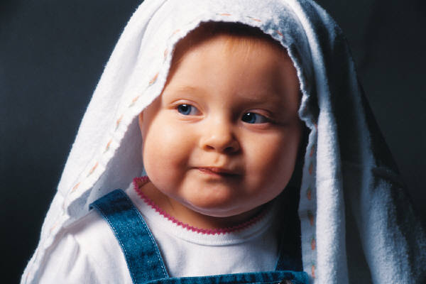
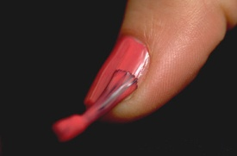

Integumentary System
Major Organs: skin, hair & nails
I cover and protect every place on the body!
I am the first line of defense against invasion and injury.
I retain body heat yet, have pores to release excess heat and wastes.
I retain moisture and your body is almost 80% water!
Notes:
Protection
Excess wastes especially urea
Regulates body temperature

Slide 6

Skeletal System
Major Organs: bones
Without me, you’d have no shape or structure…you’d be a blob.
I make you able to move!
I make your red blood cells that carry oxygen to all the cells.
I protect the precious brain, heart and spinal cord.
Notes:
Makes red blood cells for circulatory system
Provides bones for skeletal system to attach to that enables movement
Provides calcium, phosphorus, etc.
Protection of major organs by hard, bony plates
Malleable during birth and the first few years

Slide 7

Muscular System
Major Organs: muscles
The heart is made of cardiac muscle.
The internal organs are made of smooth muscle.
Without the skeletal muscles the bones couldn’t move.
Notes:
The heart muscles pump blood to carry oxygen brought in by the respiratory system
Stomach muscles break down food so it can be digested
Allow movement by pulling on bones

Slide 8
Respiratory System
Major Organs: Lungs, Trachea, Nose
I bring in the oxygen that is carried on the red blood cells…without me you’d have no oxygen to carry!
I carry the CO2 (waste gas) out of the body.
The circulatory system needs me for gas exchange.
The muscles need oxygen to move.
The brain needs
my oxygen to think.
Notes:
Without this system gas could (0₂ primarily) would not enter our systems
Without this system CO₂ could not exit the body after being expelled as a waste in cellular respiration
Circulatory system carries these gases to the alveoli to be expelled
Diaphragm ( a muscle) is what forces lungs to inhale and exhale

Slide 9
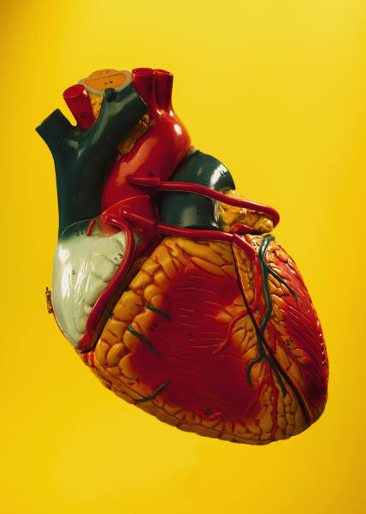
Circulatory System
I carry oxygen and nutrients to every cell in the body!
I am the heart, the veins, the arteries, capillaries and blood.
I transport the white blood cells to all the infections and injuries.
Without me, the oxygen and the CO2 in the body couldn’t reach the cells or lungs.
Notes:
Provides a platform for oxygen and nutrients to flow to all cells of the body.
The heart (a muscle) gives the blood the power to push these things to the cells
Without the veins, arteries and capillaries

Slide 10
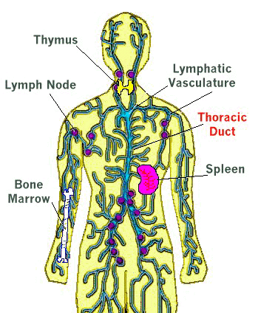
Lymphatic System
Major Organs: lymph nodes, spleen, thymus
I am a system of vessels that return extra fluid to the bloodstream.
I also help your body fight disease – Immune System
Notes:
Provides a platform for oxygen and nutrients to flow to all cells of the body.
The heart (a muscle) gives the blood the power to push these things to the cells
Without the veins, arteries and capillaries

Slide 11
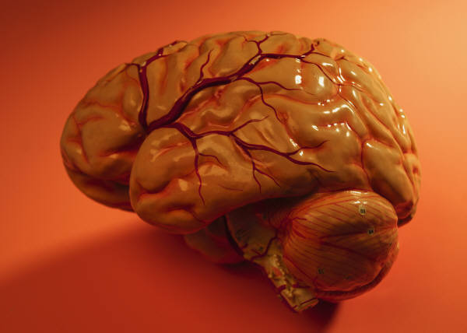
Nervous System
Major Organs: brain, spinal cord
I tell everything what to do. I tell the heart when to beat, the body when to move, the digestive system to add enzymes.
I am the leader.
Notes:
All the systems require monitoring and instructions

Slide 12
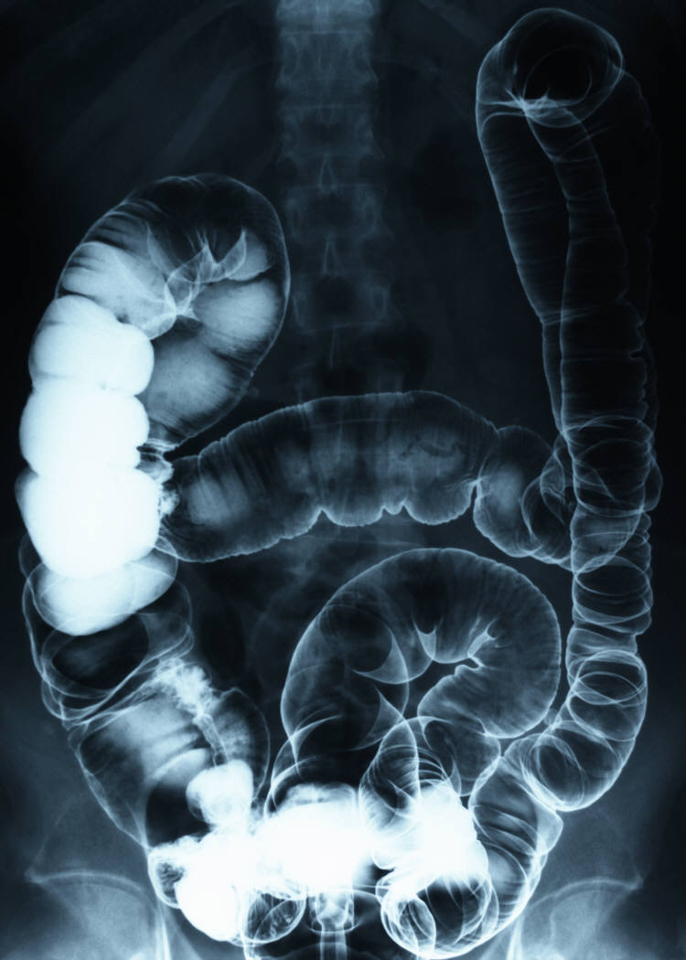
Digestive System
Major Organs: mouth, esophagus, stomach, small Intestine, large intestine, rectum
Without my system, the body would not be able to obtain energy and nutrients.
I break down all the food stuffed in my mouth into usable nutrients and expel the wastes.
Notes:
All the body systems require various nutrients to function.
The human body obtains these nutrients from the food we eat.
The digestive system then breaks down these foodstuffs into usable nutrients for the body to use

Slide 13
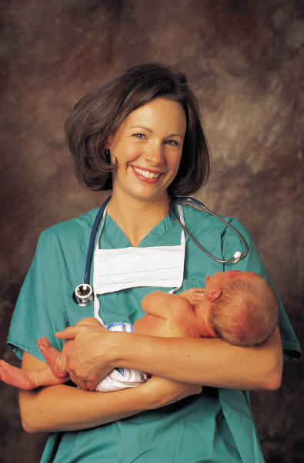
Reproduction System
Major Organs: ovaries, testes, uterus
I manufacture (make) cells that allow reproduction.
Without me, species would not continue to live.
Notes:
Individuals need not reproduce, but the species must have a way to reproduce in order to continue the species.
Sexual reproduction provides diverse offspring a positive thing for a species
The more genetically diverse a population, the more likelihood there is for it to survive

Slide 14

The Urinary System
Major Organs: kidneys, bladder, ureters, urethra
I keep your blood clean (filter out wastes)
I also make sure essential chemicals are put back into your blood
I combine waste products with water and salt to form urine so that we can get them out of your body!

Slide 15
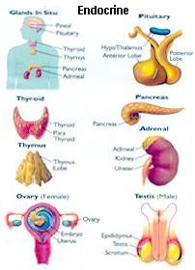
The Endocrine System
Major Organs: pituitary gland, thyroid, adrenal gland, pancreas, ovaries, testes
I am made of glands which release chemicals called hormones directly into your blood
Without my hormones, you would never grow, have mood changes, digest food, get tired, or be able to reproduce!

