Slide 1
Cruising
Source: en.wikipedia.org/wiki/Cruise_ship
Copyright © Notice: The materials are copyrighted © and trademarked ™ as the property of The Curriculum Center for Family and Consumer Sciences, Texas Tech University.

Slide 2
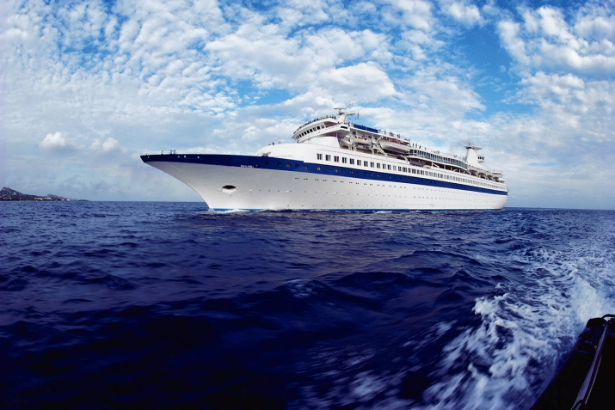
Cruise
A cruise ship or cruise liner is a passenger ship
Parts of the experience are
The voyage itself
The ship’s amenities
The different destinations
Copyright © Notice: The materials are copyrighted © and trademarked ™ as the property of The Curriculum Center for Family and Consumer Sciences, Texas Tech University.

Slide 3
Cruise Ship
Transportation is not the prime purpose. Cruise ships usually return passengers to their originating port.
Amenities cater to tourists.
Casino
Spa
Fitness center
Shops
Library
Theatre
Indoor and outdoor pools
Many restaurants
Copyright © Notice: The materials are copyrighted © and trademarked ™ as the property of The Curriculum Center for Family and Consumer Sciences, Texas Tech University.

Slide 4
Cruising
Cruising is a major part of the tourism industry.
In 2011, U.S.$29.4 billion
(that’s a lot! $29,400,000,000)
19 million passengers carried worldwide.
Copyright © Notice: The materials are copyrighted © and trademarked ™ as the property of The Curriculum Center for Family and Consumer Sciences, Texas Tech University.

Slide 5
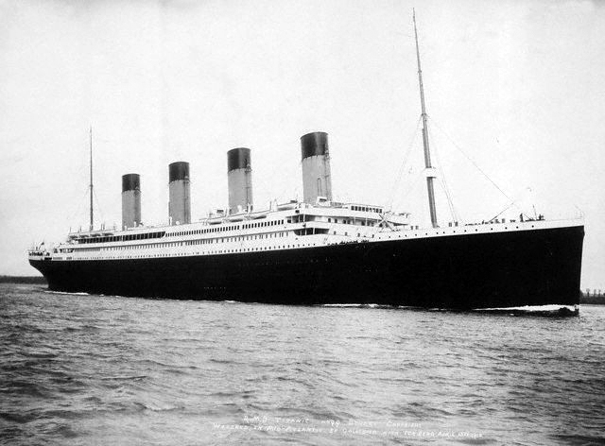
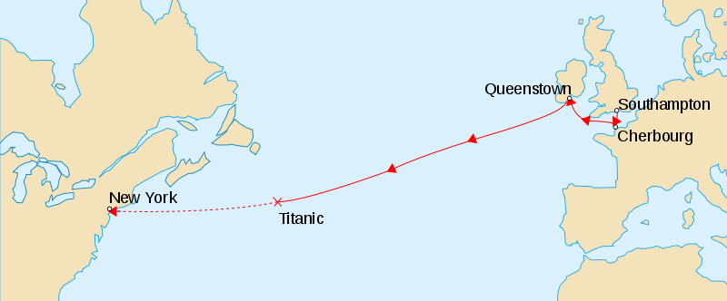
Cruise Liner
Original ocean liners transported passengers from one point to another rather than on round trips.
An example is the Titanic.

Slide 6
History
The first vessel build for cruising was completed in 1900.
To compete for customers, ocean liners added luxuries such as fine dining.
Intercontinental travelers switched from to ships to planes starting in the 1960s.
Cruising voyages, however, gained in popularity from the 1980s on.
Copyright © Notice: The materials are copyrighted © and trademarked ™ as the property of The Curriculum Center for Family and Consumer Sciences, Texas Tech University.

Slide 7
Organization
A cruise ship is organized much like a hotel.
In addition to the sailing staff, there is a complete hospitality staff.
Copyright © Notice: The materials are copyrighted © and trademarked ™ as the property of The Curriculum Center for Family and Consumer Sciences, Texas Tech University.

Slide 8
Major Cruise Companies
Royal Caribbean
Paincess Cruises
Carnival Cruise
Celebrity
Disney
Holland America
P&O
Cunard
Crystal
Norwegian Cruise
Copyright © Notice: The materials are copyrighted © and trademarked ™ as the property of The Curriculum Center for Family and Consumer Sciences, Texas Tech University.

Slide 9
FYI
What’s the difference between a ship and a boat?
Ships have to be big enough to carry boats, and boats have to be small enough to be carried by ships.
Copyright © Notice: The materials are copyrighted © and trademarked ™ as the property of The Curriculum Center for Family and Consumer Sciences, Texas Tech University.

Slide 10
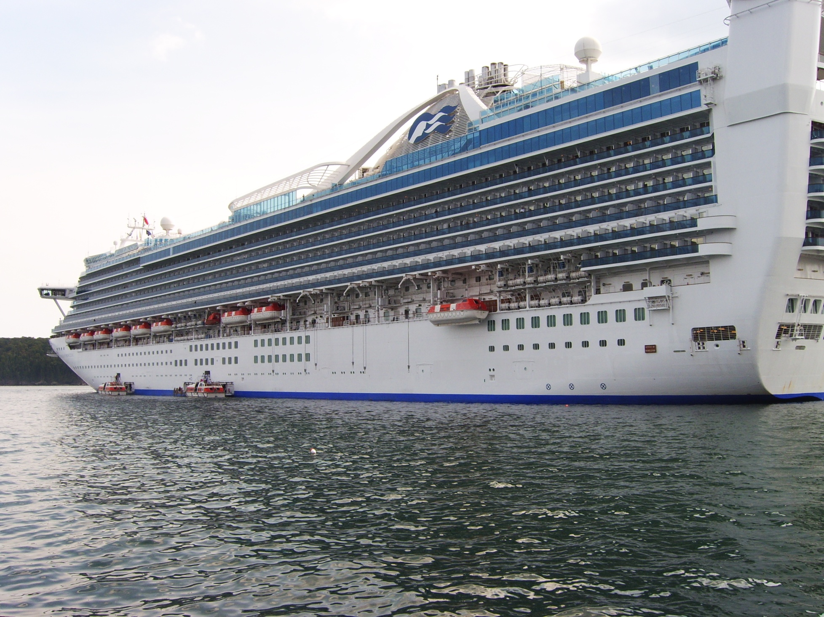
Ship
Boat
Copyright © Notice: The materials are copyrighted © and trademarked ™ as the property of The Curriculum Center for Family and Consumer Sciences, Texas Tech University.

Slide 11
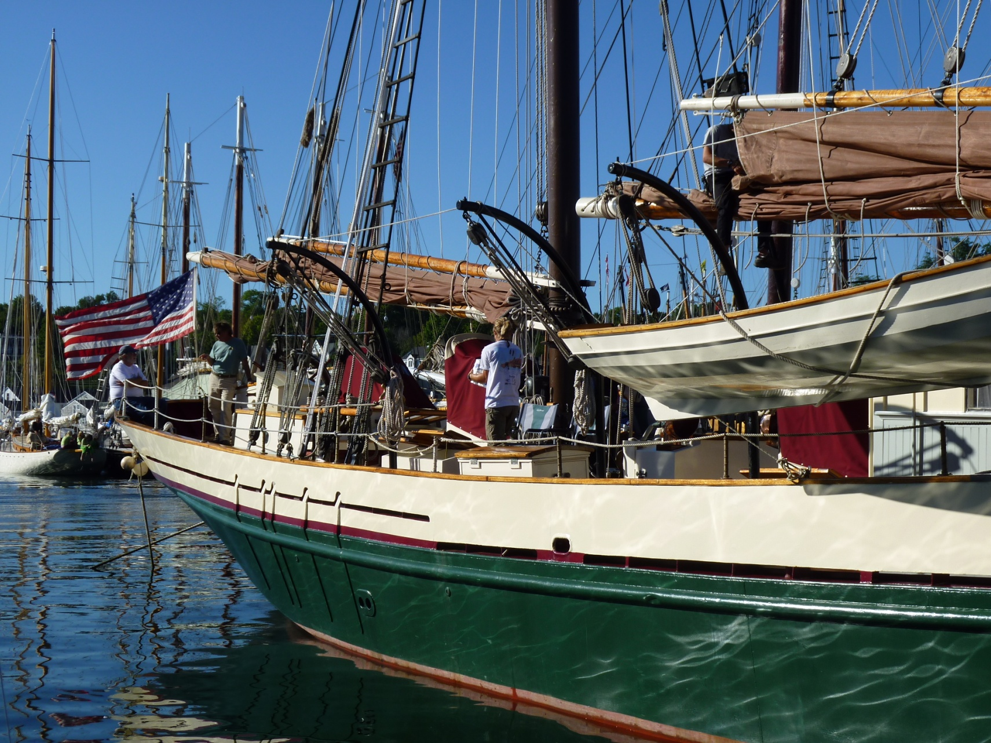
Boat
Ship
Copyright © Notice: The materials are copyrighted © and trademarked ™ as the property of The Curriculum Center for Family and Consumer Sciences, Texas Tech University.

Slide 12
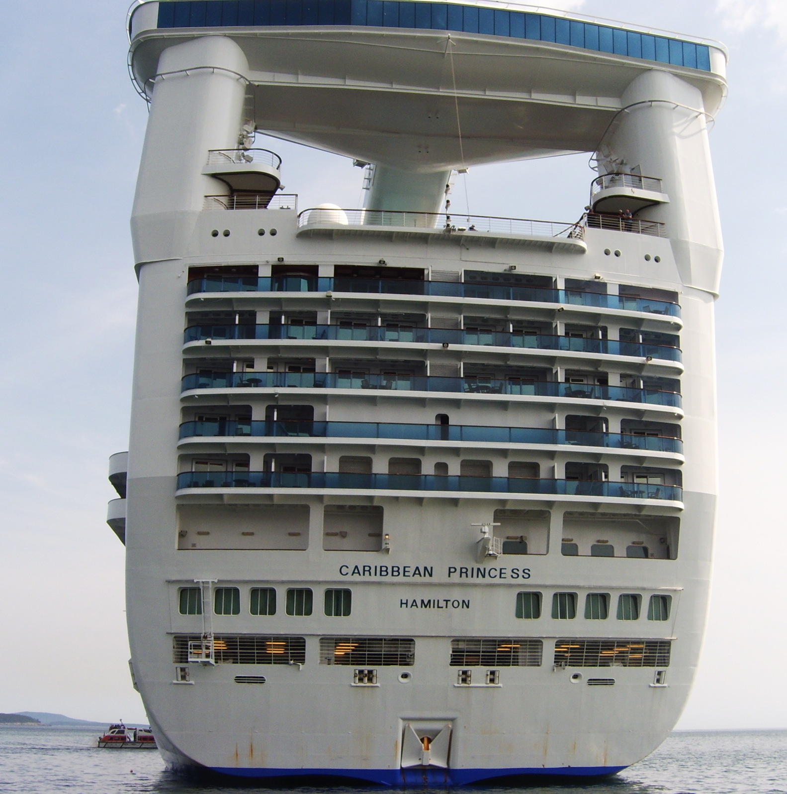
The End
Copyright © Notice: The materials are copyrighted © and trademarked ™ as the property of The Curriculum Center for Family and Consumer Sciences, Texas Tech University.

