Slide 1
Bonnie White, FACS Educator

Slide 2



Introduction
More accidents occur in the kitchen than any other room of the home. Most accidents can be prevented with some thought, pre-planning and attention to detail. We will be covering:
  How to prevent injuries in the kitchen.
  How to prevent food-borne illness.

Slide 3
Preventing Injuries
Common injuries in the kitchen:
  Cuts
  Burns & Fires
  Electrocution
  Falls
  Poisoning/Chemical Hazards

Slide 4
Preventing Cuts
Using knives safely:
  A sharp knife is safer than a dull knife.
  Use an acrylic cutting board, and cut food away from your body.
  If the knife falls, jump back and let it drop.
  Never use a knife to open cans or pry lids.
  Wash and store knives and other sharp objects separately from other utensils.

Slide 5
Preventing Cuts
Removing broken glass safely:
  Sweep broken glass into a dustpan immediately.
  Wipe the area with several layers of damp paper towel to remove glass chips.
  Place broken glass and damp paper towels in a paper bag and place the
  bag in a trash container.

Slide 6

Preventing Burns
Using cookware safely:
  Turn the handles of cookware inward on a range.
  Use thick, dry potholders when handling hot pans.
  Open lids, like a shield, away from your body to avoid steam burns.
  Pull out the oven rack first when removing hot cookware from the oven.
  Remember that the heating elements on electric ranges remain hot for a long time after being turned off.

Slide 7
Preventing Burns
Using a microwave oven safely:
  Follow the manufacturer’s instructions, especially for cooking and heating times to avoid burns from overheated foods.
    Do not use excessive amounts of time to heat water or liquids to avoid “super heating” (past boiling temperature) which can cause liquids to “explode” under certain conditions.
  Follow the manufacturer’s recommendations for appropriate cookware.
    Use potholders to remove hot cookware. Heated food and steam can make even “microwave safe” cookware hot.
    Never place metal or aluminum products in the microwave!
  Open lids or remove plastic wrap away from you to avoid steam burns.
  Microwaves should not be operated when they are empty.
The FDA has regulated microwave oven manufacturing since 1971. As long as the microwave oven meets FDA standards and is used as directed it is said to be safe.

Slide 8
Preventing Fires
Avoiding fires in the kitchen:
  Store oils away from the stove.
  Wear short or close-fitting sleeves while cooking.
  Tie back long hair when cooking.
  Keep towels, potholders, paper towels, and other flammable materials away from the stove and oven.
  Clean up grease build-up from the stove, oven and the exhaust fan regularly.
  Avoid leaving the kitchen while cooking.
  Have a smoke detector near the kitchen.

Slide 9
Preventing Fires
Putting out small fires in the kitchen:
  Small Pan Fires
    Use a larger lid to smother the flame.
  Grease Fires
    Use baking soda to put out the fire — water or flour will only make the flames larger.
  Clothing Fires
    If your clothes catch on fire - Stop, Drop & Roll!
  Fire Extinguishers
    Always have fire extinguishers or baking soda readily available in the kitchen in case of fires.

Slide 10
Preventing Electrocution
Operating electrical appliances safely:
  Unplug any electrical appliance, like a toaster, before removing food or objects that have become stuck in the appliance.
  Unplug electrical appliances from the outlet by grasping the plug, not the cord.
  Keep cords away from heat sources or from hanging over the edge of the counter.
  Dry hands completely before operating electrical appliances.
  Keep electrical appliances away from water.

Slide 11
Preventing Falls
Avoiding falls, bumps & bruises:
  Clean up spills immediately with paper towels.
  Keep cupboard doors and drawers closed or shut when they are not in use.
  Use a ladder/stool to retrieve high or
  hard-to-reach objects.

Slide 12
Preventing Poisoning
Using household chemicals safely:
  Keep drain cleaners, household cleaners, and other products which contain poisons in their original containers.
  Read all product labels and only use as intended.
  Store dangerous products out of the reach of children and pets, and away from food items.
  Don’t mix cleaning products together. Mixing some chemicals may cause a hazardous reaction.
  Follow the manufacturers directions when handling insect control chemicals.

Slide 13
Chemical Hazards
Labels
Pay attention to the labels:
  Hazard
    Potentially dangerous.
  Flammable
    Anything that ignites easily or is capable of burning rapidly.
  Use and Care Instructions
    Instructions written by manufacturers to inform consumers how to use and care for the product.
  Caustic Cleaner
    Household cleaner that may burn or corrode the skin on contact.
  Poisonous
    Capable of harming or killing if ingested.
CAUTION
Corrosive
Avoid Contact

Slide 14
Preventing Injury to Children
Childproofing your kitchen:
  If you have children under the age of 2 in the house, use a safety gate to the kitchen.
  Remove small magnets from the refrigerator to prevent choking accidents.
  Put a cover over the garbage disposal switch.
  Move household chemicals out of children’s reach and/or put safety latches on all cupboards.
  Store knives out of the reach of children.
  Teach children about kitchen safety!

Slide 15
Safety Phone Numbers
Every kitchen should have a list of important phone numbers in case of an emergency.
Safety phone numbers include:
  Fire Department
  Ambulance/Emergency Medical Care
  Family Doctor
  Poison Control Center

Slide 16
Food-borne Illness
A food-borne illness is a disease transmitted by food, the source of which is bacteria, or toxins produced by bacteria.
Symptoms are flu-like including
nausea, vomiting, diarrhea,
fever, and other reactions,
lasting a few hours to several days.

Slide 17
Food-borne Illness
Some bacteria is safe and commonly eaten, such as yeast in bread, bacteria in yogurt, and mold in blue cheese.
By proper handling of food,
illness can be prevented.

Slide 18
Risky Foods for Food-borne Illness
Risky foods are foods that are most likely to cause food-borne illness. Risky foods include:
  Raw meat, poultry, eggs, milk
  (unpasteurized) and shellfish.
  Raw fruits & vegetables which have been
  processed in unsanitary conditions (especially
  sprouts and unpasteurized fruit juices).
  Cooked plant products like pasta, rice and vegetables.
  Unpasteurized dairy products (soft cheeses).
Extra care must be taken to avoid food-borne illness when handling these foods.

Slide 19
Preventing Food-borne Illness
To fight bacteria that may cause food-borne illness, follow these steps to food safety:
  Cook foods thoroughly to destroys harmful bacteria that may be present in food.
  Separate foods to avoid cross-contamination!
  Chill - follow the COOL rules!
  Clean hands, surfaces and produce.

Slide 20
Preventing Food-borne Illness
COOK foods thoroughly to destroys harmful bacteria that may be present in food:
  Foods are properly cooked when heated for a long enough time at a high enough temperature to kill harmful bacteria.
    Ground Beef - Cook to an internal temperature of 160° F; should no longer be pink.
    Meat & Poultry - Cook until juices run clear. Roasts & steaks to at least 145° F. and Poultry 170° to 180° F.
    Eggs - Cook until the yolk and whites are firm.
    Seafood - Cook until opaque and flakes easily with a fork.
    Leftovers - Reheat quickly at a high temperature. Internal temperature should be at least 165° F. Bring sauces, soups and gravies to a boil.

Slide 21
Preventing Food-borne Illness
SEPARATE foods to avoid cross-contamination!
  Safely separate raw meat and seafood from other foods in your shopping cart and your refrigerator.
  Wash hands, cutting boards, dishes and utensils after they come in contact with raw meat, poultry, eggs and unwashed produce.
  Place cooked food on a clean plate.
  In the refrigerator, place raw foods in a sealed container to prevent meat juices from dripping
  on other food.
  Wipe up meat juice from all surfaces promptly.

Slide 22

Preventing Food-borne Illness
Follow these COOL rules:
  Keep foods out of the Danger Zone (40° F. - 140° F.)
  Thaw foods in the refrigerator or microwave.
  A refrigerator can be too full. Cold air must circulate
  to keep food safe.
CHILL leftovers:
  Remember the 2-hour rule - refrigerate foods within 2 hours.
  Divide large amounts of leftovers into smaller, low containers for quick cooling.
  Use a cooler or ice pack to keep perishable food cold, especially on hot summer days.
  When in doubt, throw it out!

Slide 23
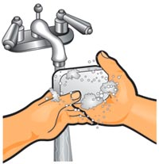
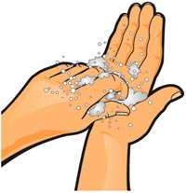
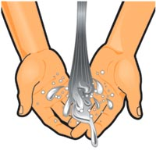
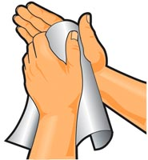
Preventing Food-borne Illness
CLEAN hands, surfaces and produce!
  Hands:
Wash hands with hot, soapy water.
Scrub hands, wrist and fingernails for at least 20 seconds.
Rinse with hot water.
Dry with a paper towel.
Wash hands before and after handling food; and after using the bathroom, handling pets, or changing diapers.

Slide 24
Preventing Food-borne Illness
CLEAN hands, surfaces and produce!
  Surfaces:
    Use paper towels to clean kitchen surfaces (throw
    germs away).
    Wash cutting boards, counters and utensils with hot, soapy water.
    Wipe up spills in the refrigerator, microwave and stove immediately.
  Produce:
    Wash raw produce under running water. Use a small vegetable brush to remove surface dirt.
    Cut away any damaged or bruised areas.

Slide 25
You’re the Expert
You are invited to a party at a friend’s house. Your friend has been preparing snacks, but you become concerned with some of his food preparation.
In small groups discuss why the following are hazardous:
  He makes a meat dish and potato salad, and leaves them sitting on the counter for over 2 hours.
  He grills hamburgers that are still pink on the inside.
  He uses the same knife and cutting board to slice chicken and to chop lettuce.

Slide 26
Kitchen Safety Quiz
Answer to the following questions:
1. What is one way you could get cut in the kitchen?
2. What is one way you could get burned in the kitchen? How can you avoid getting burned in that way?
3. What should always be readily available in the kitchen in case of an emergency?
4. Always _____ and _____ knives separately.
5. What are the symptoms of food-borne illness?

Slide 27
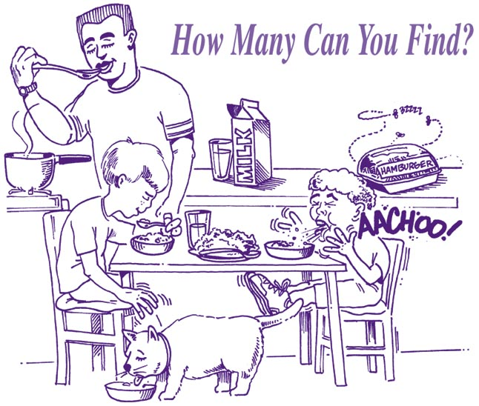
What’s Wrong in this Picture?

Slide 28
Applying What You Know
Create a kitchen safety poster for your kitchen at home. Identify the major causes of accidents in the kitchen and include emergency phone numbers.
Interview a local firefighter about his or her experience with kitchen accidents. Ask for additional tips and words of advice on preventing kitchen fires and other accidents. Write about your findings.
Make a safety flyer outlining the ways
to make the kitchen childproof.

Slide 29
Exploring the Web
Here are some suggested sites you and your class may want to investigate for more information on safety in the kitchen.
  http://www.cdc.gov/niosh/nasd/menus/tophome.html
    NASD Home Safety.
  http://vm.cfsan.fda.gov/~dms/fdkitchn.html
    FDA Can your kitchen pass a safety test?
  http://www.cdc.gov/niosh/nasd/docs3/me97019.html
    NASD Kitchen Safety.
  http://www.foodsafety.gov/~fsg/kitchen.html
    Food safety tips.
  http://www.fightbac.org
    Food Safety.
Teachers: Please note that these addresses are constantly changing and being updated. You may need to revise this list.

