Slide 1
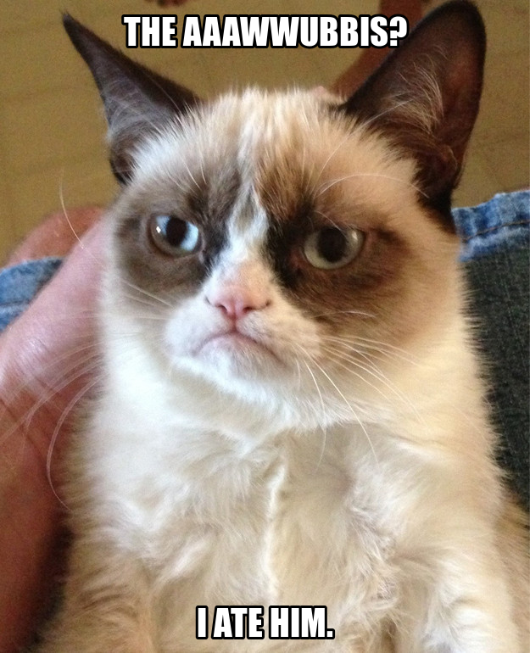
AAAWWUBBIS
After
Although
As
When
While
Until
Because
Before
If
Since
Subordinate Conjunctions

Slide 2
Not a sentence. A sentence part.
…but would make a great title!
“As the World Turns” –TV Soap Opera
While I Was Gone by Sue Miller
Because of Winn-Dixie by Katie DiCamillo
“Since You’ve Been Gone” –Kelly Clarkson

Slide 3
To use a comma, not to use a comma…that is the question.
Always if it’s the opener!
Sometimes when it’s a closer –
  non-essential, no
  essential, yes

Slide 4
Let’s Practice Commas
Since you won’t call me anymore. I don’t want to talk to you at school either. If you call me tonight. We’ll see about tomorrow.

Slide 5
Your turn!
Exit Ticket
Mayor Brooks faced challenges.
He groaned.
The operator’s manual did not help.

