Slide 1

Monday
April 13, 2015
Warm Up: Jot these notes down in Writer’s Notebook:
The VERB is the most important part of sentence.
Expresses action or state of being (“am”, “became”).
If a word is a verb, it has an “ing” form.
Can be ACTION or LINKING.
VERB PHRASE consists of main verb an any helping verbs that go with it. Max number of words in a verb phrase = 4. (will have been singing)
Adverbs can interrupt phrase. May have a compound verb.
Agenda: Idioms

Slide 2
Idiom Poster
Name on front
Title is the idiom phrase
Give figurative (actual) meaning of idiom
Write a brief paragraph describing idiom and using it correctly in sentence.
Illustrate literal meaning.

Slide 3
Graffiti & Poetry
If you had ONE message to tell the world, what would it be? Make it a visual “shout out” graffiti-style.
Then, write a poem to explain your art/message.
  At least 5 lines
  Any form (free verse, rhyme scheme, limerick)
Materials: use manila paper, markers, map colors, or chalk at tables.
Due Monday, April 6th

Slide 4
Project Instructions
Join Animoto group I give each table: crownover2@gaggle.net to crownover12@gaggle.net and password is Cowboys
Create video.
Preview video BEFORE producing (publishing).
Hit “Link” (icon on right side) and copy URL.
Log in to Edmodo. Go to Assignments page.
Copy link onto Assignment.

Slide 5
Capitalization Rules Posters
Write name(s) on back in pencil.
Write group of capitalization rules presented.
For each example on green sheet, write your own example. Edit for other conventions!
Make your rule visual for audience.

Slide 6
The Chair
2nd period Jess Holbert
3rd period Mattie Hernandez
Advisory
5th period Macy Roque
7th period Macen Bird
8th period Dina Persons

Slide 7
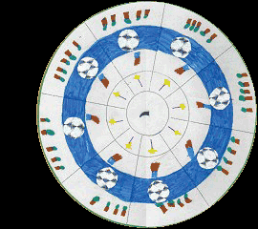
“Dragon’s Claw”
Ashley Knox — Surrey Hills Primary 3R
A sharp, pointed Dragon’s Claw,
Tapped by a bright, glistening wand,
Held in the hand of a tiny, delicate fairy,
Beside a magical, crystal ball,
In a faraway forest.

Slide 8
Hard-Earned Humor
9. A – 17 F – verb form – have fell to have fallen
10. C – 17H – pronoun case – her to she
11. A – 17E – prepositional phrase
12. C – 16C spelling
13. D – 17B – conjunctions to connect ideas
14. A – 17C – subject/verb agreement – appear to appears
15. C – 18C,D – revise by adding or deleting text
16. A – 17D – adjectives and adverbs – change fewer to few

Slide 9
Letter Writing
Criteria
Sample
Write a letter to Prejudice
Explain to him that you are breaking up with the idea
Give two reasons
Provide salutation
Dear Prejudice,
I am breaking up with you. Dhfjdhfdjhfjdhfdjfhdjh
One reason is rueirueirueidskjf.
Another reason is jkdjfkdfjdkj.
Closing sentence.
Sincerely,
Kind regards,
Warmly,
Student Signature

Slide 10
What the What?
How is the plural form of penny spelled?
What is wrong with this sentence:
  “Three out of four americans polled do not want to give up the penny.”
  - “Should We Get Rid of the Penny?”

Slide 11
What is this response missing?
I believe that we should get rid of the penny. Even though a penny is one cent, it costs two cents to produce. Another reason is that you have a better chance of getting cash back.

Slide 12
Anything missing? What do you like about this response? Any convention errors?
Although it’s money, the penny should be out of here! One reason is that the penny is worth one cent, but it takes two cents to make the near-worthless coin! This points to getting rid of pennies because it costs double the value to make one. Secondly, it’s only one cent, so finding a penny isn't as exciting as a quarter. This emphasizes getting rid of the penny because it’s nearly worthless and is a waste of time, you can’t buy anything with a penny. When looking at all of the possibilities, the penny should be out of our economy.

Slide 13
Anything missing? What do you like? What would you revise?
The us should keep making the penny. For instance, this article suggest that stores may round up the prices without it. This is not good because we would be paying more than needed, which could potentially badly impact our lives. Another good reason, is that the us has gotten along fine with making it. We haven't’ gone down in flames: we can manage to keep making it. These examples and more, are reasons why we should keep the penny. They’re an accurate way to measure money and also, fun to collect.

Slide 14
CEC paragraph outline
Sentence 1: State your claim.
Sentence 2: State your evidence.
Sentence 3: Explain your evidence (commentary).
Sentence 4: State your second piece of evidence.
Sentence 5: Explain your evidence (commentary).
Sentence 6: Wrap it up!

Slide 15
CBR Analysis
Work in table groups
Review CBR grading criteria FIRST
For each CBR student example, jot down three strengths and three weaknesses
Look over each CBR and rank in order of mastery (If you were the teacher, what grade would you give the paper?)

Slide 16
Nonsensical Poem
2 stanzas, 5 lines each
Use your wubbulous word
Create four more nonsensical words or borrow a classmates wubbulous word (must use same part of speech & definition)
Create key for words (part of speech & definition)
  Ex. Fiddlydiddlystickies – adj. crazy, delusional
Draft in Writer’s Notebook

Slide 17
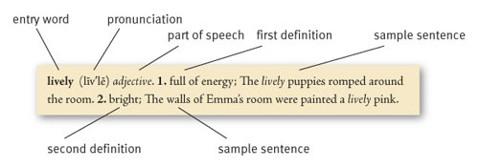
Wubbulous Words
Draw a letter from the snowman paper bag.
Use that letter to create your own wubbulous (made up) word.
Write it like a dictionary entry:
  spelling
  syllabication
  pronunciation
  part of speech
  definition

Slide 18
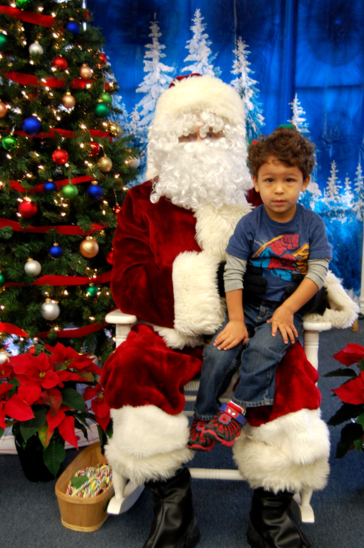

Slide 19
Unit 2 Answer Key
B
B
A
C
A
D
A
B
A
B
D

Slide 20
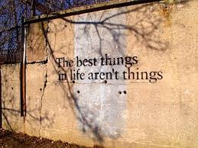

Slide 21
Persuasive Writing
Advertisements worked hard to persuade their audiences to buy a particular product.
Choose a product to advertise (toy, game, food, book)
Draw an advertisement
Create catch phrase
Use logical, emotional, and moral appeals
Use at least one propaganda technique

Slide 22
  Expository
  Prompt
READ the following quote:
“The man who does not read good books has no advantage over the man who cannot read them.”
– Mark Twain
THINK carefully about the following statement.
Reading is the most important skill a person can learn. People who are able to read well are much more likely to be successful than people who cannot.
WRITE an essay explaining why reading is such an important skill.

Slide 23
Expository
Prompt
Highlight your CLEAR controlling (main) idea
Show someone at your table to double check
Revise for sentence fluency:
  Underline simple sentences in red.
  Underline complex sentences in yellow.
  Underline compound sentences in blue.

Slide 24
Types of Writing
Personal narrative
Creative writing
Informational
  Compare & contrast
  Persuasive (Enhanced)
  Expository

Slide 25
Rough Draft
Strong thesis
Arguments are effective; have solid facts/examples to support
Strongest argument at end
Solid conclusion

Slide 26
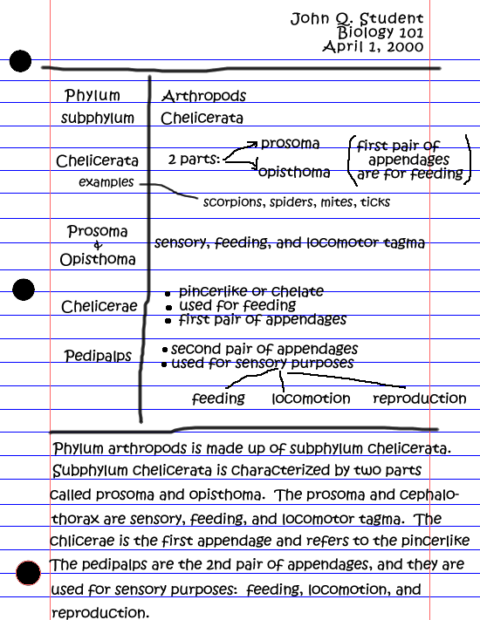
Cornell Notes
Must have three pages of Cornell Notes
  print
  online
  database (Library, Teaching Units, Death with Dignity)
Must have MLA citation for each
Rubric
  notes, 30 pts
  key words, 20 pts
  summary, 50 pts

Slide 27
If There Were an Olympic Contest for Sentence Imitating
If there were an Olympic contest for talking, Shelly Stalls would sweep the event.
Flipped (2001) p. 16
If there were an Olympic contest for ________, ________ would sweep the event.
If there were an Olympic contest for leaving stuff in my room, Coach Eason would sweep the event.

Slide 28
CBR changes
Title will be MLA citation of book
Last name, First name. Title of Book. City of Publication: Publisher, Year of Publication. Medium of Publication.
Submit via Writer Key: CBR, Unit 2, Teen Issue
Weekly book/reading checks – you’ll bring your book to class EVERY Friday.

Slide 29
Grammar Monster Contest
With the simple sentence provided to your table, add the following:
adjective to modify a noun
adverb to modify a verb
prepositional phrase to show location
appositive phrase to rename a noun
adjectival phrase to describe noun
If time allows, you may make a visual interpretation of your sentence.
All names of group members should be on front of poster.
All classes will vote Monday morning during Warm Up.

Slide 30
Grammar Monster Contest
With the simple sentence provided to your table, add the following:
adjective to modify a noun
adverb to modify a verb
prepositional phrase to show location TEK 7.19 A (v)
appositive phrase to rename a noun TEK 7.19 A(ii)
adjectival phrase to describe noun TEK 7.19 (iii)

Slide 31
Choosing your composition final publication:
Ask yourself:
  Which one was revised the most.
  Who’s my audience? (Teacher)
Get three peers’ opinions.
Make a decision before you leave class today.
You may take home over weekend to rewrite or give final touches.

Slide 32
What’s good writing?
Keep it small. Broad topics tell too mucha and aren’t focused. Skinny it down, use details to describe ONE idea.
Surprise your reader with what you know. You know something that others may not know about a particular topic.
Make your ideas crystal clear. Instead of “Our trip was exciting”, “I chased two very hungry black bears away from our camping supplies.”

Slide 33
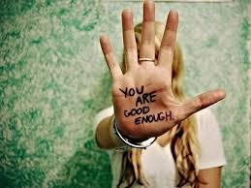
What things have my hands held or experienced that remind me of stories I want to write?

Slide 34
Poetry Friday Anthology
Notes
Rhymes
  End rhymes (thing/ring)
  Slant (almost) rhymes (start/short; today/train)
  Unrhymed couplets (ending with red/everyone; guitar/band)
You try:
Start a three stanza poem with this couplet:
Another new year:
Another new start.
You may work in pairs or alone.

Slide 35
Quarter 1 Pre-Test Answer Key
2. B
3. D
4. B
5. A
6. D
7. C
8. C
9. B
10.A
11. D
12. B
13.D
14.C

Slide 36
Edmodo Codes for
Mrs. Miller’s classes
2nd period – exufie
3rd period – b46rbt
5th period – 7ucbwp
7th period – 57w4r7
8th period – uric6w

Slide 37
FreeWriting
Write. Just write. Keep your hand moving. The only wrong way to do free writing is not to write.
Experiment with spelling, punctuation, and grammar.
Go wherever your writing (thinking on a page) takes you. If another story comes to mind, maybe that’s what you should be writing about. Go for it.
Be specific.
Everyone has doubts about their writing. Allowing some writing to be garbage allows our writing to flow and good things to emerge (Elbow 1998a).

Slide 38
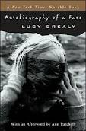
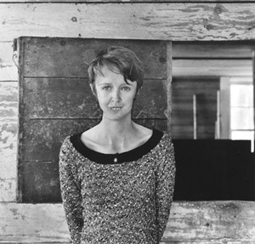

Slide 39
How do you think it affects others?
Why do you think people make fun of each other?

Slide 40
Bullying
Write about something you’ve done, experienced, or have seen happen. Start with the idea of bullying and go where the writing takes you.

Slide 41
Debate Topics
Should cigarette companies be allowed to target youth audience?
Should offensive words be banned in music, advertisements, etc.?
Should tanning beds be banned for kids under 18 years old?
Do colleges/universities spend too much money on athletics?
Should child beauty pageants be banned?
Does the U.S. have an obligation to safeguard the Ukraine?
Should orca shows be banned?
Should women be permitted in combat units?
Should the U.S. President be able to go to war without Congressional approval?

Slide 42
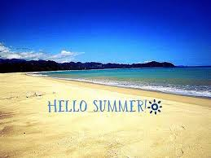
Exit Ticket
What was the most helpful strategy taught in class?
What was the least helpful?
What can I improve on as a teacher?
4. What did you like about this class?

Slide 43
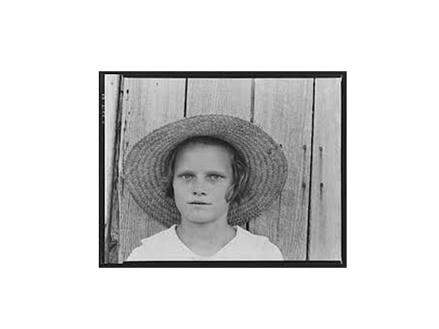
Symbolism and Connection Card
The phrase "out of the dust" appears several times in the book. At one point Billie Jo wants to escape "out of the dust," but later she says, "I can't get out of something that is inside me." How does the title of the book reflect on Billie Jo as a person? How does it reflect on the general experience of people at that time?

Slide 44
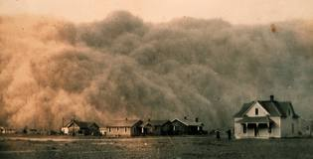

Slide 45

Green Eggs and Ham
Challenge
Dr. Seuss' editor bet him that he couldn't write
a book using 50 words or less.
He came up with Green Eggs and Ham —which uses exactly 50 words.
The 50 words, by the way, are:
a, am, and, anywhere, are, be, boat, box, car, could, dark, do, eat, eggs, fox, goat, good, green, ham, here, house, I, if, in, let, like, may, me, mouse, not, on, or, rain, Sam, say, see, so, thank, that, the, them, there, they, train, tree, try, will, with, would, you
Notes:
The Cat in the Hat was pretty simple, after all, and it used 225 words. Not one to back down from a challenge, Mr. Geisel

Slide 46
Dr. Seuss’ish Story
Criteria:
Subject is food
Rhyming words (make up words if necessary to form a rhyme)
50 words or less (different tense of a word is a different word)
Create an illustration to represent theme of story

Slide 47
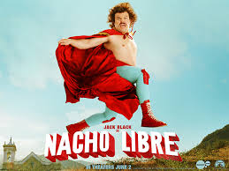

Slide 48

Ticket
What did I learn about myself today working in a group?
What is something I learned about the research topic?
Answer in complete sentences!

Slide 49
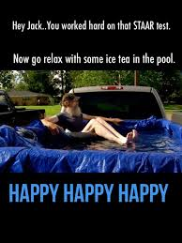

Slide 50
Examples of absolute phrases
Legs quivering, our old dog Gizmo dreamed of chasing squirrels.
Her arms folded across her chest, Professor Hill warned the class about the penalties of plagiarism.
We devoured Aunt Lenora's carrot cake, our fingers scraping the leftover frosting off the plates.

Slide 51
Misused Words
whole vs hole
since vs sense
lose vs loose
herd vs heard
were vs we’re

Slide 52
Spelling Quiz
The _____ spoke aloud with the other _____ in her support group.
For _____, in a few _____ everything can change.
I would _____ the invitation _____ I am busy.
4. The _____ had _____ with the busy doctor.

Slide 53
Questions for Thoughtful Reflection About a Memory
1. Why did you pick this moment?
2. What part of your personality has changed because of this moment?
3. Which of your values became clearer because of this moment?
4. How was this moment a pivot point in your life?
5. Now, looking back, what do you see that you didn’t see before?
6. What questions did this moment raise for me?
7. What questions did this moment answer?
8. How has this moment helped me become who I was then? Or who I am now?

Slide 54
Using Commas Between Adjectives
Use commas to separate adjectives of equal rank.
  Can use “and” between each adjective
  Order of adjectives can be changed
Bianca made a simple, polite request.
Do not use commas to separate adjectives that must appear in a specific order.
Some colorful birds perched on the roof.
Do not use a comma to separate the last adjective in a series from the noun it modifies.
We walked on a long, twisting, scenic road.

Slide 55
Let’s Practice!
We live in a red brick apartment building.
Charles prefers his sturdy old bicycle to his brother's shiny new one.

Slide 56
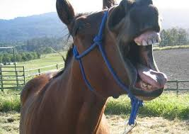
Tips from the horse’s mouth
Clearly defined focus and communicates the importance of or reasons for actions and/or consequences
Personal narratives must be realistic in nature. No obvious “fantasy” papers.

Slide 57
Overwhelming stress, headaches, confusion, and darkness. These are just a few of the memories of the time I made the most difficult decision in my life.
It was five o’clock on a school morning when my mom told me I would have to do my hair, get dressed, and get to the bus stop once she left to go visit my sister in the hospital. The only problem with that, was the fact that did not know how to do my own hair.
As soon as I got dressed, I called my mom on her cell phone. I tried telling her that I could not do my hair so I could not go to school. In her response, she told me that if I did not go to school, I would suffer consequences. I was in a pickle. I did not know whether to stay home or go to school. Since I tried to do my hair and I became late for the bus, I decided not to go to school. Later that day when my mom made it home, she told me I was in deep trouble. When I sat down to tell her about my situation, she sounded like she was frustrated with me, but I was wrong. It turned out that my mom gave me mercy. She told me that all I had to do was to apologize, so I did from the bottom of my heart.
Ever since that morning, I have always seen the mercy in the eyes of my parents. I learned that if I ever had to make a decision like that again, to go through with the hardest decision for me. In this case, it was doing my hair and going to school. The fact is that the most difficult decision turned out to be the decision I should have made.

Slide 58
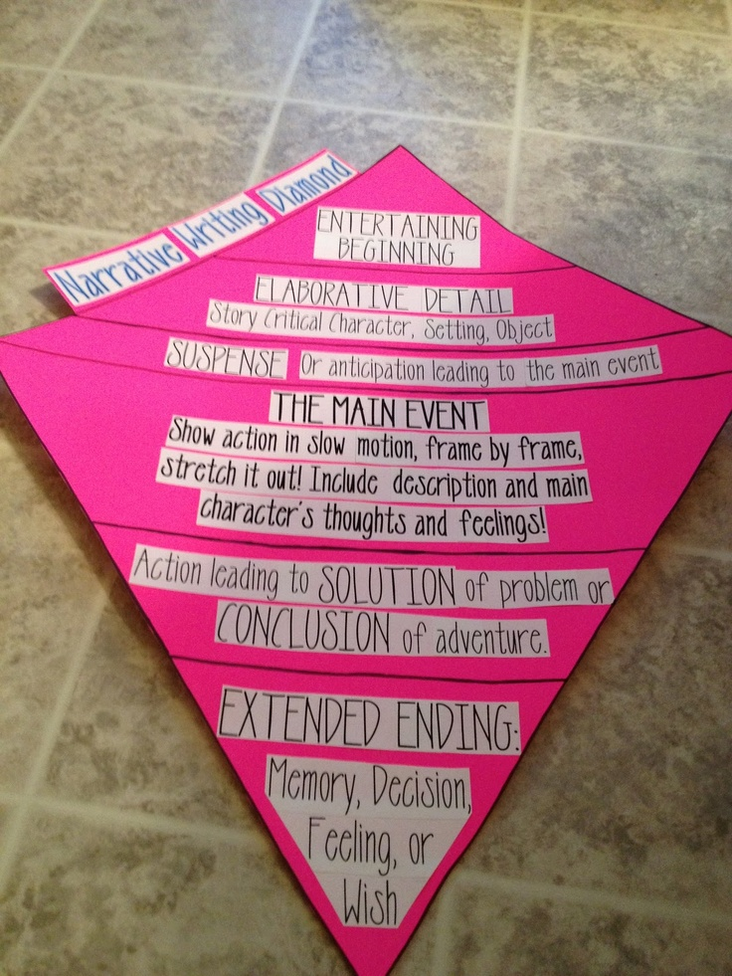

Slide 59
More Confusing Spelling Words
accept/except
woman/women
instance/instants
patience/patients

Slide 60
Confusing Words Quiz
______ or not you decide to stay is up to you.
From the looks of it, she is as unpredictable as the Texas _____.
Were you _____ entrance into the school for morning tutorials?
The judge read _____ the punishment that was given to the convicted criminal.
_____ way did they go?
With red eyes, green skin, and a pointy black hat, the _____ hoisted herself on her broom and flew away.
Running to second base, the baseball player _____ realized his mistake.
I’d rather have Coke _____ Dr. Pepper.

Slide 61
Confusing Words Quiz
______ or not you decide to stay is up to you.
From the looks of it, she is as unpredictable as the Texas _____.
Were you _____ entrance into the school for morning tutorials?
The judge read _____ the punishment that was given to the convicted criminal.
_____ way did they go?
With red eyes, green skin, and a pointy black hat, the _____ hoisted herself on her broom and flew away.
Running to second base, the baseball player _____ realized his mistake.
I’d rather have Coke _____ Dr. Pepper.
Word Bank
allowed/aloud
which/witch
then/than
weather/whether

Slide 62
parts of an exemplar expository essay
Explain
Connect
Remember (personal experience, be specific, use “I”)
So what?

Slide 63
4th Six Weeks Answer Key
Air Traffic Control
1. B
2. D
3. A
4. B
5. C
Your Amazing Brain
6. C
7. H
8. A
9. J
10. A
11.H
12. B

Slide 64
Homonyms Revisited!
Words
Activity
weather/whether
allowed/aloud
which/witch
then/than
Word used in context from mentor text.
If you can not find word example, create own sentence.
Part of speech
Definition

Slide 65
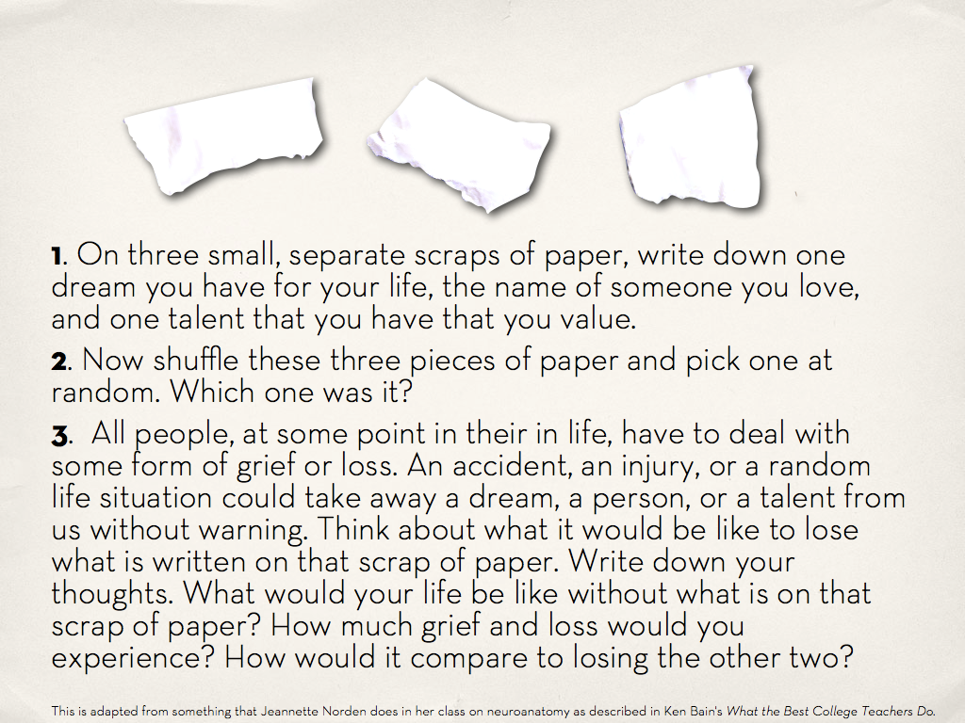

Slide 66
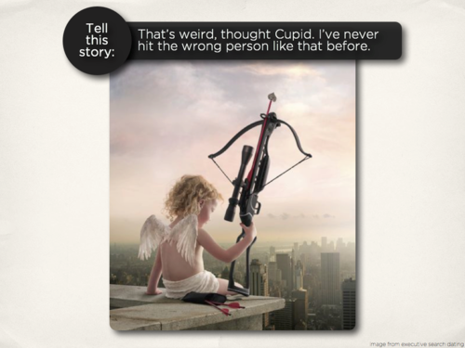

Slide 67
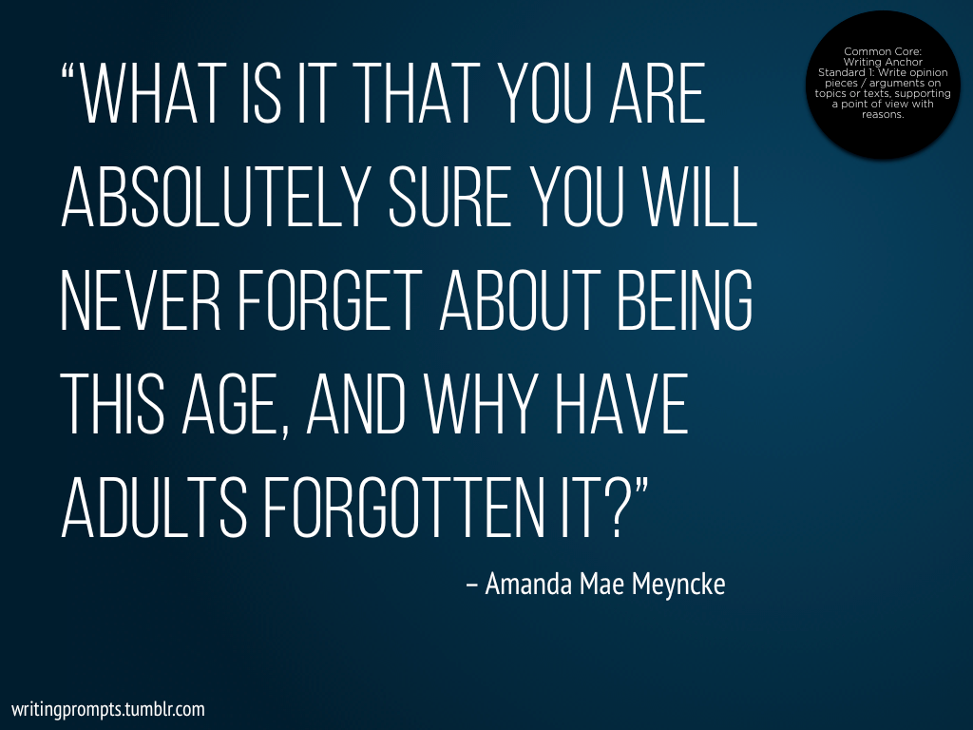

Slide 68
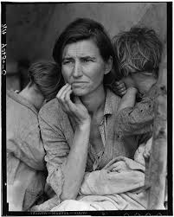

Slide 69
1. What do you hear? What do you smell?
2. What are the (visual) details? What do you see?
3. What is going on? What are the thoughts of the mother? What are the thoughts of the children?
4.What is the theme? One word.

Slide 70
What do you hear? What do you smell?
What are the (visual) details? What do you see?
What is going on? What are the thoughts of the mother? What are the thoughts of the children?
4. What is the theme? One word.

Slide 71
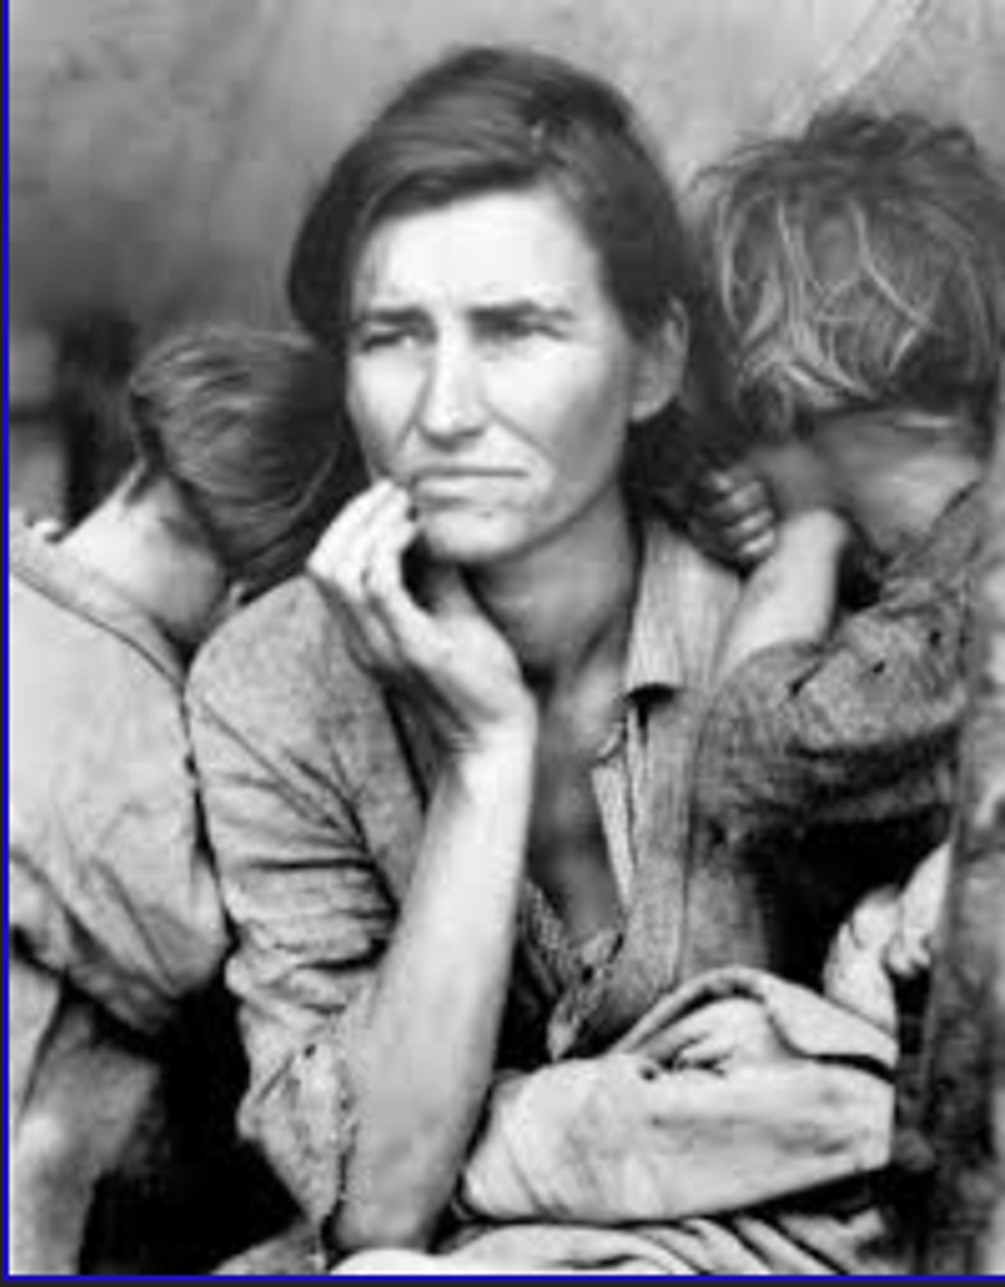

Slide 72
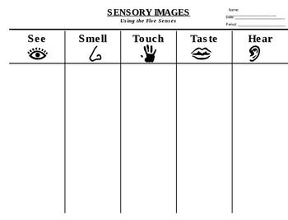

Slide 73
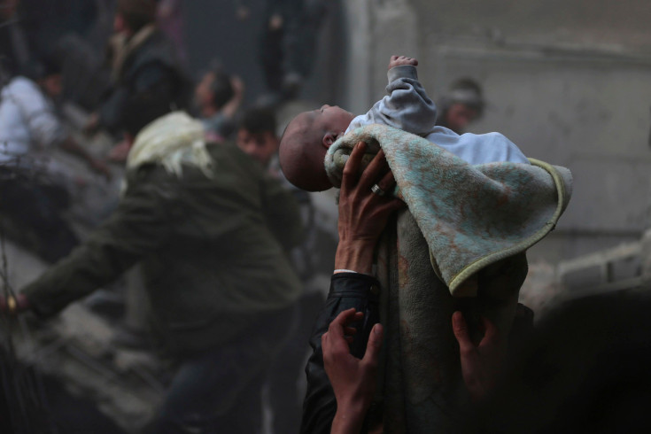

Slide 75
Word meaning
The doctor removed Alexa’s ___________.
Because of his debts, he was ____________.
The hard worker had high ____________.
The ____________ led the musicians.
The piñata was ___________ by a string.

Slide 76
RATIOCINATION
1. Draw a box around the first words of sentences. Change the word if you find that it is repeated.
2. Draw a circle around linking verbs and try to change your sentence into active voice.
3. Underline the subject once. Underline the verb twice. Check for subject/verb agreement in number. Also, make sure each sentence has a subject and a verb.
4. Draw a triangle around contracted words. Check to see that they have an apostrophe.
5. Do not divide words.
6. Highlight all conjunctions in a light color. Check to see what they are combining. Only use a comma in front of the conjunctions (FANBOYS) if they are used to combine two independent clauses.

Slide 77
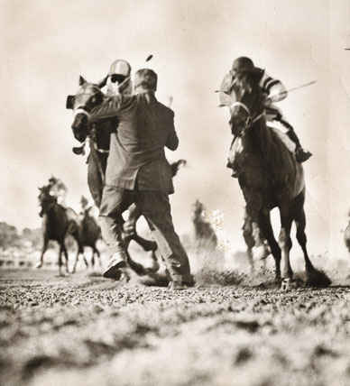

Slide 78
hyphens
Indicates that two words should be thought of as one, especially when using two adjectives or groups of words that area acting as a unit.
Join compound adjectives before a noun (hard-working student)
Join compound nouns and two-word and multiple-word concepts (mother-in-law; skin-deep)
Add a prefix to a word when clarity is needed or to avoid doubling vowels (anti-intellectual)
Divide lettered words (t-shirt)
Divide a word between syllables at the end of a line: (When in doubt about hyphen–
ation, check your dictionary)

Slide 79
TRUISMS from Matched
there is no joy without personal liberty
2. love is a mystery that can be embraced but never solved
3. eliminating free will creates a dystopia

Slide 80
Informative Prompt
In Cassia’s world, individuals are only allowed a single artifact, a treasure from the past. What can readers learn about Cassia’s world from the understanding that the Society only allows citizens one object from the past? If you were asked to select a single item to pass down to another generation, what would it be and why?

Slide 81
Informative Prompt
“Sleep hygiene” refers to the habits and environmental factors that affect the length and quality of your sleep.
What are some elements of good sleep hygiene?
What are some symptoms of insufficient sleep, from the article and your own experiences?
Most people know they should be getting more sleep. Why don’t they?

Slide 82
Look at the object at your table.
Describe it.
What does it look like?

Slide 83
Skip a line.
What is it used for?
Write as many different uses as you can think of for this object.

Slide 84
Skip a line.
What are its parts?
Think of as many different ways as you can to separate out parts of this object.

Slide 85
Skip a line.
What is it similar to?
Think of as many different things as you can that this object resembles.
What is it like?

Slide 86
Skip a line.
What can it cause?
Think of as many different things as you can that this item might possibly cause.

Slide 87
Skip a line.
This is the last part!
How has this item changed in any way?
How has it transformed?
What did it used to be in the past?
What could it change into in the future?

Slide 88
Cubing
How are you surprised at how much you found to say about this object?
Could these questions help you if you needed to talk about something?

Slide 89
Mentor Text
Every day was a happy day, and every night was peaceful. (p. 11)
-E.B. White, Charlotte’s Web
Celia says you’re in shock, but I think you’re just lazy. (p. 59)
-Nancy Farmer, The House of the Scorpion
You can pick your friends, but you’re stuck with family. (p. 1)
-Jeff Foxworthy, You Might Be a Redneck If…This Is the Biggest Book You’ve Ever Read
Hiccup leapt out of the way, but the sharp point of the blade pierced his shirt and tore a neat slice out of it. (p. 19)
-Cressida Cowell, How to Be a Pirate

Slide 90
Compound Sentence Graphic
for
and
nor
but or
yet so
Sentence
sentence

Slide 91
CBR notes
Don’t forget heading
Center title and author
Italicize book title
Page numbers
Left indent
Vary your connections
Conventions in your responses
capitalize proper nouns
combine sentences with ; or ,FANBOY

Slide 92
gone, went
Gone is the past participle of go and can be used as a verb only with a helping verb such as have or has.
Went is the past of go and is never used with a helping verb.
Incorrect James and Alice gone to the beach.
We should have went along with them.
Correct James and Alice went (or have gone) to the beach.
We should have gone along with them.

Slide 93
did, done
Remember that done is a past participle and can be used as a verb only with a helping verb such as have or has. Instead of using done without a helping verb, use did.
Incorrect I already done my English homework.
Correct I already did my English homework.
I have already done my English homework.

Slide 94
It makes me sad when…
The funniest thing that ever happened to me was…
I really get angry when…
The most exciting thing I ever did was…
The scariest thing I remember is…

