Slide 1
What have you been reading?

Slide 2
“The single factor most closely associated with reading achievement—more than socioeconomic status or any instructional approach—is independent reading.” --Stephen Krashen, The Power of Reading

Slide 3
Successful Testers Are Academic Readers
Presented by Bonnie McCormick, Anna Modrow and Rhonda Thomas, Denton ISD Middle School Librarians
Creative Contributions by Sherry Brandt, Kim Johnson, Donna Kearley, Kelly Korenek, Anna Modrow, Margarete Neale, Sandy Noles, Carol Richmond, Leslye Rosin, and Gloria Smith.
Library Harvest, October 3, 2013

Slide 4
Promotion of Books
Book Talks
Power Points:
Lone Star Power Point 2013
Binders
Series
SMS Series Binder Online
Genre
Notes:
Rhonda Thomas
Lone Star Power Point 2010 (Rhonda Thomas, Strickland MS)
Lone Star Power Point 2011 (Rhonda Thomas, Strickland MS)
Newbery Power Point (Sherry Brandt, HarpoolMS)
New Books Power Point (Carol Richmond, Wilson Elementary)

Slide 5
TV: Scrolling Announcements
Displays: Bulletin Boards, Chalk Rails, Display Cases, Shelves, Tables, Windows, Nooks and Crannies, Reading Doors
Notes:
Rhonda Thomas
Show spine labels
Add samples/links to slide
Embed PowerPoint image show to displays, and add the display PowerPoint to one of the frames

Slide 6
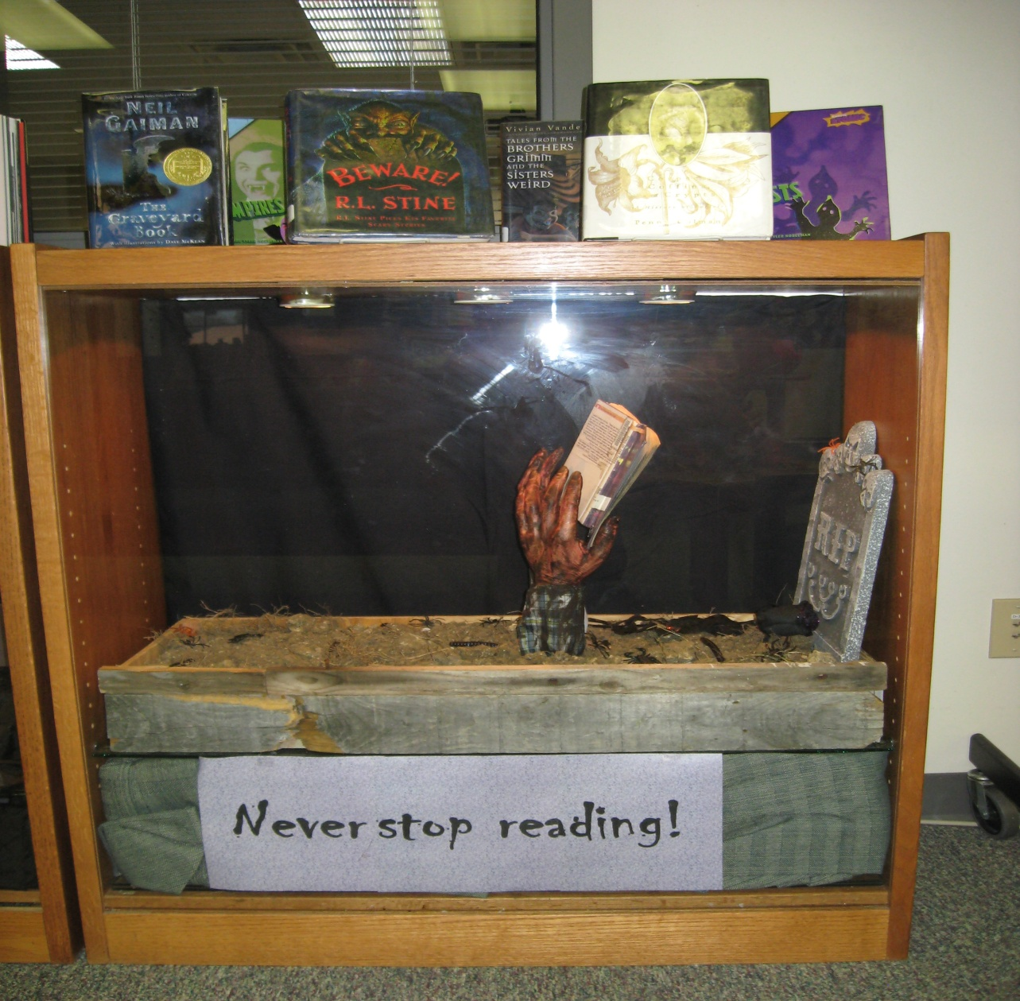
Display Cases

Slide 7
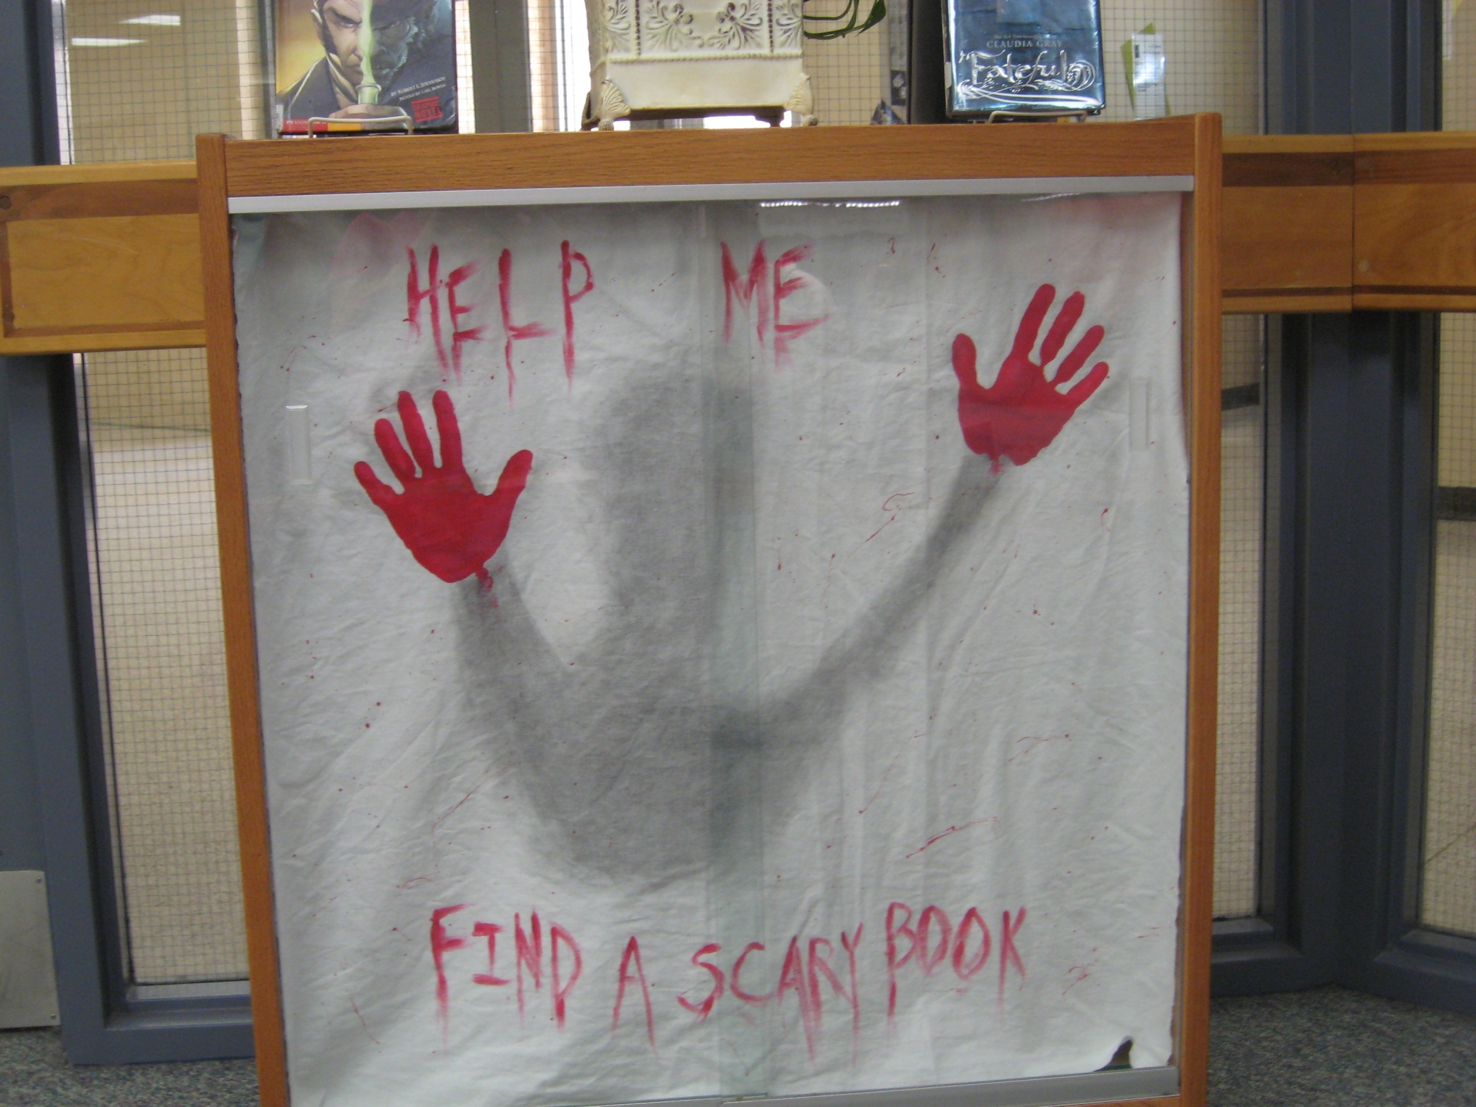

Slide 8
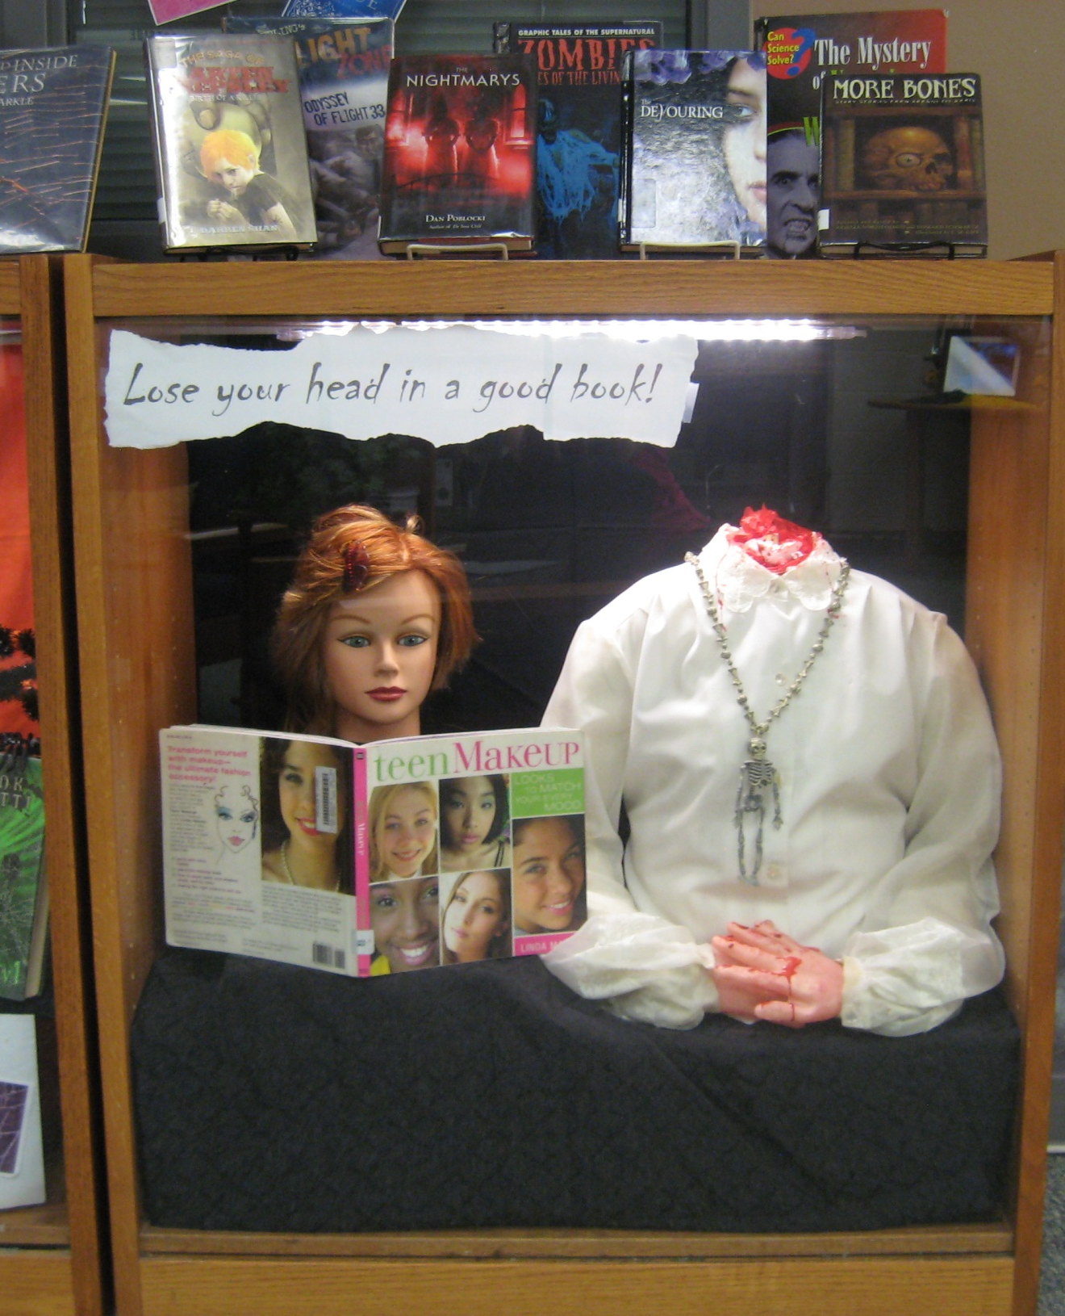

Slide 9
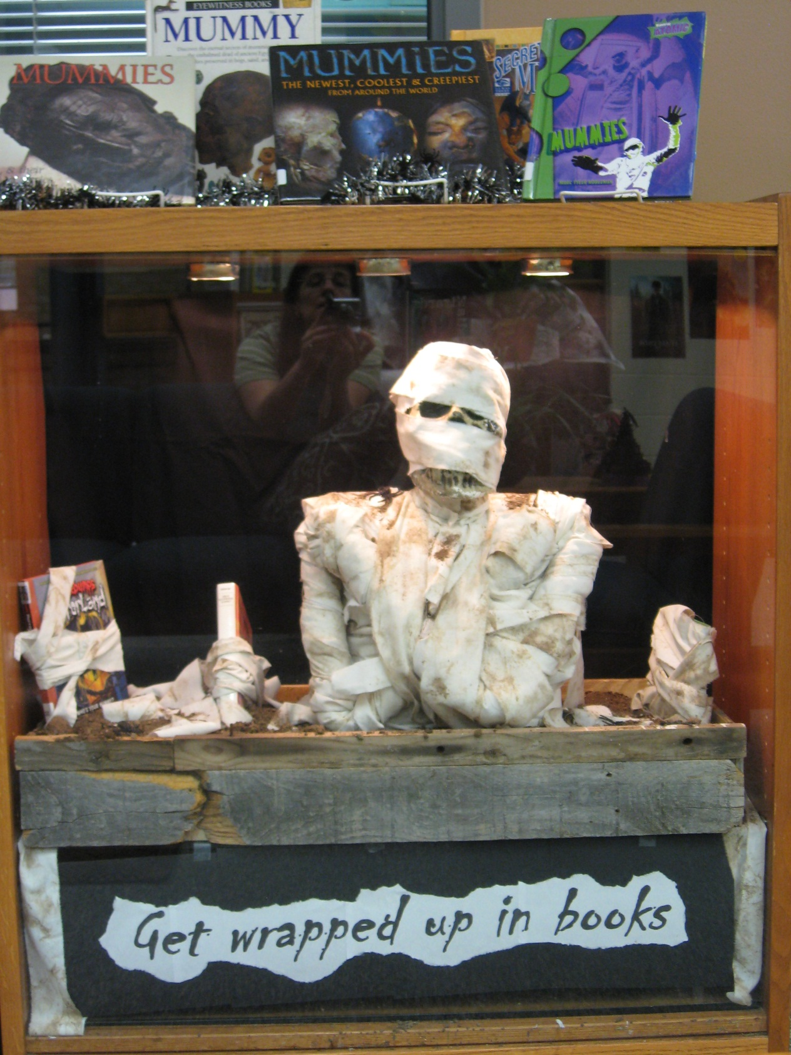

Slide 10
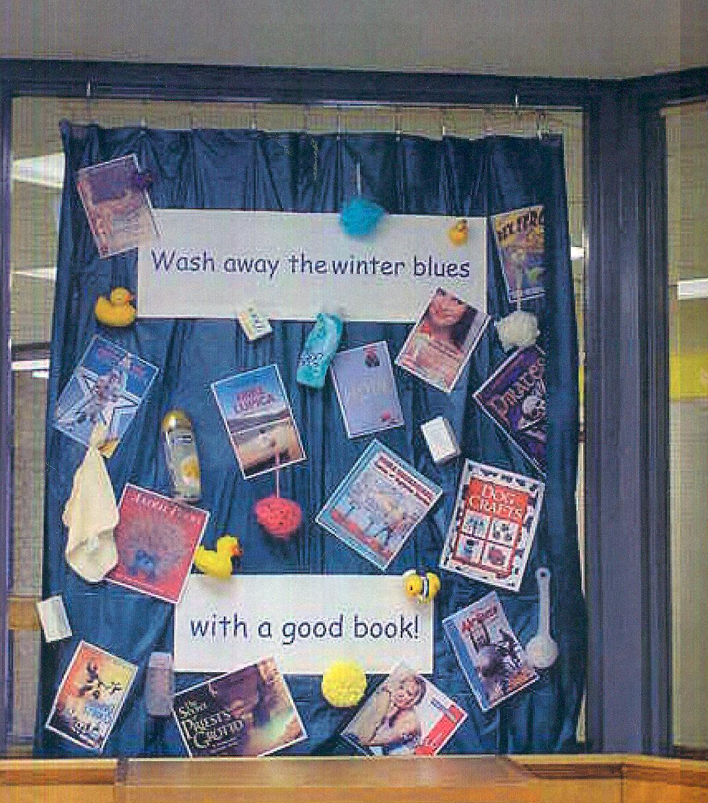
Windows

Slide 11
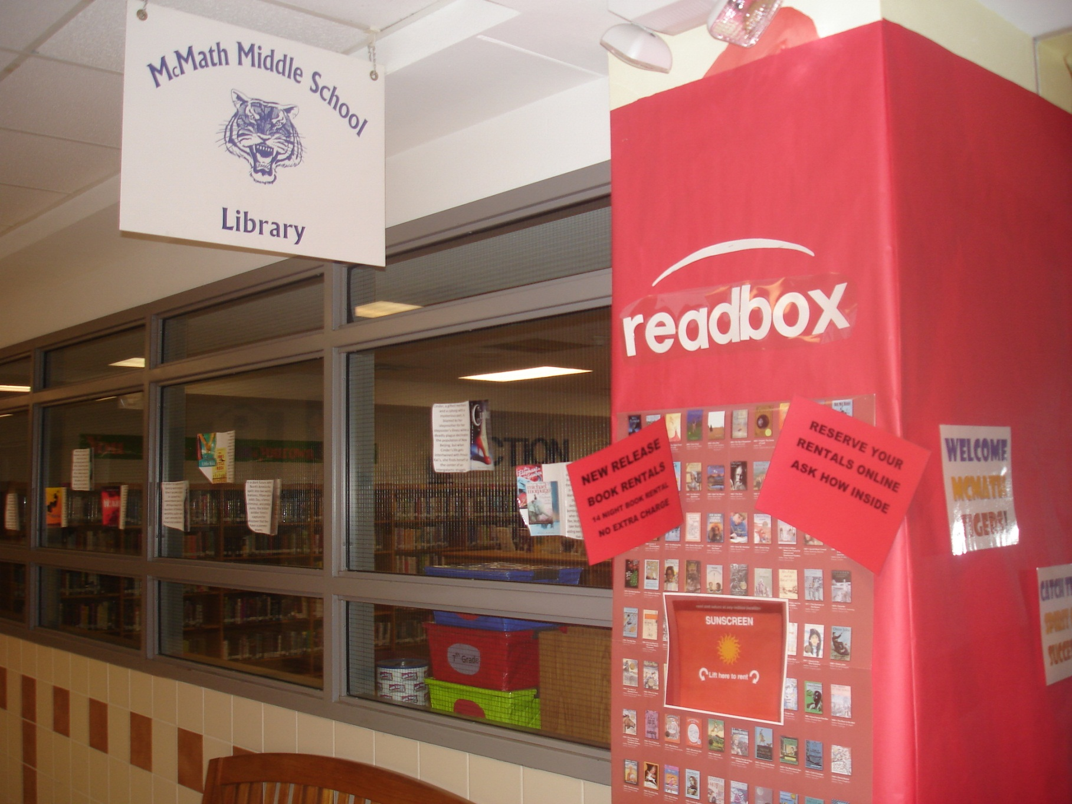
Get Creative…

Slide 12
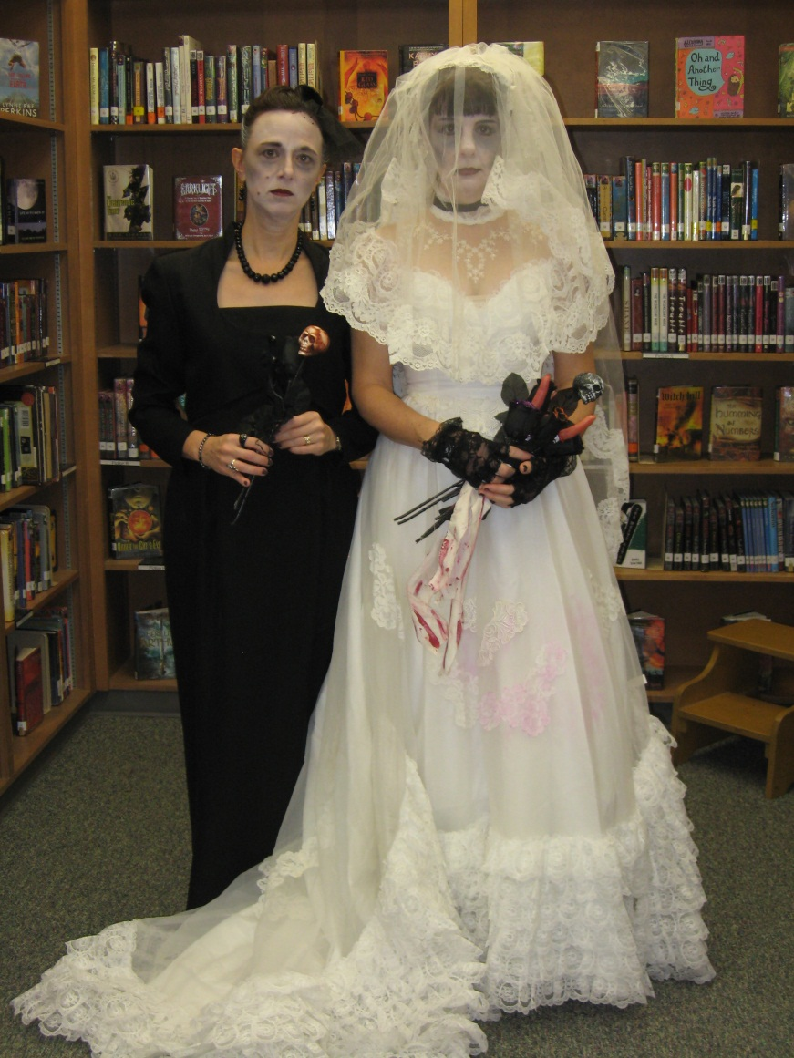
Don’t be afraid to look silly! The kids love it!!!!

Slide 13
“Choosing not to read is never discussed. It is simply not an option…I want my students to know that I see each of them as a reader.”
-- The Book Whisperer: Awakening the Inner Reader in Every Child, by Donalyn Miller (Classroom teacher at Northwest ISD and formerly of Keller ISD)

Slide 14


This is what we read:
http://www.bookwhisperer.com/
Notes:
Enjoyable experiences with text. It is all about the engaging quality of “Choice”

Slide 15
“Readers without power to make their own choices are unmotivated.”
--Donalyn Miller, The Book Whisperer: Awakening the Inner Reader in Every Child
Notes:
Rhonda reads quote

Slide 16
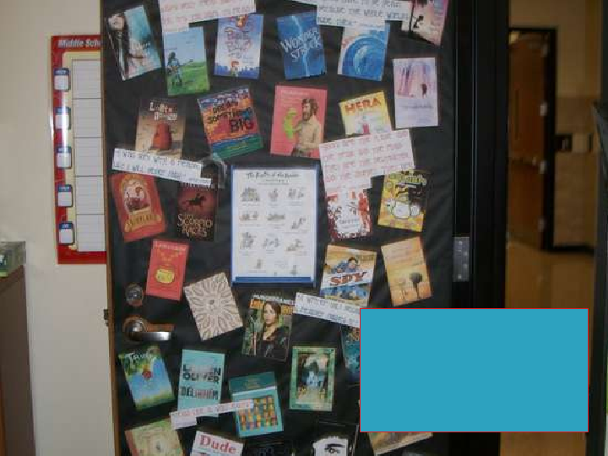
http://www.slideshare.net/Donalynm/2012-ccira-keynote-creating-classrooms-where-readers-flourish
Donalyn Miller 2012 Reading Door

Slide 17
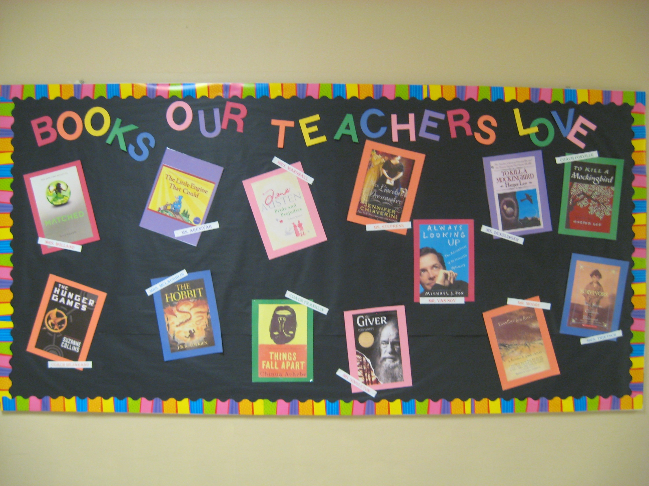

Slide 18
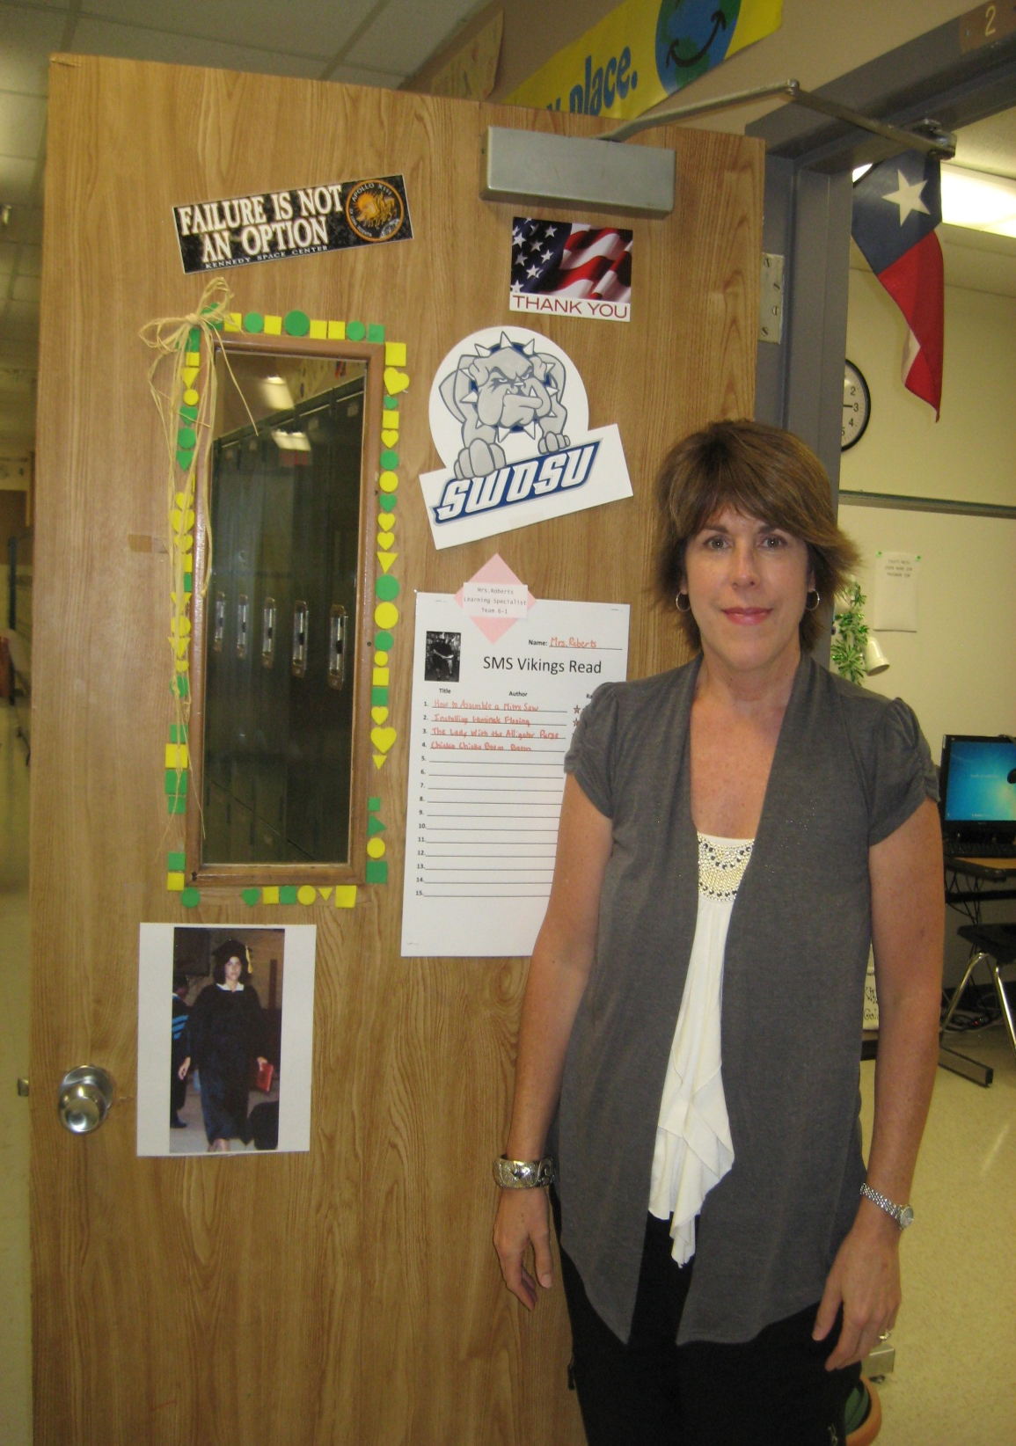
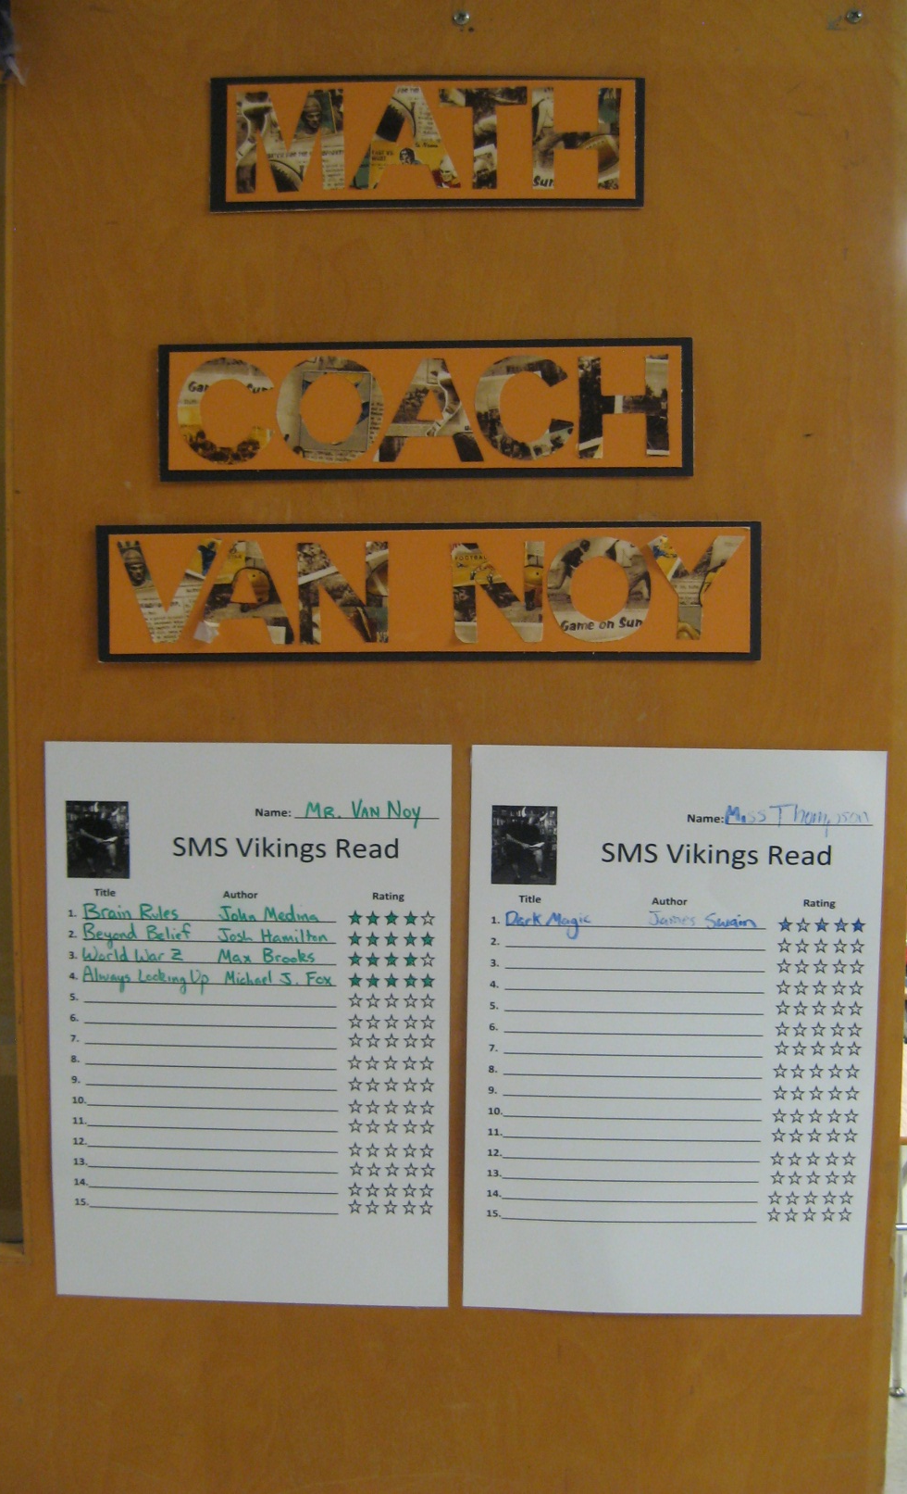

Slide 19
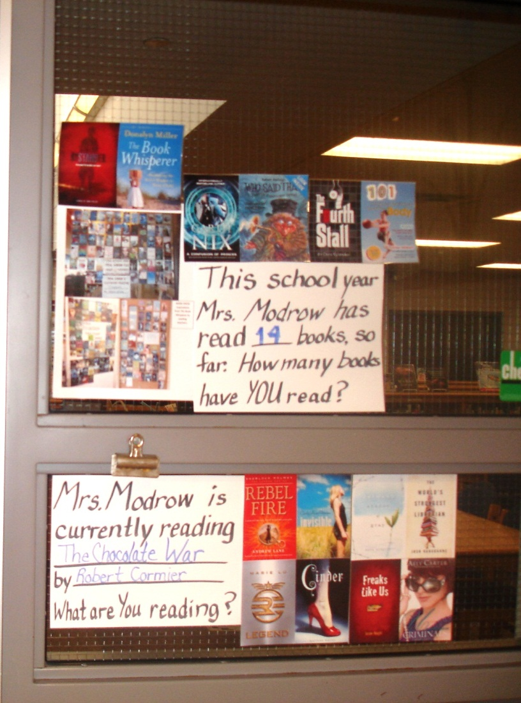

Slide 20
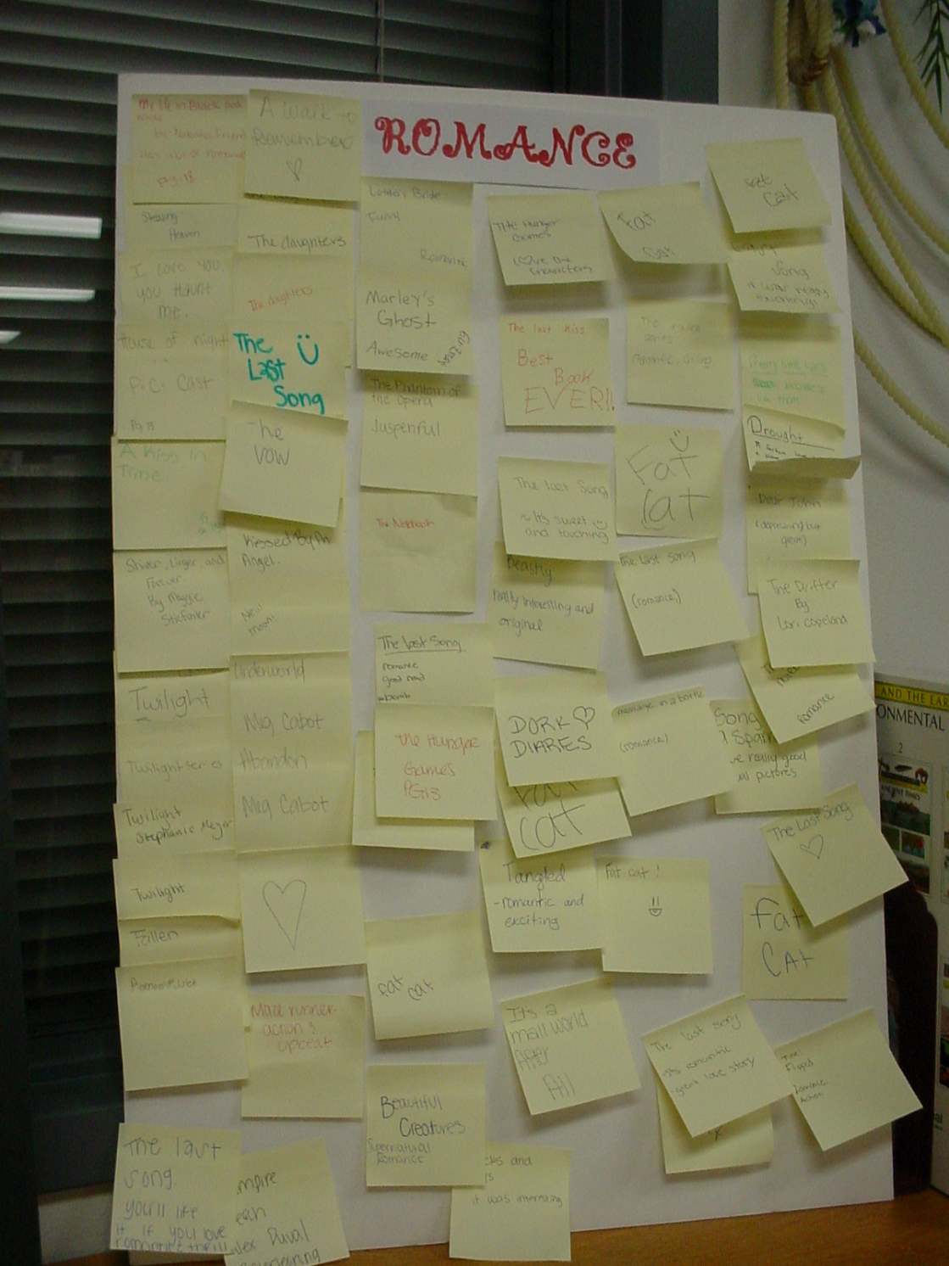
Suggestions from other students…

Slide 21
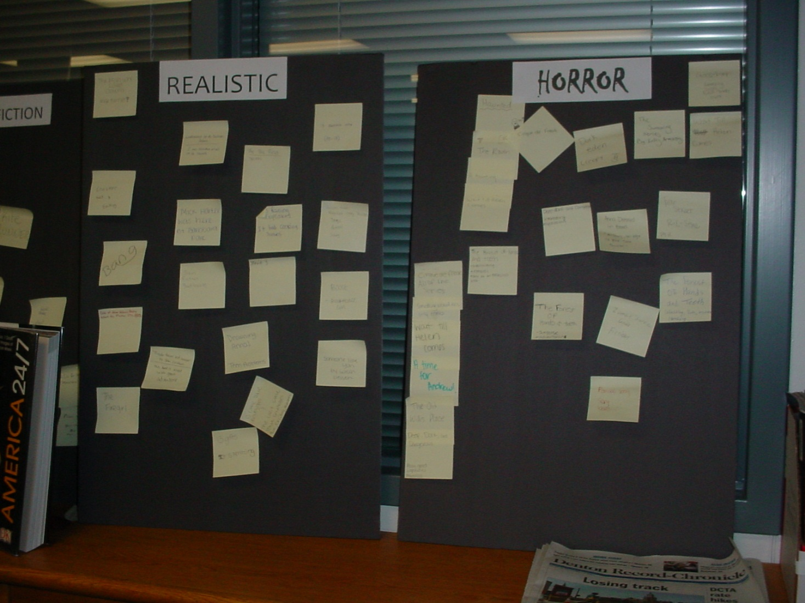

Slide 22
Our Goal is to Create Lifelong Readers
“…the amount of reading and response that my students do is the best preparation for this assessment (standardized testing in all subjects).”
--Donalyn Miller from The Book Whisperer
Notes:
Rhonda

Slide 23
Circulation Statistics…
Books Checked Out Books Renewed
August 2012: 437 57
August 2013: 1601 14
September 2012: 2854 179
September 2013: 3809 529

Slide 24
E-Books (BYOD, Bring Your Own Device)
Follett Shelf (Libraries buy individual e-books for students to check out)
StoryNory (Free e-stories)
TumbleBooks and TumbleBookCloud and TumblebookCloud Jr. (Paid Subscription very reasonable)
Storyline Online by the Screen Actor’s Guild (Free e-books)
Digital Downloads Denton Public Library (Check at your Local Public Library
Forgotten Books (Free E-Books)
Strickland Middle School E-Books

Slide 25
“Frequency of reading for pleasure correlates strongly with better test scores …”
-- To Read or Not to Read: A Question of National Consequence by the National Endowment for the Arts, November 2007

Slide 26
It is not enough to get them addicted to fiction! We have to take the opportunity to link their free-choice fiction to authentic literature.

Slide 27
Authentic Literature
Biography/Autobiograpy/Memoir
Magazines
Newspapers
Narrative Non-Fiction (True Short Stories)
The Entire Non-Fiction Section
Chalk Rail Example

Slide 28
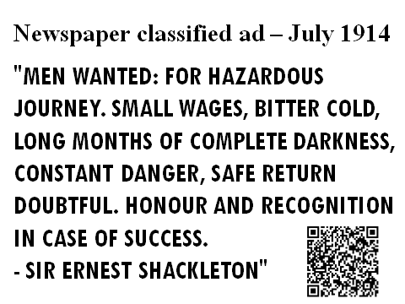

Slide 29





Thematic Paired Reading

Slide 30
There is so much more we would like to share. Alas, no time. The following slides will give you more examples and tools. You will find this power point on our website:

Slide 31
Authentic/Academic Reading
Curriculum Connections (Where are they low, what sections of your library can you focus on display)
Texas Explorers WebQuest: zunal.com (Sandy)
NASA Glogster: Space Shuttle (Sherry)
Paired Reading with the Lone Star List – LiveBinder ( Bonnie)
Explorers: Ernest Shackleton – (Bonnie)
Chalk Rail Display (QR Codes)
Magazines (Authentic Reading, Mental Floss)
Political Cartoons (Voicethread) (Bonnie)
The Great Depression (Animoto) (Bonnie)
Virtual Source Cards and Note Taking (Sherry Brandt)
Notes:
(Non-Fiction-Kelly Korenek, L.A. Nelson Elem. ) Kelly’s PP and Imbed video (Sherry)
Insert Bonnie’s Paired Reading sheet

Slide 32
Free, Web- Based Presentation and Book Promotion Tools
Edmodo(Social Networking, Blogging, Class Project Building Site) Crownover Library Website
Twitter
Instagram
iMovie

Slide 33
….continued
VoiceThread http://ed.voicethread.com/ (A VoiceThread is a collaborative, multimedia slide show that holds images, documents, and videos and allows people to navigate slides and leave comments in 5 ways - using voice (with a mic or telephone), text, audio file, or video (via a webcam)
Voki Website http://www.voki.com/ (Voki is a FREE service that lets you:
Create customized avatars. Add voice to your Voki avatars. Post your Voki to any blog, website, or profile.)
Shelfari http://www.shelfari.com/ (a way to display on your website books you have read and those you want to read)
booktrailersforall.com http://www.booktrailersforall.com (a great source for promoting books and reading
Glogster (a source for creating online posters. Sign up for Educator’s Version) http://edu.glogster.com/

Slide 34
Fantastic Fiction http://www.fantasticfiction.co.uk/ (a source list for new releases and classics. Great for use in building a classroom library)
YouTube http://www.youtube.com/results?search_query=Book+Trailers&aq=f (You can find many book trailers to promote reading and books on you tube) Always preview them.
Meet Me At the Corner (Virtual Field Trips, Chats with authors and poets) http://www.meetmeatthecorner.org/
http://bookbuilder.cast.org/ (a site to create, share, publish, and read digital books that engage and support diverse learners according to their individual needs, interests, and skills.)
http://ilearntechnology.com/ (An edublog about integrating technology into the classroom)
http://en.risingshadow.net/ ( Book Collection Building Site Risingshadow is one of the largest science fiction and fantasy book databases.)
http://education.weebly.com/weebly/userHome.php (Free Website Building for Classes)
http://tiaweeblyworkshop.weebly.com/

Slide 35
Tip Sheets
Book Talk Podcast Lesson Plan (Grades 3,4,5)
How to Create PhotoStory (All Level)
Photo Story 3 for Windows Tip Sheet (All Level)
Creating a Book Trailer (Story Board) (PDF File)
Creating a Book Trailer-Anna Modrow
Book Trailer Rubric-Anna Modrow
Tool For Reasoning Fair Use
Digital Picture Frame-Sherry Brandt
Prerequisite for Storyboard-Sandy Noles (PDF File)
Book Trailer Storyboard-Sandy Noles (PDF File)
MovieMaker Guide for book trailers-Sandy Noles
Book Trailer Project Checklist-Sandy Noles
Book Trailer Rubric-Sandy Noles (PDF File)
Saving Images from Creative Commons-Sandy Noles
Animoto: Movies in a Minute – Power Point – Bonnie McCormick Not Working
VoiceThread Tips – Bonnie McCormick Not Working
Tip Sheets and Spine Label Templates (Webpage to access all of the above)

Slide 36
Tip Sheets (Cont’d)
Book Trailer Contract: Anna Modrow
Tip Sheets\Book-trailerPS trimmed.doc-Anna Modrow
Tip Sheets\Book Trailer rubric-Moodrow.xlsx: Anna Modrow

Slide 37
Think about the how, why and where you can create a reading community on your campus as teachers and administrators.

Slide 38
“ What we have loved others will love, and we will teach them how.”
--William Wordsworth

Slide 39
Questions? Comments?

