Slide 1
What have you read this summer?

Slide 2
“The single factor most closely associated with reading achievement—more than socioeconomic status or any instructional approach—is independent reading.” --Stephen Krashen, The Power of Reading

Slide 3
Successful Testers Are Academic Readers
Presented by Bonnie McCormick, Anna Modrow and Rhonda Thomas, Denton ISD Middle School Librarians
Creative Contributions by Sherry Brandt, Kim Johnson, Donna Kearley, Kelly Korenek, Anna Modrow, Margarete Neale, Sandy Noles, Carol Richmond, Leslye Rosin, and Gloria Smith.
Tuesday, April 12, 2011
Lone Star TIA 2012, Denton, TX

Slide 4
Promotion of Books
Book Talks
Power Points:
Lone Star Power Point 2010
Lone Star Power Point 2011
Lone Star Power Point 2012
Newbery Power Point
New Books Power Point
Binders
Series
Sequels
Genre
Notes:
Rhonda Thomas
Lone Star Power Point 2010 (Rhonda Thomas, Strickland MS)
Lone Star Power Point 2011 (Rhonda Thomas, Strickland MS)
Newbery Power Point (Sherry Brandt, HarpoolMS)
New Books Power Point (Carol Richmond, Wilson Elementary)

Slide 5
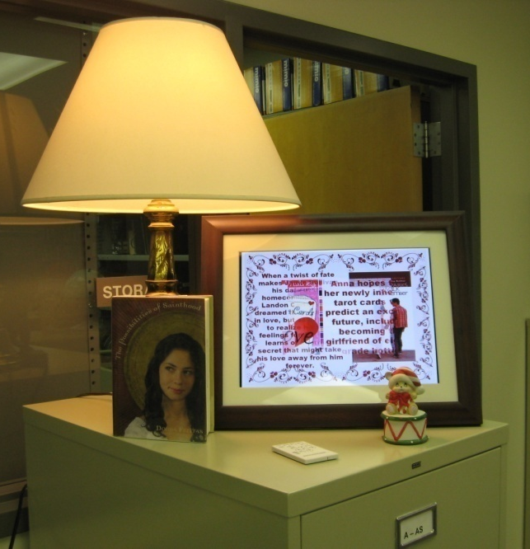
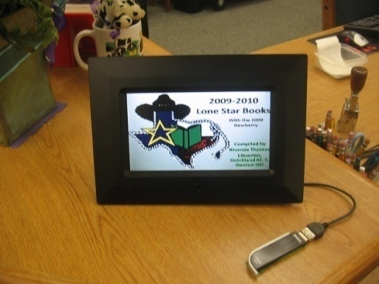
Digital Frames: Demo and Examples
Assignment Sheet
Notes:
Sherry Brandt
Physically show digital photo frames around the room and how they have been used in the classroom
Point out converting from ppt to jpg
Connect frame to computer (USB), use SD card, or flash drive to store media

Slide 6
“Choosing not to read is never discussed. It is simply not an option…I want my students to know that I see each of them as a reader.”
-- The Book Whisperer: Awakening the Inner Reader in Every Child, by Donalyn Miller (Classroom teacher at Northwest ISD and formerly of Keller ISD)

Slide 7
TV: Scrolling Announcements
Displays: Bulletin Boards, Chalk Rails, Display Cases, Shelves, Tables, Windows, Nooks and Crannies, Reading Doors
Notes:
Rhonda Thomas
Show spine labels
Add samples/links to slide
Embed PowerPoint image show to displays, and add the display PowerPoint to one of the frames

Slide 8
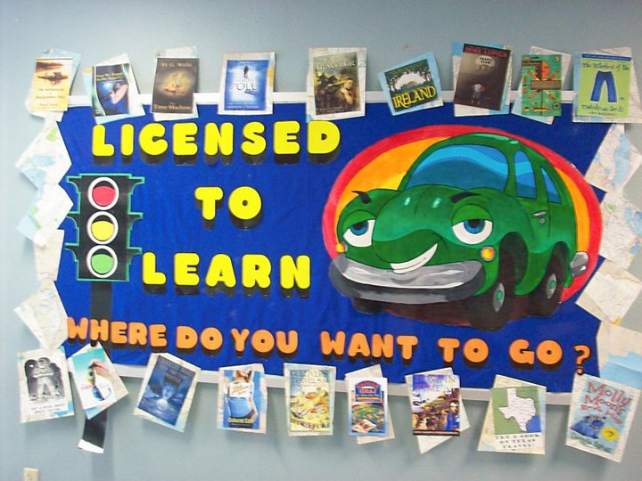
Displays: Bulletin Boards

Slide 9
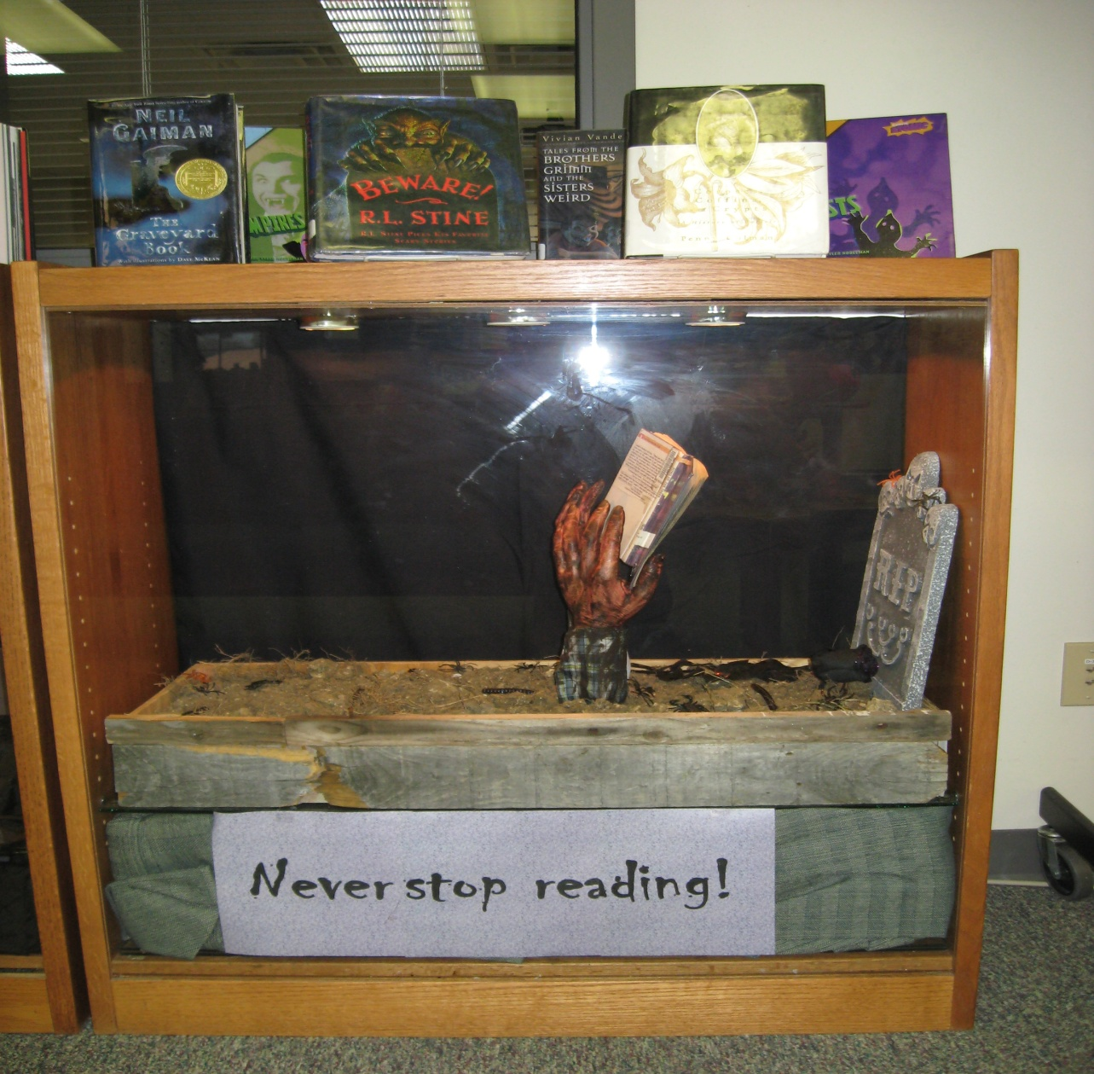
Display Cases

Slide 10
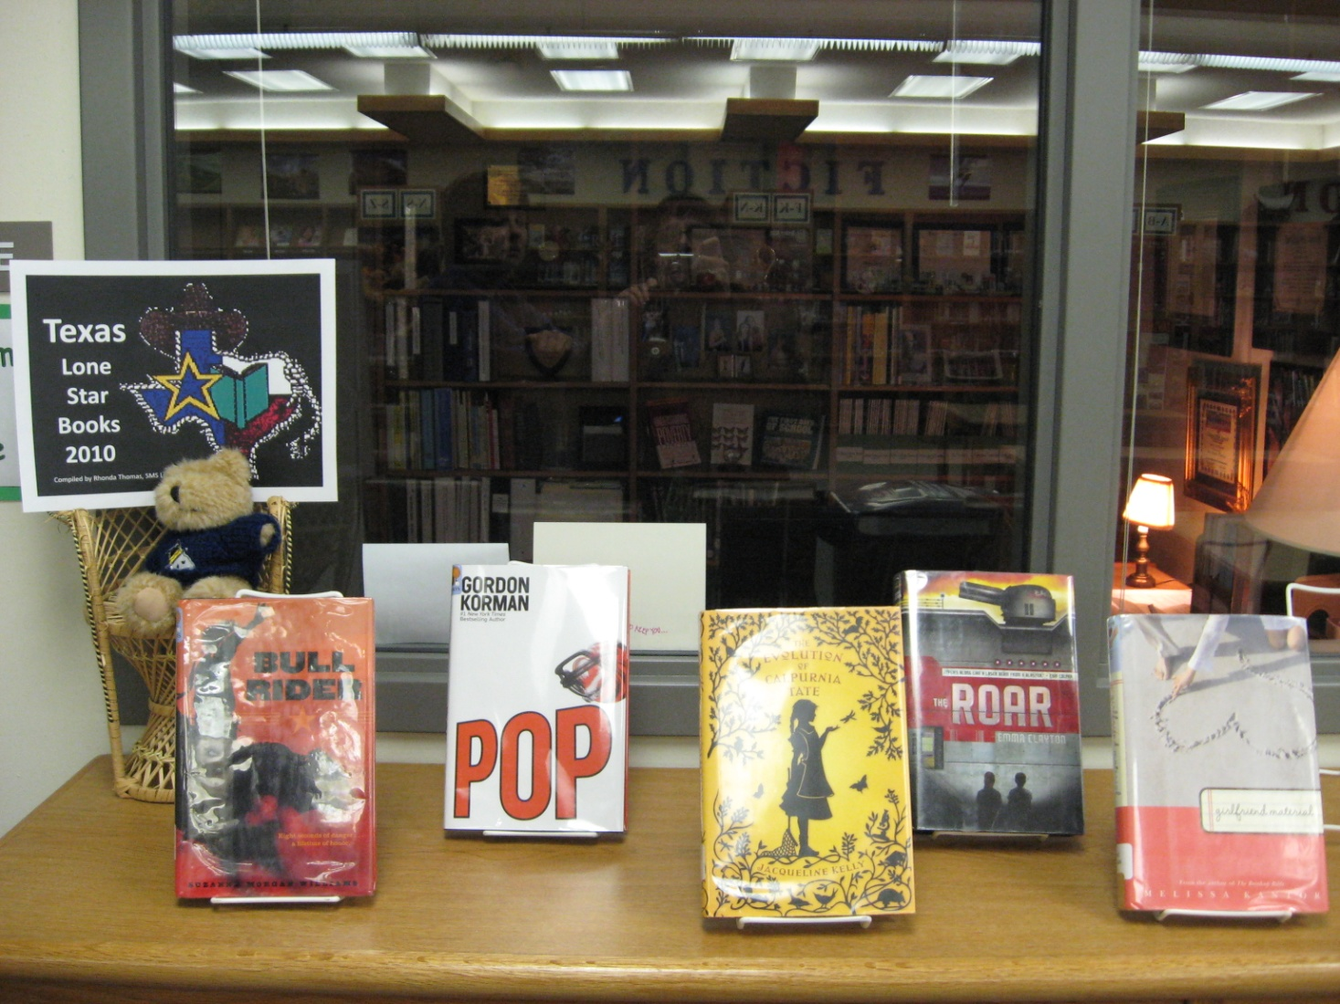
Shelves

Slide 11
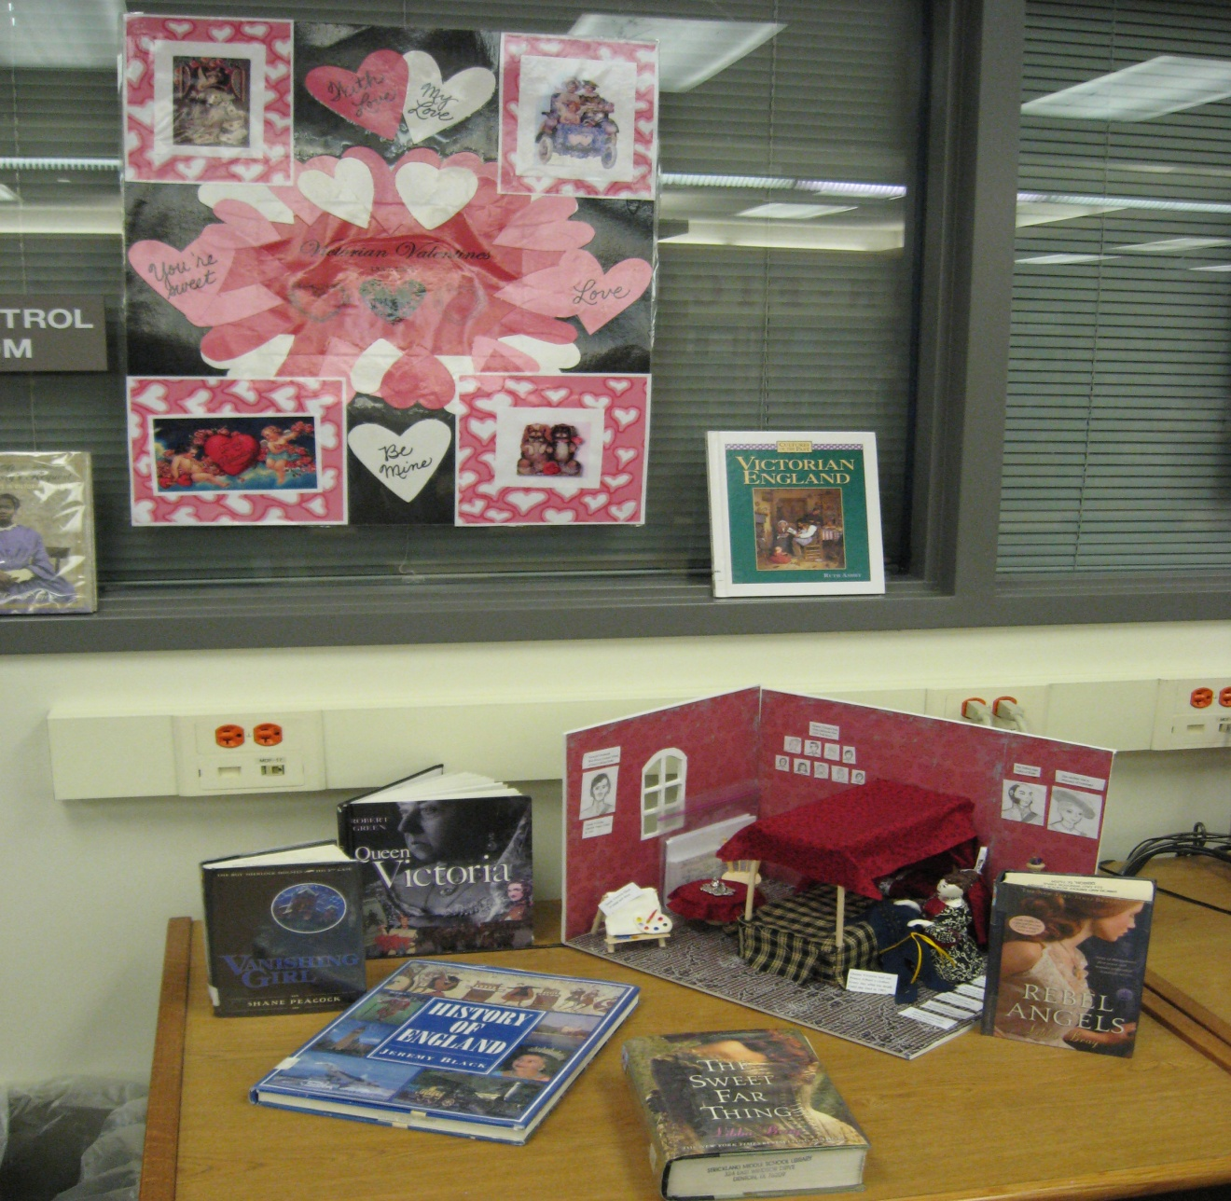
Tables

Slide 12
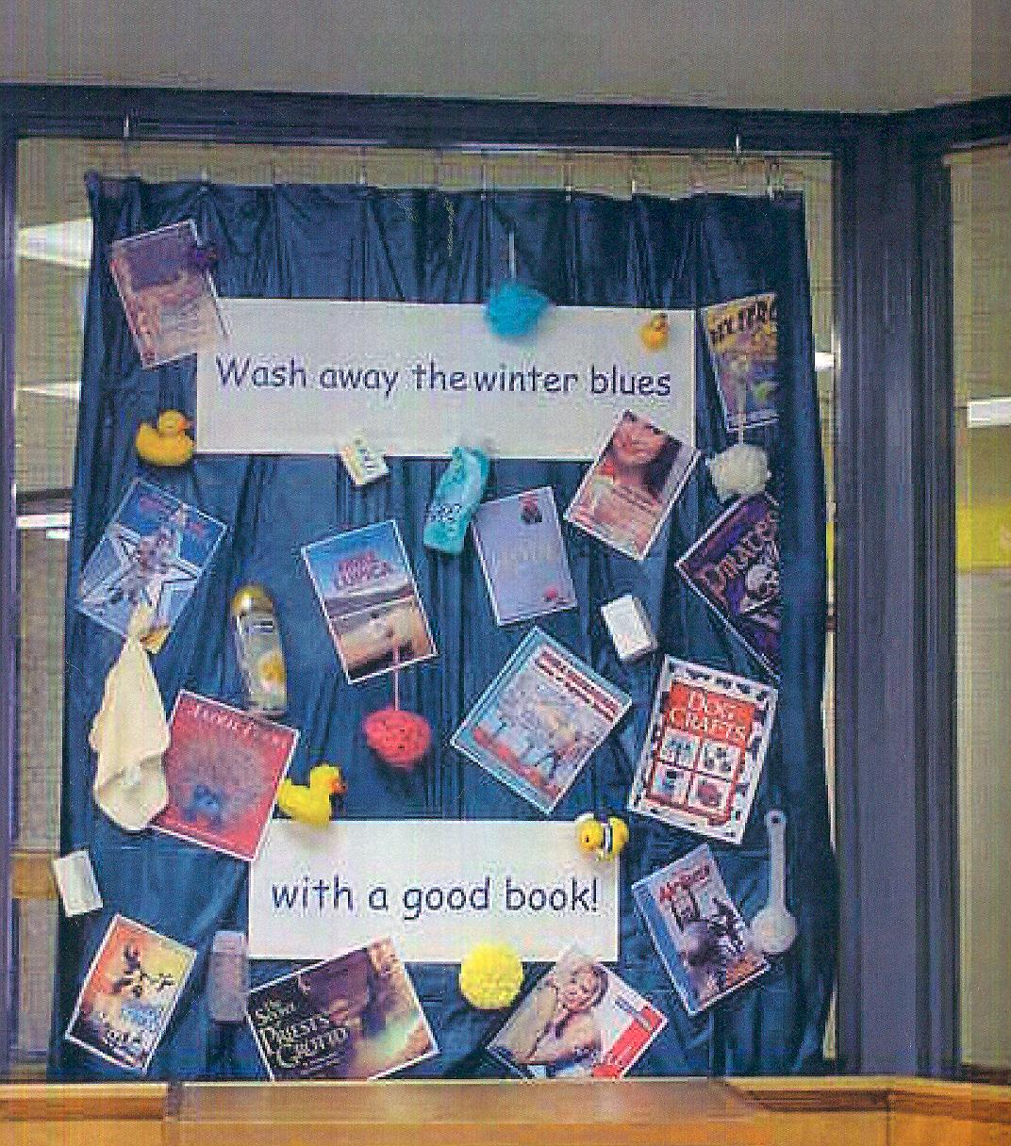
Windows

Slide 13

Nooks and Crannies

Slide 14
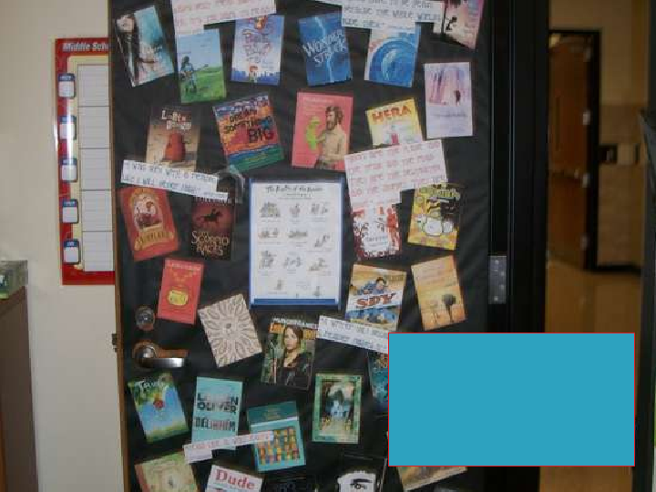
http://www.slideshare.net/Donalynm/2012-ccira-keynote-creating-classrooms-where-readers-flourish
Donalyn Miller 2012 Reading Door

Slide 15
Free, Web- Based Presentation and Book Promotion Tools
Animoto (Sign up for Educator’s Version)
Bruiser
Dragonfly
QR Codes (BYOD Buzzword, Bring Your Own Device)
(works with Smart Phones; download app for NeoReader, I-nigma, QR Scanner or ScanLife)
Edmodo(Social Networking, Blogging, Class Project Building Site) Crownover Library Website

Slide 16
….continued
VoiceThread http://ed.voicethread.com/ (A VoiceThread is a collaborative, multimedia slide show that holds images, documents, and videos and allows people to navigate slides and leave comments in 5 ways - using voice (with a mic or telephone), text, audio file, or video (via a webcam)
Voki Website http://www.voki.com/ (Voki is a FREE service that lets you:
Create customized avatars. Add voice to your Voki avatars. Post your Voki to any blog, website, or profile.)
Shelfari http://www.shelfari.com/ (a way to display on your website books you have read and those you want to read)
booktrailersforall.com http://www.booktrailersforall.com (a great source for promoting books and reading
Glogster (a source for creating online posters. Sign up for Educator’s Version) http://edu.glogster.com/

Slide 17
Fantastic Fiction http://www.fantasticfiction.co.uk/ (a source list for new releases and classics. Great for use in building a classroom library)
YouTube http://www.youtube.com/results?search_query=Book+Trailers&aq=f (You can find many book trailers to promote reading and books on you tube) Always preview them.
*Meet Me At the Corner (Virtual Field Trips, Chats with authors and poets) http://www.meetmeatthecorner.org/
http://bookbuilder.cast.org/ (a site to create, share, publish, and read digital books that engage and support diverse learners according to their individual needs, interests, and skills.)
http://ilearntechnology.com/ (An edublog about integrating technology into the classroom)
http://en.risingshadow.net/ ( Book Collection Building Site Risingshadow is one of the largest science fiction and fantasy book databases.)
http://education.weebly.com/weebly/userHome.php (Free Website Building for Classes)
http://tiaweeblyworkshop.weebly.com/

Slide 18
E-Books (BYOD, Bring Your Own Device)
Follett Shelf (Libraries buy individual e-books for students to check out)
StoryNory (Free e-stories)
TumbleBooks and TumbleReader (Paid Subscription very reasonable)
Storyline Online by the Screen Actor’s Guild (Free e-books)
Digital Downloads Denton Public Library (Check at your Local Public Library)
Strickland Middle School E-Books
Read Aloud: The Undertaker

Slide 19
Windows Software Presentation & Promotional Tools
Movie Maker Windows Tool
PhotoStory 3 Windows Tool
If you are in a district that has Apple products, there is comparable software.

Slide 20
“Frequency of reading for pleasure correlates strongly with better test scores …”
-- To Read or Not to Read: A Question of National Consequence by the National Endowment for the Arts, November 2007

Slide 21
Authentic/Academic Reading
Curriculum Connections (Where are they low, what sections of your library can you focus on display)
Texas Explorers WebQuest: zunal.com (Sandy)
NASA Glogster: Space Shuttle (Sherry)
Paired Reading with the Lone Star List – LiveBinder ( Bonnie)
Picture Books that teach literary elements and the 6 traits of writing. (Bonnie)
LiveBinders http://www.livebinders.com/ (a way to organize units, lessons, etc.) Poetry Unit
Explorers: Ernest Shackleton – (Bonnie) McCormick, Bonnie (Librarian) / CURRICULUM CONNECTIONS
Chalk Rail Display (QR Codes)
Book Suggestions (Bonnie) All Librarians have similar pages on their websites.
Magazines (Authentic Reading, Mental Floss)
Political Cartoons (Voicethread) (Bonnie)
The Great Depression (Animoto) (Bonnie)
Virtual Source Cards and Note Taking (Sherry Brandt)
Notes:
(Non-Fiction-Kelly Korenek, L.A. Nelson Elem. ) Kelly’s PP and Imbed video (Sherry)
Insert Bonnie’s Paired Reading sheet

Slide 22
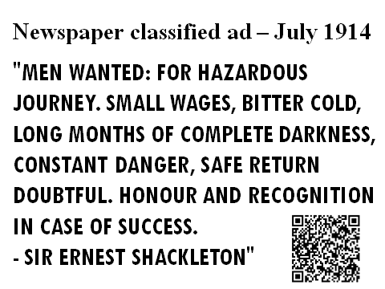

Slide 23
Tip Sheets
Book Talk Podcast Lesson Plan (Grades 3,4,5)
How to Create PhotoStory (All Level)
Photo Story 3 for Windows Tip Sheet (All Level)
Creating a Book Trailer (Story Board) (PDF File)
Creating a Book Trailer-Anna Modrow
Book Trailer Rubric-Anna Modrow
Tool For Reasoning Fair Use
Digital Picture Frame-Sherry Brandt
Prerequisite for Storyboard-Sandy Noles (PDF File)
Book Trailer Storyboard-Sandy Noles (PDF File)
MovieMaker Guide for book trailers-Sandy Noles
Book Trailer Project Checklist-Sandy Noles
Book Trailer Rubric-Sandy Noles (PDF File)
Saving Images from Creative Commons-Sandy Noles
Animoto: Movies in a Minute – Power Point – Bonnie McCormick
VoiceThread Tips – Bonnie McCormick
Tip Sheets and Spine Label Templates (Webpage to access all of the above)

Slide 24
Tip Sheets (Cont’d)
Book Trailer Contract: Anna Modrow
Tip Sheets\Book-trailerPS trimmed.doc-Anna Modrow
Tip Sheets\Book Trailer rubric-Moodrow.xlsx: Anna Modrow

Slide 25
Think about the how, why and where you can create a reading community on your campus as teachers and administrators.

Slide 26
“ What we have loved others will love, and we will teach them how.”
--William Wordsworth

Slide 27
Questions? Comments? Lone Star TIA Webpage http://www.dentonisd.org/page/16440

