Slide 1
Vocabulary
On next page of Texas Chronicle, explain the following vocabulary terms. For each term you will need to write the word, define it, and draw an illustration to show understanding. (Pg. A20)
natural region
plain
landform
escarpment
aquifer
elevation

Slide 2
The Regions of Texas
Coastal Plain Region ~ Location and Important Cities

Slide 3
The Coastal Plain Region ~ Location
Located in the south and eastern part of the state
Part along the Gulf Coast is known as the Gulf Coastal Plain
Land starts at sea level and rises until it reaches the Balcones Escarpment.
Textbook page 30 ~ look at map
Notes:
Intro: Texas is so big that most of the countries’ natural features meet in this state. A natural region is an area made up of places that have the same physical features. The coastal plain is an area of low land that follows along the coast ~ the Gulf of Mexico for us.

Slide 4
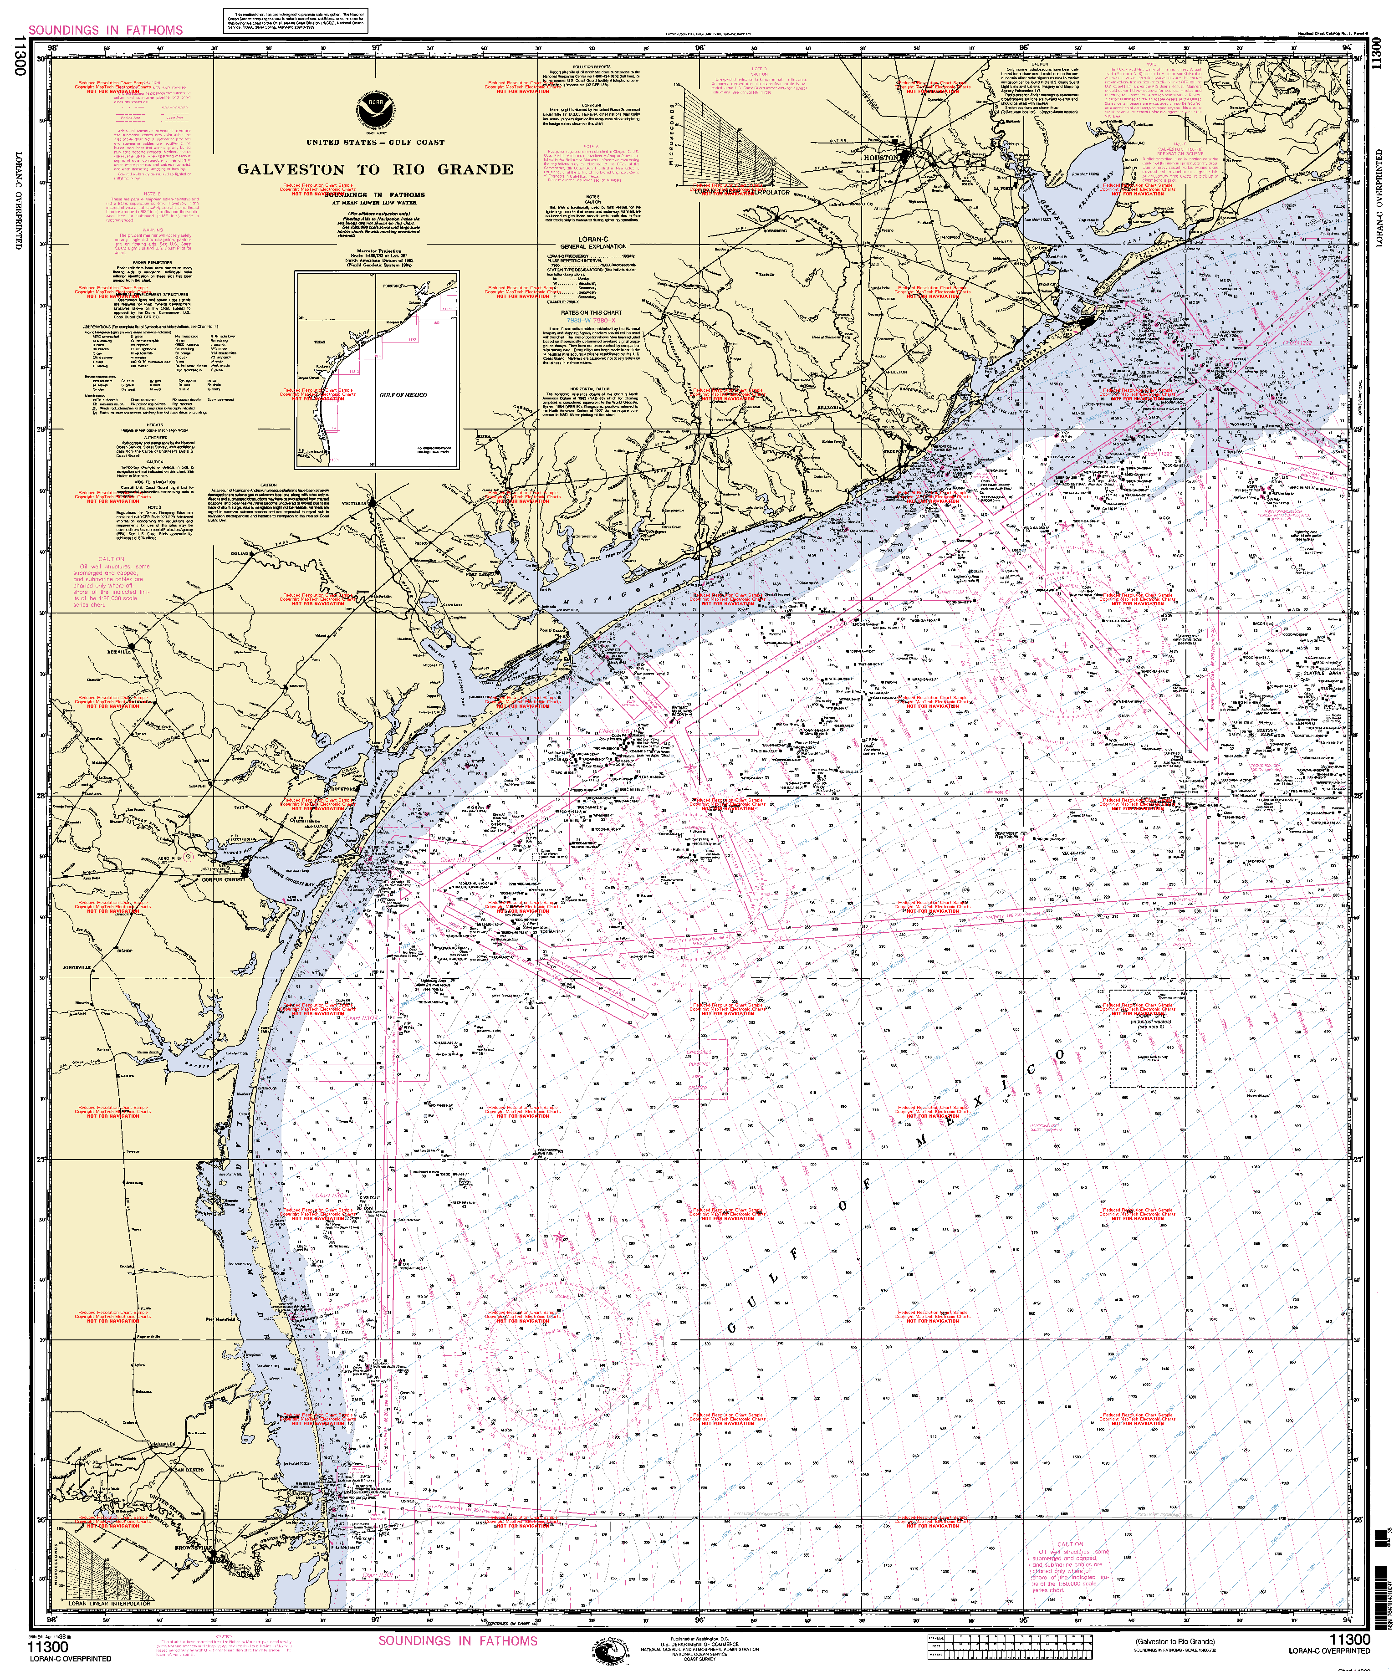
Notes:
Use this map to discuss the physical features of a coastline. They should notice all the rivers and creeks that empty into the Gulf. They should notice all the bay areas. Point out how low lying this land is.

Slide 5
Coastal Plain ~ Location
Rivers of Texas flow toward the Gulf of Mexico
What Texas rivers flow through this region?
Since the Gulf Coastal Plain is an area of low land, what problems do you think the people living here might encounter?
Flooding from too much rain or hurricanes
Floodplain is the low, flat land along a river
Bridges are built high and extends further than the usual width of the river
Notes:
Students continue to use map on pg. 30. Also see picture on page 31 to understand the large bridges that must be built over floodplains.

Slide 6
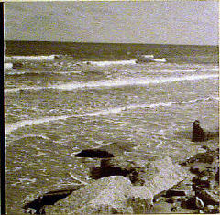
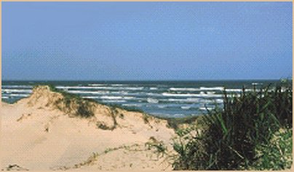
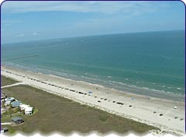
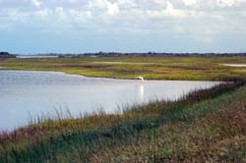
The Gulf Coastal Plain
Notes:
These are all pictures of the Gulf Coastal Plain. Do they all look the same? Some of the areas of sandy, some rocky, and some marshy. But they are all in the same region. Just because you live on the Gulf Coast, it does not mean your backyard will look like it does when you go to the beach. However, all the land is at or just above/below sea level. These areas are still prone to flooding because they are right on the coastline.

Slide 7
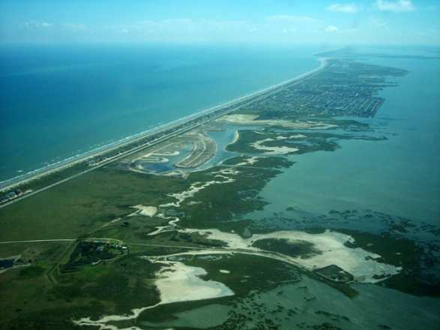

Slide 8
Coastal Plain ~ Location (cont.)
Part of coastal plain is actually not along the coast
Piney Woods of Texas is part of this region.
Where do you think it might be located? (map on pg. 30)

Slide 9
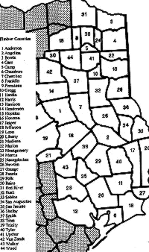
Piney Woods ~ Location
The pine forest lands or "Pineywoods" of East Texas extend from the Red River in the northeast corner of the state, southward to the region bordering Galveston Bay, and from the Louisiana border on the east to the Black Prairie region on the west. As shown in this map, this area includes all or portions of 44 Texas counties.
Notes:
Briefly explain where this is in relation to the map on pg. 30 in student book. The point is that this area is part of the coastal plain and encompasses a great area of land.

Slide 10
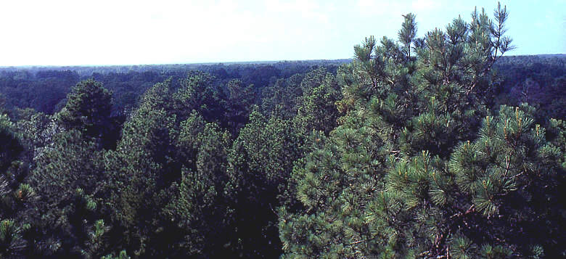
Coastal Plain Region ~ Piney Woods
The Pineywoods region encompasses the four National Forests in Texas: the Angelina, Davy Crockett, Sabine, and Sam Houston.
Notes:
Why do students think it might be called the Piney Woods? What is a national forest? Has anyone been camping in a national forest of Texas?

Slide 11
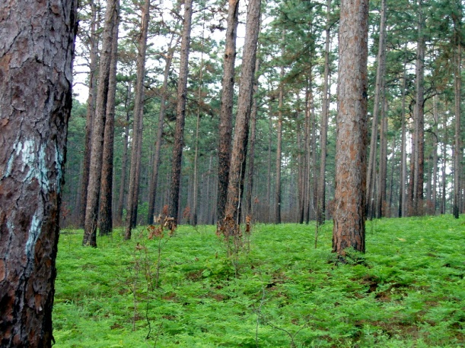
Piney woods

Slide 12
Gulf Coastal Plain ~ Important Cities
What cities do you see and recognize on map on page 30 along the coast?
What cities are in the Piney Woods part of the Coastal Plains?
Is the Dallas~Fort Worth area a part of this region? Do we live along the coast? Are we part of the Piney Woods?

Slide 13
Texas Chronicle Notebook
Color the Coastal Plain region of the Texas map given you green.
Cut out and glue onto right side of a new page of Texas Chronicle
Under the map, create a bubble map of the land features, important cities, and location we have discussed today.
Notes:
Model how to find the coastal region on the small maps, where to put in Texas Chronicle, and how to create the bubble map for today. We are only using the right side of the Texas Chronicle today (this is the input page)

Slide 14
End Day #1 stop here ☺

Slide 15
The regions of texas
Coastal Plain Region ~ Climate, Plants, Animals

Slide 16
Taking Notes
Get Texas Chronicle
On new right-hand side, title page “Coastal Plain Region Climate, Plants, Animals”
Take notes as we go through lesson. You may choose to make a bulleted list under each heading. ☺
Coastal Plain Climate
Precipitation ~
Temperatures ~
Coastal Plain Plants
Notes:
Explain to students note-taking can be a bulleted list which will help them remember what we have learned. Help them set it up as you go through this lesson. The list should be on the right hand side (input) of the Texas Chronicle. We will write on the left hand side later in this lesson.

Slide 17
Coastal Plain Region ~ Climate
Textbook map pg. 30
How large an area is this region geographically? Use map scale and determine how many miles from north to south it covers.
In the southern part of the state (Brownsville and Corpus Christi areas) it is always pretty warm ~ even in the winter. This is a good place to grow fruit and vegetable crops because it rarely freezes.
Notes:
Give students a ruler and allow them to work with a partner to determine the size of this region.

Slide 18
Coastal plain region Climate (cont.)
What kind of climate do we have here in the DFW area?
Summer?
Winter?
How does it differ from the coastal area?
How does the climate of an area effect the people who live there?
Notes:
Allow time for students to turn and talk during first question. Then, they can share out with the two specific seasons mentioned on the slide.

Slide 19
Coastal plain region ~ climate (cont.)
Precipitation ~ see map on page 35
Does all of the Coastal Plain Region receive the same amount of precipitation?
With a learning partner, determine the range of precipitation in this region.
Why do you think there is more rain in the eastern half of the state than the western half?
What are the wild weather conditions that can occur in this region?
Notes:
Remind students that precipitation is water that falls to the Earth’s surface in the form of rain, sleet, snow, or hail. Precipitation range should be 24-48 or more inches per year. Tell students that the area along the border of Louisiana can receive as much as 60 inches per year. That is 5 feet of rain! Explain to students that the forest areas receive more rain and are more humid. The humidity is the moisture in the air which helps with the water cycle causing it to get more rain. Remind students what we learned about hurricanes along the coast and tornadoes in our part of Texas.

Slide 20
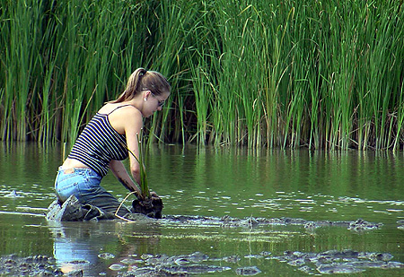
Coastal plain region ~ Plants and animals
Gulf Coastal Plain area
Full of wetlands and marshes. Some are freshwater and some are saltwater. A marsh is a wetland where a variety of tall grasses grow.
This is a flat land. Plants that grow need a lot of water and are able to survive warmer temperatures.
This woman is planting bulrushes in this marsh in order to spread population of this plant in Texas.
Notes:
ASK: Where does the salt water come from for the saltwater marshes? With the picture, have students notice how shallow the marshland is. This is not deep water. Plants root at the bottom and grow above the surface.

Slide 21
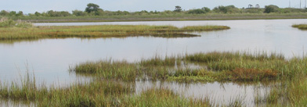
Coastal plain region ~ Plants and animals
This is a typical Texas marsh. Grasses were planted here to give wildlife a refuge (home).

Slide 22
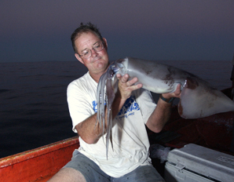
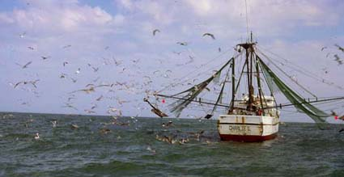
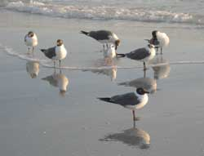
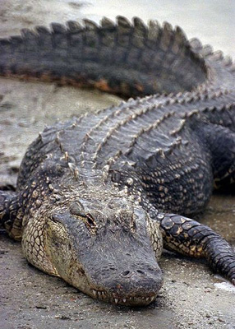
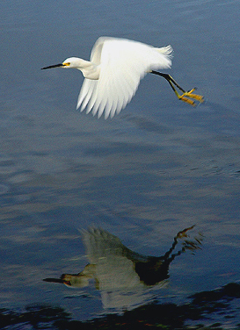
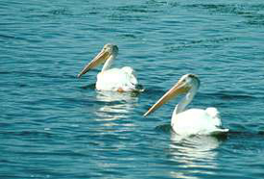
Gulf Coastal Animals
Birds eating left-overs from fishing boats
Many species of fish
Birds looking for food between waves in the sand
White Egret
Pelicans
Alligators
Notes:
Fishing is a huge industry along the coast. Many people vacation there just to go fishing. Shrimp boats bring large numbers of birds which can either float on the water to rest or have strong wings to get back to land. The white egret is a large bird that flies over the Gulf and marshes looking for food. Pelicans can be found along the seacoast and catch their prey (fish) directly out of the waves of the Gulf. Alligators are found mostly in the far eastern section of Texas along the rivers and marshes.

Slide 23
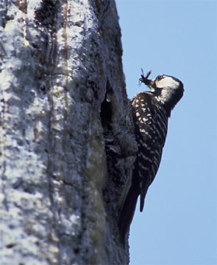
Coastal plain region ~ Plants and animals
Piney Woods area
The wooded areas bring other kinds of wildlife to Texas because they provide shelter in all types of weather and from predators
Red-cockaded woodpecker finds food inside tree holes or just under the bark. Doesn’t look like the woodpecker on the cartoons!

Slide 24
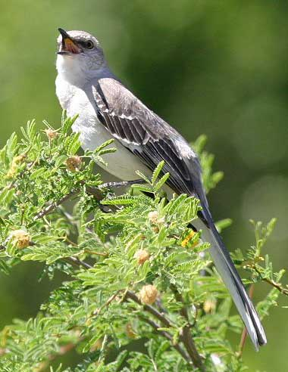
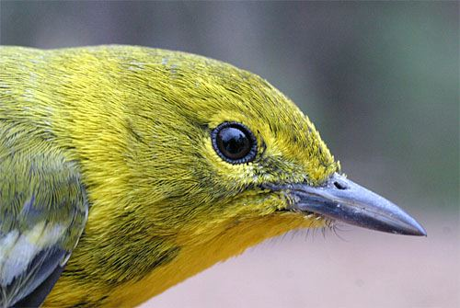
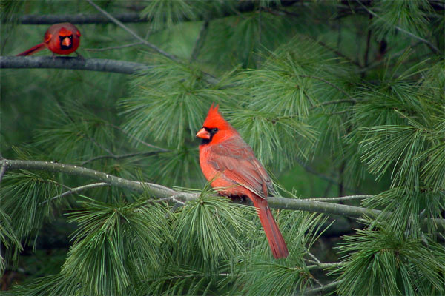
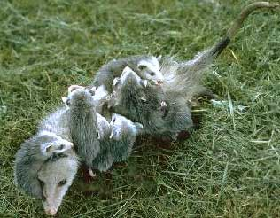
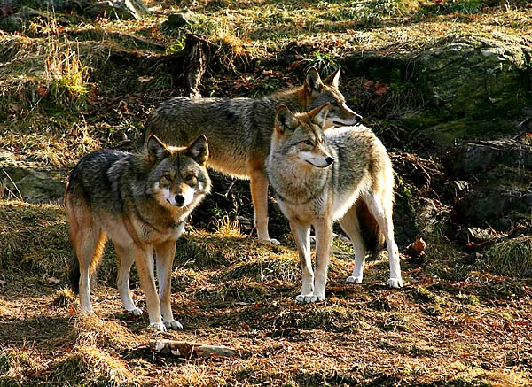
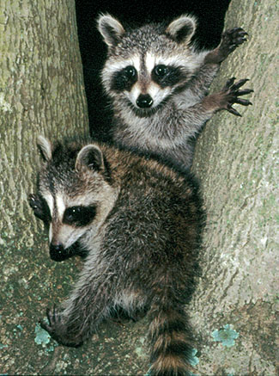
Piney Woods Animals
Cardinals
Warbler Pine
Mockingbird
Coyotes
Mother opossum carrying her babies
Raccoons
Notes:
Note: Coyotes are found all over Texas!!! We have them in our area a lot! There are many, many birds that live in the Forests.

Slide 25
Coastal Plain Region
On left side of Texas Chronicle, write a letter to a friend inviting them to visit the Coastal Plain Region of Texas.
Make it interesting, and mention why they would want to visit. Be specific about whether you are inviting them to the Gulf Coastal Region or the Piney Woods region of this area. What is the weather like, what animals would they see, etc.
Notes:
This is an optional assignment if you have time. I am NOT going to take a grade on it. The point of this assignment is for them to synthesize the information they have received today.

Slide 26
End of Day 2 stop here ☺

Slide 27
The regions of texas
Coastal Plain Region ~ Industry

Slide 28
Taking Notes
Get Texas Chronicle
On new page, take notes from today’s lesson on the right side of your page (the input page)
You will also need a textbook today.

Slide 29
Coastal Plain Region Industry
Industry ~ all the businesses that make one kind of product or provide one kind of service.
Goods ~ Products people buy and sell, such as food and clothing
Service ~ an activity that someone does for others for pay, such as cutting hair, repairing shoes, etc.
Cities have different types of goods and services. They may also have many types of industry.

Slide 30
Coastal Plains region industry
Textbook page 62.
What do you notice about this map key?
Turn and talk to partner about the industries for the coastal plains region of Texas.

Slide 31
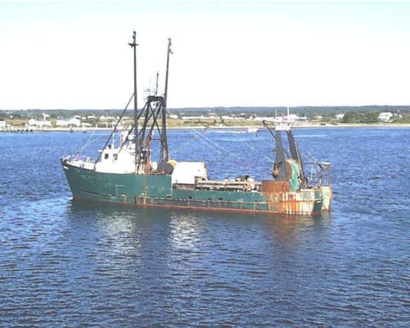
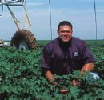
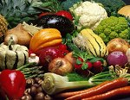
Coastal Plain Region ~ Industry
Gulf Coastal Region
Fishing
Oil
Fruits and Vegetables

Slide 32
Fishing Industry
Sea provides an almost endless supply of fish and shellfish. Fisherman must be careful not to over-fish one area.
Major place for shrimping industry
Fishing boats from Gulf of Mexico may stay out as long as 3 weeks and then return to port.

Slide 33
Oil Industry
Why do we need oil?
Off the Texas coast, there are large pockets under the ocean floor filled with oil.
Off-shore oil rigs pump the oil up from under the ocean floor.
Oil taken to refineries in the Houston area. Here the oil is made into gasoline and other products which need petroleum.

Slide 34
Agriculture Industry
The Valley’s climate provides the right temperature and precipitation for growing crops.
Fruits and vegetables can be grown year round.
The southern most area produces citrus crops such as oranges and grapefruit.
Areas just to north (but still in the Valley) produce many other fruits and vegetables.
Freezes rarely occur, but when they do our crop industry suffers.

Slide 35
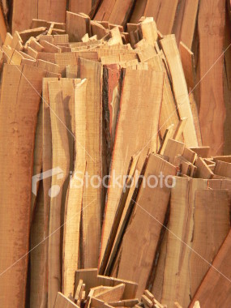
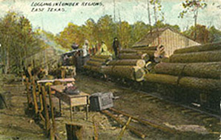
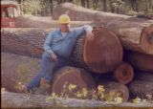
Coastal Plains Region Industry (cont.)
Piney Woods Area
Timber ~ What uses do we have for timber?
Notes:
Discuss the timber industry.

Slide 36
Population and industry
Population of an area is determined by the industry needs.
Many workers needed for the oil industry. The area around Houston is heavily populated for this reason.
The timber industry does not require quite as many workers, so the Eastern cities of Texas are not as large as the Houston area.
In the Valley, workers are needed to take care of and harvest crops. But these areas do not need large populations to do this work.
Other workers are also needed: doctors, nurses, teachers, city services, etc. These are true for all regions and generally are not included when discussing “industry.” However, Houston is well-known for its medical centers which requires larger than normal amounts of doctors, nurses, and other health related workers.

Slide 37
End of day 3 stop here ☺

Slide 38
The regions of texas
Coastal Plains Region of Texas ~ Assessment

Slide 39
Directions for Assessment
You may use your Texas Chronicle Notebook
Make a tree map for the Coastal Plains Region.
Your headings should be as follows:
Place state of Texas here and color in the location of this region.
Coastal Plains Region of Texas
Location
Landforms
Climate
Plants
Animals
Industry
NOTE: The number of lines under each heading will vary according to what you have learned. Some may have more lines than others!

Slide 40
End of coastal plains region

Slide 41
The regions of texas
Central Plains Region ~ Location, Landforms, Important Cities

Slide 42
Central plains region ~ Location
Part of the Great Central Plains of the US
Located in central portion of the state
Northern border is the Red River
Southern tip is the city of Austin
The Colorado River is the southwestern boundary
West border is the Cap Rock Escarpment
Page 30 of textbook ~ How else can you describe the location of this region
Notes:
ASK: What state borders the Central Plains? What other rivers flow through this region? Do the originate here or elsewhere? Review the terminology of plain (flat land)

Slide 43
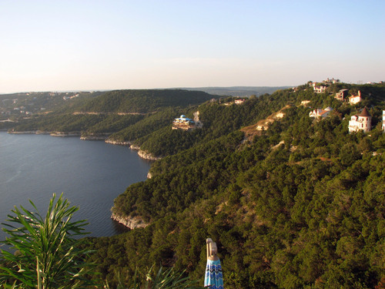
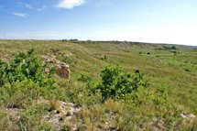
Central plains region ~ landforms
What are landforms?
Rivers
Colorado River
Brazos River
Red River
Lakes
Lake Travis is near Austin
Hills
Hill Country~just the Western edge
Plains

Slide 44
Central plains region ~ geographic features
Rolling grassy lands
Thick grasses
Cross Timbers area - large areas of hardwood trees
Limestone rock
Higher elevation because limestone doesn't wear down easily

Slide 45
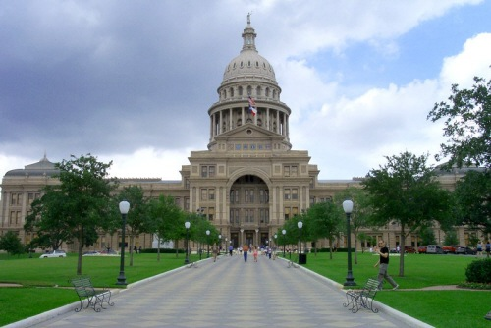
Central plains regions ~ important cities
Austin
Capitol of Texas
Located on edge of Central Plains and Gulf Coastal Plain Region
Hilly area
Lake Travis
On Colorado River
UT (major university)
State Capitol Building

Slide 46
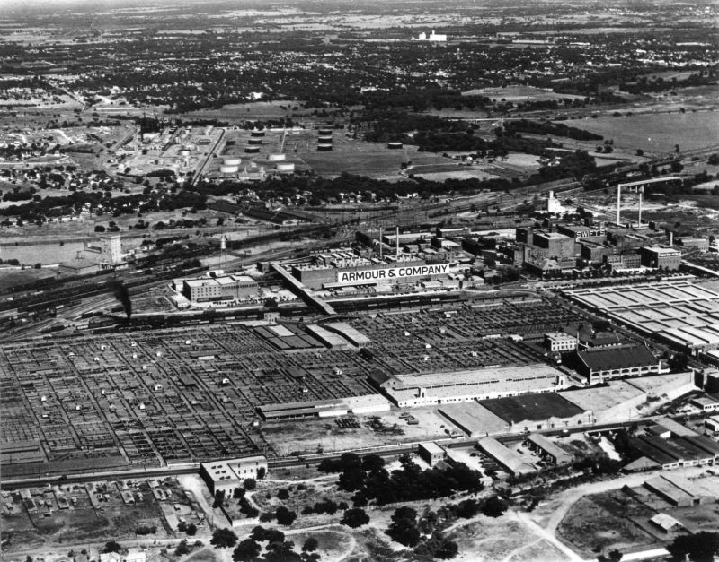
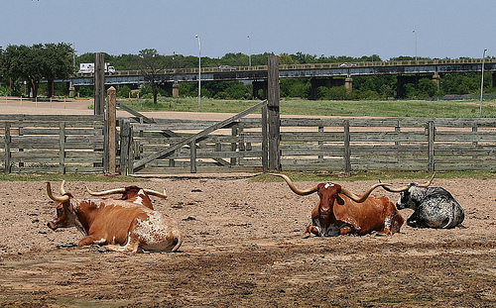
Central plains regions ~ important cities
Fort Worth
Famous for cattle industry in the past
Longhorns in Stockyards
Stockyards in 1940’s

Slide 47
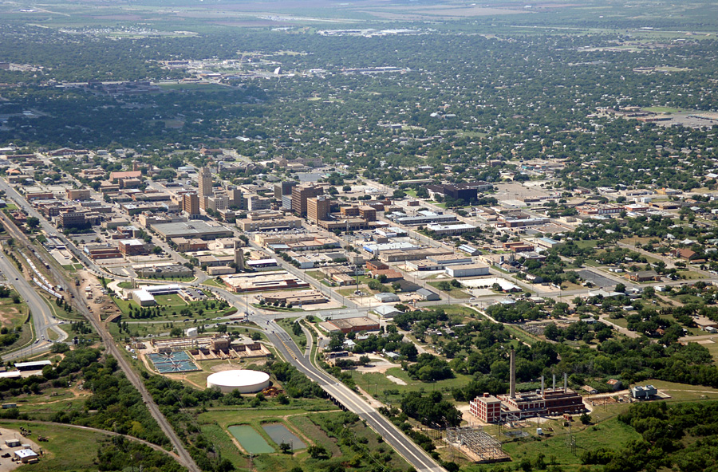
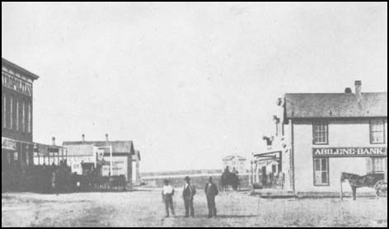
Central plains regions ~ important cities
Abilene
Two major colleges (ACU, Hardin-Simmons)
Major stop on cattle drives
1875
Abilene today

Slide 48
Central plains regions ~ important cities
Killeen
Fort Hood ~ Army base
Wichita Falls
Farming land
Cattle
Cotton industry
San Angelo
Hunting area
Farming land

Slide 49
End Day 1 stop here ☺

Slide 50
Regions of texas
Central Plains Region ~ Climate, Plants, Animals

Slide 51
Central plains region ~ Climate
Precipitation
20-30 inches per year
Dry air
Will not feel as hot as in the Coastal Plains even with same temperature
Cools off at night
Tornadoes
Weather conditions produce several tornadoes each year
Notes:
How does the precipitation compare to the Coastal Plains Region.

Slide 52
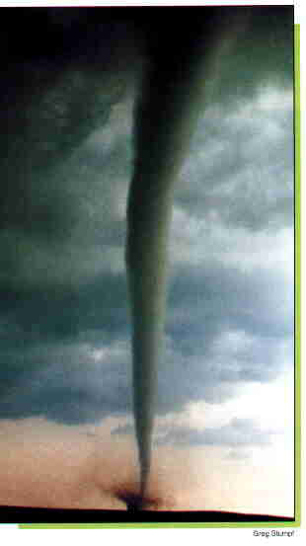
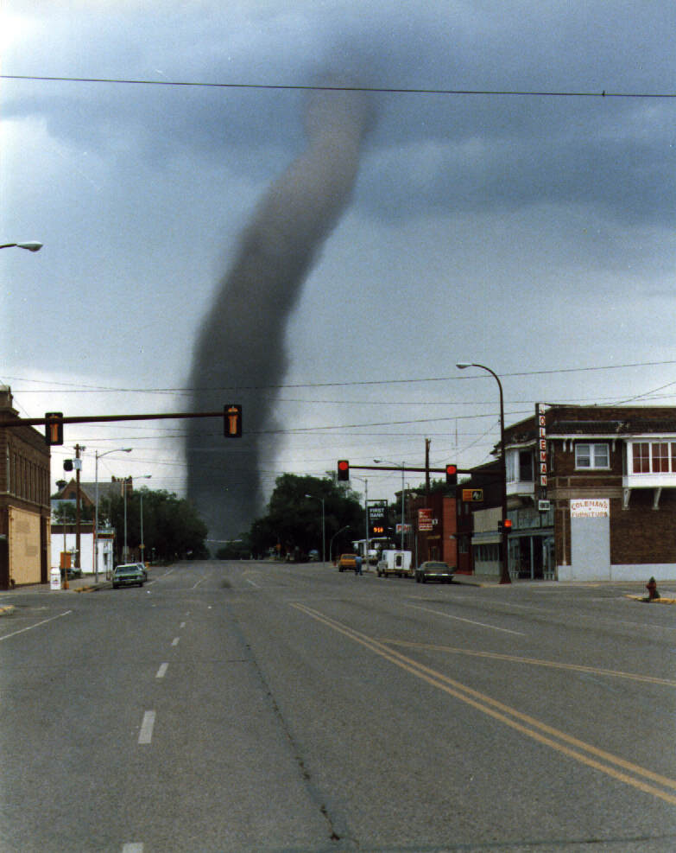
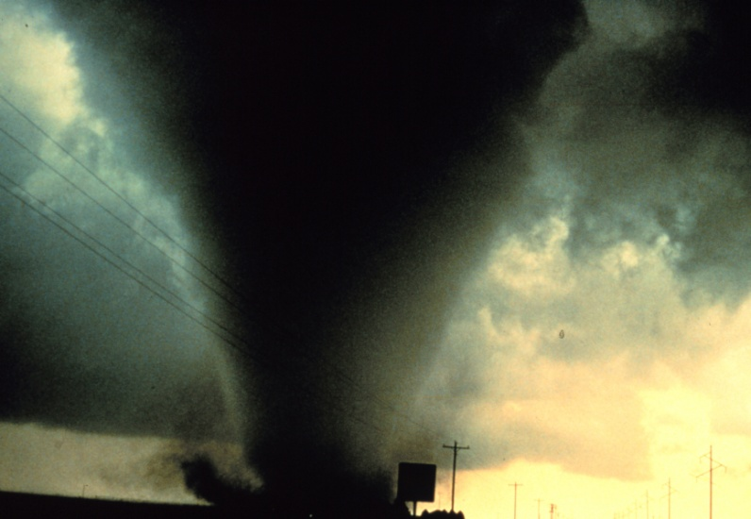
Central plains region ~ Climate
Tornadoes can be small or large. They can develop quickly. There is a lot of open land in the Central Plains, so the effects of the damage depends on whether the storm hit an open area or a heavily populated one.
Notes:
Note here the size difference of these tornadoes. Not always raining!!!

Slide 53
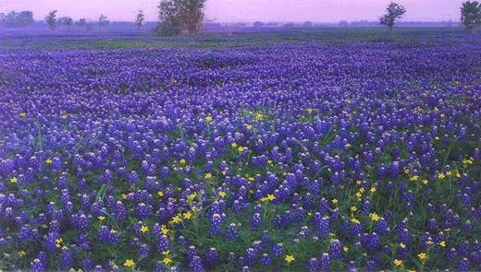
Central plains region ~ Plants
Cedar Trees
Used for making fence posts (important to farmers)
Tall grasses
Wildflowers
Many in the Hill Country

Slide 54
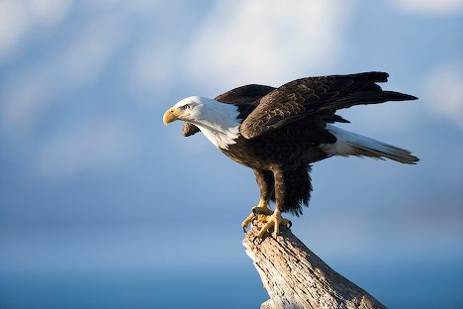
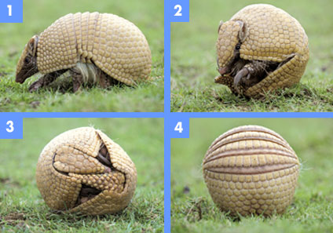
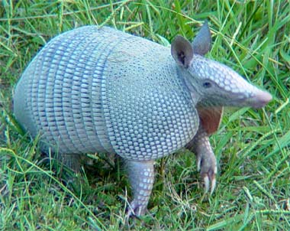
Central plains region ~ Animals
Bald Eagle
Armadillo
Defense from Predators
Notes:
Armadillos live all over the state, but are in abundance in this region.

Slide 55
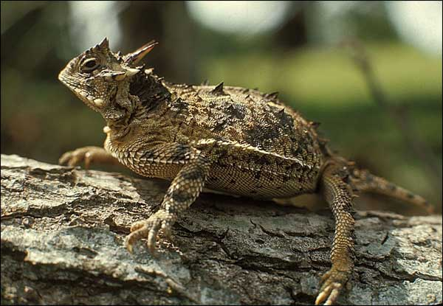
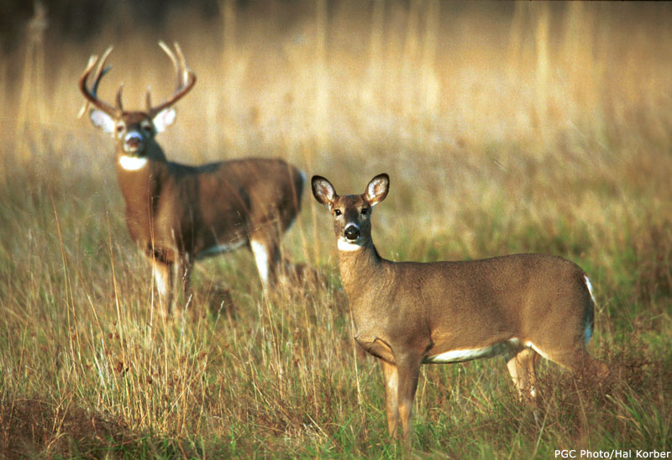
Central plains region ~ Animals
Horned Lizard
White-tailed Deer

Slide 56
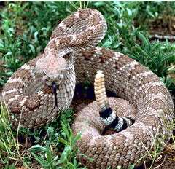
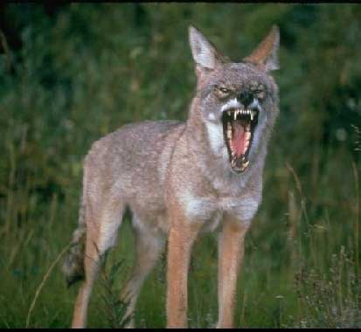
Central plains region ~ Animals
Rattlesnakes
Coyotes
Notes:
Coyotes and snakes live all over the state.

Slide 57
End of day 2 Stop here ☺

Slide 58
Regions of texas
Central Plains Region ~ Industry

Slide 59
Central plains region ~ Natural Resources
Limestone
Used for building
Minerals
Streams
Fertile lands for crops

Slide 60
Central plains region ~Industry
Farming
Fruits ~ Famous for peaches
Vegetables
Watermelons
Oats
Cotton
Ranching
Cattle
Angora goats (mohair)

Slide 61
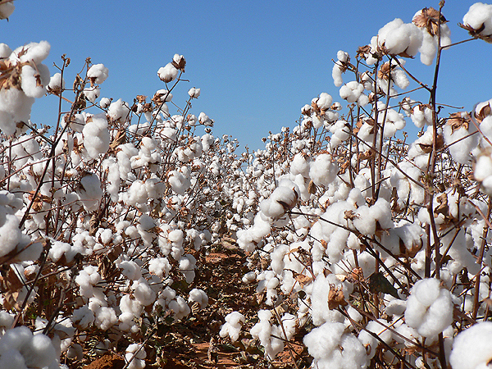
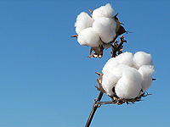
Cotton Industry

Slide 62
Central plains region ~Industry
Cedar Trees
Important for building fences
Used to build decks, closets
Oil
Natural Gas

Slide 63
Central plains region ~Industry
How does industry affect population?
Are there many large towns in West Texas?
What kinds of jobs do you think the industries in this region would provide?

Slide 64
Central plains assessment
Create a double bubble map comparing the Coastal Plains Region with the Central Plains Region
Be sure to include the following:
Climate
Landforms
Plants
Animals
Industry

Slide 65
End of central plains region

Slide 66
Regions of texas
High Plains Region ~ Location, Landforms, Important Cities

Slide 67
High plains region ~ location
Part of the Great Plains of the United States and Canada
Most of the Panhandle and Edwards Plateau
East & South borders are escarpments
Southwest border is the Mountains and Basins Region
High Plains Region

Slide 68
High plains region ~ panhandle
The northernmost area of Texas is called the Panhandle.
It is straight and narrow like the handle of a pan with the broader area of the state below it, like the bottom of a pan.
This region has mostly flat, grassy land or plains.

Slide 69
High plains region ~ location (cont.)
Geographic Subdivisions
High Plains
Edwards Plateau
Llano Basin
Panhandle plains
High Plains bluff in Panhandle

Slide 70
High plains region ~ panhandle (cont.)
The western and eastern parts of the Panhandle region divided by deep canyons.
Carved by rivers and their tributaries that wind their way through this area.
Palo Duro Canyon and Caprock Canyons State Parks are in this region.
They are sometimes called "inverteted mountains" since the land is relatively flat until you reach the long and steep canyons in the ground.

Slide 71
Palo Duro Canyon
Second largest canyon in the United States

Slide 72
High plains region ~ edwards plateau
A plateau is high, flat land. Over many millions of years, this plateau has been eroded into a hilly terrain. There are many springs and some steep canyons in this area.
Texas Hill Country is partly in this region.

Slide 73
High plains region ~ llano basin
Also known as the central mineral region.
Home to some of the oldest rocks in Texas, the central mineral region contains unique minerals and rock formations.
Characterized by large granite domes, such as Enchanted Rock near Fredericksburg.

Slide 74
High plains region ~ landforms
Flat
Few trees
Canyons in North (Palo Duro Canyon)
Higher elevation than Central Plains
Cap Rock Escarpment
Edwards Plateau
Notes:
Reminder that an escarpment is a steep slope or long cliff that results from erosion or faulting and separates two relatively level areas of differing elevations.

Slide 75
High plains region ~ important cities
Amarillo & Lubbock in the Panhandle
Midland & Odessa in the Permian Basin
Kerrville, Fredericksburg, & Del Rio in the Edwards Plateau area

Slide 76
End of day 1 stop here! ☺

Slide 77
Regions of texas
High Plains Region ~ Climate, Plants, Animals

Slide 78
High plains region ~ climate
Dry air
Hot summers
Cold winters
Dust storms
16-20 inches of precipitation per year
Notes:
Compare to other regions: this one gets less rain

Slide 79
Dust storm
Notes:
As the wall of dust gets closer, you can’t see anything.

Slide 80
Dust storm

Slide 81
High plains region ~ plants
Short grasses
Mesquite, cedar, pecan, and oak trees in Edward Plateau area
Mesquite Tree
Notes:
Mesquite tree grown today for the bark in barbequing.

Slide 82
Two lonely trees on the Texas high plains west of Amarillo.

Slide 83
High plains region ~ animals
Deer
Wild turkeys
Mountain lion
Coyote
Prairie dog
Jackrabbit
Burrowing owl
Richard Seaman

Slide 84
End of day 2 Stop here ! ☺

Slide 85
Regions of texas
High Plains Region ~ Industry and Population

Slide 86
High plains region ~ industry
Farming - cotton, wheat (irrigation from wells)
Irrigation of wheat field

Slide 87
High plains region ~ industry
Ranching - cattle, sheep, goat

Slide 88
High plains region ~ industry
Oil and gas in the Permian Basin
Gas Pump
Natural Gas

Slide 89
High plains region ~ Assessment
Create a Circle Map for this region.
Include words and illustrations that show your understanding of this region.

Slide 90
End of high plains region stop here! ☺

Slide 91
Regions of texas
Mountains and Basins Region ~ Location, Landform, Important Cities

Slide 92
Mountains and basins ~ location
Far west Texas
East border near Pecos River
South border is the Rio Grande
North border is New Mexico
Mountains and Basins Region

Slide 93
Mountains and basins ~ landforms
150 mountains in the mountain ranges
Plateaus and basins
Plateau ~ a high, flat area
Basin ~ hollow or depressed area with no outlet for water
Guadalupe Mountains
Basin in Big Bend

Slide 94
Mountains and basins ~ landforms
Deserts
Pecos and Rio Grande Rivers
Big Bend National Park
Both pictures are of the Rio Grande

Slide 95
Mountains and deserts of West Texas

Slide 96
Mountains and basins ~ important cities
El Paso
Most far western city in the state
Military base
Pecos
Cattle drives went through this city
Chisholm Trail and Loving-Goodnight Trail went through this city

Slide 97
Mountains and basins ~ important cities
Kermit & Monahans in Permian Basin area
Kermit located at the “L” of the end of the Panhandle
Monahans is where native Comanches, Mescalaro, and Lipan Apache Indians once roamed
Fort Davis, Marfa, & Alpine in Mountain area
Marfa began as a Railroad water stop

Slide 98
End of day 1 Stop here! ☺

Slide 99
The Regions of texas
Mountains and Basins Region ~ Climate, Plants, Animals

Slide 100
Mountains and basins region ~ climate
What can you infer about the climate in this location?

Slide 101
Mountains and basins ~ climate
Driest part of state
8 inches of rain per year, 20 in mountains
Hot days, cool nights
Storm east of El Paso

Slide 102
Mountains and basins ~ Plants
Short grasses, shrubs, desert plants in plateaus and basins
Pine forests in mountains
Cholla cactus

Slide 103
Mountains and basins ~ Animals
Javelina
Roadrunner
Gray-Banded King Snake

Slide 104
Mountains and basins ~ Animals
Lizard
Scorpion

Slide 105
Mountains and basins ~ industry
Ranching - cattle, sheep, goat
Farming - cotton, fruits, vegetables, cantaloupes (irrigation in El Paso and Pecos River Valley)
Oil and gas - part of Permian Basin

Slide 106
End day 2 Stop Here! ☺

Slide 107
The regions of texas
Final Assessment

Slide 108
Final assessment
Look back over your notes on all four Texas Regions.
Think about what makes each one unique.
Think about what you don’t like about a particular region.
Which region would you prefer to live in? Why? What makes that region the best one of all?

Slide 109
Final Assessment
Make a circle map for the region you think is the best one of all ~ the one you would like to live in.
Write a paper explaining why you think that region is the best. Be sure that your thoughts make sense. Make a rough draft.
Copy your paper over neatly and turn in with your circle map.

