Slide 1
Rainforest
Click on pictures. Many are hyperlinked to websites.

Slide 2
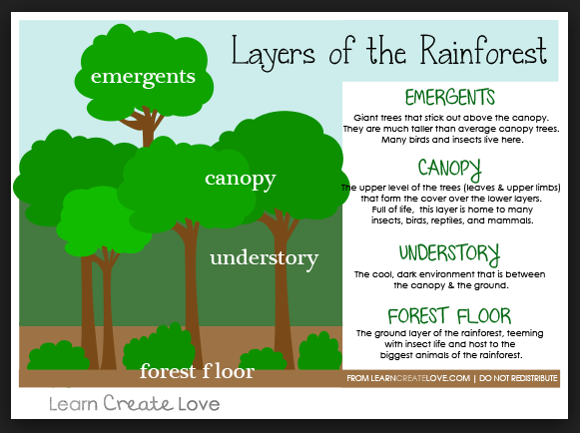
Click on picture
for video

Slide 3
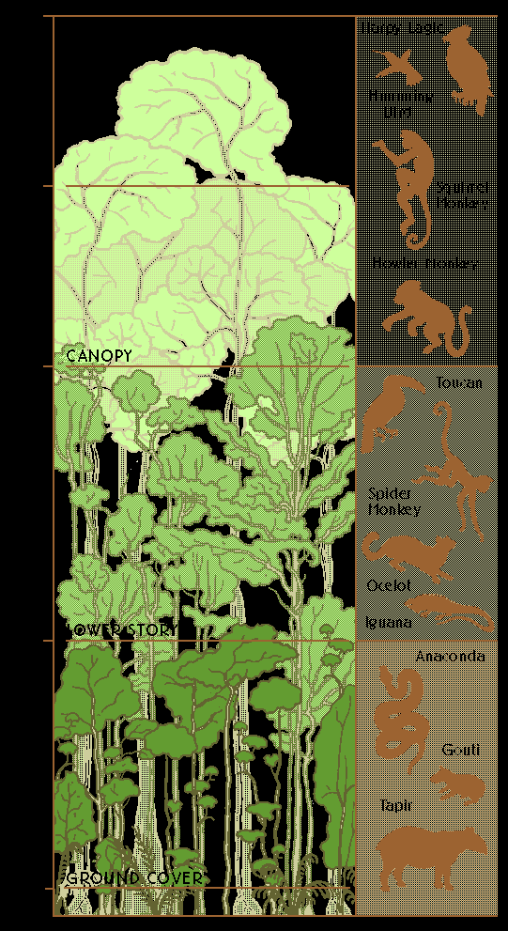
Click on picture for
informational video

Slide 4
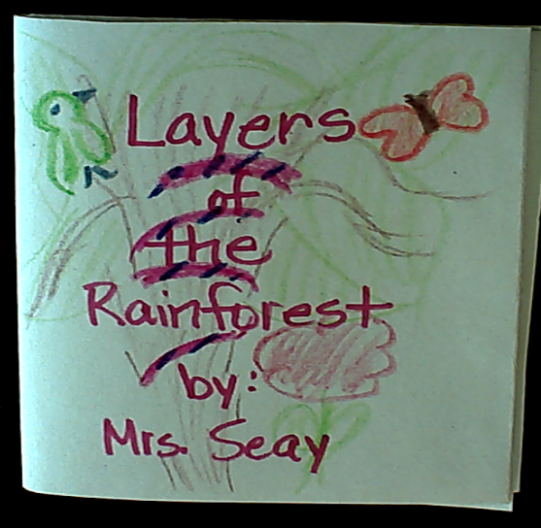

Slide 5
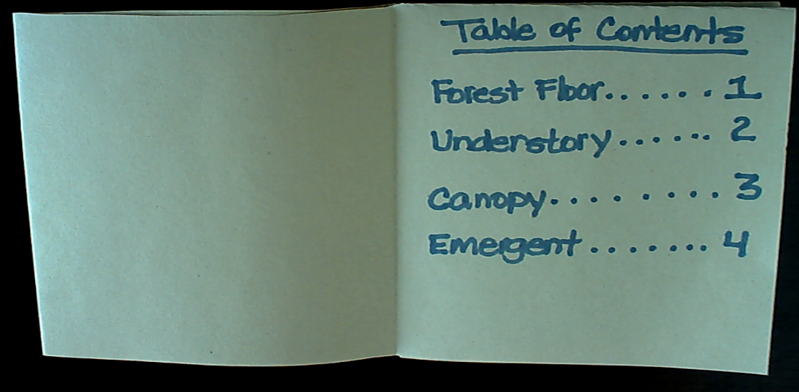

Slide 6
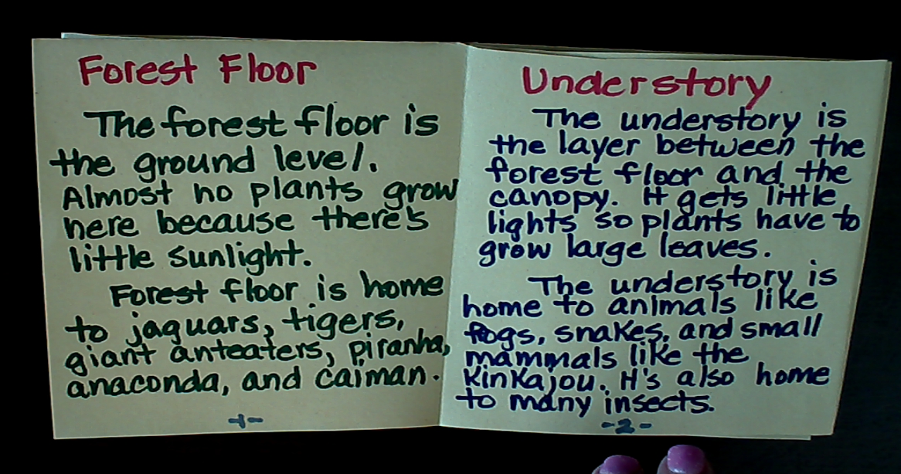

Slide 8
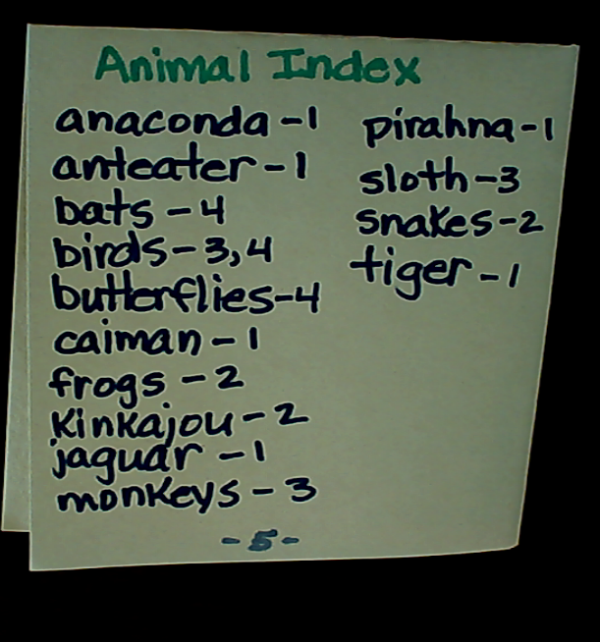

Slide 9
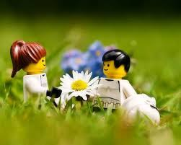
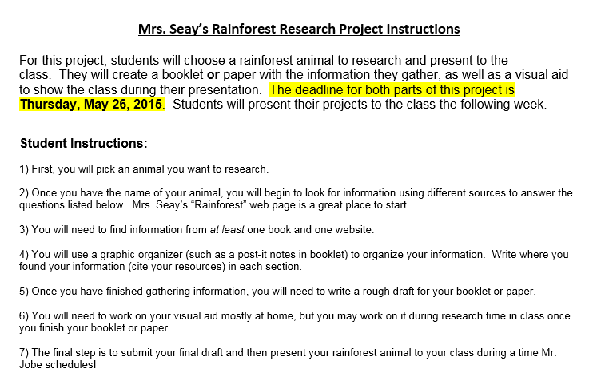
May 25, 2017
Research
Rainforest
Click on letter for video

Slide 10
Research
Rainforest

Slide 11
Cover
Animal Name
Research by:
Your Name
Picture of Animal
(Drawn or printed)

Slide 12
Table of
Contents
Appearance……………………………………….1
Habitat………………………………………………2
Food Chain…………………………………………3
Wow Facts…………………………………………4
Resources………………………………………… 5

Slide 13
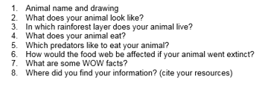

Slide 14
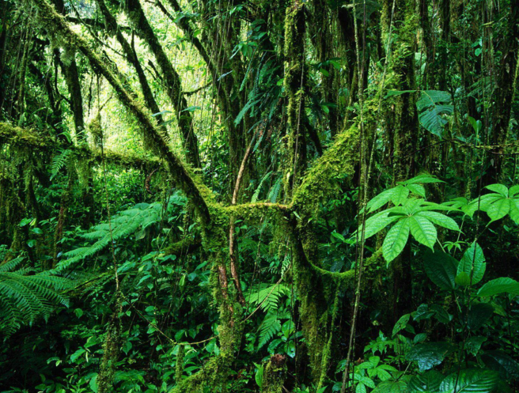
Rainforest

Slide 15
Rainforest
Click on Rainforest word to see informational slide show

Slide 16
Highs & Lows

