Slide 1
B.A.E.
Test Taking Strategy!

Slide 2
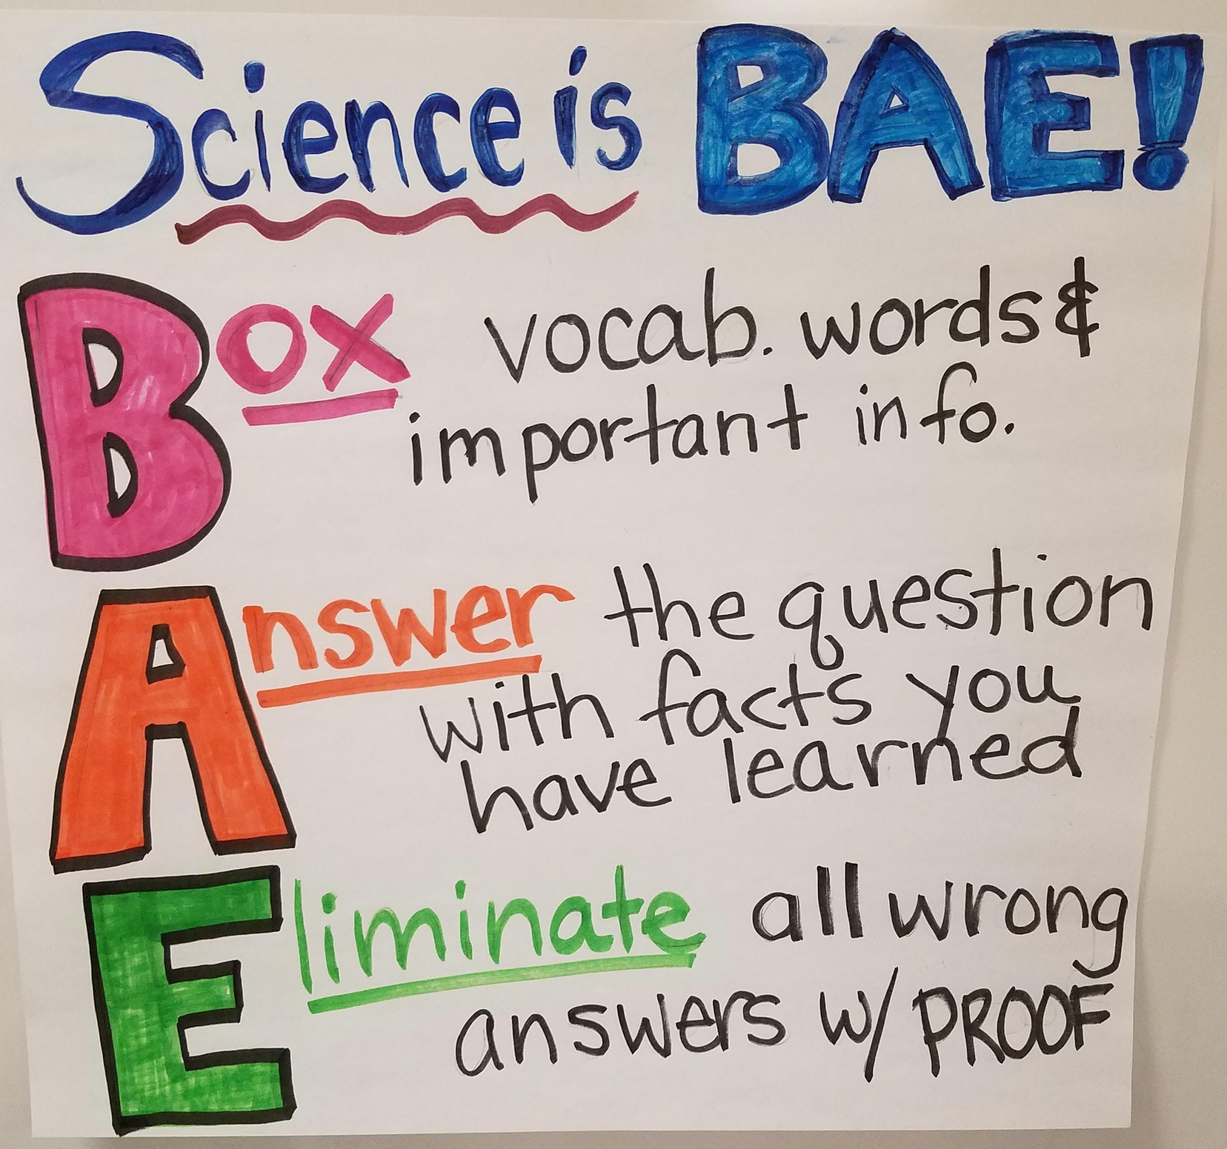

Slide 3
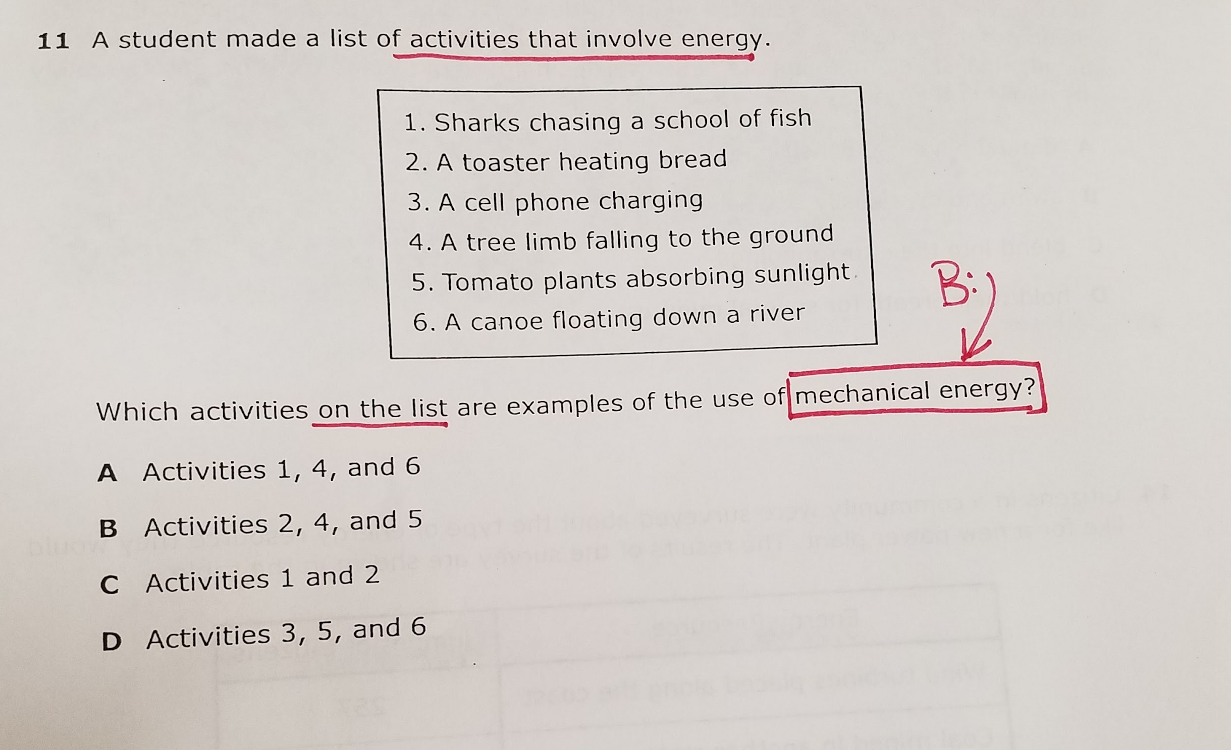
B. Box, underline, or circle any vocabulary words or important information- especially in the question!

Slide 4
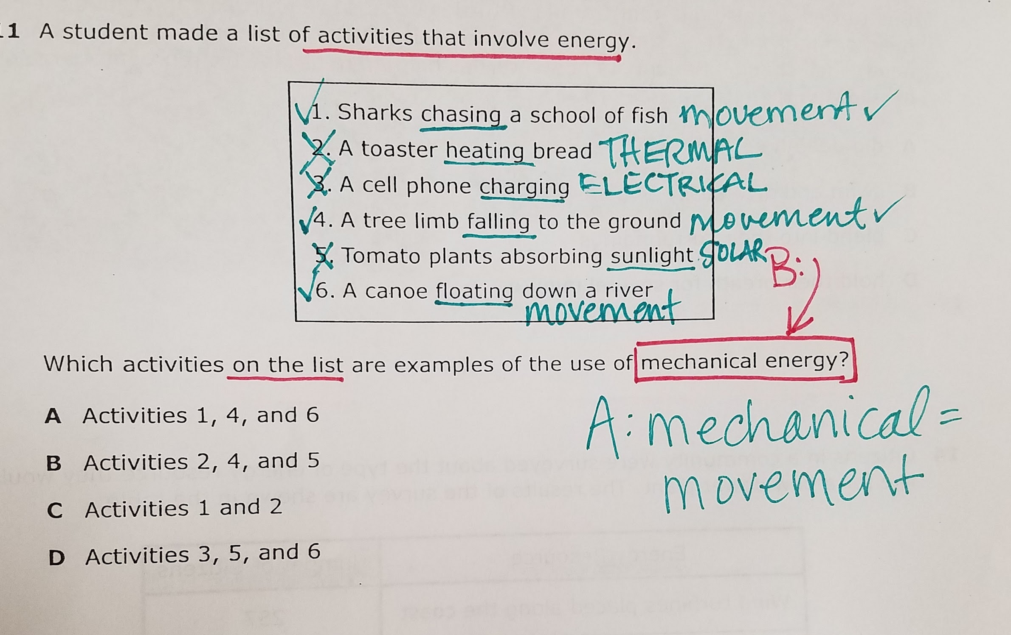
A. Answer the question before you look at the choices. Write the fact that you have learned to prove your answer. Show your work.

Slide 5
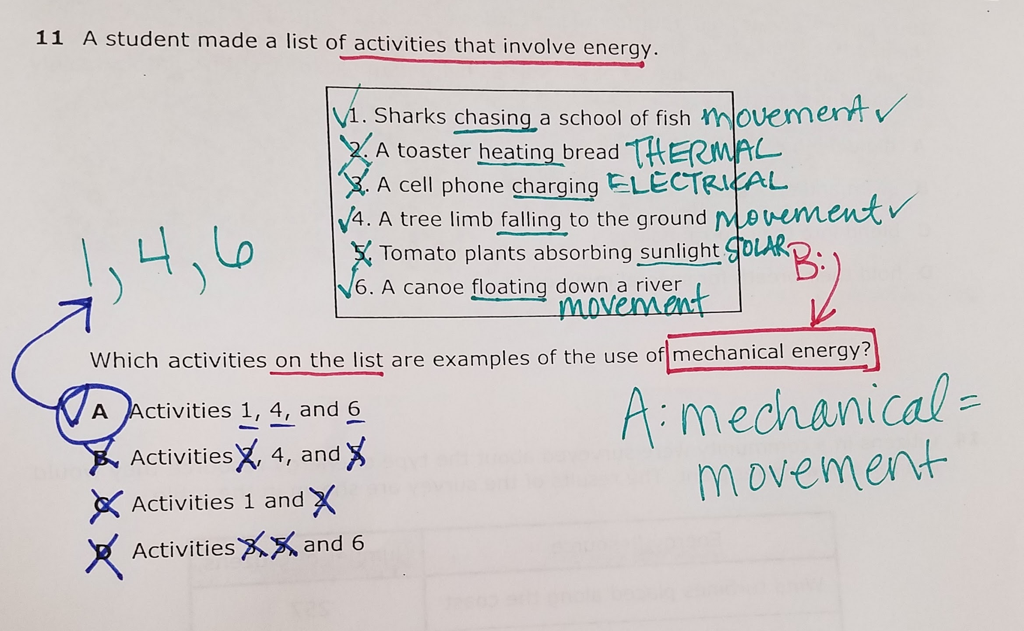
E. Eliminate all wrong answers. Be specific. Show what makes each statement incorrect.

Slide 6
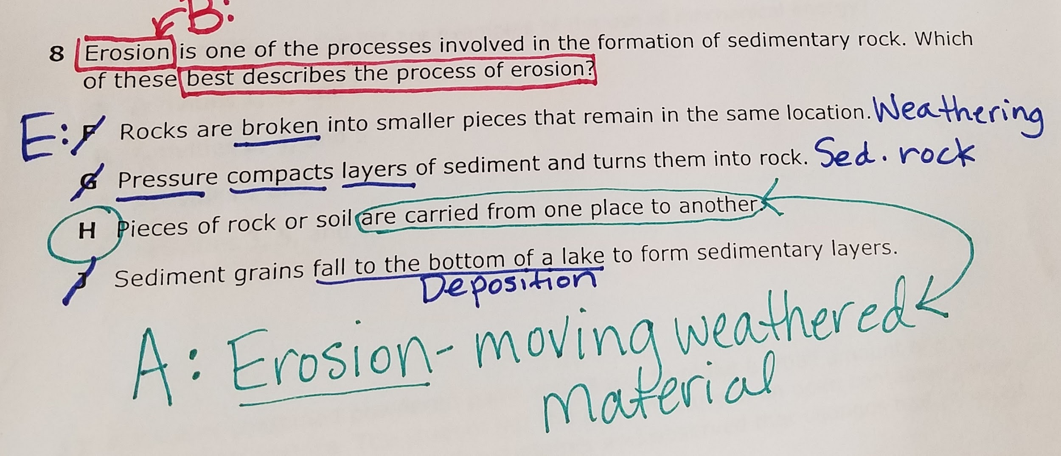

Slide 7
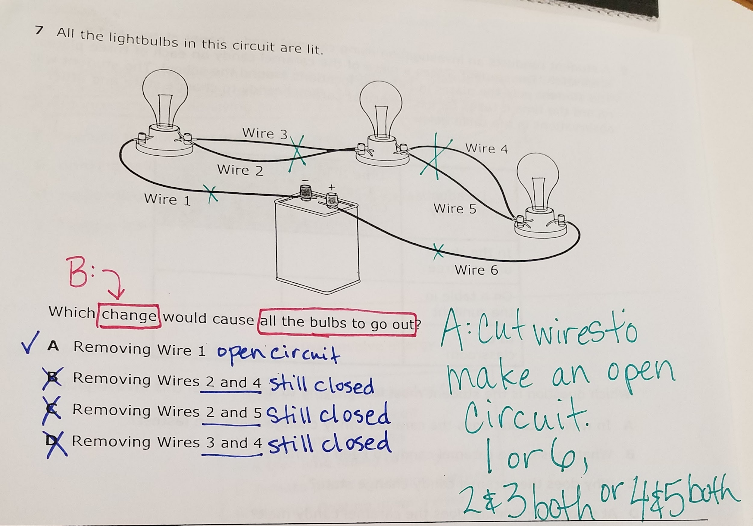

Slide 8
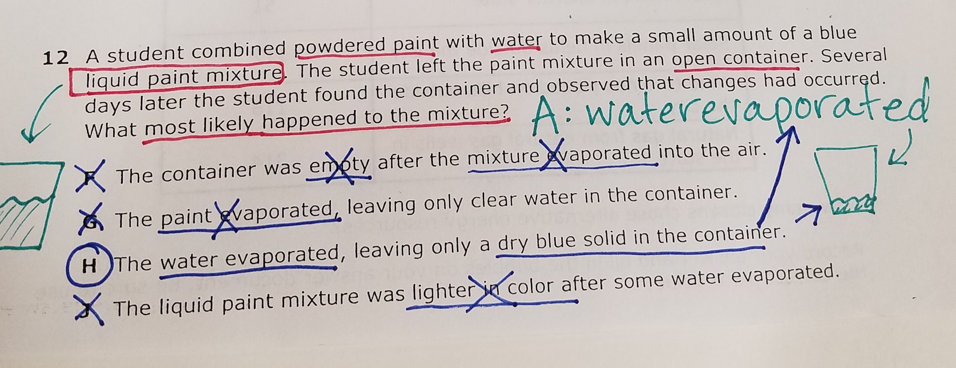

Slide 9
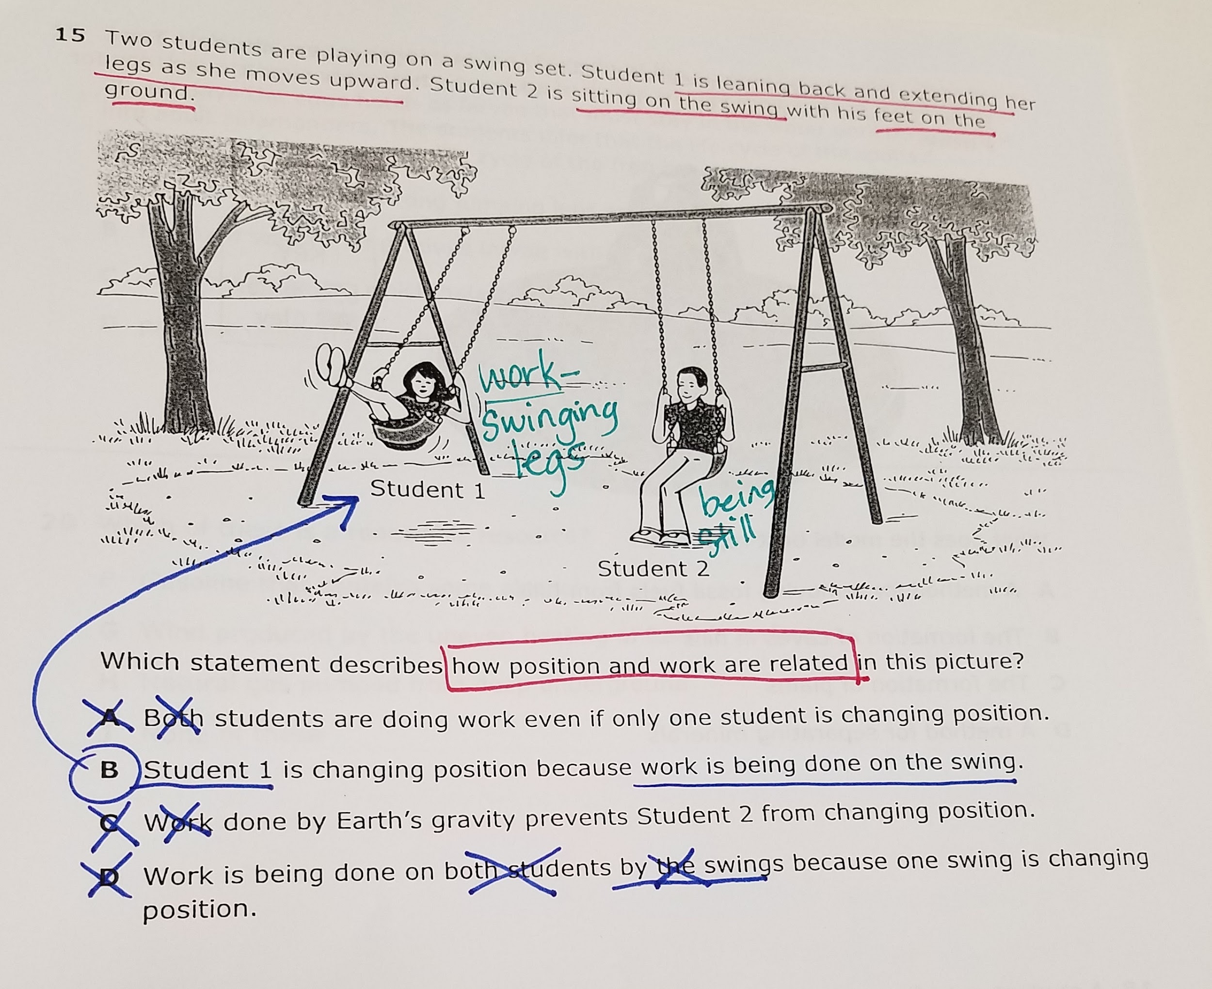

Slide 10
