Slide 1
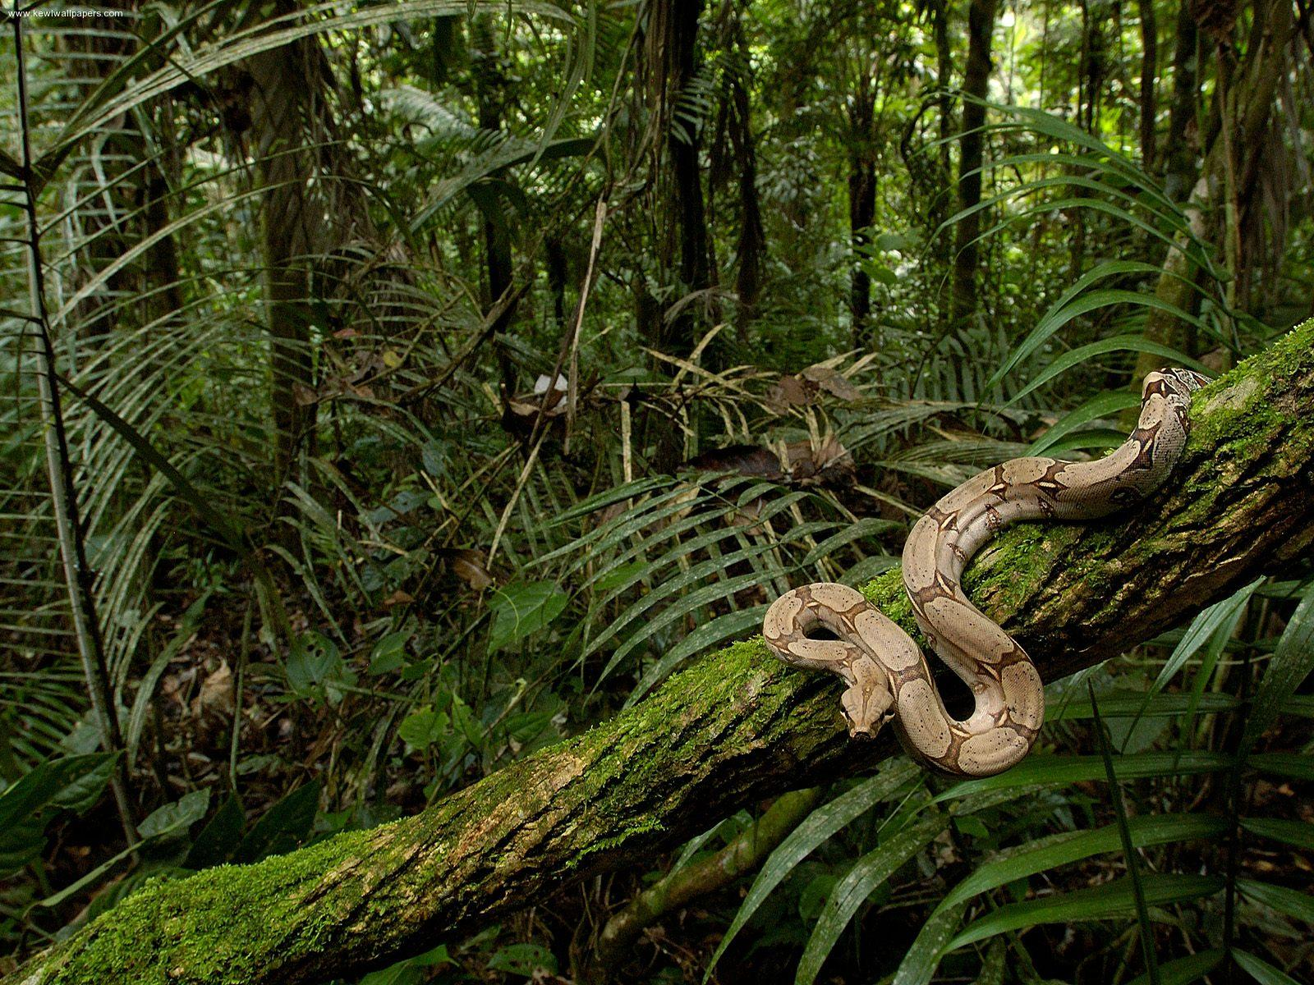
Rainforest Habitats

Slide 2
Description
Tropical forests are characterized by the greatest diversity of species. They occur near the equator. Because the equator is evenly heated by the sun, the average temperatures of the three warmest and three coldest months do not differ by more than 5 degrees.
The amount of rainfall is also about the same all year round. Average rainfall in the rainforest is around 70-80 inches.

Slide 3
PLANTS
More than half of all the world's plant and animal species live in tropical rain forests. Tropical rainforests produce 40% of Earth's oxygen.
Seventy percent of the plants in the rainforest are trees.
There are four main layers of plants in the rainforest. The top layer is called the canopy, it blocks most light from the rainforest floor.

Slide 4
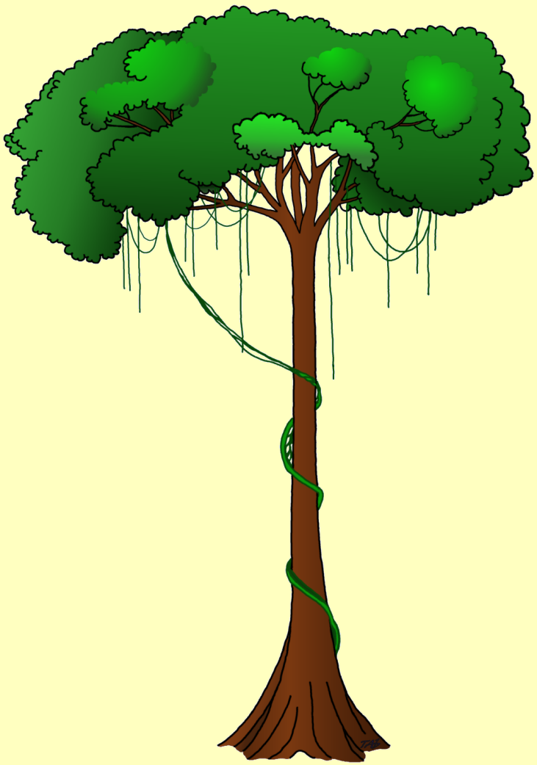
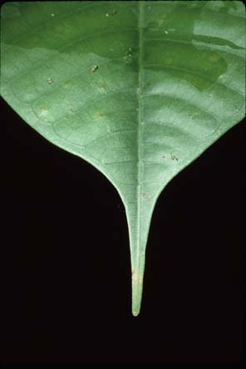
Plant Adaptations
The tallest trees have no side branches because there is little light under the canopy.
Many plants have brightly colored flowers and strong, sweetly scented fruit to attract insects and animals.
The leaves of rainforest trees have adapted to cope with the large amount of rain. The leaves are big, thick and waxy, and have 'drip tips' to let the rain drain off quickly.
Some trees have roots in the air to catch moisture.

Slide 5
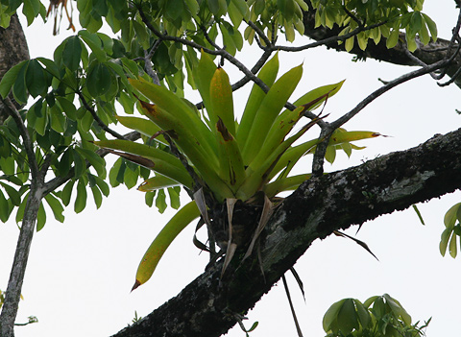
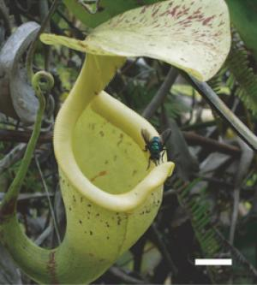
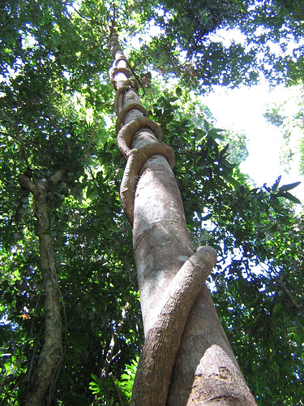
Some plants grow on the branches of the tall trees so that they are closer to the sunlight and to absorb the trees nutritents.
Most trees have smooth bark to keep other plants from climbing or living on them.
There are many carnivorous plants in the rainforest.
There are many types of plants that are climbing vines.

Slide 6
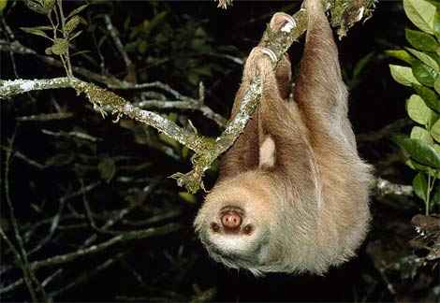
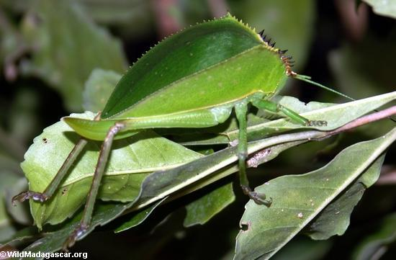
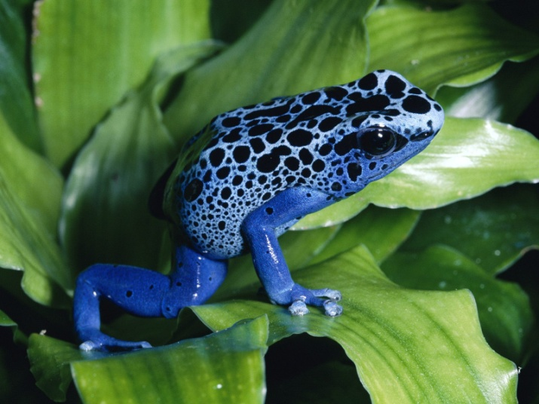
ANIMAL ADAPTATIONS
Many animals are adapted to be good at climbing since there are so many trees.
Many rainforest animals use camouflage and mimicry to 'disappear' in the rainforest.
Some animals are poisonous, and use bright colors to warn predators to leave them alone.

Slide 7
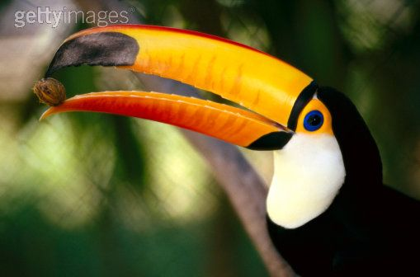
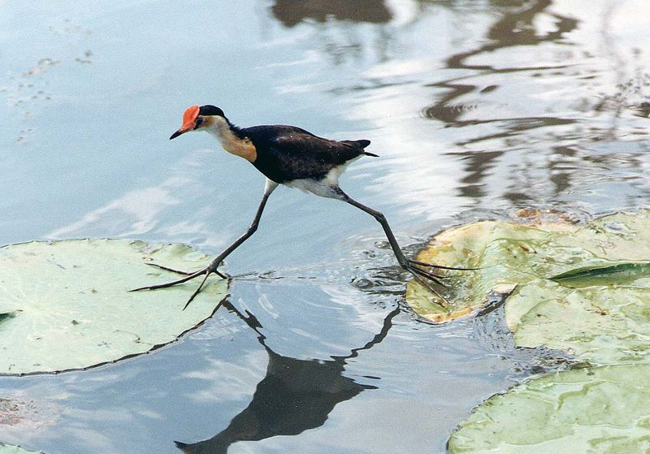
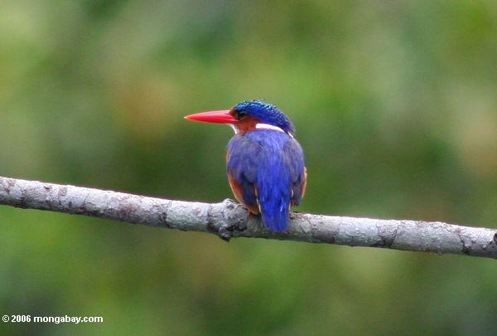
Pretty Birds! Beaks, Feet, and Feathers with a special design…
Many birds eat nuts, and developed big strong beaks to crack open the tough shells.
Tree birds have long toes that can perch easily on branches.
The Jacana has extremely long toes so it can walk on lily pads without falling through.
The kingfisher has a long, spear like beak for catching fish.

Slide 8
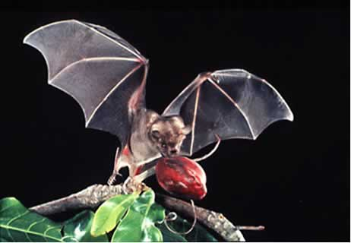
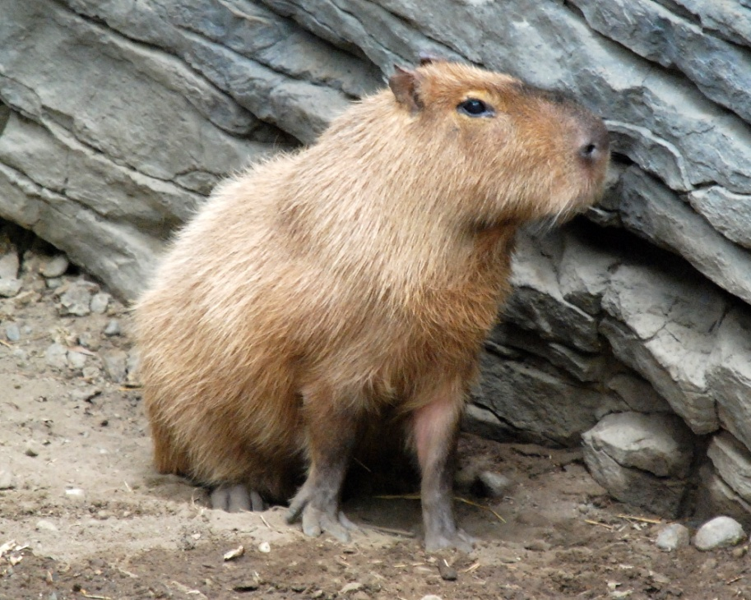
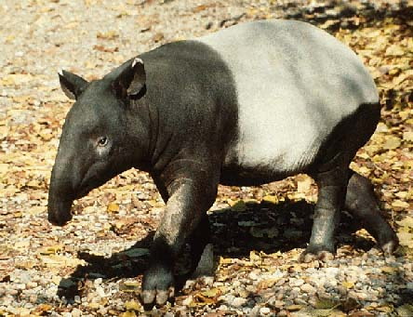
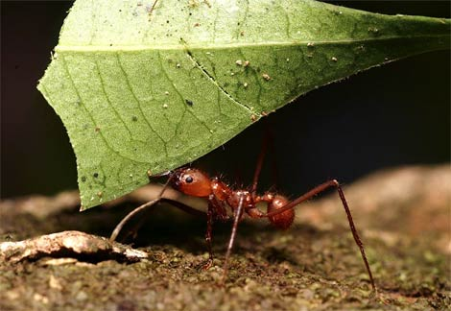
Rainforest Herbivores:
elephants, fruit bats, tapirs, gorillas, howler monkeys, iguanas, hummingbirds, tortoises, capybaras, leaf cutter ants, manatees, and hippopotami.

Slide 9
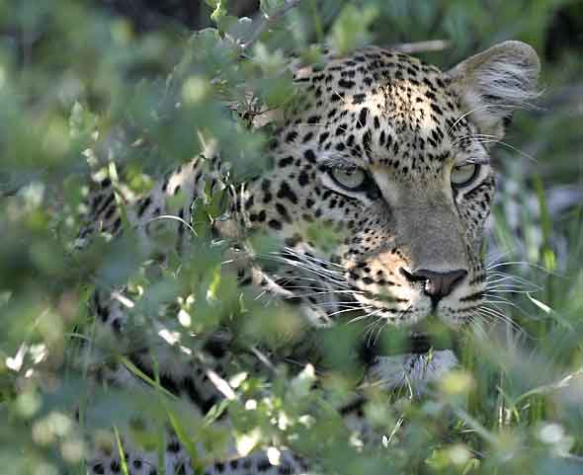
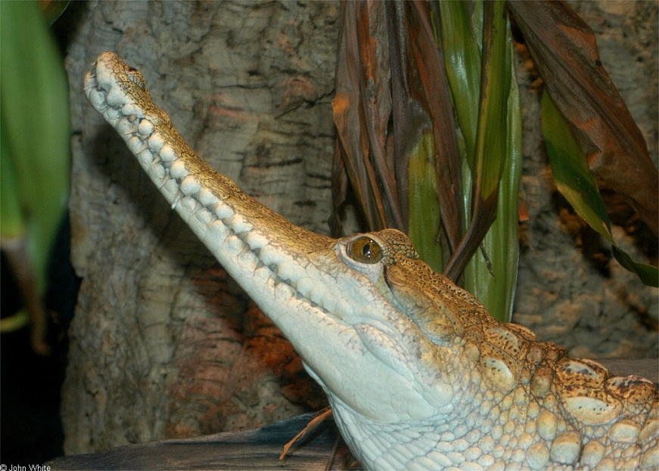
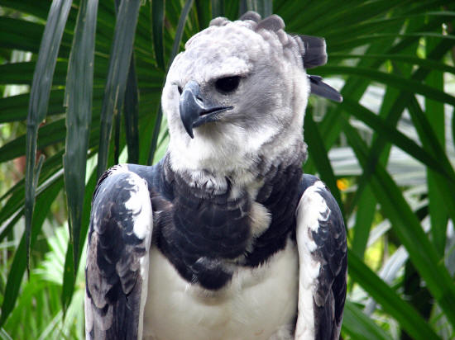
Rainforest Carnivore examples
Mammals-Leopards, tigers and other big cats.
Reptiles-Crocodiles and caimans, anacondas and other snakes
Birds-harpy eagles

Slide 10
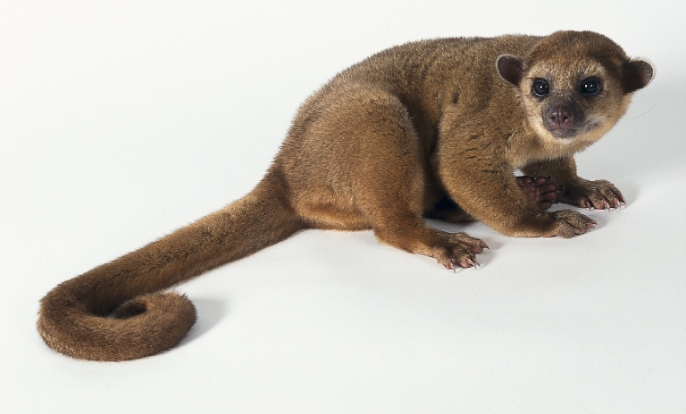
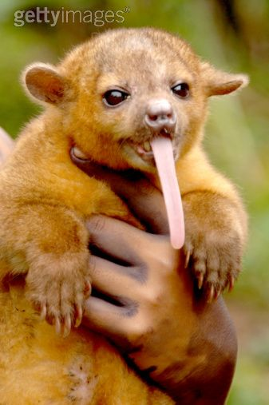
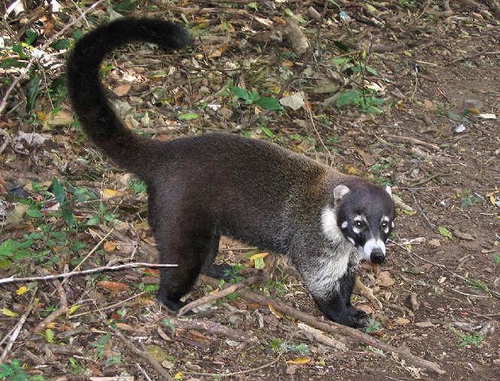
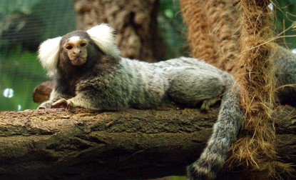
Rainforest Omnivores
Monkeys, marmosets, chimpanzees, bears, coatimundi, kinkajous, and lemurs

Slide 11
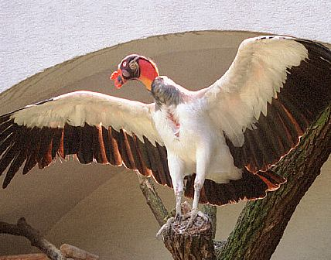
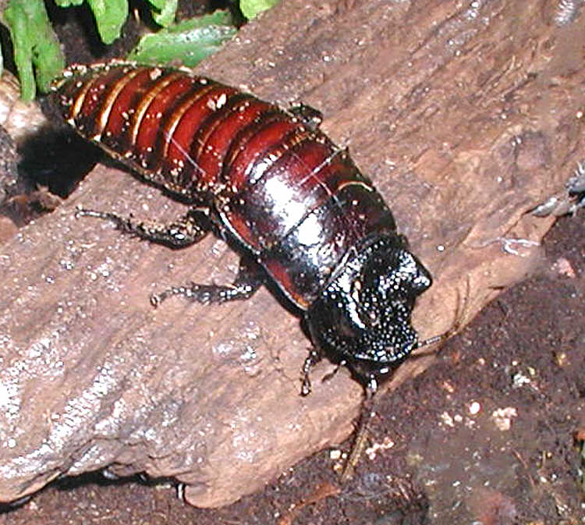
Scavengers:
vultures, ants, millipedes
Decomposers:
Fungi, worms, bacteria, termites, cockroaches,

