Slide 1
FIGURATIVE LANGUAGE & POETRY TERMS

Slide 2
SIMILES
DIRECTLY COMPARES TWO UNRELATED NOUNS USING “LIKE” OR “AS” TO BRIDGE THE CONNECTION
EX.
* STUCK LIKE GLUE
*I’M GOING TO MISS YOU
LIKE A CHILD MISSES THEIR BLANKET

Slide 3
METAPHORS
THE COMPARISON BETWEEN TWO UNRELATED NOUNS SAYING ONE THING “IS” ANOTHER THING
EX.
*BABY, YOU’RE A FIREWORK
*YOU WERE ROMEO
*I WAS A SCARLET LETTER

Slide 4
ONOMATOPOEIA
THE FORMATION OF WORDS THAT SOUND LIKE OR SUGGEST THE OBJECTS OR ACTIONS BEING NAMED
EX.
*TICK TOCK
*BANG, BANG, BANG

Slide 5
ALLITERATION
THE SAME, BEGINNING SOUND IN TWO OR MORE WORDS CLOSE TOGETHER
EX.
*SAD, SONGS, SAY, SO MUCH
*RUDOLPH THE RED NOSED REINDEER
*WHAT A WONDERFUL WORLD

Slide 6
REPETITION
REPEATING THE SAME WORDS OR PHRASES THROUGH A SONG OR POEM TO CREATE A RHYTHM OR SET A MOOD
EX.
*WE TALK ABOUT….
*LIKE A BOSS….

Slide 7
PERSONIFICATION
THE ASSIGNMENT OF HUMAN TRAITS TO THINGS, COLORS, QUALITIES, AND IDEAS
EX.*AND THE SHADOW OF THE DAY, WILL EMBRACE THE WORLD IN GRAY.
*THIS TOWN IS COLDER NOW, I THINK IT’S SICK OF US.
*HIP HOP JUST DIED THIS MORNING, AND SHE’S DEAD.

Slide 8
HYPERBOLE
USING EXAGGERATION TO MAKE A POINT
EX.
*HER EYES, HER EYES, MAKE THE STARS LOOK LIKE THEY’RE NOT SHINING.
*TODAY WAS A FAIRY TALE, YOU’VE GOT A SMILE THAT TAKES ME TO ANOTHER PLANET.

Slide 9
IMAGERY
CREATING A MENTAL PICTURE
EX.
*IF I DIE YOUNG, BURY ME IN SATIN. LAY ME DOWN ON A BED OF ROSES. SINK ME IN THE RIVER, AT DAWN….
*HER TEARS ARE LIKE DIAMONDS ON THE FLOOR

Slide 10
https://www.youtube.com/watch?v=8_QVhoLl_9U

Slide 11
ASSIGNMENT
* LOOK AT THE LYRICS FOR EACH OF THE FOLLOWING SONGS
* COPY, PASTE, & LABEL EXAMPLES FROM THE LYRICS OF EACH OF THE 8 FORMS OF FIGURATIVE LANGUAGE / POETIC DEVICES THAT YOU HAVE IN YOUR NOTES.
* EACH SONG MAY ONLY BE USED ONCE
* EACH TERM MAY ONLY BE USED ONCE

Slide 12
“You Lie” The Band Perry
“One Thing” One Direction
“Our Song” Taylor Swift
“Just the Way You Are” Bruno Mars
“The House that Built Me” Miranda Lambert
“Hoe Down Throw Down” Miley Cyrus
“Fireflies” Owl City
“Bleeding Love” Leona Lewis

Slide 13
OXYMORON
A FIGURE OF SPEECH IN WHICH TWO CONTRADICTORY TERMS APPEAR IN CONJUNCTION WITH EACHOTHER
EX. *NUMB SENSATION
*PLASTIC GLASSES
*STUDENT TEACHER

Slide 14
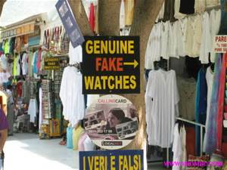

Slide 15
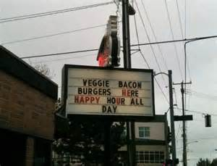

Slide 16
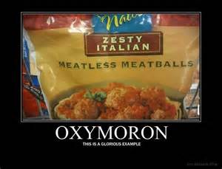

Slide 17
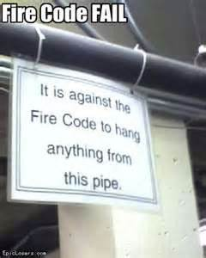

Slide 18
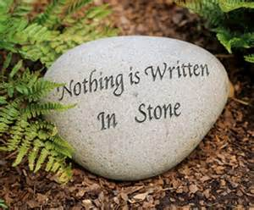

Slide 19
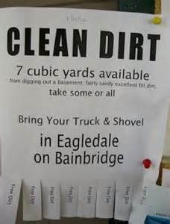

Slide 20
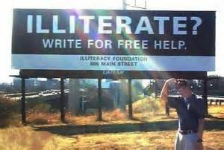

Slide 23
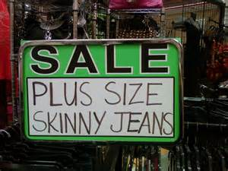

Slide 24
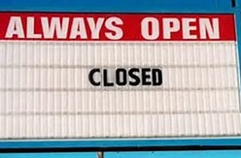

Slide 25
USING INK - ADD EACH WORD TO THE BOTTOM OF A BOX ON YOUR OXYMORON BINGO CARDS
*COPY*SWEET*TIGHTS*MOVING*
*MILLIONAIRE*NEGATIVE*DOG*
*MISUNDERSTOOD*SHRIMP*END*
*PIECE*RIBS*NEWS*GRIEF*WAR*
*CROWD*ROAR*AGAIN*DEAD*
*ALIVE*SLEEP*LIGHT*MUCH*PAIR*FLOOR
Notes:
PASS OUT BINGO CARDS. TEACHER CALLS OUT MISSING BEGINNING WORDS, AND KIDS PENCIL THEM INTO THE BOXES THEY THINK THEY GO IN.
ANSWERS (ORGINAL COPY, BITTER SWEET, BAGGY TIGHTS, POSITIVELY NEGATIVE, STILL MOVING, BANKRUPT MILLIONAIRE, CLEARLY MISUNDERSTOOD, JUMBO SHRIMP, RESTLESS SLEEP, DARK LIGHT, BIRD DOG, DULL ROAR, NEVER AGAIN, BURIED ALIVE, WALKING DEAD, SMALL CROWD, FRONT END, NOTHING MUCH, SINGLE PAIR, TOP FLOOR, CIVIL WAR, GOOD GRIEF, OLD NEWS, BONELESS RIBS, WHOLE PIECE)

Slide 26
EUPHEMISM
A WORD OR SERIES OF WORDS WHICH REPLACES SAD, UNPLEASANT, OR SHOCKING IDEAS WITH SOFTER AND NICER EXPRESSIONS
EX. *A FEW SANDWICHES SHORT OF A PICNIC
*NATURE CALLS

Slide 27
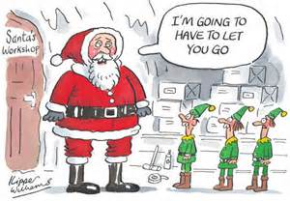

Slide 28
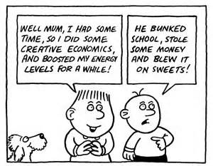

Slide 29
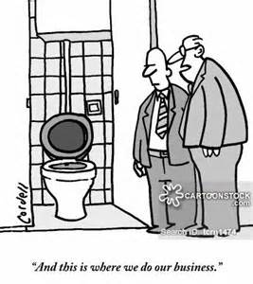

Slide 30
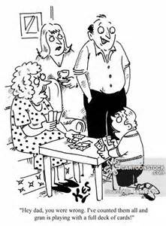

Slide 31
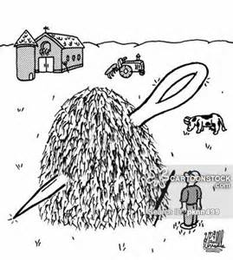

Slide 32
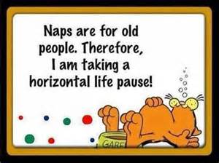

Slide 33
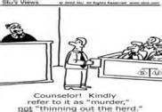

Slide 34
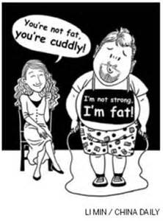

Slide 36
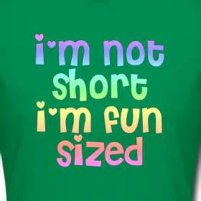

Slide 37
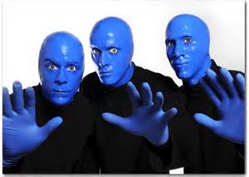
THE EUPHEMISM SONG
http://www.bing.com/videos/search?q=blue+man+group+euphemism&qs=n&form=QBVR&pq=blue+man+group+euphemism&sc=1-24&sp=-1&sk=#view=detail&mid=07809AE948BA5805637607809AE948BA58056376

Slide 38
ALLUSION
A BRIEF & INDIRECT REFERENCE TO A PERSON, PLACE, OR THING, IN HISTORY, RELIGION, LITERATURE, POP CULTURE, OR THE ARTS. IT DOES NOT DESCRIBE IN DETAIL THE PERSON OR THING TO WHICH IT REFERS. IT IS JUST A PASSING COMMENT, & THE WRITER EXPECTS THE READER TO POSSESS ENOUGH KNOWLEDGE TO SPOT THE ALLUSION & GRASP ITS IMPORTANCE IN A TEXT.

Slide 39
EXAMPLES OF ALLUSION
I WAS SURPRISED HIS NOSE WAS NOT GROWING LIKE PINOCCCHIO’S.
(REFERS TO A PUPPET NAMED PINOCCHIO WHOSE NOSE WOULD GROW EVERY TIME HE TOLD A LIE - FROM THE ADVENTURES OF PINNOCHIO BY CARLO COLLODI)

Slide 40
WHEN SHE LOST HER JOB SHE ACTED LIKE A SCROOGE.
(REFERS TO THE SCROOGE IN CHARLES DICKENS’ BOOK, A CHRISTMAS CAROL. THE SCROOGE WAS AN EXTREMELY STINGY CHARACTER.)

Slide 41
HE WAS A REAL ROMEO WITH THE LADIES.
(REFERS TO A CHARACTER IN SHAKESPEARE’S PLAY, ROMEO AND JULIET. HE WAS VERY ROMANTIC IN EXPRESSING HIS LOVE FOR JULIET.)

Slide 42
Building Background
For an allusion to be effective, it must refer to an event that the audience is familiar with. Watch this video to see a popular sequence in a film that is often alluded to in other films.
https://www.youtube.com/watch?v=532j-186xEQ
https://www.youtube.com/watch?v=bZTOV-55ivM
https://www.youtube.com/watch?v=M9kd7JXKHfM
Notes:
*play allusion card game after this last slide & assing independent practice sheet

Slide 43
COLLOQUIALISMS
WORD, PHRASE, OR OTHER FORM USED IN EVERYDAY
INFORMAL LANGUAGE
*INCORPORATES CONTRACTIONS SUCH AS I’LL, HAVEN’T, AND DOESN’T
*INCORPORATES ABBREVIATIONS SUCH AS FRIDGE, TV, AND HOOD
*A MAJOR ASPECT IS THE USE OF IDIOMS AND SLANG

Slide 44
IDIOMS
PHRASE OF FIXED EXPRESSION THAT HAS A FIGURATIVE, OR SOMETIMES LITERAL, MEANING.
___________________________________
AN IDIOMS FIGURATIVE MEANING IS DIFFERENT FROM THE LITERAL MEANING.
EX. *RAINING CATS AND DOGS
* WHEN THE FAT LADY SINGS
https://www.youtube.com/watch?v=E9DxGe94uoc

Slide 45
SLANG
*VERY INFORMAL WORDS OR PHRASES THAT ARE USUALLY RESTRICTED TO A CERTAIN GROUP OF PEOPLE
*SOME CONVEY NEGATIVE CONNOTATIONS & CAN BE OFFENSIVE
EX. DUDE, PEEPS, BAE, FLEEK

Slide 46
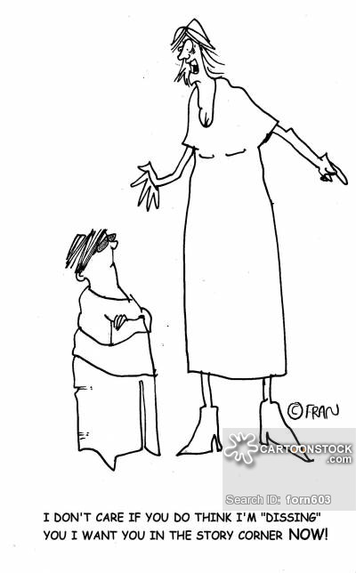

Slide 47
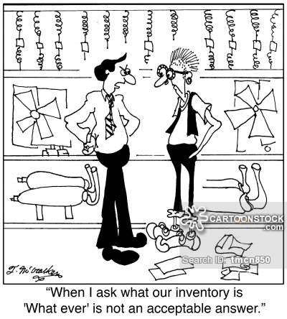

Slide 48
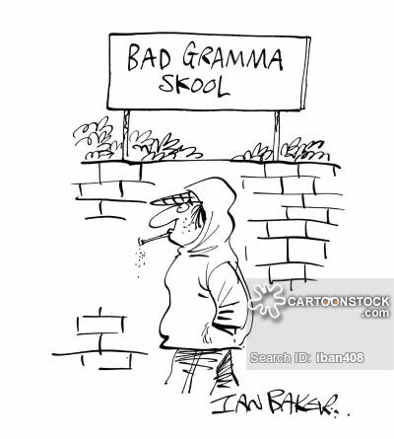

Slide 49
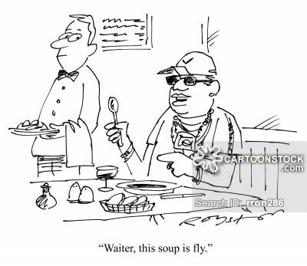

Slide 50
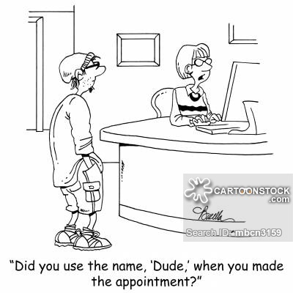
http://www.bing.com/videos/search?q=ENGLISH+SLANG+VIDEO&FORM=HDRSC3#view=detail&mid=4D5047DFEC6884659BB04D5047DFEC6884659BB0

Slide 51
JARGON
SPECIALIZED LANGUAGE AND TERMINOLOGOY ASSOCIATED WITH A PARTICULAR OCCUPATION
EX. JARGON FROM COMPUTER-RELATED FIELDS WOULD BE WORDS SUCH AS INTERFACE, BLOG, & USER-FRIENDLY http://www.tvguide.com/news/greys-anatomy-stars-medical-jargon-quiz-kevin-mckidd-jessica-capshaw/?rss=tv-hotlist&partnerid=spi&profileid=09

Slide 52
Students take Major assessment over first 16 terms and examples of each.

Slide 53
S.S.W.
(SUSTAINED SILENT WRITING)
1. YOUR STORY MUST CONTAIN AN EXAMPLE OF 10 OF THE 16 FIGURATIVE LANGUAGE / POETIC DEVICES THAT WE HAVE COVERED.
2. THE 10 EXAMPLES THAT YOU USE, CANNOT BE THE EXAMPLES I GAVE YOU IN YOUR NOTES.
3. YOU NEED TO UNDERLINE & LABEL THE EXAMPLES IN YOUR STORY.
4. THE EXAMPLES YOU USE NEED TO FIT COMFORTABLY INTO YOUR STORY.
HYPERBOLE ALLITERATION EUPHEMISM
COLLOQUIALISM METAPHOR IMAGERY, ONOMATOPOEIA ALLUSION JARGON
OXYMORON IDOIOM SLANG
PERSONIFICATION REPETITION SIMILE PUN

Slide 54
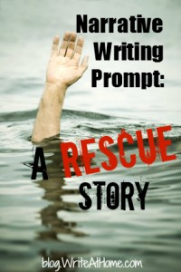
This assignment is narrative .This story is to be a “rescue story.”
It will involve at least these two characters:
Someone in danger- needing rescue.
A rescuer - the hero who tries to save the day.
Do your best to capture the reader’s attention and create suspense.
Your classmates have tied up the substitute and taken her hostage.
An fisherman is lost at sea after a storm.
A bank robber is trapped in the vault he had been trying to rob.
A rich man’s daughter is held captive by kidnappers.
A lone mountain climber hangs off a cliff by his fingertips.
A soldier in a bunker is surrounded by the enemy.
A hamster is in a pet store cage.
A vacationing family has run out of gas in the desert.
A skier is buried under an avalanche.
An astronaut’s tether has broken during a spacewalk.
Etc…………..

Slide 55
APHORISM
A STATEMENT OF TRUTH OR OPINION EXPRESSED IN A CONCISE AND WITTY MANNER
AN ADAGE IS JUST AN APHORISM THAT GETS PASSED THROUGH HISTORY AS A REGULAR PART OF THE
EX.
*YOU DON’T GET SOMETHING FOR NOTHING.
*WHERE THERE’S A WILL, THERE’S A WAY.
*YOU CAN’T TEACH AN OLD DOG NEW TRICKS.

Slide 56
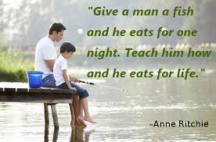
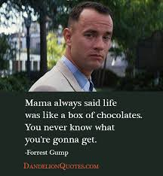
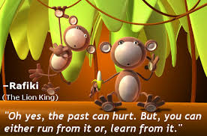
https://www.youtube.com/watch?v=fjlNFtmty3A

Slide 57
CLICHÉ
EXPRESSION, IDEA, OR ELEMENT OF AN ARTISTIC WORK WHICH HAS BECOME OVERUSED TO THE POINT OF LOSING ITS ORIGINAL MEANING OR EFFECT, EVEN TO THE POINT OF BEING IRRITATING
EX. *THE ACORN DOESN’T FALL FAR FROM THE TREE
*AN APPLE A DAY KEEPS THE
DOCTOR AWAY
*AT THE CRACK OF DAWN

Slide 58
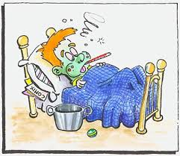
YOU SHOULD AVOID CLICHES LIKE THE PLAGUE!!!!!
Notes:
They might have looked good at one time, but they don’t look good anymore. It’s like wearing someone else’s old and dirty clothes. You need to use your own words, not someone elses!! Be original! Take out the tired words and create new cliches of your own!

Slide 59
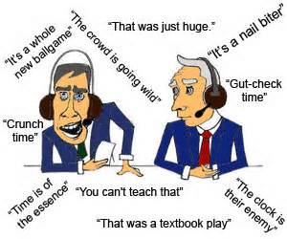

Slide 60
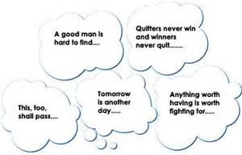

Slide 61
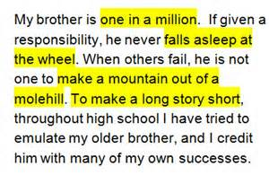
https://www.youtube.com/watch?v=eJhH5EgpkPU

Slide 62
RECOGNIZE THESE ?
*THE DREAM
*THE HAPPILY EVER AFTER
*THE HELPLESS PRINCESS
*THE CAR NEVER STARTS
*NO RECEPTION ON THE CELL PHONE
*CAN’T RUN AWAY WITHOUT FALLING DOWN
*THE BAD GUY NEVER DIES
*ETC…..

Slide 63
SYMBOLISM
A FIGURE OF SPEECH WHERE AN OBJECT, PERSON, OR SITUATION HAS ANOTHER MEANING OTHER THAN THE LITERAL MEANING
EX.
*WITH THIS RING, I THEE WED..
*SUPERMAN IS THE ICONIC
“MAN OF STEEL”.
*PRINCE CHARLES WAS BORN TO THE PURPLE.

Slide 64
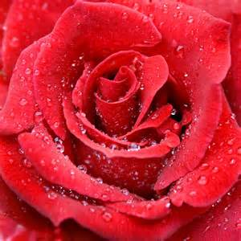
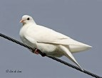
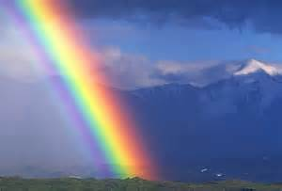
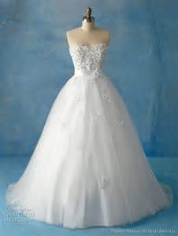
https://www.youtube.com/watch?v=WhijmmePlU8

Slide 65
VOWELS
*A, E, I, O, AND U. SOMETIMES THE LETTER Y IS CONSIDERED A VOWEL, BECAUSE IT CAN SOUND LIKE OTHER VOWELS.
*UNLIKE CONSONANTS, EACH OF THE VOWEL LETTERS HAS MORE THAN ONE TYPE OF SOUND OR CAN EVEN BE SILENT.

Slide 66
ASSONANCE
REPETITION OF A PATTERN OF SIMILAR VOWEL SOUNDS TO CREATE INTERNAL RHYMING WITHIN PHRASES OR SENTENCES. IT IS ALSO CALLED VOWEL RHYME.
EX.
*DO YOU LIKE BLUE?
*HE RECEIVED THREE EMAILS TODAY.
*THE SAILOR SAID , “HEY”TO MAE.

Slide 67
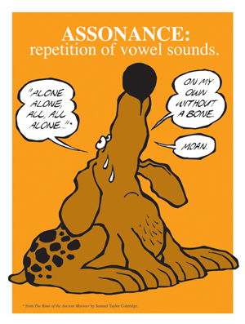
O,OW,OA

Slide 68
EE, IE, EA
http://www.bing.com/videos/search?q=ASSONANCE&FORM=HDRSC3#view=detail&mid=9C134158015BAB5C73029C134158015BAB5C7302

Slide 69
CONSONANTS
*A SPEECH SOUND THAT IS NOT A VOWEL.
*A, E, I, O, U, AND SOMETIMES Y ARE NOT CONSONANTS

Slide 70
CONSONANCE
REPETITION OF THE SAME CONSONANT SOUNDS TWO OR MORE TIMES IN SHORT SUCCESSION.
(INTERNAL OR AT THE END)
EX.*SHELLY SELLS SHELLS BY THE SEASHORE.
*DRESS AND BOSS
*SLITHER AND LATHER
*LAUGHED AND DEFT

Slide 71
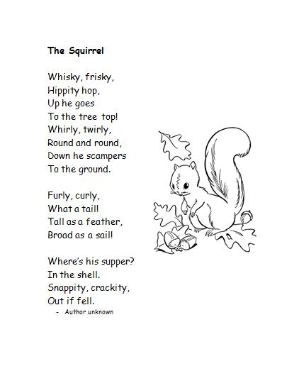
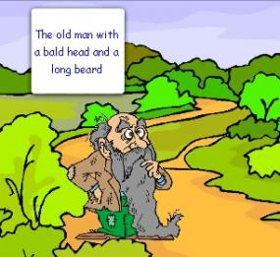
https://www.youtube.com/watch?v=ZUrxG8APyiI
https://www.youtube.com/watch?v=85PKusqduBY

Slide 72
ANAPHORA
(ALSO CALLED EPANAPHORA)
REPETITION OF A WORD OR WORDS AT THE BEGINNING OF TWO OR MORE SUCCESSIVE VERSES, CLAUSES, OR SENTENCES.

Slide 74
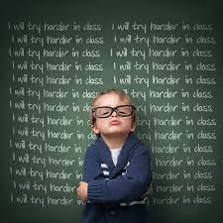
https://www.youtube.com/watch?v=SMezcWFW8ss

Slide 75
EPISTROPHE
THE REPETITION OF A WORD AT THE END OF SUCCESSIVE CLAUSES OR SENTENCES.
https://www.youtube.com/watch?v=-RP19fnff_c

Slide 76
USING YOUR DEVICES OR THE COMPUTERS, COME UP WITH ONE EXAMPLE OF EACH OF THE FOLLOWING TERMS THAT WE COVERED LAST WEEK. THESE EXAMPLES CAN BE IMAGES OR TEXT. YOUR EXAMPLES CANNOT BE THE EXAMPLES I GAVE YOU LAST WEEK. YOUR EXAMPLES MUST BE LABELED, AND YOU MUST HIGHLIGHT ON 5-8.
1. APHORISHM
2. ADAGE
3. CLICHÉ
4. SYBOLISM (& TELL WHAT YOUR EXAMPLE SYMBOLIZES)
5. EPISTROPHE (HIGHLIGHT)
6. ASSONANCE (HIGHLIGHT)
7. CONSONACNE (HIGHLIGHT)
8. ANAPHORA (HIGHLIGHT)
9. EPIGRAPHS - a short quotation or saying at the beginning of a book or chapter, intended to suggest its theme --- ALSO ADD TO YOUR NOTES!!!
THERE IS A TEST OVER ALL OF THESE THIS FRIDAY!!!!!! YOU WILL NEED TO KNOW THE DEFINITIONS & BE ABLE TO IDENTIFY AN EXAMPLE OF EACH!

