Slide 1
Disasters

Slide 2
Statistics 2011
332 Natural Disasters were recorded
Killed 30,773 people
244.7 million victims of these disasters
Costs $366.1 billion
China, the United States, the Philippines, India and Indonesia constitute together the top 5 countries that are most frequently hit by natural disasters.

Slide 3
Facts about disasters
Between 2000 and 2012, natural disasters caused $1.7 trillion in damage and affected 2.9 billion people.
2012 marked the third consecutive year of worldwide natural disaster damage exceeding $100 billion.
2011 reached a record high of $371 billion.
Wildfires are the most widespread natural disaster. Floods are the 2nd highest natural disaster.
Nearly 50 percent of the fatalities caused by natural disasters in 2012 were due to events like flooding or mass movements.
Damage paths of tornadoes can be in excess of one mile wide and 50 miles long.
Landslides often accompany earthquakes, floods, storm surges, hurricanes, wildfires, or volcanic activity. They are often more damaging and deadly than the triggering event.

Slide 4
Top 10 Disasters of All Time!
10 top Disasters

Slide 5
Types of Disasters
Here are a few examples:
What are some types of disasters?
Flood
Tornado
Hurricane
Fire
Earthquake
Oil spill
Extreme weather
Tsunami
Winter Storms
Heat Wave
Landslide
Thunderstorm
Terrorist Attacks
School Shootings

Slide 6
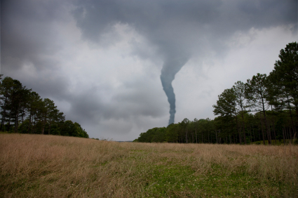
Tornados
winds can reach 300 MPH.
funnel spins at about 200 MPH.
nature's most dangerous storm.
turns the color debris it picks up.
is usually sided by hail and rain.
funnel is usually see-through, but the dust makes it look like a cloud.

Slide 7
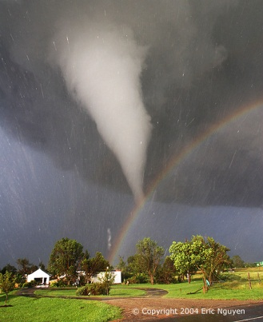
Tornados
Worst tornado happened on March 18 called the "Tri-State" killed 695 people.
The costliest tornado was in Joplin, MO on May 2011 and cost 2.8 billion dollars.
The U.S gets around 1300 tornadoes each year.
The longest tornado lasted 12 hours, and killed 354 people.
The Tornado with the highest winds was on May 3rd 1999, with winds of 302 MPH.
The biggest outbreak of Tornadoes was on April 2011 with 175 Tornadoes.

Slide 8
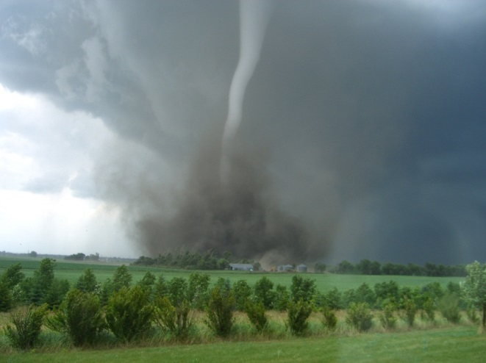
Tornado Stats
Tornados are classified as F0 to F5: https://www.youtube.com/watch?v=gieSbj2svwY
2% of all Tornadoes are F5 tornadoes.
78% of all deaths related to tornadoes are caused by flying debris.
20% of all tornado related deaths are from mobile homes.
2% of all deaths are from being sucked into the Tornado.

Slide 9
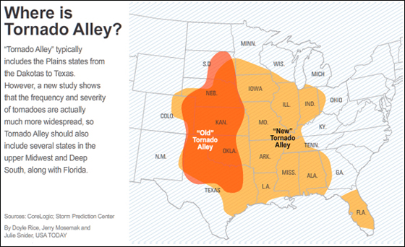
https://www.youtube.com/watch?v=4SYsIGbxOqk – 11 minutes long

Slide 10
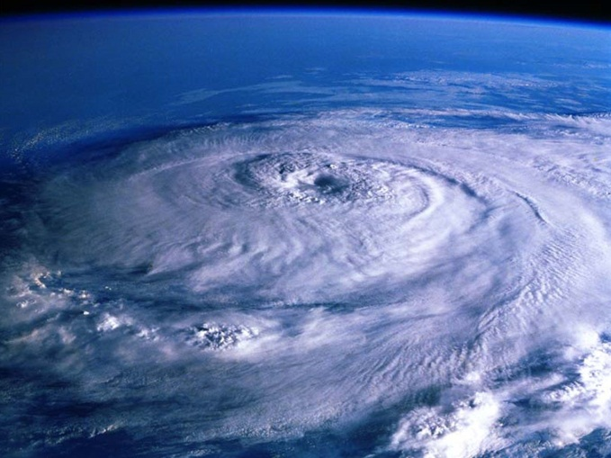
Hurricanes
Hurricanes are large, spiraling tropical storms that can pack wind speeds of over 160 miles an hour and unleash more than 2.4 trillion gallons of rain a day.
Hurricanes—
--are storms with winds at least 74 mph.
--are Tropical Cyclones.
--are condensed water vapor in the air.
--can cause trillions of dollars of destruction.
--are the biggest storms on Earth. Hurricane Katrina killed 1863 people in 2005. Hurricane Katrina affected 1,000,000 people.

Slide 11
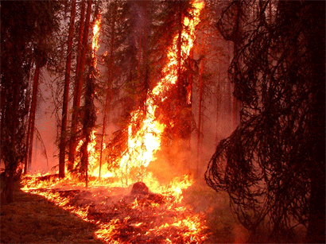
Wildfires
Wildfires are fires caused by lighting, human causes, heat, or lack of rainfall.
Wildfire usually happen in places near the equator, but, wildfires can happen anywhere in the world.
Wildfires are spread by wind, dry leaves or brush, and houses.
Wildfires can cause more damage than a hurricane in rare instances!
Some wildfires are so devastating that they can even happen in places where humidity is high and rainfall is frequent

Slide 12
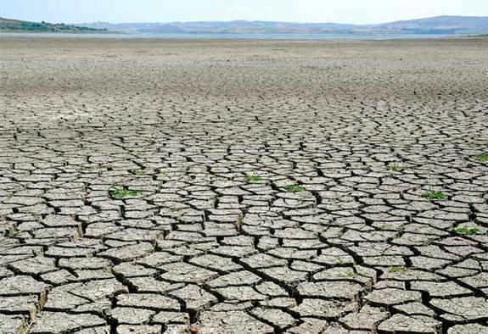
Droughts
Droughts are the lack of rain, and no water.
usually happen when El Nino is nearby.
El Nino is hot air from the ocean rushing towards the coast.
It can kill whole herds of animals.
The Texas Drought has killed half a billion trees.

Slide 13
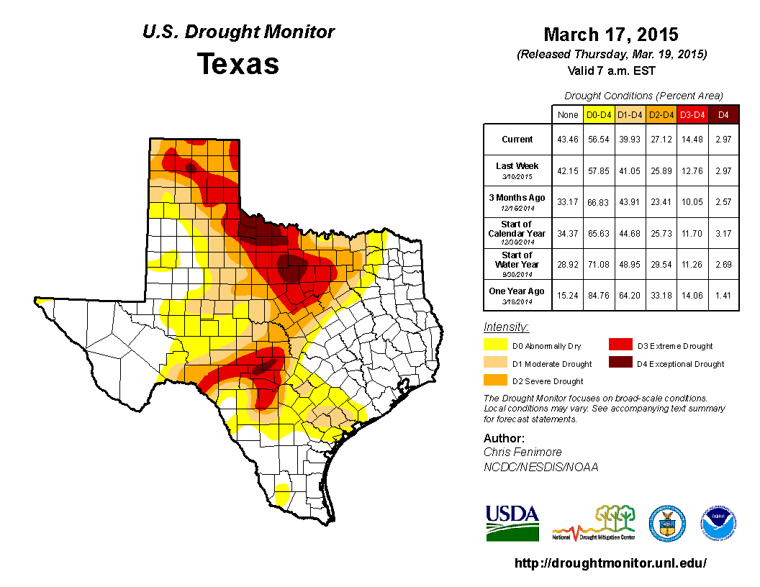

Slide 14
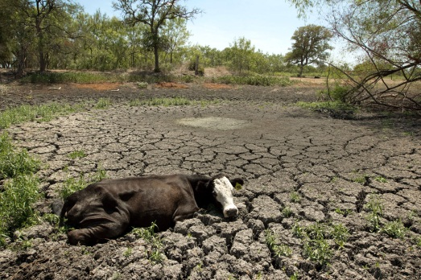
Drought Facts
Droughts can raise the temperature to 100 degrees.
Dust Storms can erode the landscape.
Famine caused by droughts is due to lack of water for irrigation.
Droughts can cause the increase of snake migration.
Wildfires are common during droughts.
Dehydration is a major effect of droughts.
Deforestation is a cause of droughts.
Rainwater harvesting is the collection of rain for usage.
Texas is having the worst drought in its history.

Slide 15
How does the Drought Effect Us?
Crop prices
Beef prices
Fish and game
Homes
Lake levels
What else?

Slide 16
Earthquakes
The 2011 Tsunami in Japan was caused by an underwater earthquake.
The earthquake in Japan killed about 20,000 people. Thousands of earthquakes happen every day, but they are so small that we don't notice them.
The Japanese Earthquake was a magnitude 9 and that is one reason the Tsunami was so devastating.

Slide 17
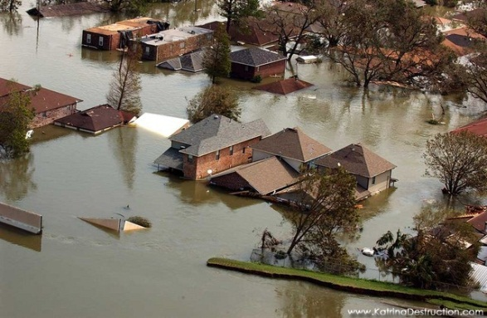
Floods
Floods-- --are bodies of water that cover normally dry land. --can wipe out most houses if strong enough. --can occur within a few minutes or hours of excessive rainfall. --can also be caused by a dam or levee failure. -- some occur seasonally when winter or spring rains. --are among the most frequent and costly Natural Disasters. --can be destructive sometimes and cause a lot of damage.

Slide 18
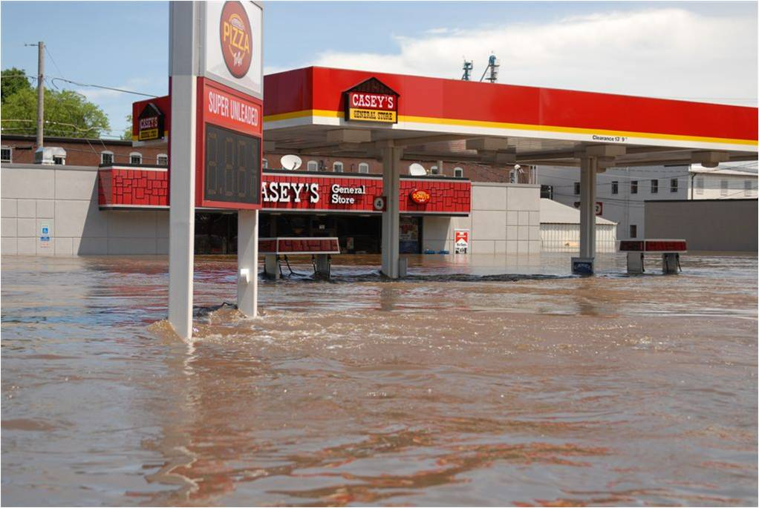
Causes of a Flood
Conditions that cause Floods includes heavy rain for several hours or days that saturates in the ground.
Flash Floods occur suddenly due to rapid water rising.
Most Flash Floods are caused by slow-moving thunderstorms.
Floods can cause major damage on poorly made structures.
Floods can also last for hours like a flowing river.
The Mississippi River, if it let out all it's water, could of caused a 500-year flood.

Slide 19
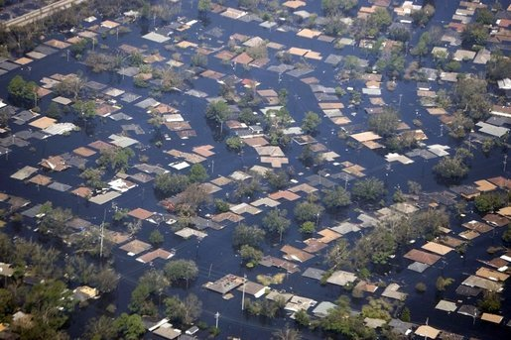
Effects of a flood
Floods can leave critical damage on houses and as well as people.
They can damage cars and trees and it will be hard to get across the freeway when a flood happens.
The effects of floods can even kill you if your not safely in a good structure.
Floods can leave from broken trees to cracking freeways and cause major traffic.
They can leave dangerous after effects if your driving a car on a road or a highway.
They can leave effects that can damage people physically and emotionally.
When a flood is over, don't think its over. There is still damage on roads and highways so be careful.

Slide 20
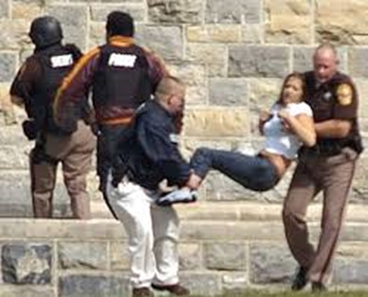

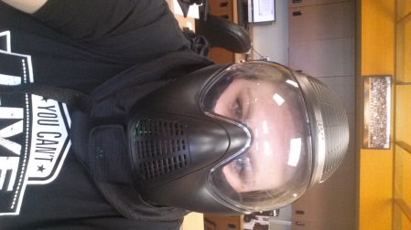
School Shootings
In 2013-2014 there were 74 school shootings in United States including colleges:
18 deaths
24 arrests
2 not arrested
6 committed suicide
13 unknown
https://www.youtube.com/watch?v=aRHcbJ9DHEg

Slide 21
Two Types of Shootings
Targeted school Violence is a term first coined by the Secret Service to identify lethal violence where a school is deliberately selected as the location for the attack.
This excludes spontaneous homicides resulting from fights, drug deals gone bad, or gang violence that coincidentally occur on school property.
The Rampage School Shooter is a student or a former student who attacks their school, students, or faculty in an act of targeted school violence. The rampage school shooter’s attacks are public acts committed in full view of others. They may intend to target specific individuals who they perceive did them some injustice, but generally people are shot randomly or as symbols of the school.

Slide 22
Danger Signals
Victim of bullying and feels concerns are ignored
Suffers from mental health issues
Obsessed with knives, guns, or other weapons
Addicted to violent video games, especially first person shooter games
Addicted to music with violent lyrics and watches violent movies over and over
Drawing excessively violent images
Writing about excessively violent subjects. “Alert Papers”
Expresses admiration for other school shooters. Or talks about how they messed up and how they could do it better
Expresses admiration for mass murderers and serial killers
Develops a hit list of enemies
Talks about plans for a shooting

Slide 23
What can happen in Texas?
Tornados
Floods
Wildfires
Drought
Heat waves
Thunderstorms

Slide 24
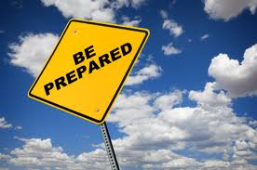
How to be prepared
Create a plan
Build an emergency kit or go bag
Should last for 72 hours
What goes in to an emergency kit?
Learn safety skills
CPR and first aid

Slide 25


Where to get help
Federal Help
FEMA
Local help
American Red Cross
Salvation Army

Slide 26
FEMA
FEMA stands for Federal Emergency Management Agency.
FEMA’s mission is to support U.S. citizens and first responders to ensure that as a nation we work together to build, sustain, and improve our capability to prepare for, protect against, respond to, recover from, and mitigate all hazards.

Slide 27
RED CROSS
The American Red Cross exists to provide compassionate care to those in need.
Disaster Releif
Supporting American’s soldiers and families
Health and Safety Services
Blood Donations
http://www.redcross.org/what-we-do

Slide 28
SALVATION ARMY
The Salvation Army is one of the nation’s largest federally recognized emergency disaster services agencies, providing relief to 1-2 million disaster survivors and first responders each year in the United States.
Immediate response activities include:
Food/Hydration Service:
Emergency Shelter:
Emergency Communications
Emotional and Spiritual care
Recovery activities include:
Restoration and rebuilding
Disaster social services
In-kind donations management

Slide 29
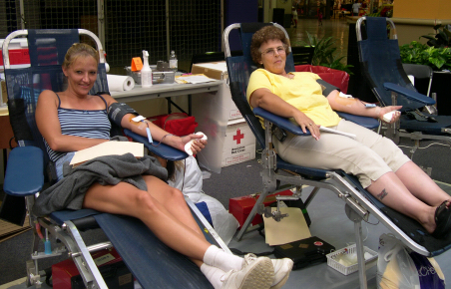
Donating Blood
Every two seconds someone in the U.S. needs blood.
The blood used in an emergency is already on the shelves before the event occurs.
A single car accident victim can require as many as 100 pints of blood.
The number of blood donations collected in the U.S. in a year: 15.7 million
The number of blood donors in the U.S. in a year: 9.2 million
Although an estimated 38% of the U.S. population is eligible to donate, less than 10% actually do each year.
Blood cannot be manufactured – it can only come from generous donors.

Slide 30
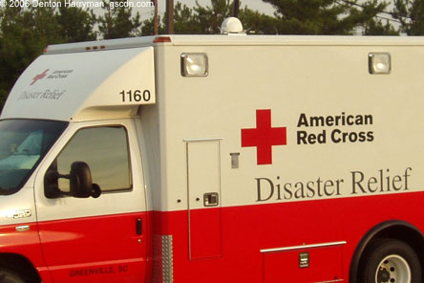
Helping Others
Donate cash
Donate time
Donate Blood
Donated items

