Slide 1
Unlocking Your Future:
Keys to Professional Success

Slide 2
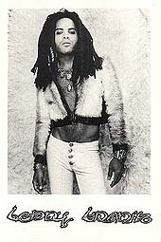
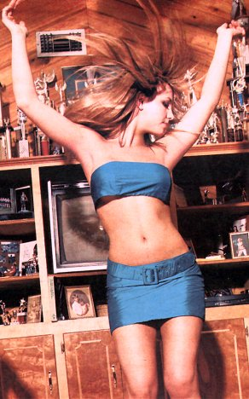
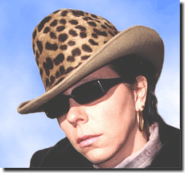
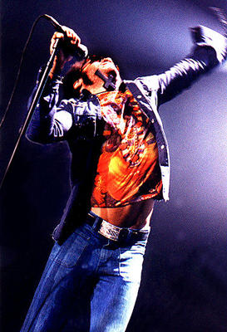
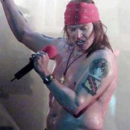
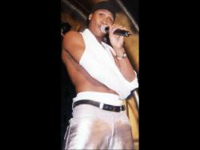
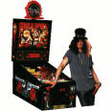
Accept me the Way I Look
Sleeveless tops
NOT!
Sun Glasses
Skirts that are too short
Bandanas
Exposed
Midriffs
Hats
Hats
Undergarments

Slide 3
Dress for Success
First impressions last a long time!!!!
Your appearance may speak louder than your words!!!!!!
Dress for the job you want!!!!

Slide 4
Keys to Business Dress
Look the part
Good grooming provides the foundation
  Hair
  Fingernails
  Teeth
  Breath
  Body
  Perfumes/Colognes/After-Shave
Notes:
Look the part
Dress one step above what you would wear on the job when going to an interview
Use common sense & good taste
Avoid fads & loud colors
Make sure you’re comfortable in the clothes
Make sure it fits
92% of Interviewers admit they’re influenced by appearance
Attire – 82%
Handshake – 74%
Unusual hair color – 73%
Unusual hair style – 64%
Body piercing – 72%
Obvious tattoos – 69%
Sources vary on the impact of beards & moustaches

Slide 5
Determining Appropriate Dress
Appropriate may be determined by your job or job description.
The following rules are universal.
  Clothes should be well fitting & modest.
    NO CLEAVAGE
    NO VISIBLE UNDERWEAR
    NO SKIRTS SHORTER THAN 2 INCHES ABOVE THE KNEE
  Clean and pressed.

Slide 6
Business Dress
Certain jobs require you to dress more professionally (doctor, lawyer, CEO)
Men should wear a matching jacket, tie, dress shoes, dress socks, and belt.
Women should wear a tailored jacket, matching slacks or skirt, light colored shirt, dress shoes.
Colors – black, gray, dark brown, navy

Slide 7
Ladies’ Business Dress
Makeup
Jewelry
Suit/Conservative dress
Blouse
Hosiery
Shoes
Notes:
Makeup – women who wear makeup earn 30% more than women who don’t
KEYWORDS: subtle, natural & neutral
Neutral eye shadow that compliments eye color
Neutral eyeliner – if any
Blush for contouring only
Lipstick – enhance lips & compliment attire – no shimmer lip gloss – no pink or orange – lip liner never darker than lipstick
Jewelry – not too much or too loud – no dangling earrings – watch, ring, earrings, necklace
Suit/classic dresses – NEVER sleveless – hemline at LOWEST current acceptable length
- below the knee, never shorter than above the knee
* Navy blue = professional, classic, seasonless & becoming to almost everyone
Dark grey or black are alternatives – could be beige or brown
Pants only if you’re trim
Blouse – cotton or silk collared shirt, silk or polyester blouse
Hosiery – light or skin toned, support hose if necessary – black with black suits – carry extra in case of run – ALWAYS wear hose
Shoes – low/moderate heel – not spikes – not too chunky – closed toe, closed heel
Dangerous items
Satin, velvet, brocade, anything with sequins or sparkles
Sheer blouses – even with camisoles
White shoes/handbags between Labor Day & Memorial Day

Slide 8
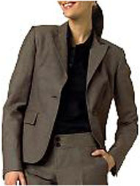
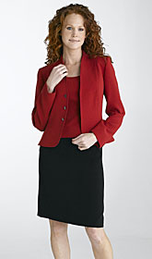
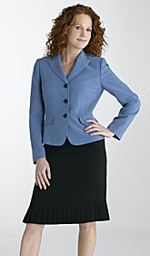
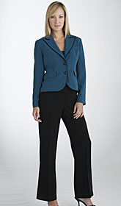
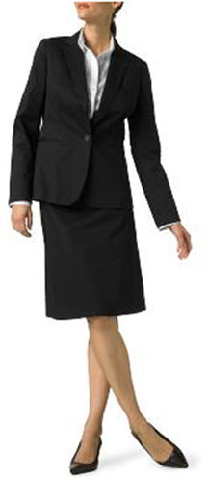
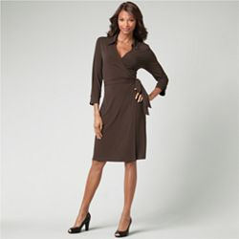

Slide 9
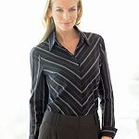
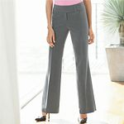
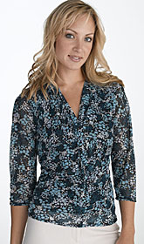
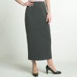
PROFESSIONAL DRESS
FOR WOMEN
Tops and bottoms can be matched together.

Slide 10

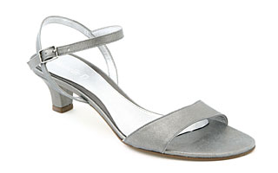
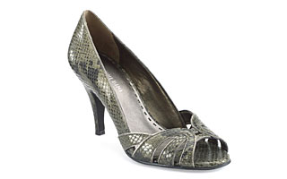
PROFESSIONAL DRESS
FOR WOMEN
These dress shoes can be worn with pants or skirt (suits) without pantyhose.

Slide 11
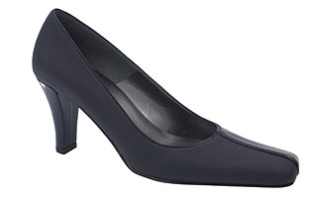
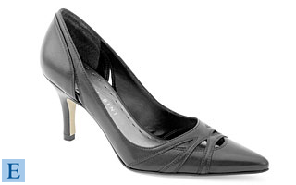
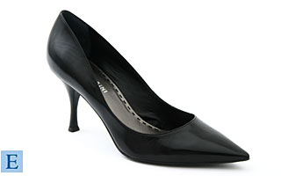
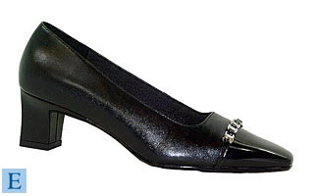
PROFESSIONAL DRESS
FOR WOMEN
These dress shoes can be worn with pants or skirt (suits) WITH pantyhose.

Slide 12
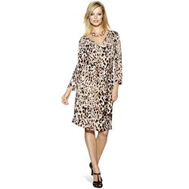
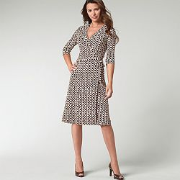
PROFESSIONAL DRESS
FOR WOMEN
These dresses can be worn with dressy sandals (without pantyhose).
(Pantyhose must be worn with closed toe dress shoes)

Slide 13
Men‘s Business Dress
Facial Hair
Good quality, wool suit
Shirt
Ties
Shoes
Socks
Jewelry
Belt/suspenders/braces
Notes:
Suit – quality tells, dark blue pinstripe is most formal, followed by dark blue, dark grey, & black
Shirt – Long sleeve, cotton – white or pale blue – sleeves extend ½” beyond jacket sleeve - wear an undershirt!
Cuffs
Traditional button cuff
French cuff
Collar
Spread – looks very British – not currently in style
Point
Snap tab
Button-down – NOT for dress
Ties – silk, paisley print, conservative – men over 6’1” need an extra long tie
Shoes – Lace-up, Wing-tips, cap-toes – shined, but not too much
Socks – match suit (I.e. dark socks with a dark suit), high enough that they don’t show when you sit
Jewelry – watch, ring – remove earrings
Belt/suspenders/braces
Belt & shoes should match
Never wear suspenders/braces with pants that have belt-loops
Braces button on – suspenders clip on

Slide 14
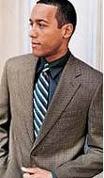
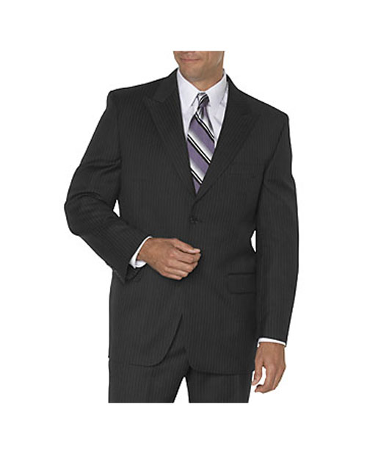
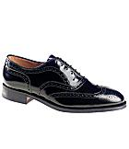
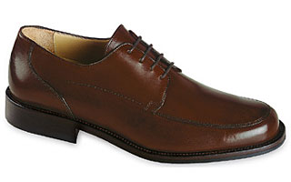
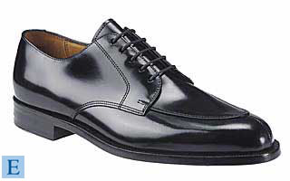
Professional Dress for Men

Slide 15
Business Casual Dress
Also called Informal Business
No excuse for inappropriate dress
Men – khakis or trousers, button down shirt, sweater, leather shoes
Women – khakis or trousers, blouse or sweater
Colors may be brighter, but always opt for the more conservative choices

Slide 16
Business Casual for Men
Standard choices
  Charcoal pants/Dress slacks
  Khaki slacks
  Blazers/Tailored Jackets
  Shirts with collars and buttons
    White oxford button down shirts
  Polo or golf shirts
  Leather belt
Notes:
Jackets can be removed to appear more casual
Shirts are more visible without a jacket, and so their importance is significant

Slide 17
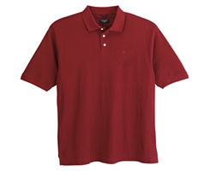
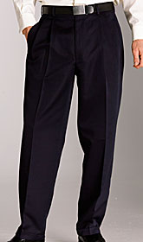
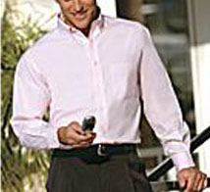
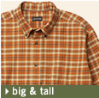
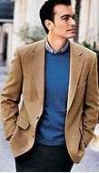
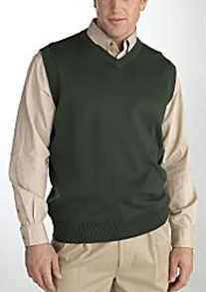
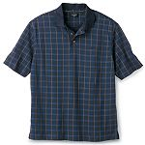
Men’s Business Casual

Slide 18
Business Casual for Men
Things to avoid
  Jeans
  Athletic/tennis shoes/Dress shoes/Bare feet
  Short-sleeved dress shirt
  Shirts without a collar/Tropical shirts
  Double breasted jacket
  Wrong tie
  Colorful pants or white pants
  Relaxed grooming habits
Notes:
Knit tie works best with casual wear. Formal silk ties for suits may be inappropriate with casual wear.

Slide 19
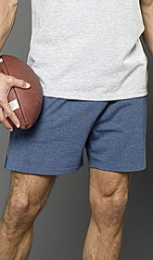


DON’T EVEN TRY THIS!!!
MEN!!!
These are NOT considered appropriate attire!

Slide 20
Business Casual for Women
Standard choices
  Dress slacks or long skirts
  Blouses
  Sweater sets
  Dresses

Slide 21
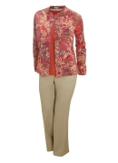
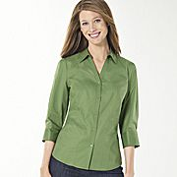
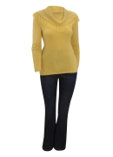
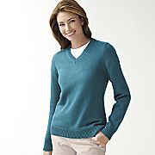
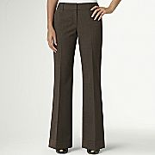
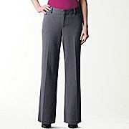
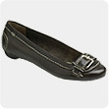
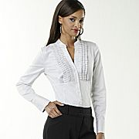
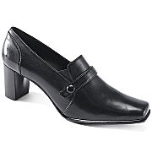
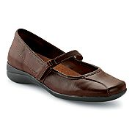
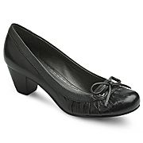
Women Business Casual

Slide 22
Business Casual for Women
Things to avoid
  Midriff baring outfits/Halters/Tank tops
  Going without hosiery
  Going without appropriate undergarments
  Provocative garments
  Frills
  Relaxed grooming habits
  Mistaking TV or magazine dress for business casual

Slide 23
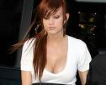





DON’T EVER TRY THIS!!!
These are NOT considered appropriate attire!

Slide 24







Don’ts
More Don’ts
No jeans
No flip-flops
No shorts
No athletic shoes
Career Center

Slide 25
Determining Appropriate Dress
Consider the environment
Consider your goals
Consider the clues
Consider others’ dress
Consider the impression you want
to leave
Notes:
Environment – country club? Office? What region are you in? Ohio v. New York or California, Canton v. Akron
Goals – get a job? Meet potential clients? Social outing? Fit in? Stand out?
Clues – location, time, event, who will be in attendance, invitation formality
Others’ dress – mimic it! Will be seen as conscientious for asking
Impression you want to leave
Trustworthiness – no facial hair, wear dark blue, keep hands out of pockets
Authority – formality begets authority – classics, contrasting color tones, high quality, all-leather tie shoes
Personal Power – wear quality, business-like clothing, hair & makeup – should be more sophisticated than high school or college

Slide 26
Business Luncheons
Before the luncheon
  R.S.V.P.
Logistics
  Layer your items
    Napkin
    Plate
    Glass
  Business card arrangement
  Keep right hand free to shake hands
Notes:
Always carry napkin & keep it handy
Glass – red wine glass held by the bowl, white wine glass held by the stem, brandy/scotch glass held by the bowl, highball glass held by the base
Wine not needed for toasting
Order club soda or 7-Up with a twist of lime if you aren’t drinking

Slide 27
Business Luncheons
Handshakes
  Universally accepted
  When to use
  Proper grip
Handling food
  Items passed on trays
  Food from buffet
  Discarded toothpicks or cocktail sticks
Notes:
Meeting someone for the first time
Meeting someone you haven’t seen for a while
Greeting a host(ess)
Greeting guests
Saying goodbye at a gathering
Someone else extends a hand
Proper Grip: Firm, about 3 seconds, one or two pumps max., involves only the hands & eye contact
Passed food – pick up with toothpick or napkin, place in mouth or on cocktail plate
Food from buffet – put on cocktail plate – not directly in mouth
Toothpicks/cocktail sticks – Don’t put back on tray – put in ashtray or on dish, wrap in napkin if necessary
Put food in mouth whole, if possible – chew quickly

Slide 28
Small Talk
Research
Set goals
Use open body language/smile
Make eye contact
Introduce yourself
Allow others to introduce you to people they know

Slide 29
Common Luncheon Faux Pas
Things to Avoid
  Making food the focus
  Uncomfortable topics
  Lengthy conversations
  Gossip
  Complaining about the event
  Flirting
  Talking during a speaker’s presentation
  Being rude/disrespectful to staff
Notes:
First Impressions
55% of perception based on first impression – 75% say that clothing or personal appearances influence attitudes about professionalism
Well-dressed, well-groomed people are associated with intelligence & achievement
Uncomfortable topics – religion, politics, relationships, income, sex, sexual proclivities, cost of anything personal, diets, off-color jokes

Slide 30
After the Luncheon
Say goodbye/excuse yourself to other guests
Thank the host/hostess as you leave
Send thank you note

Slide 31
Good Luck!

