Slide 2
The Flow of Food
Objectives:
  How to prevent cross-contamination
  How to prevent time-temperature abuse
  How to use the correct kinds of thermometers to take temperatures
4-2
Notes:
Instructor Notes
Discuss the topic objectives with the class.

Slide 3
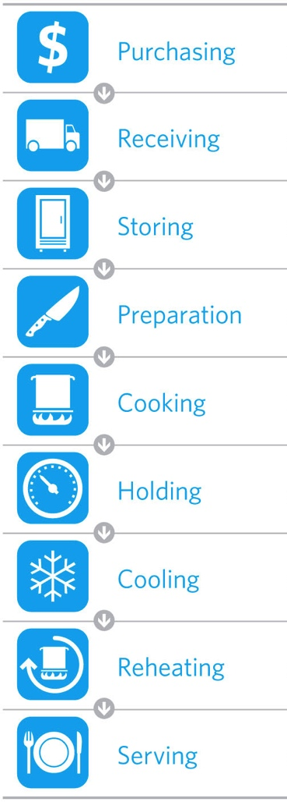
The Flow of Food
To keep food safe throughout the flow of food:
  Prevent cross-contamination
  Prevent time-temperature abuse
4-3
Notes:
Instructor Notes
You are responsible for the safety of the food at every point in this flow. For example, a frozen food might be safe when it leaves the processor’s plant. However, on the way to the supplier’s warehouse, the food might thaw. Once in your operation, the food might not be stored correctly, or it might not be cooked to the correct internal temperature. These mistakes can add up and cause a foodborne illness.

Slide 4
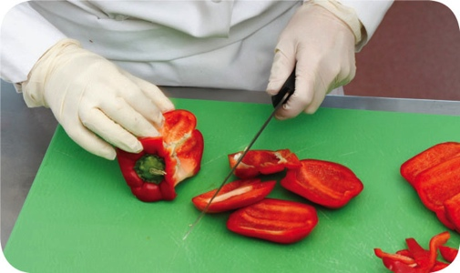
Preventing Cross-Contamination
Separate equipment:
  Use separate equipment for each type of food
Clean and sanitize:
  Clean and sanitize all work surfaces, equipment, and utensils after each task
4-4
Notes:
Instructor Notes
Each type of food should have separate equipment. For example, use one set of cutting boards, utensils, and containers for raw poultry. Use another set for raw meat. Use a third set for produce. Colored cutting boards and utensil handles can help keep equipment separate. The color tells food handlers which equipment to use with each food item. You might use yellow for raw chicken, red for raw meat, and green for produce, as the prep chef is doing in the photo.
Clean and sanitize all work surfaces, equipment, and utensils after each task. When you cut up raw chicken, for example, you cannot get by with just rinsing the equipment. Pathogens such as nontyphoidal Salmonella can contaminate food through cross-contamination. To prevent this, you must wash, rinse, and sanitize equipment.

Slide 5
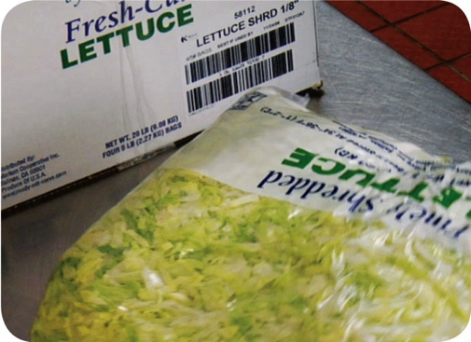
Preventing Cross-Contamination
Prep food at different times:
  Prepare raw meat, fish, and poultry at different times than ready-to-eat food (when using the same prep table)
Buy prepared food:
  Buy food items that don’t require much prepping or handling
4-5
Notes:
Instructor Notes
If you need to use the same table to prep different types of food, prep raw meat, fish, and poultry; and ready-to-eat food at different times. You must clean and sanitize work surfaces and utensils between each type of food. For example, by prepping ready-to-eat food before raw food, you can minimize the chance for cross-contamination.
Buy food that doesn’t require much prepping or handling. For example, you could buy precooked chicken breasts or chopped lettuce, as shown in the photo.

Slide 6
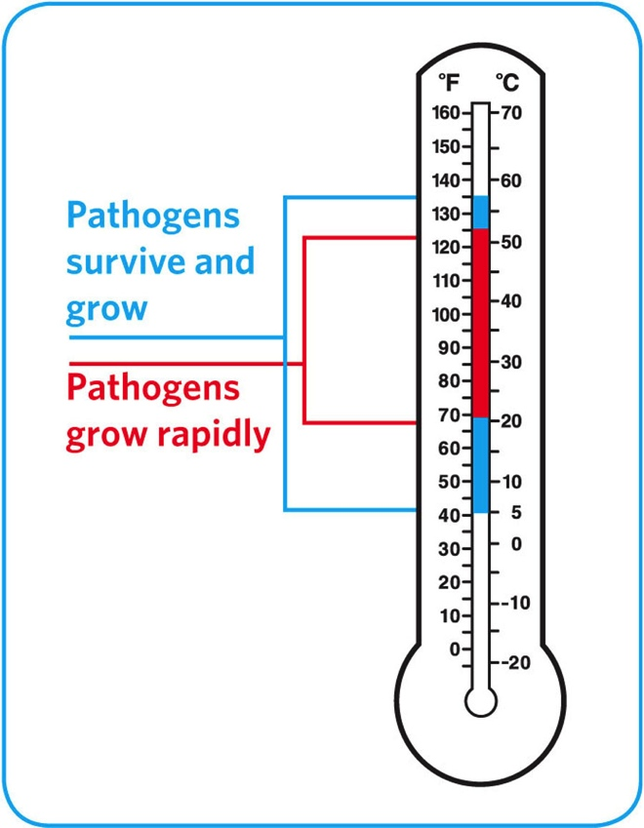
Preventing Time-Temperature Abuse
Time-temperature control:
  Food held in the range of 41˚F and 135˚F
  (5˚C and 57˚C) has been time-temperature abused
  Food has been time-temperature abused whenever it is handled in the following ways
    Cooked to the wrong internal temperature
    Held at the wrong temperature
    Cooked or reheated incorrectly
4-6
Notes:
Instructor Notes
Most foodborne illnesses happen because TCS food has been time-temperature abused. Remember, TCS food has been time-temperature abused any time it remains between 41°F and 135°F (5°C and 57°C). This is called the temperature danger zone because pathogens grow in this range. But most pathogens grow much faster between 70°F and 125°F (21°C and 52°C).
Food is being temperature abused whenever it is handled in the following ways: cooked to the wrong internal temperature, held at the wrong temperature, or cooled or reheated incorrectly.
The longer food stays in the temperature danger zone, the more time pathogens have to grow. To keep food safe, you must reduce the time it spends in this temperature range. If food is held in this range for four or more hours, you must throw it out.

Slide 7
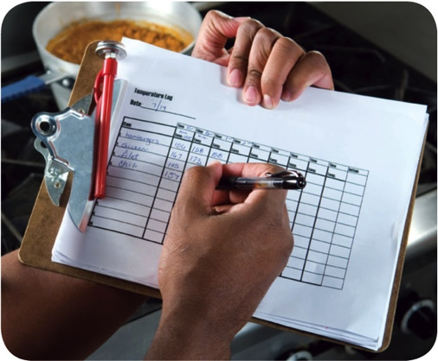
Preventing Time-Temperature Abuse
Avoid time-temperature abuse:
  Monitor time and temperature
  Make sure the correct kinds of thermometers are available.
  Regularly record temperatures and the times they are taken
  Minimize the time that food spends in the temperature danger zone
  Take corrective actions if time-temperature standards are not met
4-7
Notes:
Instructor Notes
Learn which food items should be checked, how often, and by whom.
Use timers in prep areas to check how long food is in the temperature danger zone.
A policy limiting the amount of food that can be removed from a cooler when prepping it can limit the time food spends in the temperature danger zone.
Reheating soup that was being held below 135°F (57°C) is an example of a corrective action.

Slide 8
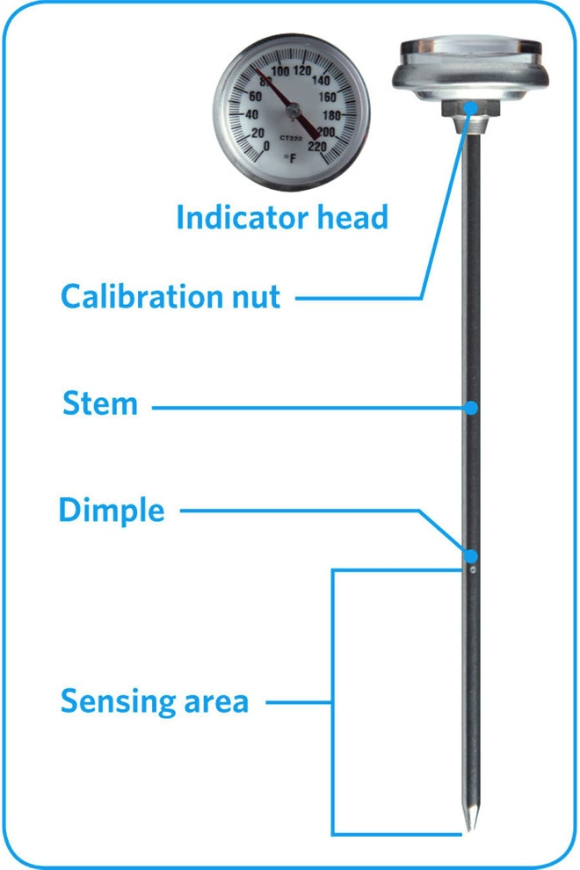
Monitoring Time and Temperature
Bimetallic stemmed thermometer
4-8
Notes:
Instructor Notes
A bimetallic stemmed thermometer can check temperatures from 0˚F to 220˚F (–18˚C to 104˚C).
This thermometer measures temperature through its metal stem. When checking temperatures, insert the stem into the food up to the dimple. You must do this because the sensing area of the thermometer goes from the tip of the stem to the dimple. This trait makes this thermometer useful for checking the temperature of large or thick food. It is usually not practical for thin food, such as hamburger patties.
The calibration nut is used to adjust the thermometer to make it accurate.

Slide 9
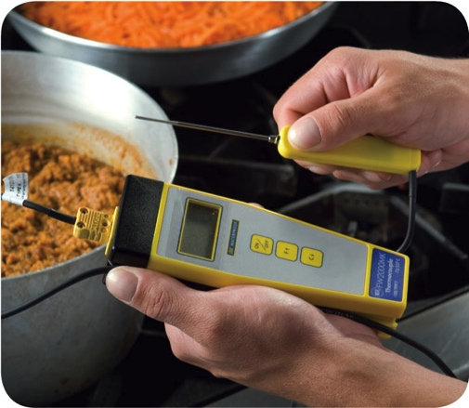
Monitoring Time and Temperature
Thermocouples and thermistors:
  Measure temperature through a metal probe
  Display temperatures digitally
  Come with interchangeable probes
    Immersion probe
    Surface probe
    Penetration probe
    Air probe
  Have a sensing area on the tip of their probe
4-9
Notes:
Instructor Notes
The sensing area on thermocouples and thermistors is on the tip of their probe. This means you don’t have to insert them into the food as far as bimetallic stemmed thermometers to get a correct reading. Thermocouples and thermistors are good for checking the temperature of both thick and thin food.
Thermocouples and thermistors come in several styles and sizes. Many come with different types of probes.
Immersion probes are used to check the temperature of liquids such as soups, sauces, and frying oil.
Surface probes are used to check the temperature of flat cooking equipment such as griddles.
Penetration probes are used to check the internal temperature of food. Small-diameter probes should be used to check the internal temperature of thin food such as meat patties and fish fillets.
Air probes are used to check the temperature inside coolers and ovens.
.

Slide 10
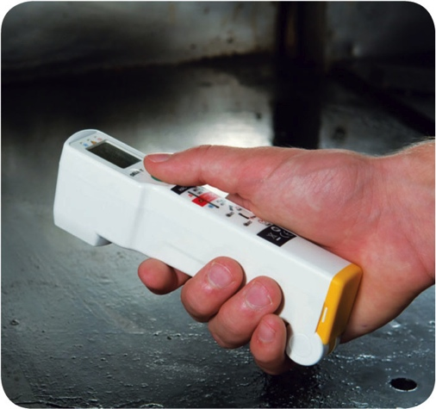
Monitoring Time and Temperature
Infrared (laser) thermometers:
  Used to measure the surface temperature of food and equipment
  Hold as close to the food or equipment as possible
  Remove anything between the thermometer and the food, food package, or equipment
  Follow manufacturers’guidelines
4-10
Notes:
Instructor Notes
These thermometers cannot measure air temperature or the internal temperature of food.
Hold the thermometer as close as possible to the food, food package, or equipment without touching it. Do NOT take readings through glass or metal, such as stainless steel or aluminum.
Always follow the manufacturers’ guidelines. This should give you the most accurate readings.

Slide 11
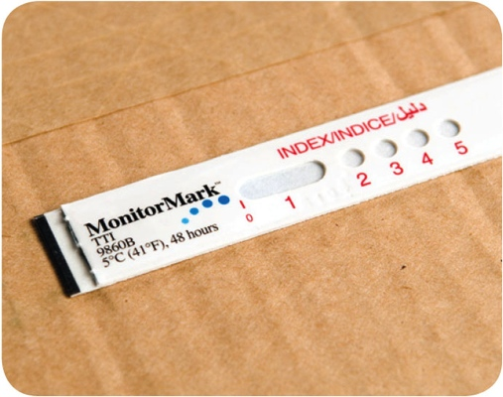
Monitoring Time and Temperature
  Time-temperature indicators (TTI):
  Monitor both time and temperature
  Are attached to packages by the supplier
  A color change appears on the device when
  time-temperature abuse has occurred
Maximum registering tape:
  Indicates the highest temperature reached
  during use
  Used where temperature readings cannot
  be continuously observed
4-11
Notes:
Instructor Notes
Some devices monitor both time and temperature. The time-temperature indicator (TTI) is an example. These tags are attached to packaging by the supplier. A color change appears in the window if the food has been time-temperature abused during shipment or storage. This color change is not reversible, so you know if the food has been abused.
Some suppliers place temperature-recording devices inside their delivery trucks. These devices constantly check and record temperatures. You can check the device during receiving to make sure food was at safe temperatures while it was being shipped.
Other tools are available that can help you monitor temperature. A maximum registering thermometer is one type. This thermometer indicates the highest temperature reached during use and is used where temperature readings cannot be continuously observed. It works well for checking final rinse temperatures of dishwashing machines.

Slide 12
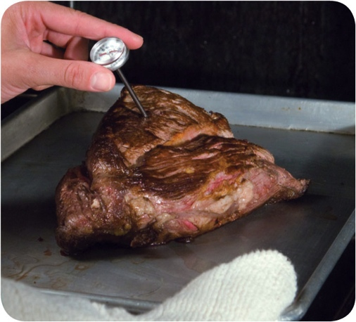
General Thermometer Guidelines
When using thermometers:
  Wash, rinse, sanitize, and air-dry thermometers before and after using them
  Calibrate them before each shift to
  ensure accuracy
  Make sure thermometers used to measure the temperature of food are accurate to
  +/- 2˚F or +/- 1˚C
  Only use glass thermometers if they are enclosed in a shatterproof casing
4-12
Notes:
Instructor Notes
Thermometers should be washed, rinsed, sanitized, and air-dried before and after each use to prevent cross-contamination. Be sure the sanitizing solution you use is for food-contact surfaces.
Thermometers can lose their accuracy when they are bumped or dropped. It can also happen when they go through severe temperature change. When this happens, the thermometer must be calibrated, or adjusted, to give a correct reading. Make sure your thermometers are accurate by calibrating them regularly. You should do this before each shift. You should also do this before the first delivery arrives. Some thermometers cannot be calibrated and must be replaced. Others will need to be sent back to the manufacturer for calibration. Follow the manufacturer’s directions regarding calibration.
Glass thermometers, such as candy thermometers, can be a physical contaminant if they break. They can only be used when enclosed in a shatterproof casing.

Slide 13
General Thermometer Guidelines
When using thermometers:
  Insert the thermometer stem or
  probe into thickest part of the product
  (usually the center)
  Take more than one reading in different spots
  Wait for the thermometer reading to steady before recording the temperature
4-13
Notes:
Instructor Notes
When checking the temperature of food, insert the probe into the thickest part of the food, as shown in the photo. This is usually in the center. Also take another reading in a different spot. The temperature may vary in different areas. Before recording a temperature, wait for the thermometer reading to steady. Wait at least 15 seconds after you insert the stem or the probe into the food.

Slide 15
The Flow of Food: Purchasing, Receiving, and Storage
Objectives:
  Purchase food from approved, reputable suppliers
  Use criteria to accept or reject food during receiving
  Label and date food
  Store food and nonfood items to prevent time-temperature abuse and contamination
5-2
Notes:
Instructor Notes
Discuss the topic objectives with the class.

Slide 16
General Purchasing and Receiving Principles
Purchase food from approved, reputable suppliers:
  Have been inspected
  Meet all applicable local, state, and federal laws
Arrange deliveries so they arrive:
  When staff has enough time to do inspections
  When they can be correctly received
5-3
Notes:
Instructor Notes
Food must be purchased from approved, reputable suppliers. These suppliers have been inspected and can show you an inspection report. They also meet all applicable local, state, and federal laws. This applies to all suppliers in the supply chain. Your operation’s chain can include growers, shippers, packers, manufacturers, distributors (trucking fleets and warehouses), and local markets.
Develop a relationship with your suppliers, and get to know their food safety practices. Consider reviewing their most recent inspection reports. These reports can be from the U.S. Department of Agriculture (USDA), the Food and Drug Administration (FDA), or a third-party inspector. They should be based on Good Manufacturing Practices (GMP) or Good Agricultural Practices (GAP).

Slide 17
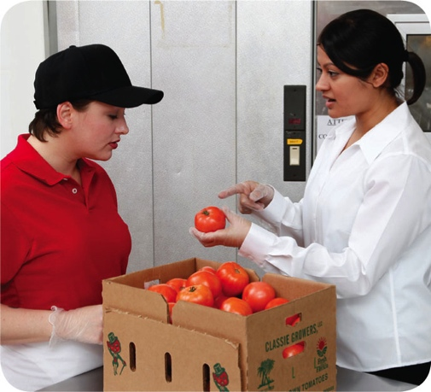
General Purchasing and Receiving Principles
Receiving principles:
  Make specific staff responsible for receiving
    Train them to follow food safety guidelines
    Provide them with the correct tools
  Have enough trained staff available to
  receive food promptly
    Inspect delivery trucks for signs of contamination
    Visually check food items and check temperatures
  Store items promptly after receiving
5-4
Notes:
Instructor Notes
Make specific staff responsible for receiving.
Provide staff with the tools they need, including purchase orders, thermometers, and scales. Then make sure enough trained staff is available to receive and inspect food items promptly. This starts by visually inspecting delivery trucks for signs of contamination. It continues with visually inspecting the food items and checking to make sure they have been received at the correct temperature.
Once inspected, food items must be stored as quickly as possible in the correct areas. This is especially true for refrigerated and frozen items.

Slide 18
Receiving and Inspecting
Key drop deliveries:
  Supplier is given after-hour access to the operation
  to make deliveries
  Deliveries must meet the following criteria
    Be inspected upon arrival at the operation
    Be from an approved source
    Have been placed in the correct storage location to
    maintain the required temperature
    Have been protected from contamination in storage
    Is NOT contaminated
    Is honestly presented
5-5
Notes:
Instructor Notes
Some foodservice operations receive food after-hours when they are closed for business. This is often referred to as a key drop delivery.
The supplier is given a key or other access to the operation to make the delivery. Products are then placed in coolers, freezers, and dry storage areas. The delivery must be inspected once you arrive at the operation and meet the criteria identified in the slide.

Slide 19
Receiving and Inspecting
Rejecting deliveries:
  Separate rejected items from accepted items
  Tell the delivery person what is wrong with the item
  Get a signed adjustment or credit slip before giving
  the rejected item to the delivery person
  Log the incident on the invoice or receiving document
5-6
Notes:
Instructor Notes
Occasionally, you may be able to recondition and use items that would have been rejected. For example, a shipment of cans with contaminated surfaces may be cleaned and sanitized, allowing them to be used. However, the same cans may not be reconditioned if the contamination was a result of damage to the cans.

Slide 20
Receiving and Inspecting
Recalls:
  Identify the recalled food items
  Remove the item from inventory, and place it in a secure and appropriate location
  Store the item separately from food, utensils, equipment, linens, and single-use items
  Label the item in a way that will prevent it from being placed back in inventory
  Inform staff not to use the product
  Refer to the vendor’s notification or recall notice to determine what to do with the item
5-7
Notes:
Instructor Notes
Food items you have received may sometimes be recalled by the manufacturer. This may happen when food contamination is confirmed or suspected. It can also occur when items have been mislabeled or misbranded. Often food is recalled when food allergens have not been identified on the label. Most vendors will notify you of the recall. However, you should also monitor recall notifications made by the FDA and the USDA. Follow the guidelines in the slide when notified of a recall.
Identify the recalled food items by matching information from the recall notice to the item. This may include the manufacturer’s ID, the time the item was manufactured, and the item’s use-by date.
Remove the item from inventory, and place it in a secure and appropriate location. That may be a cooler or dry-storage area.
The recalled item must be stored separately from food, utensils, equipment, linens, and single-use items.
Label the item in a way that will prevent it from being placed back in inventory. Some operations do this by including a Do Not Use and Do Not Discard label on recalled food items. Inform staff not to use the product.
Refer to the vendor’s notification or recall notice for what to do with the item. For example, you might be instructed to throw it out or return it to the vendor.

Slide 21
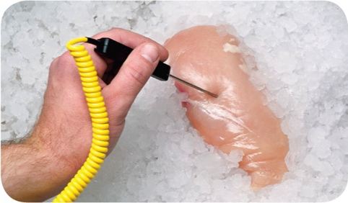
Receiving and Inspecting
Checking the temperature of meat, poultry,
and fish:
  Insert the thermometer stem or probe into the thickest part of the food (usually the center)
5-8

Slide 22
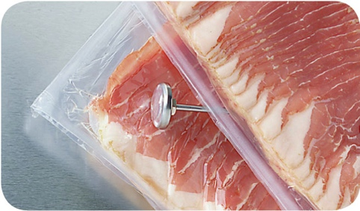
Receiving and Inspecting
Checking the temperature of ROP Food
(MAP, vacuum-packed, and sous vide food):
  Insert the thermometer stem or probe between
  two packages
  As an alternative, fold packaging around the thermometer stem or probe
5-9
Notes:
Instructor Notes
ROP stands for reduced-oxygen packaging. It includes MAP, vacuum-packed, and sous vide food.
It may be possible to check the temperature of bulk food by folding the packaging around the thermometer stem or probe. You must be careful not to puncture the packaging when using this method.

Slide 23
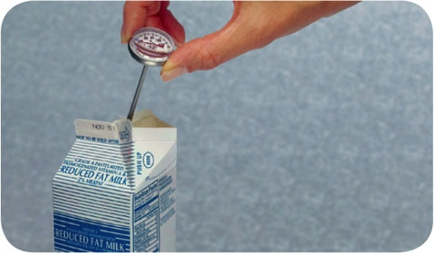
Receiving and Inspecting
Checking the temperature of other packaged food:
  Open the package and insert the thermometer stem or probe into the food
5-10
Notes:
Instructor Notes
When checking the temperature of food by this method, make sure the sensing area of the thermometer stem or probe is fully immersed in the food. It must not touch the package.

Slide 24
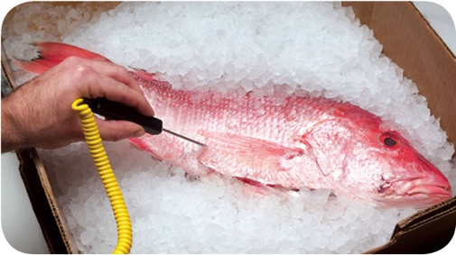
Receiving and Inspecting
Temperature criteria for deliveries:
  Cold TCS food: Receive at 41˚F (5˚C) or lower, unless otherwise specified
  Live shellfish: Receive oysters, mussels, clams, and scallops at an air temperature of 45˚F (7˚C) and an internal temperature no greater than
  50˚F (10˚C)
    Once received, the shellfish must be cooled to 41˚F (5˚C) or lower in four hours
  Shucked shellfish: Receive at 45˚F (7˚C)
  or lower
    Cool the shellfish to 41˚F (5˚F) or lower in
    four hours
5-11

Slide 25
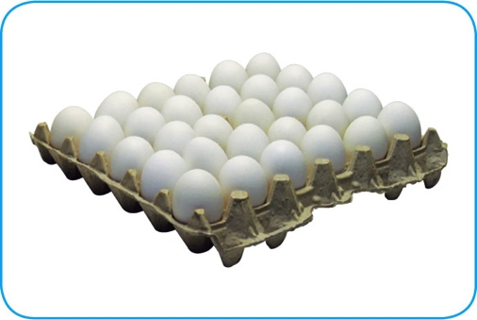
Receiving and Inspecting
Temperature criteria for deliveries:
  Shell eggs: Receive at an air temperature of 45˚F (7˚C) or lower
  Milk: Receive at 45˚F (7˚C) or lower
    Cool the milk to 41˚F (5˚C) or lower in four hours
  Hot TCS food: Receive at 135˚F (57˚C) or higher
  Frozen food: Receive frozen solid
5-12

Slide 26
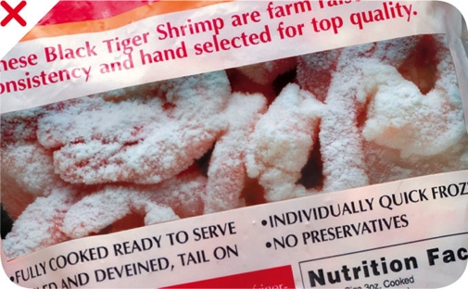
Receiving and Inspecting
Temperature criteria for deliveries:
  Reject frozen food if there is evidence of thawing and refreezing
    Fluids or water stains in case bottoms or
    on packaging
    Ice crystals or frozen liquids on the food
    or packaging
5-13
Notes:
Instructor Notes
Thawing and refreezing shows that the food was time-temperature abused.

Slide 27
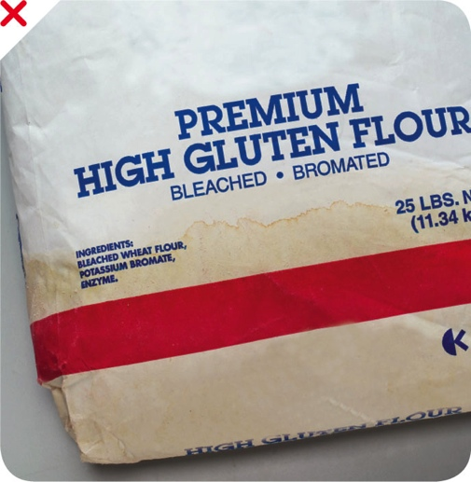
Receiving and Inspecting
Reject packaged items with:
  Tears, holes, or punctures in packaging; reject cans with swollen ends, rust, or dents
  Bloating or leaking (ROP food)
  Broken cartons or seals
  Dirty and discolored packaging
  Leaks, dampness, or water stains
  Signs of pests or pest damage
  Expired use-by/expiration dates
  Evidence of tampering
5-14
Notes:
Instructor Notes
Both food items and nonfood items such as single-use cups, utensils, and napkins, must be packaged correctly when you receive them. Items should be delivered in their original packaging with a manufacturer’s label. The packaging should be intact, clean, and protect food and food-contact surfaces from contamination. Reject food and nonfood items if packaging has any of the problems listed on the slide.

Slide 28
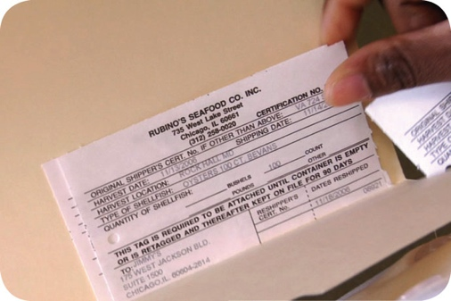
Receiving and Inspecting
Required documents:
  Shellfish must be received with shellstock identification tags
    Tags indicate when and where the shellfish were harvested
    Must be kept on file for 90 days from the date the last shellfish was used from its delivery container
5-15

Slide 29
Receiving and Inspecting
Required documents:
  Fish that will be eaten raw or partially cooked
    Documentation must show the fish was correctly frozen before being received
    Keep documents for 90 days from the sale of the fish
  Farm raised fish
    Must have documentation stating the fish was raised to FDA standards
    Keep documents for 90 days from the sale of the fish
5-16

Slide 30
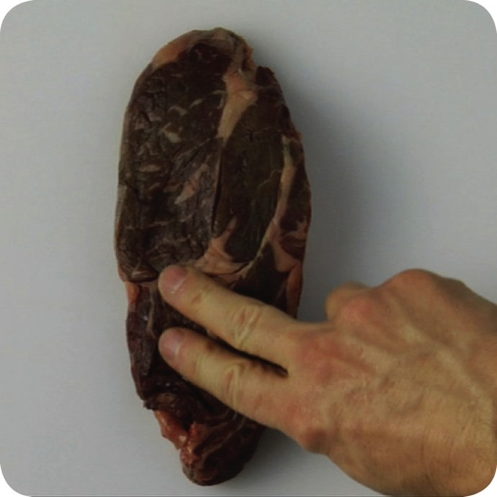
Receiving and Inspecting
Assessing food quality:
  Appearance: Reject food that is moldy or has an abnormal color
  Texture: Reject meat, fish, or poultry if
    It is slimy, sticky, or dry
    It has soft flesh that leaves an imprint when touched
  Odor: Reject food with an abnormal or unpleasant odor
5-17
Notes:
Instructor Notes
Poor food quality can be a sign that the food has been time-temperature abused and, therefore, may be unsafe.
In addition to the guidelines above, you should always reject any item that does not meet your company’s standards for quality.

Slide 31
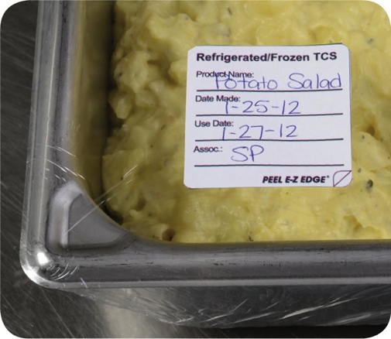
Storage
Labeling food for use on-site:
  All items not in their original containers must be labeled
  Food labels should include the common name of the food or a statement that clearly and accurately identifies it
  It is not necessary to label food if it clearly will not be mistaken for another item
5-18
Notes:
Instructor Notes
Labeling food is important for many reasons. Illnesses have occurred when unlabeled chemicals were mistaken for food such as flour, sugar, and baking powder. Customers have also suffered allergic reactions when food was unknowingly prepped with a food allergen that was not labeled.
It is not necessary to label food if clearly it will not be mistaken for another item. The food must be easily identified by sight

Slide 32
Storage
Labeling food packaged on-site for retail sale:
  Common name of the food or a statement clearly identifying it
  Quantity of the food
  If the item contains two or more ingredients, list the ingredients
  and sub ingredients in descending order by weight
  List of artificial colors and flavors in the food, including
  chemical preservatives
  Name and place of business of the manufacturer, packer,
  or distributor
  Source of each major food allergen contained in the food
5-19
Notes:
Instructor Notes
Food packaged in the operation that is being sold to customers for use at home must be labeled. The label must include the information on the slide.
Naming the source of each major food allergen contained in the food is not necessary if the source is already part of the common name of the ingredient.
These labeling requirements do not apply to customers’ leftover food items placed in carry-out containers.

Slide 33
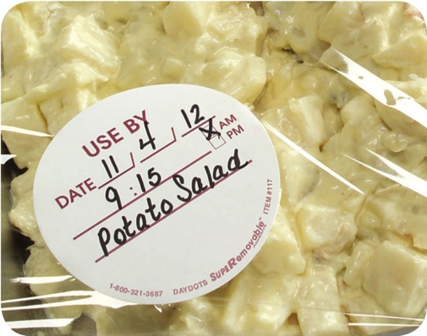
Storage
Date marking:
  Ready-to-eat TCS food must be marked if held for longer than 24 hours
    Date mark must indicate when the food must be sold, eaten, or thrown out
5-20
Notes:
Instructor Notes
Refrigeration slows the growth of most bacteria. Some types, such as Listeria monocytogenes, grow well at refrigeration temperatures. When food is refrigerated for long periods of time, these bacteria can grow enough to cause illness. For this reason, ready-to-eat TCS food must be marked if held for longer than 24 hours. It must indicate when the food must be sold, eaten, or thrown out.

Slide 34
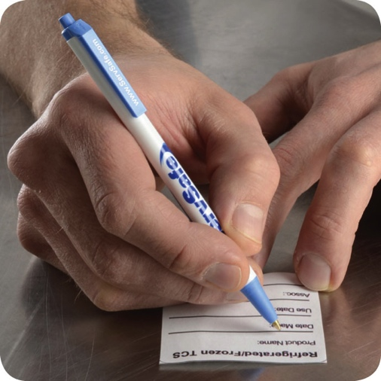
Storage
Date marking:
  Ready-to-eat TCS food can be stored for only seven days if it is held at 41˚F (5˚C)
  or lower
    The count begins on the day that the food was prepared or a commercial container
    was opened
    For example, potato salad prepared and stored on October 1 would have a discard date of October 7 on the label
    Some operations write the day or date the food was prepared on the label. Others write the use-by day or date on the label
.
5-21

Slide 35
Storage
Date marking:
  If:
  A commercially processed food has a use-by date that is less
  than seven days from the date the container was opened
  Then:
  The container should be marked with this use-by date
  as long as the date is based on food safety
5-22
Notes:
Instructor Notes
Operations have a variety of systems for date marking. Some write the day or date the food was prepped on the label. Others write the use-by day or date on the label, as shown in the photo at left.

Slide 36
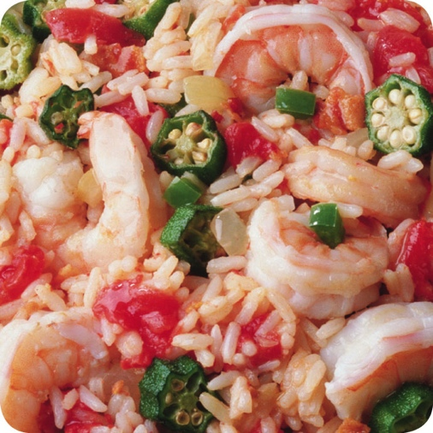
Storage
Date marking:
  When combining food in a dish with different
  use-by dates, the discard date of the dish should be based on the earliest prepared food
  Consider a shrimp and sausage jambalaya prepared on December 4
    The shrimp has a use-by date of December 8
    The sausage has a use-by date of December 10
    The use-by date of the jambalaya is December 8
5-23
Notes:
Instructor Notes

Slide 37
Storage
Temperatures:
  Store TCS food at an internal temperature
  of 41˚F (5˚C) or lower or 135˚F (57˚C)
  or higher
  Store frozen food at temperatures that keep it frozen
  Make sure storage units have at least one air temperature measuring device. It must be accurate to +/- 3˚F or +/- 1.5˚C
  Place the device in the warmest part of refrigerated units, and the coldest part of hot-holding units
5-24
Notes:
Instructor Notes
Pathogens can grow when food is not stored at the correct temperature. Follow the guidelines on the slide to keep food safe.

Slide 38
Storage
Temperatures:
  Do NOT overload coolers or freezers
    Prevents airflow
    Makes unit work harder
  Frequent opening of the cooler lets warm air inside, which can affect food safety
  Use open shelving
    Lining shelving restricts circulation
  Monitor food temperatures regularly
    Randomly sample food temperatures
5-25
Notes:
Instructor Notes
Do not overload coolers or freezers. Storing too many food items prevents good airflow and makes the units work harder to stay cold.
Be aware that frequent opening of the cooler lets warm air inside, which can affect food safety.
Use open shelving. Do not line shelves with aluminum foil, sheet pans, or paper. This restricts circulation of cold air in the unit.
Monitor food temperatures regularly. Randomly sample the temperature of stored food to verify that the cooler is working..

Slide 39
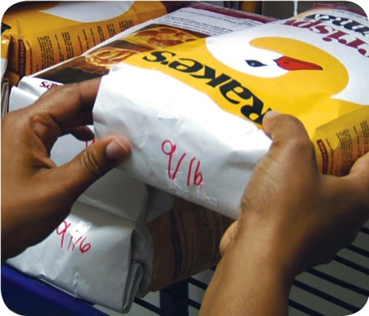
Storage
Rotate food to use the oldest inventory first:
  One way to rotate products is to follow FIFO
    Identify the food item’s use-by or expiration date
    Store items with the earliest use-by or expiration dates in front of items with later dates
    Once shelved, use those items stored in front first
    Throw out food that has passed its manufacturer’s use-by or expiration date
5-26
Notes:
Instructor Notes
Food must be rotated in storage to maintain quality and limit the growth of pathogens. Food items must be rotated so that those with the earliest use-by or expiration dates are used before items with later dates.
Many operations use the first-in, first-out (FIFO) method to rotate their refrigerated, frozen, and dry food during storage. The slide shows one way to use the FIFO method.

Slide 40
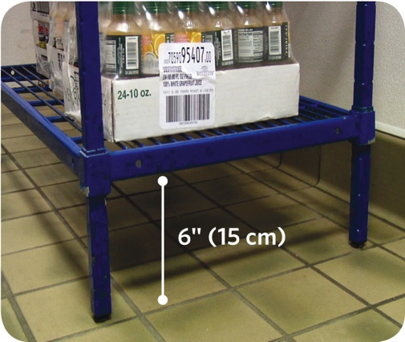
Storage
Preventing cross-contamination:
  Store all items in designated storage areas
    Store items away from walls and at least
    six inches (15 centimeters) off the floor
    Store single-use items (e.g., sleeve of
    single-use cups, single-use gloves) in
    original packaging
5-27

Slide 41
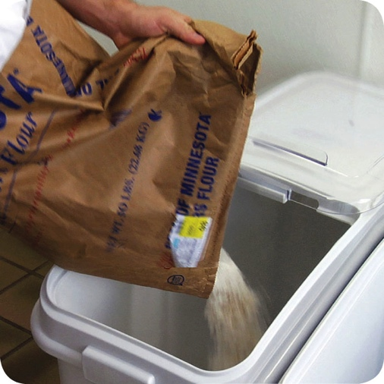
Storage
Preventing cross-contamination:
  Store food in containers intended for food
  Use containers that are durable, leak proof, and able to be sealed or covered
  NEVER use empty food containers to store chemicals; NEVER put food in empty chemical containers
5-29

Slide 42
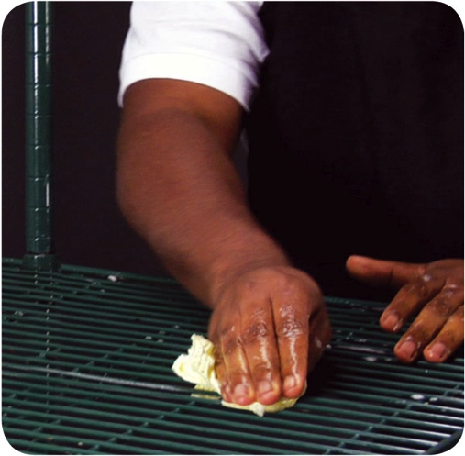
Storage
Preventing cross-contamination:
  Keep all storage areas clean and dry
  Clean up spills and leaks immediately
  Clean dollies, carts, transporters, and trays often
  Store food in containers that have been cleaned and sanitized
  Store dirty linens in clean, nonabsorbent containers or washable laundry bags
5-30
Notes:
Instructor Notes
Keep all storage areas clean and dry. Clean floors, walls, and shelving in coolers, freezers, dry-storage areas, and heated holding cabinets on a regular basis.
Clean up spills and leaks promptly to keep them from contaminating other food.
• Store dirty linens away from food.

Slide 43
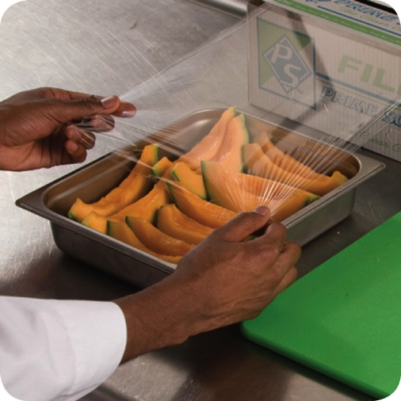
Storage
Preventing cross-contamination:
  Wrap or cover food
  Store raw meat, poultry, and seafood separately from ready-to-eat food
    If this is not possible, store ready-to-eat food above raw meat, poultry, and seafood
    This will prevent juices from raw food from dripping onto ready-to-eat food
5-31

Slide 44
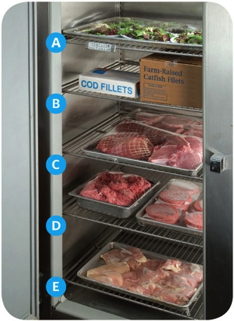
Storage
Preventing cross-contamination:
  Store food items in the following
  top-to-bottom order
    Ready-to-eat food
    Seafood
    Whole cuts of beef and pork
    Ground meat and ground fish
    Whole and ground poultry
  This storage order is based on the minimum internal cooking temperature of each food
5-32
Notes:
Instructor Notes
Raw meat, poultry, and seafood can be stored with or above ready-to-eat food in a freezer if all of the items have been commercially processed and packaged.
Frozen food that is being thawed in coolers must also be stored below ready-to-eat food.
As an exception, ground meat and ground fish can be stored above whole cuts of beef and pork. To do this, make sure the packaging keeps out pathogens and chemicals. It also must not leak.

Slide 45
Storage
Food should be stored in a clean, dry location away from dust and other contaminants:
  To prevent contamination, NEVER store food in these areas
    Locker rooms or dressing rooms
    Restrooms or garbage rooms
    Mechanical rooms
    Under unshielded sewer lines or leaking water lines
    Under stairwells
5-33

Slide 47
General Preparation Practices
Objectives:
  Prevent cross-contamination and time-temperature abuse
  Thaw food correctly
  Cook food to a minimum internal temperature
  Cool and reheat food to the correct temperature in the correct amount of time
6-2
Notes:
Instructor Notes
Discuss the topic objectives with the class.

Slide 48
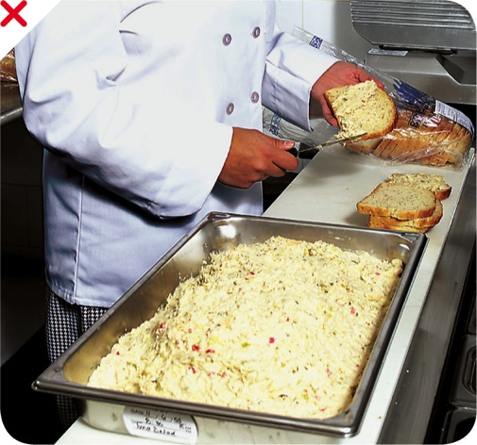
General Preparation Practices
When prepping food:
  Only remove as much food from the cooler as you can prep in a short period of time
    This limits time-temperature abuse
  Return prepped food to the cooler or cook it as quickly as possible
  Make sure workstations, cutting boards, and utensils are clean and sanitized
6-3

Slide 49
General Preparation Practices
Food and color additives:
  Only use additives approved by your local regulatory authority
  NEVER use more additives than are allowed by law
  NEVER use additives to alter the appearance of food
  Do NOT sell produce treated with sulfites before it was received in the operation
  NEVER add sulfites to produce that will be eaten raw
6-4

Slide 50
General Preparation Practices
Present food honestly:
  Do NOT use the following to misrepresent the appearance of food
    Food additives or color additive
    Colored overwraps
    Lights
  Food not presented honestly must be thrown out
6-5
Notes:
Instructor Notes
Food must be offered to customers in a way that does not mislead or misinform them. Customers must be able to judge the true appearance, color, and quality of food.

Slide 51
General Preparation Practices
Corrective actions:
  Food must be thrown out in the following situations
    When it is handled by staff who have been restricted or excluded from the operation due to illness
    When it is contaminated by hands or bodily fluids from the nose or mouth
    When it has exceeded the time and temperature requirements designed to keep food safe
6-6
Notes:
Instructor Notes
• Food that has become unsafe must be thrown out unless it can be safely reconditioned. All food—especially ready-to-eat food—must be thrown out in the situations highlighted in the slide.
• Sometimes food can be restored to a safe condition. This is called reconditioning. For example, a hot food that has not been held at the correct temperature may be reheated if it has not been in the temperature danger zone for more than two hours.

Slide 52
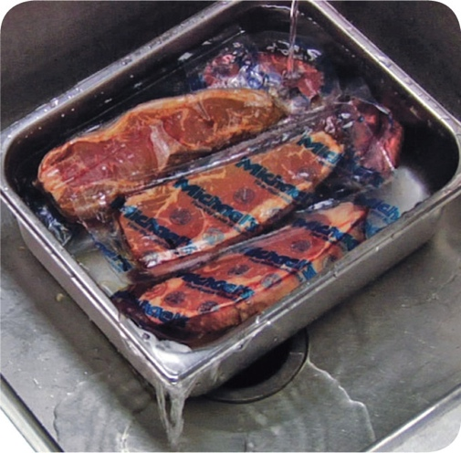
Thawing
Four methods for thawing food:
  Thaw food in a cooler, keeping its temperature at 41˚F (5˚C) or lower
  Submerge food under running water at
  70˚F (21˚C) or lower
    Never let the temperature of the food go above 41˚F (5˚C) for longer than four hours
  Thaw food in a microwave, only if cooked immediately after thawing
  Thaw as part of the cooking process
6-7
Notes:
Instructor Notes
When frozen food is thawed and exposed to the temperature danger zone, pathogens in the food will begin to grow. To reduce this growth, never thaw food at room temperature.
When thawing food under running water, the flow of the water must be strong enough to wash loose food bits into the drain. Always use a clean and sanitized food-prep sink when thawing food this way. Never let the temperature of the food go above 41°F (5°C) for longer than four hours. This includes the time it takes to thaw the food plus the time it takes to prep or cool it. The photo shows the correct way to thaw food under running water.
After food is thawed in a microwave oven, it must be cooked in conventional cooking equipment, such as an oven.

Slide 53
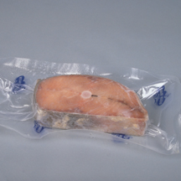
Thawing ROP Fish
  Frozen fish received in ROP packaging must be thawed carefully.
  If the label states that the product must remain frozen until use, then remove fish from packaging:
    Before thawing under refrigeration.
    Before or immediately after thawing under running water.
6-8
Notes:
Instructor Notes
Because of concerns about the potential for Botulism, frozen fish in ROP packaging has special handling practices.

Slide 54
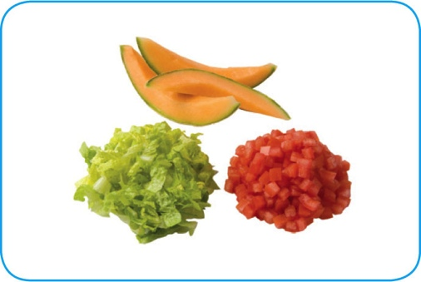
Prepping Specific Food
Produce:
  Make sure produce does not touch surfaces exposed to raw meat, seafood, or poultry
  Wash it thoroughly under running water before
    Cutting
    Cooking
    Combining with other ingredients
6-9
Notes:
Instructor Notes:
Special care must be taken when handling ice and when preparing produce, eggs, and salads that contain TCS food
Instructor Notes
Wash produce thoroughly under running water. This is especially important before cutting, cooking, or combining it with other ingredients. The water should be a little warmer than the produce.
Pay special attention to leafy greens such as lettuce and spinach. Remove the outer leaves, and pull the lettuce or spinach completely apart and rinse thoroughly.

Slide 55
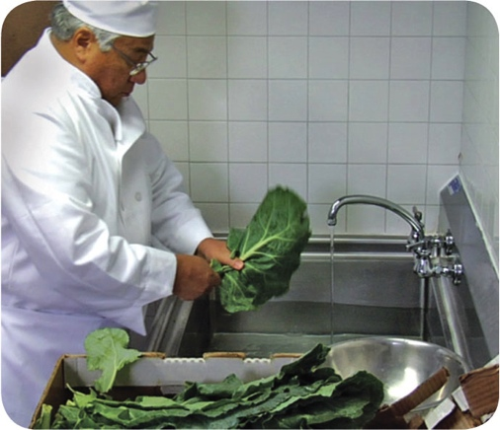
Prepping Specific Food
Produce:
  Produce can be washed in water containing ozone to sanitize it
    Check with your local regulatory authority
  When soaking or storing produce in standing water or an ice-water slurry, do NOT mix
    Different items
    Multiple batches of the same item
6-10
Notes:
Instructor Notes
Certain chemicals may be used to wash fruits and vegetables. Also, produce can be treated by washing it in water containing ozone. This treatment helps control pathogens. Check your local regulatory requirements.

Slide 56
Prepping Specific Food
Produce:
  Refrigerate and hold sliced melons,
  cut tomatoes, and cut leafy greens at
  41˚F (5˚C) or lower
  Do NOT serve raw seed sprouts if primarily serving a high-risk population
6-11
Notes:
Instructor Notes:
Special care must be taken when handling ice and when preparing produce, eggs, and salads that contain TCS food

Slide 57
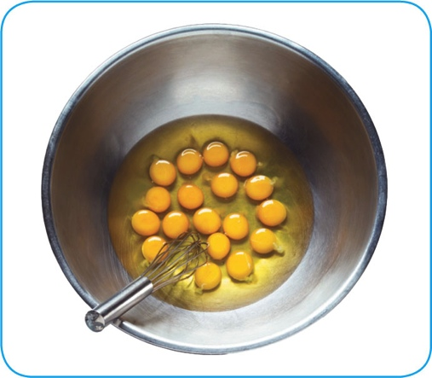
Prepping Specific Food
Eggs and egg mixtures:
  Handle pooled eggs (if allowed) with care
    Cook promptly after mixing or store at 41˚F (5˚C) or lower
    Clean and sanitize containers between batches
  Consider using pasteurized shell eggs or egg products when prepping dishes that need little or no cooking
6-12
Notes:
Instructor Notes
Pooled eggs are eggs that are cracked open and combined in a container.
Check with your local regulatory authority to see if pooling eggs is allowed.
Egg dishes requiring little or no cooking include: Caesar salad dressing, Hollandaise sauce, tiramisu, and mousse.
Use pasteurized eggs or egg products when serving raw or undercooked dishes to high-risk populations.

Slide 58
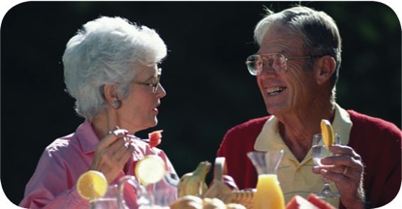
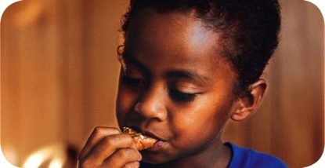
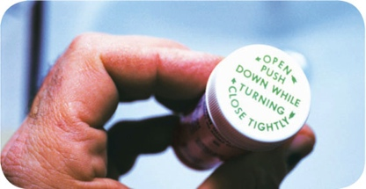
Prepping Specific Food
Eggs for high-risk populations:
  Use pasteurized shell eggs if eggs
  will be pooled
  Use pasteurized eggs or egg
  products when serving raw or undercooked dishes
    Unpasteurized shell eggs can be
    used if the dish will be cooked all the way through (i.e. omelets, cakes)
6-13

Slide 59
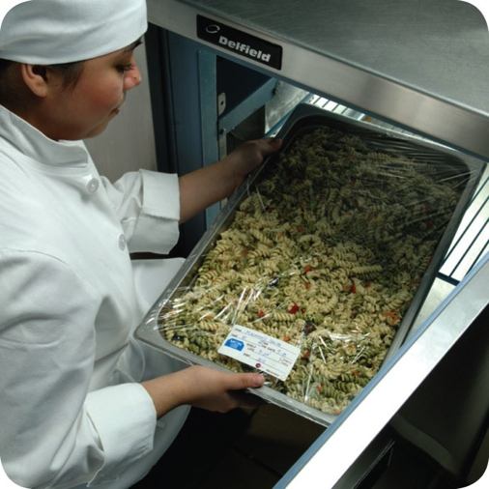
Prepping Specific Food
Salads containing TCS food:
  Make sure leftover TCS ingredients (i.e. pasta, chicken, potatoes) have been handled safely by ensuring that they were
    Cooked, held, and cooled correctly
    Stored for less than seven days at
    41˚F (5˚C) or lower
6-14
Notes:
Instructor Notes
Chicken, tuna, egg, pasta, and potato salads have all been involved in foodborne-illness outbreaks. These salads are not usually cooked after preparation. This means you do not have a chance to reduce pathogens, such as Staphylococcus aureus, that may have gotten into the salad.
Leftover TCS food such as pasta, chicken, and potatoes can be used only if it has been cooked, held, and cooled correctly.
Throw out leftover food held at 41°F (5°C) or lower after seven days. Check the use-by date before using stored food items.

Slide 60
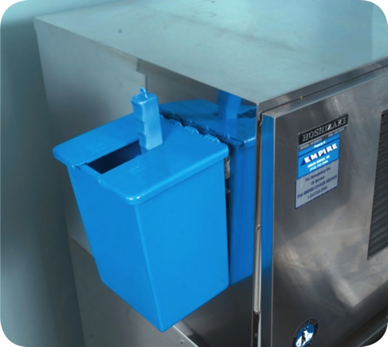
Prepping Specific Food
Ice:
  NEVER use ice as an ingredient if it was used to keep food cold
  Transfer ice using clean and sanitized containers and scoops
  NEVER hold ice in containers that held chemicals or raw meat, seafood, or poultry
6-15
Notes:
Instructor Notes
Make ice from water that is safe to drink.
Never use ice as an ingredient if it was used to keep food cold. For example, if ice is used to cool food on a salad bar, it cannot then be used in drinks.

Slide 61
Prepping Specific Food
Ice:
  Store ice scoops outside ice machines in a clean, protected location
  NEVER use a glass to scoop ice or touch ice with hands
6-16

Slide 62
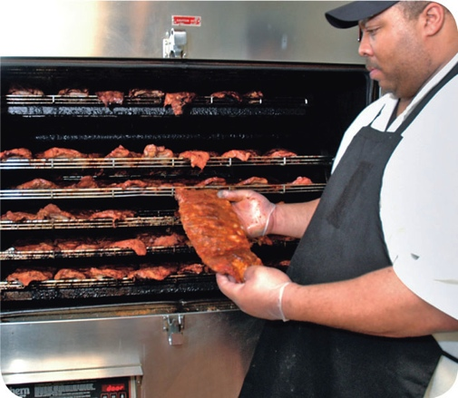
Preparation Practices That Have Special Requirements
You need a variance if prepping food in these ways:
  Packaging fresh juice on-site for sale at a later time, unless the juice has a warning label
  Smoking food to preserve it but not to
  enhance flavor
  Using food additives or components to preserve or alter food so it no longer needs time and temperature control for safety
  Curing food
6-17
Notes:
Instructor Notes
You will need a variance when prepping food in certain ways. A variance is a document issued by your regulatory authority that allows a regulatory requirement to be waived or changed.
When applying for a variance, your regulatory authority may require you to submit a HACCP plan. The plan must account for any food safety risks related to the way you plan to prep the food item.

Slide 63
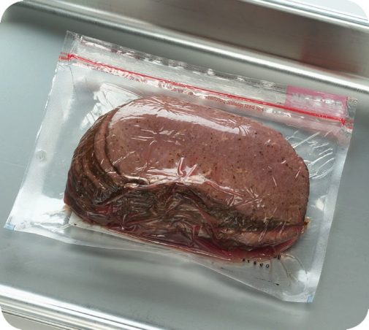
Preparation Practices
You need a variance if prepping food in these ways:
  Packaging food using a reduced-oxygen packaging (ROP) method
  Sprouting seeds or beans
  Offering live shellfish from a display tank
  Custom-processing animals for personal use (i.e. dressing a deer)
6-18
Notes:
Instructor Notes
Clostridium botulinum and Listeria monocytogenes are risks to food packaged using a reduced-oxygen packaging method. This includes MAP, vacuum-packed and sous vide foods.

Slide 64
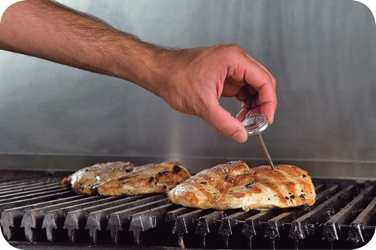
Cooking Food
When cooking TCS food, the internal portion must:
  Reach the required minimum
  internal temperature
  Hold that temperature for a specific amount of time
6-19
Notes:
Instructor Notes
The only way to reduce pathogens in food to safe levels is to cook it to its required minimum internal temperature. This temperature is different for each food.
If customers request that food items be cooked to temperatures lower than their minimum internal temperatures, you need to inform the customers of the potential risk of foodborne illness. Also be aware of special menu restrictions if you serve high-risk populations.
While cooking reduces pathogens in food, it does not destroy spores or toxins they may have produced. You still must handle food correctly before you cook it.

Slide 65
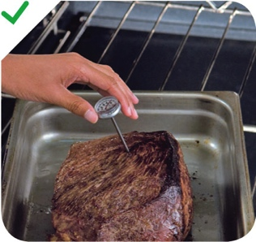
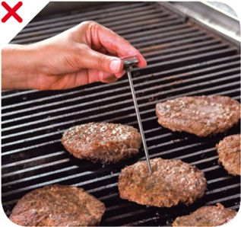
Cooking Food
When checking temperatures:
  Pick a thermometer with a probe that is the correct size for the food
  Check the temperature in the thickest part of the food
    Take at least two readings in different locations
6-20

Slide 66
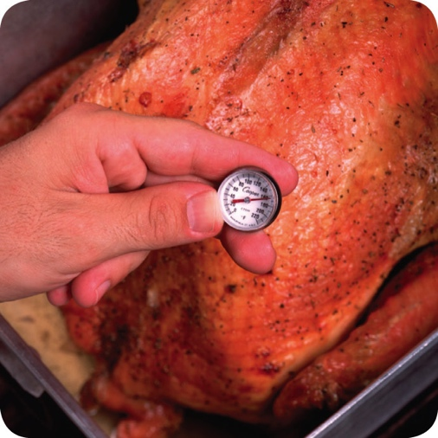
Cooking Requirements for Specific Food
Minimum internal cooking temperature:
165˚F (74˚C) for 15 seconds
  Poultry—whole or ground chicken, turkey or duck
  Stuffing made with fish, meat, or poultry
  Stuffed meat, seafood, poultry, or pasta
  Dishes that include previously cooked, TCS ingredients
6-21

Slide 67
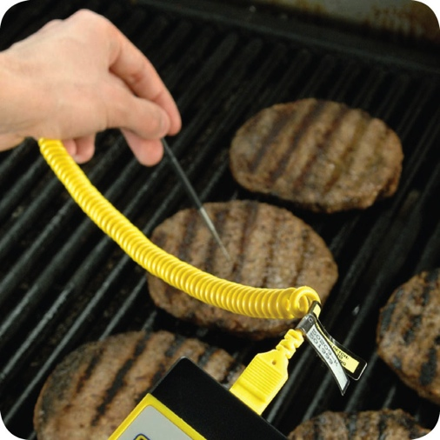
Cooking Requirements for Specific Food
Minimum internal cooking temperature:
155˚F (68˚C) for 15 seconds
  Ground meat—beef, pork, and other meat
  Injected meat—including brined ham and flavor-injected roasts
  Mechanically tenderized meat
  Ratites including ostrich and emu
  Ground seafood—including chopped or minced seafood
  Shell eggs that will be hot-held for service
6-22

Slide 68
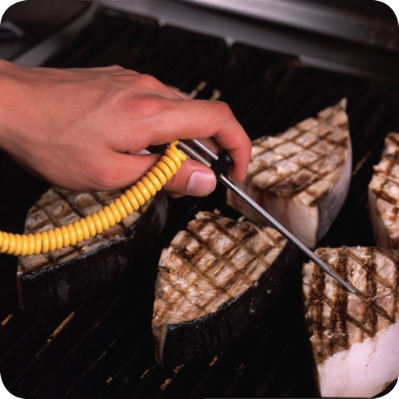
Cooking Requirements for Specific Food
Minimum internal cooking temperature:
145˚F (63˚C) for 15 seconds
  Seafood—including fish, shellfish, and crustaceans
  Steaks/chops of pork, beef, veal, and lamb
  Commercially raised game
  Shell eggs that will be served immediately
6-23

Slide 69
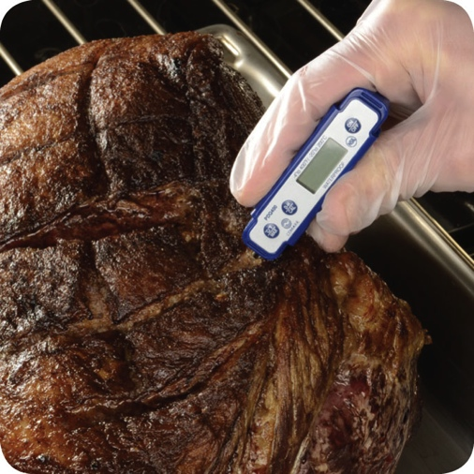
Cooking Requirements for Specific Food
Minimum internal cooking temperature:
145˚F (63˚C) for four minutes
  Roasts of pork, beef, veal, and lamb
  Alternate cooking times/temperatures
    130˚F (54˚C) 112 minutes
    131˚F (55˚C) 89 minutes
    133˚F (56˚C) 56 minutes
    135˚F (57˚C) 36 minutes
    136˚F (58˚C) 28 minutes
    138˚F (59˚C) 18 minutes
    140˚F (60˚C) 12 minutes
    142˚F (61˚C) 8 minutes
    144˚F (62˚C) 5 minutes
6-24
Notes:
Instructor Notes:
Roasts may be cooked to these alternate cooking times and temperatures depending on the type of roast and oven used:
130°F (54°C) 112 minutes
131°F (55°C) 89 minutes
133°F (56°C) 56 minutes
135°F (57°C) 36 minutes
136°F (58°C) 28 minutes
138°F (59°C) 18 minutes
140°F (60°C) 12 minutes
142°F (61°C) 8 minutes
144°F (62°C) 5 minutes

Slide 70

Cooking Requirements for Specific Food
Minimum internal cooking temperature:
135˚F (57˚C)
  Fruit, vegetables, grains (rice, pasta), and legumes (beans, refried beans) that will be hot-held for service
6-25

Slide 71

Cooking TCS Food in a Microwave
Minimum internal cooking temperature:
165˚F (74˚C)
  Meat
  Seafood
  Poultry
  Eggs
6-26

Slide 72
Cooking TCS Food in a Microwave
Guidelines for microwave cooking:
  Cover food to prevent the surface from drying out
  Rotate or stir it halfway through cooking so heat reaches the food more evenly
  Let it stand for at least two minutes after cooking to let the food temperature even out
  Check the temperature in at least two places to make sure the food is cooked through
6-27

Slide 73

Partial Cooking During Preparation
If partially cooking meat, seafood, poultry, or eggs or dishes containing these items:
  NEVER cook the food longer than
  60 minutes during initial cooking
  Cool the food immediately after
  initial cooking
  Freeze or refrigerate the food after cooling it
  Heat the food to its required minimum internal temperature before selling or serving it
  Cool the food if it will not be served immediately or held for service
6-28
Notes:
Instructor Notes
Some operations partially cook food during prep and then finish cooking it just before service. You must follow the steps in the slide if you plan to partially cook meat, seafood, poultry, or eggs; or dishes containing these items.
Your local regulatory authority may require you to have written procedures that explain how the food cooked by this process will be prepped and stored. These procedures must be approved by the regulatory authority and describe the following:
How the requirements will be monitored and documented
Which corrective actions will be taken if requirements are not met
How these food items will be marked after initial cooking to indicate that they need further cooking
How these food items will be separated from ready-to-eat food during storage, once initial cooking is complete

Slide 74

Consumer Advisories
If your menu includes raw or undercooked TCS items, you must:
  Note it on the menu next to the items
    Asterisk the item
    Place a footnote at the menu bottom indicating the item is raw, undercooked, or contains raw or undercooked ingredients
  Advise customers who order this food of the increased risk of foodborne illness
    Post a notice in the menu
    Provide this information using brochures, table tents, or signs
6-29
Notes:
Instructor Notes:
If your menu includes TCS items that are raw or undercooked, you must note it on the menu next to these items. This can be done by placing an asterisk next to the item that points customers to a footnote at the bottom of the menu. The footnote must include a statement that indicates the item is raw or undercooked, or contains raw or undercooked ingredients.
You must advise customers who order food that is raw or undercooked of the increased risk of foodborne illness. You can do this by posting a notice in your menu. You can also provide this information using brochures, table tents, signs, or other written methods.
Instructor Notes:
TCS Food must be cooked to the minimum internal temperatures unless a customer requests otherwise.

Slide 75

Consumer Advisories
The FDA advises against offering these items on a children’s menu if they are raw or undercooked:
  Meat
  Poultry
  Seafood
  Eggs
6-30
Notes:
Instructor Notes
The Food and Drug Administration (FDA) advises against offering raw or undercooked meat, poultry, seafood, or eggs on a children’s menu. This is especially true for undercooked ground beef, which may be contaminated with Shiga toxin-producing E. coli O157:H7.

Slide 76

Operations That Mainly Serve High-Risk Populations
NEVER serve:
  Raw seed sprouts
  Raw or undercooked eggs, meat, or seafood
    Over-easy eggs
    Raw oysters on the half shell
    Rare hamburgers
6-31

Slide 77


Cooling Food
Cooling requirements:
6-32
Notes:
Instructor Notes
As you know, pathogens grow well in the temperature danger zone. However, they grow much faster at temperatures between 125°F and 70°F (52°C and 21°C). Food must pass through this temperature range quickly to reduce this growth.
Cool TCS food from 135°F (57°C) to 41°F (5°C) or lower within six hours.
First, cool food from 135˚F to 70˚F (57˚C to 21˚C) within two hours.
Then cool it to 41˚F (5˚C) or lower in the next four hours.
If food has not reached 70˚F (21˚C) within two hours, it must be reheated and then cooled again.

Slide 78
Cooling Food
If you cool food from 135˚F to 70˚F (57˚C to 21˚C)
in less than two hours:
  Use the remaining time to cool it to 41˚F (5˚C) or lower
  The total cooling time cannot be longer than six hours
Example:
  If you cool food from 135˚F to 70˚F (57˚C to 21˚C) in one hour
  Then you have five hours to get the food to 41˚F (5˚C) or lower
6-33

Slide 79

Methods for Cooling Food
Before cooling food, start by reducing its size:
  Cut larger items into smaller pieces
  Divide large containers of food into smaller containers or shallow pans
6-34
Notes:
Instructor Notes:
The denser the food, the more slowly it will cool.
Size of the food Large food items cool more slowly than smaller items. To let food cool faster, you should reduce its size. Cut large food items into smaller pieces. Divide large containers of food into smaller containers or shallow pans,

Slide 80



Methods for Cooling Food
Methods for cooling food safely and quickly:
  Place food in an ice-water bath
  Stir it with an ice paddle
  Place it in a blast chiller
6-35
Notes:
Instructor Notes
Never cool large amounts of hot food in a cooler. Most coolers are not designed to cool large amounts of hot food quickly. Also, placing hot food in a cooler may not move the food through the temperature danger zone quickly enough.
After dividing food into smaller containers, place them in a clean prep sink or large pot filled with ice water. Stir the food frequently to cool it faster and more evenly.
Ice paddles are plastic paddles that can be filled with ice or with water and then frozen. Food stirred with these paddles will cool quickly.
Blast chillers blast cold air across food at high speeds to remove heat. They are typically used to cool large amounts of food.
When cooling soups or stews you can add ice or cold water as an ingredient to cool it. To use this method the recipe is made with less water than required. Cold water or ice is then added after cooking to cool the food and provide the remaining water.

Slide 81
Storing Food for Further Cooling
When storing food for further cooling:
  Loosely cover food containers before storing them
  Food can be left uncovered if protected from contamination
    Storing uncovered containers above other food, especially raw seafood, meat, and poultry, will help prevent cross-contamination
6-36
Notes:
Instructor Notes:
Loosely cover food containers before storing them. Food can be left uncovered if stored in a way that prevents contaminants from getting into it. Storing uncovered containers above other food, especially raw seafood, meat, and poultry, will help prevent cross-contamination.

Slide 82

Reheating Food
Food reheated for immediate service:
  Can be reheated to any temperature if it was cooked and cooled correctly
Food reheated for hot-holding:
  Must be reheated to an internal temperature of 165˚F (74˚C) for 15 seconds within two hours
  Reheat commercially processed and packaged ready-to-eat food to an internal temperature of at least 135˚F (57˚C)
6-37
Notes:
Instructor Notes
These guidelines apply to all heating methods, such as ovens or microwave ovens.

