Slide 2
Service
Objectives:
Holding hot food
Holding cold food
Using time as a method of control for food
Preventing contamination in self-service areas and when serving food to customers
7-2
Notes:
Instructor Notes
Discuss the topic objectives with the class.

Slide 3
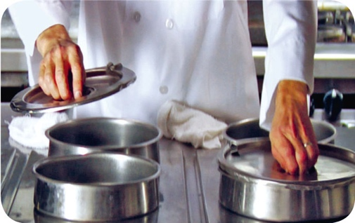
Guidelines for Holding Food
Food covers and sneeze guards:
Cover food and install sneeze guards to protect food from contaminants
Covers protect food from contamination and help maintain food temperatures
7-3

Slide 4
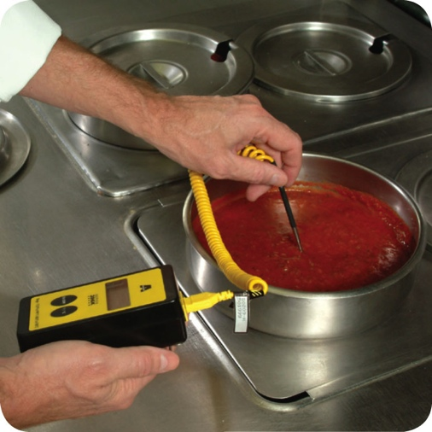
Guidelines for Holding Food
Temperature:
Hold TCS food at the correct temperature
Hot food: 135˚F (57˚C) or higher
Cold food: 41˚F (5˚C) or lower
Check temperatures at least every four hours
Throw out food not at 41˚F (5˚C) or lower
Check temperatures every two hours to leave time for corrective action
7-4
Notes:
Instructor Notes
Hold hot food at 135°F (57°C) or higher. This will prevent pathogens such as Bacillus cereus from growing to unsafe levels.
Hold cold food at 41°F (5°C) or lower. This will prevent pathogens such as Staphylococcus aureus from growing to unsafe levels.
Use a thermometer to check a food’s internal temperature. Never use the temperature gauge on a holding unit to do it. The gauge does not check the internal temperature of the food.

Slide 5
Guidelines for Holding Food
Temperature:
NEVER use hot-holding equipment to reheat food unless it’s designed for it
Reheat food correctly, and then move it into a holding unit
7-5

Slide 6
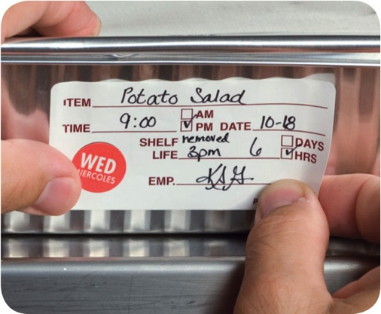
Holding Food Without Temperature Control
Cold food can be held without temperature control for up to six hours if:
It was held at 41˚F (5˚C) or lower before removing it from refrigeration
It does not exceed 70˚F (21˚C) during service
Throw out food that exceeds this temperature
It has a label specifying:
Time it was removed from refrigeration
Time it must be thrown out
It is sold, served, or thrown out within six hours
7-6
Notes:
Instructor Notes
If your operation displays or holds TCS food without temperature control, it must do so under certain conditions. The conditions for holding cold food are different from those for holding hot food. Before using time as a method of control, check with your local regulatory authority for specific requirements.
For cold food, label the food with the time you removed it from refrigeration and the time you must throw it out. The discard time on the label must be six hours from the time you removed the food from refrigeration.
For example, if you remove potato salad from refrigeration at 3:00 p.m. to serve at a picnic, the discard time on the label should be 9:00 p.m. This equals six hours from the time you removed it from refrigeration.

Slide 7
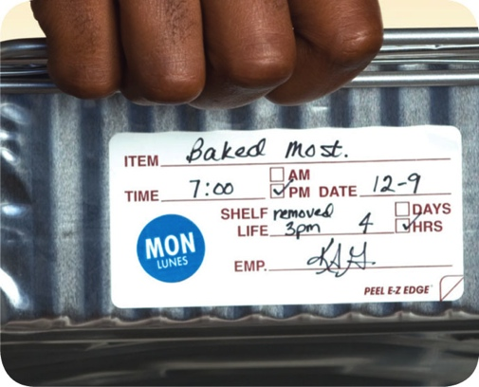
Holding Food Without Temperature Control
Hot food can be held without temperature control for up to four hours if:
It was held at 135˚F (57˚C) or higher before removing it from temperature control
It has a label specifying when the item must be thrown out
It is sold, served, or thrown out within four hours
7-7
Notes:
Instructor Notes
Before using time as a method of control, check with your local regulatory authority for specific requirements.
For hot food, the discard time on the label must be four hours from the time you removed the food from temperature control.

Slide 8
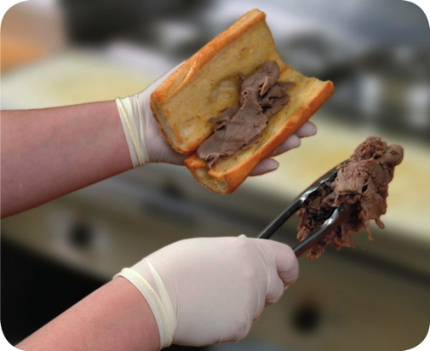
Kitchen Staff Guidelines
Prevent contamination when serving food:
Wear single-use gloves whenever handling ready-to-eat food
As and alternative use spatulas, tongs, deli sheets, or other utensils
Use clean and sanitized utensils for serving
Use separate utensils for each food
Clean and sanitize utensils after each task
At minimum, clean and sanitize them at least once every four hours
7-8

Slide 9
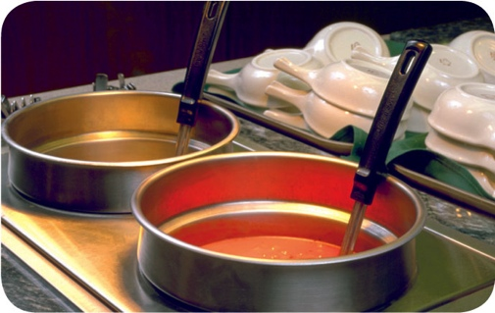
Kitchen Staff Guidelines for Serving Food
Prevent contamination when serving food:
Store serving utensils correctly between uses
On a clean and sanitized food-contact surface
In the food with the handle extended above the container rim
7-9
Notes:
Instructor Notes
Spoons or scoops used to serve food such as ice cream or mashed potatoes can be stored under running water that is 135°F (57°C).

Slide 10
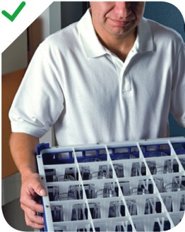
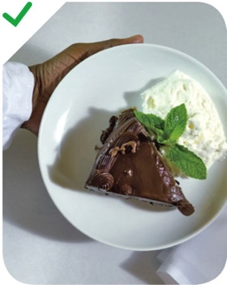
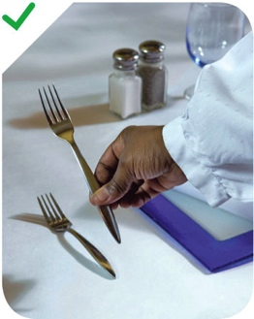
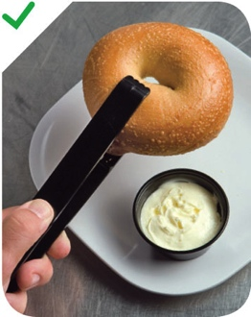
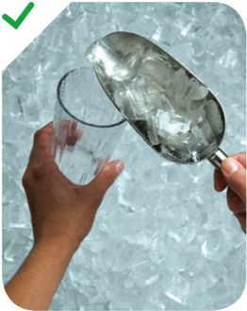
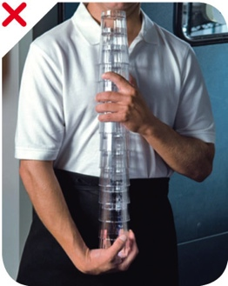
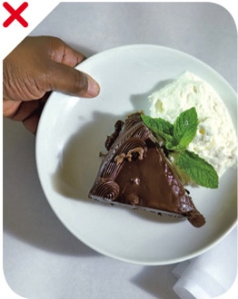
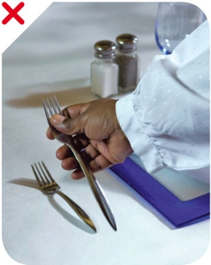
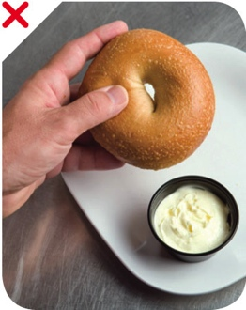
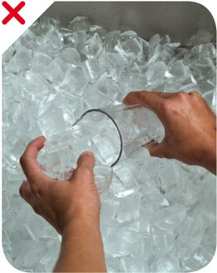
Service Staff Guidelines for Serving Food
Handling dishes and glassware:
Correct
Incorrect
7-10
Notes:
Instructor Notes
Carry glasses in a rack or on a tray to avoid touching the food-contact surfaces. Do not stack glasses when carrying them.
Hold dishes by the bottom or edge. Hold glasses by the middle, bottom, or stem. Do not touch the food-contact areas of dishes or glassware.

Slide 11
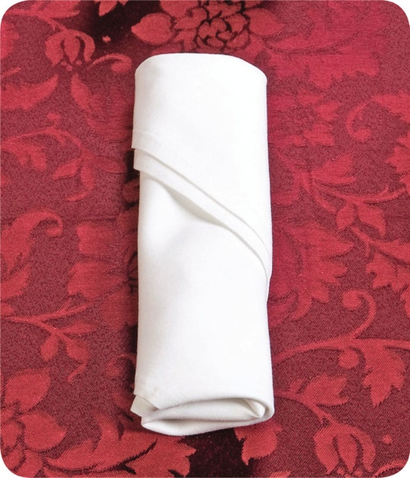
Preset Tableware
If you preset tableware:
Prevent it from being contaminated
Wrap or cover the items
Table settings do not need to be wrapped or covered if extra settings:
Are removed when guests are seated
Are cleaned and sanitized after guests have left
7-11
Notes:
Instructor Notes
Table settings do not need to be wrapped or covered if extra settings meet these requirements.
They are removed when guests are seated.
If they remain on the table, they are cleaned and sanitized after guests have left.

Slide 12
Refilling Returnable Take-Home Containers for Food
Some jurisdictions allow the refilling of take-home food containers.
Take-home food containers must be:
Designed to be reused
Provided to the customer by the operation
Cleaned and sanitized correctly
7-12
Notes:
Instructor Notes
Some jurisdictions allow food handlers to refill take-home containers brought back by a customer with food and beverages. Take-home containers can be refilled if they meet these conditions:
They were designed to be reused
They were provided to the customer by the operation
They are cleaned and sanitized correctly

Slide 13
Refilling Returnable Take-Home Containers for Beverages
Some jurisdictions allow the refilling of take-home beverage containers.
These can be refilled for the same customer with non-TCS food. The container must be:
Able to be effectively cleaned at home and at the operation
Rinsed with fresh, pressurized hot water before refilling
Refilled using a process that prevents contamination
7-13
Notes:
Instructor notes
Take-home beverage containers can be refilled as long as the beverage is not a TCS food, and the container will be refilled for the same customer. The container must also meet these conditions:
It can be effectively cleaned at home and in the operation
It will be rinsed before refilling with fresh, hot water under pressure
It will be refilled by staff in the operation or by the customer using a process that prevents contamination

Slide 14
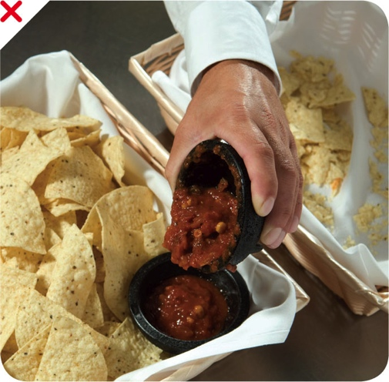
Re-serving Food
NEVER re-serve:
Food returned by one customer to another customer
Uncovered condiments
Uneaten bread
Plate garnishes
Generally, only unopened, prepackaged food in good condition can be re-served:
Condiment packets
Wrapped crackers or breadsticks
7-14
Notes:
Instructor Notes
You must protect condiments from contamination. Serve them in their original containers or in containers designed to prevent contamination. Offering condiments in individual packets or portions can also help keep them safe. Never re-serve uncovered condiments. Do not combine leftover condiments with fresh ones. Throw away opened portions or dishes of condiments after serving them to customers. Salsa, butter, mayonnaise, and ketchup are examples.
Change linens used in bread baskets after each customer.
In general, only unopened prepackaged food can be re-served. That includes condiment packets, wrapped crackers or breadsticks, and bottles of ketchup and mustard.

Slide 15
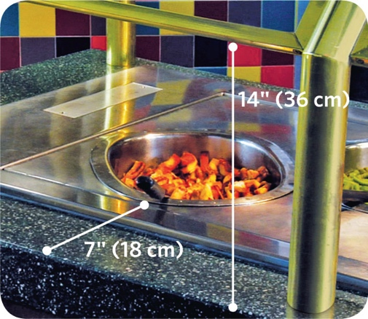
Self-Service Areas
Prevent time-temperature abuse and contamination:
Use sneeze guards
Must be located 14" (36cm) above the counter
Must extend 7" (18cm) beyond the food
Identify all food items
Label food
Place salad dressing names on ladle handles
7-15
Notes:
Instructor Notes
Food can also be protected by placing it in display cases or by packaging it in a way that will protect it from contamination. Whole, raw fruits and vegetables and nuts in the shell that require peeling or hulling before eating do not require the protection measures discussed.

Slide 16
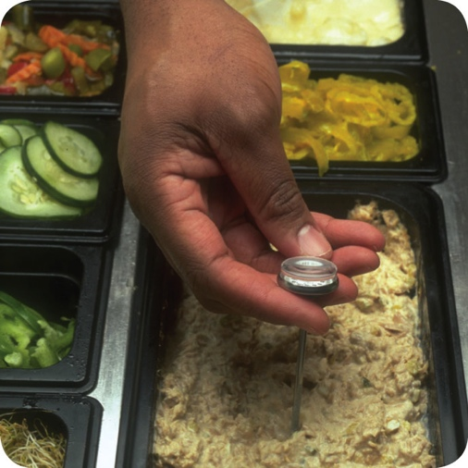
Self-Service Areas
Prevent time-temperature abuse and contamination:
Keep hot food at 135˚F (57˚C) or higher
Keep cold food at 41˚F (5˚C) or lower
Keep raw meat, fish, and poultry separate from ready-to-eat food
Do NOT let customers refill dirty plates or use dirty utensils at self-service areas
7-16
Notes:
Instructor Notes
Typically, raw, unpackaged meat, poultry, and seafood cannot be offered for self-service. However, the following items are exceptions to this rule: ready-to-eat food at buffets or salad bars that serve food such as sushi or raw shellfish; ready-to-cook portions that will be cooked and eaten immediately on the premises, such as at Mongolian barbeques; raw, frozen, shell- on shrimp or lobster.
Assign a staff member to monitor guests. Post signs reminding customers not to reuse plates and utensils.
Stock food displays with the correct utensils for dispensing food. This might include tongs, ladles, or deli sheets.

Slide 17
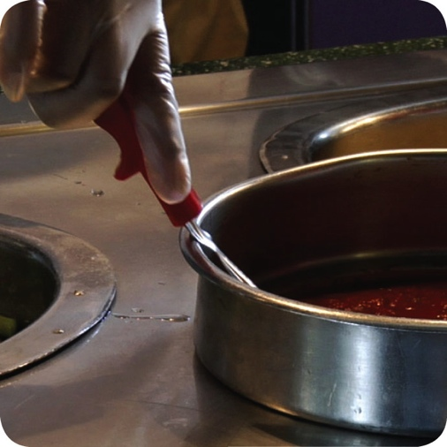
Self-Service Areas
Prevent time-temperature abuse and contamination:
Stock food displays with the correct utensils for dispensing food
Do NOT use ice as an ingredient if it was used to keep food or beverages cold
7-17
Notes:
Instructor Notes
Stock food displays with the correct utensils for dispensing food. This might include tongs, ladles, or deli sheets.

Slide 18
Labeling Bulk Food in Self-Service Areas
When labeling bulk food in self-service areas:
Make sure the label is in plain view of the customer
Include the manufacturer or processor label provided with the food
As an alternative, provide the information using a card, sign, or other labeling method
7-18

Slide 19
Labeling Bulk Food in Self-Service Areas
A label is not needed for bulk unpackaged food, such as bakery products, if:
The product makes no claim regarding health or nutrient content
No laws requiring labeling exist
The food is manufactured or prepared on the premises
The food is manufactured or prepared at another regulated food operation or processing plant owned by the same person
7-19
Notes:
Instructor Notes
Bulk unpackaged food, such as bakery products and unpackaged food portioned for customers, does not need to be labeled if it meets the conditions identified in the slide.

Slide 20
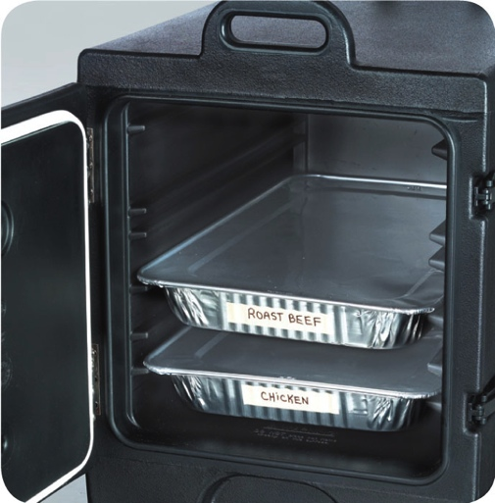
Off-Site Service
When delivering food off-site:
Use insulated, food-grade containers designed to stop food from mixing, leaking, or spilling
Clean the inside of delivery vehicles regularly
Check internal food temperatures
Label food with a use-by date and time, and reheating and service instructions
7-20
Notes:
Instructor Notes
Delays from the point of preparation to the point of service increase the risk that food will be exposed to contamination or time-temperature abuse.
At the service site, use appropriate containers or equipment to hold food at the correct temperature.
Check internal food temperatures. If containers or delivery vehicles are not holding food at the correct temperature, reevaluate the length of the delivery route or the efficiency of the equipment being used.

Slide 21
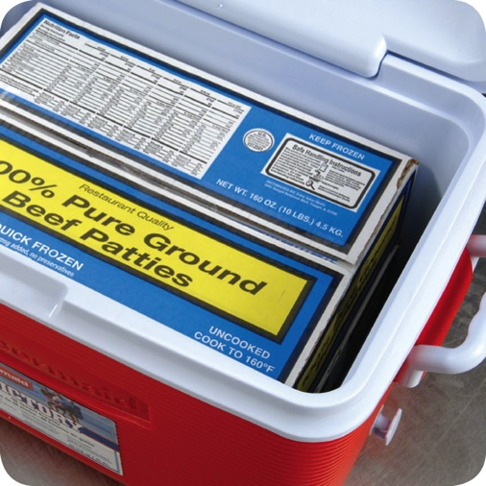
Off-Site Service
When delivering food off-site:
Make sure the service site has the correct utilities
Safe water for cooking, dishwashing, and handwashing
Garbage containers stored away from food-prep, storage, and serving areas
Store raw meat, poultry, and seafood, and ready-to-eat items separately
7-21

Slide 22
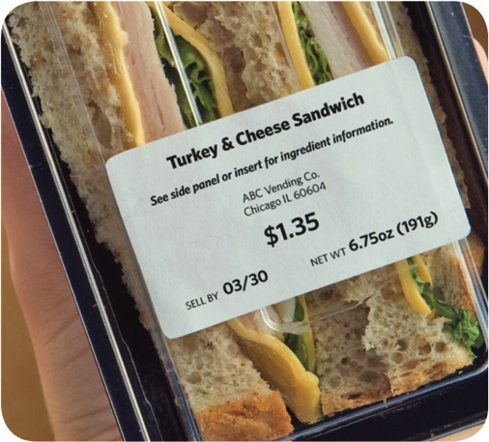
Vending Machines
To keep vended food safe:
Check product shelf life daily
Refrigerated food prepped on-site and not sold in seven days must be thrown out
Keep TCS food at the correct temperature
Dispense TCS food in its original container
Wash and wrap fresh fruit with edible peels before putting it in the machine
7-22
Notes:
Instructor Notes
Handle food prepped and packaged for vending machines with the same care as any other food served to customers. Vending operators should protect food from contamination and time-temperature abuse during transport, delivery, and service.
Check product shelf life daily. Products often have a code date, such as an expiration or a use-by date. If the date has expired, throw out the food immediately. Throw out refrigerated food prepped on-site if not sold within seven days of preparation.
Keep TCS food at the correct temperature. It should be held at 41°F (5°C) or lower, or at 135°F (57°C) or higher. These machines must have controls that prevent TCS food from being dispensed if the temperature stays in the danger zone for a specified amount of time. This food must be thrown out

Slide 24
Service
Objectives:
Food safety management systems
Active managerial control
Hazard Analysis Critical Control point (HACCP)
8-2
Notes:
Instructor Notes
Discuss the topic objectives with the class.

Slide 25
Food Safety Management Systems
Food safety management system:
Group of practices and procedures intended to prevent foodborne illness
Actively controls risks and hazards throughout the flow of food
8-3

Slide 26
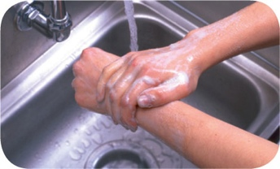
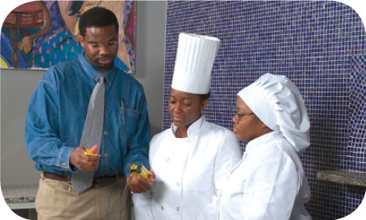
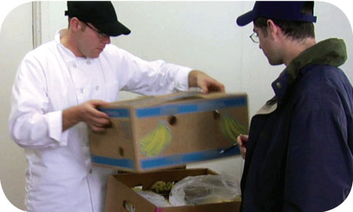
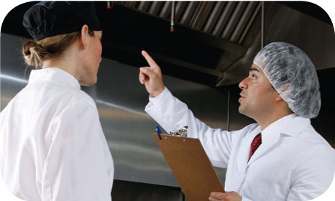
Food Safety Programs
These are the foundation of a food safety management system:
Personal hygiene program
Food safety training program
Supplier selection and specification program
Quality control and assurance program
8-4
Notes:
Instructor Notes
Having food safety programs already in place gives you the foundation for your system. The principles presented in the ServSafe program are the basis of these programs.

Slide 27
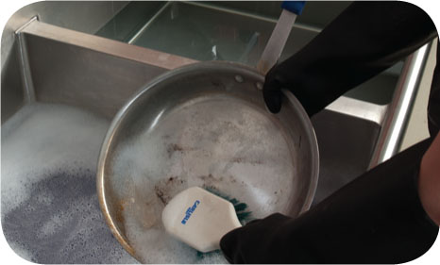
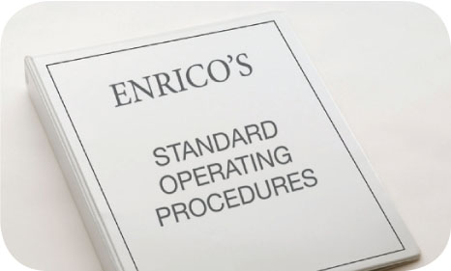
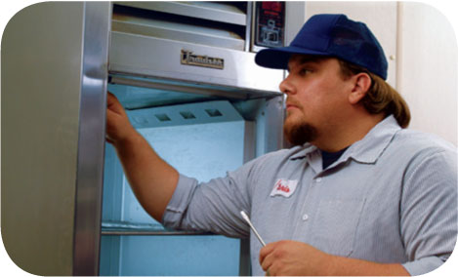
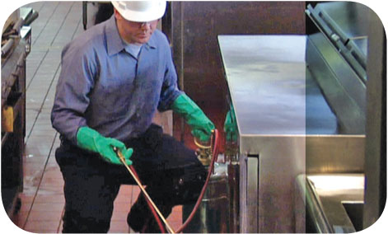
Food Safety Programs
These are the foundation of a food safety management system:
Cleaning and sanitation program
Standard operating procedures (SOPs)
Facility design and equipment maintenance program
Pest control program
8-5
Notes:
Instructor Notes
Having food safety programs already in place gives you the foundation for your system. The principles presented in the ServSafe program are the basis of these programs.

Slide 28
Active Managerial Control
Focuses on controlling the five most common risk factors for foodborne illness:
Purchasing food from unsafe sources
Failing to cook food adequately
Holding food at incorrect temperatures
Using contaminated equipment
Practicing poor personal hygiene
8-6
Notes:
Instructor Notes:
There are many ways to achieve active managerial control in the operation. According to the Food and Drug Administration (FDA), you can use simple tools such as training programs, manager supervision, and the incorporation of SOPs. Active Managerial Control can also be achieved through more complex solutions such as a HACCP Program.
Monitoring is critical to the success of active managerial control. Food will be safe if managers monitor critical activities in the operation.
Managers must also take the necessary corrective action when required. They must also verify that the actions taken to control the risk factors for foodborne illness are actually working.

Slide 29
Active Managerial Control
There are many ways to achieve active managerial control in the operation:
Training programs
Manager supervision
Incorporation of standard operating procedures (SOPs)
HACCP
These are critical to the success of active managerial control:
Monitoring critical activities in the operation
Taking the necessary corrective action when required
Verifying that the actions taken control the risks factors
8-7
Notes:
Instructor Notes:
There are many ways to achieve active managerial control in the operation. According to the Food and Drug Administration (FDA), you can use simple tools such as training programs, manager supervision, and the incorporation of SOPs. Active Managerial Control can also be achieved through more complex solutions such as a HACCP Program.
Monitoring is critical to the success of active managerial control. Food will be safe if managers monitor critical activities in the operation.
Managers must also take the necessary corrective action when required. They must also verify that the actions taken to control the risk factors for foodborne illness are actually working.
Instructor Notes
It is the manager’s responsibility to actively control these and other risk factors for foodborne illness. This is called active managerial control.
There are many ways to achieve active managerial control in the operation. According to the Food and Drug Administration (FDA), you can use simple tools such as training programs, manager supervision, and the incorporation of SOPs. Active managerial control can also be achieved through more complex solutions such as a HACCP program.
Monitoring is critical to the success of active managerial control. Food will be safe if managers monitor critical activities in the operation. Managers must also take the necessary corrective action when required. They must also verify that the actions taken to control the risk factors for foodborne illness are actually working.

Slide 30
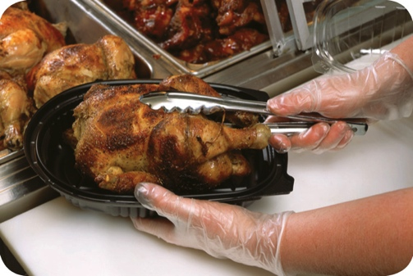
Active Managerial Control
The FDA provides recommendations for controlling the common risk factors for foodborne illness:
Demonstration of knowledge
Staff health controls
Controlling hands as a vehicle of contamination
Time and temperature parameters for controlling pathogens
Consumer advisories
8-8
Notes:
Instructor Notes
Demonstration of knowledge: As a manager, you must be able to show that you know what to do to keep food safe. Becoming certified in food safety is one way to show this.
Staff health controls: Procedures must be put in place to make sure staff are practicing personal hygiene. For example, staff must know that they must report illnesses and illness symptoms to management.
Controlling hands as a vehicle of contamination: Controls must be put in place to prevent bare-hand contact with ready-to-eat food. This might include requiring the use of tongs to handle ready-to-eat food.
Time and temperature parameters for controlling pathogens: Procedures must be put in place to limit the time food spends in the temperature danger zone. Requiring food handlers to check the temperature of food being hot-held every two hours is an example.
Consumer advisories: Notices must be provided to customers if you serve raw or undercooked menu items. These notices must include a statement about the risks of eating these foods.

Slide 31
HACCP
The HACCP approach:
HACCP is based on identifying significant biological, chemical, or physical hazards at specific points within a product’s flow through an operation
Once identified, hazards can be prevented, eliminated, or reduced to safe levels
8-9
Notes:
Instructor Notes
There are many systems you can implement to achieve active managerial control of foodborne illness risk factors. Hazard Analysis Critical Control Point (HACCP) is one such system. HACCP (pronounced HASS-ip) is based on identifying significant biological, chemical, or physical hazards at specific points within a product’s flow. Once identified, the hazards can be prevented, eliminated, or reduced to safe levels.

Slide 32
HACCP
To be effective, a HACCP system must be based on a written plan:
It must be specific to each facility’s menu, customers, equipment, processes, and operations
A plan that works for one operation may not work for another
8-10
Notes:
Instructor Notes
Each HACCP plan is unique, a plan that works for one operation may not work for another.

Slide 33
The 7 HACCP Principles
The seven HACCP principles:
Conduct a hazard analysis
Determine critical control points (CCPs)
Establish critical limits
Establish monitoring procedures
Identify corrective actions
Verify that the system works
Establish procedures for record keeping and documentation
8-11
Notes:
Instructor Notes
In general terms, the HACCP principles can be broken into three groups.
Principles 1 and 2 help you identify and evaluate your hazards.
Principles 3, 4, and 5 help you establish ways for controlling those hazards.
Principles 6 and 7 help you maintain the HACCP plan and system and verify its effectiveness.

Slide 34
The 7 HACCP Principles
Principle 1: Conduct a hazard analysis
Identify potential hazards in the food served by looking at how it is processed
Identify TCS food items and determine where hazards are likely to occur for each one; look for biological, chemical, and physical contaminants
8-12
Notes:
Instructor Notes
Here is a real-world example showing the efforts of Enrico’s, an Italian restaurant, as it implements a HACCP program.
The management team at Enrico’s decided to implement a HACCP program. They began by analyzing their hazards.
The team noted that many of their dishes are received, stored, prepared, cooked, and served the same day. The most popular of these items was the spicy charbroiled chicken breast.
The team determined that bacteria were the most likely hazard to food prepared this way.

Slide 35
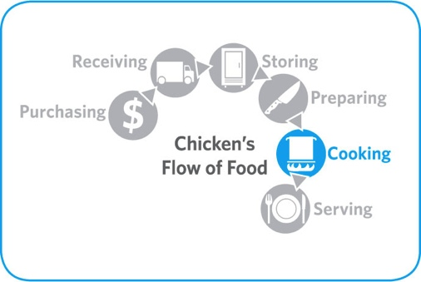
The 7 HACCP Principles
Principle 2: Determine critical control points (CCPs)
Find points in the process where identified hazards can be prevented, eliminated, or reduced to safe levels—these are the CCPs
Depending on the process, there may be more than one CCP
8-13
Notes:
Instructor Notes
Here is a real-world example showing the efforts of Enrico’s, an Italian restaurant, as it implements a HACCP program.
Enrico’s management identified cooking as the CCP for food prepared and cooked for immediate service. This included the chicken breasts.
These food items must be handled correctly throughout the flow of food. However, correct cooking is the only step that will eliminate or reduce bacteria to safe levels.
Because the chicken breasts were prepared for immediate service, cooking was the only CCP identified.

Slide 36
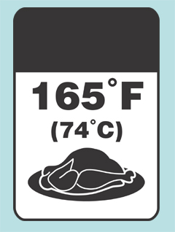
The 7 HACCP Principles
Principle 3: Establish critical limits
For each CCP, establish minimum or maximum limits
These limits must be met to
Prevent or eliminate the hazard
Reduce it to a safe level
Critical
Limit
8-14
Notes:
Instructor Notes
Here is a real-world example showing the efforts of Enrico’s, an Italian restaurant, as it implements a HACCP program.
With cooking identified as the CCP for Enrico’s chicken breasts, a critical limit was needed. Management determined that the critical limit would be cooking the chicken to a minimum internal temperature of 165°F (74°C) for 15 seconds.
They decided that the critical limit could be met by cooking chicken breasts in the broiler for 16 minutes.

Slide 37
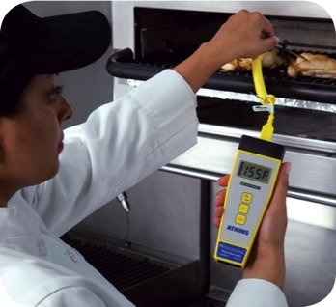
The 7 HACCP Principles
Principle 4: Establish monitoring procedures
Determine the best way to check critical limits
Make sure they are consistently met
Identify who will monitor them and how often
8-15
Notes:
Instructor Notes
Here is a real-world example showing the efforts of Enrico’s, an Italian restaurant, as it implements a HACCP program.
At Enrico’s, each charbroiled chicken breast is cooked to order. The team decided to check the critical limit by inserting a clean and sanitized thermocouple probe into the thickest part of each chicken breast.
The grill cook must check the temperature of each chicken breast after cooking. Each chicken breast must reach the minimum internal temperature of 165°F (74°C) for 15 seconds.

Slide 38
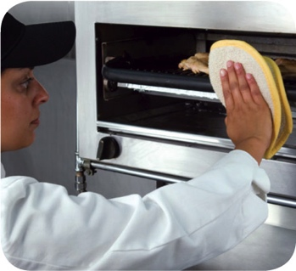
The 7 HACCP Principles
Principle 5: Identify corrective actions
Identify steps that must be taken when a critical limit is not met
Determine these steps in advance
8-16
Notes:
Instructor Notes
Here is a real-world example showing the efforts of Enrico’s, an Italian restaurant, as it implements a HACCP program.
If the chicken breast has not reached its critical limit within the 16-minute cook time, the grill cook at Enrico’s must keep cooking the chicken breast until it has reached it.
This and all other corrective actions are noted in the temperature log.

Slide 39
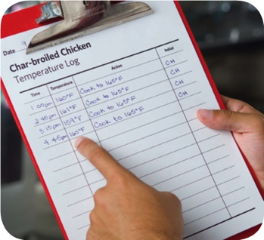
The 7 HACCP Principles
Principle 6: Verify that the system works
Determine if the plan is working as intended
Evaluate the plan on a regular basis using
Monitoring charts
Records
Hazard analysis
Determine if your plan prevents, reduces, or eliminates identified hazards
8-17
Notes:
Instructor Notes
Here is a real-world example showing the efforts of Enrico’s, an Italian restaurant, as it implements a HACCP program.
Enrico’s management team performs HACCP checks once per shift. They make sure that critical limits were met and appropriate corrective actions were taken when needed.
They also check the temperature logs on a weekly basis to identify patterns. This helps to determine if processes or procedures need to be changed. For example, over several weeks they noticed problems toward the end of each week. The chicken breasts often failed to meet the critical limit. The appropriate corrective action was being taken.
Management discovered that Enrico’s received chicken shipments from a different supplier on Thursdays. This supplier provided a six-ounce chicken breast. Enrico’s chicken specifications listed a four-ounce chicken breast. Management worked with the supplier to ensure they received four-ounce breasts. The receiving procedures were changed to include a weight check.

Slide 40
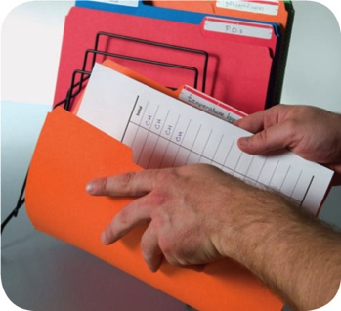
The 7 HACCP Principles
Principle 7: Establish procedures for record keeping and documentation
Keep records for these actions:
Monitoring activities
Corrective actions
Validating equipment (checking for good working condition)
Working with suppliers (invoices, specifications, etc.)
8-18
Notes:
Instructor Notes
Maintain your HACCP plan and keep all documentation created when developing it.
Here is a real-world example showing the efforts of Enrico’s, an Italian restaurant, as it implements a HACCP program.
Enrico’s management team determined that time-temperature logs should be kept for three months. Receiving invoices would be kept for 60 days. The team used this documentation to support and revise their HACCP plan.

Slide 41
HACCP
These specialized processing methods require a variance and may require a HACCP plan:
Smoking food as a method to preserve it (but not to enhance flavor)
Using food additives or components such as vinegar to preserve or alter food so it no longer requires time and temperature control for safety
Curing food
Custom-processing animals
8-19
Notes:
Instructor Notes
Some food processes are highly specialized and can be a serious health risk if specific procedures are not followed. Typically these processes are carried out at processing plants.
A variance from the regulatory authority will be required before processing food this way. A variance is a document that allows a requirement to be waived or changed.
A HACCP plan may also be required if the processing method carries a higher risk of causing a foodborne illness. There may also be dangers unique to these processes that are best addressed by HACCP.

Slide 42
HACCP
These specialized processing methods require a variance and may require a HACCP plan:
Packaging food using ROP methods including
MAP
Vacuum-packed
Sous vide
Treating (e.g. pasteurizing) juice on-site and packaging it for later sale
Sprouting seeds or beans
8-20
Notes:
Instructor Notes
Always check with your local regulatory authority to see if a variance is also required when prepping food in these ways.
A HACCP plan is required when packaging food using reduced-oxygen packaging (ROP) methods. This includes MAP, vacuum-packed, and sous vide food. Clostridium botulinum and Listeria monocytogenes are risks to food packaged in these ways.

Slide 44
Safe Facilities and Pest Management
Objectives:
Pick materials and equipment that are safe for use in foodservice operations
Install and maintain equipment
Avoid food safety hazards caused by utilities
Maintain your facility
Handle emergencies
Prevent and control pests
9-2
Notes:
Instructor Notes
Discuss the topic objectives with the class.

Slide 45
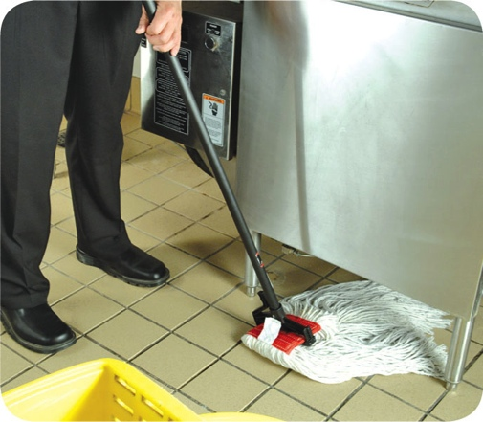
Interior Requirements for a Safe Operation
Floors, walls, and ceilings:
Materials must be smooth and durable for easier cleaning
Must be regularly maintained
9-3
Notes:
Instructor Notes:
Once installed, flooring, walls, and ceilings must be regularly maintained. Replace missing or broken ceiling tiles. Do the same for flooring. Repair all holes in walls.
Instructor Notes:
When choosing flooring, wall, and ceiling materials, pick those that are smooth and durable. This makes cleaning easier. Once installed, flooring, walls, and ceilings must be regularly maintained. Replace missing or broken ceiling tiles. Do the same for flooring. Repair all holes in walls.

Slide 46
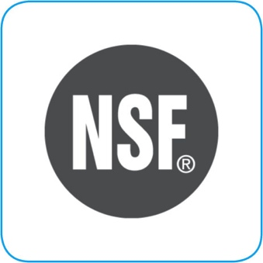
Equipment Selection
Foodservice equipment must meet these standards if it will come in contact with food:
Nonabsorbent, smooth, and corrosion resistant
Easy to clean
Durable
Resistant to damage
9-4
Notes:
Instructor Notes
Foodservice equipment must meet certain standards if it will come in contact with food.
NSF is an organization that creates these national standards. NSF is accredited by the American National Standards Institute (ANSI).
NSF/ANSI standards for food equipment require that it be nonabsorbent, smooth, and corrosion resistant. Food equipment must also be easy to clean, durable, and resistant to damage.

Slide 47
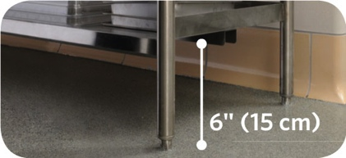
Installing and Maintaining Equipment
Floor-mounted equipment must be either:
Mounted on legs at least six inches (15 centimeters) high
Sealed to a masonry base
9-5
Notes:
Instructor Notes
Stationary equipment should be easy to clean and easy to clean around.
When installing equipment, follow the manufacturer’s recommendations. Also, check with your regulatory authority for requirements.

Slide 48
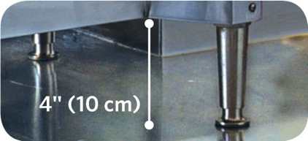
Installing and Maintaining Equipment
Tabletop equipment should be either:
Mounted on legs at least four inches (10 centimeters) high
Sealed to the countertop
9-6
Notes:
Instructor Notes
Stationary equipment should be easy to clean and easy to clean around.
When installing equipment, follow the manufacturer’s recommendations. Also, check with your regulatory authority for requirements.

Slide 49
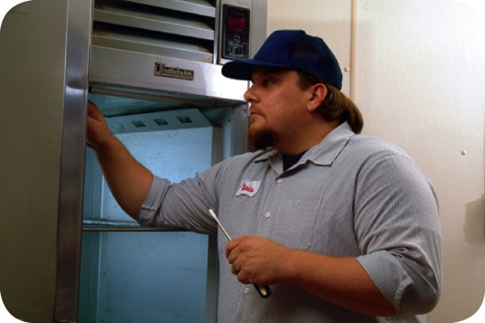
Installing and Maintaining Equipment
Once equipment has been installed:
It must be maintained regularly
Only qualified people should maintain it
Set up a maintenance schedule with your supplier or manufacturer
Check equipment regularly to make sure it is working correctly
9-7

Slide 50
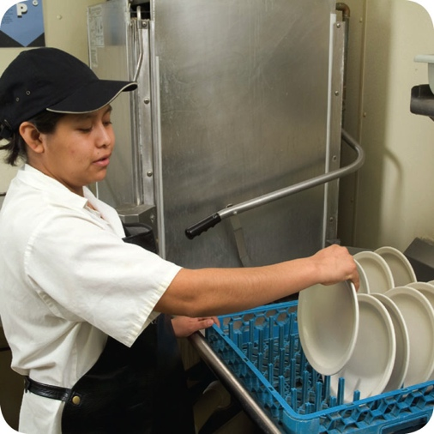
Dishwashing Machines
Dishwashers must be installed:
So they are reachable and conveniently located
In a way that keeps utensils, equipment, and other food-contact services from becoming contaminated
Following manufacturer’s instructions
9-8
Notes:
Instructor Notes
Always follow the manufacturer’s instructions when installing, operating, and maintaining dishwashers.

Slide 51
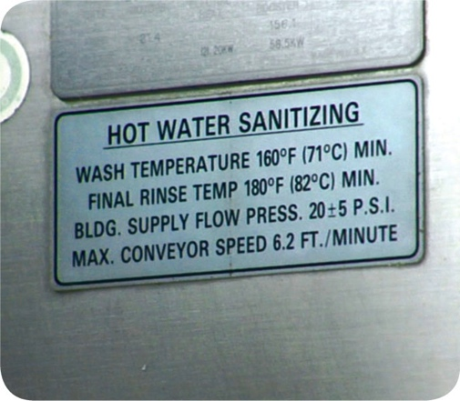
Dishwashing Machines
When selecting dishwashers make sure:
The detergents and sanitizers used are approved by the local regulatory authority
They have the ability to measure water temperature, water pressure, and cleaning and sanitizing chemical concentration
Information about the correct settings is posted on the machine
9-9

Slide 52
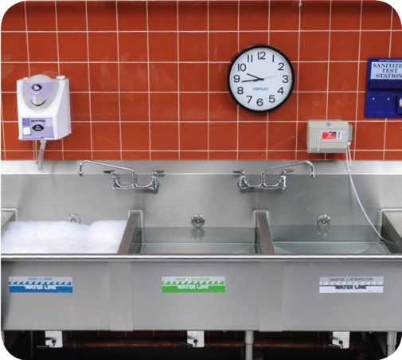
Three-Compartment Sinks
Purchase sinks large enough to accommodate large equipment and utensils.
9-10
Notes:
Instructor Notes
You should also have other methods for cleaning these items.

Slide 53
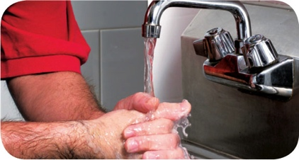
Handwashing Stations
Handwashing stations must be conveniently located and are required in:
Restrooms or directly next to them
Food-prep areas
Service areas
Dishwashing areas
Handwashing sinks must be used only for handwashing.
9-11
Notes:
Instructor Notes
Handwashing stations should be put in areas that make it easy for staff to wash their hands often. Make sure these stations work correctly and are well stocked and maintained. They must also be available at all times.
Handwashing stations cannot be blocked by portable equipment or stacked full of dirty kitchenware.

Slide 54
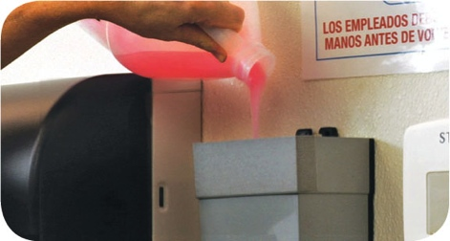
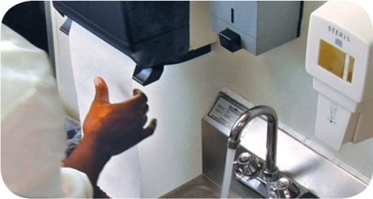
Handwashing Stations
Handwashing stations must have:
Hot and cold running water
Soap
A way to dry hands
Garbage container
Signage
9-12
Notes:
Instructor Notes
The water must be drinkable and meet temperature and pressure requirements.
The soap can be liquid, bar, or powder.
Disposable paper towels or a continuous towel system that supplies the user with a clean towel can be used. Hands can also be dried with a hand dryer using either warm air or room-temperature air delivered at high velocity.
Garbage containers are required if disposable paper towels are used.
A clearly visible sign or poster must tell staff to wash hands before returning to work. The message should be in all languages used by staff in the operation.
Some jurisdictions allow the use of automatic handwashing facilities in an operation. Check with your local regulatory authority for more information.

Slide 55
Water and Plumbing
Acceptable sources of drinkable water:
Approved public water mains
Regularly tested and maintained private sources
Closed, portable water containers
Water transport vehicles
9-13
Notes:
Instructor Notes
Each regulatory authority establishes standards for water in their jurisdiction. Only water that is drinkable can be used for the preparation of food and come in contact with food-contact surfaces.

Slide 56
Water and Plumbing
Cross-connection:
Physical link between safe water and dirty water from
Drains
Sewers
Other wastewater sources
9-14
Notes:
Instructor Notes
Plumbing that is not installed or maintained correctly can allow drinkable and unsafe water to be mixed. This can cause foodborne-illness outbreaks. Have only licensed plumbers work on the plumbing in your operation.
The greatest challenge to water safety comes from cross-connections. A cross-connection is a physical link between safe water and dirty water, which can come from drains, sewers, or other wastewater sources. A cross-connection is dangerous because it can let backflow occur.

Slide 57
Water and Plumbing
Backflow:
Reverse flow of contaminants through a cross-connection into the drinkable water supply
Backsiphonage:
A vacuum created in the plumbing system that sucks contaminants back into the water supply
Can occur when high water use in one area of the operation creates a vacuum
A running hose in a mop bucket can lead to backsiphonage
9-15
Notes:
Instructor Notes
Backflow can be the result of pressure pushing contaminants back into the water supply. It can also happen when high water use in one area of an operation creates a vacuum in the plumbing system that sucks contaminants back into the water supply. This is called backsiphonage.
A running faucet below the flood rim of a sink is an example of a cross-connection that can lead to backsiphonage. A running hose in a mop bucket is another example.

Slide 58
Water and Plumbing
Backflow prevention methods:
Vacuum breaker
Air gap
9-16
Notes:
Instructor Notes
The best way to prevent backflow is to avoid creating a cross-connection. Do not attach a hose to a faucet unless a backflow prevention device, such as a vacuum breaker, is attached. A vacuum breaker is a mechanical device that prevents backsiphonage. It does this by closing a check valve and sealing the water supply line shut when water flow is stopped.
Other mechanical devices are used to prevent backflow. These include double check valve and reduced pressure zone backflow preventers. These devices include more than one check valve for sealing off the water supply. They also provide a way to determine if the check valves are operational.
Backflow prevention devices must be checked periodically to make sure they are working correctly. This work must be done and documented by a trained and certified technician. Always follow local requirements and manufacturer’s recommendations.
The only sure way to prevent backflow is to create an air gap. An air gap is an air space that separates a water supply outlet from a potentially contaminated source. A sink that is correctly designed and installed usually has two air gaps, as shown in the graphic on the slide. One is between the faucet and the flood rim of the sink. The other is between the drainpipe of the sink and the floor drain of the operation.

Slide 59
Lighting
Consider the following when installing and maintaining lighting:
Different areas of the facility have different lighting intensity requirements
Local jurisdictions usually require prep areas to be brighter than other areas
All lights should have shatter-resistant lightbulbs or protective covers
Replace burned out bulbs with correct size bulbs
9-17
Notes:
Instructor Notes
Good lighting makes it easier to clean things in your operation. It also provides a safer environment.
Lighting intensity—how bright the lights are in the operation—is usually measured in units called foot-candles or lux. Local jurisdictions usually require prep areas to be brighter than other areas. This allows staff to recognize the condition of food. It also allows staff to identify items that need cleaning.
Once the appropriate level of lighting has been installed in each area of the facility, you must monitor it. Replace any bulbs that have burned out. And, make sure they are the correct size. All lights should have shatter-resistant lightbulbs or protective covers. These products prevent broken glass from contaminating food or food-contact surfaces.

Slide 60
Ventilation
Ventilation
Ventilation systems:
Must be cleaned and maintained to prevent grease and condensation from building up on walls and ceilings
Follow manufacturer’s recommendations
Meet local regulatory requirements
9-18
Notes:
Instructor Notes
Ventilation improves the air inside an operation.
Ventilation systems must be cleaned and maintained according to manufacturer’s recommendations and/or local regulatory requirements.

Slide 61
Garbage
Garbage:
Remove from prep areas as quickly as possible
Be careful not to contaminate food and food-contact surfaces
Clean the inside and outside of containers frequently
Clean them away from food-prep and storage areas
9-19
Notes:
Instructor Notes
Garbage can attract pests and contaminate food, equipment, and utensils if not handled correctly.
Staff must be careful when removing garbage so they do not contaminate food or food-contact surfaces. The food handler in the photo has not been careful and may contaminate the prep table.
Clean the inside and outside of garbage containers frequently. This will help prevent the contamination of food and food-contact surfaces. It will also reduce odors and pests. Do not clean garbage containers near prep or food-storage areas.

Slide 62
Garbage
Indoor containers must be:
Leak proof, waterproof, and pest proof
Easy to clean
Covered when not in use
Designated storage areas:
Store waste and recyclables separately from food and food-contact surfaces
Storage must not create a nuisance or a public health hazard
9-20
Notes:
Instructor Notes
Containers must be covered when not in use.
Waste and recyclables must be stored separately from food and food-contact surfaces. The storage of these items must not create a nuisance or a public health hazard.

Slide 63
Garbage
Outdoor containers must:
Be placed on a smooth, durable nonabsorbent surface
Asphalt or concrete
Have tight-fitting lids
Be covered at all times
Have their drain plugs in place
9-21
Notes:
Instructor Notes
Outdoor containers must have tight-fitting lids and must be kept covered at all times. Keep their drain plugs in place.

Slide 64
Emergencies That Affect the Facility
Imminent health hazard:
A significant threat or danger to health
Requires immediate correction or closure to prevent injury
Possible imminent health hazards:
Electrical power outages
Fire
Flood
Sewage backups
9-22
Notes:
Instructor Notes
Certain crises can affect the safety of the food you serve. Common crisis’ include electrical power outages, fire, flooding, and sewage backups. Local regulatory authorities consider these to be imminent health hazards. An imminent health hazard is a significant threat or danger to health that requires immediate correction or closure to prevent injury.
Temperature control: Power failures and refrigeration breakdowns can threaten your ability to control the temperature of TCS food, which can result in the growth of pathogens.
Physical security: Unauthorized people inside a facility are a risk to food safety. This is especially true when they can access storage and processing areas. Also, acts of nature can weaken a facility’s security.
Drinkable water supply: Threats to the drinkable water supply must also be considered. Broken water mains and breakdowns at water treatment facilities are a risk to the safety of food. Terrorist contamination of the water supply could also be a threat.

Slide 65
Emergencies That Affect the Facility
How to respond to a crisis affecting the facility:
Determine if there is a significant risk to the safety or security of your food
If the risk is significant
Stop service
Notify the local regulatory authority
Decide how to correct the problem
Establish time-temperature control
Clean and sanitize surfaces
Verify water is drinkable
Reestablish physical security of the facility
9-23

Slide 66
Pest Management
Three rules of pest prevention:
Deny pests access to the operation
Deny pests food, water, and shelter
Work with a licensed Pest Control Operator (PCO)
9-24

Slide 67
Pest Prevention
To keep pests from entering with deliveries:
Check deliveries before they enter the operation
Refuse shipments if pests or signs of pests (egg cases, body parts) are found
9-25

Slide 68
Pest Prevention
Make sure all of the points where pests can access the building are secure:
Screen windows and vents
Seal cracks in floors and walls, and around pipes
Install air curtains (also called air doors or fly fans) above or alongside doors
9-26
Notes:
Instructor Notes
Screen all windows and vents, and patch or replace them when needed.

Slide 69
Pest Prevention
Deny pests shelter:
Throw out garbage quickly and correctly
Keep containers clean and in good condition
Keep outdoor containers tightly covered
Clean up spills around containers immediately
Store recyclables correctly
Keep recyclables in clean, pest-proof containers
Keep containers as far away from the building as regulations allow
9-27
Notes:
Instructor Notes
Careful cleaning eliminates the pests’ food supply, destroys insect eggs, and reduces the places pests can take shelter.
Store recyclables in clean, pest-proof containers, as far away from your building as local regulations allow.

Slide 70
Pest Prevention
Deny pests shelter:
Store food and supplies quickly and correctly
Keep them away from walls and at least six inches (15 cm) off the floor
Rotate products (FIFO) so pests cannot settle and breed
Clean the operation thoroughly
Clean up food and beverage spills immediately
Clean break rooms after use
Keep cleaning tools and supplies clean and dry
9-29
Notes:
Instructor Notes
Store all food and supplies correctly and quickly. Keep food and supplies away from walls and at least six inches (15 centimeters) off the floor. Use FIFO to rotate products, so pests do not settle in and breed.
Clean up food and beverage spills immediately, including crumbs and scraps.

Slide 71
Pest Control
Contact your PCO immediately if you see these or any other pest-related problems:
Feces
Nests
Damage on products, packaging, and the facility itself
9-30
Notes:
Instructor Notes
Even after you have made every effort to keep pests out, they may still get into your operation. Work with a PCO to get them under control. Even if you only spot a few pests, they may actually be present in large numbers. Infestations can be very difficult to eliminate. Look for feces, nests, and damage on products, packaging, and the facility itself. Contact your PCO immediately.

Slide 73
Cleaning and Sanitizing
Objectives:
Different methods of sanitizing and how to make sure they are effective
How and when to clean and sanitize surfaces
How to wash items in a dishwasher or a three-compartment sink and then store them
How to use and store cleaning tools and supplies
How to develop a cleaning program
10-2
Notes:
Instructor Notes
Discuss the topic objectives with the class.

Slide 74
Cleaners
Cleaners must be:
Stable and noncorrosive
Safe to use
When using them:
Follow manufacturers’ instructions
Do NOT use one type of detergent in place of another unless the intended use is the same
10-3
Notes:
Instructor Notes
If not used the correct way, cleaners may not work and can even be dangerous.

Slide 75
Sanitizing
Surfaces can be sanitized using:
Heat
The water must be at least 171˚F (77˚C)
Immerse the item for 30 seconds
Chemicals
Chlorine
Iodine
Quats
10-4
Notes:
Instructor Notes
Food-contact surfaces must be sanitized after they have been cleaned and rinsed. This can be done by using heat or chemicals.
One way to sanitize items is to soak them in hot water. For this method to work, the water must be at least 171°F (77°C). The items must be soaked for at least 30 seconds. Another way to sanitize items is to run them through a high-temperature dishwasher.
Tableware, utensils, and equipment can be sanitized by soaking them in a chemical sanitizing solution. Or you can rinse, swab, or spray them with sanitizing solution. Chemical sanitizers are regulated by state and federal environmental protection agencies (EPAs). For requirements, check with your local regulatory authority.

Slide 76
Sanitizing
Chemical sanitizing:
Food-contact surfaces can be sanitized by either
Soaking them in a sanitizing solution
Rinsing, swabbing, or spraying them with a sanitizing solution
In some cases a detergent-sanitizer blend can be used
Use it once to clean
Use it a second time to sanitize
10-5
Notes:
Instructor Notes
In some cases, you can use detergent-sanitizer blends to sanitize. Operations that have two-compartment sinks often use these.

Slide 77
Sanitizer Effectiveness
Concentration:
Sanitizers should be mixed with water to the correct concentration
Not enough sanitizer may make the solution weak and useless
Too much sanitizer may make the solution too strong, unsafe, and corrode metal
10-6
Notes:
Instructor Notes
Several factors influence the effectiveness of chemical sanitizers. The most critical include concentration, temperature, contact time, water hardness, and pH.
Sanitizer solution is a mix of chemical sanitizer and water. The concentration of this mix—the amount of sanitizer to water—is critical. Too much water may make the solution weak and useless. Too much sanitizer may make the solution too strong and unsafe. It can also leave a bad taste on items or corrode metal.

Slide 78
Sanitizer Effectiveness
Concentration:
Check concentration with a test kit
Make sure it is designed for the sanitizer used
Check the concentration often
Change the solution when
It’s dirty
The concentration is too low
10-7
Notes:
Instructor Notes
Concentration is measured in parts per million (ppm). To check the concentration of a sanitizer solution, use a test kit. Make sure it is made for the sanitizer being used. These kits are usually available from the chemical manufacturer or supplier.
Hard water, food bits, and leftover detergent can reduce the solution’s effectiveness. Change the solution when it looks dirty or its concentration is too low. Check the concentration often.

Slide 79
Sanitizer Effectiveness
Temperature:
Follow manufacturer’s recommendations for the correct temperature
Contact time:
The sanitizer must make contact with the object for a specific amount of time
Minimum times differ for each sanitizer
10-8
Notes:
Instructor Notes
The bain in the photo is being sanitized in a an iodine sanitizing solution. It must be in contact with the solution for at least 30 seconds.

Slide 80
Sanitizer Effectiveness
Water hardness and pH:
Find out what your water hardness and pH is from your municipality
Work with your supplier to identify the correct amount of sanitizer to use
10-9
Notes:
Instructor Notes
Water hardness can affect how well a sanitizer works. Water hardness is the amount of minerals in your water.
Water pH can also affect a sanitizer.

Slide 81
Guidelines for the Effective Use of Sanitizers
Chlorine
Water temperature | ≥100°F (38°C) | ≥75°F (24°C)
Water pH | ≤10 | ≤8
Water hardness | As per manufacturer’s recommendations
Sanitizer concentration range | 50–99 ppm | 50–99 ppm
Sanitizer contact time | ≥7 sec | ≥7 sec
10-10

Slide 82
Guidelines for the Effective Use of Sanitizers
 | Iodine | Quats
Water temperature | 68°F (20°C) | 75°F (24°C)
Water pH | ≤5 or as per manufacturer’s recommendations | As per manufacturer’s recommendations
Water hardness | As per manufacturer’s recommendations | ≤500 ppm or as per manufacturer’s recommendations
Sanitizer concentration range | 12.5–25 ppm | As per manufacturer’s recommendations
Sanitizer contact time | ≥30 sec | ≥30 sec
10-11

Slide 83
How and When to Clean and Sanitize
How to clean and sanitize:
Scrape or remove food bits from the surface
Wash the surface
Rinse the surface
Sanitize the surface
Allow the surface to air-dry
10-12
Notes:
Instructor Notes
All surfaces must be cleaned and rinsed. This includes walls, storage shelves, and garbage containers. However, any surface that touches food, such as knives, stockpots, cutting boards, or prep tables, must be cleaned and sanitized.
Scrape or remove food bits from the surface. Use the correct cleaning tool such as a nylon brush or pad, or a cloth towel.
Wash the surface. Prepare the cleaning solution with an approved detergent. Wash the surface with the correct cleaning tool such as a cloth towel.
Rinse the surface. Use clean water. Rinse the surface with the correct cleaning tool such as a cloth towel.
Sanitize the surface. Use the correct sanitizing solution. Prepare the concentration per manufacturer requirements. Use the correct tool, such as a cloth towel, to sanitize the surface. Make sure the entire surface has come in contact with the sanitizing solution.
Allow the surface to air-dry.

Slide 84
How and When to Clean and Sanitize
Food-contact surfaces must be cleaned and sanitized:
After they are used
Before working with a different type of food
Any time a task was interrupted and the items may have been contaminated
After four hours if the items are in constant use
10-13

Slide 85
How and When to Clean and Sanitize
Cleaning and sanitizing stationary equipment:
Unplug the equipment
Take the removable parts off the equipment
Wash, rinse, and sanitize them by hand or run the parts through a dishwasher if allowed
Scrape or remove food from the equipment surfaces
Wash the equipment surfaces
10-14
Notes:
Instructor Notes:
Equipment manufacturers will usually provide instructions for cleaning and sanitizing stationary equipment, such as a slicer.
Unplug the equipment.
Take the removable parts off the equipment. Wash, rinse, and sanitize them by hand. You can also run the parts through a dishwasher if allowed.
Scrape or remove food from the equipment surfaces.
Wash the equipment surfaces. Use a cleaning solution prepared with an approved detergent. Wash the equipment with the correct cleaning tool such as a nylon brush or pad, or a cloth towel.

Slide 86
How and When to Clean and Sanitize
Cleaning and sanitizing stationary equipment:
Rinse the equipment surfaces with clean water
Sanitize the equipment surfaces
Make sure the sanitizer comes in contact with each surface
Allow all surfaces to air-dry
Put the unit back together
10-15
Notes:
Instructor Notes:
Rinse the equipment surfaces with clean water. Use a cloth towel or other correct tool.
Sanitize the equipment surfaces. The food handler in the photo at left is sanitizing the surfaces of a slicer. Make sure the sanitizer comes in contact with each surface. The concentration of the sanitizer must meet requirements.
Allow all surfaces to air-dry.
Put the unit back together.

Slide 87
How and When to Clean and Sanitize
Clean-in-place equipment:
Equipment holding and dispensing TCS food must be cleaned and sanitized every day unless otherwise indicated by the manufacturer
Check local regulatory requirements
10-16
Notes:
Instructor Notes:
Some pieces of equipment, such as soft-serve yogurt machines, are designed to have cleaning and sanitizing solutions pumped through them. Since many of them hold and dispense TCS food, they must be cleaned and sanitized every day unless otherwise indicated by the manufacturer. You should also check your local regulatory requirements.
Instructor Notes
Soft-serve yogurt machines are designed to have cleaning and sanitizing solutions pumped through them. Because they hold TCS food, they must be cleaned and sanitized on a daily basis unless otherwise indicated by the manufacturer.

Slide 88
Machine Dishwashing
High-temperature machines:
Final sanitizing rinse must be at least 180˚F (82˚C)
165˚F (74˚C) for stationary rack, single-temperature machines
Chemical-sanitizing machines:
Clean and sanitize at much lower temperatures
Follow the temperature guidelines provided by the manufacturer
10-17
Notes:
Instructor Notes
Dishwashing machines sanitize by using either hot water or a chemical sanitizing solution.
High-temperature machines use hot water to clean and sanitize. If the water is not hot enough, items will not be sanitized. Extremely hot water can also bake food onto the items.
The dishwasher must have a built-in thermometer which checks water temperature at the manifold. This is where the water sprays into the tank.
Chemical-sanitizing machines can clean and sanitize items at much lower temperatures. Because sanitizers require different water temperatures, follow the dishwasher manufacturer’s guidelines.

Slide 89
Dishwasher Operation
Guidelines:
Clean the machine as often as needed
Scrape, rinse, or soak items before washing
Use the correct dish racks
NEVER overload dish racks
Air-dry all items
Check the machine’s water temperature and pressure
10-18
Notes:
Instructor Notes
Clean the machine as often as needed, checking it at least once a day. Clear spray nozzles of food and foreign objects. Remove mineral deposits when needed. Fill tanks with clean water, and make sure detergent and sanitizer dispensers are filled.
Presoak items with dried-on food.
Load dish racks so the water spray will reach all surfaces. Never overload dish racks.
Never use a towel to dry items. You could re-contaminate them.
Check water temperature, pressure, and sanitizing levels. Take appropriate corrective action if necessary. Use heat tape or test strips to monitor the temperature of the sanitizing rinse or use a maximum registering thermometer.

Slide 90
Monitoring High Temperature Dishwashing Machines
When using high-temperature dishwashing machines, provide staff with tools to check the temperature of the items being sanitized.
Options include:
Maximum registering thermometers
Temperature sensitive tape
10-19
Notes:
Instructor Notes:
Operations using high-temperature dishwashing machines must provide staff with an easy and quick way to measure the surface temperatures of items being sanitized.
The method used must provide an irreversible record of the highest temperature reached during the sanitizing rinse. This ensures that the dishwasher can reach correct sanitizing temperatures during operation.
Maximum registering thermometers or heat sensitive tape are good tools for checking temperatures.

Slide 91
Manual Dishwashing
Setting up a three-compartment sink:
Clean and sanitize each sink and drain board
Fill the first sink with detergent and water at least 110˚F (43˚C)
Fill the second sink with clean water
Fill the third sink with water and sanitizer to the correct concentration
Provide a clock with a second hand to let food handlers know how long items have been in the sanitizer
10-20

Slide 92
Three-Compartment Sinks
Steps for cleaning and sanitizing:
1. Rinse, scrape, or soak items before washing them
2. Wash items in the first sink
3. Rinse items in the second sink
4. Sanitize items in the third sink
5. Air-dry items on a clean and sanitized surface
10-21
Notes:
Instructor Notes
Step 1: Rinse, scrape, or soak items before washing them. If items are being soaked in the first sink, change the solution when food bits start to build up or the suds are gone.
Step 2: Wash items in the first sink. Use a brush, cloth towel, or nylon scrub pad to loosen dirt. Change the water and detergent when the suds are gone or the water is dirty.
Step 3: Rinse items in the second sink. Spray the items with water or dip them in it. Make sure you remove all traces of food and detergent from the items being rinsed. If dipping the items, change the rinse water when it becomes dirty or full of suds.
Step 4:Sanitize items in the third sink. Change the sanitizing solution when the temperature of the water or the sanitizer concentration falls below requirements. Never rinse items after sanitizing them. This could contaminate their surfaces. The only exception to this rule is when you are washing items in a dishwasher that can safely rinse items after they have been sanitized.
Step 5: Air-dry items on a clean and sanitized surface. Place items upside down so they will drain.

Slide 93
Storing Tableware and Equipment
When storing clean and sanitized tableware and equipment:
Store them at least six inches (15 cm) off the floor
Clean and sanitize drawers and shelves before items are stored
Store glasses and cups upside down on a clean and sanitized shelf or rack
10-22
Notes:
Instructor Notes
Once utensils, tableware, and equipment have been cleaned and sanitized, they must be stored in a way that will protect them from contamination.
Tableware and utensils should be protected from dirt and moisture.

Slide 94
Storing Tableware and Equipment
When storing clean and sanitized tableware and equipment:
Store flatware and utensils with handles up
Cover the food-contact surfaces of stationary equipment until ready for use
Clean and sanitize trays and carts used to carry clean tableware and utensils
10-23

Slide 95
Cleaning and Sanitizing in the Operation
When cleaning the premises:
Clean nonfood-contact surfaces regularly
Includes floors, ceilings, walls, equipment exteriors, etc.
Prevents dust, dirt, food residue and other debris from building up
10-24
Notes:
Instructor Notes:

Slide 96
Cleaning and Sanitizing in the Operation
Cleaning up after people who get sick:
Diarrhea and vomit in the operation must be cleaned up correctly
It can carry Norovirus, which is highly contagious
Correct cleanup can prevent food from becoming contaminated and keep others from getting sick
Check with your local regulatory authority regarding requirements for cleaning up vomit and diarrhea. A written cleanup plan may be required.
10-25
Notes:
Instructor Notes
If a person has diarrhea or vomits in the operation, these spills must be cleaned up the correct way. Vomit and diarrhea can carry Norovirus, which is highly contagious. Correct cleanup can prevent food from becoming contaminated. It will also keep others from getting sick. The way you clean up these substances is different from the way you clean other items in the operation. Many jurisdictions require a written cleanup plan.

Slide 97
Cleaning and Sanitizing in the Operation
Consider the following when developing a plan for cleaning up vomit and diarrhea:
How you will contain liquid and airborne substances, and remove them from the operation
How you will clean, sanitize, and disinfect surfaces
When to throw away food that may have been contaminated
What equipment is needed to clean up these substances, and how it will be cleaned and disinfected after use
When a food handler must wear personal protective equipment
10-26
Notes:
Instructor Notes:
There are several things to think about when developing a plan for cleaning up vomit and diarrhea.
How you will contain liquid and airborne substances, and remove
them from the operation
How you will clean, sanitize, and disinfect surfaces
When to throw away food that may have been contaminated
What equipment is needed to clean up these substances, and how it will be cleaned and disinfected after use
When a food handler must wear personal protective equipment
How staff will be notified of the correct procedures for
containing, cleaning, and disinfecting these substances
How to segregate contaminated areas from other areas
When staff must be restricted from working with or around food
or excluded from working in the operation
How sick customers will be quickly removed from the operation
How the cleaning plan will be implemented

Slide 98
Cleaning and Sanitizing in the Operation
Develop a plan for cleaning up vomit and diarrhea:
How staff will be notified of the correct procedures for containing, cleaning, and disinfecting these substances
How to segregate contaminated areas from other areas
When staff must be restricted from working with or around food or excluded from working in the operation
How sick customers will be quickly removed from the operation
How the cleaning plan will be implemented
10-27
Notes:
Instructor Notes:
If a person has diarrhea or vomits in the operation, these spills must be cleaned up the correct way. Vomit and diarrhea can carry Norovirus, which is highly contagious. Correct cleanup can prevent food from becoming contaminated. It will also keep others from getting sick. The way you clean up these substances is different from the way you clean other items in the operation. There are several things to think about when developing a plan for cleaning up vomit and diarrhea.
How you will contain liquid and airborne substances, and remove
them from the operation
How you will clean, sanitize, and disinfect surfaces
When to throw away food that may have been contaminated
What equipment is needed to clean up these substances, and how it will be cleaned and disinfected after use
When a food handler must wear personal protective equipment
How staff will be notified of the correct procedures for
containing, cleaning, and disinfecting these substances
How to segregate contaminated areas from other areas
When staff must be restricted from working with or around food
or excluded from working in the operation
How sick customers will be quickly removed from the operation
How the cleaning plan will be implemented

Slide 99
Cleaning and Sanitizing in the Operation
Storing cleaning tools and chemicals:
Place in a separate area away from food and prep areas
The storage area should have:
Good lighting so chemicals can be easily seen
Utility sink for filling buckets and washing cleaning tools
Floor drain for dumping dirty water
Hooks for hanging cleaning tools
10-28

Slide 100
Cleaning and Sanitizing in the Operation
NEVER:
Dump mop water or other liquid waste into toilets or urinals
Clean tools in sinks used for
Handwashing
Food prep
Dishwashing
10-29
Notes:
Instructor Notes
When storing cleaning tools, consider the following:
Air-dry towels overnight.
Hang mops, brooms, and brushes on hooks to air-dry.
Clean, and rinse buckets. Let them air-dry, and store them with other tools.

Slide 101
Using Foodservice Chemicals
Chemicals:
Only purchase those approved for use in foodservice operations
Store them in their original containers away from food and food-prep areas
If transferring them to a new container, label it with the common name of the chemical
10-30

Slide 102
Using Foodservice Chemicals
Chemicals:
Keep MSDS for each chemical
When throwing chemicals out, follow
Instructions on the label
Local regulatory requirements
10-31
Notes:
Instructor Notes
The Occupational Safety and Health Administration (OSHA) has requirements for using chemicals. OSHA requires chemical manufacturers and suppliers to provide a material safety data sheet (MSDS) for each hazardous chemical they sell.
MSDS are often sent with the chemical shipment. You also can request them from your supplier or the manufacturer. Staff have a right to see an MSDS for any hazardous chemical they work with. Therefore, you must keep these sheets where they can be accessed.

Slide 103
Developing a Cleaning Program
To develop an effective cleaning program:
Create a master cleaning schedule
Train your staff to follow it
Monitor the program to make sure it works
10-32

Slide 104
Developing a Cleaning Program
To create a master cleaning schedule, identify:
What should be cleaned
Who should clean it
When it should be cleaned
How it should be cleaned
10-33
Notes:
Instructor Notes
List all cleaning jobs in one area. Or list jobs in the order they should be performed.
Assign each cleaning task to a specific individual.
Staff should clean and sanitize as needed. Schedule major cleaning when food will not be contaminated or service will not be affected. Schedule work shifts to allow enough time.
Have clear, written procedures for cleaning. List cleaning tools and chemicals by name. Post cleaning instructions near the item. Always follow manufacturers’ instructions when cleaning equipment.

Slide 105
Developing a Cleaning Program
Monitoring the cleaning program:
Supervise daily cleaning routines
Check cleaning tasks against the master schedule every day
Change the master schedule as needed
Ask staff for input on the program
10-34

