Slide 1

Welcome to First Grade

Slide 2
Grading System
√+ or 3= on-level/I Can Explain It – I can do it without mistakes and I can explain my thinking.
√ or 2= progressing/I Can Do It – I understand but I may make an occasional mistake.
√- or 1= at-risk/I Need Help – I still need some instruction.

Slide 3

See Saw App
Stephens Elementary is using Seesaw this year! Seesaw gives your child creative tools to capture and reflect on their learning - in real time. Then this work is shared with you. Seesaw will give you a window into each of our classrooms and into your student’s learning process. We will use Seesaw to reflect and grow.
You can download Seesaw’s Parent App for iOS, Android, or use the web to view your student’s learning artifacts. When your child adds new work, you will receive a notification to see, hear and respond to your child’s learning item. You only have access to your own child’s work and all of the content is stored securely.
Please be on the lookout for information regarding how to download, log in, and use this tool!

Slide 4

Daily Communication Binders
Please sign conduct calendar each night and return binders daily.
Homework
Weekly Newsletter
Place notes in the first pocket.

Slide 5
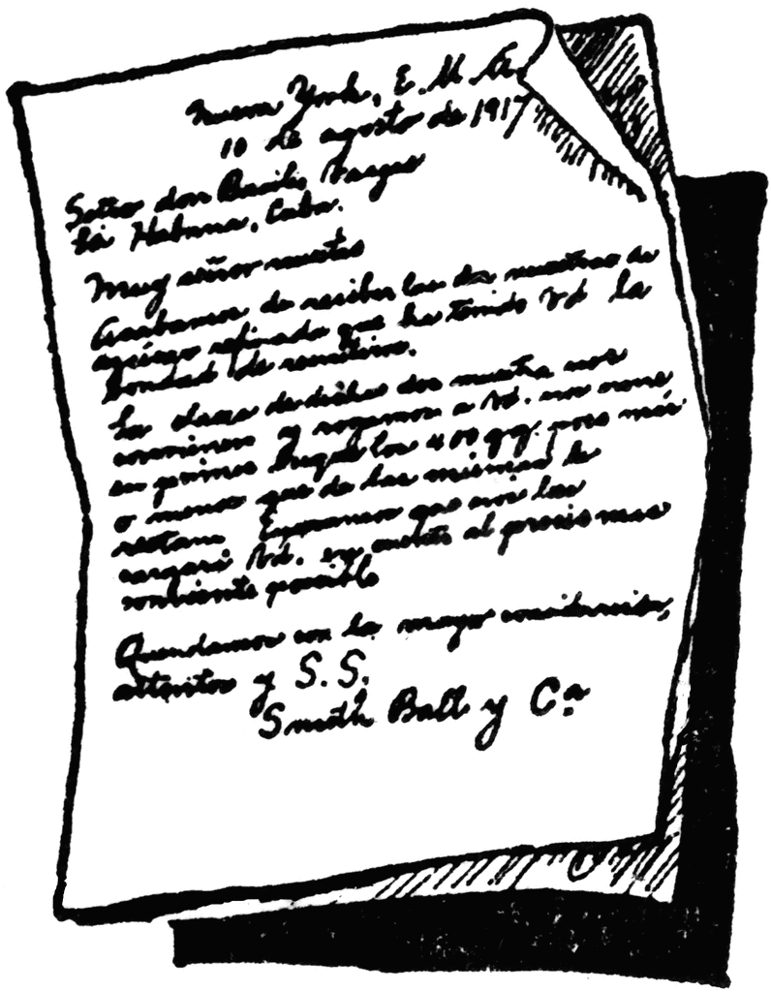
Family Letters
Family Letters will be sent home each 6 weeks in your child’s daily communication binder.
These letters explain what your child will be learning in each subject area and ways to help at home.

Slide 6



Math

Slide 7
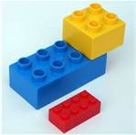
District Assessments
In Denton ISD, we give the Kathy Richardson math assessment to all K-2 graders. These skills will be assessed at the beginning of the year, middle of the year, and at the end of the year.
Hiding Assessment – (Decomposing Numbers) – Practice hiding everyday items and asking how many are missing. IE: We had 7 LEGOS, but now there are only 3 LEGOS. How many are hiding?

Slide 8


Subitizing: Instantly knowing the value of a numbers
Ten Frame: Math tool to help visually see numbers and combinations within ten.
Tally Marks: A form of counting in groups of 5 used to organize data.
Addition: To combine parts to make a whole
Subtraction: To break whole numbers into parts
Practice basic facts such as make ten: 1+9, 2+8, 3+7, etc. Students will be able to use these anchor problems to help them with other basic facts later.
Practice doubles facts 6+6, 8+8, 9+9, etc. Then practice using doubles to help with neighbors. (ex. 6+6=12 so 6+7=13).
Identifying the names of coins and counting change.
Skip counting with 2s, 5s, and 10s.

Slide 9
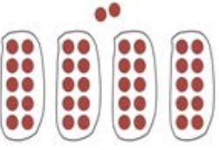
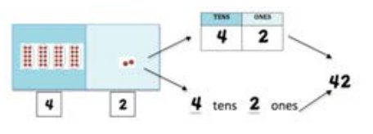

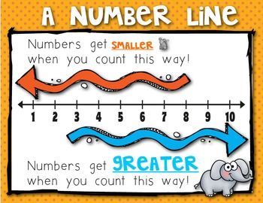
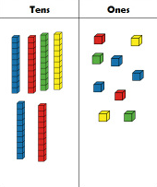
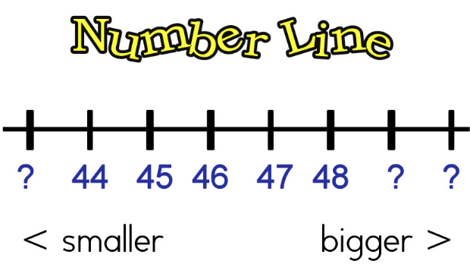
Ways to Represent Place Value
Concrete Models counting out groups of 10 with counters building groups of 10 and some more Decomposing groups of tens and ones | Pictorial models Decomposing groups of tens and ones and placing the digit in the correct place on the place value chart

Slide 10

Science

Slide 11

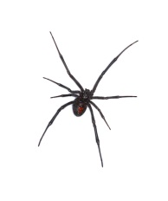
First Grade Science Units:
Pumpkins
Food Chains
Life Cycles
Penguins
Energy: Heating and Cooling
Oviparous Animals
The World Around Us: Soil and Plants
Insects
Oceans
We Are Scientists!
Weather (measuring temperature, wind speed, cloud cover, precipitation)
Air and Sky: Day / Night
Seasons
Spiders
Force and Motion: Magnets

Slide 12
First Grade Science Objectives:
Assessments: The students will….
Classifies objects by materials from which they are made. Identifies the characteristics of the seasons of the year. Identifies the characteristics of day and night. Predicts and describes how magnets can be used to push or pull and object. Predicts and identifies changes in materials caused by heating and cooling. Observes, compares, describes, and sorts soil components. Record the life cycle of an animal.

Slide 13
Vocabulary To Use At Home:
Open-Ended Questions:
When we look closely, we are making observations.
We can use our five senses to make observations.
We use tools to keep us safe and help us observe. (hand lenses, tongs, goggles, lab coats, scales, etc…)
We can draw pictures and write words to record our data.
We can make models of what we observe.
We can research using pictures, books, and the internet.
We can present our findings to others.
What do you notice?
Do you have a prediction?
What else do you wonder?
How can we research to find out?
Tell me about your plan.

Slide 14

Language Arts

Slide 15



What is The Daily Five?
A structure that helps students develop the daily habits of reading, writing, and working independently that will lead to a lifetime of literacy independence. www.thedailycafe.com
We start Daily Five from the 1st day of school. We make charts describing what each part of Daily Five should look like and graph how long we are able to do each task until we get to 20 minutes.
Read to Self: students read independently
Read to Someone: students read with a partner
Word Work: students practice spelling and sight words
Listen to Reading: students listen to books on tapes, CDs and the computer
Work on Writing: students free-write independently
During each Daily Five, the teacher will be doing Guided Reading Groups.

Slide 16
What is CAFÉ?
CAFE is an acronym for Comprehension, Accuracy, Fluency, and Expanding Vocabulary, and the system includes goal-setting with students in individual conferences, posting of goals on a whole-class board, developing small group instruction (Guided Reading Groups), whole-class instruction and conferring one-on-one with students. www.thedailycafe.com
CAFÉ Menu of Strategies:
Remind your child to use these when reading at home!
Check for Understanding
Just Right Books
Back Up and Re-Read
Tune into Interesting Words
Stretch the Sounds and Reread
Cross Checking

Slide 17

Guided Reading Groups
A few things to know:
Your child will be bringing home a “Just Right Book” 2-3 times a week. These will be books that your child has read in class and shouldn’t be a struggle.
Please read these books nightly and return daily.
Have your child use their strategies before helping them. Avoid covering up the pictures, allowing your child to memorize the book, and telling your child the word right away.
Before, during and after reading the book, ask your child questions. Such as:
  What do you think the book will be about?
  What were the characters? Setting? Problem? Solution?
  Who was your favorite character? Why?
  Starting from the beginning, retell the story in your own words.

Slide 19

Social Studies

Slide 20
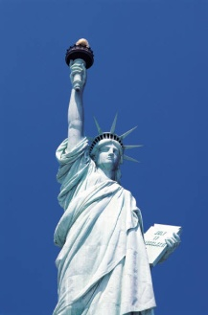
What will my child learn?
Local Authority Figures-
  Someone who is in charge of you, keeps your safe, makes rules and laws, and gives you consequences for breaking rules and laws.
  Examples: Mom, Dad, Grandma, Grandpa, Older Siblings, Police Officer, Teacher, Principal
Why do we have rules and laws?
  To keep us safe, to keep things in order, and to make things fair.
United States Symbols
  Statue of Liberty- In New York, Stands for Freedom, gift from France
  Liberty Bell- In Philadelphia, PA, Stands for Freedom
  American Flag- Red, White and Blue, 50 stars for the 50 states, 13 stripes for the original 13 colonies
Constitution Day- September 17th
Historical Figures and Good Citizens who have helped shape the community, state and nation: Benjamin Franklin, Eleanor Roosevelt, and Francis Scott Key

Slide 21

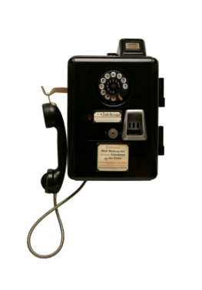

What will my child learn?
Goods and Services
  Goods are items you can see and touch, such as a book, a pen, salt, shoes, hats, a folder etc.
  Services are provided for you by other people, such as; a doctor, a lawn mower worker, a dentist, haircut and eating in restaurants.
National Authority Figures: President and Vice President
Historical Figures and Good Citizens who have helped shape the community, state and nation.
  Martin Luther King Jr.
  Abraham Lincoln
  George Washington
Inventors:
  Thomas Edison- Inventor of the Light Bulb
  Garret Morgan- Inventor of the Gas Mask and Traffic Signal
  Alexander Graham Bell- Inventor of the Telephone

Slide 22


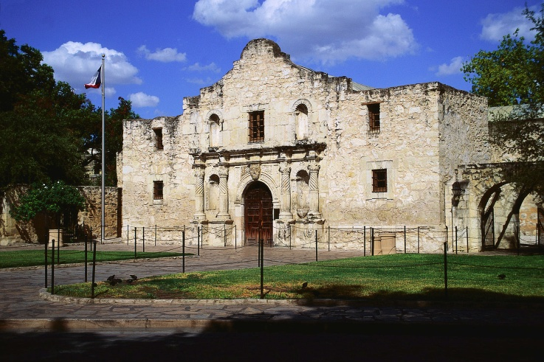
What will my child learn?
Maps and Globes-
  Cardinal Directions- North, South, East, West
  Purpose of Maps and Globes
  Location of Texas on a map
  Locate Landforms (rivers, mountains, islands, lakes, oceans) on a map
Texas Symbols-
  Texas Flag
  The Alamo
  Bluebonnets

Slide 23

Writing

Slide 24

What will my child learn?
Writing conventions for first grade
1. Capitalization at beginning of sentence
2. Spells some high frequency words correctly; uses inventive spelling
3. Punctuation at the end of sentences
4. Adequate spacing between words
5. Combined sentences(two thoughts connected with “and”)
6. All sentences make sense

Slide 25
Organization
1.Students can articulate to the teacher what his/her writing will be about
2. Students use thinking maps (with teacher support) to plan and organize for writing- student makes a plan and works the plan
3.Story has a beginning, middle and end
4. Each sentence is complete and coherent
5. Sentences flow in a logical sequence throughout the writing

Slide 26
Main Idea and Supporting Details
Writing addresses the prompt
All sentences relate to the prompt
No unrelated information
Each sentence is a complete thought
Uses adjectives and adverbs
Uses descriptive phrases ( “as pretty as a butterfly” or “ran as fast as he could”)

Slide 27


