Slide 1
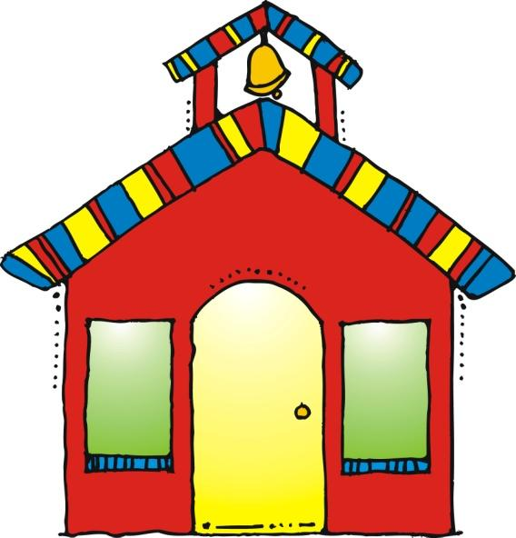
Welcome to Parent Night
1st Grade

Slide 2
Grading System
√+ or 3= on-level/I Can Explain It – I can do it without mistakes and I can explain my thinking.
√ or 2= progressing/I Can Do It – I understand but I may make an occasional mistake.
√- or 1= at-risk/I Need Help – I still need some instruction.

Slide 3

Student Data Binders
Students will use their data binders to track their learning and share with you.
Will be sent home at least 2 times each grading period, require parent signatures and need to be returned the next day.
More information at parent-teacher conferences.

Slide 4

Take Home Binders
Please sign conduct calendar each night and return binders daily.
Homework
Weekly Newsletter
Place notes in the first pocket.

Slide 5



Math
with Mrs. Wilkinson

Slide 6
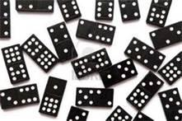
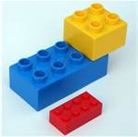
District Assessments
In Denton ISD, we give the Kathy Richardson math assessment to all K-2 graders. These skills will be assessed at the beginning of the year, middle of the year, and at the end of the year.
Number Arrangement (Dot Cards) – The ability to subitize (recognize the number of items at a glance) helps to support a child’s development of number sense and arithmetic strategies. Practice recognizing dot patterns on dominoes at home.
Hiding Assessment – (Decomposing Numbers) – Practice hiding everyday items and asking how many are missing. Ie: We had 7 LEGOS, but now there are only 3 LEGOS. How many are hiding?

Slide 7

Report Cards
1= At-risk
2= Progressing
3= On-level
1st Grading period: Kathy Richardson Assessment
2nd Grading period: Measure and describe length
3rd Grading period: Compose/Decompose numbers 1-120
Compare/Order numbers 1-120
4th Grading period: Geometry: Identifies, describes, and classifies
2-D and 3-D shapes.
5th Grading period: Applies basic addition/subtraction strategies
Generates and solves addition/subtraction
problems and explains strategies used
6th Grading period: Graphs: Collects data, creates graphs, and
draws conclusions from graphs
Identifies and counts a collection of coins
and describes the relationship among them.
To score a 3 and be considered “on-level” your child is expected to be able to problem solve and explain their thinking. Practice “math language” with them.

Slide 8
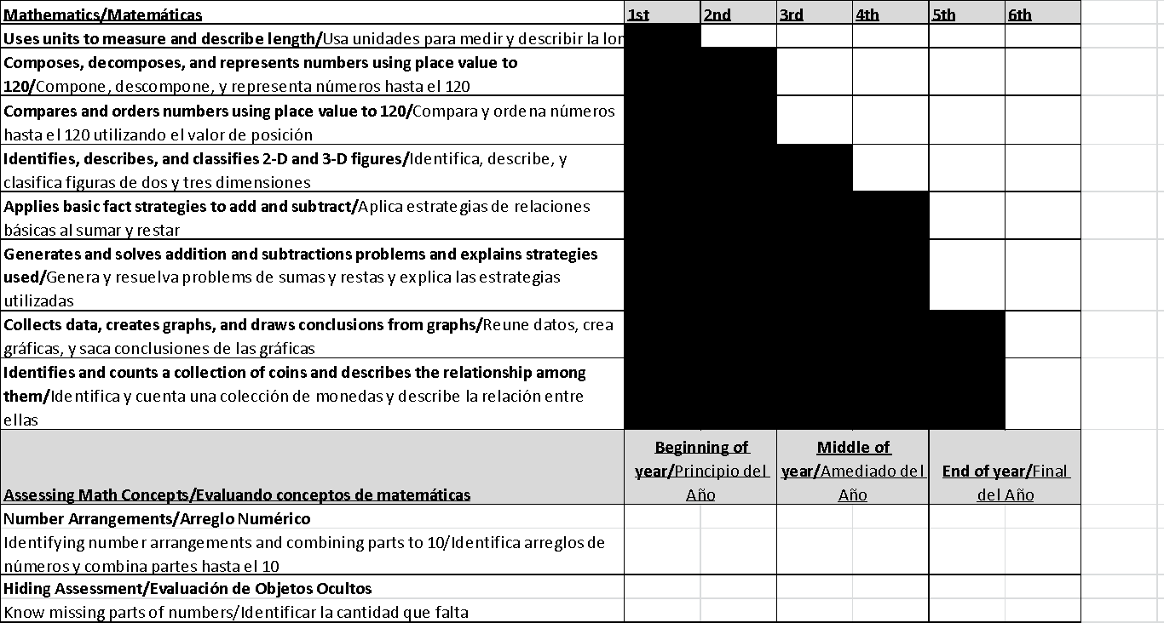
Report Cards
It is possible to see your child’s score decrease on the Kathy Richardson Assessments because the materials are increasingly difficult. If you have a concern, please contact your child’s teacher for a conference.

Slide 9

How can I help at home?
Everything we teach is NOT on the report card!
Encourage your child to read a digital and analog clock to the hour and half hour.
Have your child identify the coins in your pocket or purse. Later in the year, you may even ask them to trade you to practice coin relationships. Ie: 2 nickels for a dime
Go on a 2-D or 3-D shape scavenger hunt!
Help your child to find fractions in everyday life. “3 out of 5 of those plates are pink!” or “I ate ¼ of that pizza!”
In first grade, we only use non-standard forms of measurement. In other words, we use short things to measure long things. “How many paper clips long is your patio?”
Most of all try to use math vocabulary with your child. We use words like place value, order, add, subtract, estimate, measure, greater than, less than, sum, difference, fraction, etc.
Your child’s homework helps them build confidence and allows them to show YOU what they have accomplished. Your praise goes a long way!

Slide 10

Science
with Mrs. Kuykendall

Slide 11


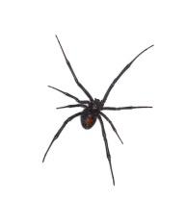

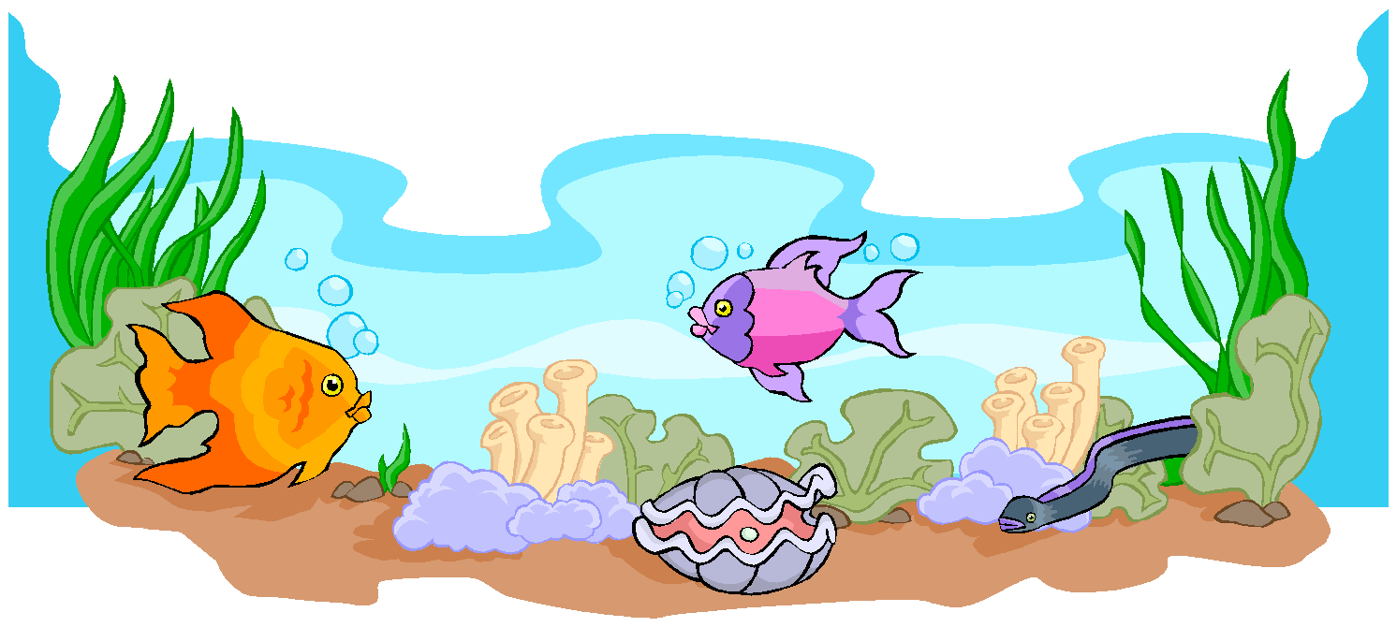
First Grade Science Units:
Pumpkins
Food Chains
Life Cycles
Penguins
Energy: Heating and Cooling
Oviparous Animals
The World Around Us: Soil and Plants
Insects
Oceans
Classifying Objects
Weather (measuring temperature, wind speed, cloud cover, precipitation)
Air and Sky: Day / Night
Seasons
Spiders
Force and Motion: Magnets

Slide 12
First Grade Science Objectives:
Assessments: The students will….
Classifies objects by materials from which they are made. Identifies the characteristics of the seasons of the year. Identifies the characteristics of day and night. Predicts and describes how magnets can be used to push or pull and object. Predicts and identifies changes in materials caused by heating and cooling. Observes, compares, describes, and sorts soil components. Record the life cycle of an animal.

Slide 13
Vocabulary To Use At Home:
Open-Ended Questions:
When we look closely, we are making observations.
We can use our five senses to make observations.
We use tools to keep us safe and help us observe. (hand lenses, tongs, goggles, lab coats, scales, etc…)
We can draw pictures and write words to record our data.
We can make models of what we observe.
We can research using pictures, books, and the internet.
We can present our findings to others.
What do you notice?
Do you have a prediction?
What else do you wonder?
How can we research to find out?
Tell me about your plan.

Slide 14

Language Arts
with Mrs. Kuykendall

Slide 15



What is The Daily Five?
A structure that helps students develop the daily habits of reading, writing, and working independently that will lead to a lifetime of literacy independence. www.thedailycafe.com
We start Daily Five from the 1st day of school. We make charts describing what each part of Daily Five should look like and graph how long we are able to do each task until we get to 20 minutes.
Read to Self: students read independently
Read to Someone: students read with a partner
Word Work: students practice spelling and sight words
Listen to Reading: students listen to books on tapes, CDs and the computer
Work on Writing: students free-write independently
During each Daily Five, the teacher will be doing Guided Reading Groups.

Slide 16

What is CAFÉ?
CAFE is an acronym for Comprehension, Accuracy, Fluency, and Expanding Vocabulary, and the system includes goal-setting with students in individual conferences, posting of goals on a whole-class board, developing small group instruction (Guided Reading Groups), whole-class instruction and conferring one-on-one with students. www.thedailycafe.com
CAFÉ Menu of Strategies: (see handout for more information)
Remind your child to use these when reading at home!
Check for Understanding
Just Right Books
Back Up and Re-Read
Tune into Interesting Words
Stretch the Sounds and Reread
Cross Checking

Slide 17

Guided Reading Groups
A few things to know:
Your child will be bringing out a “Just Right Book” 2-3 times a week. These will be books that your child has read in class and shouldn’t be a struggle.
Please read these books nightly and return daily.
Have your child use their strategies before helping them. Avoid covering up the pictures, allowing your child to memorize the book, and telling your child the word right away.
Before, during and after reading the book, ask your child questions. Such as:
What do you think the book will be about?
What were the characters? Setting? Problem? Solution?
Who was your favorite character? Why?
Starting from the beginning, retell the story in your own words.

Slide 18

Social Studies
with Mrs. Hoang

Slide 19


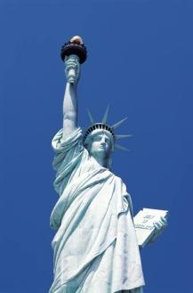
What will my child learn?
1st and 2nd 6 Weeks:
Local Authority Figures-
Someone who is in charge of you, keeps your safe, makes rules and laws, and gives you consequences for breaking rules and laws.
Examples: Mom, Dad, Grandma, Grandpa, Older Siblings, Police Officer, Teacher, Principal
Why do we have rules and laws?
To keep us safe, to keep things in order, and to make things fair.
United States Symbols
Statue of Liberty- In New York, Stands for Freedom, gift from France
Liberty Bell- In Philadelphia, PA, Stands for Freedom
American Flag- Red, White and Blue, 50 stars for the 50 states, 13 stripes for the original 13 colonies
Constitution Day- September 17th
Historical Figures and Good Citizens who have helped shape the community, state and nation: Benjamin Franklin, Eleanor Roosevelt, and Francis Scott Key

Slide 20

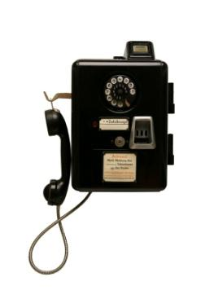

What will my child learn?
3rd and 4th 6 Weeks:
Goods and Services
Goods are items you can see and touch, such as a book, a pen, salt, shoes, hats, a folder etc.
Services are provided for you by other people, such as; a doctor, a lawn mower worker, a dentist, haircut and eating in restaurants.
National Authority Figures: President and Vice President
Historical Figures and Good Citizens who have helped shape the community, state and nation.
Martin Luther King Jr.
Abraham Lincoln
George Washington
Inventors:
Thomas Edison- Inventor of the Light Bulb
Garret Morgan- Inventor of the Gas Mask and Traffic Signal
Alexander Graham Bell- Inventor of the Telephone

Slide 21
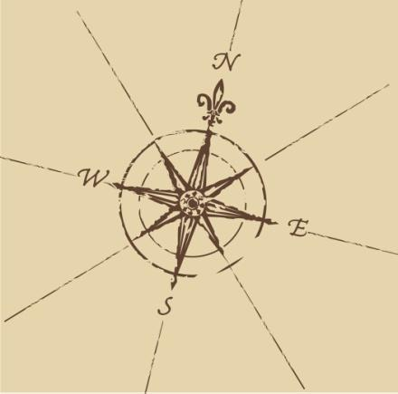

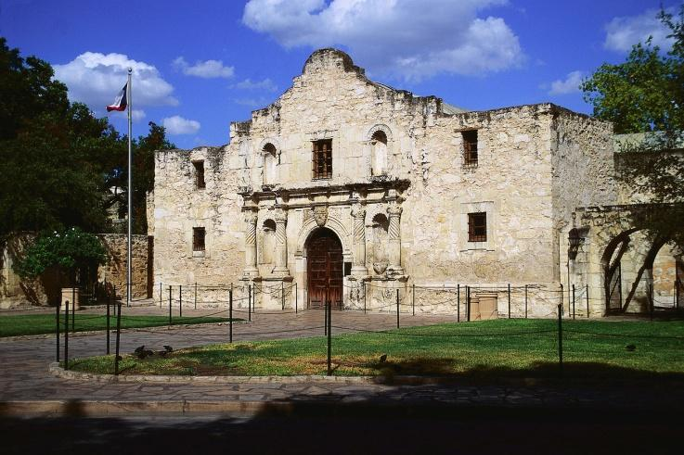
What will my child learn?
5th and 6th 6 Weeks:
Maps and Globes-
Cardinal Directions- North, South, East, West
Purpose of Maps and Globes
Location of Texas on a map
Locate Landforms (rivers, mountains, islands, lakes, oceans) on a map
Texas Symbols-
Texas Flag
The Alamo
Bluebonnets

Slide 22

Writing
with Ms. Kelch

Slide 23

What will my child learn?
Writing conventions for first grade
1. Capitalization at beginning of sentence
2. Spells some high frequency words correctly; uses inventive spelling
3. Punctuation at the end of sentences
4. Adequate spacing between words
5. Combined sentences(two thoughts connected with “and”)
6. All sentences make sense

Slide 24
Organization
1.Students can articulate to the teacher what his/her writing will be about
2. Students use thinking maps (with teacher support) to plan and organize for writing- student makes a plan and works the plan
3.Story has a beginning, middle and end
4. Each sentence is complete and coherent
5. Sentences flow in a logical sequence throughout the writing

Slide 25
Main Idea and Supporting Details
Writing addresses the prompt
All sentences relate to the prompt
No unrelated information
Each sentence is a complete thought
Uses adjectives and adverbs
Uses descriptive phrases ( “as pretty as a butterfly” or “ran as fast as he could”)

Slide 26
Book Fair!

Slide 27


