Slide 1
Principles of Business, Marketing, and
Finance
Business in a Global Society
UNT in partnership with TEA, Copyright ©. All rights reserved

Slide 2
International Business
UNT in partnership with TEA, Copyright ©. All rights reserved 2
All business activities needed to:
  Create
  Ship
  Sell
Goods and services across national borders.
Notes:
Ask students what activities are necessary to produce and sell an imported automobile in the United States

Slide 3
Other Names for International
Global business
International Trade
Foreign Trade
UNT in partnership with TEA, Copyright ©. All rights reserved 3
Notes:
Ask students to describe a part of the world where a global business opportunity exists. Describe the opportunity.

Slide 4
Importance of International Business
lGobal Opportunities
Imports
-meet Consumer Demands
Exports
-increase Business
Materials and Parts are Needed from Other Countries
UNT in partnership with TEA, Copyright ©. All rights reserved 4

Slide 5
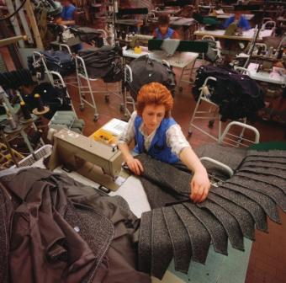
Domestic Business
Business Within One Country
Making, Buying, Selling Goods and Services within One Country
UNT in partnership with TEA, Copyright ©. All rights reserved 5

Slide 6
Types of Business Activities
Produce Raw Goods
Process Raw Goods
Manufacture Goods from Processed Goods
Distribute Goods
Manufacture Goods from Raw Goods
Provide Services
UNT in partnership with TEA, Copyright ©. All rights reserved 6
Notes:
Ask the class to give one example of each type of business

Slide 7
Fundamentals of International Trade
Imports
Exports
Trade Barriers
  Protectionism
  Tariff
  Quota
  Embargo
UNT in partnership with TEA, Copyright ©. All rights reserved 7
Notes:
Ask students to give examples of situations where the types of trade barriers would be appropriate
Protectionism-limiting trade with other countries to protect business at home
Tariff-a tax placed on imported products to make them more expensive than domestic products
Quota-a limit placed on the quantities of a product that can be imported
Embargo-a ban on the import or export of a product

Slide 8

International Business Environment
Geography
Economic Conditions
Cultural and Social Factors
Political and Legal Factors
UNT in partnership with TEA, Copyright ©. All rights reserved 8

Slide 9
Global Marketplace
Multinational Corporation
  conducts business in many countries.
  has facilities and offices in many countries.
  works like a shopping mall or a supermarket.
UNT in partnership with TEA, Copyright ©. All rights reserved 9
Notes:
Ask students to explain why some American companies outsource their manufacturing processes.

Slide 10

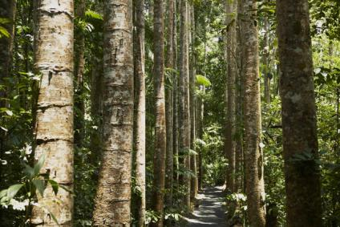
Resources for a Country
Human
Natural
UNT in partnership with TEA, Copyright ©. All rights reserved 10

Slide 11
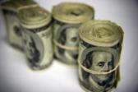
Specialization
What a country does the best depends upon
financial
human
Nnatural resources
UNT in partnership with TEA, Copyright ©. All rights reserved 11

Slide 12

Currency
Exchange Rate
  Price at which one currency can buy another currency
  Exchange rates change daily
  Currency rate depends on how many other countries want to buy the country’s products
UNT in partnership with TEA, Copyright ©. All rights reserved 12

Slide 13
Different Exchange Rate Scenarios
Favorable
-when the value of a country’s currency goes up compared to another country’s currency
Unfavorable
-when the value of a country’s currency goes down compared to another country’s currency
Countries lower the value of the currency to increase business
UNT in partnership with TEA, Copyright ©. All rights reserved 13

Slide 14
Balance of Trade
Trade Surplus
-more exports than imports
Trade Deficit
-more imports than exports
UNT in partnership with TEA, Copyright ©. All rights reserved 14
Notes:
Ask students what they think can be done for the U.S. to improve its balance of trade?

