Slide 1
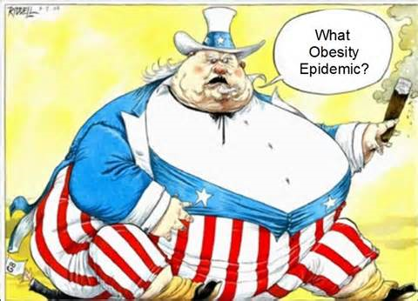
Obesity

Slide 2
What is Obesity
Obesity is an excess proportion of total body fat. A person is considered obese when his or her weight is 20% or more above normal weight. The most common measure of obesity is the body mass index, or BMI.
A person is considered overweight if his or her BMI is between 25 and 29.9; a person is considered obese if his or her BMI is over 30.

Slide 3
Morbid Obesity
"Morbid obesity" means that a person is either 50%-100% over normal weight, more than 100 pounds over normal weight, has a BMI of 40 or higher, or is sufficiently overweight to severely interfere with health or normal function.

Slide 4
Health Risks
Type 2 Diabetes
High Blood Pressure
High Cholesterol
Stroke
Heart Attack
Sleep Apnea

Slide 5
An Epidemic?
Obesity has reached epidemic proportions in the United States. Over two-thirds of adults are overweight or obese, and one in three Americans is obese.
The prevalence of obesity in children has increased markedly, with approximately 20%-25% of children either overweight or obese.

Slide 6
Causes
Taking in more calories than you burn can lead to obesity because the body stores unused calories as fat. Obesity can be caused by:
Eating more food than your body can use
Drinking too much alcohol
Not getting enough exercise

Slide 7
More Causes
Age (As you get older, your body's ability to metabolize food slows down and you do not require as many calories to maintain your weight.)
Gender (Women tend to be more overweight than men. Men have a higher resting metabolic rate (meaning they burn more energy at rest) than women.)
Genetics (Obesity (and thinness) tends to run in families.)
Environmental Factors (lifestyle behaviors such as what a person eats and how active he or she is.)
Medication (Certain drugs, such as steroids and some antidepressants, may cause excessive weight gain.)

Slide 8
It’s Easy
The way we eat when we are children can affect the way we eat as adults.
The way we eat over many years becomes a habit, affecting what we eat, when we eat, and how much we eat.
We are surrounded by things that make it easy to overeat and hard to stay active.

Slide 9
Continued
Many people do not have time to plan and make healthy meals.
More people today work desk jobs compared to more active jobs in the past.
People with less free time have less time to exercise.

Slide 10
Treatment
An active lifestyle and plenty of exercise, along with healthy eating, is the safest way to lose weight. Even modest weight loss can improve your health. You will need a lot of support from family and friends.

Slide 11
Continued
Healthy food choices
Healthy snacks
How to read nutrition labels
New ways to prepare food
Portion sizes

Slide 12
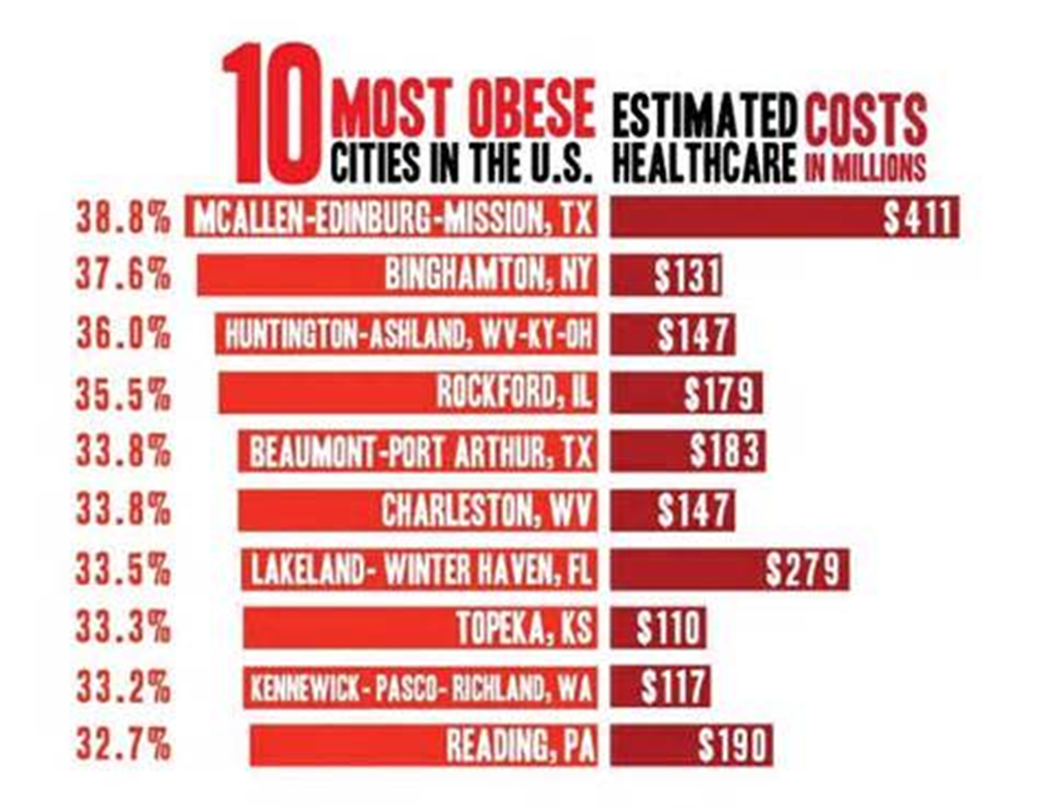
Fun Fact

Slide 13


Slide 14


Slide 15


Slide 16
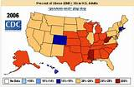

Slide 17
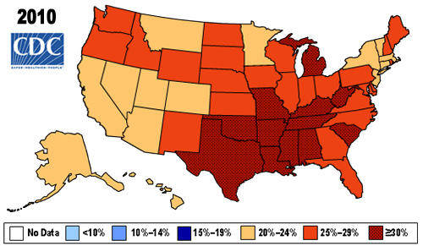

Slide 18
Video’s
http://www.brainpop.com/health/diseasesinjuriesandconditions/obesity/
http://www.brainpop.com/health/nutrition/bodyweight/

