Slide 1
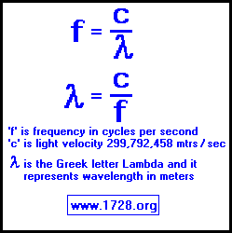
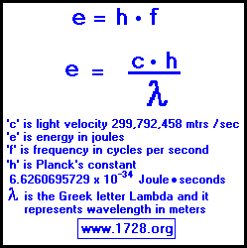

Slide 2
Wavelength, Frequency, and Energy Practice Problems

Slide 3
1. A certain violet light has a wavelength of 413 nm. What is the frequency of this light?

Slide 4
2. What is the wavelength of radiation whose frequency is 1.50 x 10¹³ Hz?

Slide 5
3. How much energy is associated with a photon in the microwave region of the spectrum with a frequency of 6.6 x 10¹² Hz?

Slide 6
4. A hydrogen lamp emits several lines in the visible region of the spectrum. One of these lines has a wavelength of 6.56 x 10⁻⁵ cm. What is the energy of this radiation?

Slide 7
5. A very bright line in the bright-line spectrum of sodium has a wavelength of 590 nm. What is the speed of this wave?

