Slide 1
Information about three circles is listed below.
Circle P has a diameter of 26 cm.
Circle Q has a diameter of 52 cm.
Circle R has a radius of 52 cm.
Based on this information, which statement is true?
F. The diameter of circle P is the same length as the diameter of circle R.
G. The radius of circle P is the same length as the radius of circle Q.
H. The diameter of circle P is the same length as the radius of circle Q.
J. The radius of circle P is the same length as the diameter of circle R.

Slide 2
In a first-aid kit the ratio of large bandages to small bandages is 3 to 2. Based on this ratio, how many large bandages are in the kit if there are a total of 80 bandages?

Slide 3

At 7: 26 a.m., Dante started delivering packages.
At 10:34 a.m., he delivered the last package.
He delivered 18 packages.
He spent about the same amount of time delivering each package.
Estimate the number of minutes Dante spent delivering each package.

Slide 4
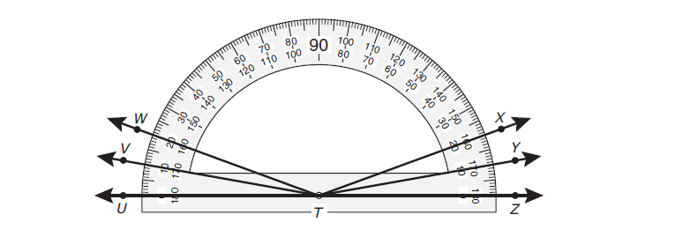
Which angle does not appear to have a measure of 160°

Slide 5
A worker at a clothing company uses 200 buttons to make 50 shirts. At this rate, how many buttons would the worker use to make 350 shirts?

Slide 6
All the minutes used by Mrs. Larsen and her 3 children for cell phone calls last month were reported on the same bill.
The bill showed that a total of 1,850 minutes had been used last month.
Mrs. Larsen used 462 minutes.
Her son used twice as many minutes as she used.
Each of her daughters used the same number of minutes.
Her expression below can be used to find the number of minutes
(1,850 – 462 -462 x 2) ÷2
What was the number of minutes each of Mrs. Larsen’s daughters used?

Slide 7
In the figure below, the vertices of triangle RST are on a circle.
7in
8in
Line segment TS contains the center of the circle.
The perimeter of triangle RST is 24 inches.
What is the circle’s radius?

Slide 8
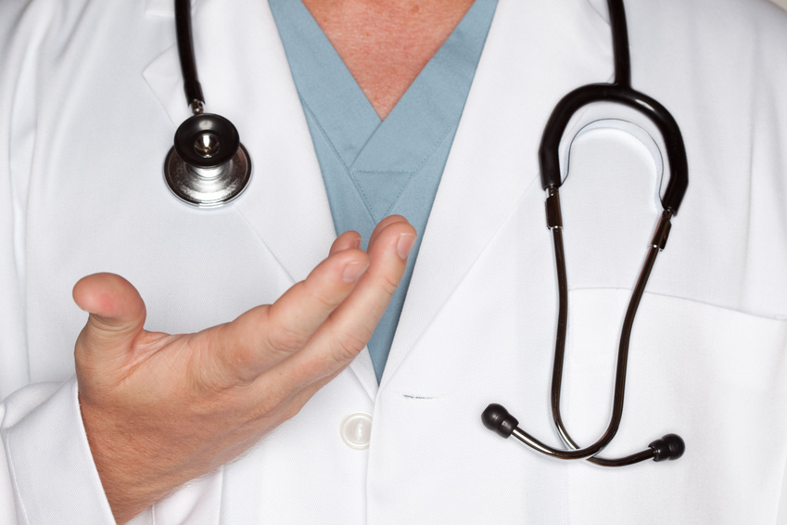
An adult human body contains about 10 pints of blood. How many fluid ounces is the equivalent of 10 pints?

Slide 9
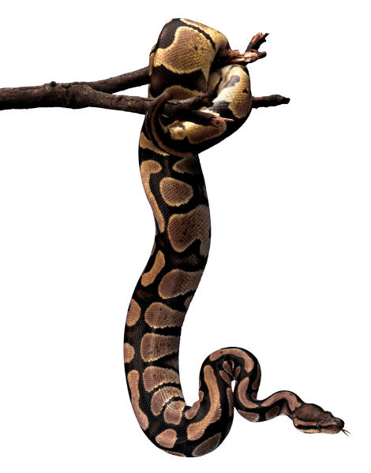
31
          A king snake is m long. What is an equivalent length of this king snake in meters?
          F. 0.31 m
          G. 3 m
          H. 0.062 m
          J. Not here
50
1
50

Slide 10
Vanessa is making a sauce for a chicken dish. The list below shows the amount of each ingredient she needs in order to make 4 servings of the sauce.
2 tablespoons of black pepper
1 cup of peanut butter
3 tablespoons of vinegar
2 tablespoons of soy sauce
1 cup of water
Based on this information, which statement is true?
For 16 servings, she would need to use 12 tablespoons of vinegar.
For 20 servings, she would need to use 7 tablespoons of soy sauce.
For 2 servings, she would need to use 4 tablespoons of black pepper.
For 12 servings, she would need to use 9 cups of peanut butter.

Slide 11
Angie had a bag that contained 14 oranges. She put 3 of the oranges in her brother’s lunch box. She put 2 times as many oranges in the refrigerator as she put in her brother’s lunch box. She used the rest of the oranges to make orange juice. Based on the expression below, how many oranges did Angie use to make orange juice?
14 – (3 + 2 x 3)

Slide 12
The circular opening of a tunnel has a circumference of 36 meters. Which equation can be used o find d, the diameter of the tunnel opening in meters?
F. Π x 36 = d
G. 36 / 2Π = d
H. 2 x Π x 36 = d
J. 36 / Π = d

Slide 13
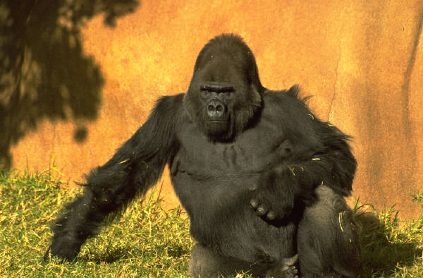
Every day a zookeeper feeds 4 adult gorillas a total of 160 lbs of food. At this rate, how many pounds of food would the zookeeper need every day to feed 6 adult gorillas?

Slide 14
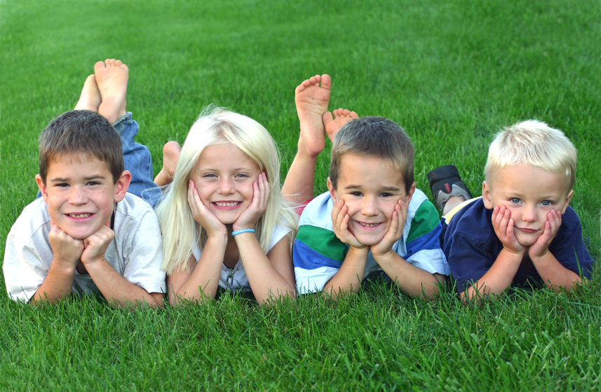
At 8:00 a.m., 26 children were at a day care. By 3:00 p.m., 12 of these children were no longer at the day care. What integer best represents the change in the number of children at the day care from 8:00 a.m. to 3:00 p.m.?

