Slide 1
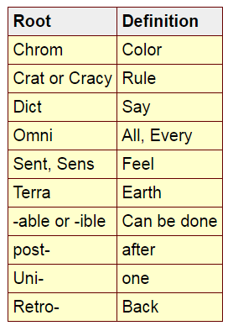

Slide 2
Chrom – color
Chrome
Polychromatic
Chromatic
Monochromatic
Chromosome (Decides things like hair color.)

Slide 3
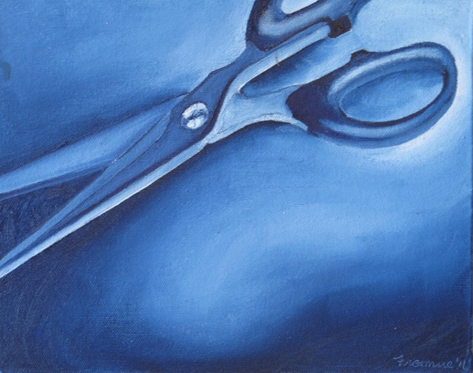

Slide 4
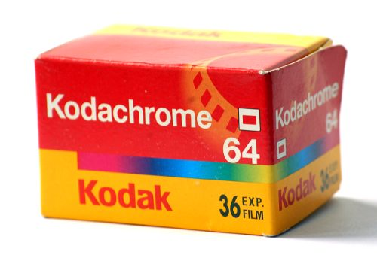

Slide 5
Crat or cracy: rule
Autocrat
Aristocrat
Theocracy
Technocracy
Meritocracy
Idiocracy
Democracy

Slide 6
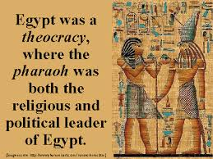

Slide 7
Dict: words
Dictionary
Dictate
Dictator
Edict
Predict
Verdict
Contradict
Benediction

Slide 8
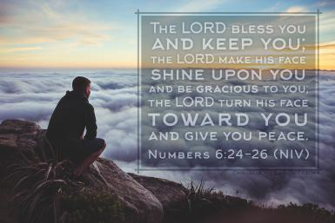
Common benediction

Slide 9
Omni: all or every
Omnipotent
Omniscient
Omnipresent
Omnivore
Omnimax

Slide 10
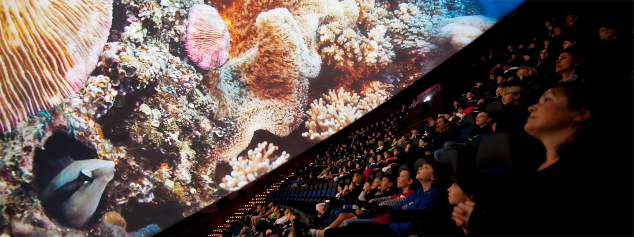
Omnimax

Slide 11
Sent, sens: feel
Sentiment
Consent
Resent
Dissent
Sentimental
Sense
Sensation
Sensitive
Sensory
Dissension

Slide 12
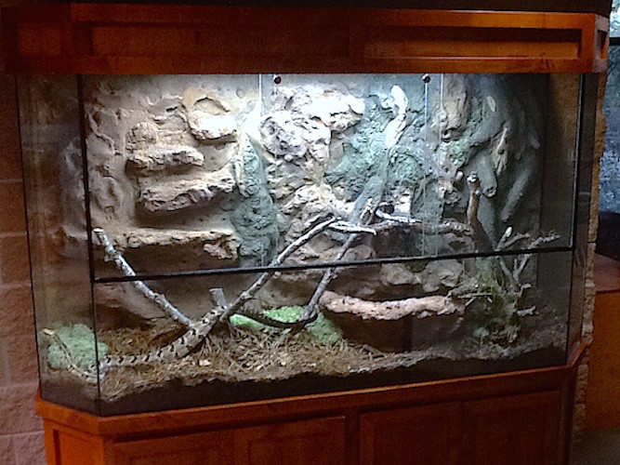
Terra: earth
Terrain
Terrarium
Territory
Terrestrial
Extraterrestrial

Slide 13
-able or -ible: can be done
Audible
Breakable
Visible
Likable
Endurable
Lovable
Overcomeable

Slide 14
Post-: after
Postgame
Postwar
Post-emergency
Post-graduation
Postmodern

Slide 15
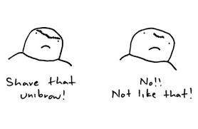
Uni: one
Unicorn
Unicycle
Universe
Unibrow

Slide 16
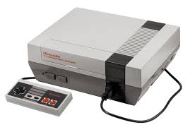
Retro: past
Retroactive
Retro
Retrograde
Retrofit
Retrospective

Slide 17
tinyurl.com/jo264eo

