Slide 1
Air Masses and Fronts
What’s the difference?

Slide 2
Air Mass
An air mass is a large volume of air with the same temperature and moisture content.
As an air mass forms, it takes on the characteristics of the area over which it develops.
It becomes what it hangs around!

Slide 3
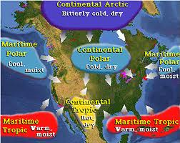
Types of air masses:
Continental or Maritime

Slide 4
Two opposing air masses are the teams!
What’s a FRONT?
  It’s like a wrestling match where two opposing athletes meet…

Slide 5
Who will end up on TOP???
Fronts develop when air masses of different temperatures and humidity collide, causing a change in the weather.
There are four types, but most are classified as either cold or warm.
Knowing what you do about density, how do you think cold and warm fronts will interact?

Slide 6
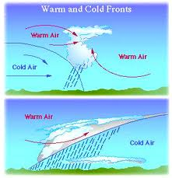
Cold air sinks, warm air rises!
Warm air RISES, cooler air SINKS!

Slide 7
.
What does the weather do when a COLD FRONT hits?
A cold front brings rain, thunderstorms and clouds. If there is a large temperature difference between fronts, tornadoes can occur.
What is the weather symbol for a cold front?

Slide 8
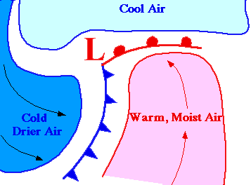
Cold and Warm Front Symbols

Slide 9
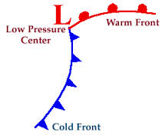
When warm and cold meet, it’s Go time! Something is bound to happen.

Slide 10
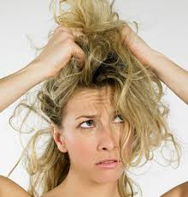
It’s bad hair day weather when warm fronts appear.
Warm fronts occur when slower moving warm air replaces retreating cooler air. The warm air rides over top of the cooler air, producing light to moderate rain. Warmer temps and higher humidity occur after the passage of a warm front.

Slide 11
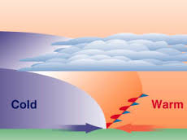
A stationary front occurs when the air masses are NOT moving.

Slide 12
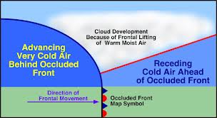
An occluded front happens when a cold front overakes a warm front.

Slide 13
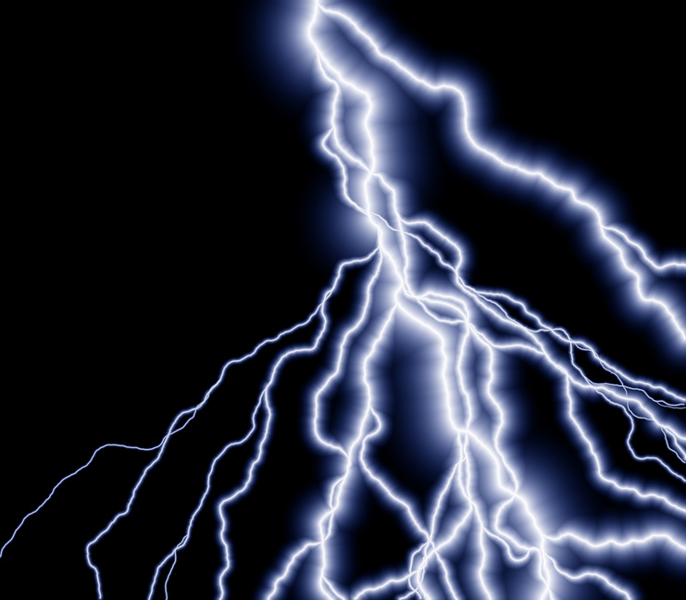
Conclusion: Fronts arrive and weather changes.

Slide 14
Number your paper from 1-10.
1. A front is the same thing as an air mass.
2. An air mass is a large volume of air with the same air pressure and climate.
3. The Earth’s atmospheric changes occur in part because the Earth strives to maintain equilibrium.
TRUE OR FALSE?

Slide 15
True or False
4. A front is a type of boundary where two air masses meet.
5. Systems of high pressure typically bring cloudy, rainy weather.
6. Temperature and humidity decrease after the passage of a cold front.
Snowflakes

Slide 16
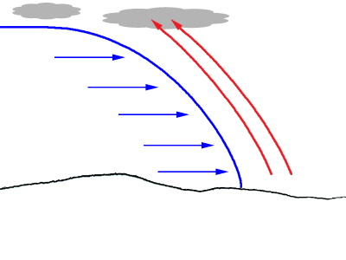
Quiz, continued
7. Draw the picture to the left and label the cold and warm front using correct weather symbols.
8. Why is the warm air rising?
9. What type of pressure system is occuring as the warm air rises? HIGH OR LOW?
10. Write one thing you learned from today’s lesson.

