Slide 1
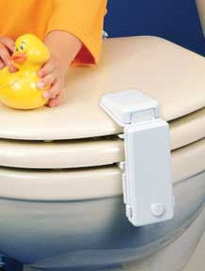
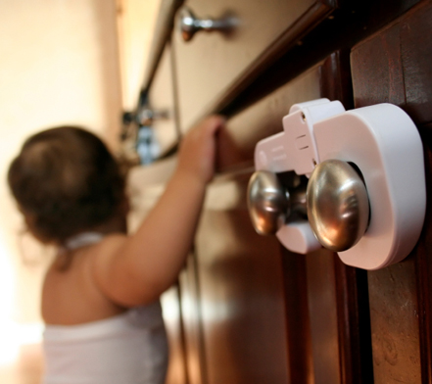
Warm-Up
Scan the classroom and write down any items you see that may be dangerous to children.
In what ways could you childproof a room or home?
What play ground equipment could be dangerous? In what way?

Slide 2
Warm-Up
As a parent, what security features would you look for in a preschool?
What measures do child care centers use to ensure children are checked out safely?
Do you see similar security measures used in our school? Explain.

Slide 3
Warm-Up
What excuses might a parent give if a child shows signs of non accidental physical injury?
What is the teachers responsibility regardless of the explanation?
What are the 4 types of abuse?

Slide 4
Chapter 11: Promoting Children’s Safety
Child Guidance*Kilgore

Slide 5
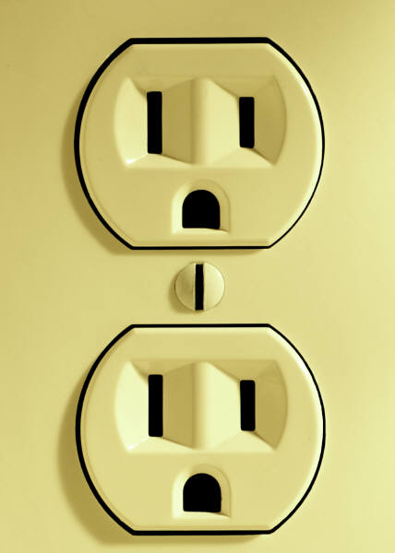
Child Safety
Dangers can be found everywhere in a child care center.
Electrical outlets, cleaning supplies, outdoor climbing equipment, etc.
Accidents are more likely to occur when the children’s routine is disrupted or when staff is absent, busy or tired.

Slide 6
Safety Objectives
Supervise children at ALL times.
Maintain the minimum adult-child ratio.
Develop safety limits.
Provide a safe environment.
Practice fire safety.
Develop plans for weather emergencies.
Know procedures for poisoning.
Recognize signs of abuse and report suspected cases.
Teach children how to protect themselves from sexual assault.

Slide 7
Assignment
Scenario: You work at an Early Childhood (0-Kindergarten) program as a teacher. You are preparing your classroom for the first day. Child safety is critical for children of all ages. You have to help protect the safety of children.
Create a poster that illustrates:
One safety issue
What to do to prevent
Create a management plan for when it happens.

Slide 8
1. Supervision
Teachers should supervise constantly!
Young children are unpredictable, quick and fearless. May not recognize actions that can cause injury.

Slide 9
2. Maintain Minimum Adult-Child Ratios
Never have fewer adults than required by state law!
If a child is injured while a staff ratio is not met, the center/staff may be liable.

Slide 10
Assignment – Ratio Requirements based on Program Type
Groups:
Summer, Kaylie O, Alyssa
Maddy, Megan, Austin
Kaylie M, Alex, Yasmin
Meredith, Drew, Morgan
Review the state minimum standards for adult to child ratio
Summarize the requirements; capture on paper
Present requirements to class

Slide 11
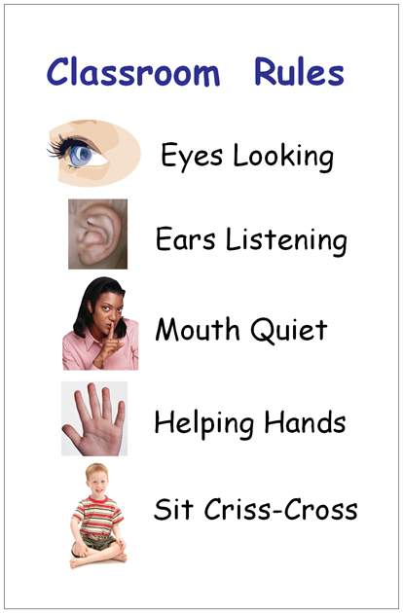
3. Develop Safety Limits
Limits= are guides to actions and behaviors that reflect the goals of a program, aka rules.
Make them clear, simple and easy:
Walk indoors.
Use blocks for building.
Clean up after yourself.

Slide 12
4. Provide a Safe Environment
Toys and materials-examine toys for safety or repairs.
Playground equipment-evaluate equipment for safety. Playground tips
Transportation-car accidents pose the greatest threat to children’s lives.
Infants up to 22 lbs should be placed in a rear facing car seat.
Children under 54 inches who have outgrown car seats need a booster seat, lap belt and shoulder harness.
A first aid kid should always be in your vehicle.
Car Safety

Slide 13
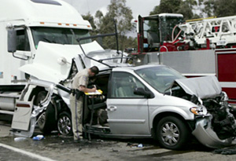
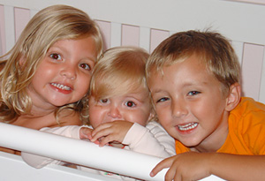
The Coble Family
Tragedy turns to Miracle

Slide 14
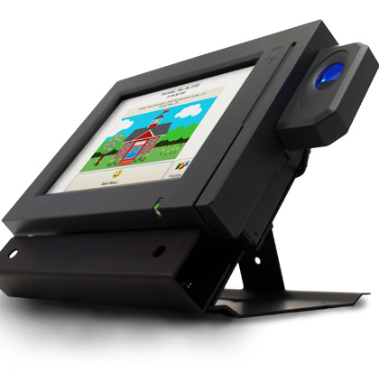
Safety Measures
Building security-safety measures taken to control unauthorized access to the building.
Some centers use keypads or card keys.
Cameras can monitor entrances and exits.
Classroom doors should have see through panes to view students.
Sliding patio doors or doors with glass panels can be dangerous. Apply decals at eye level to warn children of the glass they may not see.

Slide 15
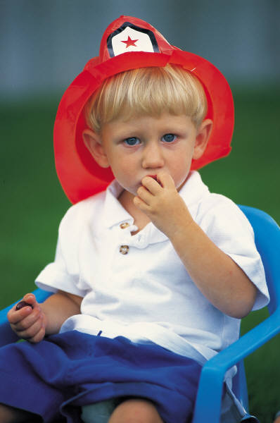
5. Practice fire safety-
Check for fire hazards, test smoke alarms at least once a month.
Fire extinguishers-should be found in kitchen, classrooms, laundry, etc.
Fire drills-once a month, post evacuation procedures in every room.
Fire safety

Slide 16
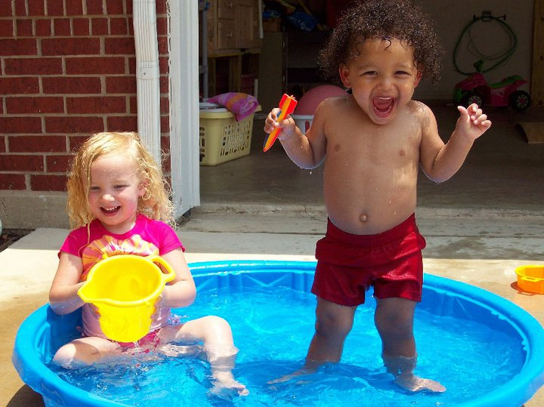
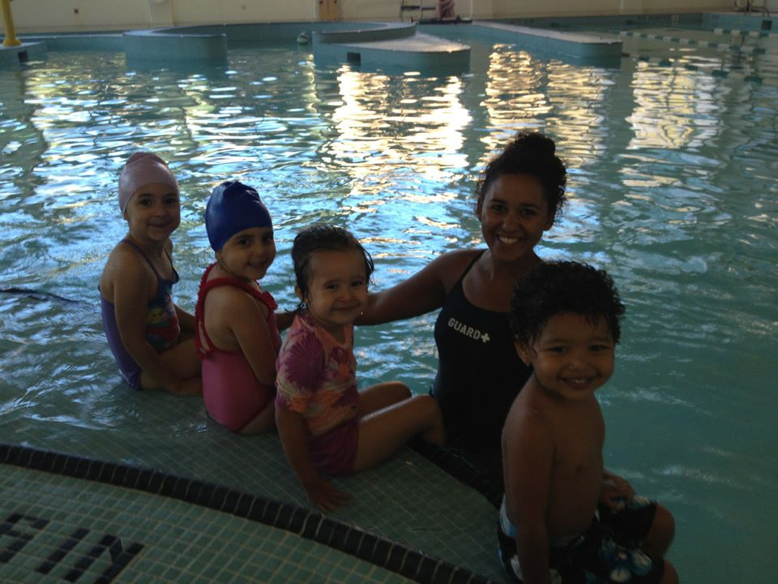
6. Sun Safety
Rays are strongest between 10am-4pm, apply sunscreen, wear hats/sunglasses. Use shadow rule=if a child cannot see their shadow, then they should seek shade or go indoors.
Sun safety tips

Slide 17
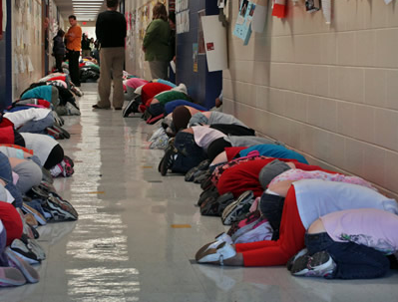
7. Emergencies
Weather or disaster emergencies-blizzards, hurricanes, floods, electrical storms, tornadoes, earthquakes.
Have a plan for emergencies!
Always keep a radio, flashlights, blankets, water, food and first aid kit handy.

Slide 18
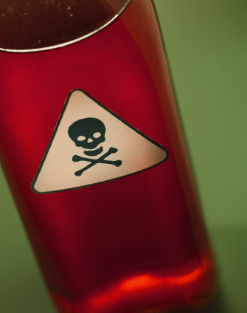
8. Poisonings
Poisonings-studies show that children under five years of age account for almost 2/3 of poisoning that occur each year.
Call poison control!
An emetic is a substance that induces vomiting when swallowed.
Many poisonings in children come from plants.

Slide 19
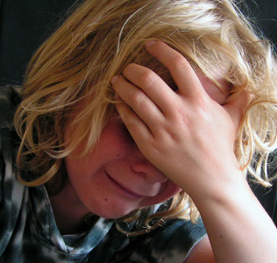
9. Neglect and Abuse
During the past 25 years, the number of reported abused or neglected children has almost tripled.
90% of abusers are family members.
3 leading risk factors: financial problems, substance abuse, and the stress of handling parental responsibilities.

Slide 20
Types of Abuse
Non accidental physical injury=physical injury inflicted on purpose.
Neglect=when children are not given the basic needs of life.
Emotional abuse=abuse through words or actions.
Sexual abuse=forcing a child to observe or engage in sexual activities with an adult.
Incest=sexual abuse by a relative.
Molestation=sexual contact made by someone outside the family with a child.

Slide 21
Reporting Child Abuse
Statute=a formal document drawn up by elected officials explaining your legal responsibilities.
Immediately file a report if you have evidence of abuse.
Background checks-licensing requirement, will determine if they have had any felony or child abuse convictions.
Protection education-children need to learn how to deal with dangers outside the classroom.
Warn children about strangers!
Educate children about sexual abuse.
Helping families-encourage parenting classes, support groups, financial planning, family counseling, help lines, health care programs, nutrition.

Slide 22
10. Liability
Center directors are liable for their employees’ actions.
Liable=having a responsibility that is upheld by the law.
Privacy laws=designed to protect children, states that a child’s records cannot be given to anyone other than parents without the parents’ permission.

Slide 23
Types of Liability
A child care center can be liable for no doing the following:
Obtaining a signed health form for each child.
Not providing staff background checks.
Providing safe indoor/outdoor equipment.
Correct child/staff ratio.
Providing proper supervision.
Food safety/storage.
Providing staff with info about children’s special needs.
Refraining from corporal punishment
Covering electrical outlets.
Removing children who are a hazard to themselves/others.

