Slide 1
Your Health and Fitness
Your Physical Fitness

Slide 2
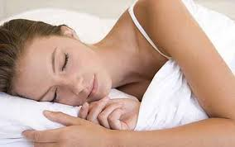
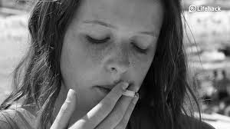
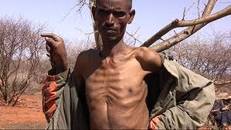
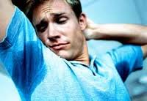
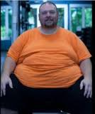
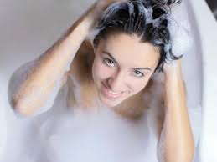
Number your paper 1 – 15
Write ONE word to describe each of these pictures
#1
#2
#3
#4
#5
#6

Slide 3
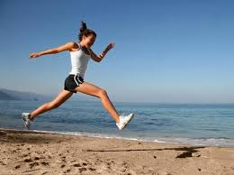
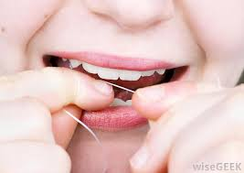
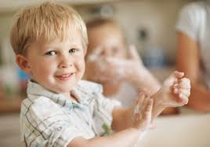
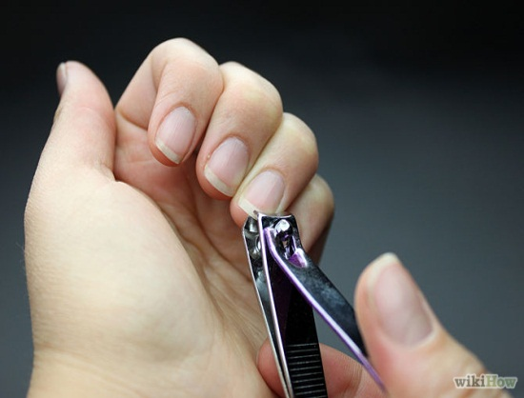
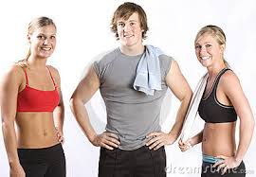
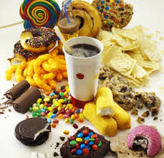
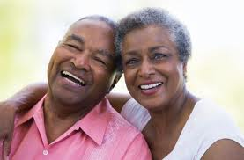
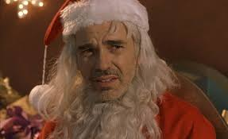
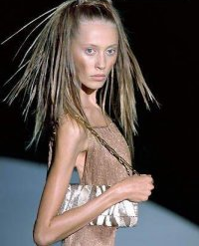
#7
#8
#9
#10
#11
#12
#13
#14
#15

Slide 4
Current Health Trends
What are the current health trends in news, media, society?

Slide 5
Careers
What are some careers in Health and Wellness and Fitness?
Notes:
Spa attendant
Recreation aide
Health records technician
Public Health Profession
Health Educator
Personal Trainer
Health and Wellness Instructor teacher

Slide 6
Your Physical Fitness Vocabulary
Wellness – describes a desired state of health
Physical wellness – state of health in which body is able to fight illness and infection and repair damage
Physical Fitness – condition of your body
Aerobic Capacity – is a measure of the condition of your heart and lungs.
Insomnia – is the inability to get the amount of sleep you need when you need it.
Notes:
HEALTH

Slide 7
Your Physical Fitness
What you will learn in this unit…
Explain why good health is important
Describe two areas on which physical activity should focus
Use suggestions for getting adequate sleep

Slide 8
Your Physical Fitness
Wellness
Physical Wellness
High level of vitality
What’s vitality?
Because of this increased vitality, how does that change your lifestyle?
Look and feel better
More energy
Small % of people enjoy this level of good health
Notes:
How would you describe a person who is physically fit?
What factors play a role in determining physical fitness?
Wellness – describes a desired state of health
Physical wellness – state of health in which body is able to fight illness and infection and repair damage
A person who has physical

Slide 9
How do you achieve physical wellness?
Professional medical care
What does that include?
Good Self-care
What’s that?
Notes:
Professional medical care – Doctor – NP/Other HCP: Preventive health with regular checkups and needed treatments
Self-care
Good nutrition
Weight Management
Physical activity

Slide 10
Your Physical Fitness
What is physical fitness?
What’s that look like?
Seen
Unseen
Fitness and Wellness
What’s the connection?
What are the key factor (s) impacting both fitness and wellness?
Notes:
Physical Fitness – condition of your body – What’s that mean?
Phsycially fit people
strong heart
Muscles are toned
Lungs are clear
Perform a variety of tasks
Connection b/c wellness defition says
And Wellness says
You can’t have one without the other.

Slide 11
YOU
Notes:
Your Self-care – you have to take responsibility for your health and fitness.

Slide 12
Importance of Good Health
How does your health affect you?
How does poor health affect you more significantly in some jobs/careers?
What are some examples?
Notes:
How does your health affect you?
Improved Alertness and attention
Success in school, work etc
More energy
Self-esteem/concept
Negative affects
Lack of energy
Decreased self-esteem/concept/image
Sleepiness/fatigue
Lack of attention and alertness
Slow/lag
Careers affected by poor health – highly labor intensive (farmers, plumbers, landscapers, coaches, etc.)
Personal and family life
More patient b/c more energy
More engaged better participation
Not so sleepy/tired – need for rest

Slide 13
Being Physically Active
KEY to building and maintaining physical fitness
Daily
How does physical activity help?
PLUS, it’s FUN!
Notes:
Physical activity helps:
Can enhance posture
Improve blood circulation
Increase lung function/capacity
Relieve stress, boredom, depression
Build strength and flexibility
Weight management

Slide 14
Being Physically Active
What’s it look like?
What are some examples?
Do you have to have a gym?
Vigorous activity
Examples
Moderate physical activity
Examples
Notes:
Being Physically Active –
Does not have to be in the gym.
It does NOT have to be strenuous.
Many are a part of your daily routine –and provide moderate physical activity
Walking, biking, raking leaves, cleaning house
Enjoy vigorous workouts?
Dancing, swimming, tennis basketball, running, aerobics, etc.

Slide 15
Being Physically Active
How much is enough?
What should you do before starting a exercise/activity program, if you have NOT been active?
Why?
What can the doctor do to help?
As a rule of thumb
Start with short simple workouts and build-up from there
STICK WITH IT!
Notes:
How many of you get at least 60 minutes/day.
You need at least 60 minutes/day
Does not have to be all at once
Break it up into segments.
Doctor help recommend a program/activity.

Slide 16
Being Physically Active
Making physical activity worth it…
HOW?
Component One
Aerobic capacity
How do you measure this?
What are examples of activities that increase aerobic capacity?
Notes:
Aerobic Capacity – is a measure of the condition of your heart and lungs.
It’s measure by your pulse rate – by the number of beats per minute.
Better shape you are in the lower pulse you have.
Recovery time after workouts measures your aerobic capacity
Walking, running, jogging, biking, swimming, basketball, sports (most)

Slide 17
Muscle Strength and Flexibility
Component two
Muscular strength - your muscles ability to do work.
Do you have to lift weights to build muscle strength?
Activities that build strength
Notes:
Common household goods
Push-ups, and own- body weight activities

Slide 18
Muscle Strength and Flexibility
Flexibility – your body’s range of motion.
Why is it important?
What are activities to help improve flexibility?
Notes:
Who in here is flexible?
Why?
Help avoid muscle injuries
Dancing and stretching help improve flexibility – yoga, pilates, etc.

Slide 19
Activity 12.1
Handout

