Slide 1
Project example: Byron sheehan’s dream home
Byron Sheehan
Construction Technologies
Period 1 May 3, 2015

Slide 2
Home Description
My ideal home would be a house that’s about 3200sf, 4 bedroom, 3 bathroom, 3 car garage with 3 outbuildings. A shop, an animal barn, and an in-laws quarters. It would sit upon about 80 to 100 acres.
My reasoning behind all of this is that I have older kids now, getting married, maybe grandkids soon and would like to have places for them to stay when they come visit. My 2 youngest children still live with my wife and I. My father-in-law lives with us due to medical reasons, but he needs his space, we need ours. I have many tools and like to work with my hands. I wish to have a place to go to do this. The barns are for animals, different types. I love working with animals and my 2 youngest boys are into 4H/FFA.

Slide 3
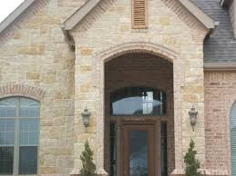
House Exterior
I chose to use Austin Stone for my exterior finishes. The white stone with the subtle hints of browns portrays strength & power and as well lend to accentuating the exterior finishes

Slide 4
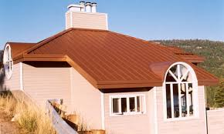
Roofing
I am choosing to use a copper color metal roof as the copper will blend well with the brown tones in the Austin stone and that metal roofing, although a little more expensive, when properly installed last longer than shingles.

Slide 5
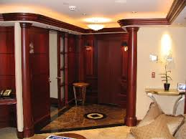
Interior Finishes
I love the the classic look of wood stained finishes. It to me is more elegant than painted finishes. In this picture is wood panel siding, doors, columns, and crown molding

Slide 6
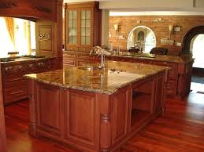
Kitchen and Counter tops
Marble Countertops are very durable lasting many years. They lend very well to stained wood cabinets. Having a big, open kitchen like this is a requirement as my family cooks at home 95% of the time.

