Slide 1
Figurative Language
Just what are we really saying?

Slide 2
alliteration
(9) a pattern of sound that includes the repetition of consonant sounds at the beginning of words within a phrase, sentence, or paragraph. Poets often use alliteration to audibly represent the action that is taking place.
Over the cobbles he clattered and clashed.
Peter Piper picked a peck of pickled peppers.

Slide 3
allusion
(8) a reference in a literary work to a person, place, or thing in history or another work of literature. Allusions are often indirect or brief references to well-known characters or events.
She has the smile of the Mona Lisa.
Those two are as close as Cain and Abel.
This will be his D-Day.
If it keeps raining, we will need an Arc.

Slide 4
antithesis
(11) a figure of speech characterized by strongly contrasting words, clauses, sentences, or ideas.
Everybody doesn't like something, but nobody doesn't like Sara Lee.“
You're easy on the eyes; Hard on the heart.
One small step for a man, one giant leap for all mankind.
Not that I loved Caesar less, but that I loved Rome more.

Slide 5
cliché
(9) any expression so often used that its freshness and clarity have worn off
“Whatever.”
There's no place like home.
When it rains, it pours.
Better late than never.
Roses are red, violets are blue…
He is just green with envy.

Slide 6
colloquialism
(11) an expression used in informal conversation but not accepted universally in formal speech or writing
She recently dumped her boyfriend.
I was fixin’ to head over to Wallyworld.
Do y’all want a coke?

Slide 7
Connotation and Denotation
connotation – (9) an association that comes along with a particular word. Connotations relate not to a word's actual meaning (denotation), but rather to the ideas or qualities that are implied by that word; the emotional implication of a word.
denotation – (9) the direct meaning of a word without the feelings or suggestions that the word may imply.
House and home
Thin and skinny
Overweight and obese

Slide 8
euphemism
(11) used when writing about matters such as sex, violence, death, crimes and "embarrassing" topics. The purpose of euphemisms is to substitute unpleasant and severe words with more genteel ones in order to mask the harshness.
Garbage collector is a sanitation engineer.
Dead becomes eternal rest, great beyond, or even kicked the bucket.
You didn’t fail. You achieved limited success.
It wasn’t a speeding ticket. It’s a certificate of exceptional movement.

Slide 9
foreshadowing
(8) The use of clues by the author to prepare readers for events that will happen in a story. It is not directly stated.
“I knew it was going to be a bad day.” Not foreshadowing.
“There are more birds about than usual...And daring. Some of them taking no notice of the tractor. One or two gulls came so close to my head this afternoon I thought they'd knock my cap off." From The Birds.

Slide 10
hyperbole
(8) a figure of speech involving great exaggeration for effect.
I’m so hungry I could eat a horse.
I have a ton of homework.
My mother will kill me.
I never get to do anything.
My boss is going to work me to death.

Slide 11
idiom
(10) an expression whose meaning is not predictable from the usual meanings of the expression's elements. For example, the expression ‘kick the bucket’ meaning 'to die' has nothing to do with kicking or buckets, but the entire expression has a meaning that is familiar to most people.
He jumped out of the frying pan and into the fire.
A penny for your thoughts.
A little birdie told me what you were up to.

Slide 12
imagery
(8) the sensory details that provide vividness in a literary work and tend to arouse emotions or feelings that abstract language does not. It should appeal to a sense in multiple ways or to multiple senses.
The crimson liquid spilled from the neck of the white dove, staining and matting its pure, white feathers.
"I lay still and took another minute to smell: I smelled the warm, sweet, all-pervasive smell of silage, as well as the sour dirty laundry spilling over the basket in the hall. I could pick out the acrid smell of Claire's drenched diaper, her sweaty feet, and her hair crusted with sand. The heat compounded the smells, doubled the fragrance."(excerpt from "A Map of the World“)

Slide 13
inversion
(11) switching of the usual order of the parts of a sentence, primarily for emphasis or to achieve a certain rhythm or rhyme.
“United there is little we cannot do in a host of cooperative ventures. Divided there is little we can do.” John F. Kennedy’s inaugural address
“Size matters not, ... Look at me. Judge me by size, do you?” Yoda

Slide 14
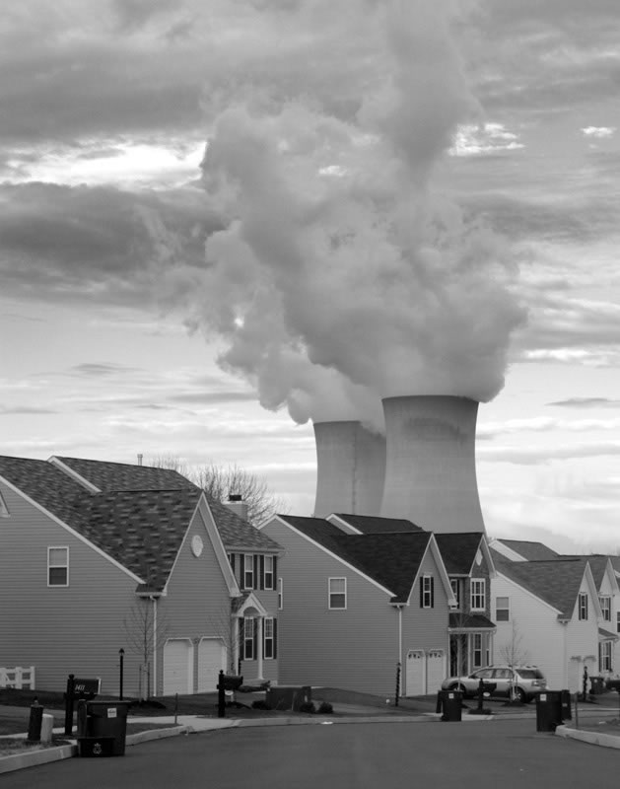
juxtaposition
(11) the placing of a word or phrase directly against another word or phrase without any transitional word connecting the two halves. The purpose of juxtaposing in literature is to highlight the contrast between the two and compare them.

Slide 15
metaphor
(8) a figure of speech that makes a comparison between two unlike things, in which one thing becomes another thing without the use of the word like, as, than, or resembles
“Between the lower east side tenements the sky is a snotty handkerchief.” Marge Piercy, "The Butt of Winter”
“The streets were a furnace, the sun an executioner.” Cynthia Ozick, “Rosa”
“The rain came down in long knitting needles.” Enid Bagnold, National Velvet

Slide 16
onomatopoeia
(8) the use of words to represent sounds
"It went zip when it moved and bop when it stopped, and whirr when it stood still. I never knew just what it was, and I guess I never will." Tom Paxton, "The Marvelous Toy"

Slide 17
oxymoron
(9) a self- contradictory combination of words or smaller verbal units.
peace force
silent scream
clean kill
educated guess
jumbo shrimp

Slide 18
paradox
(9) a statement, often metaphorical, that seems to be self-contradictory but that has valid meaning. An apparent contradiction that is actually true.
I always tell a lie.
We learn from history that we do not learn form history.
It is opposite day today.
“Some day you will be old enough to start reading fairy tales again.” C.S. Lewis
I must be cruel to be kind. – Shakespeare, Hamlet
time travel

Slide 19
personification.
(8) a metaphor in which a nonhuman thing or quality takes on human characteristics or capabilities.
Earth felt the wound; and Nature from her seat, Sighing, through all her works, gave signs of woe. - John Milton
Oreo: Milk’s favorite cookie.
The sun kissed her cheeks.
Time crawled.

Slide 20
pun
(9) a play on words based on the similarity of sound between two words with different meaning
A gossip is someone with a great sense of rumor.
He worked at an orange juice factory until he got canned because he couldn’t concentrate.
At a pizza shop: 7 days without pizza makes one weak.

Slide 21
rhetorical question
(11) one offered for its rhetorical effect and not requiring a reply or intended to induce a reply
Do you think money grows on trees?
Why do we kill people who kill people to show them that killing people is wrong?
If the professor on Gilligan's Island can make a radio out of a coconut, why can't he fix a hole in a boat?

Slide 22
symbolism
(8) the use of an object, a person, a situation, an action, or some other item that has a literal meaning in the work, but suggests or represents a more abstract meaning.
“A rose by any other name would smell as sweet.”
Dove = peace
The raven in Edgar Allen’s poem “The Raven” represents grief and lost love.
The Letter “A” symbolizes adultery in Hawthorne’s Scarlett Letter.

Slide 23
synecdoche
(11) a type of figurative language in which the whole is used for the part or the part used for the whole.
He has too many mouths to feed.
The Navy captain yelled that he needed all hands on deck.
“Give us this day our daily bread.”
“Twenty sails came into harbor.”

Slide 24
understatement.
(12) (opposite of hyperbole) statement which says less than is really meant; hyperbole exaggerates; understatement minimizes.
“It isn’t very serious. I have this tiny tumor in my brain.” – The Catcher in the Rye by J.D. Salinger
When the White Sox lost the game to the Rangers, 41-0, the manager told the reporter, “It wasn’t our best effort.”
No, 'tis not so deep as a well, nor so wide as a church-door; but 'tis enough, ‘twill serve: ask for me to-morrow, and you shall find me a grave man. –Mercutio in Romeo and Juliet

