Slide 1

Some important dates for you ☺
AP Practice Exams
April 9 & April 16 (both Saturday)
12 pm – 3:30 pm
Lecture Hall
After-School Study Sessions
Monday – Thursday PM
4:15

Slide 2
EAST & SOUTHEAST ASIA 1450 – 1750
Transitions and the Quest for
Political Stability

Slide 3
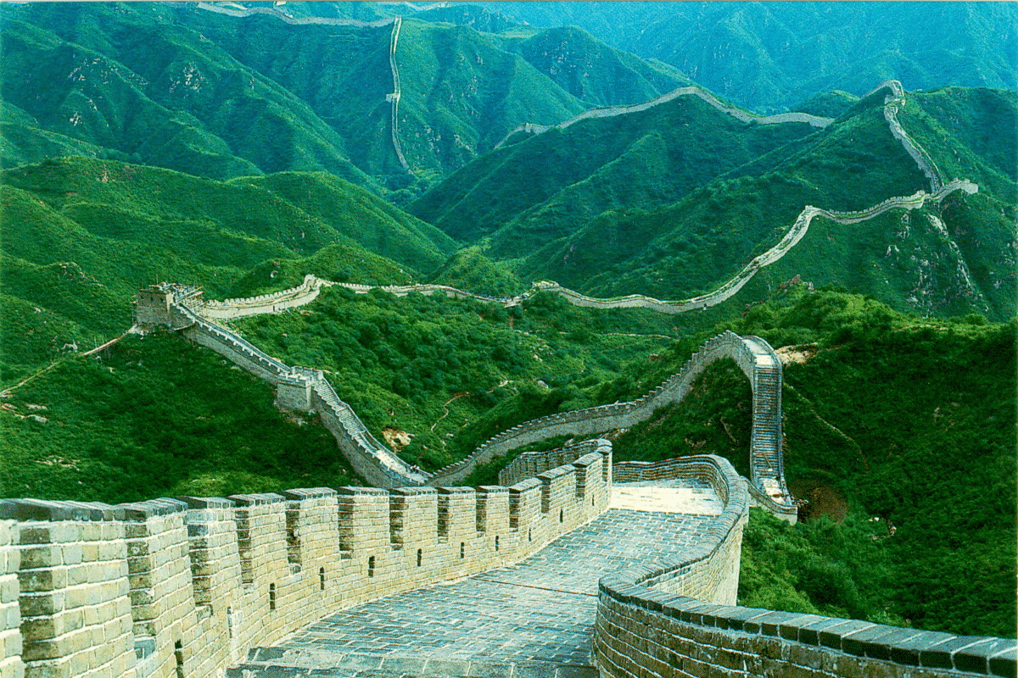
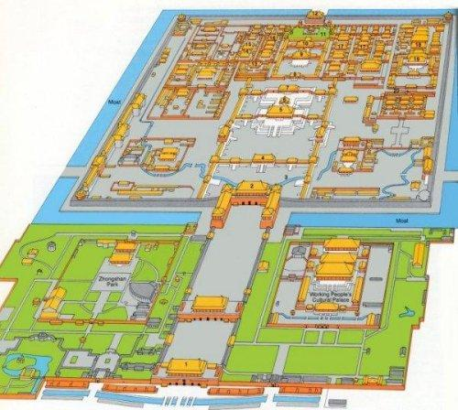
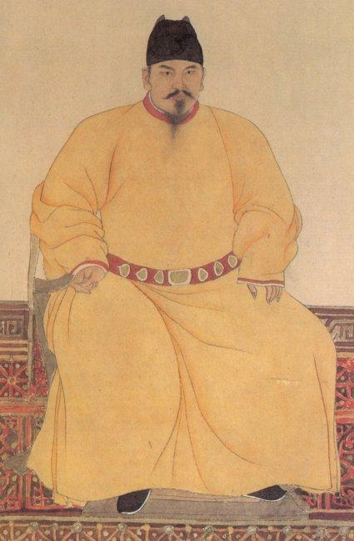
THE MING DYANSTY
Ming government (1368-1644)
Drove the Mongols out of China
Constantly faced threats of new nomad invasions
Rebuilt Great Wall to prevent northern invasions
Centralized government control
Restored Chinese cultural traditions
Restored Confucian bureaucracy, civil service examinations
Eunuchs given impressive role in Forbidden City as bureaucrats
Ming attempted to recreate the past, not improve upon it
Moved capital to Beijing
Built Forbidden City for emperor, bureaucrats
City was closer to danger of north
Extended Grand Canal to the north to bring food to city
Ming decline
Centralized government ran poorly under weak emperors
Weak emperors isolated by eunuchs, advisors
Public works fell into disrepair
Coastal cities, trade disrupted by pirates, 1520 – 1560
Government corruption and inefficiency
Caused by powerful eunuchs
Overshadowed by inability of bureaucrats to reform, innovate
Famines and peasant rebellions: 1630s and 1640s
Rebellion by army units opens door to nomadic invasion
Nomadic Manchu invaders led to final Ming collapse, 1644
Notes:
Reasons for Ming decline:
A series of weak emperors/weak rulers → corruption, inefficiency, concentration of land ownership, peasant rebellions and famine along the northern frontier
High taxes (w/ increase bc rulers and officials are taking some off the top)
Foreign silver pours in pay for Chinese goods, inflation → English/Dutch start interrupting the trade w/ the Spanish, w/ drops silver imports, raises its price, and freaks everyone out again
Crop yields & harsh weather → famine, makes it harder for the government to provide food
Final straw: epidemic devastates population → peasant revolt under a postal worker, Li Zicheng – captures capital in 1644
Last Ming emperor dies hanging himself from a tree in the palace gardern
Ming had dealt w/ their northern nomadic neighbors through alliances & trade privileges
One of them is the Manchus (modern-day Manchuria, ne of Great Wall)
Are like, “yo, let’s overthrow the rebels that just overthrew the Ming dynasty” & team up with the military commanders that just deserted the Ming

Slide 4
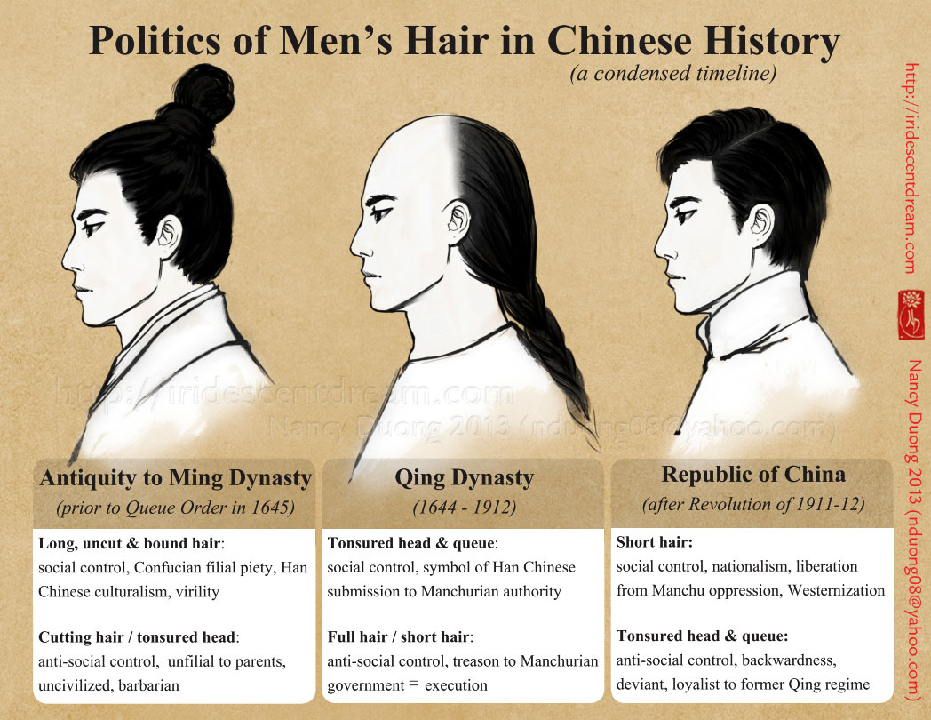

Slide 5
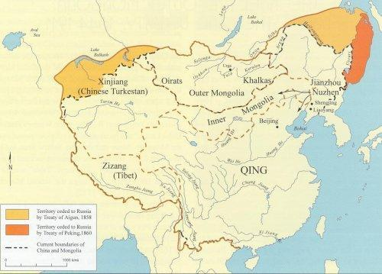
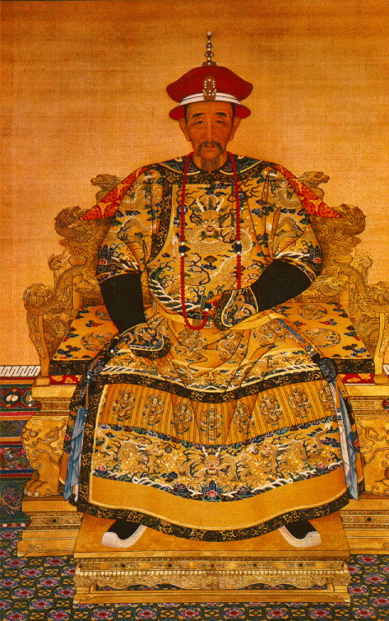
THE QING DYANSTY
Manchus (1644-1911)
Nomadic invaders
Originated in Manchuria
Last of the steppe invaders, dynasties
Overwhelmed Chinese forces
Proclaimed Qing dynasty
Originally pastoral nomads
Military force called banner armies
Captured Mongolia first, then China
Remained an isolated ethnic elite
Forbade intermarriage with Chinese
Forbade Chinese immigration to Manchuria, Mongolia
Permitted Confucian scholars to run government
Maintained Confucian system
Emperor Kangxi (1661-1722)
Confucian scholar; effective, enlightened ruler
Conquered Taiwan
Extended control to Central Asia, Tibet, Sinkjiang
Emperor Qianlong (1736-1795)
A sophisticated and learned ruler, poet, and artist
Vietnam, Burma, Nepal made vassal states of China
China was peaceful, prosperous, and powerful
Notes:
CHINA’S RULED BY FOREIGNERS AGAIN but this time it works better than the Mongols!
The Mongols had tried to impose their own methods of ruling – rule China in a “Mongol style”
The Manchus take the Chinese political system and adapt themselves into it – eventually people consider them legit
“Lose your hair or lose your head”
Kangzi & Qianlong
Like the Ming, a couple of rulers early-on who are successful at regaining socioeconomic security & control in China
Kangzi takes over at the tender age of seven – cultivates the supports of scholars, extends empire along the northern and western borders
Political structure:
Keep the Ming political system – stress their devotion to the principles of Confucianism – Kangxi studies Confucian classics and issues “sacred edicts” for the empire to follow
Manchu’s are legally distinct from the rest of China (2% of the top) – did not allow Chinese intermarriage, immigration to Manchuria/ Mongolia
Created banners (eight military units stationed throughout China in various locations) as a fighting force, way of maintaining power
BUT allow ethnic Chinese people into the imperial administration:
Diarchy – administrative positions are shared equally by Chinese & Manchu peoples (both in higher-up & regional governments) not perfect but works well

Slide 6
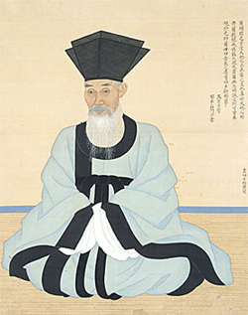
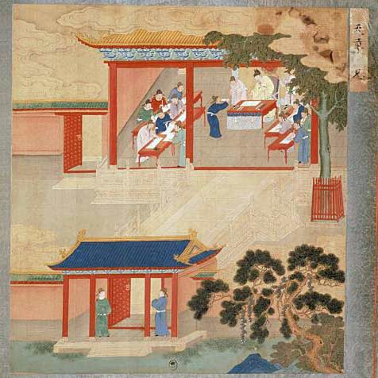
SON OF HEAVEN & SCHOLAR BUREAUCRATS
Ming, Qing reestablish Sui, Tang, Song system
Neo-Confucianism predominated
Not nearly as flexible or vibrant as the previous system
Emperor considered "the son of heaven"
Heavenly powers, maintained order on the earth
Privileged life, awesome authority, paramount power
Kowtow in his presence
Governance of the empire
Fell to civil servants, called scholar-bureaucrats
Schooled in Confucian texts, calligraphy
Had to pass rigorous examinations with strict quotas
Often used eunuchs when not opposed by Confucians
Often riddled with etiquette, proper form
Examination system and Chinese society
Civil service exam intensely competitive
Few chosen for government positions
Others could become local teachers or tutors
System was meritocracy
Ideal: best students running country
Wealthy families had advantages over poor families
Often the test was mere recitation, not original learning
Confucian curriculum fostered common values
Notes:
The kowtow causes drama when the Russian tsar comes to visit (hoping to trade fur between Siberia and Manchuria) and his envoys refuse to perform the kowtow --- traditionally, all people in his court, especially all foreign ambassadors, are supposed to do this

Slide 7
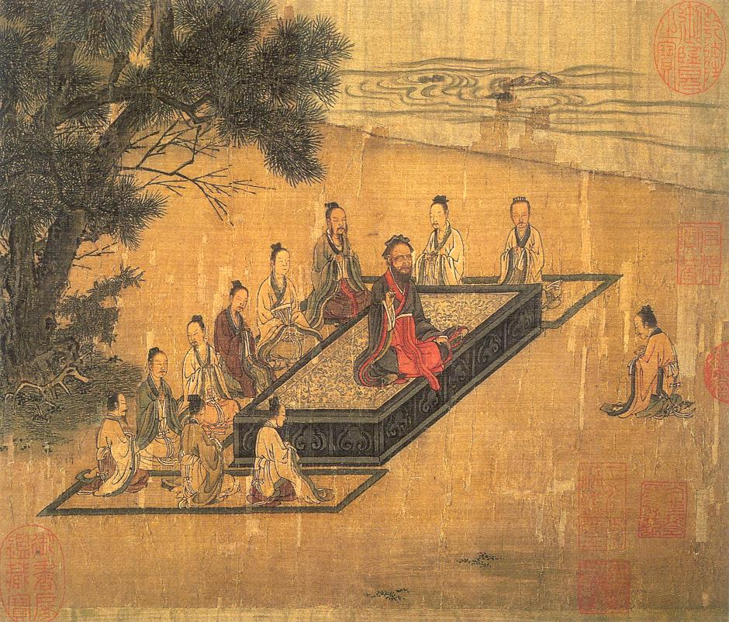
THE PATRIARCHAL SYSTEM
Ming restored social system; Qing maintained traditions
Basic unit of Chinese society
Remained the family
Highest value, filial piety
Family mirrored state-individual relations
Confucian duties of loyalty, reciprocity
Children to parents
Subjects to the emperor
Wife to husband (women to men)
Younger to elder
Important functions of clan, extended families
Justice, government administered through extended families
Reward, punishment effected all
Gender relations
Strict patriarchal control over all females
Parents preferred boys over girls
Marriage was to continue male line
Female infanticide; widows encouraged to commit suicide
Footbinding of young girls increased
Lowest status person in family was a young bride
Notes:
Ming China restore traditional patterns of the family, Qing maintain those traditions
Extended family plays a key role
Three to four generations under one roof – when a son marries, he and his wife come live in a new unit on the family home (if they have the money to do so)
Maybe only like 40% --- some families didn’t have enough land to support an extended household – there’s a theory here that the young would support the old as they age, and so on…
A labor-intensive economy based on the cultivation of rice – China needs large families to help with the harvest and provide security for older family members – it’s a source of a lot of employment, sometimes the source of government & justice (state-individual relations) – because there’s not a lot of outside economic opportunity besides this at times
Clans
Dozens to hundreds of joint/nuclear families linked by a clan council of elders – benefits
Can rent out lands to poorer families, richer fams can support poor – can sometimes provide educational support – not universal, maybe surviving from an earlier era of China
Gender
Emperor Kangzi’s Sacred Edict – the first two rules are filial piety and loyalty to the family – oldest male has the rule everyone gotta listen to
Arranged marriages are the norm – not romance-based, would actually go against the goal of benefiting the larger family unit – couple sometimes wouldn’t meet until the actual ceremony
Ostensibly the father is supposed to provide support for wife and children and treat people in his care w/ love and compassion – but like, privileges w/o following through responsibilities is a real thing
Males are preferred –- continues the patriarchal line (female infanticide – if the woman marries your family has to pay a dowry)
Women are “very secluded and virtuous, a very rare thing to see a woman in the cities and large towns unless she is an old crone” --- work rural era
Ideas that men are the only ones that can carry on sacred rituals, have talent to govern others --- widows often have all her relatives who push her to remarry so that they’d get all her property and the original dowry
No divorce rights or property rights
Sometimes took a role in the family (budget, educating children, Confucian schooling a little) – in novels, treated as maids/love objects – there’s an unfortunate trend of suicide among young brides and widows

Slide 8
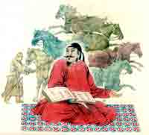
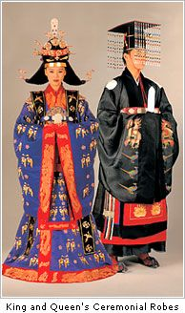
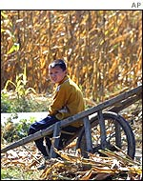
THE SOCIAL SYSTEM
Dynastic Family
Composed of emperor, family, wives, children, relatives
Lived in the Forbidden City; isolated lives of ease
Under the Qing, this group were Manchu, not Chinese
Privileged classes
Scholar-bureaucrats: passed the civil examinations
Landed gentry: inherited land, wealth, titles
Occupied highest government, intellectual positions
Directed local government, society
Generally became landed as soon as able
Included priests, monks of Confucians, Taoists, Buddhists
Peasants
Largest class
Esteemed by Confucius for their honest labor
Generally referred to as the mean people
Artisans, other skilled workers
Some economic status
Merchants
Often powerful and wealthy
Had little social status as they made wealth through money
Lower classes: slaves, servants, entertainers, prostitutes

Slide 9
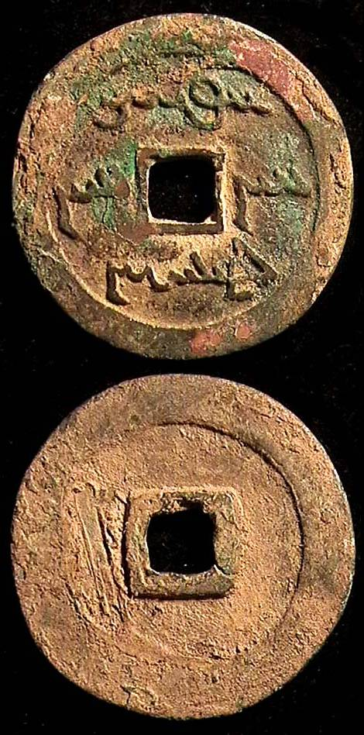
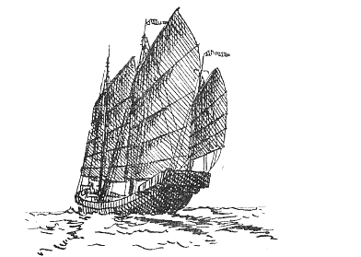
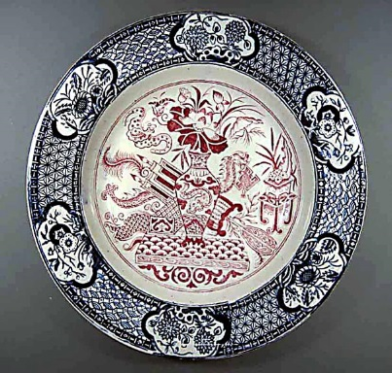
POPULATION GROWTH, ECONOMIC DEVELOPMENT
Intense garden-style agriculture fed a large population
Chinese began to expand to South, Yangtze valley, clear forested lands
American food crops in seventeenth century
Maize, sweet potatoes, peanuts grew on marginal soils, without much irrigation
Added to traditional foods: rich (South), wheat, millet, sorghum (north)
Available land reached maximum productivity by mid-17th century
Population growth: 80 million in 14th century to 300 million in 1800
Manufacturing and trade benefited from abundant, cheap labor
Exported large quantities of silk, porcelain, lacquer, and tea
Compensated for the exports by importing silver bullion
Internal Commerce and Foreign trade
Both expanded under Ming tremendously
Exported tea, lacquer, silk, porcelain
Imported gold, exotics, spices
Brought wealth to the dynasty, merchants
Threatened Confucian scholar-bureaucrats
Kangxi began policy of strict control on foreign contact
Western merchants restricted to ports of Macao and Quangzhou
Western merchants often had to act through Chinese intermediaries
Government and technology
China (along with much of Asia) was a labor intensive economy
Two types of systems possible: labor intensive or capital intensive
Europeans preferred capital intensive as it allowed better use of labor, was cheaper
Difference is capital intensive economies require machine, industrialization
Ming, Qing dynasties considered technological change disruptive
Abundant skilled labor, why not use it
Labor-saving technologies unnecessary as they put people out of work
Notes:
During the Ming & Qing, remains a predominantly agricultural society – 85% farmers – but economy changing & leading to rapid growth of a new industrial/commercial sector – starts growing under contact w/ outside world, and sometimes it makes China a little bit uncomfortable
Population growth from 80 million in 14th century to 300 million in 1800
Had remained between 50-100 mil for centuries, rising when times are good and falling when things are worse (foreign invasion/etc)
Reasons:
Relatively long period of peace under the early Qing
Intro of new crops from the Americas like peanuts, sweet potatoes, maize (not a lot of irrigation needed)
New faster growing rice from SE Asia
→ starts using up all the available land to grow crops → pressure on bad harvests/natural disasters, strain on resources, tension over rural hunger/poverty & if rich people are owning too much/all of the land (yes)
ALSO, a growth in manufacturing/commerce & trade with the “outside world”
Starts in the Ming dynasty – peace and prosperity → merchants and manufacturers start expanding their trade beyond the usual borders
Trade in silk, metal, wood, cotton, tobacco, cotton – starts expanding
Ming court stops banning it, and start trading w/ the rest of the world → trade surplus (more silver coming in than stuff going out) → causes economic problems and distortions
Restrictions on outsiders – can only trade through certain ports
Tension w/ British
Portuguese replaced by English by end of 17th century --- operating through East India Company, establish a trading post at Canton
Trade w/ China (silk, tea to England) – increased rapidly --- the Chinese give them exclusive rights to trade w/ West @ Canton, put them on an island outside the city where they can only stay….from October through March
British are cool w/ this for a while, but the balance of trade (where they send out silver) starts disquieting them, and they try to convince them to open trade (China says no) – Britain says China is an “old-crazy, first-rate man of war that had once merely awed its neighbors through her bulk and appearance,” but now has incompetent leaders who will “dash them to pieces on the shore.”
Damn, son
Tension within China – potential for economic change
Some historians have argued China was in the perfect position to transition fully from an agricultural economy to a manufacturing/commercial economy (which happens in Europe, through the Industrial Revolution)
But theyr’e a labor-intensive economy, not a capital-intensive economy – China is like, why not just use all the skilled laborer we have? Not really a point to creating a factory, puts people out of work
Merchant class less independent than Europe – control of the state
Political and economic resistance/tension against merchants (they don’t like them) – gotta get prestige from being a scholar-bureaucrat tho! -- the elites don’t like trade or the natural sciences, see it as a threat to their Confucian-y way of life

Slide 10
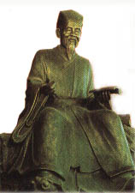
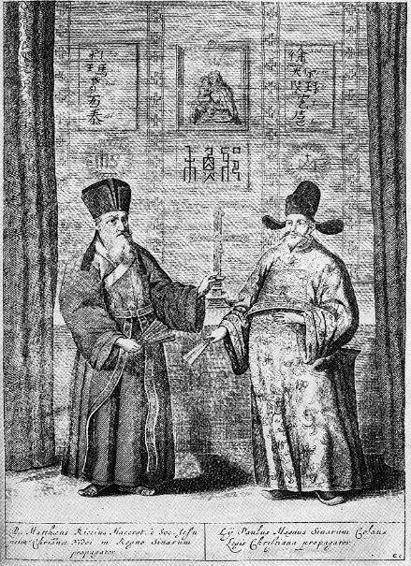
TRADITION & NEW CULTURAL INFLUENCES
Neo-Confucianism
Confucianism
Education, traditions supported by Min and Qing emperors
Hanlin Academy in Beijing, provincial schools
Prepared students for civil service exams
Blended with Buddhism, Daoism to produce a Chinese synthesis
Popular culture
Expanded to include novels, romances, travel adventures
Imperial cultural projects: encyclopedias and libraries
Christianity comes to China
Nestorian Christians not unknown in China, but had little influence
Portuguese brought Catholicism to China, courts
Matteo Ricci (1552-1610), an Italian Jesuit in the Ming court
A learned man who mastered written and oral Chinese
Impressed Chinese with European science and mathematics
Popular mechanical devices: glass prisms, harpsichords, clocks
Confucianism and Christianity
Jesuits respectful of Chinese tradition, but won few converts
Chinese had problems with exclusivity of Christianity
Franciscan, Dominican missionaries criticized Jesuits' tolerance
When pope upheld critics, Emperor Kangxi denounced Christianity
Jesuits
An important bridge between Chinese and western cultures
Introducing each to the achievements of the other
Notes:
At the root of a whole bunch of the tension here is this idea of Neo-Confucianism
“investigation of things” early on, but now very focused as it gets passed on, on the elucidation of moral principles, not science --- instead, scholars look at antiquity to understand the world, moral and belief
Continuity > change
Tension visible in the introduction to Christianity that China experiences
Portuguese visit China early on,
Kangxi is interested in the Christians, missionaries become influential, there are Christians in the court
But the Jesuits are cool w/ allowing local beliefs and practices to facilitate conversion (ancestor veneration = civil ceremonies and Christians could still do them)
The Franciscans and Domincans complain to the pope, who gets made and says all missionaries/converts have to do it by the official book back in Europe – so Kangxi denounces Christianity
Jesuits help introduce China and Europe to the achievements of each other
Mateo Ricci’s clocks – a Jesuit priest who brings evidence of science and mathematics – advanced European clocks driven by weights and springs
Emperor is fascinated, but the population at large doesn’t adopt the invention – they’re treated as a novelty at court
Playthings “will be received here with much greater interest than scientific instruments”

Slide 11
Some important dates for you ☺
AP Practice Exams
April 9 & April 16 (both Saturday)
12 pm – 3:30 pm
Lecture Hall
After-School Study Sessions
Monday – Thursday PM
4:15

Slide 12

MR. STORCK FINISHED GRADING DBQS

Slide 13
Grading Scale
0 pts = 50
1 pt = 57
2 pts = 62
3 pts = 67
4 pts = 72
5 pts = 77
6 pts = 82
7 pts = 87
8 pts = 92
9 pts = 97

Slide 14
Takeaways from DBQs
The average grade across all classes: 5.2105
Most commonly missed points:
Thesis (3+ sentences, specifying social AND economic effects)
Point of View (why/how author’s perspective affects the silver trade)
Calls for Additional Docs (1 per bucket)
Make sure you try to use all docs
Supporting thesis with evidence:
explain how docs prove social or economic effects
Sometimes just restating what the doc says – that only gets you point for “understanding basic meaning”
What to do if you run out of time

Slide 15

Reassessments
Rewrite a new version of the essay – keep what you had on the old version
Highlight additional changes (I won’t take it if you don’t do this)
Read any comments I made on your paper – ask me if you have Qs

Slide 16
EAST & SOUTHEAST ASIA 1450 – 1750
Tokugawa Japan
& Southeast Asia

Slide 17
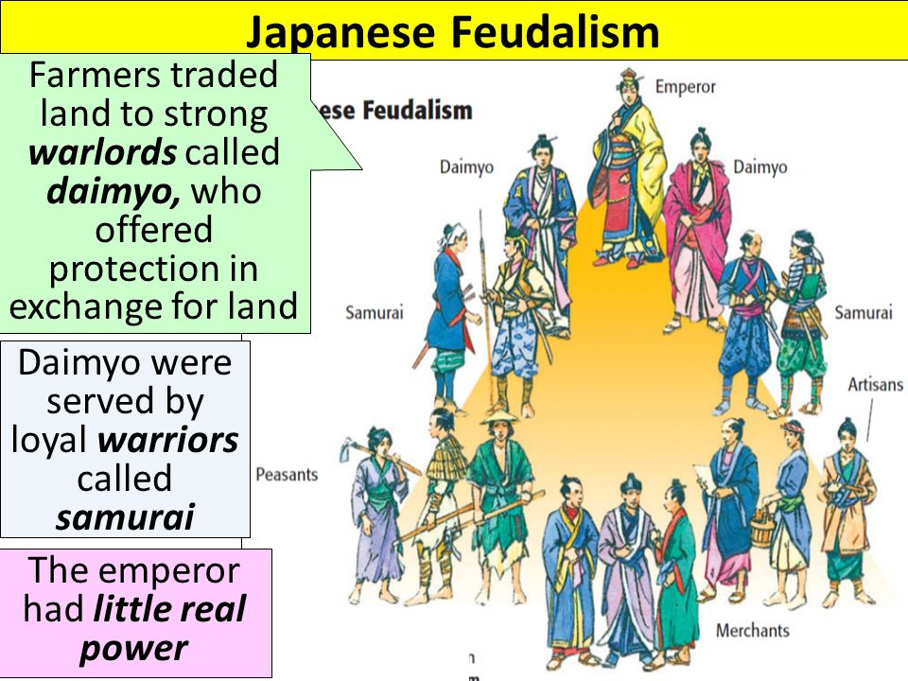

Slide 18
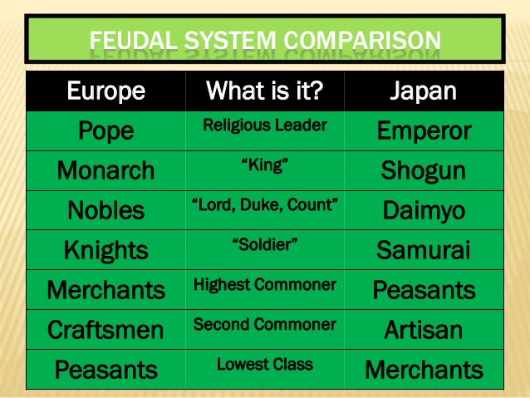

Slide 19
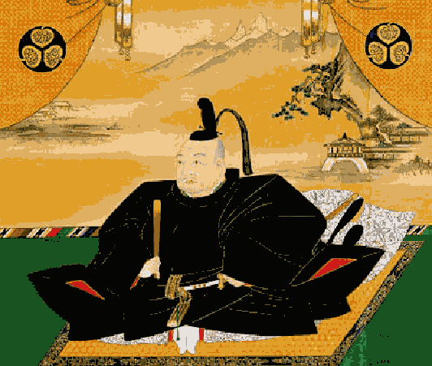
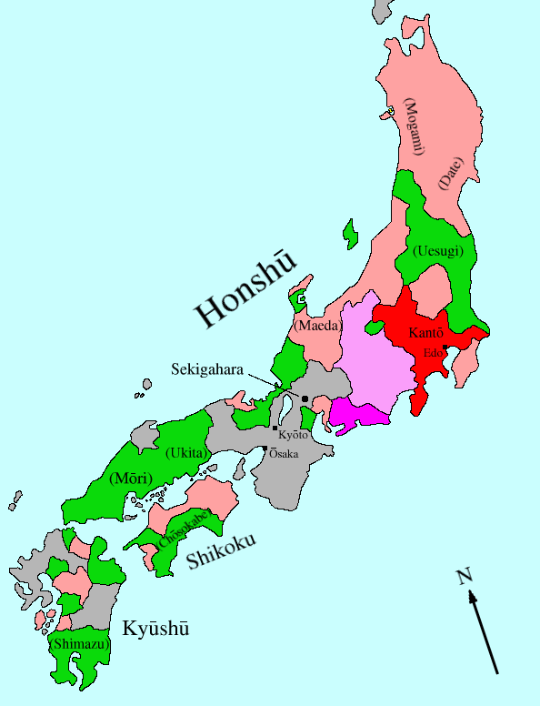
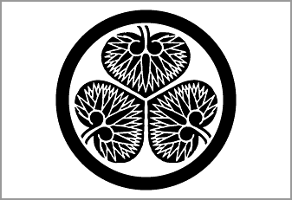
TOKUGAWA SHOGUNATE IN JAPAN TO 1867
The Warring States Period
15th century: Japanese civil war breaks out
Japan divided into warring feudal estates
Various daimyo begin to enact own laws
Europeans arrive 1543, give guns to Southern daimyo
Last Ashikaga Shogun lost control, eliminated in 1573
Nobunaga, Hideyoshi attempt to unite Japan
Nobunaga
Innovative, brilliant general, merciless, from a minor family
Deposed Ashikaga shogun, tries to conquer Japan
Assassinated by vassal general
Toyotomi Hideyoshi
Ablest general to Nobunaga but son of a peasant
Wanted to break hold of daimyo, samurai
Unites Japan temporarily 1590
Invades Korea; threatens to invade China, Philippines
Tokugawa Ieyasu
General to Hideyoshi, from a minor family
Conquered Kanto, richest part of Japan
Ended Korean campaign, concentrates on ruling Japan
Wins civil war, establishes shogunate in 1603
Moves capital to Edo (Tokyo), reestablishes stability
First need to control the daimyo, powerful local lords
Each daimyo absolute lord within his domain
Tokugawa required daimyo to live alternative years at Edo
Bakufu controlled daimyo marriages, travel, expenditures
Daimyo allowed to rule lands, paid tax to the shogun
Notes:
There’s been a traditional system in Japan, and there’s a turning point where the traditional government, the Ashikaga Shogunate, falls apart – after previous attempts under rulers like Prince Shotoku to unify Japan
(a good cutting off point – there’s reasons for why this is a break from Japan traditions)
Period of Warring States in the 15th century
Daimyos (local leaders) and people below with very loose allleigance to him – not a lot of central authority
Daimyos enacting their own laws, Europeans give guns to the southern daimyo, so now they’re just fighting – but with guns
But, it’s about to unify – a lot!
The Three Great Unifiers
Oda Nobunaga – late 1500s – seizes the capital of Kyoto
From a minor family, kind of an obscure one right next to Kyoto
Attempts to consolidate his rule by defeating his rivals and conquering Japan
It works! Until he dies
Totoyomi Hideyoshi
Farmer’s son who’s worked his way up through the ranks to become a military commander – next best general to succeeed Nobunaga – temporarily unites Japan in 1590, gets all the local daimyo to listen to him, creates a national currency, invades Korea
He’s like someone naming himself “Donald Goodpresident”
But it’s still very local – the daimyo just swear allegiance to him and go on “sword hunts” to disarm the population
Tokugawa Ieyasu – moves in to fill the vacuum, and he’s the guy who sticks
Moves out of Korea, a general to Hideyoshi, focuses on ruling Japan
Moves capital to Edo (Tokyo) and restablishes stability, reclaims the title of shogun for the first of these three guys
Peace for like 300+ years, until the mid-1800s
Priority one – gotta control the local lords – the daimyo have a lot of local power
Ostensibly autonomous, allowed to collect their own taxes
BUT -- Tokugawa’s like, cool – you gotta keep two houses, one in your local domain and one at Edo – which gets expense!

Slide 20
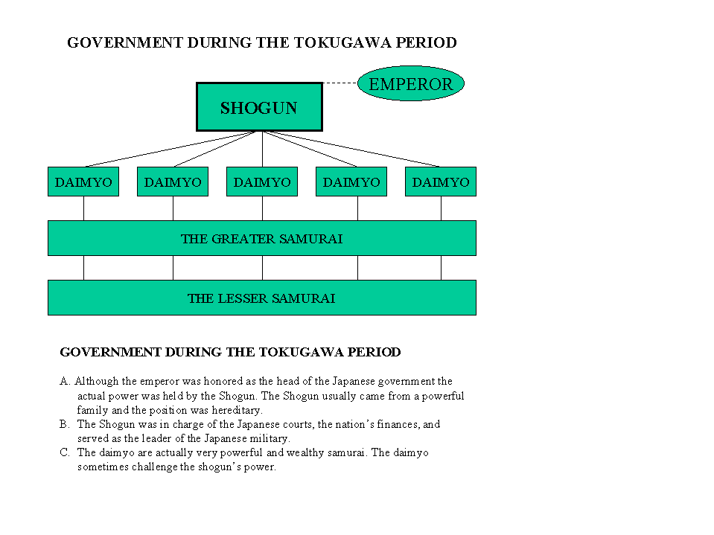
TOKUGAWA GOVERNMENT
Emperor was honored as the head of state
Actual power was held by the shogun
Japan was an example of a centralized feudal state
The title of shogun was hereditary within the Tokugawa family
Shogun was in charge of courts, finance, appointed all officials
Shogun was head of the army; made all grants of land to daimyo
Daimyo were land holding samurai
Some were powerful enough to challenge the Shogun
The daimyo managed their domains or feudal possessions
Greater samurai owned land but not much; lesser samurai were warriors
Notes:
Previously, the samurai were retainers to the daimyo – over time the Tokugawa tinker with this, make them salaried (to make it a less personal and more business-y relationship) – later they kinda stop being a warrior class, have to live in castle towns

Slide 21
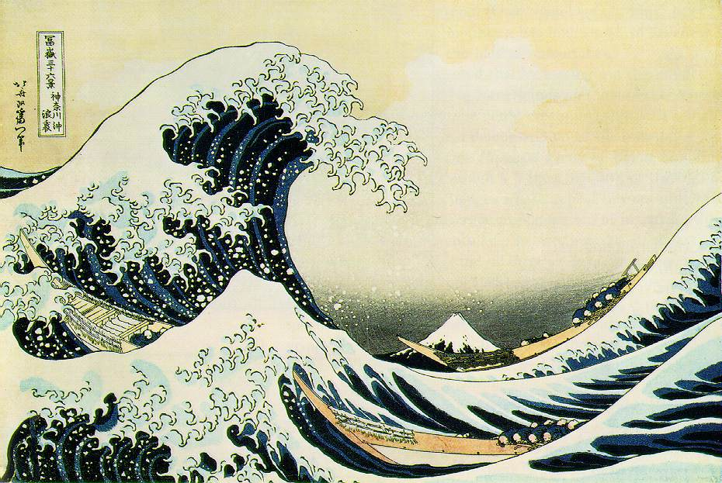
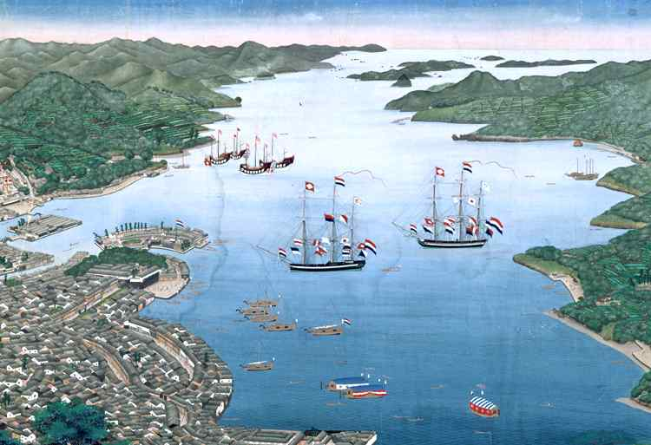
SELF-IMPOSED ISOLATION
The European Threat
European contacts introduced clocks, guns, printing press
Japanese learned to make guns, used them to unify Japan
Guns threatened the social order: peasants could fire one, no art!
New Ideas: Christianity
Successful in converting much of Kyushu
Christianity threatened social order
Difficult to unify Japan, control new contacts
Control of foreign contacts
Control Catholics
Hideyoshi ordered missionaries to leave
Not enforced closely at first
Active persecutions began
Tokugawa order Japanese to renounce faith
Many thousands crucified for refusing
Control Contacts
Tokugawa banned Japanese from foreign contacts, travel/trade abroad
Shoguns adopted policy of isolation
Japan closed to outsiders 163s until 1854
Foreign trade was under tight restriction
One Dutch ship a year allowed to come to Nagasaki
Despite policy, Japan was never completely isolated
Notes:
While all of this is unification is going down, the Europeans show up – oops
Portuguese might have been blown off course to get there? But by the mid 1500s, they’re stopping at a regular basis to trade between Japan, China, Southeast Asia
Welcomed at first – leaders are a little ambivalent
Traders/merchants super cool w/ expanding trade, when Ming dynasty tries to ban trade in the 1530s, Japanese merchants turn to piracy, because, y’know, the $$$ (Japan and China leaders are like, noooo)
Europeans show up @ court bringing goods – clocks, guns, printing press, etc
At first, they purchase guns, then learn how to make them – useful by Hideyoshi/etc. to help unify Japan
Borrow ideas of castles → castle towns
Also, new ideas in the form of Christianity!
Missionaries come with too! – Francis Xavier is really bad at translating so he messes up some sacred concepts – but start converting thousands of Japanese in the southern islands, Kyushu, etc.
This freaks out the social order --- Pope claims loyalty of the Japanese Christians, and Europeans have a way of messing with yr business, so, what do….
SOLUTION ONE – try to control the Catholics
Kick out the missionaries – doesn’t work
More active banning/persecution – Hideyoshi declares Japan as “the land of the gosd” – it’s “sacriligeous” (and to be fair the Christians were destroying Shinto shrines)
Merchants are allowed – but the missionaries protest, Franciscans don’t want to listen → orders eviction of all missionaries, persecution/crucifixion, bloody revolts suppressed
SOLUTION 2
→ Well, let’s ban trade/contact, or at least strictly limit it
Close major foreign factories, close all the trading ports, ban Japanese from foreign contacts and trade
EXCEPT FOR one Dutch community, that can bring one ship a year, and hang out for a few months

Slide 22
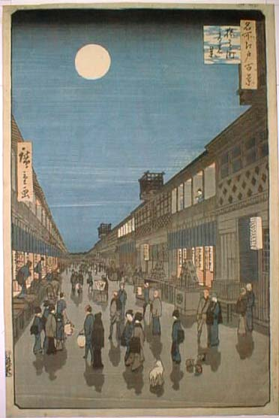
ECONOMIC, SOCIAL CHANGE
Population growth and urbanization
Agricultural production
Doubled between 1600 and 1700
Annual production of rice was 25 million koku
One koku is around 5 bushels
American foods were not introduced into Japan
Population rose by 1/3 from 1600 to 1700
Expansion of cities
Castle-Towns expanded: became cities
Edo developed commerce, industry to support shogunate
Hokkaido Island
Hokkaido had been settled by Ainu (Caucasians) prior to Japanese
Japanese pushed further north on island, settlers from Honshu arrived
Economic and Commercial Changes
Japanese begin to develop inter-coastal shipping
Construction of well maintained national roads, bridges
Crafts included carpentry, stonemasonry, sake-brewing, lacquering
Japan traded sporadically with China, got American silver from China
Notes:
Long period of peace under the Tokugawa shogunate → movement towards capitalism, rise in commerce and manufacturing
Agriculture expands (doubles) → new technology and more land to grow crops on → increased standard of living, population increase

Slide 23
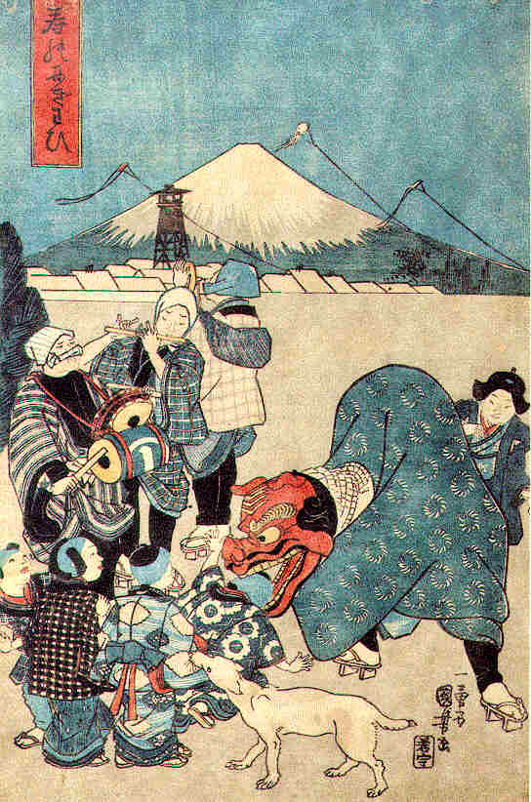
JAPANESE SOCIAL CLASSES
Strict 4-class system existed under Tokugawa
Samurai at the top of social hierarchy
Followed by peasants, artisans, merchants.
Members of classes not allowed to change social status
Others: priests, entertainers
Outcasts (eta): professions considered impure were 5th class
Shoguns enacted laws governing hair style, dress, accessories
Social change from 17th to 19th century
Peace undermined social, economic role of warrior elites
Shogun put samurai on regular salary: one koku per warrior
Koku was the rice ration needed to sustain one man for one year
Provinces ranked by koku produced yearly given only to most loyal retainers
Samurai began to move into castle-towns, which lowered their social status
Became increasingly in debt as forced to maintain an expensive life style
Rise of the Chonin: Merchants
Cities became more numerous, populous giving rise to merchants
Lowest ranked people in society; they profited from what other people produced
Over time they were to become very wealthy and powerful
Farmers
Law outlined the duties and conduct of the farmers
Reinforced by degree that peasants could not own weapons
With passage of time, class distinctions blurred
Peasants moved to towns, samurai moved to towns
Samurai became merchants
Merchants became landowners, intermarried with samurai

Slide 24
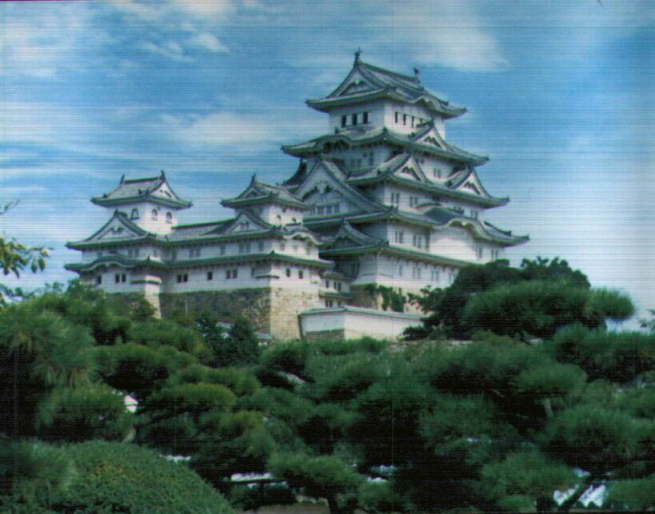
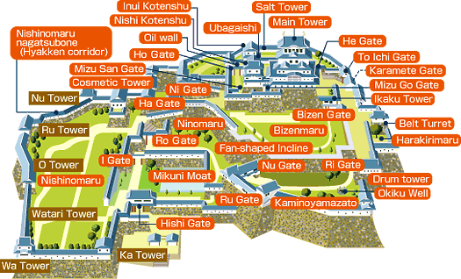
CASTLE TOWNS

Slide 25
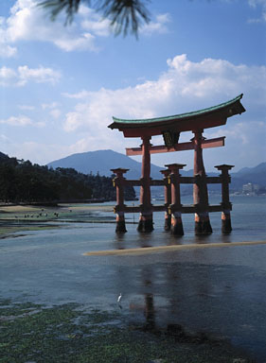
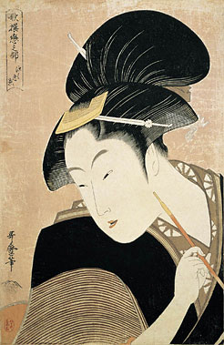
NEO-CONFUCIANISM & JAPANESE CULTURE
Neo-Confucianism (loyalty, submission)
Became the official ideology of the Tokugawa
But borrowing from Chinese culture avoided
School of National Learning
Scholars of "native learning“ replace Confucian teaching
Tried to establish distinctive Japanese identity
Shinto emphasized
Japanese Buddhism
Each variety developed its own distinctive Japanese version
Chan Buddhism became Zen Buddhism
Zen was the most popular with samurai
Outside Learning
Tokugawa used outside learning if they controlled, regulated it
Introduced printing press to Japan
Dutch Learning
Japanese scholars permitted to learn Dutch
After 1720 some Japanese permitted to read Dutch books
Shoguns became proponents of Dutch learning by mid-18th century
European art, medicine, and science influenced Japanese scholars
"Floating worlds"-- centers of urban culture
Included teahouses, theaters, brothels, public baths
Poet, novelists, art encourage
Kabuki theaters and bunraku (puppet) very popular
Development of tea ceremony, martial arts
Ukiyoe school of art depicted every day life

Slide 26
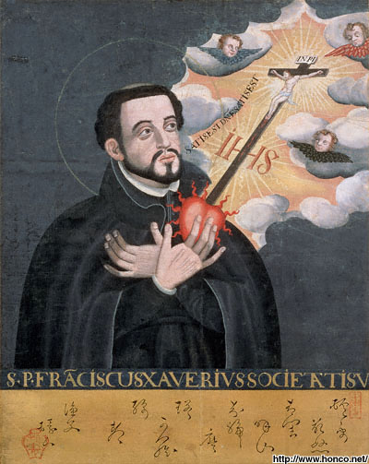
CHRISTIANITY AND JAPAN
Christian missionaries
Dominicans, Franciscans arrived with the Portuguese
Jesuits came later
Had significant success in sixteenth century with samurai, daimyo
Adopted Japanese style wording, dress, manner including speaking Japanese
St. Francis Xavier visited Japan
Estimated that much of Kyushu including daimyo converted
The Influence of Will Adams
An Englishmen who was shipwrecked in Japan with a Dutch trade mission
Extremely gifted linguist who became friend, advisor to Tokugawa; became a samurai
Adams was Protestant and hated Catholics; was very honest about facts with Tokugawa
The real man behind Clavel’s great piece of fiction, Shogun
Heavily influenced how Tokugawa came to see Catholics
Anti-Christian campaign
Launched by Tokugawa shoguns
Feared anything that might help daimyos, weaken shogun
Many daimyo were in contact with Europeans for weapons
Buddhists and Confucians resented Christian exclusivity
After 1612, Christians banned from islands
Tokugawa Ieyasu told Catholics to renounce faith
Many did, many more were crucified
Thousands went underground only to reappear in 1854

Slide 27
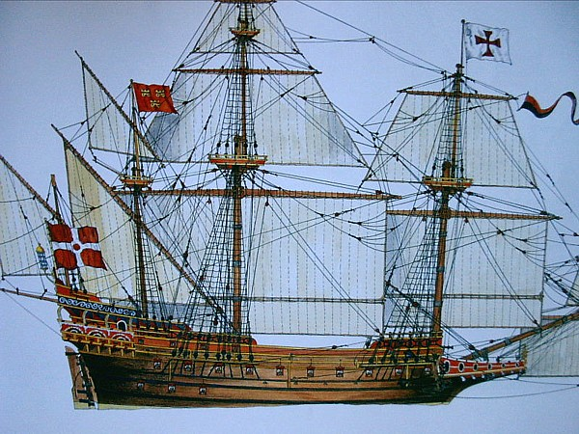
SOUTHEAST ASIA
The Asian Sea Trading Network c. 1500
Characteristics
Area divided into three zones dictated by monsoonal wind patterns
West Indian Ocean between SW Asia, Africa, and Western India controlled by Arabs, Swahili
East Indian Ocean zone between Eastern India, Indonesia controlled by Indians
East Asian zone from SE Asia to China controlled by Chinese
Merchants from Muslim, Indian, Chinese worlds met at exchange points
Two types of trade: interregional (luxuries), intraregional (staples)
Two types of commodities: luxury (highest profit margin), staple (rice, wood used as ballast)
Government: suppressed piracy but no central control
Observed rules, stability, trade peacefully; no military
Arrival of the Europeans
Portuguese arrive in India
Unprepared to abide by common rules, traditions
Aside from gold, silver, Portugal had little to trade
Portuguese were mercantilists: I want it all
Establish trade network in Indian Ocean
Destroyed, pillaged more than traded
Learned could make more profit in trade
Do not control whole area
Tried to monopolize all luxuries trade, control all trade
Controlled choke points: Goa, Macao, Malucca, Mombasa, Hormuz
Each was a fortified port with factories, church, warehouses
Men intermarried with locals, raised mixed families who came to join trade
Tended to war on other states

Slide 28
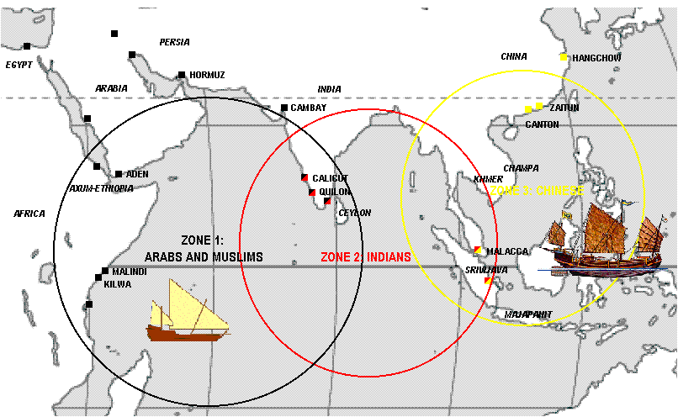
INDIAN OCEAN TRADE NETWORK
CLOTH
YARN
SILKS
INDIGO
PEPPER
GEMS
ANIMALS
DRUGS
SILVER
LACQUER
SILK
PORCELAIN
SUGAR
LUXERIES
TEA
COFFEE
SLAVES
IVORY
HORSES
SILKS
GOLD
STEEL
SPICES
TIMBER
RICE
MEDICINES

Slide 29
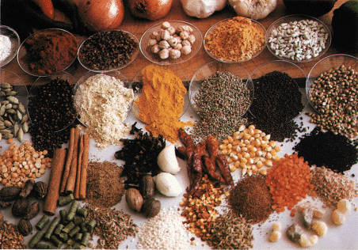
EUROPEANS, ASIAN CHANGE OVER TIME
Portugal had liabilities
Too small of a nation, too little population: could not control whole region
Asian resistance, poor discipline, shipping loses, corruption hurt
In 1590, Portugal inherited by Spanish king; Portuguese interests ignored
Spanish enemies: Dutch, English begin to raid Portuguese territories
Dutch establish their own Indian Ocean trading empire
Captured Malacca, came to control East Indies (Indonesia)
Followed Portuguese model of port, fort, factory
Systematized monopoly, built, used better, more ships in trade
Decided to monopolize the spice trade
Established plantations, transplanted crops: spices, coffee
Biggest change was to work with Asians, cooperate in system
Decided to monopolize transshipping trade between ports
As middlemen would buy in one area, sell in another
English lose battle for spice to Dutch, concentrate on India
Established trading stations throughout country
Made alliances with local princes against Mughals, Portuguese
Concentrated on controlling cloth industry
Going Ashore
Europeans could not fight, control large land masses: learned their lesson, their places
Concentrated on controlling islands where their naval advantage helped
Dutch conquered Ceylon, Java, East Indies
Spanish conquered Philippine Islands
Set up tribute systems for the local populations: taxes paid in produce produced under forced labor conditions
Content to let Asians retain old systems, traditions provided tribute paid
Spreading the Faith
Portuguese, Spanish introduced Catholicism, missionaries: Dutch, English could have cared less
Problem: Christian equality conflicted with class, rank, traditions: made little initial impression
Greatest success was on Philippines where most people converted, even if they retained some traditions

Slide 30
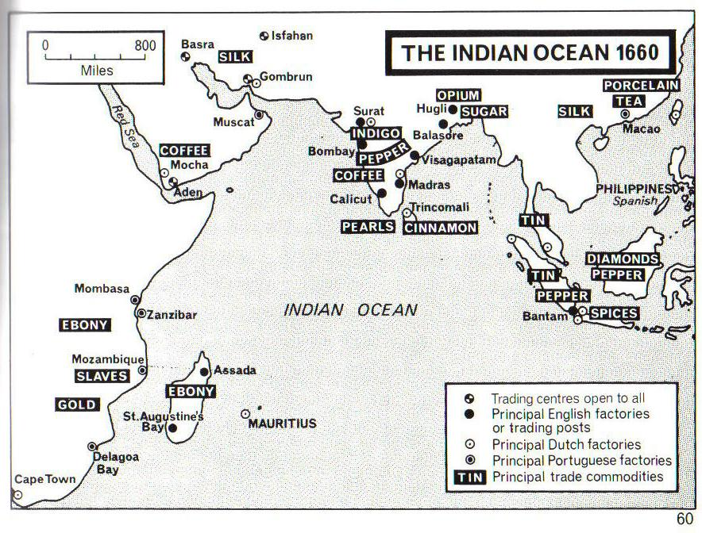
INDIAN OCEAN c. 1650 C.E.

Slide 31
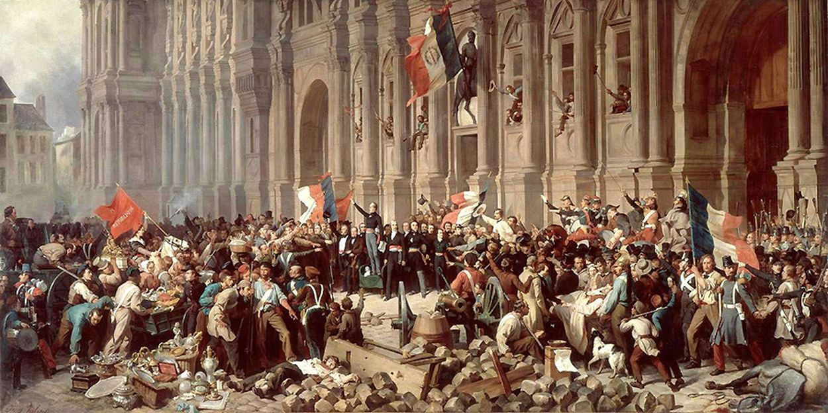
Political Revolutions Reading Guide
Minor Assessment due Friday 4/22 (A) & Monday 4/23 (B)
Quiz
Ming/Qing China, Tokugawa Japan, SE Asia
1st, A3, 5th: Wednesday 4/20 B3, B4: Thursday 4/21

