Slide 1
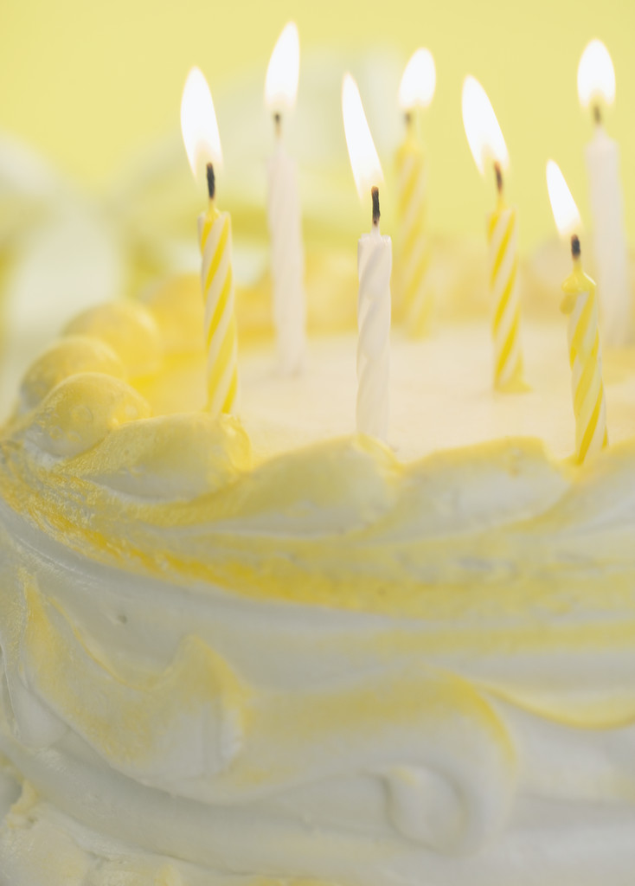
Chapter 23 Cakes, Cookies, Pies, and Candies

Slide 2
Objectives
Describe the functions of basic ingredients used in cakes.
Identify six types of cookies.
Explain principles of pastry preparation.
Compare characteristics of crystalline and noncrystalline candies.
Prepare cakes, cookies, pies, and candies.

Slide 3
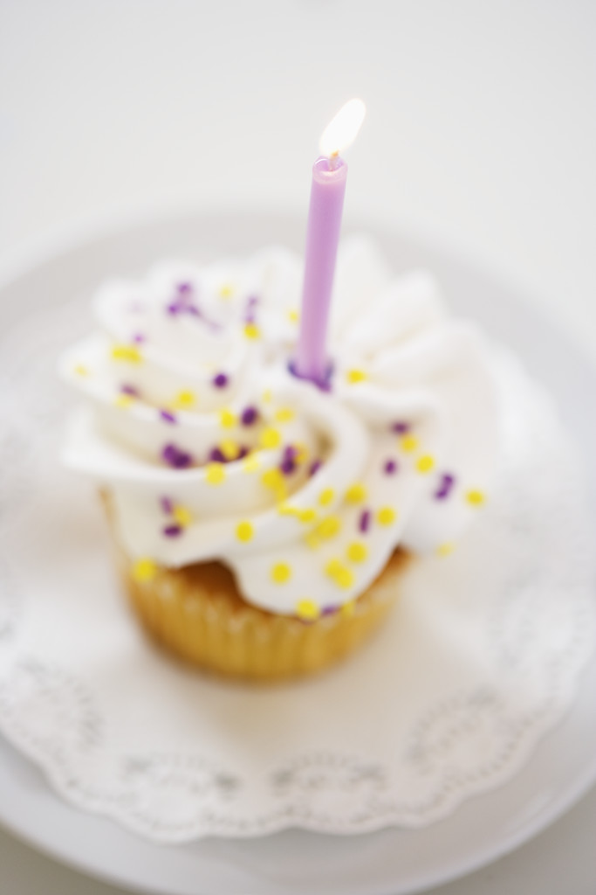
Cakes, Cookies, Pies, and Candies
Cakes, cookies, and pies are three of the most popular desserts. Candies are really not desserts. Most desserts are high in calories because they contain large amounts of sugar and fat. Desserts should never replace grain foods, fruits, vegetables, milk products, or protein foods in the diet.

Slide 4
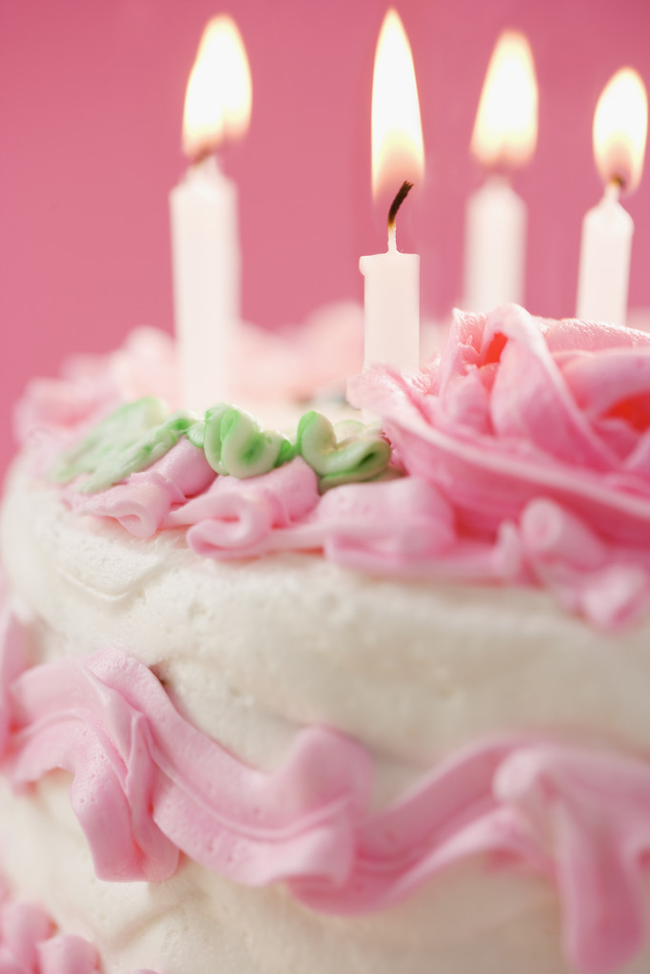
Kinds of cakes-
Cakes are classified into two groups: shortened and unshortened. Shortened cakes contain fat. This is why people call shortened cakes butter cakes. Most shortened cakes contain leavening agents, and are tender, moist, and velvety.

Slide 5
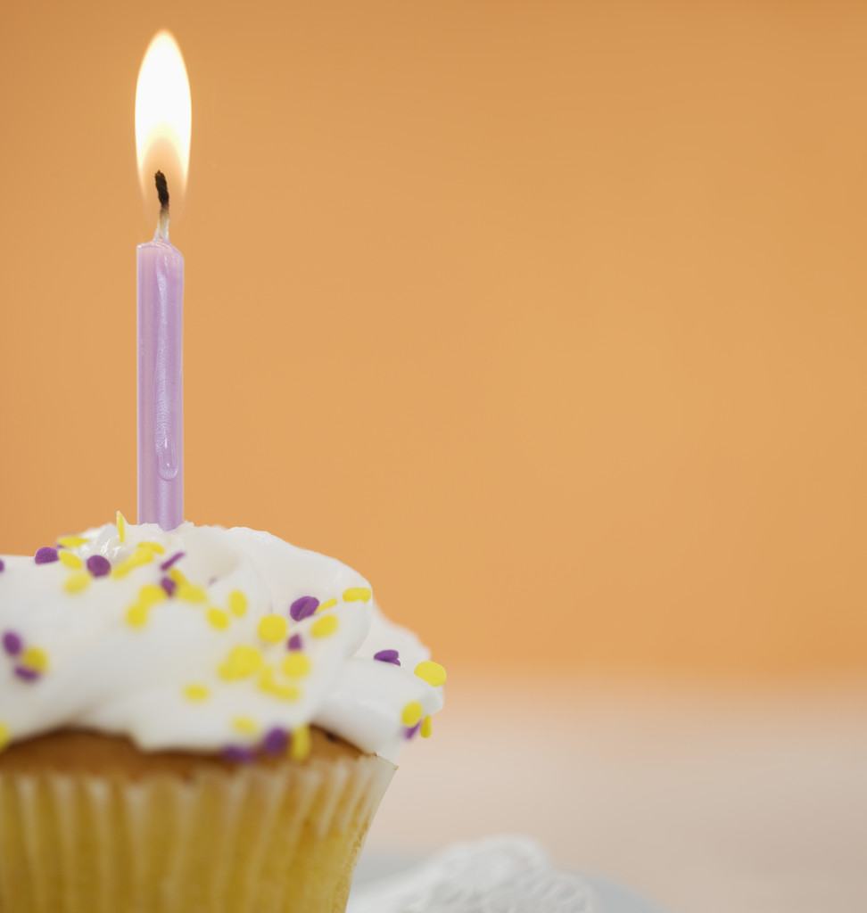
Unshortened cakes, sometimes called foam cakes, contain no fat. They are leavened by air and steam rather than chemical leavening agents. Angel food and sponge cakes are unshortened cakes. The main difference between these two cakes is the egg content. Angel food cakes contain just egg whites. Sponge cakes contain whole eggs. Unshortened cakes are light and fluffy.
Chiffon cakes are a cross between shortened and unshortened cakes. They contain fat like shortened cakes and beaten egg whites like unshortened cakes. They have large volumes, but they are not as light as unshortened cakes.

Slide 6
Cake Ingredients-
Cakes contain flour, sugar, eggs, liquid, and salt. All shortened cakes also contain fat, and most cakes contain a leavening agent. Unshortened cakes contain cream of tartar, too.
Flour gives structure to a cake. You can make cakes with cake flour or all-purpose flour. Cakes made with cake flour are more delicate and tender.

Slide 7
Sugar gives sweetness to cakes. It also tenderizes the gluten and improves the texture of cakes.
Eggs improve both the flavor and color of cakes. The coagulated egg proteins also add structure to cakes. In angel food and sponge cakes, eggs are important for leavening. Eggs hold the air that is beaten into them.
Liquid provides moisture and helps blend ingredients.
Salt provides flavoring.

Slide 8
Fat tenderizes the gluten. Examples of fat are butter, margarine, hydrogenated vegetable shortening, or oil.
Leavening agents are added to most shortened cakes to make the cakes rise and become porous and light. Examples are baking powder or baking soda and sour milk.

Slide 9
Cream of Tartar is an acid that makes egg whites whiter and makes the cake grain finer. Angel food and sponge cake recipes call for this.
Flavorings are not essential ingredients in cakes, but they help make cakes special. You can add spices, extracts, fruits, nuts, poppy seeds, and coconut to cake batters

Slide 10
Food Science Principles of Preparing Cakes
Successfully preparing a cake depends on measuring, mixing, and baking. You must measure ingredients accurately and mix them correctly. You must bake the cake batter in the correct pan at the correct temperature. You also need to watch baking time carefully.

Slide 11
Measuring Ingredients-
Flour, fat, sugar, liquid, and eggs affect the development of gluten. A cake made with too much flour is compact and dry. A cake made with too little flour is coarse, and it may fall.
Optimum amounts of fat and sugar tenderize gluten. Too much fat or sugar over tenderizes the gluten and weakens it. A cake made with too much of either ingredient will be heavy and coarse, and it may fall. A cake made with too little of either ingredient will be tough.

Slide 12
The optimum amount of liquid provides the moisture needed for gluten to develop. Too much liquid will make a cake soggy and heavy. Too little liquid will make a cake dry and heavy.
The optimum number of eggs contributes proteins that strengthen the gluten framework. Too many eggs will make a cake rubbery and tough.

Slide 13
Mixing Cakes-
The correct proportions of ingredients must be mixed according to the method specified in the recipe. Cake batters should be neither overmixed nor under- mixed. Overmixing will cause the gluten to overdevelop… causing the cake to be tough.

Slide 14
Baking Cakes-
Bake cake batter in pans that are neither too large nor too small. If the pans are too small, the batter will overflow. If the pans are too large, the cake will be too flat and may be dry. The correct pan size will produce a cake with a gently rounded top.
You should grease the pans for most shortened cakes and flour them lightly. You should not grease the pans for un-shortened cakes. This is because angel food and sponge cake batters must cling to the sides of the pan during baking.
Place cakes in a preheated oven set at the correct temperature and bake them just until they test done.

Slide 15
Preparing a Shortened Cake
You can mix shortened cakes by the conventional method or the quick mix method.
Conventional method – Cream the fat and sugar together until light and fluffy. Beat the eggs into the creamed fat and sugar. Then add the dry ingredients alternately with the liquid.
Quick mix method – Also called the one-bowl method, takes less time than the conventional method. Measure the dry ingredients into the mixing bowl. Beat the fat and part of the liquid with the dry ingredients. Add the remaining liquid and unbeaten eggs last.

Slide 16
Arrange the pans in the oven so the heat circulates freely around the cake. The pans should not touch each other or any part of the oven. If they do, hot spots may form, and the cake may bake unevenly.
To test a cake for doneness, lightly touch the center with your fingertip. If the cake springs back, it is baked. You can also insert a toothpick into the center of the cake. If the toothpick comes out clean, the cake is baked.

Slide 17
Most recipes will tell you to let cakes cool in the pans for about 10 minutes after removing the pans from the oven. This cooling period makes it easier to remove the cakes from the pans. To remove a cake from the pan, run the tip of a spatula around the sides of the cake to loosen it. Invert a cooling rack over the top of the pan and gently flip the cooling rack and the pan. The cake should slide out of the pan. Let the cake layers cool thoroughly before frosting them.

Slide 18
Characteristics of a Shortened Cake-
A high-quality shortened cake is velvety and light. The interior has small, fine cells with thin walls. The crusts are thin and evenly browned. The top crust is smooth or slightly pebbly and gently rounded. The flavor is mild and pleasing.

Slide 19
Pound Cakes-
Pound cakes are shortened cakes that contain no chemical leavening agents. Pound cakes rely on air and steam for leavening. You must thoroughly cream the fat and sugar when making pound cake. Beat the eggs into the creamed mixture. Add the dry ingredients and the liquid to the creamed mixture. Pound cakes are more compact than other shortened cakes, and they have a closer grain.

Slide 20
Preparing an Unshortened Cake
Angel food cake is the most frequently prepared unshortened cake. When preparing an angel food cake, the ingredients should be at room temperature. Egg whites that are cold will not achieve maximum volume when beaten.
For an angel food cake, beat the egg whites with some of the sugar until stiff. Carefully fold the flour and remaining sugar into the beaten egg whites.

Slide 21
Carefully pour the batter for an unshortened cake into an ungreased tube pan. Run a spatula through the batter to release large air bubbles and seal the batter against the sides of the pan. Bake the cake in a preheated oven for the recommended time. Test the cake for doneness by gently touching the cracks. They should feel dry and no imprint should remain.
When you remove an unshortened cake from the oven, immediately suspend the pan upside down over the neck of a bottle. Hanging the cake upside down prevents a loss of volume during cooling. Cool the cake completely before removing it from the pan.

Slide 22
Characteristics of an Unshortened Cake-
A high-quality angel food cake has a large volume. The interior is spongy and porous and has thin cell walls. The cake is tender and moist, but it is not gummy.

Slide 23
Sponge Cakes-
Sponge cakes contain whole eggs rather than just egg whites. To make a sponge cake – beat the egg yolks until they are thick and lemon colored. Add the liquid, sugar, and salt to the yolks. Continue beating until the mixture is thick. Gently fold the flour into the yolk mixture. Then fold the stiffly beaten egg whites into the flour-yolk mixture.

Slide 24
Preparing a Chiffon Cake
Mix a chiffon cake by combining the egg yolks, oil, liquid, and flavoring with the dry ingredients. Beat the mixture until smooth. Beat the egg whites with the sugar and cream of tartar. Then fold the egg white mixture into the other mixture.
Characteristics of a Chiffon Cake-
A high-quality chiffon cake has a large volume, although not quite as large as that of an angel food cake. The interior is moist and has cells with thin walls. The cake is tender and has a pleasing flavor.

Slide 25
Filling and Frosting Cakes
Fluffy whipped cream, creamy puddings, and sweet fruits are among the popular fillings for cakes.
Canned frostings and frosting mixes are available, but you can easily make frostings from scratch. Frostings may be cooked or uncooked. Cooked frostings use the principles of candy making. They include ingredients that interfere with the formation of crystals in a heated sugar syrup. Then you beat them until fluffy.

Slide 26
Uncooked frostings are popular for their creamy texture. They are easily made by beating the ingredients together until they reach a smooth, spreadable consistency.
Cream cheese frosting and butter cream are well-liked uncooked frostings.

Slide 27
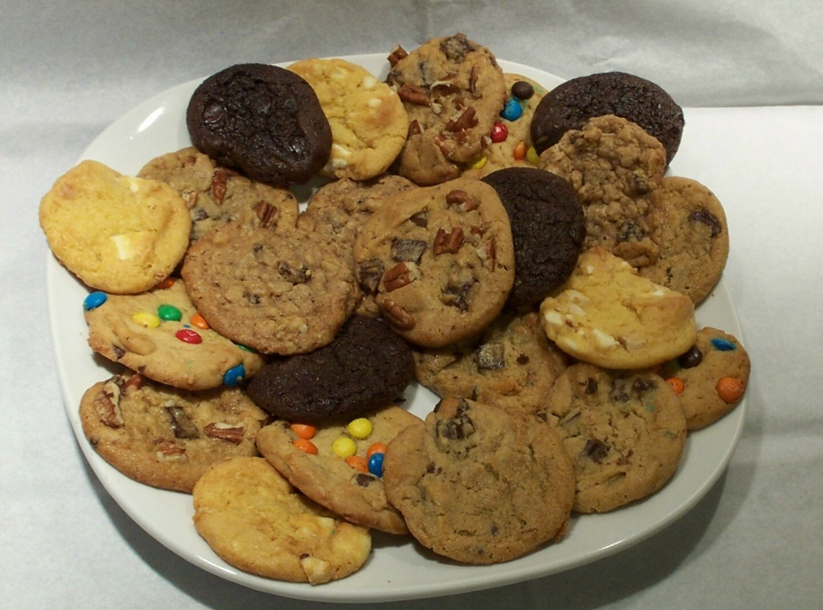
Kinds of Cookies
All cookies belong to one of six basic groups: rolled, drop, bar, refrigerator, pressed, or molded.
The ingredients used to make different kinds of cookies are similar. However, the doughs differ in consistency, and they are shaped differently.

Slide 28
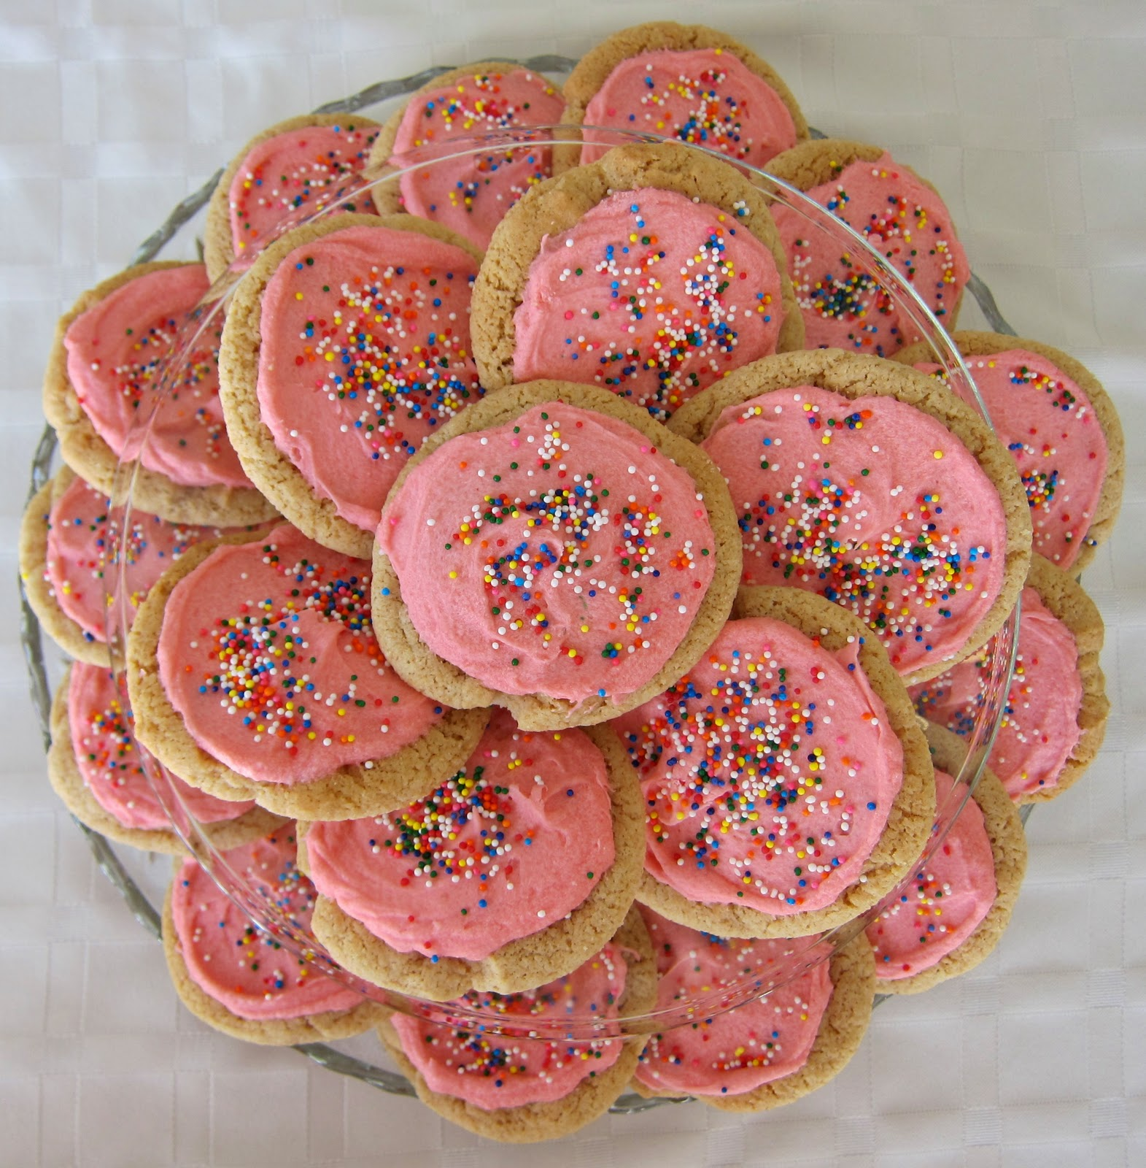
A stiff dough is used to make rolled cookies. Roll the dough on a pastry cloth or board to a thickness of 1/8 to ¼ inch. Cut the cookies from the dough with a cookie cutter and transfer them to a cookie sheet.
Sugar cookies are popular rolled cookies.

Slide 29
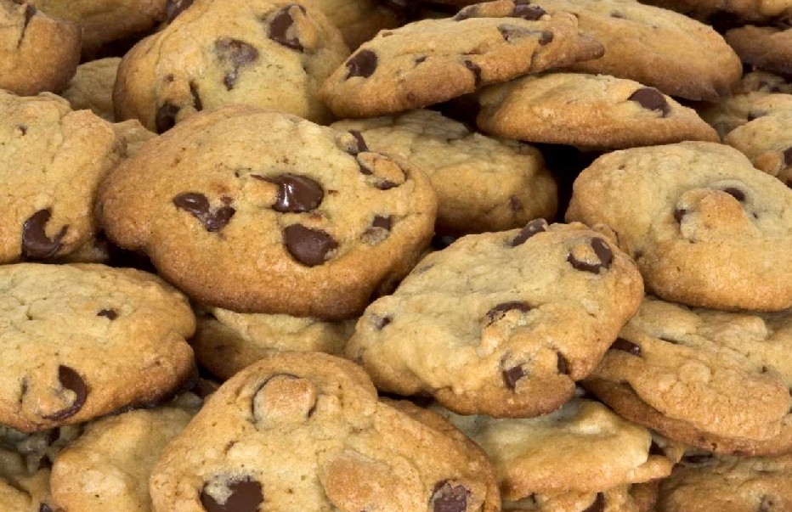
A soft dough is used to make drop cookies. Drop or push the dough from a spoon onto cookie sheets. Leave about 2 inches of space between cookies. Drop cookies will spread more than rolled cookies. Chocolate chip cookies are popular drop cookies.

Slide 30
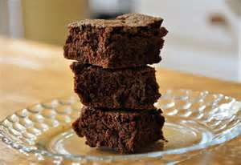
A soft dough is also used to make bar cookies. Spread the dough evenly in a jelly roll pan or square cake pan and bake it. Depending on the thickness of the dough, bar cookies may be chewy or cakelike. Bar cookies can be cut into different shapes after baking. Brownies are popular bar cookies.

Slide 31
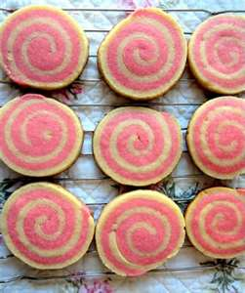
Refrigerator cookies contain a high proportion of fat. Form the stiff dough into a long roll, about two inches in diameter. Wrap the rollin foil or plastic wrap and refrigerate it until firm. When the dough has hardened, cut it into thin slices. Place the cookies on lightly greased cookie sheets and bake them. Pinwheel cookies are popular refrigerator cookies.

Slide 32
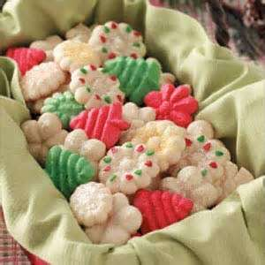
A very rich, stiff dough is used to make pressed cookies. Pack the dough into a cookie press. This utensil has perforated disks through which the dough is pushed onto cookie sheets. The cookies vary in shape and size, depending on the disk used. Swedish spritz cookies are pressed cookies.

Slide 33
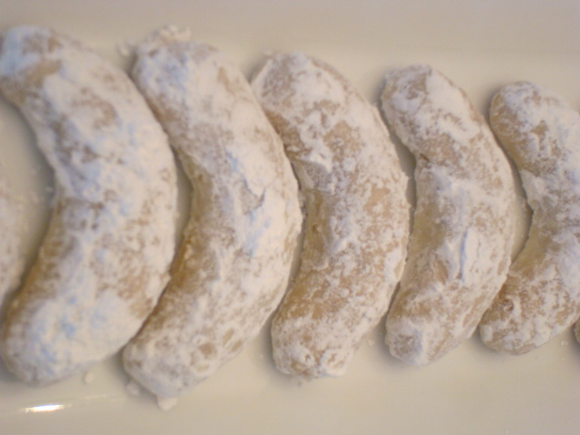
A stiff dough is also used to make molded cookies. Small pieces of dough are broken off and shaped with the fingers. Crescents and small balls are popular shapes.

Slide 34
Cookie Ingredients
Cookies contain the same basic ingredients used to make cakes. They contain flour, sugar, liquid, fat, salt, egg, and leavening agents. Most cookies contain more fat and sugar and less liquid than cakes.
Rolled cookies often contain no liquid.
The proportion of ingredients, as well as the way the cookies are shaped, determines if cookies are soft or crisp.

Slide 35
Mixing Methods for Cookies
Many cookies are made using the conventional mixing method used for shortened cakes. Blend the sugar and fat until smooth. Add the eggs, liquid, flavorings, followed by the dry ingredients.
Most cookies are crisp or chewy rather than light and delicate. Therefore, the fat and sugar do not need to be creamed as thoroughly as they are for a cake. Also, in most cases, the flour can be added all at once rather than in parts.
Macaroons, meringues, and kisses contain beaten egg whites. They are mixed like angel food and sponge cakes.

Slide 36
Pans for Baking Cookies
Bake drop, rolled, refrigerator, pressed, and molded cookies on flat baking pans or cookie sheets.
Cookie sheets should not have high sides, or cookies will bake unevenly.
Bake bar cookies in pans with sides.
Cookies baked on bright, shiny cookie sheets will have a light, delicate brown color.
Cookies baked on dark cookie sheets will have dark bottoms.
Cookie sheets should be cool when cookies are placed on them for baking. Warm sheets will cause cookies to spread and lose their shape.

Slide 37
Storing Cookies
Store crisp cookies in a container with a loose-fitting cover.
Store soft cookies in a container with a tight-fitting cover. (Never store crisp and soft cookies together. The soft cookies will soften the crisp cookies.)
Bar cookies can be stored in their baking pan if they are covered and they will be eaten in a short time.
Many cookies freeze well both in dough form and after baking.

Slide 38
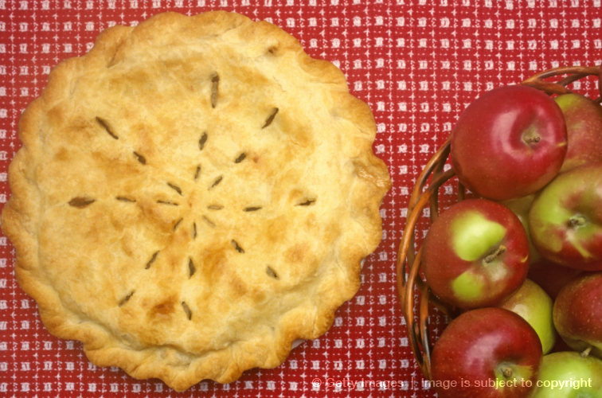
Pies
Apple pie is a favorite dessert in the U.S.
Apple pie begins with pastry. Pastry is the dough used to make piecrusts.

Slide 39
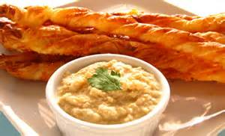
Uses for Pastry
Pastry can be used in many ways. It is mainly used when making dessert pies. However, pastry can be used when making main dish pies, such as meat pies and quiche. Small pastry shells can be used to make tarts filled with pudding or ice cream. Pastry can also be used to make appetizers such as cheese sticks.

Slide 40
Kinds of Pies
The four basic kinds of pies are fruit, cream, custard, and chiffon.
Fruit pies usually are two-crust pies. They may have a solid top crust, or they may have a lattice or other decorative top. Filling made from canned, frozen, dried, or fresh fruit may be used.
Cream pies usually are one-crust pies. Use a cornstarch-thickened pudding mixture to make a cream filling. Cream pies often have a meringue topping.

Slide 41
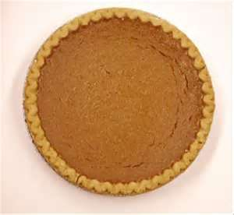
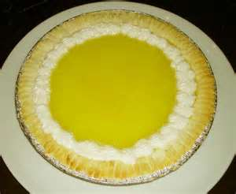
Custard pies are one-crust pies filled with custard made from milk, eggs, and sugar. The custard may or may not contain other ingredients. Pumpkin pie is a popular custard pie.
Chiffon pies are light and airy. They are one-crust pies filled with a mixture containing gelatin and cooked beaten egg whites. Some chiffon pie fillings also contain whipped cream.

Slide 42
Ingredients for Pastry
Four basic ingredients are used to make pastry—flour, fat, water and salt. When combined correctly, the four ingredients will produce pastry that is tender and flaky.
Flour gives structure to pastry.
Fat makes pastry tender by inhibiting the development of gluten.
Water provides the moisture needed for the development of the gluten and the production of steam.
Salt contributes flavor to pastry.

Slide 43
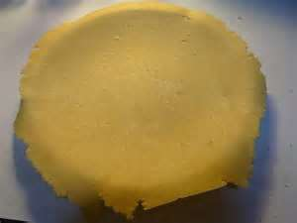
Food Science Principles of Preparing Pastry
To make pastry that is both tender and flaky, the correct ingredients must be used. They must be measured accurately. The dough must be handled gently and as little as possible.

Slide 44
Measuring the Ingredients
Flour, fat, and liquid all affect the tenderness of pastry. If these ingredients are not measured accurately, a poor-quality pastry will result.
Gluten develops when flour is moistened and stirred. The gluten creates a frame-work that traps air and holds steam formed during baking. This trapped air and steam is what causes pastry to be tender and flaky. Too much flour will make pastry tough.
Layers of fat physically separate the layers of gluten that form. As a result, the pastry is both tender and flaky. Too little fat will make pastry tough; too much fat will make pastry crumbly.
Water hydrates the flour so the gluten will develop. It also produces the steam needed for flakiness. Too much liquid will make the pastry tough. Too little liquid will make it crumbly and difficult.

Slide 45
Preparing Pastry
Several methods can be used to mix pastry, but the biscuit method (sometimes called the pastry method) is most popular.
When making a one-crust pie that will be filled after baking, flute the edges. Prick the bottom and sides of the piecrust with a fork to prevent blistering during baking. Do not prick the bottom or sides of a crust that will be filled before baking.

Slide 46
Characteristics of Pastry
High-quality pastry is both tender and flaky. The amount and distribution of gluten determines tenderness. Flakiness is due to layers of gluten separated by layers of fat and expanded by steam.
If pastry is tender, it will cut easily with a fork and “melt in the mouth; when eaten.
Aside from having pastry that is tender, flaky, and crisp, a pie should be lightly and evenly browned. The filling should have a pleasing flavor and be neither too runny nor too firm.

Slide 47
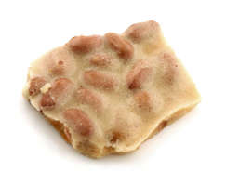
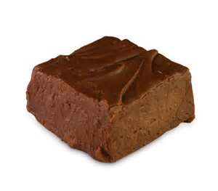
Candy
Homemade fudge, divinity, peanut brittle, toffee, and caramels are fun to make and give as gifts.
To make good candy, directions must be followed exactly. Candies must be mixed correctly and cooked to the exact temperature specified in the recipe. Otherwise, they are likely to fall.

Slide 48
Kinds of Candy
A few kinds of candies do not need to be cooked, but these require special recipes.
Most candies are cooked. Cooked candies are either crystalline or noncrystalline candies.
Crystalline candies contain fine sugar crystals. They are smooth and creamy. Fudge, fondant, and divinity are crystalline candies.
Noncrystalline candies do not contain sugar crystals. They can be chewy or brittle. Caramels, peanut brittle, and toffee are noncrystalline candies.

Slide 49
Food Science Principles of Candy Making
All cooked candies begin with sugar syrup. This is a mixture of sugar and liquid that is cooked to a thick consistency. Successful candy making depends on how this sugar syrup is treated.
When making crystalline candies, the sugar syrup should form crystals. These crystals need to be very small and fine.
To produce small sugar crystals, the sugar syrup must be heated to a specific temperature. It must then be cooled to a specific temperature and beaten vigorously.

Slide 50
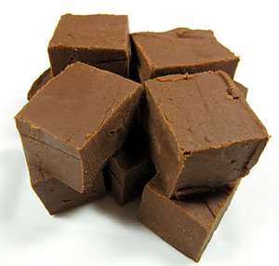
Fudge is one of the most popular crystalline candies. High-quality fudge tastes smooth and creamy because it contains small sugar crystals. It has a deep brown color and a satiny sheen.
Poor-quality fudge tastes grainy because it contains large sugar crystals.

Slide 51
When making noncrystalline candies, the sugar syrup should not form crystals.
Crystal formation can be prevented by heating the syrup to a very high temperature.
Substances like corn syrup, milk, cream, or butter can be added, which interfere with crystallization.
A combination of high temperatures and interfering substances can also be used to prevent crystals from forming.

Slide 52
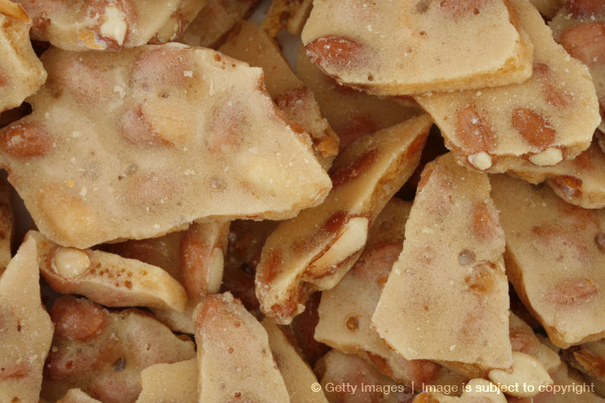
Peanut brittle is a popular noncrystalline candy. High-quality peanut brittle has a golden color and looks foamy. Cooking the candy to a very high temperature and using interfering substances prevent crystal formation.

Slide 53
Whether making crystalline or noncrystalline candies, temperature is very important.
A candy thermometer is the most accurate method of testing the temperature of sugar syrups.
Each type of candy requires a specific temperature.
The candy thermometer will accurately indicate when sugar syrup reaches the correct temperature.
A heavy saucepan or an iron skillet should be used to cook candy.
Mixtures that contain large amounts of sugar burn easily.
A heavy saucepan will help prevent scorching.

Slide 54
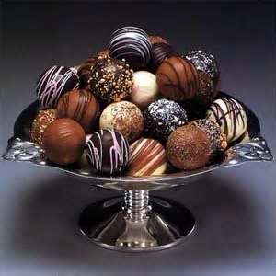
Chocolate
Even novices can melt chocolate to make simple candies. Melted chocolate can be poured into molds. It can be used to make clusters of raisins, nuts, or coconut. Fondant or caramels can also be dipped in a coating of melted chocolate.

Slide 55
To melt chocolate, chop bars into small pieces or use chocolate chips.
Place chocolate in the top of a double boiler over hot water and stir constantly.
Remove chocolate from heat as soon as it is melted to prevent scorching.
Chocolate can also be melted in a microwave oven.
Place the chocolate in a glass bowl.
Microwave on high power for 30 seconds at a time until chocolate is melted.
Be sure to stir the chocolate after each microwaving period.

