Slide 1
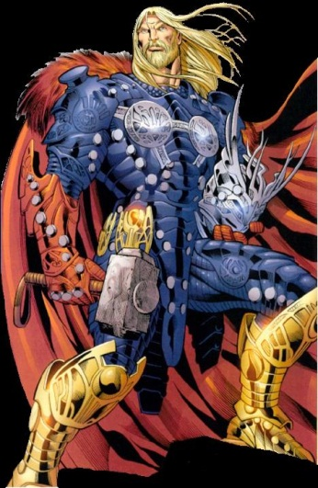
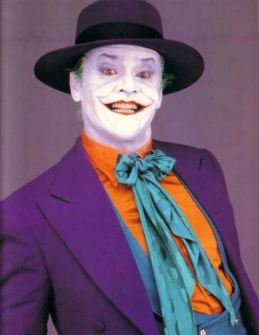
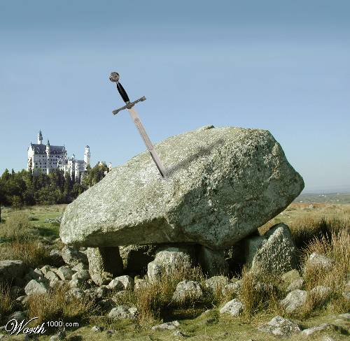
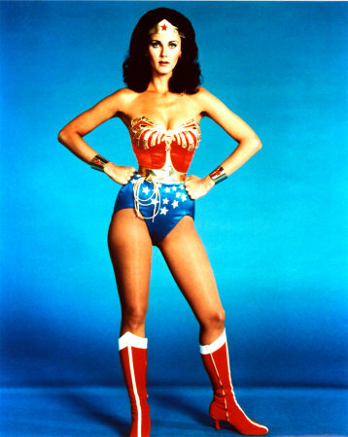
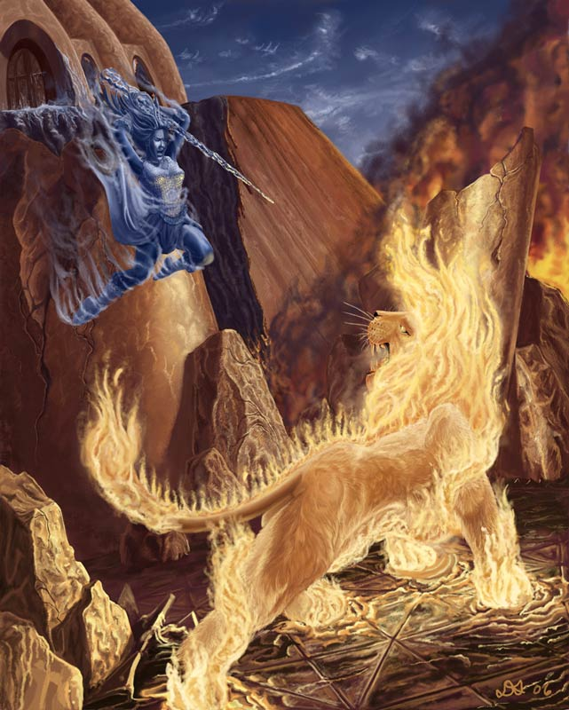
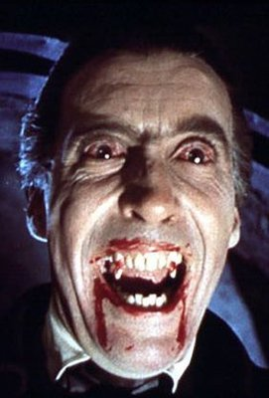
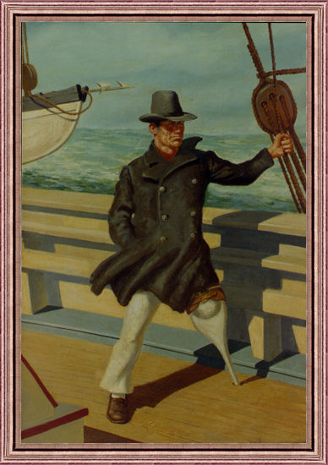
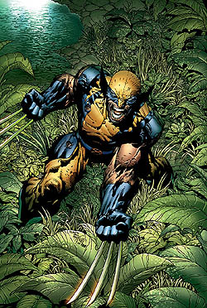
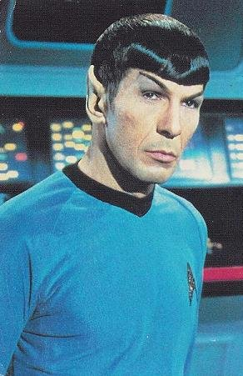
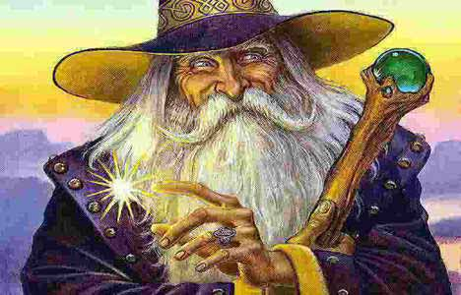
Archetypes
The Models of Our Entertainment and Philosophies

Slide 2
Agree or Disagree?
As the following statements appear on the screen, show me thumbs up if you strongly agree. If you strongly disagree with the statement, show me thumbs down.

Slide 3
There is no such thing as a completely original idea.
Certain symbols mean the same thing to everyone.
Everyone can agree on what is right and what is wrong.
Everyone is capable of doing evil.
Symbols and dreams mean different things to every person.
There is a knowledge we are all born with that influences our experiences and behavior.
People have been acting the same way since time began.
Human behavior is the same across different cultures.
Stereotypes are real and valid.
Every story contains the same characters.

Slide 4
What is an Archetype?
An original model which other things are similarly patterned after
An image, story pattern, character type, representation, or recurring idea
Evokes strong associations to the reader or observer

Slide 5
An Archetype can be defined as…
A shared idea with all humanity
An inherited part of the human being that connects us all
A constant and universal idea
Though it may differ from place to place, the concept is worldwide

Slide 6
What kinds of Archetypes are there?
There are three main archetypes:
Situational
Symbolic
Character

Slide 7
What is a Situational Archetype?
A given experience that a hero or character must endure to move from one place in life to the next
Actions and events that add to the plot
A common event seen throughout stories in may different genres

Slide 8
Situational Archetypes
Situational Archetypes include the following:
The Quest
The Task
The Initiation
The Journey
The Fall
Death and Rebirth
Nature vs. Mechanistic World
Good vs. Evil
The Unhealable Wound
The Ritual

Slide 9
Situational Archetypes: The Quest
A quest describes a search for someone or something of great power or importance
A quest is never easily accomplished and often includes near impossible challenges

Slide 10
Situational Archetypes: The Task
The Hero must perform some nearly superhuman deed
This is done to save the kingdom, win the girl, or find himself
Example: Arthur pulls the sword from the stone.

Slide 11
Situational Archetypes: The Initiation
An initiation symbolizes a rite of passage
An adolescent may come into adulthood through an initiatory
Very much connected with growing up and maturity

Slide 12
Situational Archetypes: The Journey
Sends the hero on a search for some truth or information
Forces the hero to discover many unpleasant truths
At his lowest point, the hero will return to the world of the living

Slide 13
Situational Archetypes: The Fall
Shows a descent from a higher to lower state of being
Represents a loss of innocence
Usually comes with some type of expulsion as a result of disobedience

Slide 14
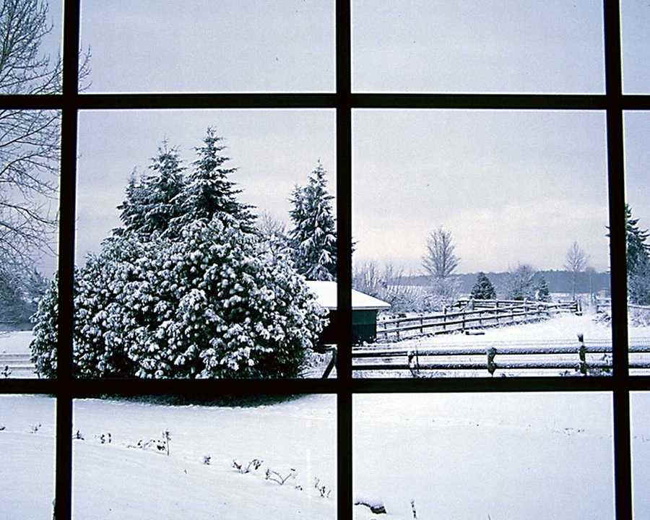
Situational Archetypes: Death & Rebirth
The most common of all situational archetypes
Parallels the cycle of nature with the cycle of life
Morning or Spring = Birth or Youth
Evening or Winter = Old Age or Death

Slide 15
Situational Archetypes: Nature vs. Mechanistic World
Nature represents purity and good
Technology represents evil and corruption
Inventions destroy nature

Slide 16
Situational Archetype: Good vs. Evil
Battle between two primal forces
Traditionally, Good will triumph over evil
Can be found in almost any movie, book, or television show
(protagonist vs. antagonist)

Slide 17
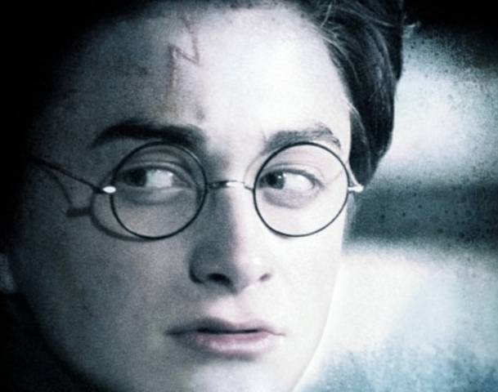
Situational Archetypes: The Unhealable Wound
Either physical or psychological damage that cannot be repaired
Indicates a loss of innocence
Drive the sufferer to extremes

Slide 18
Situational Archetypes: The Ritual
Mark a rite of passage
Show character’s role in society
Explain a person’s role in the world

Slide 19
Situational Archetypes
The Quest
Death & Rebirth
The Task
Nature vs. Tech.
The Initiation
Good vs. Evil
The Journey
Unhealable Wound
The Fall
The Ritual
Let’s Review. Situational Archetypes are events or happenings that a character goes through in order to transcend from one place to the next. They include :

Slide 20
Symbolic Archetypes
Serve as a representation of a specific person, act, deed, place or conflict. They are easily recognizable but not as common as situational archetypes.
The Archetypes Include:
Light vs. Darkness
Water vs. Desert
Heaven vs. Hell
The Magic Weapon
Innate Wisdom vs. Educated Stupidity
Haven vs. Wilderness
Supernatural Intervention
Fire vs. Ice

Slide 21
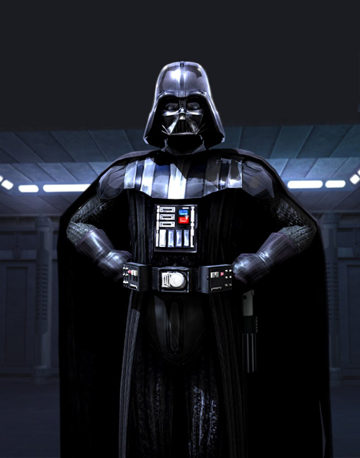
Symbolic Archetypes: Light vs. Darkness
Light suggests hope, renewal, or enlightenment
Darkness implies mystery, ignorance, or despair

Slide 22
Symbolic Archetypes: Water vs. Desert
A Desert typically represents a loss of life, hope, or faith
Water may symbolize a spiritual birth or the beginning of something

Slide 23
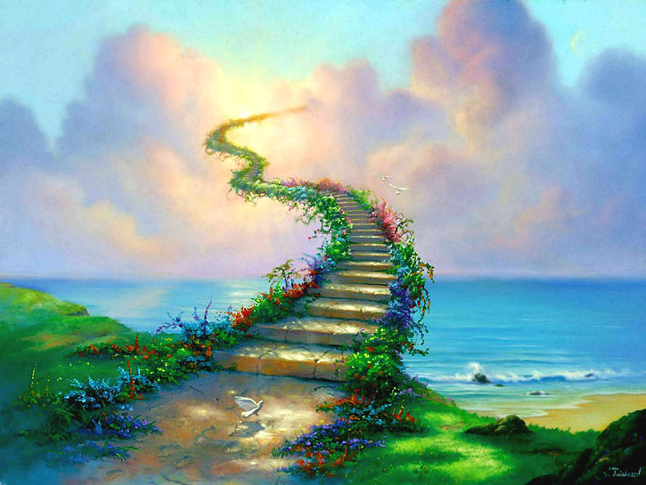
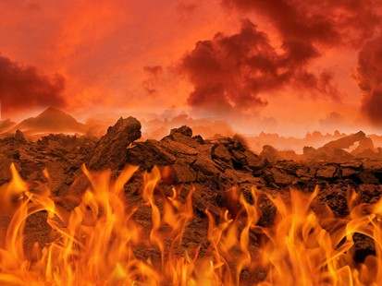
Symbolic Archetypes: Heaven vs. Hell Places not easily accessible by man are regarded as the dwelling places of either the gods or demons
Heaven
Hell
The skies, clouds, or mountains house the gods
Canyons, caves, and the inner earth play home to the evil forces of the world.

Slide 24
Symbolic Archetypes: The Magic Weapon
A symbol of the hero’s extraordinary quality
No other can use it to its full potential
Traditionally given by a mentor

Slide 25
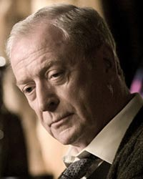
Symbolic Archetypes: Innate Wisdom vs. Educated Stupidity
Though they work as a team, Alfred is wise with experience while Bruce Wayne is a college graduate who has a knack for flying by the seat of his pants despite his butler’s advice.
Some characters are more experienced and in turn have a mystique wisdom
Other characters are educated, powerful, and often times…stupid.
The wise one is usually an assistant while the stupid-smarty is a leader

Slide 26
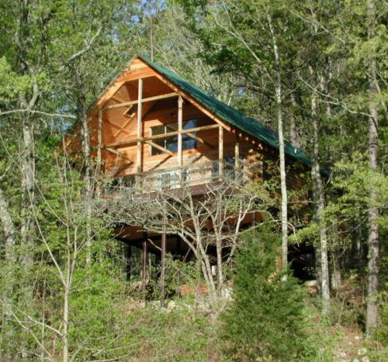
Symbolic Archetypes: Haven vs. Wilderness
Places of safety contrast with the unknown threatening forces of the wilderness
Heroes often must return to a safe haven in order to regain health or supplies

Slide 27
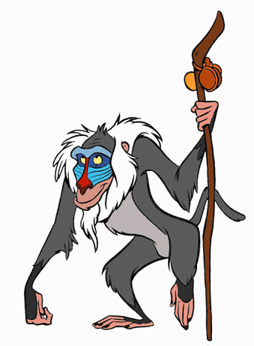
Symbolic Archetypes: Supernatural Intervention
God or gods intervene in a given situation
The gods will often favor the hero but occasionally they do not.
This is seen throughout Greek Mythology as well as most practiced religions

Slide 28
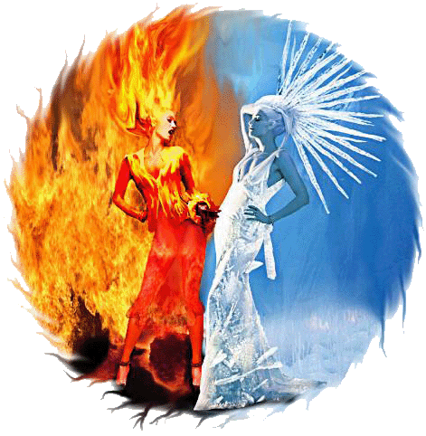
Symbolic Archetypes: Fire vs. Ice
Typically, fire represents knowledge, light, life,
fertility and (re)birth
Ice will usually represent a deserted place,
ignorance, sterility, and death

Slide 29
Symbolic Archetypes
Let’s Review. Symbolic Archetypes represent a specific person, act, deed, place or conflict.
Symbolic Archetypes Include:
Light vs. Darkness
Water vs. Desert
Heaven vs. Hell
Innate Wisdom vs. Educated Stupidity
Haven vs. Wilderness
Supernatural Intervention
Fire vs. Ice

Slide 30
Character Archetypes A person or being that serves as a representative of a greater ideal
Character Archetypes include the following:
Unfaithful Wife
Temptress
Star-Crossed Lovers
Damsel In Distress
The Scapegoat
The Devil Figure
The Creature of Nightmares
Friendly Beast
The Hero
Mentor
Young man from the Provinces
The Initiates
Hunting Group of Companions
Loyal Retainers
The Outcast
The Evil Figure with the Ultimately Good Heart
Earthmother

Slide 31
Character Archetypes: The Hero
Traditionally the protagonist of a story
Often his past is a mystery
He is the champion, king, leader or savior of many
Endures pain and sorrow that all lead to a greater good
Typically must go on a great journey

Slide 32
Character Archetypes: Mentor
Serve as a teacher or counselor to the initiate or future hero
Role Model
Sometimes a Father or Mother figure

Slide 33
Character Archetypes: The Initiates
Young heroes who must endure training
Must complete some type of quest
They are Innocent and often wear white

Slide 34
Character Archetypes: Young man from the Provinces
A hero is spirited away as a young man and raised by strangers
Later returns home where he is a stranger who looks to find a solution to problems

Slide 35
Character Archetypes: Naïve Youngster from the Country
usually leaves the country and is exposed to more complicated, dangerous world
often relies on a mentor

Slide 36
Character Archetypes: Earthmother
Symbolic of abundance, fertility, and knowledge
Offers spiritual and emotional advice or nourishment to those she meets

Slide 37
Character Archetypes: Temptress
Sensuous with beauty
The hero is physically attracted to her but she will ultimately bring about his downfall

Slide 38
Character Archetypes: The Unfaithful Wife
Woman, married to a man she sees dull
Attracted to a more interesting or handsome man
Commits an act of Infidelity

Slide 39
Character Archetypes: Damsel in Distress
Vulnerable woman who must be rescued by the hero
She is often used as bait to trap the hero

Slide 40
Character Archetypes: Star-Crossed Lovers
These two characters are engaged in a love affair
Fated to end tragically
Society, family, or friends do not approve of the relationship

Slide 41
Character Archetypes: Loyal Retainers
Somewhat heroic
Similar to a servant with hero like qualities
Duty: Protect the Hero

Slide 42
Character Archetypes: The Outcast
Banished by Society or a social group
Destined to become a wanderer
Moves from place to place

Slide 43
Character Archetypes: Monster
Monster usually summoned from the deepest, darkest parts of the mind
Threatens the life of the hero
Often a perverse or desecrate form of human

Slide 44
Character Archetypes: The Scapegoat
Human or Animal
Public Death is a sin of the community
Death makes him a more powerful force than when he lived

Slide 45
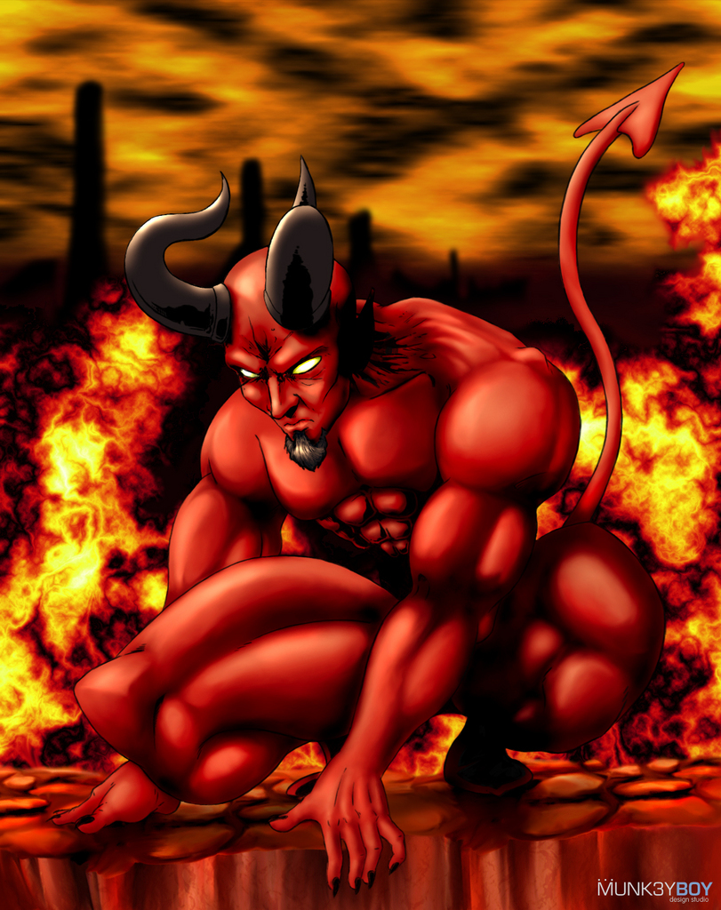
Character Archetypes: Devil Figure
Evil Incarnate
Offers Worldly Goods
Will tempt, cheat, steal, lie, and destroy anyone or anything he comes into contact with

Slide 46
Let’s Review! Character Archetypes include the following…
Temptress
Unfaithful wife
Star-Crossed Lovers
Damsel In Distress
The Scapegoat
The Devil Figure
The Creature of Nightmares
Friendly Beast
The Hero
Mentor
Young man from the Provinces
The Initiates
Hunting Group of Companions
Loyal Retainers
The Outcast
The Evil Figure with the Ultimately Good Heart
Earthmother

