Slide 1
Why college
What pays more

Slide 2
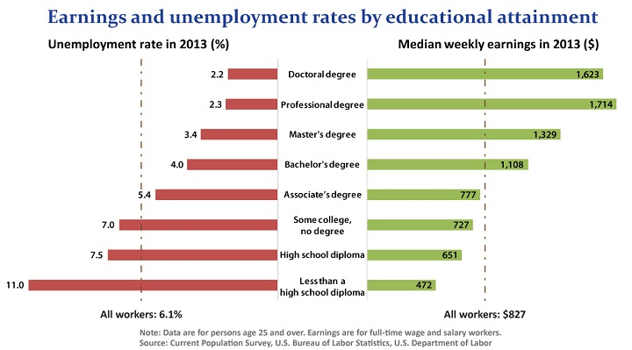
Weekly earnings & unemployment

Slide 3
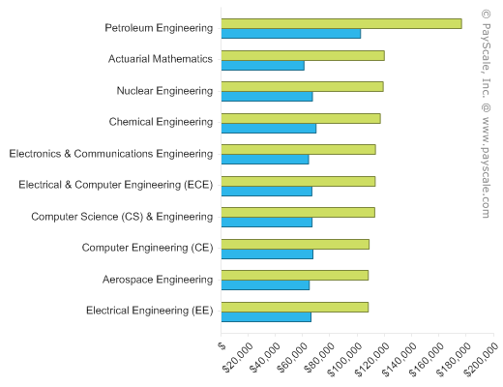
Highest paying degrees

Slide 4
College project part 2
On a separate page in your power point presentation add the career you want and the degree you will need for your career.
List the classes you will have to take to achieve this degree.

Slide 5
Where to look
Find the College within your university
Then find you’re the specific degree plan for you
Pick several course to list in your presentation
Finally list several high school courses you need to take to prepare yourself for your degree.

