Slide 1
Black Tuesday & Unemployment
(Great Depression Part 1)

Slide 2
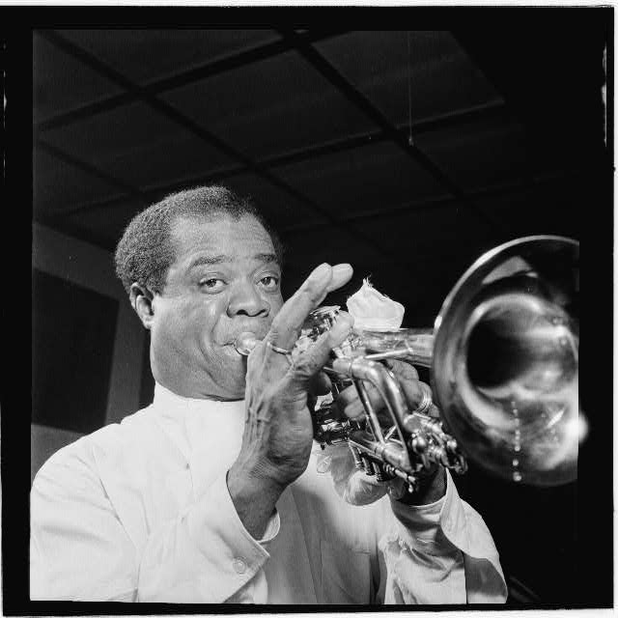
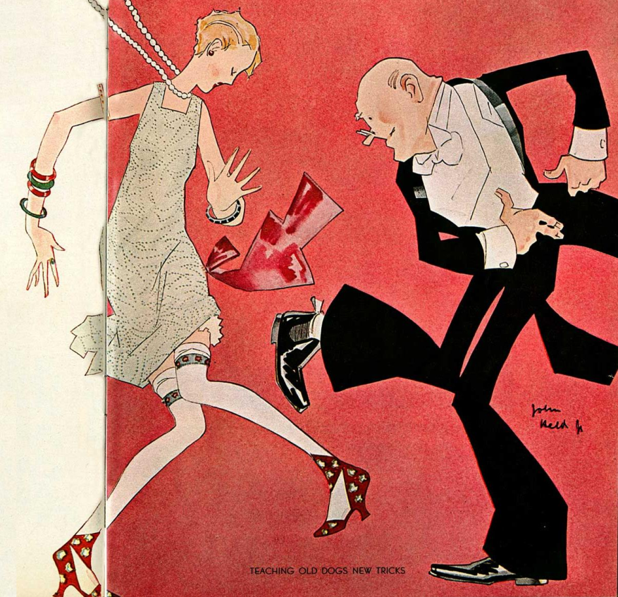
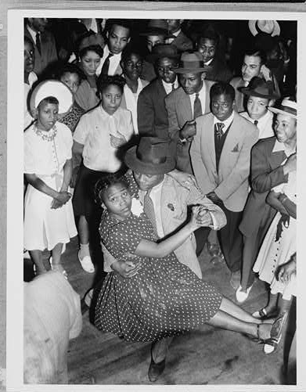
Roaring Twenties
Great time of economic prosperity in the U.S.
Drinking, dancing, jazz music, culture
People bought lots of consumer goods (radios, appliances, automobiles)

Slide 3

Bull market: a period of rising stock prices
Bear market: a period of falling stock prices

Slide 4
The Stock Market in the 1920s
Bull market: people thought they could get rich
Buying on margin: buying stocks using money you borrowed from a stockbroker
  Huge investments of imaginary money
Led to a stock market bubble: demand for stock → prices go up past actual values of companies

Slide 5
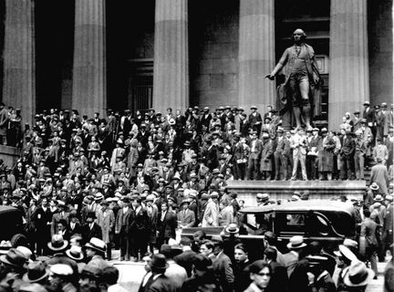
Black Thursday
As soon as stock prices drop a little, everyone panics
October 24, 1929: first stock market crash
  Dow Jones fell 11%, tons of people selling stock
  Banks bought large chunks of stock to calm investors

Slide 6
Black Tuesday
October 29, 1929
Worst stock market crash in the history of U.S.
Everyone selling → stock prices collapsed
Dow Jones fell 89%
16.4 million shares sold on one day
Beginning of the Great Depression

Slide 7
Your stock portfolio on October 28 was worth $2000. On Black Tuesday, stocks fell 89%. How much is your portfolio worth now?
How would this stock market crash affect consumer spending?
$220 ☹
It went down…a lot

Slide 8
After the Stock Market Crash:
People lose tons and tons of savings
Banks can’t pay back deposits → bank failures
Consumer spending drops, businesses cut jobs
Out west, severe drought cuts agricultural jobs
  Also leads to the Dust Bowl
All this combined leads to…

Slide 9
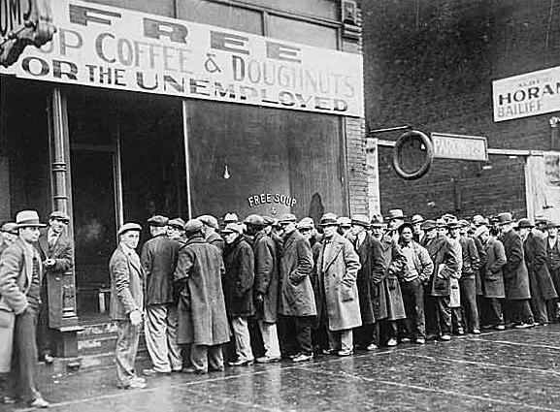
U%
(Unemployment)

Slide 10
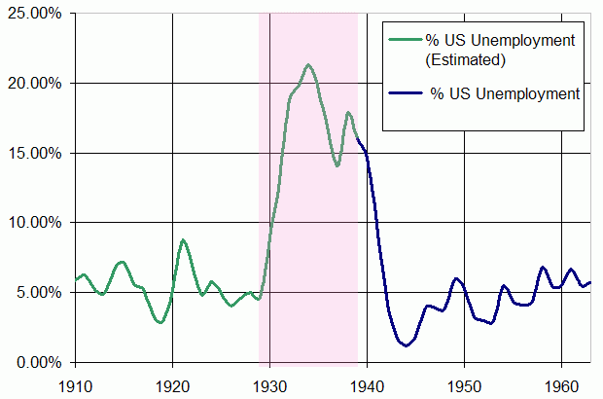
Great
Depression

Slide 11
Types of Unemployment
Frictional
  “between jobs”, voluntary, good for individuals and society
Structural
  Associated with lack of skills or declining industry (ex. High school dropouts, type-writer repairmen). Think “Creative Destruction”
Cyclical
  U% because of downturns in business cycle, when the economy is shrinking. Bad for society and individuals.
Seasonal
  Mall Santas, Schlitterbahn Life-guards, Ride operators at Fiesta Texas, Golf-pros in Alaska during January.

Slide 12
Labor Force
Population
  Number of people in a country
Labor force
  Number of people in a country that are either employed or unemployed
Not in Labor Force
  Kids, military personnel, retired people, stay at home Moms and Dads, full-time students, your 40 year old uncle who sleeps on the couch all day, the incarcerated, most of the homeless.
Population (in 2014) | 319,000,000
Labor Force (Feb. 2015) | 157,000,000

Slide 13
Employed vs Unemployment
Employed
  People 16 years and older that have a job.
  It doesn’t matter if it’s part-time or full-time, as long as they work at least 1 hour every 2 weeks
Unemployed
  People 16 years and older that don’t have a job, but have actively searched for a job in the last 2 weeks
Unemployment =
rate (U%)
# of people unemployed
X 100
# of people in labor force

Slide 14
UNEMPLOYMENT BUCKET
Are you…
Employed?
Unemployed?
  Frictional (between jobs)
  Structural (skills don’t match)
  Seasonal (job only part of the year)
  Cyclical (US economy is doing poorly)
Not in the Labor Force?
  Can’t work, don’t want to work, not actively searching

Slide 15
How much U% do we want?
Not all unemployment is bad
  Structural, frictional, seasonal
Cyclical = bad, we want as little as possible
When we’re at full potential, unemployment is about 4% to 5%
  During Great Depression: over 20%
  Natural rate of unemployment: The level of unemployment experienced when the economy is producing at its full potential.

Slide 17

Econ News of the Day: 4/1
Welding is booming in DFW. Starting salaries are around $45 per hour, and businesses can’t hire enough people to meet their demand. Some have started hiring people still in welding programs at technical colleges. –KERA, March 31
Why would someone facing structural unemployment be interested in welding right now?
What happens to the wages a welder would make when demand for welders is high and supply is low?
(Draw the graph if you want to be super cool.)

