Slide 1
The Interwar Years
Europe and America in Reaction

Slide 2
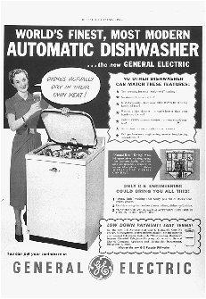
Consumer Goods
After the war new Consumer Goods are made available:
  Washing Machine
  Affordable automobile
  Radio
  Toaster
  Vacuum Cleaner
  Curling Iron
  Refrigerators
  Movie Theaters
  Durable goods!

Slide 3
Art/Culture
The heady days of Imperialism were behind many in Europe/USA.
The Harlem Renaissance emerges as the dominant literary/artistic undertaking of the time period in the West.
  Central Question: What does it mean to be a Black American?
    Frozen out of the dominant “white culture.”
    Establish a definitive concept of “Blackness” and what it means.

Slide 4
Harlem Renaissance
  Central Question: What does it mean to be a Black American?
    Frozen out of the dominant “white culture” through segregation and lynchings.
    Seek to establish a definitive concept of “Blackness” and what it means.
      Black Art
        Jazz
        Poetry
        Literature
        Art

Slide 5
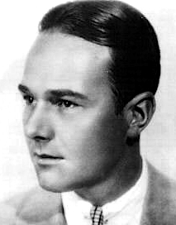
1920s Gay Rights Movement
Homosexual organizations begin to pop up in major urban areas.
  Rome
  New York
  London
  Paris
  Berlin
Push for an end to:
  formal legal prohibitions against homosexuals.
  discriminatory practices
Relatively liberal period: William Haines, the biggest actor in Hollywood lived as an openly gay man with his partner. Still a huge box office draw.

Slide 6
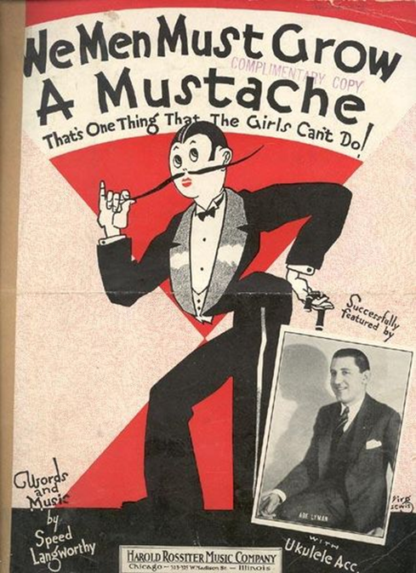
Women’s Issues
1920- Women get the right to vote in the United States.
Women attend college in ever-larger numbers.
Push for an Equal Rights Amendment in the United States.

Slide 7
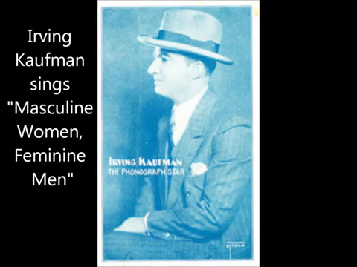
“Masculine Women, Feminine Men” (1926)

Slide 8
Italy
Widespread discontent with the traditional power centers in Italy.
HUGE worker uprisings in the early 1920s and many of the factories are taken over.
King Victor Emanuelle asks a former Socialist and current nationalist to put down the unions.
Mussolini leads his black shirt thugs to attack and break up the demonstrators.
The King offers to let Mussolini to form a government.
Mussolini’s fascists come to power.

Slide 9

Fascism Explained by Umberto Eco
Cult of Tradition
Rejection of Modernity
Irrationalism/Action for Action’s Sake
Fear of difference/diversity
Feeling of humiliation/defeat
Elitism
No Struggle for Life- Life is Lived for Struggle
Hero Worship
Logocide/New Speak
Selective Populism

Slide 10
Mussolini and Fascism
“Fascism should more properly be called corporatism, since it is the merger of state and corporate power.”
“The democrats of Il Mondo [an Italian Newspaper] want to know our program? It is to break the bones of the democrats of Il Mondo.”
Fascist Program:
  Labor unions broken.
  Other political parties broken.
  Dreams of rebuilding the Roman Empire.

Slide 11
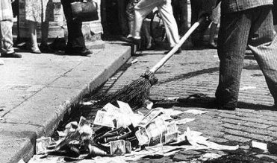
Weimar Germany
Germany is in a terrible depression due to the restrictions of the Versailles Peace Treaty.
  Hyperinflation → Money basically becomes worthless.
  Limited to a 100,000 man army.
  Very unstable.

Slide 12
Reactionaries in Germany
The German people are exhausted by the war and angry at the Versailles Treaty.
  Rise of left-wing and right-wing movements.
    Free Corps movement (right wing)- angry, nationalist veterans of WWI.
    Most of the left wing movements were decimated in 1918-1920 through violence→ Fairly weak throughout the period.
    Central Government seems incapable of holding the country together.

Slide 13
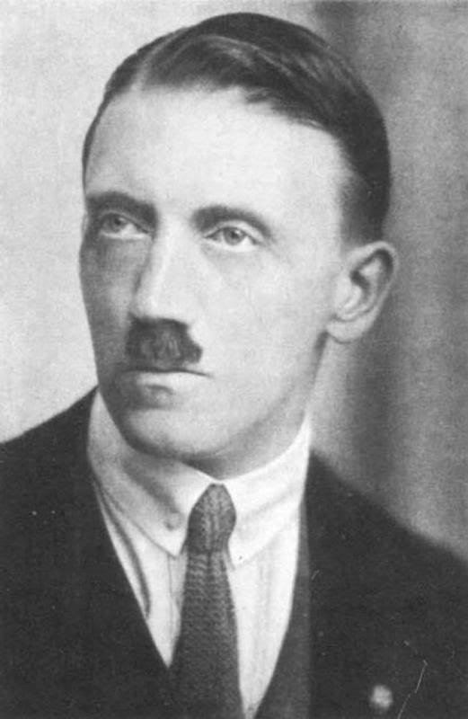
Nazi Party
Nazis are only one of these right-wing movements.
Organized by a Corporal from WWI by the name of Adolf Hitler.
Constantly involved in street-fighting and sometimes used to break unions by industrialists.

Slide 14

The Backstabbing Myth
Backstabbing Myth has one of two different forms:
  The civilian government that replaced the Kaiser/Military High Command at the end of the war betrayed the country.
  The Jews betrayed Germany and were to blame.
  Finds fertile ground amongst Reactionary Movements in Germany.

Slide 15
Soviet Union
The Soviets, after the failure of other Socialist/Communist revolutions in Europe find themselves isolated from the international community.
Cut off and alone, they struggle to rebuild Russia from the horrors of World War I, the Revolution, and the Russian Civil War.
In 1926, Lenin dies.
  Two chief lieutenants are left: Trotsky and Stalin.
Trotsky’s Plans
  Mass industrialization program.
  Fears the Nazis and believes the USSR must be ready to fight them.
  Modernization program.
  Cut back the bureaucracy and strengthen the worker’s councils.
  Focus on the International question and try to spread the Revolution
Stalin’s Plans
  Reintroduce some elements of capitalism for the peasants.
  “Socialism in One Country”
  Build Socialism in the USSR to make a fortress against capitalist powers.

Slide 16
Left Opposition vs. the Troika
Stalin and Trotsky are going to wage a political struggle throughout most of the 1920s.
Stalin wins
  Editor of Pravda.
  Trotsky was an egghead and could be off-putting.
  Many Bolsheviks feared that Trotsky would be Napoleon: Victorious general who overthrew the government created by the Revolution and use his personal popularity and military power to maintain control.
In 1929, Trotsky is exiled.
  Spends time in Turkey, Norway, Switzerland, New York, etc.
  Finally settles in Mexico City where he carries on an affair with Frieda Kahlo.
  Stalinist agent murders him with an icepick in 1940.

Slide 17
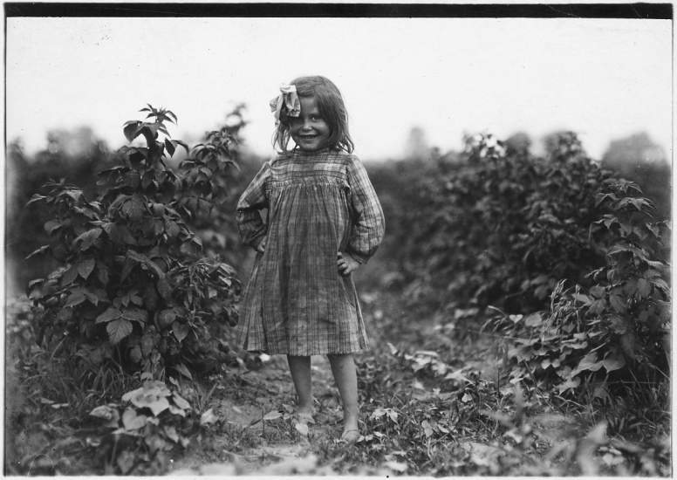
The Great Depression
1929 Stock Market Crash DOES NOT cause the Great Depression. → Symptom, not a cause.
Farmers enter the Great Depression immediately after the war.
  High food production for the war meant that food prices plunged after the fighting stopped..
  Faced with lower prices farmers grow more food.
  Larger food supply causes food prices to fall.
  Faced with lower prices farmers grow more food.
  Larger food supply causes food prices to fall.
  Faced with lower prices farmers grow more food.
  Larger food supply causes food prices to fall.
  Faced with lower prices farmers grow more food.
  Larger food supply causes food prices to fall.
  CYCLE MEANS THAT FARMERS ENTER THE DEPRESSION IN THE 1920s.

Slide 18
The Great Depression
Consumer Goods
  Companies were selling durable, high-quality consumer goods in large numbers in the early-1920s.
  By the late-1920s, most people already owned these goods.
  Companies continue to build them in ever-larger numbers, regardless.
  Leads to a price collapse in the late 1920s.

Slide 19
Purchasing Power
Purchasing Power → Ability to buy goods.
Worker wages were still very low.
Still largely living in Industrial Era conditions.
THE WORKERS THAT BUILD ALL OF THESE GOODS ARE TOO POOR TO BUY THEM.
Throughout the Depression, store shelves will be FULL, but no one will have any cash to be able to afford them!
DEMAND COLLAPSE

Slide 20
Responses in the West
John Maynard Keynes- British economist at Versailles
  Fired for opposing saddling Germany with reparations
  Believed it would cause a Great Depression and another World War
  Writes a book: The General Theory of Employment, Interest and Money
  Argues that governments should step in to increase demand:
    Hire the unemployed to build infrastructure.
      Workers will build useful infrastructure.
      Workers will have money in their pockets.
      Workers will buy goods/services from the private sector.
      Revives the economy.
      Slowly transfer workers from government employment to private sector employment.
      REPEAT AS NEEDED.

Slide 21
Keynes, continued
Keynes says that these programs should be paid for:
  Higher taxes on the rich.
  Deficit Spending → Pay off the debt after the crisis has passed.
  Britain and the United States will both attempt to implement these policies. (In the USA this is known as The New Deal.)
    However, they refuse to deficit spend→ Balance the budget.
    As such, always short of cash.
    Never goes far enough to end the Depression.
    Depression lingers until WWII → War forces governments to deficit spend to stimulate the economy.

Slide 22
Nazis Come to Power in Germany
The Great Depression puts tremendous pressure on the already-weak Weimar government.
In 1933, Hitler and his Nazis come to power.
  Fake a “Jewish-Communist-Terrorist” attack: The Burning of the Reichstag“
    Pass Enabling Act → All power is turned over to Hitler.
Hitler immediately begins a military build-up that partially restores the German economy.
  Industrialists support Hitler because he hates labor unions/socialists.
  Widespread attacks on labor unions → Wages fall in Germany.

Slide 23
Eugenics in Germany
Hitler plays extensively on the Backstabbing Myth. Targets:
  The Mentally/Physically Disabled
  Homosexuals
  Jews
  Roma (Gypsies)
  Slavs (Eastern Europeans)
  Liberals/Socialists/Communists

Slide 24
USSR
Soviet Union remains isolated from the West.
  Stalin implements Trotsky’s plans- a mass industrialization program:
    Build heavy industry
    Build physical infrastructure
    Build schools.
    Very difficult period.
      Unable to import, production is based only on building everything internally.
      Fairly successful overall, but with large scale death.

Slide 25
USSR
Soviets fear Nazi Germany → Hitler hates Communists.
Soviets frantically attempt to ally with Britain/France against Germany.
  Britain and France want to see the USSR destroyed.
  Britain and France want to use Germany as a bulwark against the Communists.
  Throughout the 1930s, Britain and France freeze-out the USSR and work closely with Germany.
  Few leaders in the West recognize the threat fascism represents: Churchill in Britain and DeGaul in France.
  Soviets speed up industrialization programs, fearing that they will have to fight the fascists alone.

Slide 26
Japan in the 1930s
Military takes power in Japan → Begins military build up that partially restores Japan’s economy.
Military leadership seeks more resources for Japan
  Mainland China represents the best opportunity.
  China is fighting a Civil War: Communists vs Nationalists
  Japanese invade and seize part of China.
  Japan wants to take Europe’s colonies in Asia and is only waiting for an opportunity to take them.

